Slide 1
Prediction of fire occurence

Slide 2
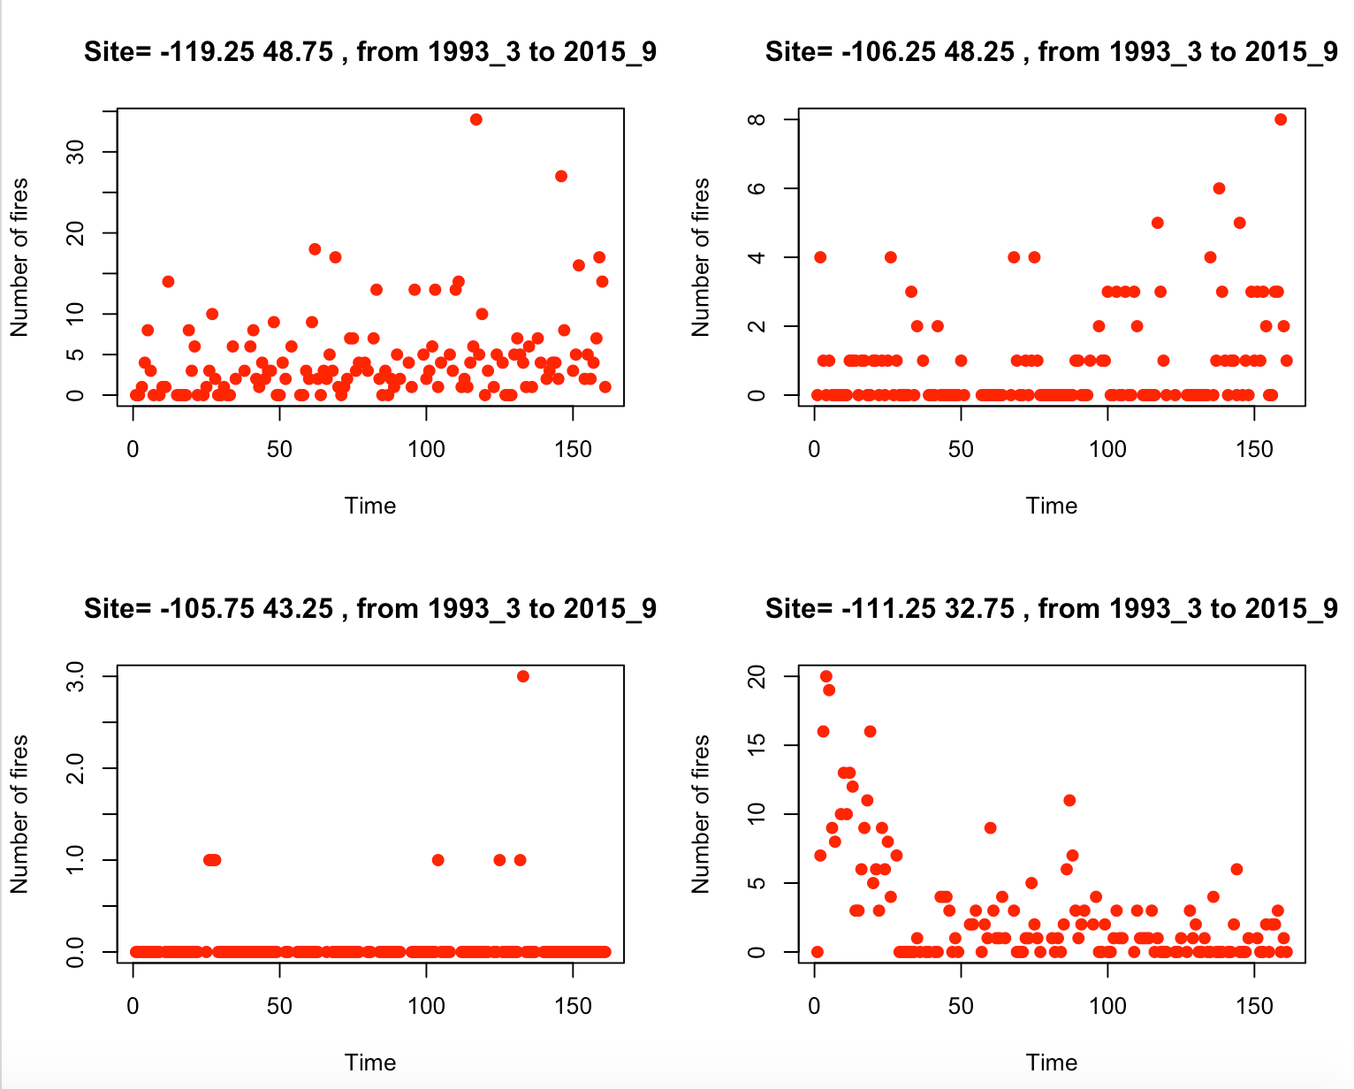

Slide 3
Full training dataset
50% for
training of candidate models
K fitted models
50% for
model selection
Testing dataset
One selected model
Predictions

Slide 4
Full training dataset
50% for
training of candidate models
K fitted models
50% for
model selection
Testing dataset
One selected model
Predictions

Slide 5
Full training dataset
50% for
training of candidate models
glm
LASSO min
LASSO 1se
50% for
model selection
Testing dataset
One selected model based on the criterion
Predictions

Slide 6
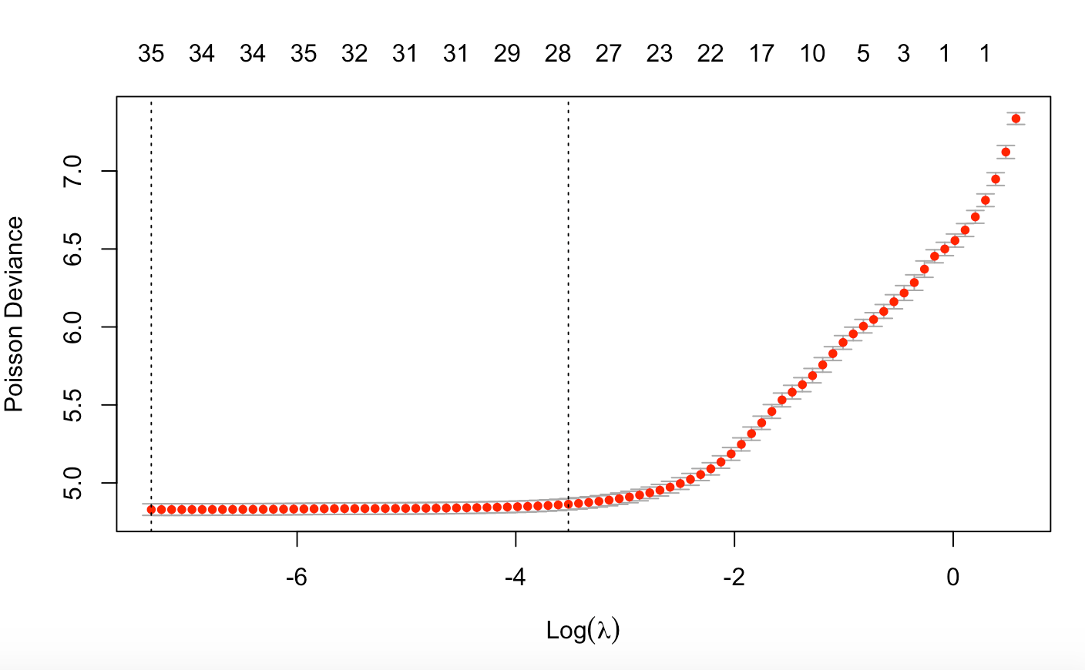
LASSO: selection of penalty coefficient
Lambda min
Lambda 1se

Slide 7
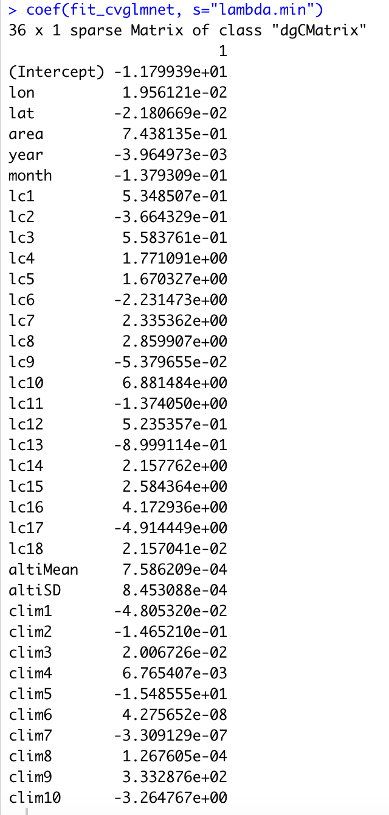
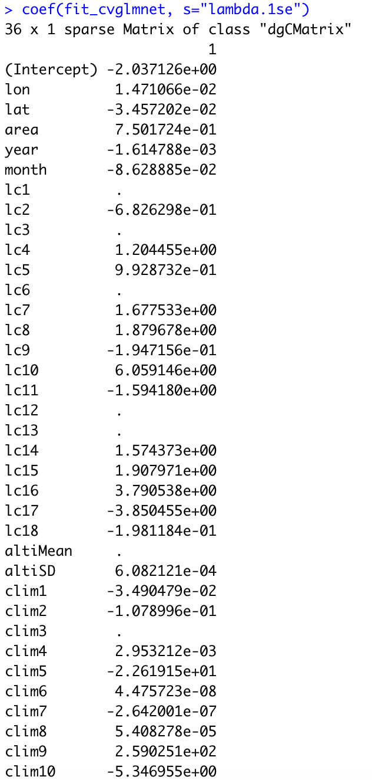

Slide 8
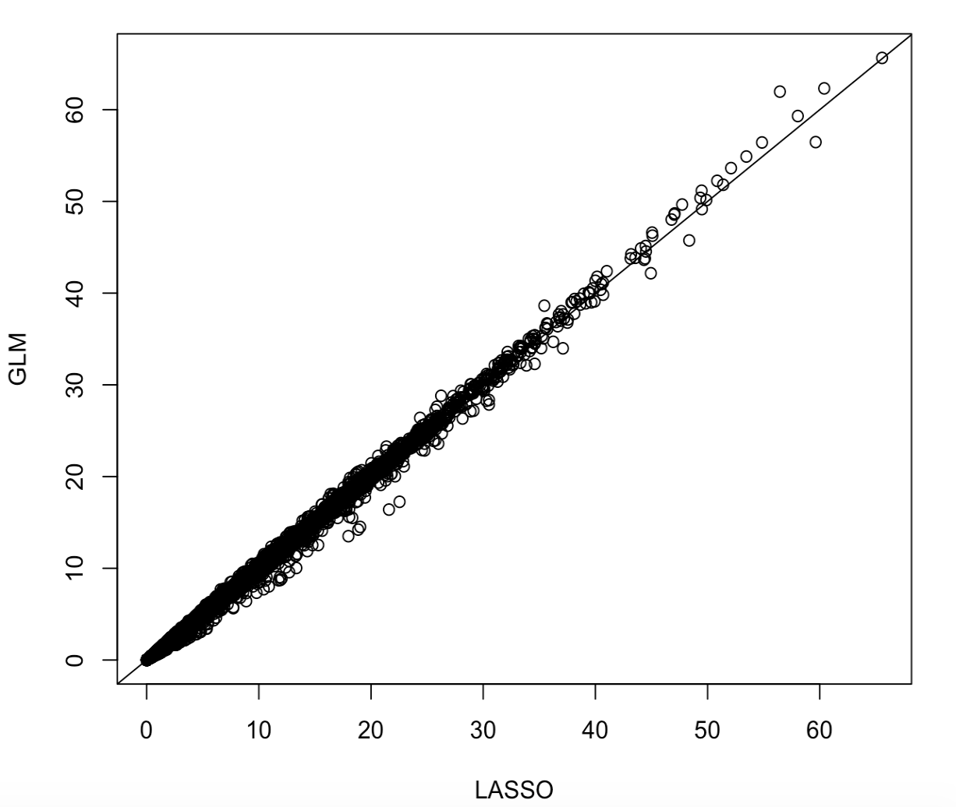
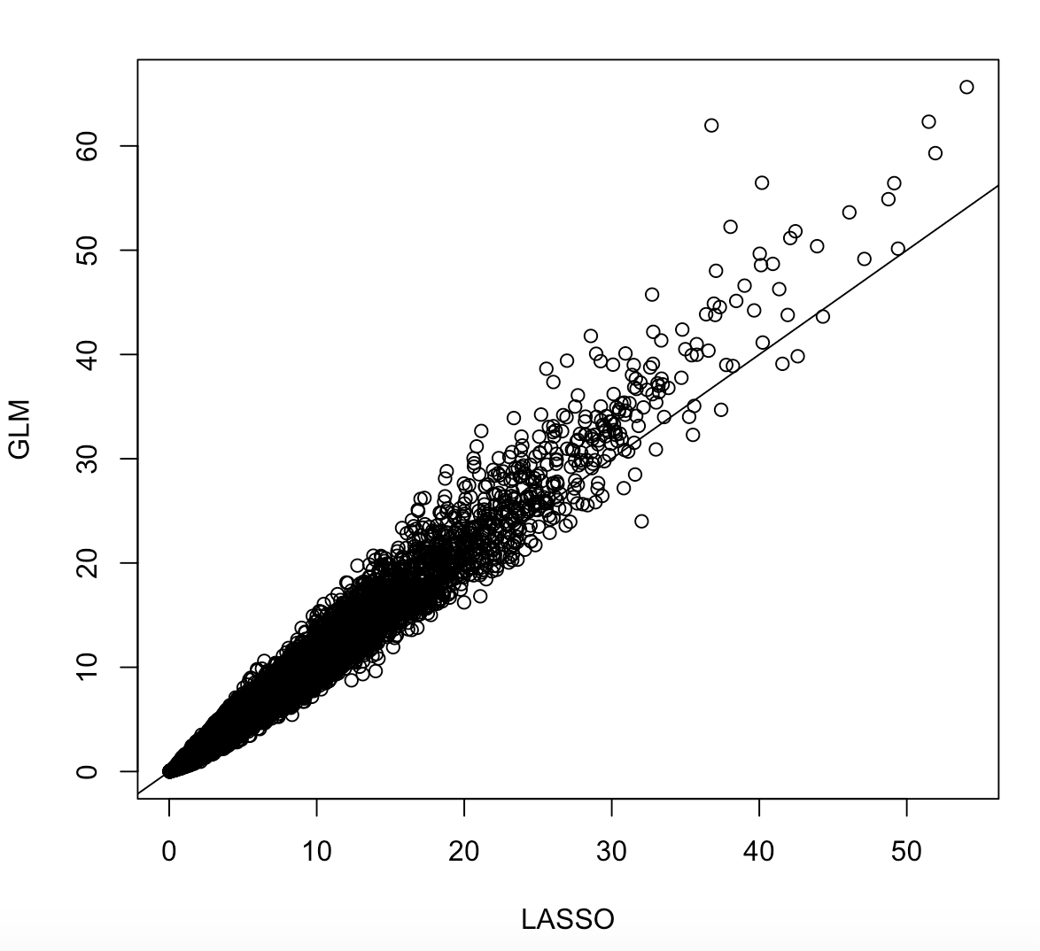
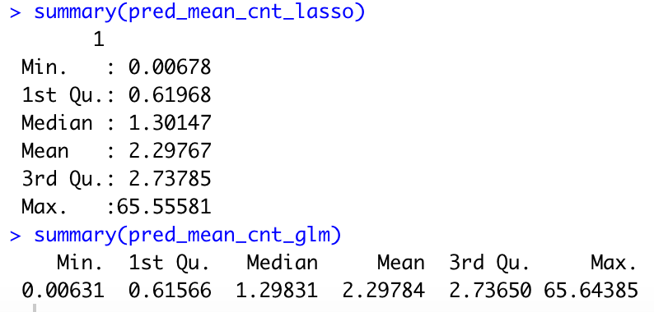
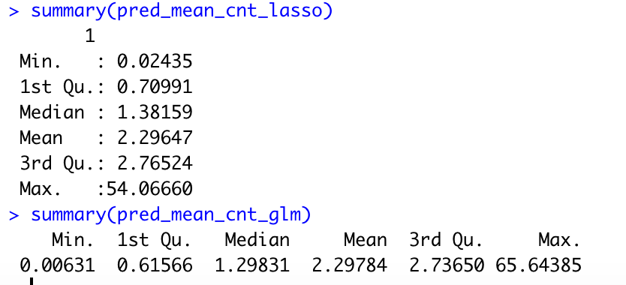
Lambda min
Lambda 1se

Slide 9
Full training dataset
50% for
training of candidate models
K fitted models
50% for
model selection
Testing dataset
One selected model
Predictions

Slide 10
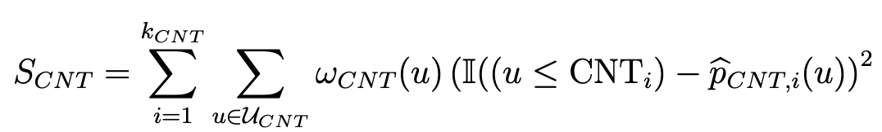
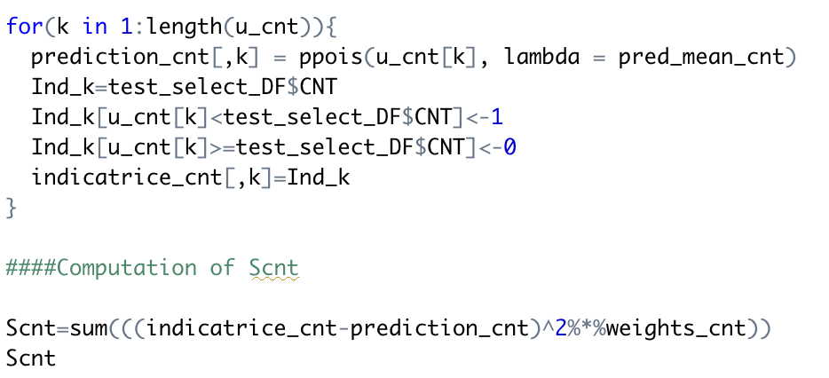

Slide 11
Model | Scnt
glm | 930116.7
LASSO min | 930119.9
LASSO 1se | 930310.0

