Slide 1

RefinedC
Automating the Foundational Verification of C Code with Refined Ownership types
Notes:
Say first names of authors

Slide 2


RefinedC
Automated
Γ⊢e:τ
Foundational
Guide proof search
via a type system
Semantic model
in Coq / Iris
Notes:
We start by building on a foundational model on Iris, Coq.
Then to automate this we use the following insight: We need to restrict the proof search via type system.
Transition: What should this type system look like?

Slide 3
Ownership types
Refinement types
Handle pointers and memory management
Handle functional correctness

Slide 4
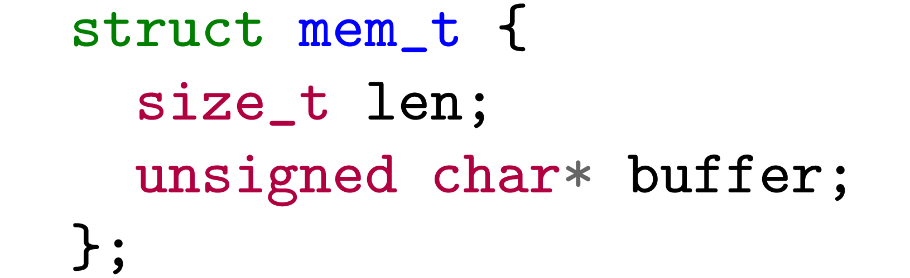
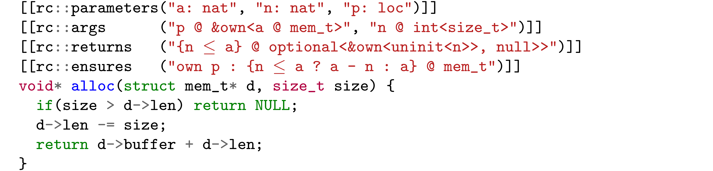
RefinedC in action
Ownership types
(encode allocator guarantee)
address of
mem_t struct
Notes:
Explain more. Explain a and n and p,
Change sz into size
Ownership types represent ownership of the buffer
Refinement types show length of the buffer
Meaning of the Refinement depends on the type it is refining. Explain optional
Get back to foundational and automatic: Types are defined using a semantic model in Coq and verification is sound wrt. To a operational semantics of C in Coq
Verification is automatic using Coq tactic

Slide 5


RefinedC in action
bytes available
from allocator
requested
allocation size
address of
mem_t struct
Refinement types
(encoding functional correctness)
⊢
Notes:
Explain more. Explain a and n and p,
Change sz into size
Ownership types represent ownership of the buffer
Refinement types show length of the buffer
Meaning of the Refinement depends on the type it is refining. Explain optional
Get back to foundational and automatic: Types are defined using a semantic model in Coq and verification is sound wrt. To a operational semantics of C in Coq
Verification is automatic using Coq tactic

Slide 6
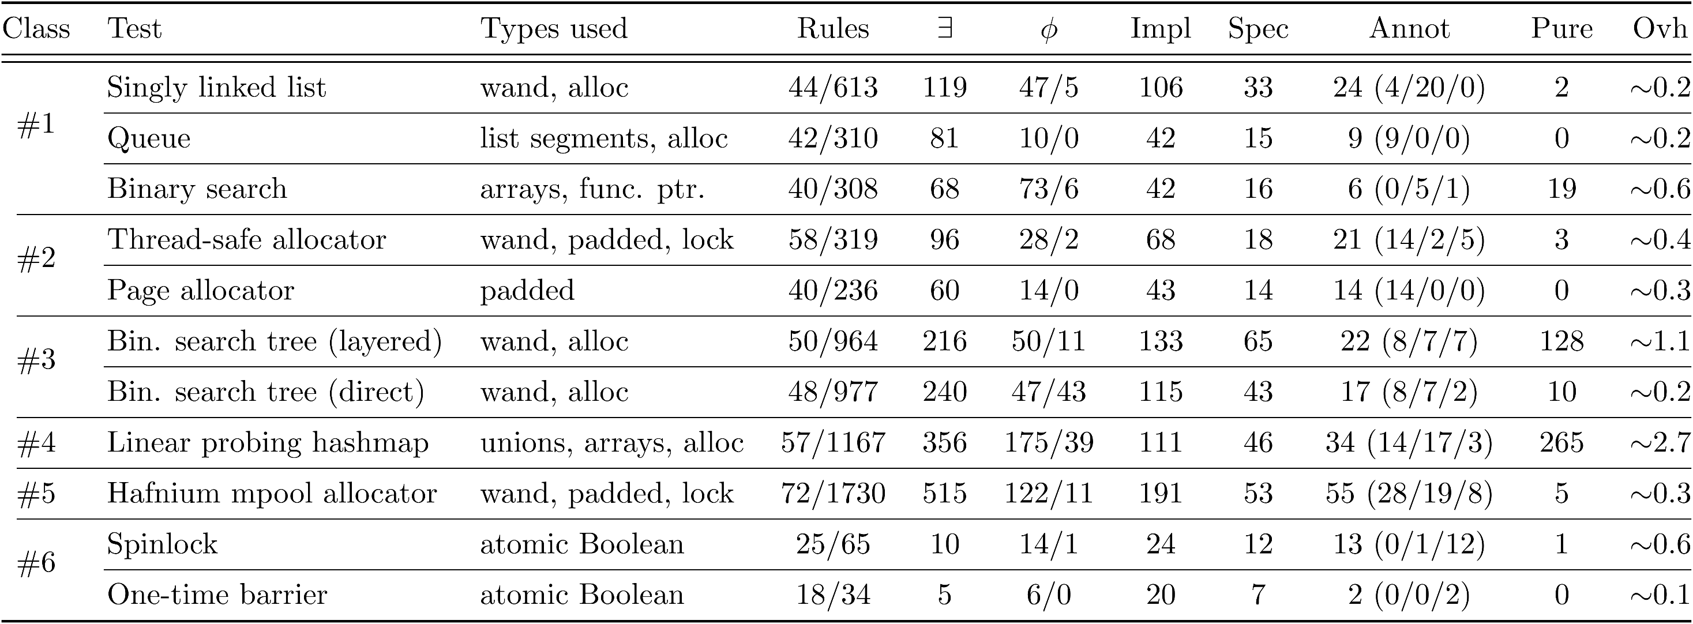
Evaluation
Notes:
Transition from previous slide: This is just one example, but RefinedC scales well as we have shown via many different case studies covering data structures, memory allocators…

Slide 7


Separation logic automation technique (Lithium)
Reasoning about pointers / local variables using ownership types
Reasonably accurate memory model
(VIP, based on PNVI-ae-udi)
Frontend for C code with annotations
Using types to guide the proof search
Extensibility of the type system via Iris
Foundational proofs
Duff’s device
Relatively young
Amount of annotations
→ Annotation inference via biabduction
Connection to assembly code
→ Translation validation
Performance (large examples take minutes)
Error messages currently expose state of type system
Automation for pure sideconditions can be improved
Missing features of C (floating point, strings, block scoped local variables, seq. points, …)
Documentation / Tutorials

Slide 8
RefinedC
Available at
https://plv.mpi-sws.org/refinedc/
Automated
Γ⊢e:τ
Foundational
Notes:
Qualify scalable

