Slide 1
VeriFast: Verify your C or Java code

Slide 2
VeriFast: Verify your C or Java code
Takes as input a C or Java source code file annotated with
function/method preconditions and postconditions
loop invariants
auxiliary logical definitions
proof hints

Slide 3
VeriFast: Verify your C or Java code
Takes as input an annotated C or Java source code file
Thinks for a little while (usually less than a second)
Reports either “0 errors found”
or shows a failing symbolic execution path in a debugger-like GUI

Slide 4
VeriFast: Verify your C or Java code
If VeriFast reports “0 errors found”, this means the program
has no buffer overflows or other undefined behavior
has no data races (threads accessing a variable w/o synchronization)
uses APIs in compliance with their pre/postconditions
complies with its own specified pre/postconditions

Slide 5
VeriFast: Verify your C or Java code
VeriFast never reports “0 errors found” incorrectly
except due to bugs in VeriFast
biggest known bug:
VeriFast uses a naive C semantics (memory is a byte array) without regard for
pointer provenance (pointers are not just addresses)
indeterminate values (uninitialized memory has no stable valid value)
type-based alias analysis (casts from T1* to T2* are OK only if T1 = T2)

Slide 6
VeriFast: Verify your C or Java code
VeriFast never reports “0 errors found” incorrectly
i.e. “no false negatives”
except due to bugs in VeriFast
This distinguishes it from bug-finding tools like Coverity and Facebook’s Infer tool

Slide 7
VeriFast: Verify your C or Java code
VeriFast is modular: it verifies each function/method separately
It executes the body of each function/method
symbolically (using logical terms instead of concrete values)
using a representation of memory based on separation logic
starting from a symbolic state that represents an arbitrary state that satisfies the precondition
checking that each final state satisfies the postcondition
using called functions/methods’ specifications instead of their bodies

Slide 8
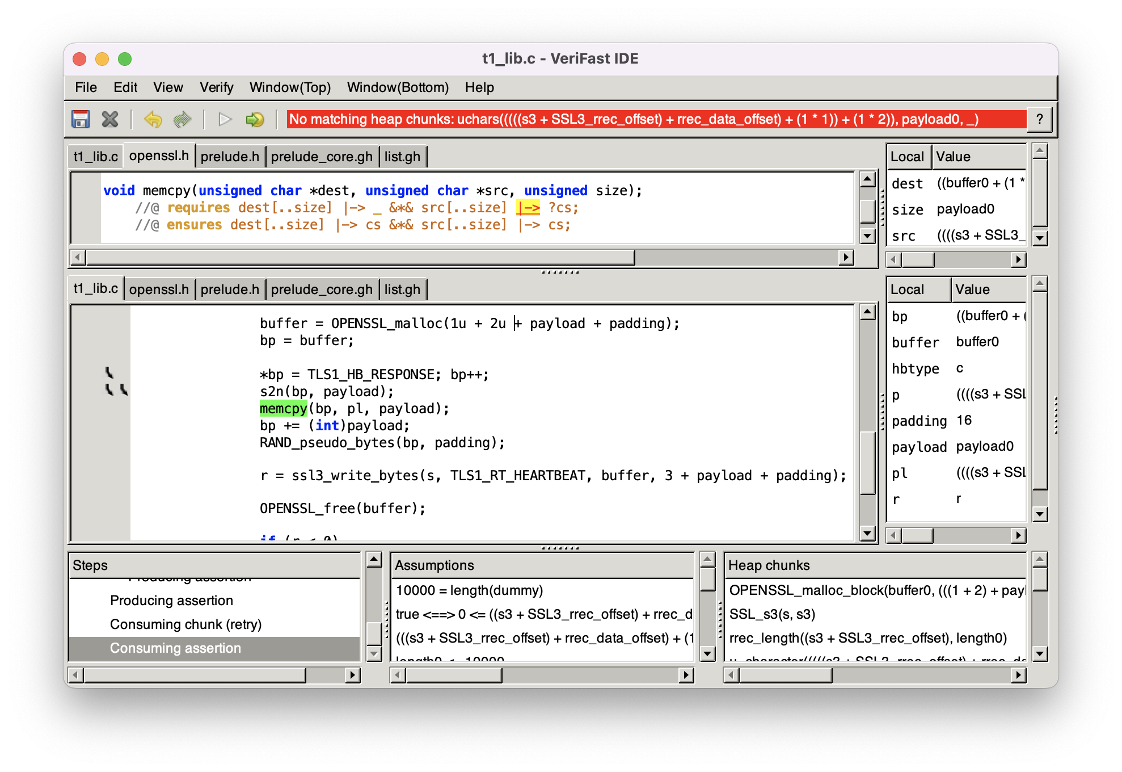
VeriFast: Verify your C or Java code
If verification fails, a failing symbolic execution path is shown in a debugger-like GUI:

Slide 9
VeriFast: Verify your C or Java code
We used VeriFast to verify memory safety and data-race-freedom of a C program that runs on a European telecom operator’s Home Gateway product
We found and fixed some data races in the process

Slide 10
VeriFast: Verify your C or Java code
We used VeriFast to verify memory safety and card tearing safety of the Java Card code running on the Belgian electronic identity cards
or at least of the code provided by the Belgian government to allow app developers to test their apps against the eID

Slide 11
VeriFast: Verify your C or Java code
We used VeriFast to verify memory safety and data-race-freedom of the Linux USB Boot Protocol keyboard driver
We found and reported a concurrency bug in the process
Our patch was accepted and merged into Linux

Slide 12
VeriFast: Verify your C or Java code
We used VeriFast to verify memory safety, data-race-freedom and functional correctness of some tricky fine-grained concurrent data structures, including
RDCSS
MCAS
Lock-coupling set
Jayanti’s snapshot algorithm
Michael-Scott queue
Treiber stack with hazard pointers

Slide 13
VeriFast: Verify your C or Java code
Nathan Chong at Amazon Web Services’ Automated Reasoning group used VeriFast to verify memory safety, data-race-freedom and functional correctness of the concurrent queue data structure that lies at the core of the popular FreeRTOS real-time operating system used in many embedded systems

Slide 14
VeriFast: Verify your C or Java code
The Vigor project at EPFL used VeriFast as part of a multi-tool approach for formally verifying network infrastructure such as NATs

Slide 15
VeriFast: Verify your C or Java code
We used VeriFast to validate research results on
expressive fine-grained concurrency specification
safe and live exception handling
verifying unloadable modules (e.g. Linux kernel modules)
verifying absence of deadlocks in programs using condition variables or involving tricky patterns with channels (requiring obligation transfer)
verifying termination of object-oriented programs with dynamically bound method calls
verifying safety and liveness properties of a program’s I/O behavior
verifying integrity and confidentiality of cryptographic protocol implementations
verifying termination of programs that perform busy waiting

Slide 16
VeriFast: Verify your C or Java code
Ongoing projects:
Adding support for C++ and Rust
Verifying that Rust unsafe code preserves type system invariants
On successful runs, generating a machine-checkable foundational proof of correctness wrt an accurate mechanized C semantics
Combining the strengths of VeriFast and more automatic approaches such as the C Bounded Model Checker

