Slide 1

Part 1: 7:30-7:50 (name)
About Mentoring at the Event: Everything you need to know about what we’re doing when and what you should be ready to do.
Part 2: 7:51-8:30 (name)
Taking a look at AppLab: Tips and suggestions for becoming familiar with the coding environment.
Mentoring the Event
March 2017
http://tinyurl.com/hack-train
Hit record. Archive. Mute people. [Name] monitor chat.

Slide 2
Sponsored By
GreenCourt
College of Education - Fusion Center
College of Science and Math
Walmart Community Foundation

Slide 3
When & How To Get There
Hackathon Event Hours (for kids): 10am-4pm
Mentor Check-in Time: 9:30am
Mentor Departure: We would love to have you till 4; we could spare you at 2:45.
Parking and Checking In: Park in the Tyus Lot at the University of West Georgia, and enter the Education Center. There will be a registration/check-in table, where you can check in and get your T-shirt and name badge.
See Campus Maps: https://www.westga.edu/about-uwg/maps-and-directions.php

Slide 4
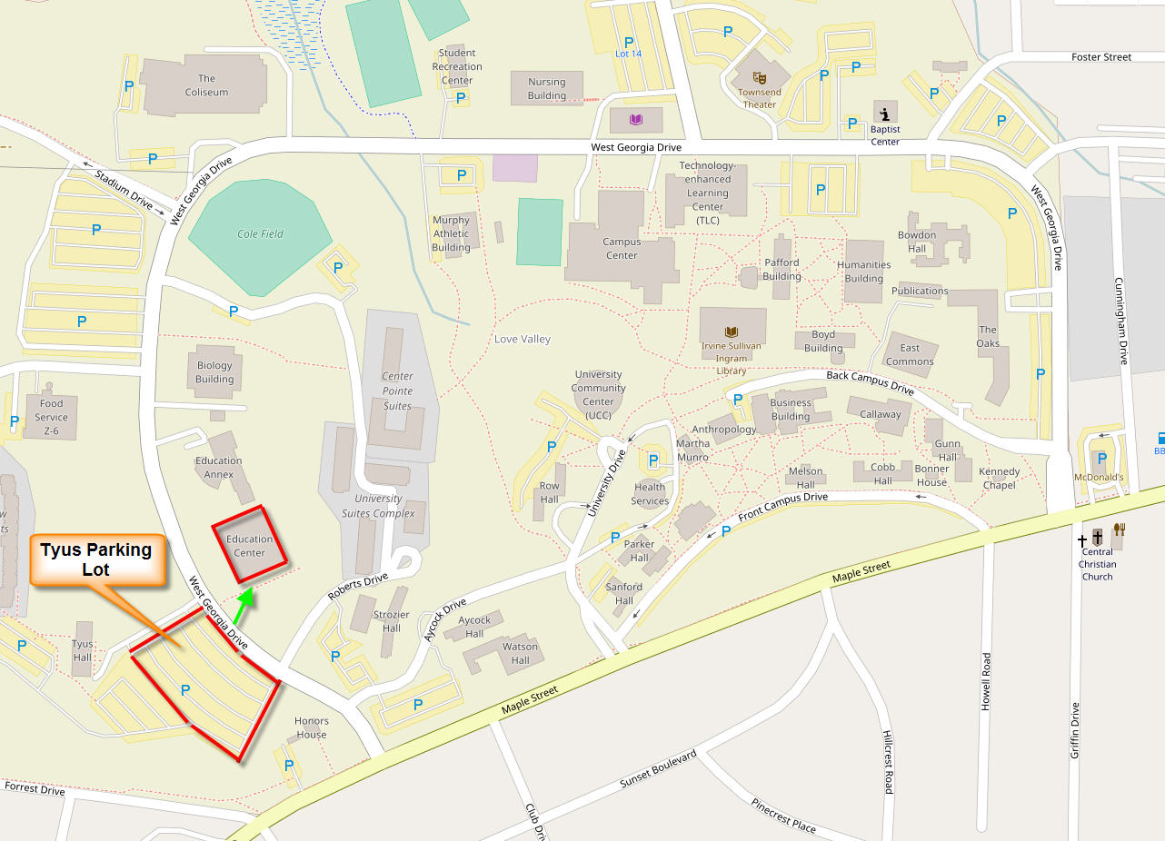
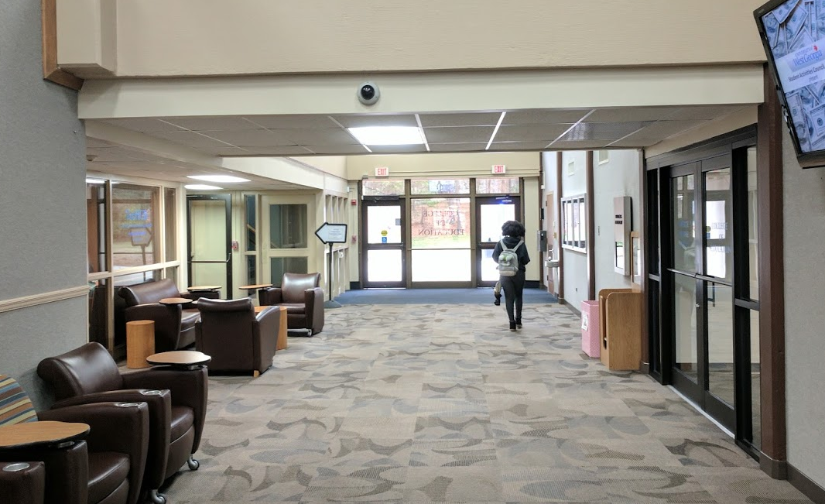

Slide 5
Schedule
10-10:15am | Registration and Greeting | Foyer
10:15-10:30am | Opening talks | Room 2
10:30-10:45am | Forming teams | Room 2
10:45am | Code start | Room 1
11-11:20am | App Lab Workshop I | Lab 204/205
11:30-11:40am | App Lab Workshop II | Lab 204/205
12-1pm | Lunch | Room 2
2:45pm | Code stop | Room 1
3-3:30pm | Demonstrations | Room 2
3:45-4pm | Awards ceremony | Room 2
Again, we would love it if you can stay until 4pm. But we really need you until at least 2:45pm.

Slide 6
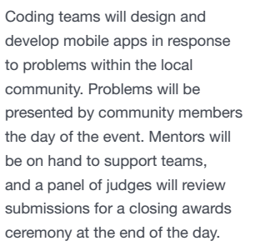
Hackathon Focus: Solving a Community Problem
As mentors, our job will be to support the ~35 kids in...
joining a team,
learning to use AppLab, choosing an angle to focus on,
designing an app,
producing an app, and communicating about/demo-ing the app.

Slide 7
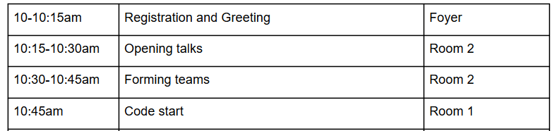
The First Hour
Mentor introductions (hook)
Icebreaker 1: Whole Group
Icebreaker 2: Team
Hackathon How Tos
Code Start@1045am

Slide 8
What does a mentor do?
Mentoring takes many forms over the course of the Hackathon:
Introducing yourself;
Modeling problem-solving processes;
Idea generation;
How to use AppLab;
How to narrow down a focus;
How to plan and storyboard;
How to communicate about one’s app (in the demo phase);
How to involve teammates who might be withdrawing;
How to think more broadly or narrowly about some aspect of the poverty theme;
How to be interested in kids’ demos.

Slide 9
Handouts for Kids
Poverty Resources, including lists of resources in Carrollton
Poverty Factsheet
App Demonstration Checklist
Others--trying to streamline

Slide 10
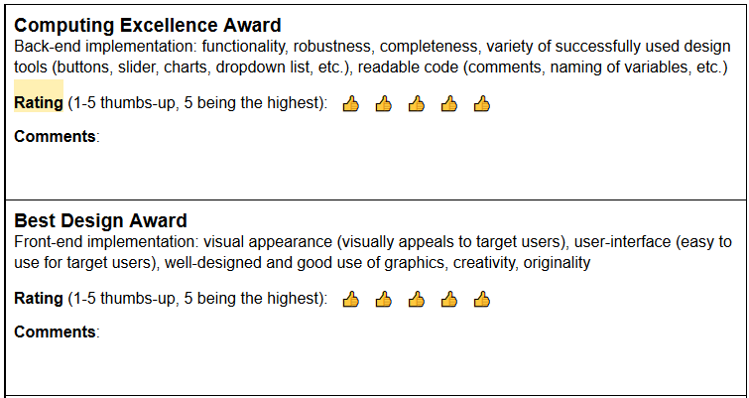
Awards
3 Judges will watch the demonstrations and rate them.

Slide 11
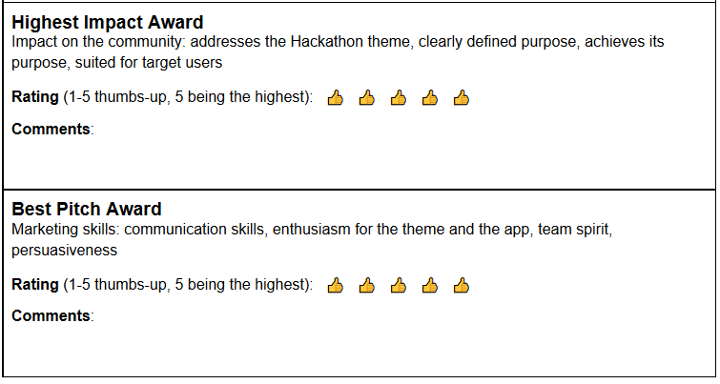
Awards (cont.)

Slide 12
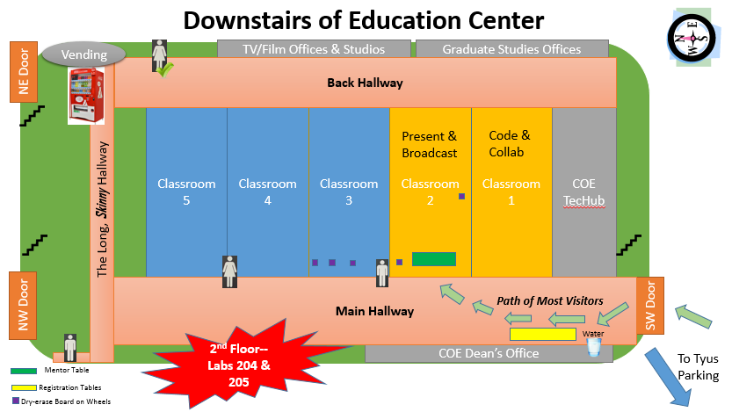
Education Center Map

Slide 13
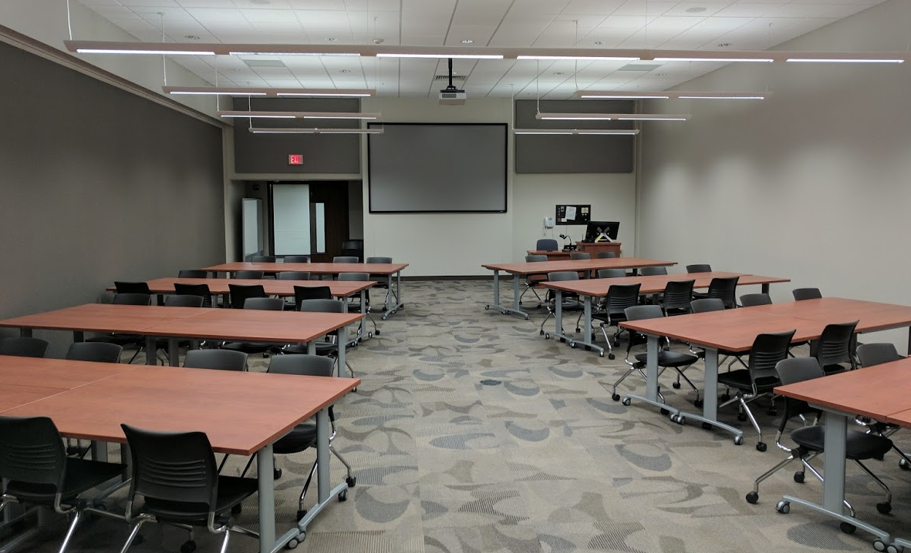
Room 2 for Presentations
Hour 1 Presentations
Hackathon Instructions
Mentor Introductions
Icebreaker 1: Bingo
Icebreaker 2: Blanket
Lunchroom
Some Horseshoe Pods in back
Final Demos and Awards

Slide 14
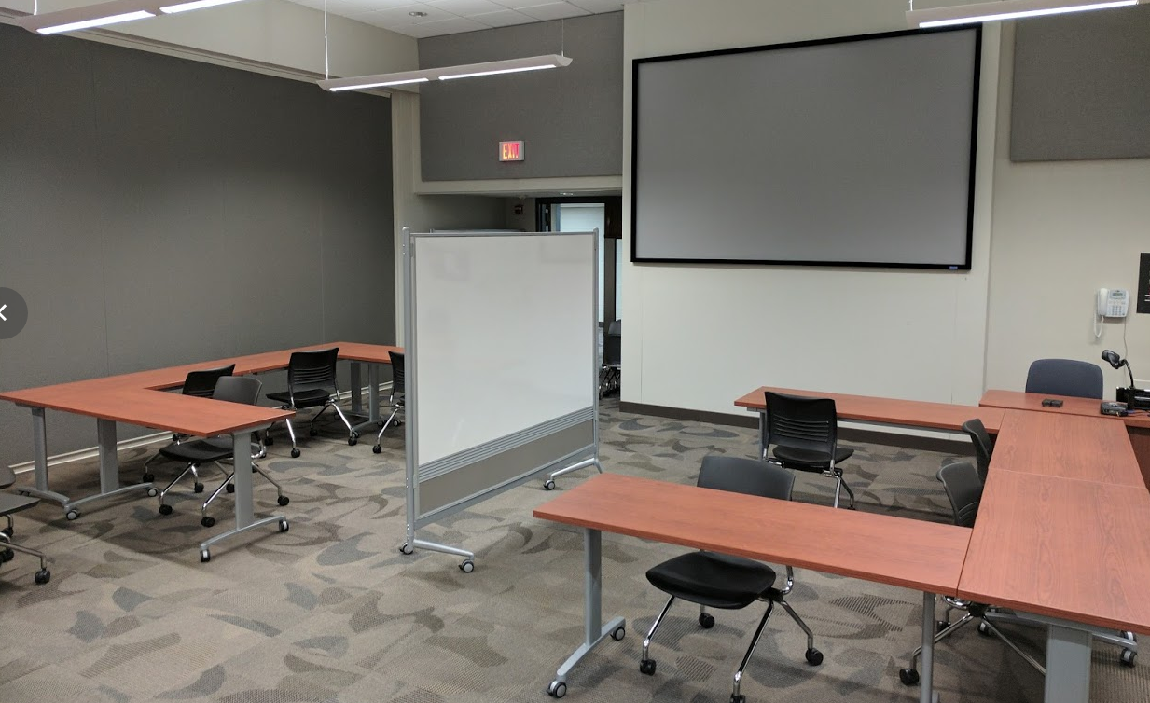
Room 1 for Coding, Collaborating, “Hacking”
1 side of a whiteboard
Group spaces that allow for individual work and group collaboration
Supply Table in room

Slide 15
Other Details
Some kids will bring their own laptops.
Some kids will check out laptops and mice from us.
We will have about 10 mic headsets available, if needed.
WiFi access will be provided.
Remixing and re-using will be acceptable in app creation.

Slide 16
Questions?
Do you have any questions?
Do you have any dietary restrictions? Email [Organizer 1 email] or [Organizer 2 email].

Slide 17

Thank You!
Updates: to be emailed around noon of Friday, March 17
Folder link: http://tinyurl.com/hack-train
Hackathon Website: https://www.westga.edu/academics/education/ucode/hackathon-2017.php

