Slide 1
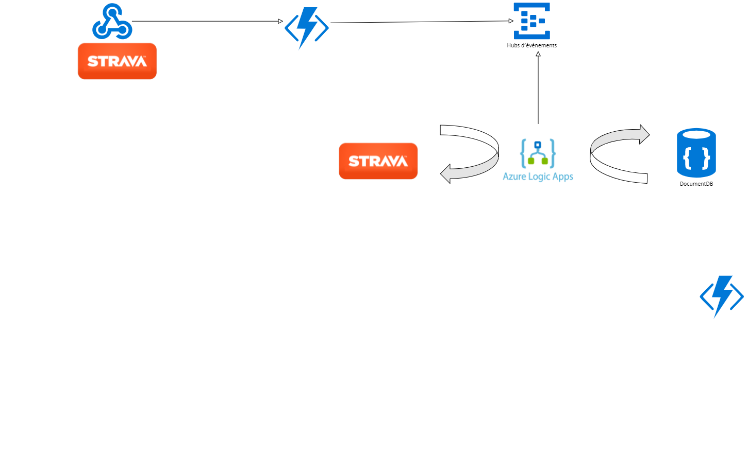
POST
Logic App listens to
new events from event hub
and fetches the whole set
of activities using a token
and persists them
The Azure function posts a
newActivity event to Event Hub
Strava notifies Azure Function
about new activity
It fetches activities from the db
when getting activities,
GET
ACTIVITIES
REMSTRAVA JULY 2021

