Slide 1


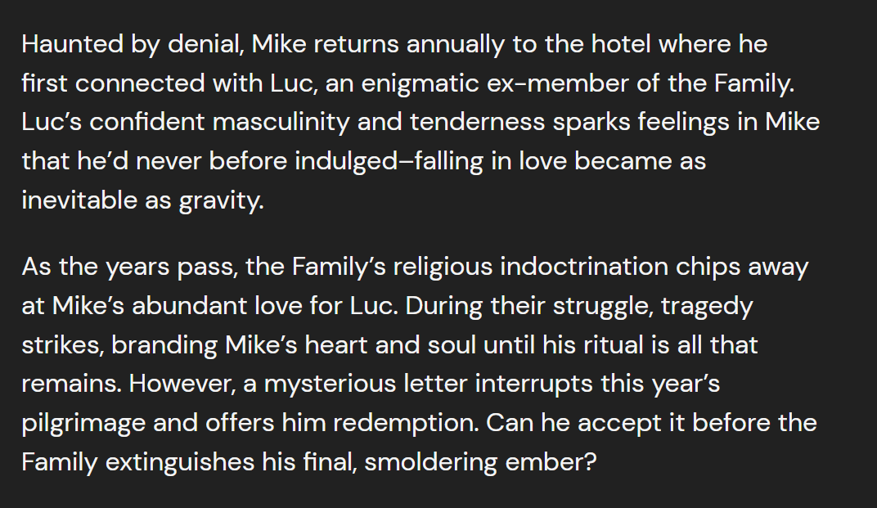




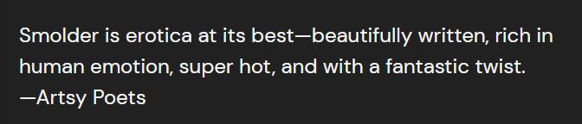

Slide 3
header
bookblurb
bookcover
bookquotes
storytypes
time_period
testimonials
website
footer

