Slide 1
CASESTUDY
CORRELATION ANALYSIS
Submitted by
REMYA TR
ADIT(TVM-012)

Slide 2
Introduction
Correlation a LINEAR association between two random variables
Correlation analysis show us how to determine both the nature and strength of relationship between two variables
When variables are dependent on time correlation is applied
Correlation lies between +1 to -1

Slide 3
A zero correlation indicates that there is no relationship between the variables
A correlation of –1 indicates a perfect negative correlation
A correlation of +1 indicates a perfect positive correlation

Slide 4
Types of Correlation
There are three types of correlation
Types
Type1
Type2
Type3

Slide 5
If two related variables are such that when one increases (decreases), the other also increases (decreases).
If two variables are such that when one increases (decreases), the other decreases (increases)
If both the variables are independent
Type1
Positie
Negative
No
Perfect

Slide 6
Type 2
Linear
Non – linear
When plotted on a graph it tends to be a perfect line
When plotted on a graph it is not a straight line

Slide 7
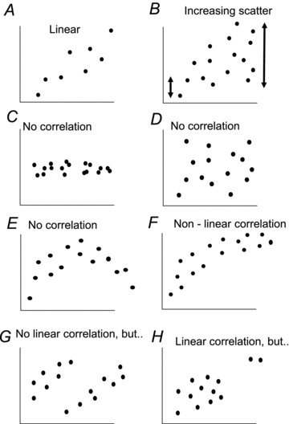

Slide 8
Two independent and one dependent variable
One dependent and more than one independent variables
One dependent variable and more than one independent variable but only one independent variable is considered and other independent variables are considered constant
Type 3
Simple
Multiple
Partial

Slide 9
Methods of Studying Correlation
Scatter Diagram Method
Karl Pearson Coefficient Correlation of Method
Spearman’s Rank Correlation Method

Slide 10
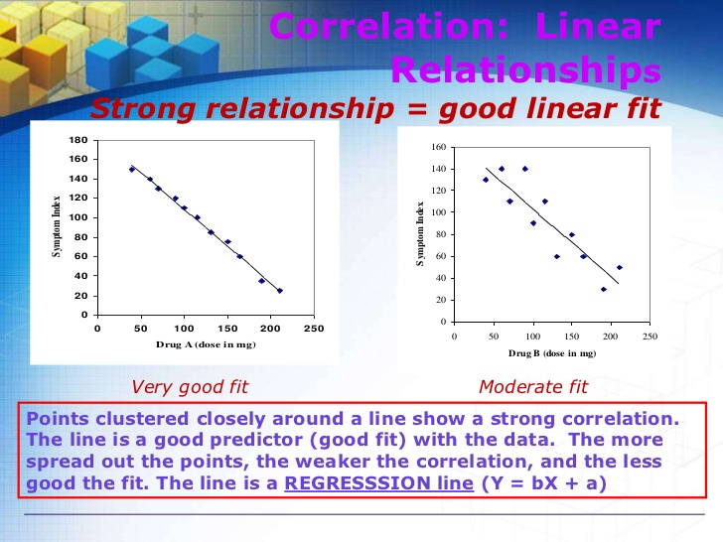

Slide 11
Coefficient of Correlation
A measure of the strength of the linear relationship between two variables that is defined in terms of the (sample) covariance of the variables divided by their (sample) standard deviations
Represented by “r”
r lies between +1 to -1
Magnitude and Direction

Slide 12
-1 < r < +1
The + and – signs are used for positive linear correlations and negative linear correlations, respectively

Slide 13
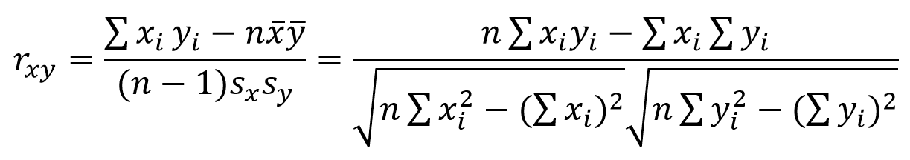
Shared variability of X and Y variables on the top
Individual variability of X and Y variables on the bottom

Slide 14
Interpreting Correlation Coefficient r
strong correlation: r > .70 or r < –.70
moderate correlation: r is between .30 & .70 or r is between –.30 and –.70
weak correlation: r is between 0 and .30 or r is between 0 and –.30

Slide 15
Spearman’s rank coefficient
A method to determine correlation when the data is not available in numerical form and as an alternative the method, the method of rank correlation is used.
Thus when the values of the two variables are converted to their ranks, and there from the correlation is obtained, the correlations known as rank correlation.

Slide 16


