Slide 1



Web based application – Enterprise User Search
A Code-A-Thon Entry

Slide 2
The Problem
Technical/Enterprise User locked out.
Inquiry regarding with the associate number to be used when connecting to the same store.
Hijacking of Store/s to be used has become a common avenue.
Batch Apply Status

Slide 3
Our Solution
Provide the ability for each AS associates to search for the technical/enterprise user and check the current status of that user through color coding scheme.
AS associates have the capability to check what are the available associates to use when connecting to another store without asking the store owner.
AS associates has now the power to hijacked every store.
Ease of checking the record for the number of users applied once done executing batch apply for “User”.

Slide 4




Architecture
Database
Lemme

Slide 5

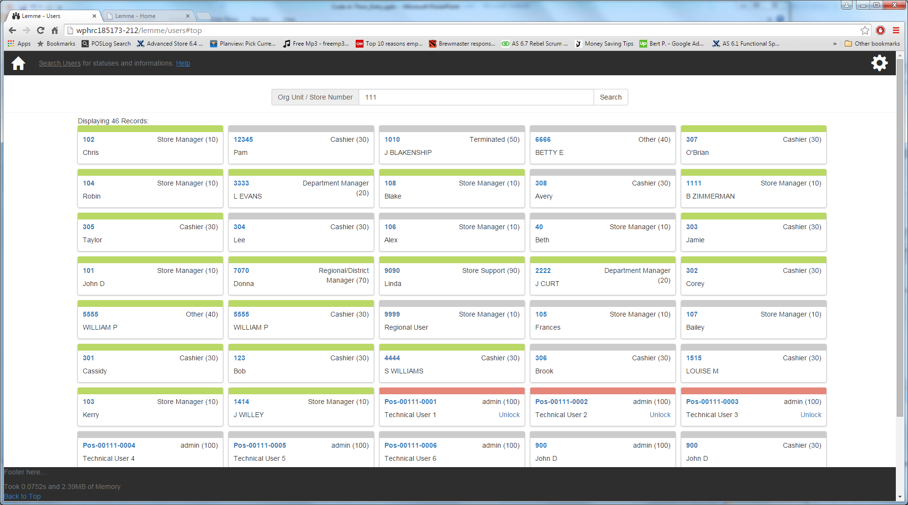
Architecture
Database
Lemme

Slide 6
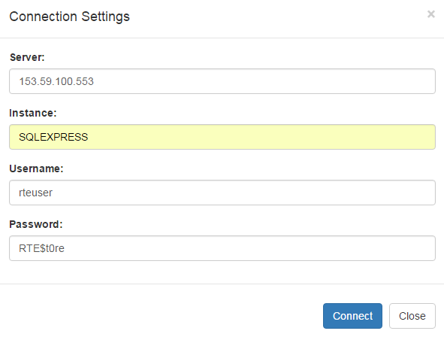


Screenshots

Slide 7
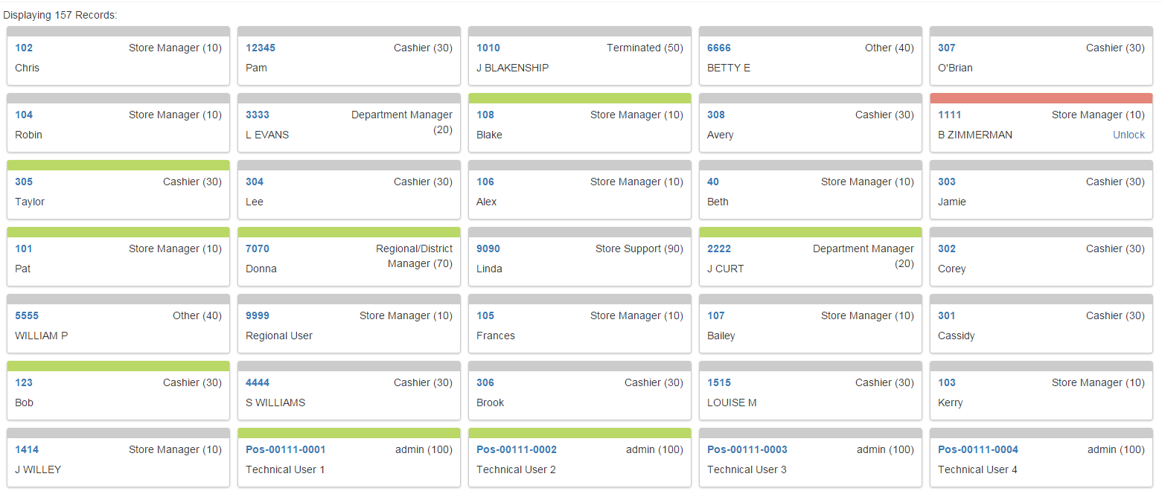
Screenshots
Result Screen:

Slide 8



Screenshots
User Status:
Active
Locked
Inactive

Slide 9
Advantages
Can connect to any enterprise without the need of any prerequisites.
Real Time results.
Makes life easier.

