Slide 1
ConvNeXt Based Lung Cancer Survival Prediction using Dual Energy CT
Advisor: Ruey-Feng Chang, Ph.D.
張瑞峰教授
Student: Chao-Hsun Yang
楊朝勛

Slide 2
Contents
Introduction
Lung cancer
Survival prediction
Material
Dual Energy CT
Clinical Data
Methods
Preprocessing
Classification
Experiments
Discussion
Conclusion

Slide 3
Contents
Introduction
Material
Methods
Experiments
Discussion
Conclusion

Slide 4
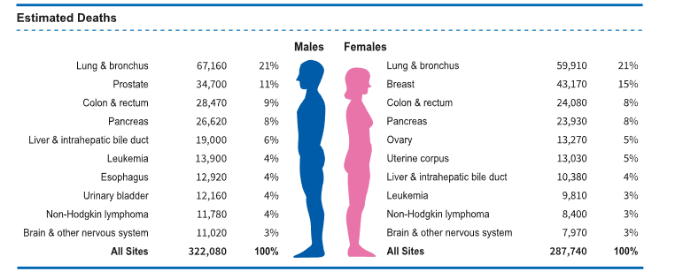
Lung Cancer
Leading Cause of Mortality
Patients with the same clinical and pathological status may experience different survival times.
Considering survival as a new and distinct marker is essential in making informed decisions regarding further treatment for patients.
Notes:
越早治療存活率越高
2023年
127070 死亡 350 死亡/天
238340 肺癌
Localized: There is no sign that the cancer has spread outside of the lung.
Regional: The cancer has spread outside the lung to nearby structures or lymph nodes.
Distant: The cancer has spread to distant parts of the body, such as the brain, bones, liver, or the other lung.

Slide 5
Survival Prediction
Machine Learning
Support vector machine on the Surveillance, Epidemiology, and End Results (SEER) data.
Random forest classifier on radiomic features extracted from computed tomography (CT) images.
Deep Neural Network (DNN)
Four hidden layers, each with 40 neurons, with rectifed linear unit (ReLU) on clinical data.
Notes:
SEER data? 40年 pathological clinical data <-> 社會經濟
可申請獲得部分數據
Epidemiology 流行病學
沒有CNN與CT images

Slide 6
3D Convolution Neural Network
Study Objective:
3D CNNs can capture spatial relationships and contextual information across multiple slices.
Our approach:
Leverage 3D CNNs to extract features from Dual Energy CT.
Integrate the extracted features with clinical data for survival prediction.
Notes:
Anatomical 解剖學的

Slide 7
Contents
Introduction
Material
Methods
Experiments
Discussion
Conclusion

Slide 8
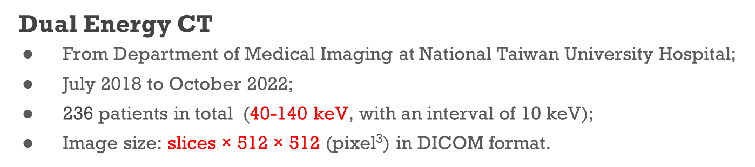
Dataset
Dual Energy CT
From Department of Medical Imaging at National Taiwan University Hospital;
July 2018 to October 2022;
236 patients in total (40-140 keV, with an interval of 10 keV);
Image size: slices$\text{×}\text{ 512 }\text{×}\text{ 512}$ (pixel³) in DICOM format.
Clinical data
Clinical and pathological information.
n = 236
Deceased | Survivor
34 | 202
Notes:
Kilovoltage peak (kVp) is the peak potential applied to the x-ray tube
kiloelectron volts (keV)

Slide 9
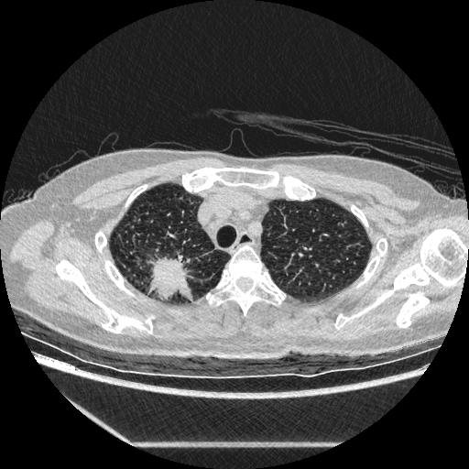
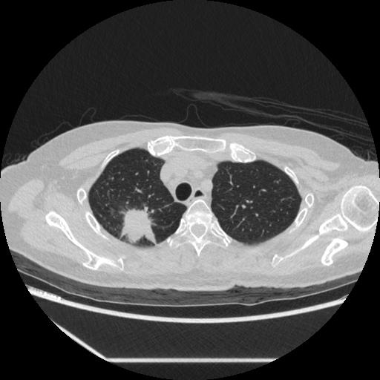
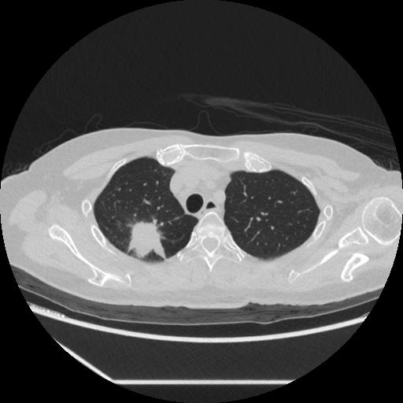

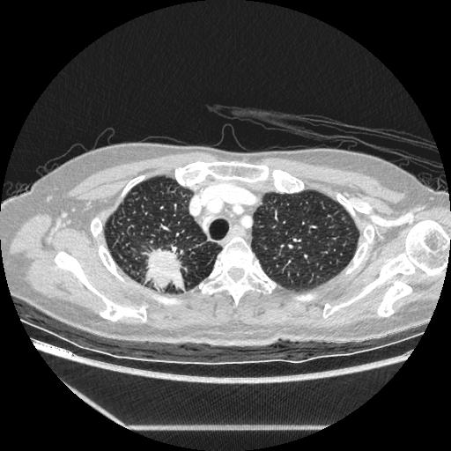


Dual Energy CT
Tumor
C-40 (keV)
C-70
C-100
C-140
w/o contrast
C+40
C+70
C+100
C+140
Contrast
Notes:
雙能量CT以兩種不同的管電壓(通常是80kVp與140kVp)進行掃描組織時，得到兩個X光射線衰減級別係數的數據集，這些數據經過電腦的運算，可分辨人體內不同的組織特性，可組出單能量(40至140 keV)影像。
一般而言較低的單能量影像可以產生較好的對比度，但相反的會有產大的雜訊，而較高的單能量影像清晰度較佳，假影及雜訊較少。
kiloelectron volts (keV)
70 醫生比較常用。
Contrast -> tumor的紋路比較明顯 (以C40為例)

Slide 10
Clinical Data
Clinical information
gender, port-a/resection, differentiation, lymphovascular invasion (LVI), clinical staging, smoking, pack per day (PPD), hypertension (HTN), diabetes mellitus (DM), family history of lung cancer, complications, forced vital capacity (FVC), forced expiratory volume in one second (FEV1), FEV1/FVC
Pathological information
tumor size, tumor location, anaplastic lymphoma kinase (ALK), ROS-1, epidermal growth factor receptor (EGFR), EGFR mutation, pathological staging, metastasis, recurrence
Notes:
0 -> 分化只有poorly和moderately
LVI 腫瘤細胞經由淋巴管或血管散布
間變性淋巴瘤激酶(ALK) 5%
原癌基因酪氨酸蛋白激酶(ROS1) 1-2%, ROS1 is an oncogene(致癌基因), like the ALK oncogene
表皮生長因子受體基因(EGFR) 55%
臨床分期——基於臨床檢查、影像學檢查、腫瘤活體檢查所獲得的信息。有 時，其它檢查例如血液檢查結果也是重要的分期因素。
0 -> 臨床分期TNM (4, 3, 1) 且病理分期很多都-

Slide 11
Contents
Introduction
Material
Methods
Preprocessing
Dual Energy CT
Clinical data
Classification
ConvNeXt
Attention Block
Damper Block
Focal Loss
Experiments
Discussion
Conclusion

Slide 12
Survival Prediction Workflow
Clinical information
gender, port-a/resection, differentiation, LVI, clinical staging, smoking, PPD, HTN, DM, family history of lung cancer, complications, FVC, FEV1, FEV1/FVC
Pathological information
tumor size, tumor location, tumor size, ALK, ROS-1, EGFR, EGFR mutation, pathological staging, metastasis, recurrence
Notes:
最後補個總結
加文字敘述

Slide 13
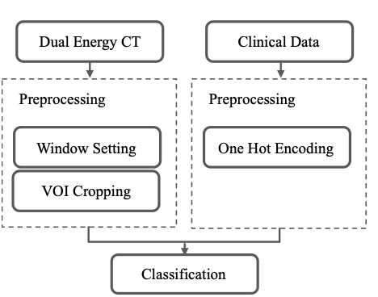
Dual Energy CT
Set the window center and window width to focus on the relevant organ structures like lung.
Perform a Volume of Interest (VOI) cropping, where we center the images around the VOI and cut them into 128×224×224 dimensions from the original size.
Air with a Hounsfield Unit (HU) value of -1000
Water with a HU value of 0
Bones with HU values ranging from 400 to 1000
Notes:
-1024 –> 3071 (4096)

Slide 14
Clinical Data
One hot encoding used to convert categorical variables, such as text or non-ordinal data, into numerical representations.
Obtain a total of 150 clinical features.
Notes:
文字 -> 數字
Gender
自由設定規則
標號？

Slide 15
Classification
Use ConvNeXt as the backbone.
Bring in damper block to integrate the VOI size as an effect parameter.
Combine image features with clinical data.
Notes:
Stem
Conv(k=4, s=4)
Layernorm
Downsample
layernorm
Conv(k=2, s=2)

Slide 16
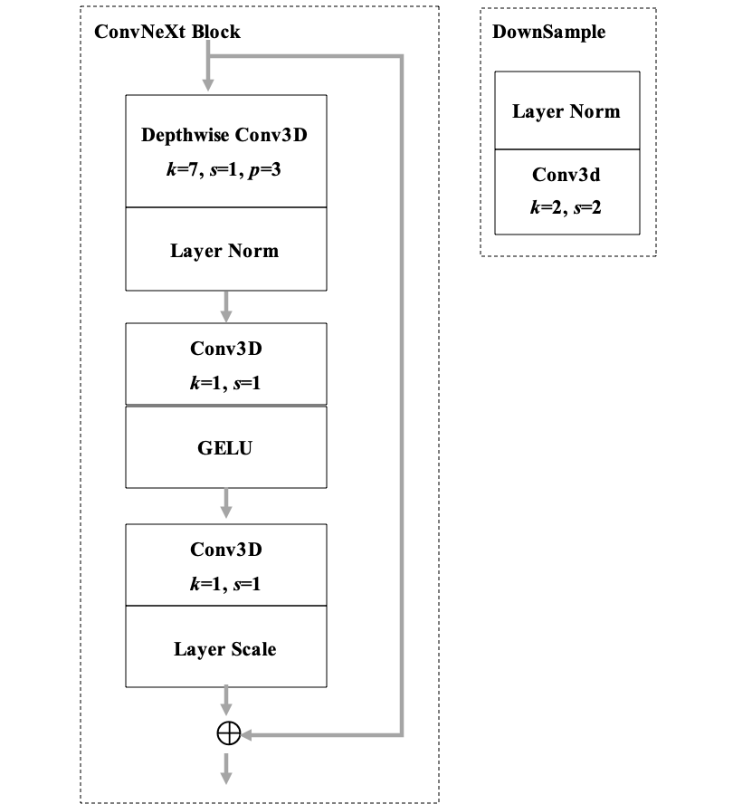
ConvNeXt
Derive from ResNet and ResNeXt and mimic certain aspects of Vision Transformers.
Reduce number of ConvNeXt blocks.
Reduce channel numbers in each ConvNeXt block.

Slide 17
Classification
Employed channel attention block to distinguish features with varying levels of importance within the channels.
Combine SE block and GCT block to one channel attention block.
Notes:
Stem
Conv(k=4, s=4)
Layernorm
Downsample
layernorm
Conv(k=2, s=2)

Slide 18


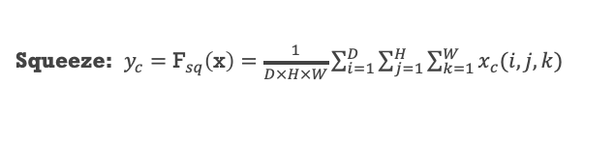
Squeeze and Excitation (SE)
A channel attention block.
Allow the network to focus on informative channels and suppress less useful ones.
Squeeze: $y_{c}={\text{F}}_{sq}\left(\text{x}\right)=\frac{1}{D×H×W}\sum_{i=1}^{D}{\sum_{j=1}^{H}{\sum_{k=1}^{W}{x_{c}(i, j,k)}}}$
Excitation: $z={\text{F}}_{ex}\left(\text{y}\right)= σ({\text{W}}_{2}δ({\text{W}}_{1}\text{y}))$
Weight recalibration: $\tilde{\text{x}}={\text{F}}_{scale}\left(\text{x},\text{z}\right)=z_{c}x_{c}$

Slide 19
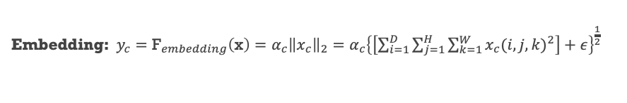
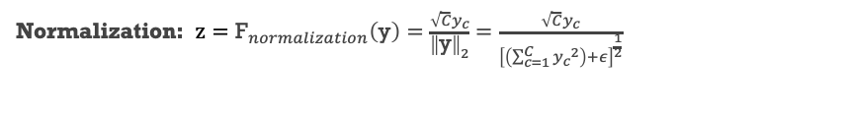
Gated Channel Transformation (GCT)
A channel attention block.
Enhance the channel-wise feature representation, similar with SE block.
Embedding:$y_{c}={\text{F}}_{embedding}\left(\text{x}\right)=α_{c}{\left\|x_{c}\right\|}_{2}=α_{c}{\left\{\left[\sum_{i=1}^{D}{\sum_{j=1}^{H}{\sum_{k=1}^{W}{{x_{c}(i, j,k)}^{2}}}}\right]+ε\right\}}^{\frac{1}{2}}$
Normalization: $z={\text{F}}_{normalization}\left(\text{y}\right)=\frac{\sqrt{C}y_{c}}{{\left\|\text{y}\right\|}_{2}}=\frac{\sqrt{C}y_{c}}{{\left[\left(\sum_{c=1}^{C}{{y_{c}}^{2}}\right)+ε\right]}^{\frac{1}{2}}}$
Gating: $\tilde{\text{x}}={\text{F}}_{gating}\left(\text{x},\text{z}\right)=x_{c}\left[1+σ(γ_{c}z_{c}+β_{c})\right]$

Slide 20
Proposed Attention Block
Combine SE block and GCT block to one channel attention block.
Allow the network to focus on informative channels and suppress less useful ones.

Slide 21

Damper block
In the proposed CNN model, the size of input images is fixed. Thus, the output features do not capture information about the size of the VOI.
Aim to normalize the output features by considering the size of the VOI.
Damper Operation: $\tilde{x}=I− \frac{Sum(I.∗V)}{n(I.∗V)}$
Notes:
右上角

Slide 22
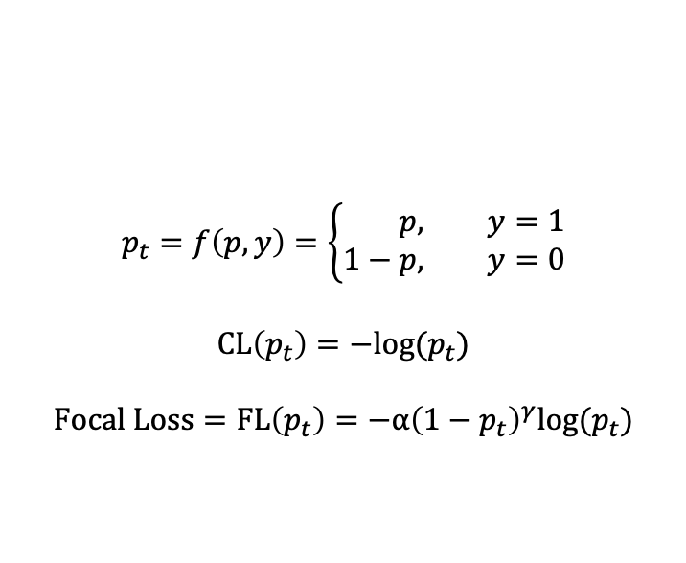
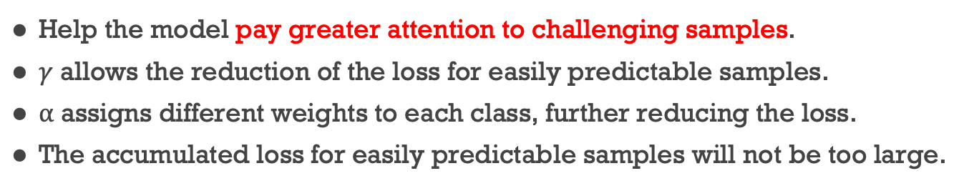
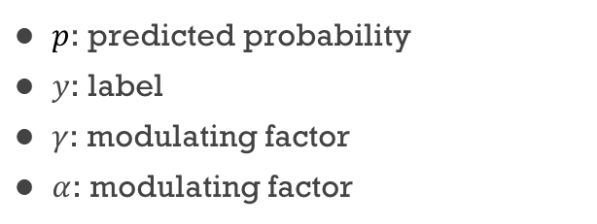
Focal Loss
Help the model pay greater attention to challenging samples.
$γ$ allows the reduction of the loss for easily predictable samples.
$α$ assigns different weights to each class, further reducing the loss.
The accumulated loss for easily predictable samples will not be too large.
$$p_{t}=f\left(p, y\right)=\left\{\begin{aligned}p, &y=1 \\ 1−p, &y=0\end{aligned}\right.$$
$$CL\left(p_{t}\right)=−log⁡(p_{t})$$
$$Focal Loss=FL\left(p_{t}\right)=−α{\left(1−p_{t}\right)}^{γ}\text{log}\text{(}p_{t}\text{)}$$
$p$: predicted probability
$y$: label
$γ$: modulating factor
$α$: modulating factor

Slide 23
Contents
Introduction
Material
Methods
Experiments
Dual Energy CT with 40, 70, 100, 140 keV
Different Attention Blocks
Positions of the Attention Block
With and Without the Damper Block
Cross Entropy Loss or Focal Loss
Comparison with Other Models
Discussion
Conclusion

Slide 24
Dual Energy CT with Four Different keV
Select 40, 70, 100, and 140 keV as the experimental settings and compared the results with and without contrast agents.
"-" : without contrast, while "+" : contrast
keV | ACC (%) | SEN (%) | SPEC (%) | PPV (%) | NPV (%) | AUC
C-40 | 85.60±6.42 | 82.86±11.95 | 86.19±7.85 | 54.38±18.51 | 96.70±2.32 | 0.8871±0.0523
C-70 | 85.18±6.17 | 76.19±8.91 | 86.64±7.17 | 52.72±18.70 | 95.63±1.48 | 0.8867±0.0571
C-100 | 85.18±6.17 | 82.86±11.95 | 85.69±7.63 | 53.29±18.25 | 96.69±2.32 | 0.8887±0.0495
C-140 | 84.75±6.25 | 73.33±7.22 | 86.64±7.17 | 51.81±18.97 | 95.09±1.27 | 0.8853±0.0571
C+40 | 85.59±6.09 | 73.33±12.42 | 87.62±8.11 | 56.94±25.07 | 95.24±1.89 | 0.8900±0.0467
C+70 | 85.59±6.09 | 73.81±11.42 | 87.64±8.24 | 57.34±24.93 | 95.23±1.92 | 0.8742±0.0654
C+100 | 85.60±6.42 | 80.00±16.29 | 86.69±8.78 | 57.71±25.29 | 96.28±2.82 | 0.8858±0.0486
C+140 | 86.03±6.45 | 82.86±11.95 | 86.69±7.84 | 55.29±18.35 | 96.72±2.33 | 0.8908±0.0470

Slide 25
Different Attention Blocks
We compared the performances using different attention blocks.
Include Bottleneck Attention Module (BAM) and Convolutional block Attention Module (CBAM).
 | ACC (%) | SEN (%) | SPEC (%) | PPV (%) | NPV (%) | AUC
SE | 85.59±6.09 | 73.33±7.22 | 87.62±7.29 | 53.81±18.06 | 95.16±1.19 | 0.8889±0.0499
GCT | 84.32±6.47 | 82.38±6.21 | 84.67±8.51 | 51.98±18.63 | 96.66±0.88 | 0.8788±0.0583
BAM | 85.62±7.48 | 70.48±17.63 | 88.19±9.39 | 59.72±28.09 | 94.79±2.68 | 0.9002±0.0381
CBAM | 84.75±5.48 | 76.19±13.47 | 86.14±8.01 | 51.99±17.96 | 95.78±2.37 | 0.8712±0.0550
SE + GCT | 86.03±6.45 | 82.86±11.95 | 86.69±7.84 | 55.29±18.35 | 96.72±2.33 | 0.8908±0.0470
BAM + GCT | 84.77±7.50 | 76.19±8.91 | 86.19±8.61 | 54.72±26.88 | 95.60±1.52 | 0.9037±0.0410
CBAM + GCT | 84.76±5.01 | 70.48±2.13 | 87.17±5.82 | 51.21±18.38 | 94.61±0.29 | 0.8740±0.0574

Slide 26
Positions of Attention Block
We placed the Attention block at different stages of the ConvNeXt blocks.
We primarily placed the attention block in the third and fourth stages because these stages capture more detailed features.
ConvNeXt Block |  |  |  |  |  | ACC (%) | SEN (%) | SPEC (%) | PPV (%) | NPV (%) | AUC
Stage1 | Stage2 | Stage3 |  |  | Stage4
 |  |  |  |  |  | 84.32±6.47 | 79.52±12.55 | 85.17±9.47 | 55.31±25.77 | 96.24±1.81 | 0.8926±0.0405
 |  |  |  | ✓ |  | 86.03±6.45 | 82.86±11.95 | 86.69±7.84 | 55.29±18.35 | 96.72±2.33 | 0.8908±0.0470
 |  | ✓ | ✓ | ✓ |  | 85.59±6.09 | 76.19±8.91 | 87.12±7.17 | 53.61±18.04 | 95.66±14.59 | 0.8845±0.0438
 |  |  |  |  | ✓ | 85.59±5.71 | 76.67±12.42 | 87.14±7.33 | 54.23±16.85 | 95.71±2.14 | 0.8836±0.0458
 |  |  |  | ✓ | ✓ | 84.75±5.48 | 77.14±16.29 | 86.19±7.85 | 52.83±16.93 | 95.74±2.86 | 0.8858±0.0507
✓ | ✓ | ✓ | ✓ | ✓ | ✓ | 84.75±6.25 | 64.76±7.22 | 88.14±8.12 | 55.14±26.14 | 93.71±1.14 | 0.8830±0.0496

Slide 27
Ablation Studies
Comparison between the model with and without the damper block.
Damper Block | ACC (%) | SEN (%) | SPEC (%) | PPV (%) | NPV (%) | AUC
Without | 85.15±5.26 | 76.67±7.22 | 86.60±5.83 | 50.75±9.85 | 95.60±1.59 | 0.9163±0.0404
With | 86.03±6.45 | 82.86±11.95 | 86.69±7.84 | 55.29±18.35 | 96.72±2.33 | 0.8908±0.0470
Comparison between Cross Entropy Loss and Focal Loss.
 | ACC (%) | SEN (%) | SPEC (%) | PPV (%) | NPV (%) | AUC
Cross Entropy Loss | 85.19±6.14 | 80.00±16.29 | 86.21±8.33 | 54.05±17.63 | 96.26±2.87 | 0.8954±0.0358
Focal Loss | 86.03±6.45 | 82.86±11.95 | 86.69±7.84 | 55.29±18.35 | 96.72±2.33 | 0.8908±0.0470

Slide 28
Comparison with Other Models
We compared different CNN models.
The proposed model achieves the highest performance.
CNNs | ACC (%) | SEN (%) | SPEC (%) | PPV (%) | NPV (%) | AUC
ResNet | 84.32±8.06 | 79.52±7.45 | 85.14±9.19 | 51.53±16.94 | 96.04±1.70 | 0.8747±0.0428
ResNeXt | 84.77±4.47 | 76.67±12.42 | 86.21±6.90 | 52.23±16.58 | 95.73±1.98 | 0.8787±0.0508
ResNeSt | 84.30±6.18 | 79.52±16.11 | 85.10±6.47 | 49.05±11.99 | 96.12±3.20 | 0.8785±0.0319
Swin Transformer | 83.48±5.03 | 82.86±11.95 | 83.71±6.99 | 48.00±10.41 | 96.66±2.21 | 0.8940±0.0495
Proposed Model | 86.03±6.45 | 82.86±11.95 | 86.69±7.84 | 55.29±18.35 | 96.72±2.33 | 0.8908±0.0470

Slide 29
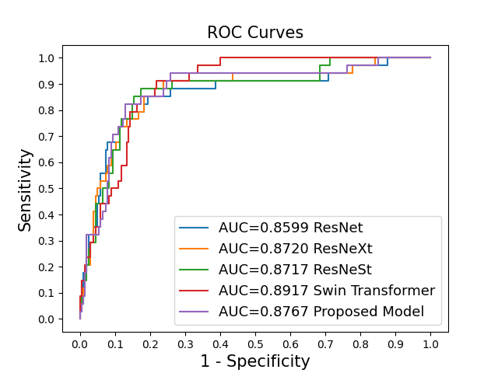
ROC curve
Swin Transformer achieves the highest AUC.
We manly focus on sensitivity > 0.8 and (1 – specificity) < 0.2.

Slide 30
Contents
Introduction
Material
Methods
Experiments
Discussion
Conclusion

Slide 31
Discussion
Utilize ConvNeXt and incorporated channel attention block in filtering image features.
Bring in damper block to combines detailed image features with tumor size features.
Merge the features from the images with clinical and pathology information.

Slide 32
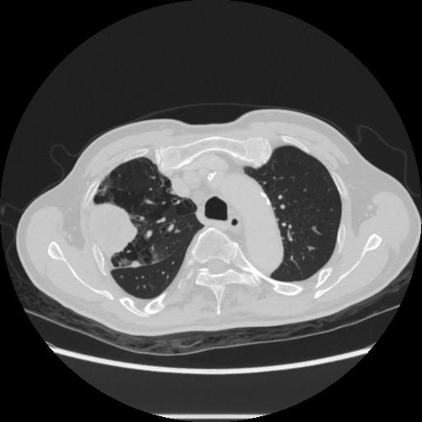
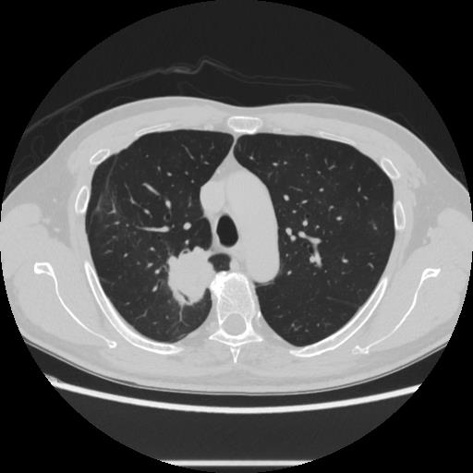
Cross Entropy Loss vs Focal Loss
Two samples that model predicts correctly with focal loss, but predicts wrongly with cross entropy loss.
Deceased, brain metastasis
Survivor
Notes:
Turmor size = 5 (cm)? 5.2 (cm)
左邊大區域可能是腫瘤?

Slide 33
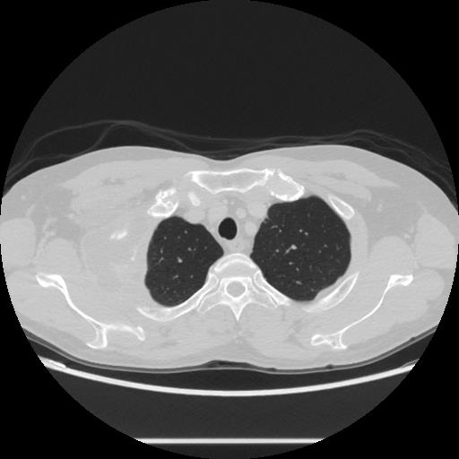
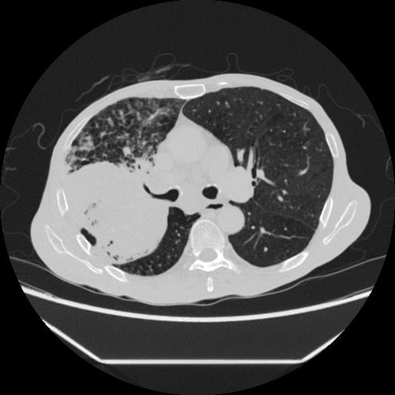
Model With or Without Damper Block - Deceased
Two deceased samples are predicted correctly from model with damper block, but wrongly from model without damper block.
Incorporating damper block, model predicts survival outcome correctly for the data that tumor size > 5 cm.
Notes:
Turmor size = >7 (cm) >10 (cm)
左邊大區域可能是腫瘤?

Slide 34
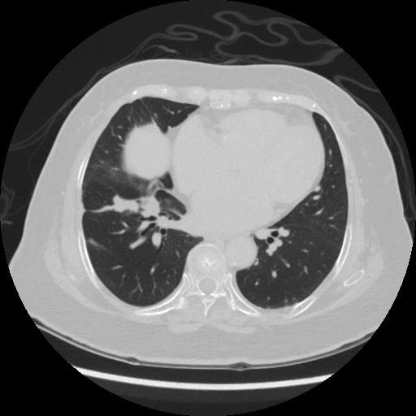
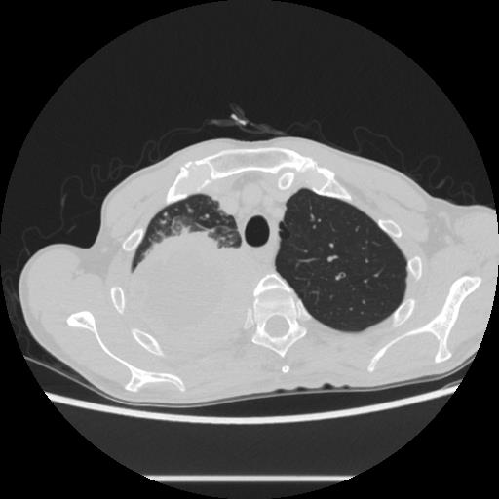
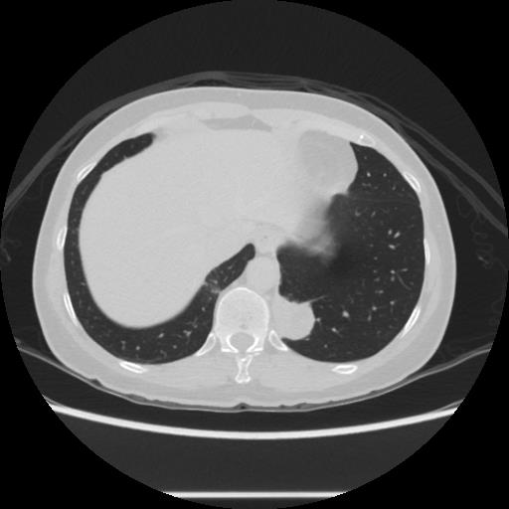
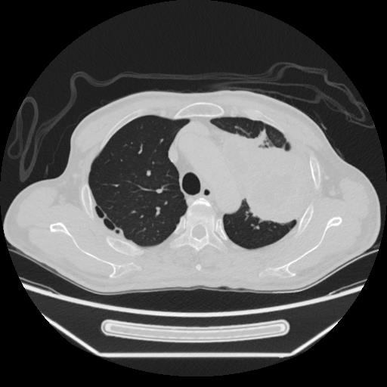
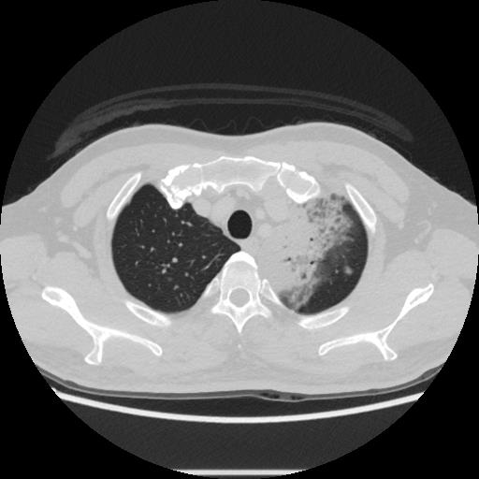
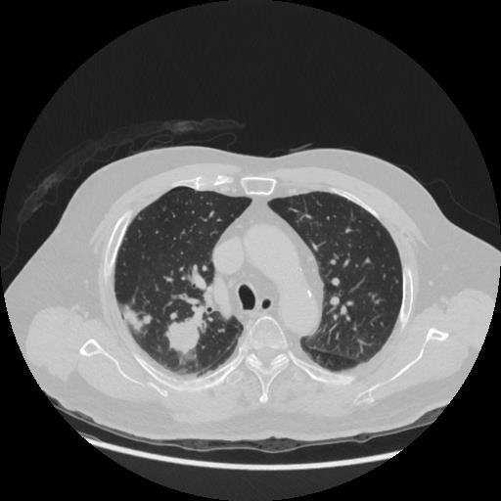
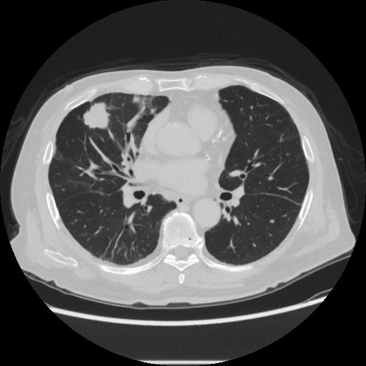
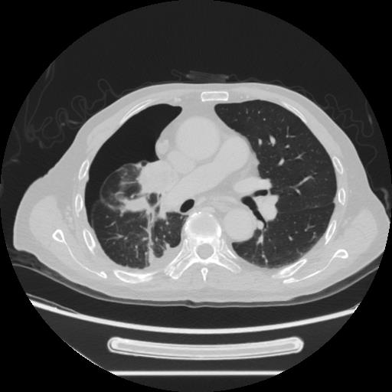
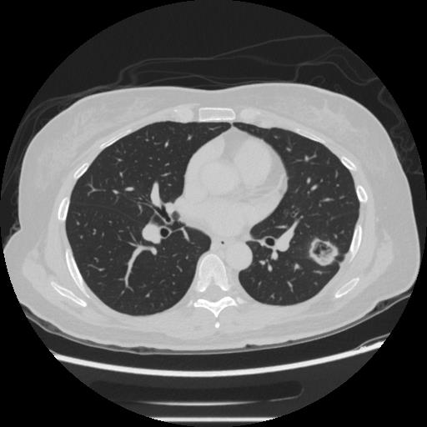
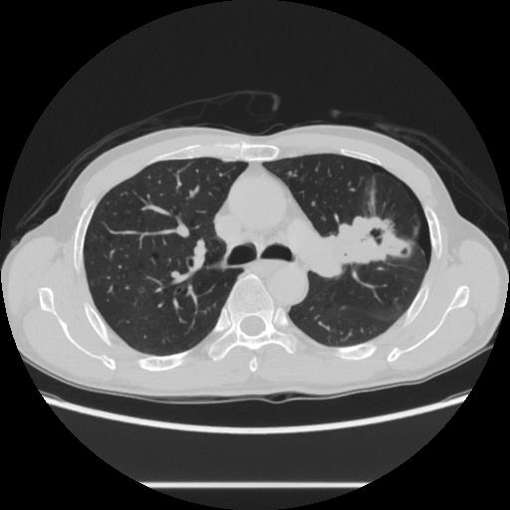
Model With or Without Damper Block - Survivor
Model predicts wrongly after adding damper block.
Model predicts correctly after adding damper block.
Notes:
Turmor size =
4.5 8.3 3.2 11 1.4(太小?)
2.6 2.7 3.8 2.5 4.5
8.3 和 11有可能較容易被認為是Deceased

Slide 35
Train the model simultaneously using 40, 70, and 140 keV
Train the model simultaneously using 40, 70, and 140 keV with contrast agent enhancement.
keV | ACC (%) | SEN (%) | SPEC (%) | PPV (%) | NPV (%)
C+40, C+70, C+140 | 84.75±6.14 | 76.19±16.29 | 86.14±8.33 | 54.75±17.63 | 95.83±2.87
C+140 | 86.03±6.45 | 82.86±11.95 | 86.69±7.84 | 55.29±18.35 | 96.72±2.33

Slide 36
Comparison with Other Papers
We compared the performances of different papers.
The Dataset is not the same.
CNNs | ACC (%) | SEN (%) | SPEC (%) | PPV (%) | NPV (%) | AUC
Agrawal, A., et al. | 85.50 (48952/57254) | - | - | - | - | 0.8870
Lai, Y-H., et al. | 75.44 (129/171) | - | - | - | - | 0.8163
He, B., et al. | 84.00 (63/75) | 83.78 (31/37) | 84.21 (32/38) | 83.78 (31/37) | 84.21 (32/38) | -
Chang Sin-You | 80.78 (353/437) | 73.57 (103/140) | 84.18 (250/297) | 68.67 (103/150) | 87.11 (250/287) | 0.8425
Proposed Model | 86.02 (203/236) | 82.35 (28/34) | 86.63 (175/202) | 50.91 (28/55) | 96.69 (175/181) | 0.8767
Notes:
Agrawal, A., et al. Test 120318Test 57254 machine learning and NN (ensemble)
13 attributes
Lai, Y-H., et al. 512 (Deceased 157 Survivor 355) Train 256 Val 85 Test 171 non-small cell lung cancer (NSCLC) biomarkers * 7 + prognostic biomarkers * 8 5 year
He, B., et al. SMOTE 186 (Deceased 37 Survivor 149) -> 298 -> Train 223 Val 75 random forest on radiomics ACC 89.33 AUC 0.9296 是因為調整threshold

Slide 37
Contents
Introduction
Material
Methods
Experiments
Discussion
Conclusion

Slide 38
Conclusion
The study:
Design a CNN to predict the 3-year survival outcomes of lung cancer patients.
We achieved favorable results by making certain architectural adjustments and integrating image and clinical, pathological data.
Address the issue of label imbalance in the dataset.
Future work:
Continuous data collection and ongoing improvement to the proposed model are necessary.

Slide 39
Thank you.

Slide 40
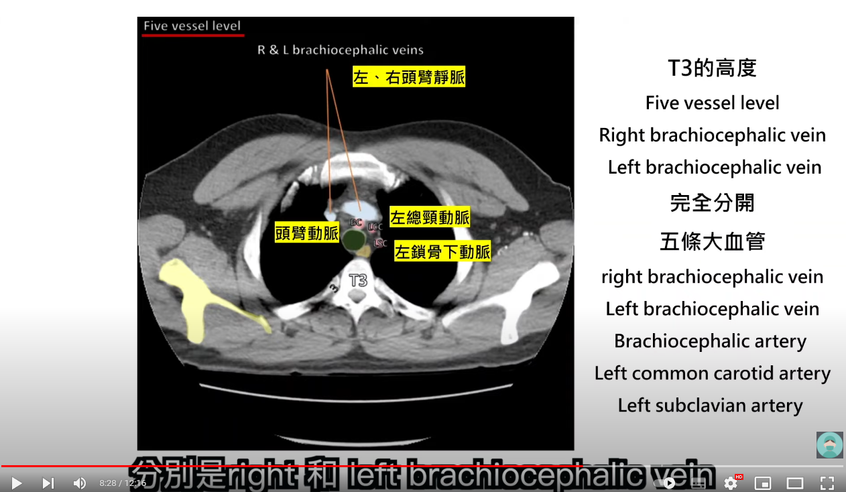

Slide 41
Clinical Data
150 features
'Data number', 'Sex', 'Location', 'Size(cm)', 'PORT-A/切除', '切除肺葉', 'Differentiation分化', 'LVI(Lymphovascular invasion)', 'ALK', 'ROS-1', 'EGFR', 'EGFR mutation', '臨床分期T', '臨床分期N', '臨床分期M', '臨床分期stage', '病理分期T', '病理分期N', '病理分期M', '病理分期stage', '有無轉移', '轉移器官', '有無復發', '復發器官', 'Smoking', 'PPD', '抽菸年份', 'HTN 高血壓', 'DM 糖尿病', '存在lung cancer家族病史', 'Complications併發症', ‘FVC_Predicted’, ‘FEV1_Predicted’, ‘Observed'
size: >=3、 >=2、 >=1、 <1
轉移器官: 淋巴腺、腦、骨骼、肝臟、腎上腺、其他、無
復發器官: 肺、淋巴腺、腦、骨骼、肝臟、其他、無
併發症: 有、無
FVC_Predicted: >=0.8、 <0.8、 無
FEV1_Predicted: >=0.8、 <0.8、 無
Observed: >=0.7、 <0.7、 無

Slide 42
訓練改動
讓input圖片大小相同: (128, 224, 224)
用validation data的accuracy與abs(sencitivity - specificity)<0.15尋找最好的模型。
ConvNeXt的block數量改為 (1, 1, 3, 1) ，channel數量從(32, 64, 128, 256)改為 (8, 16, 32, 64)。
加入scheduler和warm up。
lr : 0.000001 - 0.001
cycle : 20 epochs

Slide 43
Confusion matrix
 | tp | fn | fp | tn
fold 1 | 6 | 1 | 5 | 35
fold 2 | 6 | 1 | 4 | 36
fold 3 | 5 | 2 | 9 | 31
fold 4 | 5 | 2 | 1 | 39
fold 5 | 6 | 0 | 8 | 34
PPV = tp / (tp + fp) 所以PPV才會不到一半

Slide 44
Confusion matrix (全加)
 | tp | fn | fp | tn
Total | 28 | 6 | 27 | 175
PPV = tp / (tp + fp) = 28 / (28 + 27) 所以PPV才會不到一半

Slide 45
5 fold cross validation (label=0)
 | 筆數 (Sum=236) | Train | Val | Test
存活 | 202 | 128 | 32 | 42
死亡 | 34 | 21 | 6, 7 | 7, 6
7
6
Test
Val
Train
7
6
Train
Test
Val
Train
7
6
Train
Test
Val
Train
7
6
Train
Test
Val
7
6
Val
Train
Test

Slide 46
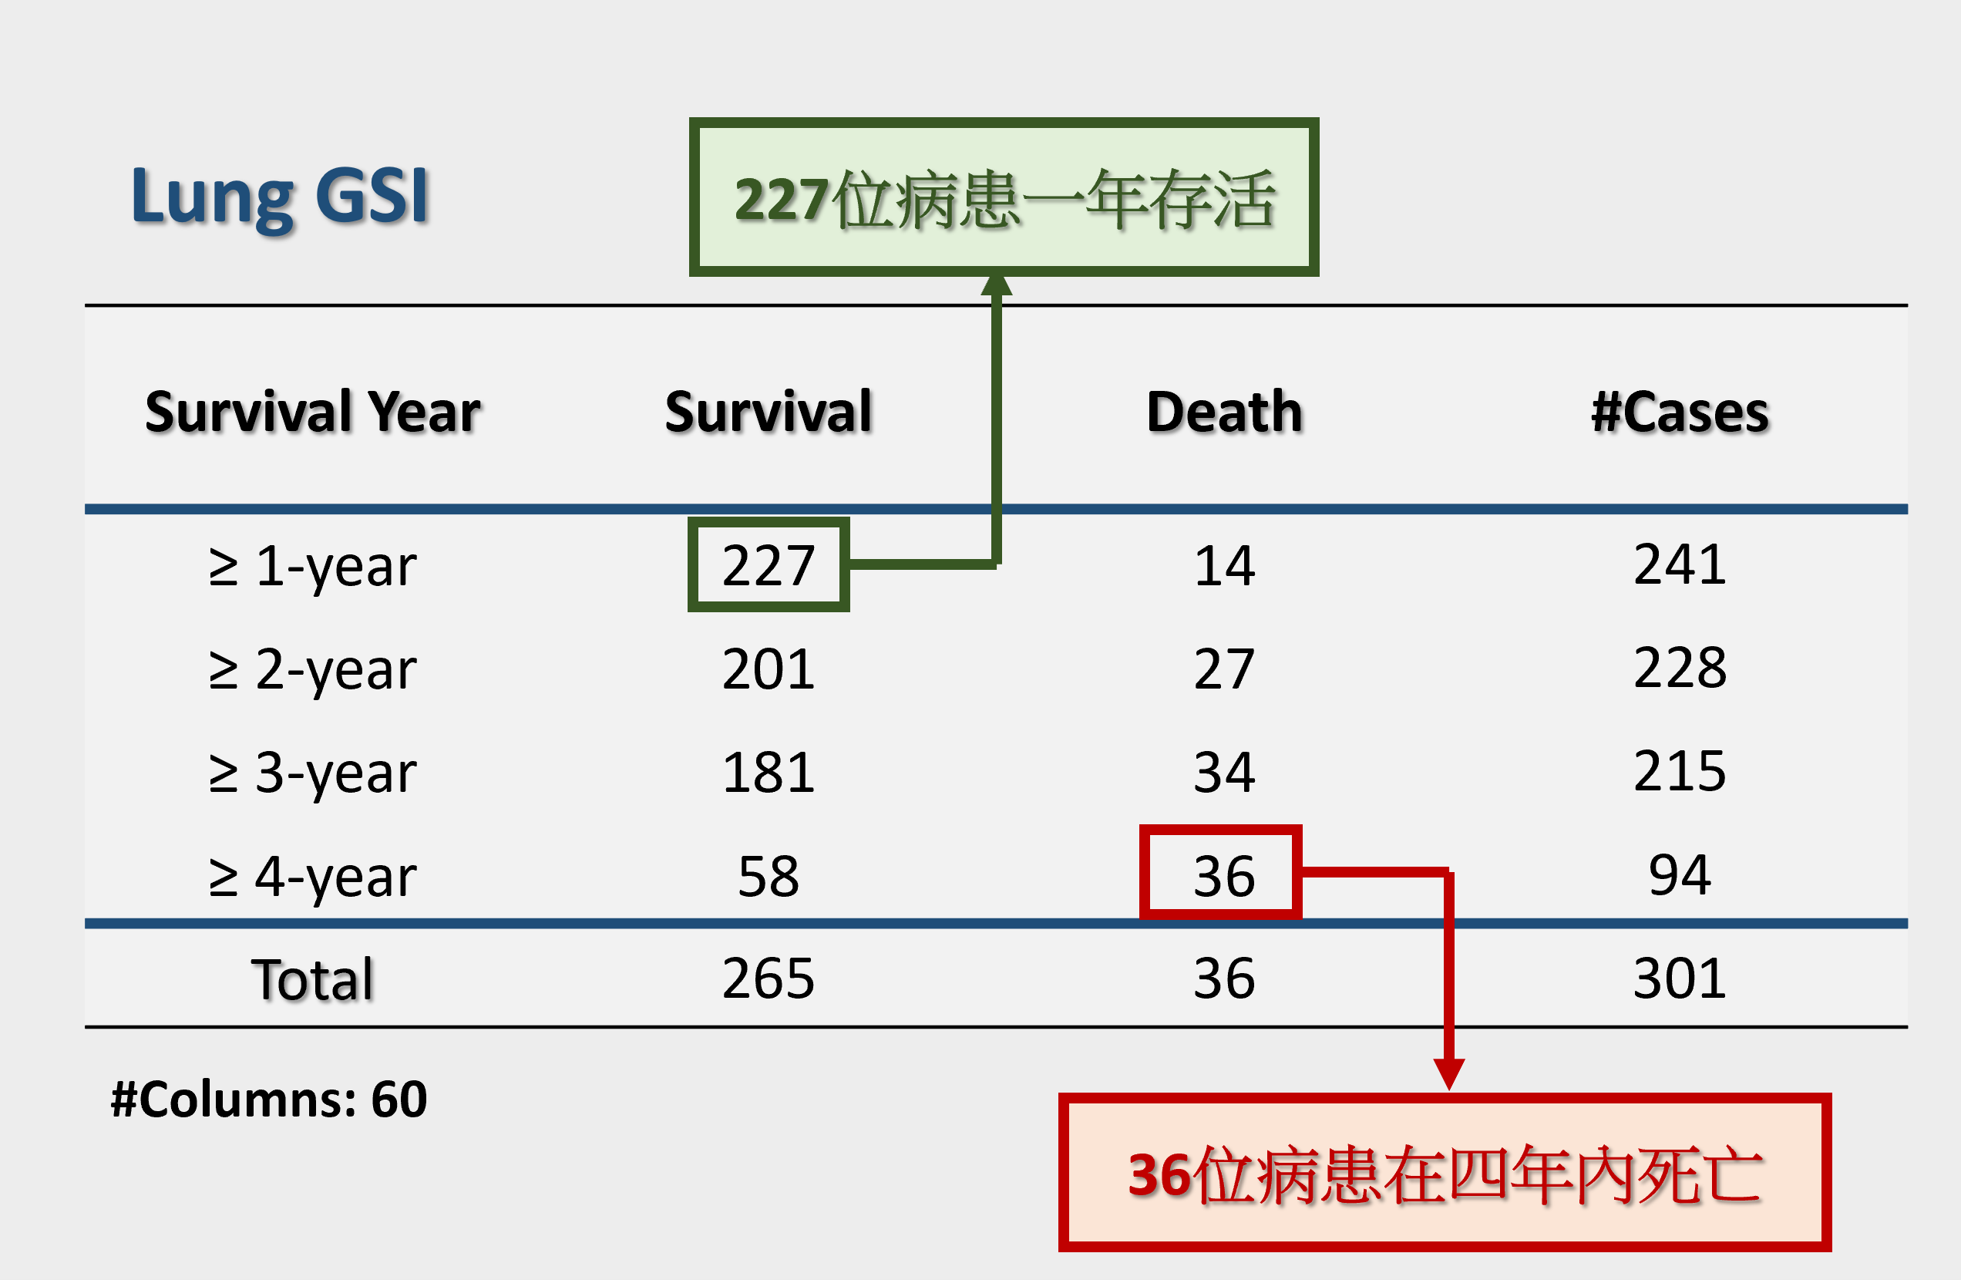
Number of Patients

