Slide 1
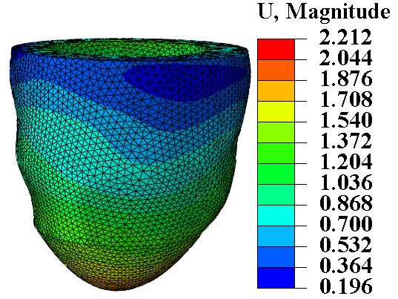
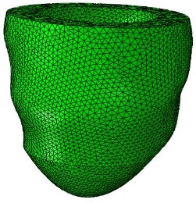
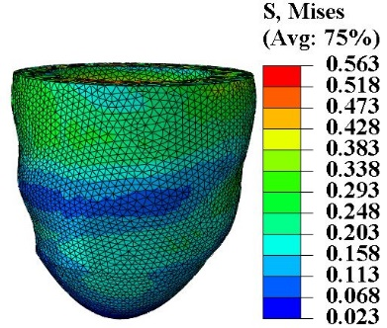
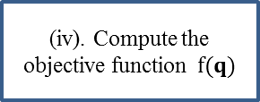
(i). Initialize constitutive parameters
Get volume data
(ii). Pressurize from 0 to 8 mm Hg
(iii). Fit the pressure-volume and pressure-strain
Get strain data
(iv). Compute the objective function$f(q)$
A new round by updating constitutive parameters
(v). Converged or not
No
Yes
Output parameters and results

Slide 2
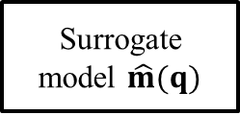
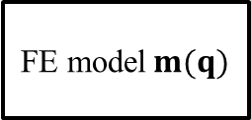

Real-world system or process
Simulation
FE model$m(q)$
Emulation
Surrogate model $\hat{m}(q)$
Sampling
Training
Datasets$𝔻$

Slide 3









$$q_{1}$$
$$q_{2}$$
$$q_{3}$$
$$q_{4}$$
Input layer
$$w_{h}$$
$$b_{h}$$
...
Hidden layer
$$w_{o}$$
$$b_{o}$$
Output layer
$$y$$

Slide 4
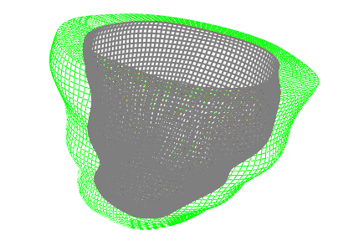



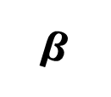




Base
$$W_{l}$$
$$n$$
$$f$$
$$α$$
Long axis
$$W_{c}$$
$$β$$
$$W_{r}$$
$$s$$
Apex

Slide 5
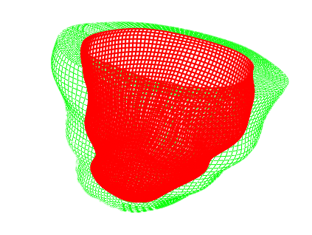








$$W_{l}$$
$$n$$
$$f$$
$$α$$
$$W_{c}$$
$$β$$
$$W_{r}$$
$$s$$

Slide 6







Input
$$q=(q_{1},q_{2},q_{3},q_{4})$$
ML Model
Sub-1
Sub-2
Sub-3
Sub-4
Sub-5
Sub-6
Prediction
$${\hat{α}}_{0}$$
$${\hat{β}}_{0}$$
$${\hat{α}}_{1}$$
$${\hat{β}}_{1}$$
$${\hat{α}}_{2}$$
$${\hat{β}}_{2}$$

Slide 7

Input
$$q=(q_{1},q_{2},q_{3},q_{4})$$
ML Model
Sub-1
Sub-2
Sub-3
Prediction
$${\hat{α}}_{0}$$
$${\hat{β}}_{0}$$
$${\hat{α}}_{1}$$
$${\hat{β}}_{1}$$
$${\hat{α}}_{2}$$
$${\hat{β}}_{2}$$

Slide 8







Input
$$q=(q_{1},q_{2},q_{3},q_{4})$$
ML Model
Single model
Prediction
$${\hat{α}}_{0}$$
$${\hat{β}}_{0}$$
$${\hat{α}}_{1}$$
$${\hat{β}}_{1}$$
$${\hat{α}}_{2}$$
$${\hat{β}}_{2}$$

Slide 9
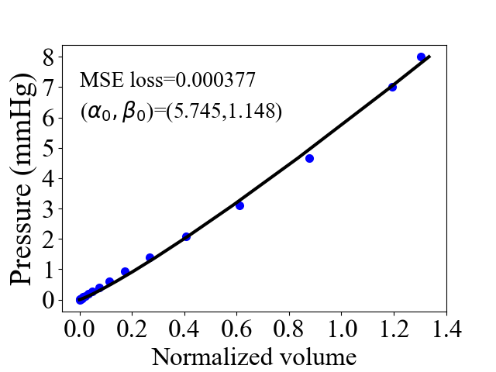
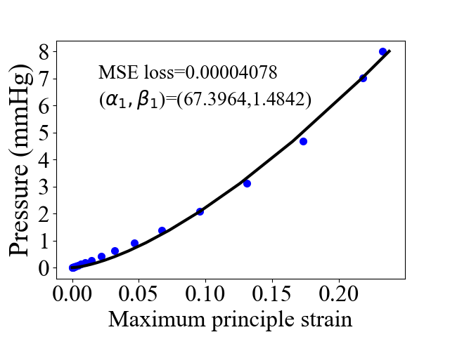
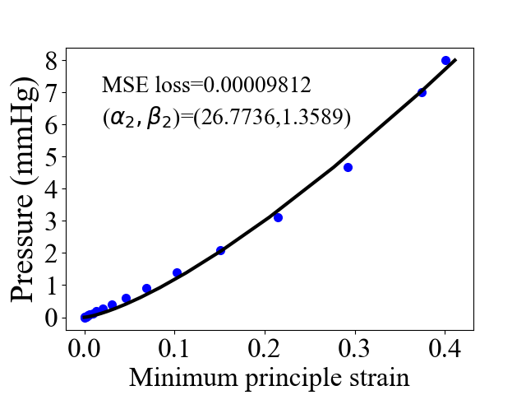
(a)
(b)
（c）

Slide 10
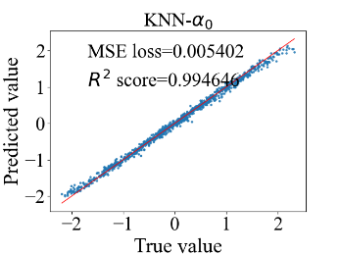
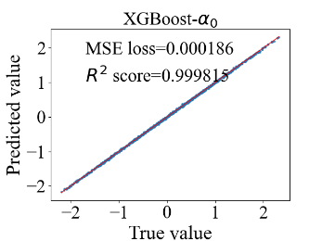
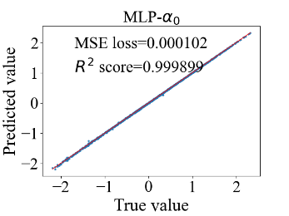
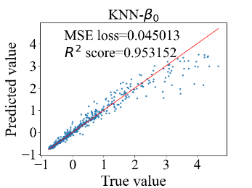
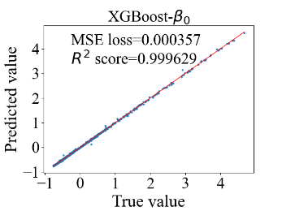
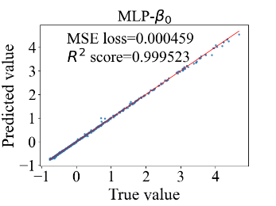
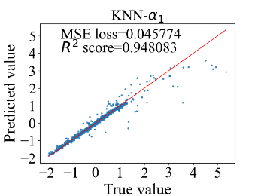
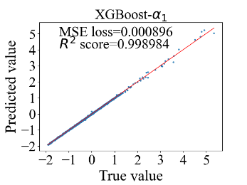
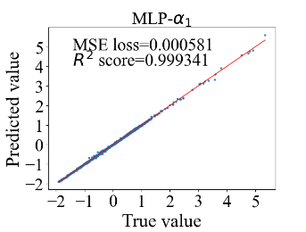
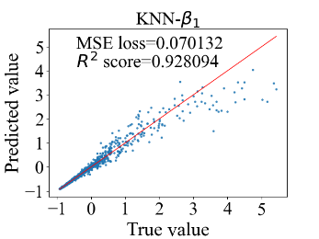
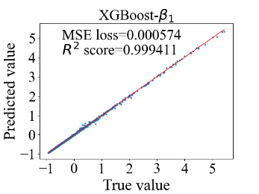
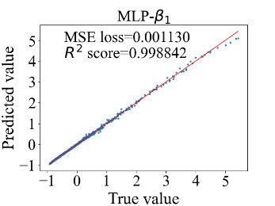
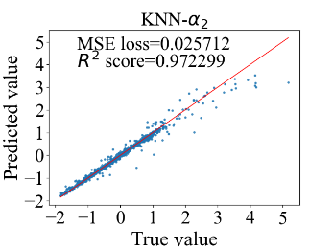
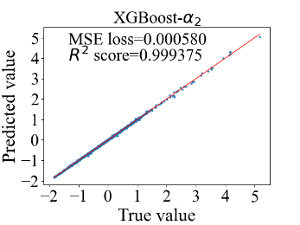
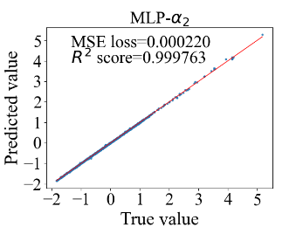
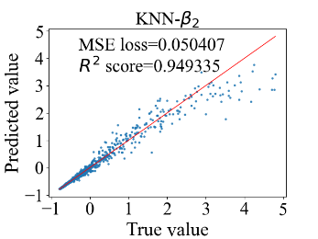
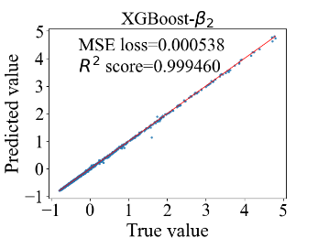
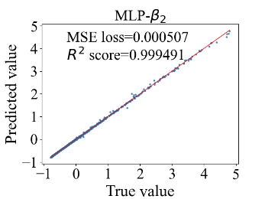
(a)
(g)
(m)
(b)
(h)
(n)
(c)
(i)
(o)
(d)
(j)
(p)
(e)
(k)
(q)
(f)
(l)
(r)

Slide 11
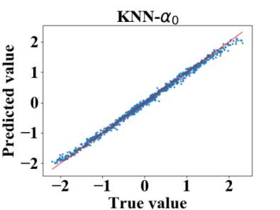
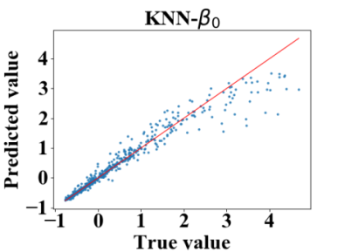
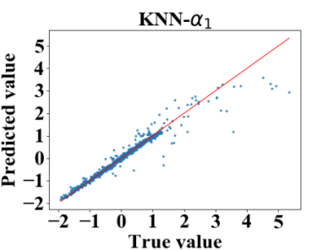
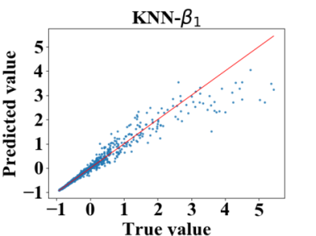
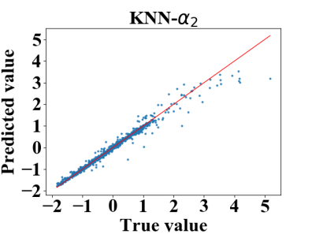
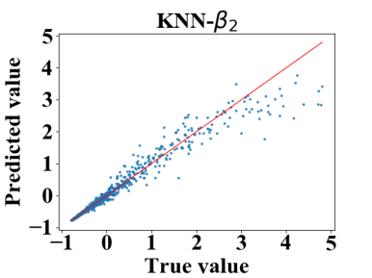
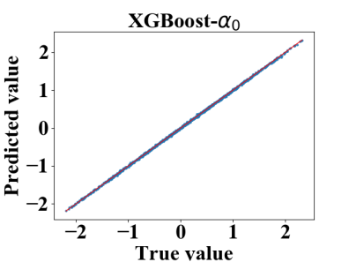
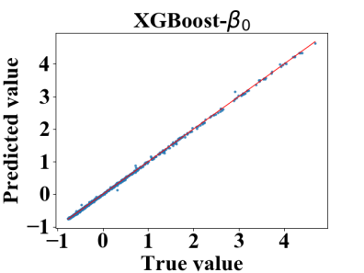
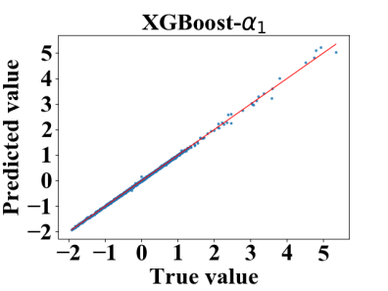
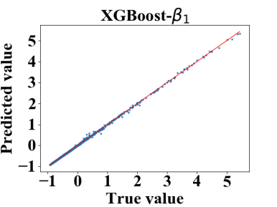
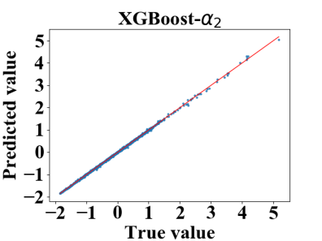
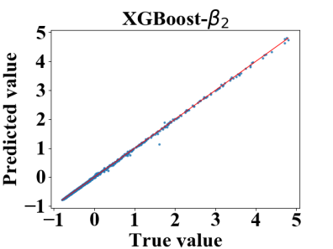
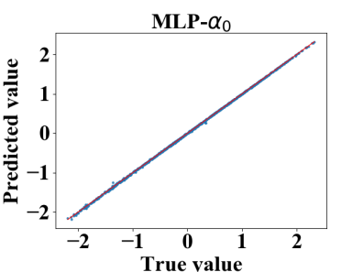
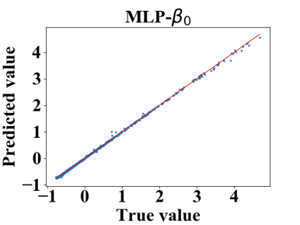
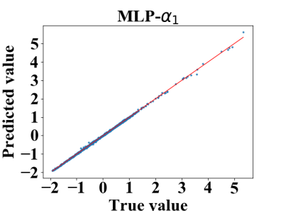
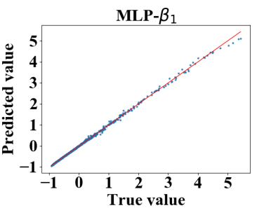
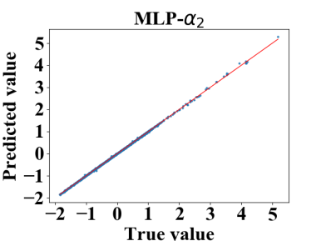
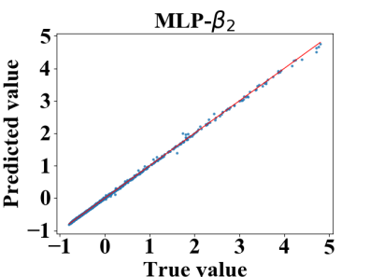
A
B
C
D
E
F
G
H
I
J
K
L
M
N
O
P
R
S

Slide 12
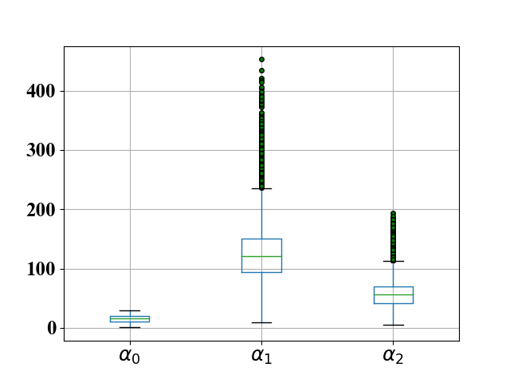
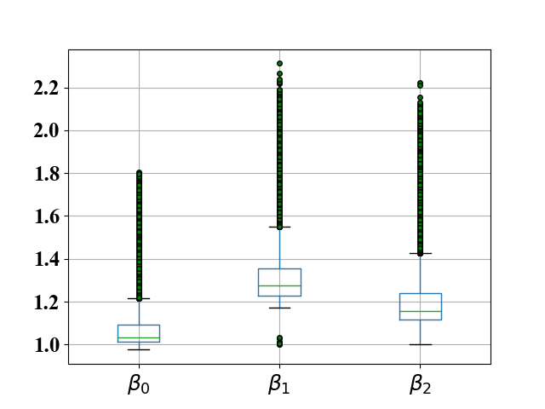
A
B

Slide 13




(a)
(b)
(c)
(d)

Slide 14


(a)
(b)

Slide 15




(a)
(b)
(c)
(d)

Slide 16




(a)
(b)
(c)
(d)

