Slide 1

Brain Tumor Detection using CNN

Slide 2
Introduction
Brain tumors are serious medical conditions that require early detection for effective treatment. MRI scans are commonly used to identify tumors, but manual analysis can be slow and error-prone. Convolutional Neural Networks (CNNs) offer a powerful way to automatically detect and classify brain tumors from MRI images. This project focuses on developing a CNN-based system to assist doctors by providing fast and accurate brain tumor diagnosis.

Slide 3
Objectives
To develop a CNN model for automatic detection of brain tumors from MRI images.
To classify tumors into different types accurately using the model.
To optimize and evaluate the model for high diagnostic accuracy.
To assist medical professionals by providing a reliable automated diagnostic tool.

Slide 4
Problem Statement
The objective of this project is to develop an automated system for brain tumor detection and classification using Convolutional Neural Networks (CNN). The CNN model will analyze MRI scans to accurately identify the presence of tumors and classify them into different types (e.g., benign or malignant).

Slide 5
Methodology
Data Collection:
Model Design:
Using Kaggle for dataset
Build a Convolutional Neural Network architecture with multiple convolutional, pooling, and fully connected layers tailored for image classification.
Data Preprocessing:
Resize images to a uniform size suitable for the CNN input.
Normalize pixel values to improve model convergence.
Augment data with techniques like rotation, flipping, and zoom to increase diversity and prevent overfitting.
Model Evaluation:
Test the trained model on unseen MRI images and evaluate using metrics like accuracy, precision, recall, F1-score, and confusion matrix.

Slide 6
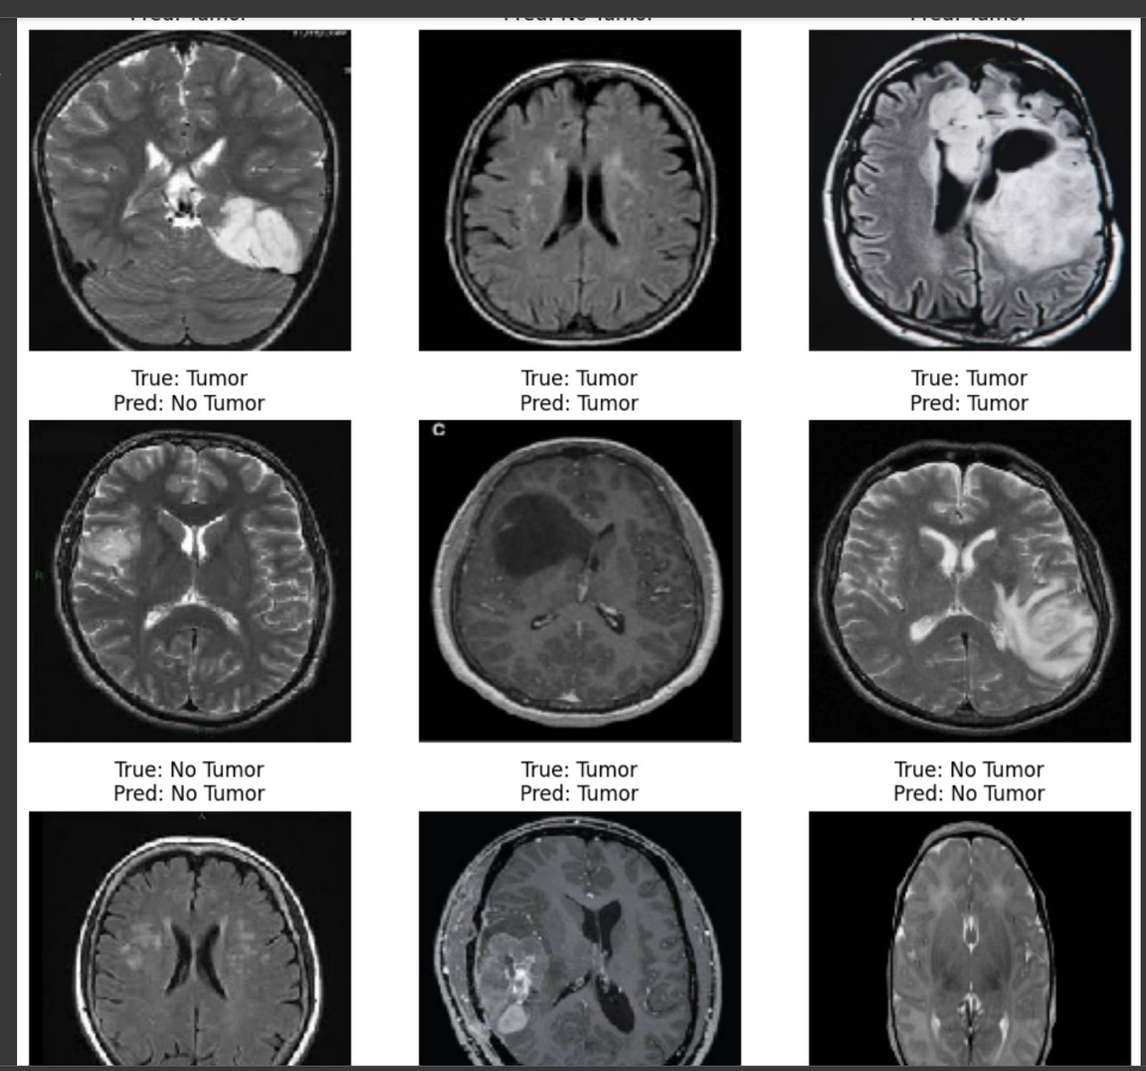
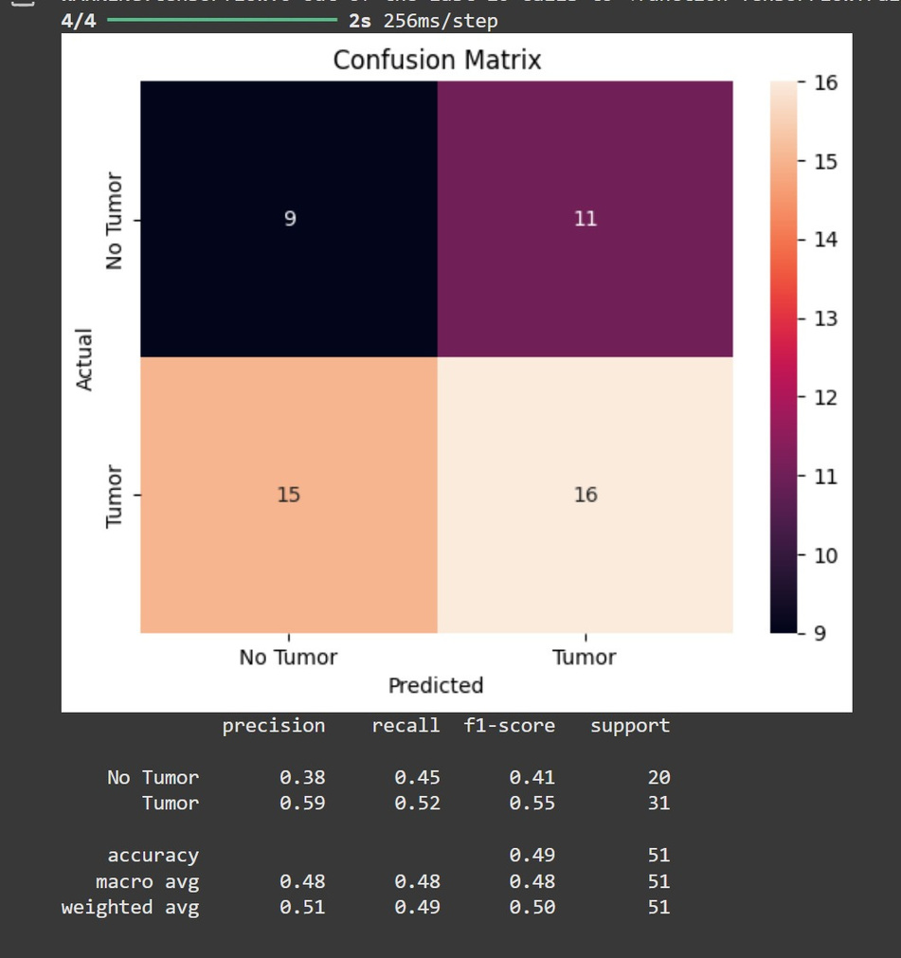
Result

Slide 7
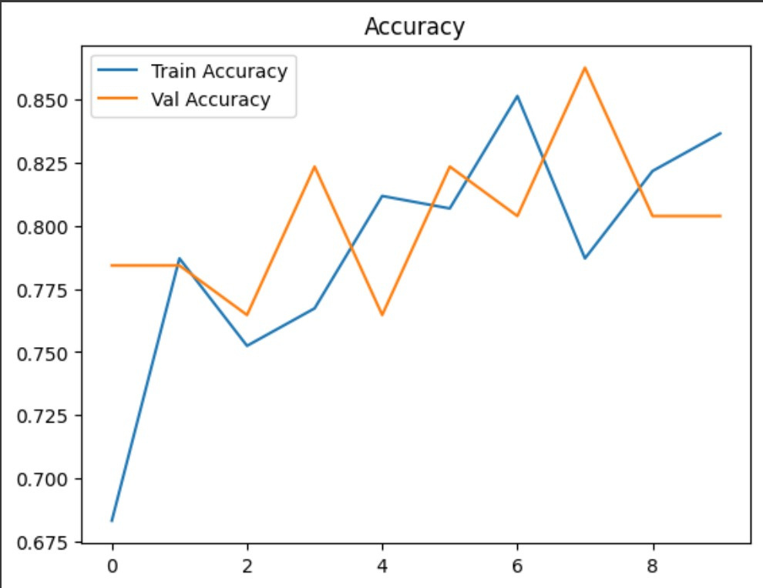
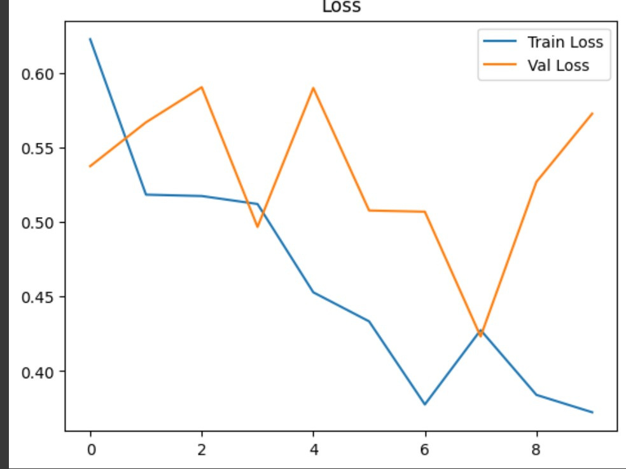
Results

Slide 8
References
Seaborn visualization library
Matplotlib for graphs
Kaggle for dataset
Tensorflow for CNN architecture and training models

Slide 9
Prepared by-
Aarjav Jain
Amit Kumar Verma
Archie Jindal
Aryan Singh

