Slide 1
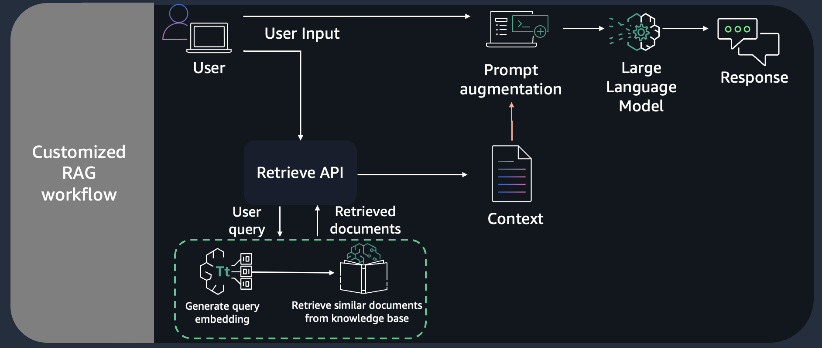

Slide 2





User query
Retrieve API
User
Knowledge Base
Prompt Augmentation
Retrieve
Contexts
Invoke_model API
Bedrock
Generate Response

