Slide 1
MARS-PLUS Windows Static Binary
Speaker: Chen-Hsuan Huang (黃晨軒)
Advisor: Dr. Shiang-Tai Lin (林祥泰 博士)
Dept. Chemical Engineering, National Taiwan University

Slide 2
Package Distribution without Revealing the Source Codes of MARS-PLUS
Delete MARS-PLUS_WINS_binary\MARS-PLUS\MARS-PLUS.dev and the directory MARS-PLUS_WINS_binary\MARS-PLUS\src
Distribute it.

Slide 3
Usage
Note: .\ = MARS-PLUS_WINS_binary\MARS-PLUS\
Check the control file: MARS-PLUS_WINS_binary\MARS-PLUS\INPUTS\control.in PROGRAM_DIR: Directory of MARS-PLUS source code (No need to revise) MDS_DIR: Directory for outputting “molecular data structures” (i.e. .enc files) (No need to revise) LOG_DIR: Directory for outputting the tabulated results of operations (No need to revise) ELEMENT_LIST: The specifications of each “building genes” (No need to revise) IF_ION: 1 for demonstrating ILs/salts case, 0 for demonstrating neutral molecule case IF_ENUMERATION: 1 for activating SMILES enumeration for each newly designed species. 0 for disabling it. IF_OUTPUT_MDS: 1 for outputting “molecular data structures” (i.e. .enc files) to MDS_DIR. 0 for disabling it. IF_PROTECT: 1 for activating molecular fragment protection (e.g. charged atoms). 0 for disabling it. Protection prevents fragments from operations. See prct() function in MOLECULE.cpp. OPERATIONS: The operations you want to apply, typically ALL. EPOCH: Epochs for iterative design. Specifying 1 if you do not need iteration. CHEMICAL_IUPUTLIST: For ILs/salts case (IF_ION=1), specify the route to a list that contains at least 1 IL/salts. For example: MARS-PLUS_WINS_binary\MARS-PLUS\INPUTS\INPUT_CHEMICALS\IL4.in For neutral molecule case (IF_ION=0), specify the route to a list that contains at least 1 neutral molecule. For example: MARS-PLUS_WINS_binary\MARS-PLUS\INPUTS\INPUT_CHEMICALS\IL.in You can use “#” to write comment .

Slide 4

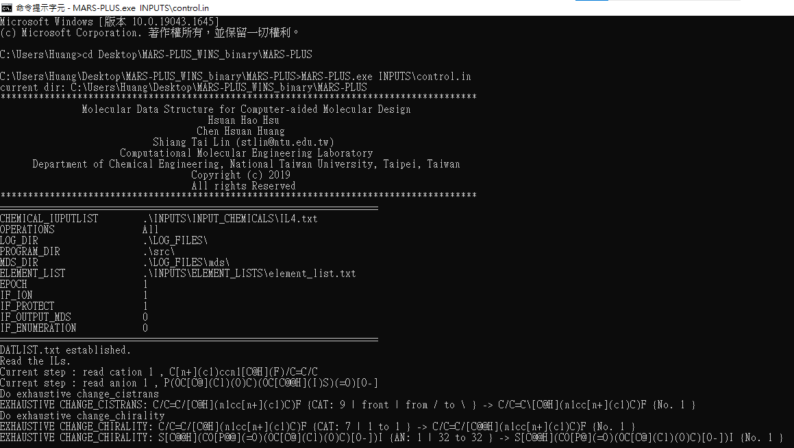
Usage
Open the CMD 1. Enter the directory MARS-PLUS_WINS_binary\MARS-PLUS\ 2. Execute “MARS-PLUS.exe INPUTS\control.in”

Slide 5
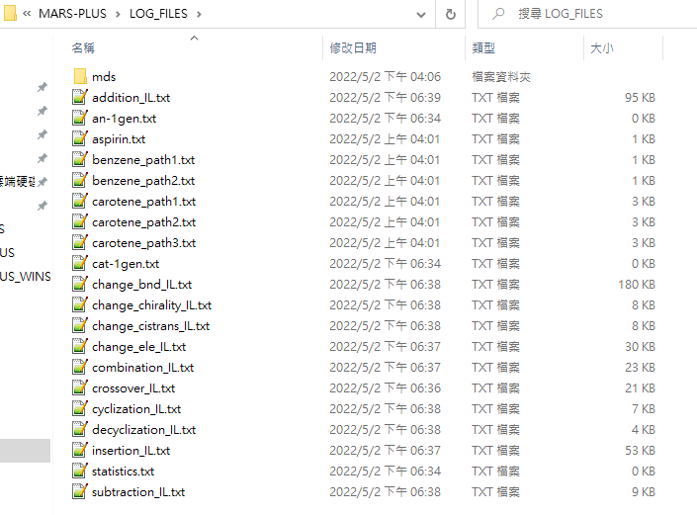
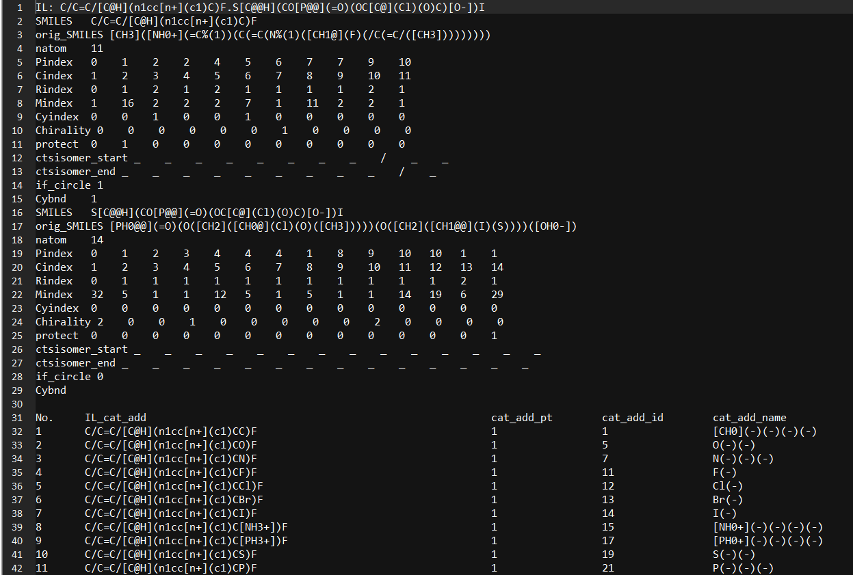
Results
All The results are outputted to LOG_DIR (default: MARS-PLUS_WINS_binary\MARS-PLUS\LOG_FILES\)
addition_IL.txt

Slide 6
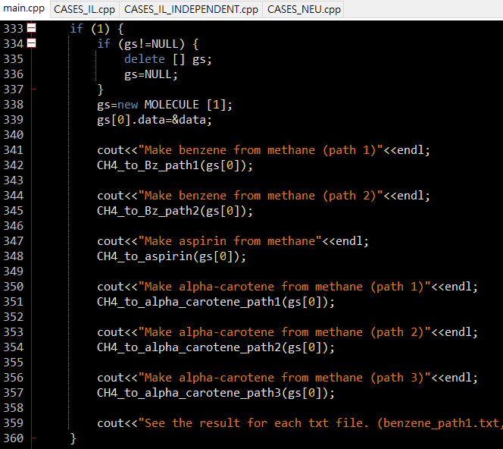
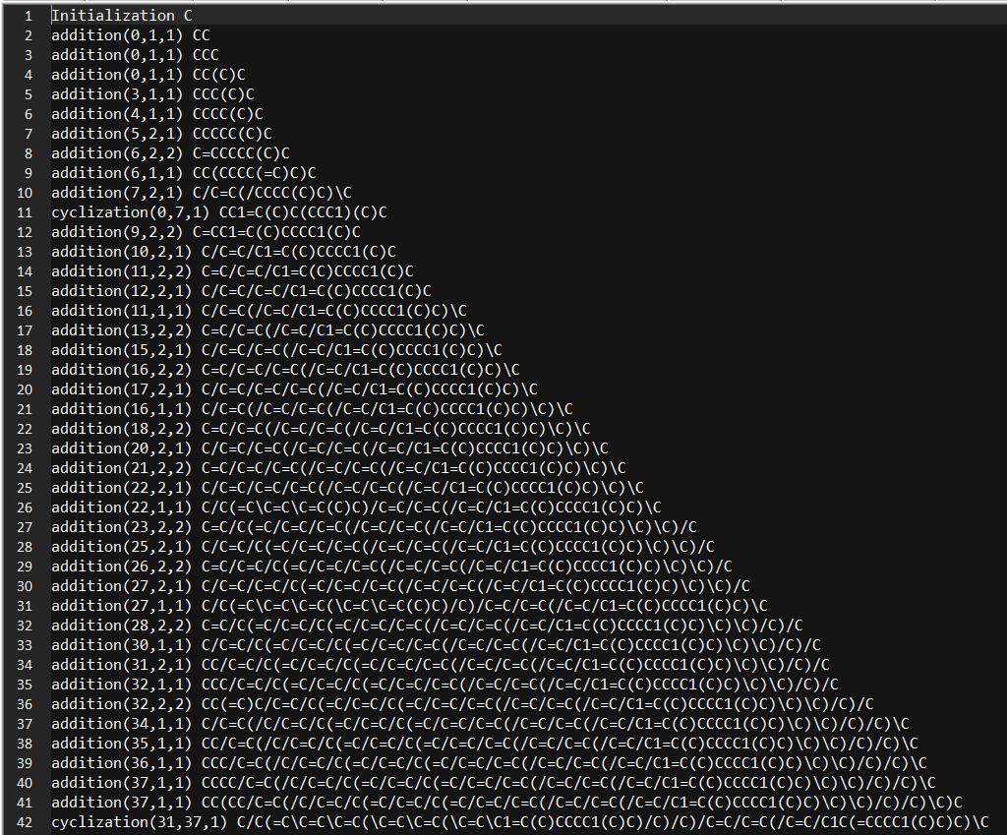
Results
Virtual synthesis pathways are defined in CASES_NEU.cpp and called in main.cpp. One can append more examples. The source codes should be re-compiled after any modification.
carotene_path3.txt

Slide 7
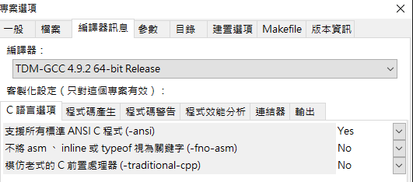
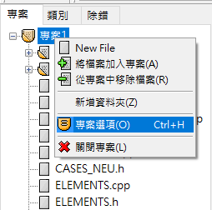
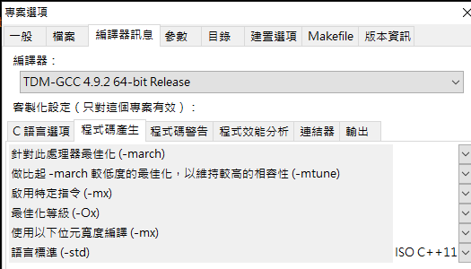
Developer / Re-compilation
Download Orwell Dev-C++ 5.11 and install.
Open MARS-PLUS_WINS_binary\MARS-PLUS\MARS-PLUS.dev using Dev C++.
Follow the settings below.
right-click

Slide 8
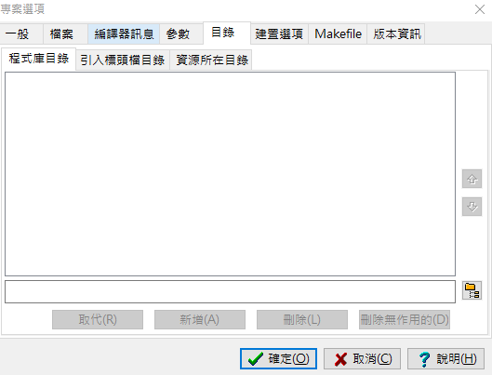
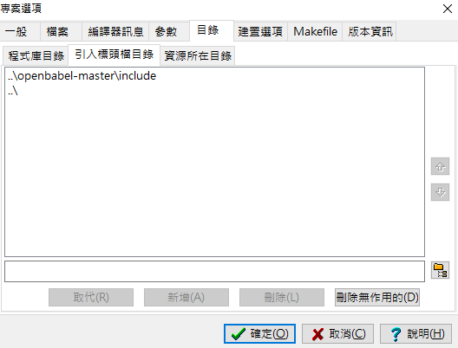
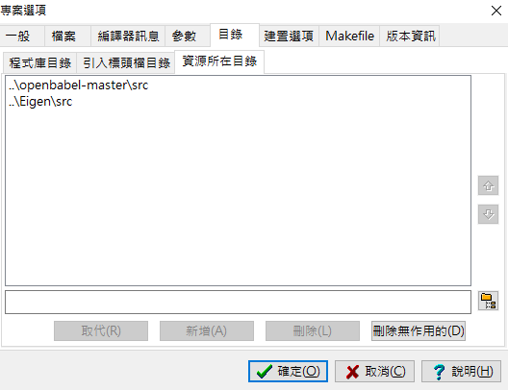
Developer / Re-compilation
Follow the settings below

Slide 9
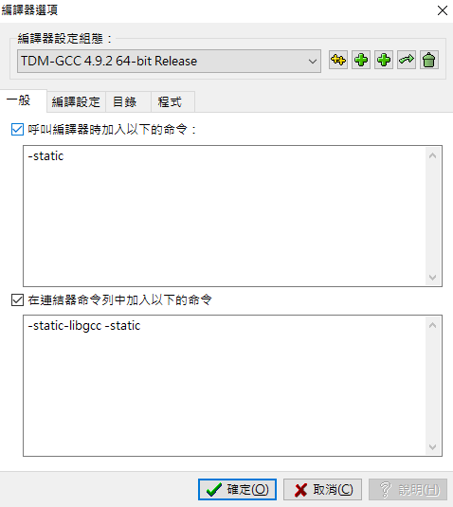
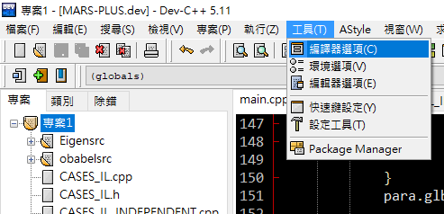
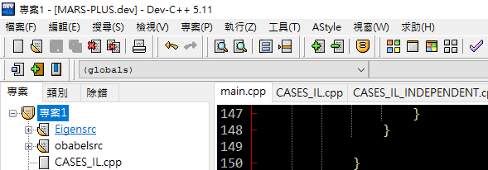
Developer / Re-compilation
Follow the settings below
At main.cpp page, click “全部重新建置” (or press F12).

