Slide 1
Message Passing Interface CLE Project 2
Renan Ferreira - 93168
João Reis - 115513

Slide 2
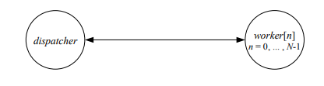
Algorithm 1 Architecture
The master process (rank 0) reads input files, divides them into chunks, and assigns the chunks to worker processes (ranks 1 to nProcesses-1) to process. Each worker process receives a chunk to process and returns the results to the master process. The master process collates the results and outputs them.
The program uses several structs to represent data structures such as TextStruct to represent input files, WorkerTask to represent the work assigned to each worker, and WorkerResult to store the results produced by each worker.

Slide 3
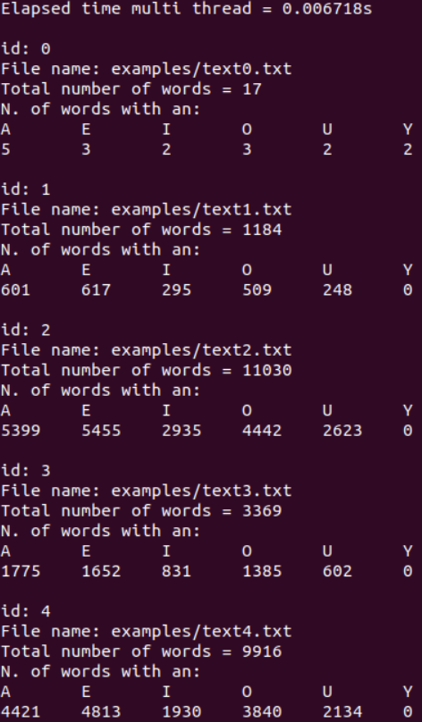
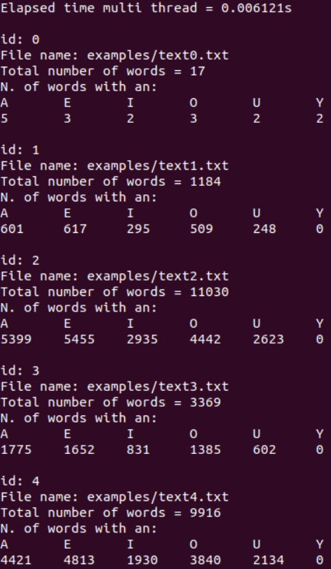
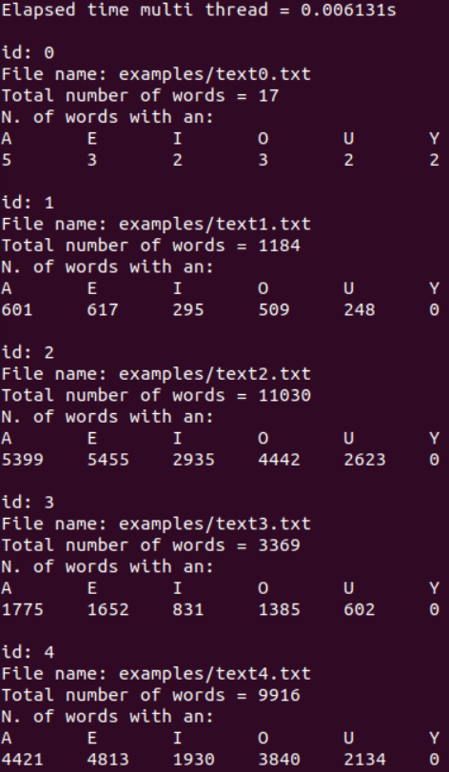
Results P1
mpiexec –n # ./prog1 –f examples/text0.txt –f examples/text1.txt –f examples/text2.txt –f examples/text3.txt –f examples/text4.txt
Fig1. Results of program 1 with 2 workers
Fig2. Results of program 1 with 4 workers
Fig3. Results of program 1 with 8 workers

Slide 4

Algorithm 2 Architecture
The architecture is based on the master-worker model, where a single process (rank 0) acts as the master and dispatches work to the worker processes. The workers perform the actual computation on the data and communicate with the master to receive instructions and report results. The program uses MPI functions to manage the communication between the master and the workers, to divide the work among the workers, and to synchronize the execution. The program includes error handling to detect and report failures during execution.

Slide 5
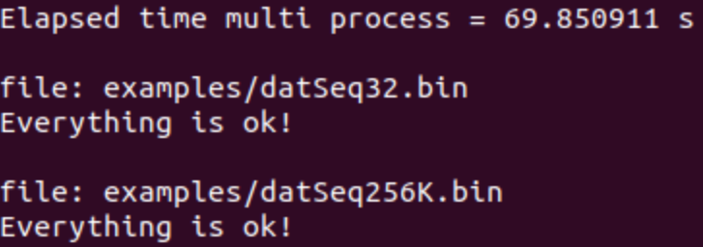
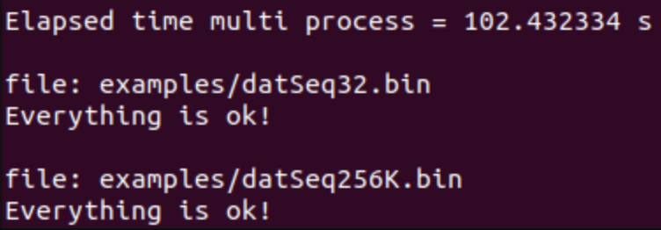
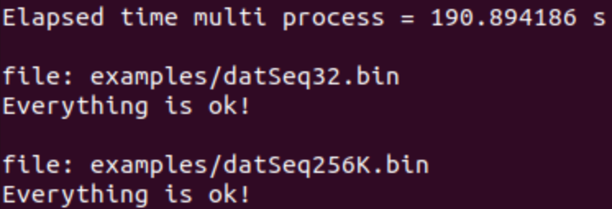
Results P2
mpiexec –n # ./prog1 –f datSeq32.bin –f datSeq256K.bin
Fig1. Results of program 2 with 2 workers
Fig2. Results of program 2 with 4 workers
Fig3. Results of program 2 with 8 workers

Slide 6
Conclusions
We have successfully created two programs using MPI that demonstrate the power and efficiency of parallel computing. The success of these programs highlights the importance of parallel computing in solving computationally intensive problems and demonstrates the effectiveness of the MPI model for achieving parallelism. By utilizing MPI, we were able to distribute the workload across multiple processors and harness their combined power to complete the tasks faster than a single processor could.

