Slide 1
Binary Formats &
Low-Level Foundations
Domains 1–2: ELF, PE/COFF, Process Memory, OS Primitives
Enterprise Security Reference Library — 2025

Slide 2
Agenda
1
ELF Binary Format — Structure & Internals
2
ELF Loading & Dynamic Linking
3
RELRO Protection Levels
4
PE/COFF Format — Windows Executables
5
ELF vs PE Comparison
6
Virtual Address Space Layout
7
Page Tables & Memory Management
8
System Calls & Seccomp-BPF
9
Linux Capabilities & Namespaces
10
LSM Hooks & cgroups
11
Key Takeaways & Cross-References

Slide 3
ELF File Structure
ELF Header (64 bytes)
e_ident[16] magic, class, endian
Program Header Table
p_type, p_offset, p_vaddr, p_memsz
.text (executable code)
Machine code — .text segment
.rodata (read-only data)
.data (initialized data)
.bss (uninitialized data)
PLT stubs → GOT entries → ld.so
.plt / .got (dynamic linking)
.dynamic (linker metadata)
sh_name, sh_type, sh_offset, sh_size
.symtab / .strtab (symbols)
Section Header Table

Slide 4
ELF Header — Key Fields
e_ident[0..3] = 0x7F 'E' 'L' 'F'
Magic bytes — identifies file as ELF. All ELF parsers check these first.
e_type: ET_EXEC (2), ET_DYN (3), ET_REL (1)
Executable, shared object (PIE), or relocatable object file.
e_entry: Virtual entry point address
Where execution begins — _start symbol, or ld-linux.so for dynamic executables.
e_phoff / e_phnum: Program header table
Offset and count of program headers — used by kernel for loading segments.
e_shoff / e_shnum: Section header table
Offset and count of section headers — used by linker/debugger, not loader.
e_machine: EM_X86_64 (62), EM_AARCH64 (183)
Target architecture. Kernel rejects binaries for wrong architecture.
e_flags: Architecture-specific flags
ARM: soft/hard float. MIPS: ABI version. x86_64: usually 0.

Slide 5
Program Headers vs Section Headers
Program Headers (Segments)
Section Headers (Sections)
Used by: kernel loader (execve)
Used by: linker, debugger, objdump
Describes: memory segments
Describes: file sections
PT_LOAD — loadable segment
SHT_PROGBITS — code/data
PT_INTERP — path to ld-linux.so
SHT_SYMTAB — symbol table
PT_DYNAMIC — .dynamic section addr
SHT_RELA — relocation entries
PT_GNU_STACK — stack exec flag
SHT_DYNAMIC — dynamic linking info
PT_GNU_RELRO — read-only after reloc
SHT_NOTE — build-id, ABI tag
Required at runtime: YES
Required at runtime: NO (strippable)

Slide 6
ELF Loading Process
execve()
load_elf_binary()
PT_INTERP
ld.so init
_start → main()
Kernel validates ELF magic,
reads e_ident & e_type
Kernel maps PT_LOAD
segments via mmap
Kernel loads ld-linux.so
(dynamic linker)
Resolves DT_NEEDED libs,
processes relocations
Control transfers to
application entry point
Key security check: kernel verifies e_type, refuses ET_CORE. PT_GNU_STACK controls whether stack is executable (NX enforcement). ASLR randomizes mmap base, stack, heap, and PIE base addresses. For static binaries, no ld.so step — kernel jumps directly to e_entry.

Slide 7
Dynamic Linking: PLT/GOT Mechanism
.plt stub
jmp *GOT[n]
push reloc_index
jmp PLT[0]
.got.plt[n]
(initially → PLT+6
after resolve → libc)
call printf@PLT
printf()
in libc
Lazy Binding (first call):
1. PLT stub jumps to GOT entry → initially points back to PLT+6 (resolver stub)
2. Resolver stub pushes relocation index, jumps to PLT[0] → _dl_runtime_resolve()
3. ld.so looks up symbol in DT_NEEDED libraries, patches GOT entry with real address
4. Subsequent calls: PLT stub → GOT → directly to resolved function (one indirection)
Security implications:
• GOT entries are writable → GOT overwrite attack hijacks control flow
• Full RELRO makes .got.plt read-only after relocation → prevents GOT overwrites
• Partial RELRO protects .got but not .got.plt → still exploitable

Slide 8
RELRO Protection Levels
No RELRO
Partial RELRO
Full RELRO
.got writable
.got read-only
.got read-only
.got.plt writable
.got.plt WRITABLE
.got.plt READ-ONLY
.dynamic writable
.dynamic read-only
.dynamic read-only
GOT overwrite trivial
GOT overwrite still possible
GOT overwrite blocked
gcc default (old)
gcc -Wl,-z,relro
gcc -Wl,-z,relro,-z,now
Trade-off: Full RELRO forces eager binding (all symbols resolved at load time) → slower startup for large binaries with many imports. Modern distros default to Full RELRO. Combine with PIE + stack canaries + NX for layered defense.

Slide 9
PE/COFF Format Structure (Windows)
DOS Header (64 bytes) — e_magic = 'MZ'
Key differences from ELF:
• RVA (Relative Virtual Address)
instead of absolute vaddr
• Import Address Table (IAT)
≈ GOT in ELF
• Data Directories index
critical structures
• Authenticode signatures
in security directory
• Rich header (undocumented)
— build environment info
DOS Stub (optional legacy code)
PE Signature = 'PE\0\0'
COFF Header — machine, section count, timestamp
Optional Header — entry point, image base, subsystem
Data Directories[16] — import, export, reloc, TLS, CLR
.text — executable code
.rdata — read-only data, import tables
.data / .bss — initialized/uninitialized data
.rsrc — resources (icons, manifests)
.reloc — base relocation table (for ASLR)

Slide 10
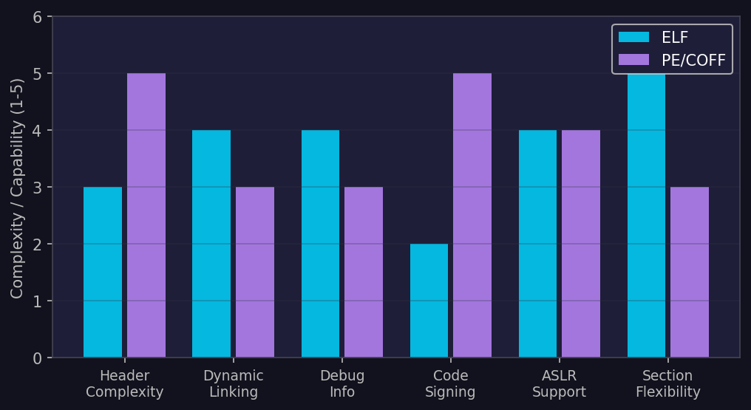
PE vs ELF — Feature Comparison
ELF excels in section flexibility and dynamic linking granularity. PE leads in code signing (Authenticode) and header metadata richness. Both support full ASLR with appropriate compilation flags.

Slide 11
II
Process Memory &
OS Primitives
Virtual address space, page tables, syscalls, seccomp, capabilities, namespaces, LSMs, and cgroups

Slide 12
x86-64 Virtual Address Space Layout
0xFFFFFFFF_FFFFFFFF Kernel Space (upper half)
0xFFFF8000_00000000 Kernel text, modules, vmalloc
ASLR randomizes:
• Stack base (28 bits)
• mmap base (28 bits)
• Heap base (13 bits)
• PIE base (28 bits)
Kernel half isolated
by KPTI (Meltdown fix)
NX bit enforced per page:
stack = RW (no exec)
code = RX (no write)
heap = RW (no exec)
— canonical hole —
0x7FFFFFFF_FFFF [stack] ↓ grows down
↕ mmap region (libraries, anon)
[heap] ↑ grows up (brk)
.bss / .data (RW)
.rodata (R)
.text (RX) — code
0x0000_00400000 ELF base (non-PIE) or random (PIE)
0x0 NULL page (unmapped)

Slide 13
4-Level Page Table Hierarchy (x86-64)
CR3 Register
PGD (Page Global Dir)
512 entries — bits [47:39]
PUD (Page Upper Dir)
512 entries — bits [38:30]
PMD (Page Middle Dir)
512 entries — bits [29:21]
PTE (Page Table Entry)
512 entries — bits [20:12]
4 KiB
Physical
Page Frame
Each PTE contains: physical frame number, Present bit, Read/Write, User/Supervisor, NX (No-Execute), Accessed, Dirty flags.
Security-relevant bits:
• NX (bit 63): prevents code execution from data pages — DEP/W^X enforcement
• U/S (bit 2): separates kernel and user pages — SMEP/SMAP enforcement
• R/W (bit 1): write protection — used for COW, RELRO, code integrity
5-level paging (LA57) adds PML5 for 57-bit virtual addresses (128 PiB).
Huge pages: 2 MiB (PMD maps directly) or 1 GiB (PUD maps directly) — reduces TLB pressure but coarser permission granularity.

Slide 14
System Call Flow (x86-64 Linux)
User Process
CPU
Kernel Entry
Seccomp
Check
Syscall
Handler
mov rdi, arg1
mov rsi, arg2
mov rax, __NR_xxx
syscall
Ring 3 → Ring 0
Load MSR_LSTAR
(entry_SYSCALL_64)
swapgs
Switch to kernel stack
Save pt_regs
BPF filter evaluates
syscall nr + args
ALLOW / KILL / TRAP
sys_call_table[rax]
Execute handler
Return to user
Key security mechanisms in the syscall path:
• KPTI: separate page tables for user/kernel — mitigates Meltdown
• Seccomp-BPF: per-process syscall filter — reduces kernel attack surface
• ptrace: debugging interface — can intercept/modify syscalls (PTRACE_SYSCALL)
• Audit: auditd hooks into syscall return path for logging
• LSM hooks: SELinux/AppArmor checks after basic DAC permissions
Performance: syscall instruction ~ 100-200ns, sysenter (legacy 32-bit) similar. vDSO maps select syscalls (gettimeofday, clock_gettime) into userspace for zero-cost calls.

Slide 15
Seccomp-BPF Architecture
Seccomp BPF Filter
IF nr == __NR_open
→ ERRNO(EPERM)
IF nr == __NR_write
→ ALLOW
DEFAULT → KILL
Application
(sandboxed)
ALLOW
KILL / TRAP
Seccomp-BPF inspects: syscall number, architecture, and up to 6 arguments (arg[0]–arg[5]).
Filter actions (SECCOMP_RET_*):
KILL_PROCESS — terminate entire process (SIGSYS)
KILL_THREAD — terminate calling thread only
TRAP — deliver SIGSYS, handler can inspect seccomp_data
ERRNO(val) — return -val without executing syscall
USER_NOTIF — send to userspace supervisor (seccomp_unotif)
LOG — allow but log the violation
ALLOW — permit syscall to proceed
Filters are inherited across fork/exec. Once installed, cannot be removed (only tightened). Used by: Chrome (renderer sandbox), Docker (default 300+ syscall allowlist), systemd (SystemCallFilter=), Firejail, Flatpak.

Slide 16
Linux Capabilities Model
Traditional Root (UID 0)
Capability-Based (fine-grained)
UID 0 = all 41 capabilities
CAP_NET_BIND_SERVICE — port <1024
Single compromise = full control
CAP_NET_RAW — raw sockets
No granularity
CAP_SYS_PTRACE — ptrace any proc
All or nothing model
CAP_DAC_OVERRIDE — bypass file perms
setuid binaries inherit all caps
CAP_SYS_ADMIN — catch-all (avoid!)
Three capability sets per thread: Effective (active), Permitted (can activate), Inheritable (preserved across execve). Ambient set (Linux 4.3+) allows non-root processes to inherit caps without setuid. Bounding set limits which caps can ever be gained. Container runtimes drop most capabilities — Docker default keeps only 14 of 41.

Slide 17
Linux Namespace Isolation
PID NS
Isolated process tree
PID 1 inside container
Network NS
Separate network stack
veth pairs, own iptables
Mount NS
Isolated filesystem view
pivot_root, bind mounts
User NS
UID/GID mapping
root-in-container = non-root-on-host
UTS NS
Separate hostname
and NIS domain name
IPC NS
Isolated SysV IPC
and POSIX message queues
Cgroup NS
Isolated cgroup hierarchy
view of /proc/self/cgroup
Time NS
Per-namespace CLOCK
(Linux 5.6+)
Containers = namespaces + cgroups + seccomp + capabilities + LSM. unshare(2) and clone(2) with CLONE_NEW* flags create new namespaces. User namespaces are the key enabler for rootless containers (Podman). Escape vectors: host PID namespace access, privileged containers, CVE-2022-0185 (fsconfig heap overflow in user namespace).

Slide 18
Linux Security Module (LSM) Architecture
Process
(subject)
VFS /
Syscall Layer
DAC Check
(uid/gid/mode)
LSM Hooks
(200+ hook points)
Resource
(object)
SELinux
Type Enforcement (TE)
Mandatory Access Control
Fedora, RHEL, Android
AppArmor
Path-based profiles
Easier to configure
Ubuntu, SUSE, Debian
Landlock
Unprivileged sandboxing
Filesystem restrictions
Linux 5.13+
LSM stacking (Linux 5.1+): multiple LSMs can be active simultaneously. Typical production: SELinux + BPF LSM, or AppArmor + Landlock. BPF LSM (Linux 5.7+) allows attaching eBPF programs to LSM hooks — enables dynamic, programmable security policies (used by Cilium Tetragon, Falco). Security decision: LSM hook returns 0 (allow) or -EACCES (deny). DAC check happens first — LSM can only further restrict, never grant.

Slide 19
Control Groups (cgroups v2)
Resource Limiting
cpu.max: CPU time quota/period. memory.max: hard memory limit. io.max: block I/O bandwidth. pids.max: process count cap.
Hierarchy & Delegation
Single unified hierarchy (cgroups v2). Parent can delegate sub-tree to unprivileged processes. systemd manages slice/scope/service cgroup units.
Security Implications
Memory cgroup prevents fork bombs and OOM attacks against other tenants. CPU cgroup prevents crypto-mining abuse. Device cgroup restricts /dev access.
Container Integration
Each container gets its own cgroup. Docker/containerd set limits via OCI runtime spec. Kubernetes: requests (soft) and limits (hard) map to cgroup settings.
Monitoring & Detection
cgroup.events: populated, frozen state. memory.events: oom_kill counter. PSI (Pressure Stall Information): some/full pressure tracking for CPU, memory, I/O.

Slide 20
Key Takeaways & Defense Recommendations
✓ Compile with Full RELRO + PIE + Stack Canaries + NX — layered binary hardening
✓ Use seccomp-BPF to restrict syscall surface — default-deny policy where possible
✓ Drop unnecessary capabilities — avoid CAP_SYS_ADMIN, use fine-grained caps
✓ Leverage namespaces for isolation — user namespaces enable rootless containers
✓ Deploy LSM policies (SELinux/AppArmor) — mandatory access control beyond DAC
✓ Monitor cgroup events for resource abuse — OOM kills, CPU throttling, fork storms
✓ Audit ELF binaries: checksec verifies RELRO, NX, PIE, canaries, FORTIFY

Slide 21
Cross-Reference Map
Domain 3 — Memory Corruption
Stack/heap exploitation relies on understanding virtual memory layout and ELF structure.
Domain 4 — Code Reuse Attacks
ROP/JOP gadgets found in .text; PLT/GOT mechanics enable ret2plt techniques.
Domain 5 — Kernel Exploitation
Kernel memory layout, page table manipulation, and namespace escapes.
Domain 6 — Mitigation Bypass
ASLR, NX, RELRO bypass techniques depend on binary format internals.
Domain 10 — Cloud & Containers
Container isolation = namespaces + cgroups + seccomp + capabilities.
Domain 11 — Malware
ELF/PE parsing for malware analysis; packing/obfuscation techniques.

