Slide 1
Mitigation Bypass &
Hardware-Level Attacks
Domains 4B, 6, 7 · Speculative Execution · CFI/PAC/MTE · Cache Side Channels

Slide 2
AGENDA
1. Defense-in-Depth Mitigation Stack
2. Intel CET: Shadow Stack & IBT
3. ARM PAC & MTE Mechanisms
4. CFG / XFG / Clang CFI
5. KASLR & ASLR Bypass Techniques
6. DEP/W^X Bypass via ROP
7. Stack Canary & RELRO Bypass
8. Kernel Mitigation Stack
9. Spectre & Meltdown Attack Flows
10. Cache Side-Channel Taxonomy
11. SGX & Rowhammer Attacks
12. Microarchitectural Defense Timeline

Slide 3
Defense-in-Depth Mitigation Stack
CFI / CET / PAC — Forward-edge + backward-edge control flow
Stack Canaries — Buffer overflow detection at function return
ASLR / KASLR — Randomize virtual address layout each execution
DEP / W^X / NX — Non-executable data pages, non-writable code pages
RELRO / FORTIFY — GOT hardening, bounds-checked libc functions
Seccomp / Sandboxing — Syscall filtering, least privilege execution
▲ Each layer compensates if the one above is bypassed ▲

Slide 4
Intel CET — Shadow Stack & IBT
Shadow Stack (Backward-Edge)
IBT — Indirect Branch Tracking (Forward-Edge)
CALL instruction
Push return addr to both stacks
Indirect JMP/CALL
Sets TRACKER state machine
RET instruction
Compare shadow vs regular stack
Target must start with
ENDBR64 / ENDBR32
Mismatch
#CP exception → process killed
Missing ENDBR
#CP exception → process killed
Protected by
Supervisor shadow stack flag in PTE
Legacy interop
NOTRACK prefix + LE bit
CET available since Intel Tiger Lake (11th gen, 2020). Requires OS + compiler support. Linux 5.18+, Windows 10+ (Hardware-enforced Stack Protection).

Slide 5
ARM Pointer Authentication (PAC)
Pointer
(48-bit VA)
PAC Key
(128-bit)
QARMA
Cipher
PAC Bits
(7-16 bits)
Signed
Pointer
64-bit pointer layout: [PAC bits | upper VA bits | 48-bit virtual address]
Keys: APIAKey, APIBKey, APDAKey, APDBKey, APGAKey — 5 distinct key families in ARMv8.3+
Known Bypass Research:
▸ PACMAN (2022): speculative execution to brute-force PAC without crashing
▸ ForgePAC: signing gadgets that compute valid PACs from leaked keys
▸ PAC bypass via kernel gadgets: find AUT+BR sequence without check

Slide 6
ARM Memory Tagging Extension (MTE)
Pointer Tag (4-bit)
Stored in top byte
Memory Tag (4-bit)
Per 16-byte granule
Hardware Compare
Tag match? → proceed
Mismatch? → fault
Synchronous MTE
Immediate fault on tag mismatch. Precise. High overhead (~3-5%)
Asynchronous MTE
Deferred reporting via TFSR. Lower overhead (~1-2%). Less precise
Asymmetric MTE
Sync for reads, async for writes. Balance precision/performance
MTE detects: heap overflow, use-after-free, double-free, uninitialized memory access.
Pixel 8 = first production device with MTE (2023). Android 14+ supports MTE in userspace.
4-bit tag = 1/16 probability of collision (brute-force requires ~16 attempts on average).

Slide 7
Windows CFG / XFG Architecture
Indirect Call
Site
CFG Bitmap
Lookup
Valid Target?
Check bit
Call
Proceeds
CFG (Control Flow Guard): 1-bit per 8-byte aligned address. Coarse-grained.
XFG (Xtended Flow Guard): adds type hash — indirect call must match function prototype.
CFG Bypasses:
▸ Call existing valid targets (JIT code, longjmp, coroutines)
▸ Abuse 8-byte granularity to land at unintended instruction boundary
▸ Mark writable pages as valid via VirtualAlloc/VirtualProtect
▸ XFG hash collision: find valid target with matching type signature

Slide 8
Clang CFI — Type-Based Control Flow Integrity
cfi-vcall
Virtual call check — vtable pointer must reference valid vtable for the static type
cfi-nvcall
Non-virtual member call — validate derived class pointer
cfi-derived-cast
Derived cast check — static_cast must be valid
cfi-unrelated-cast
Unrelated cast check — reinterpret_cast validation
cfi-icall
Indirect call — function pointer must match expected signature
Requires LTO (Link-Time Optimization) for cross-module enforcement.
Android uses Clang CFI for kernel (KCFI) since Android 13.
Bypass: type confusion within same CFI equivalence class.

Slide 9
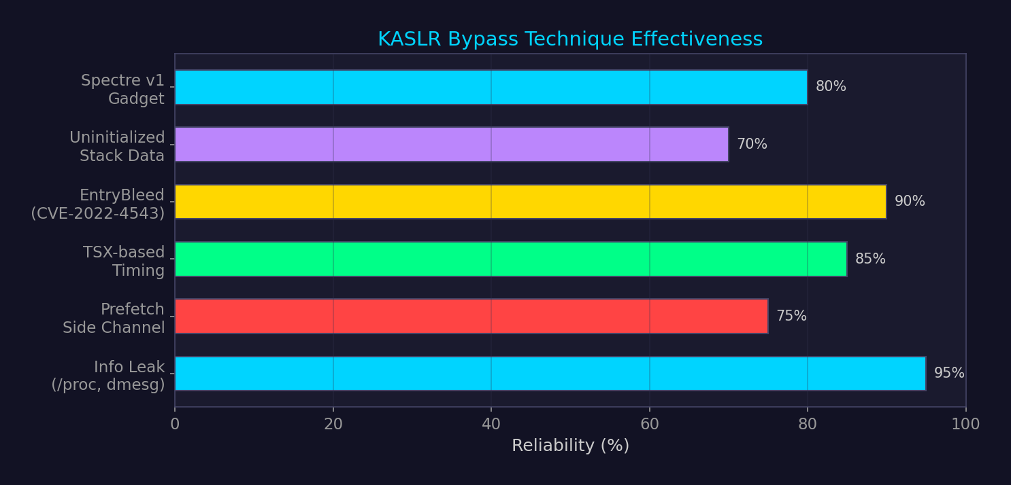
KASLR Bypass Techniques — Comparison

Slide 10
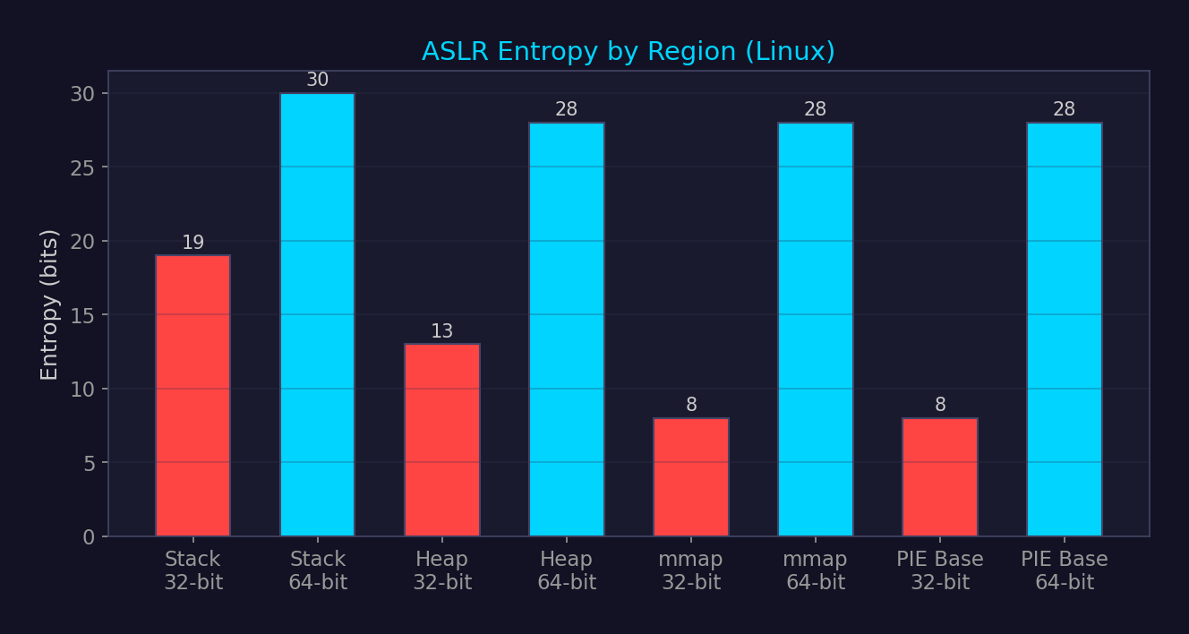
ASLR Entropy Comparison

Slide 11
DEP / W^X Bypass via ROP Chain
Buffer
Overflow
Gadget 1:
pop rdi; ret
Gadget 2:
pop rsi; ret
Gadget 3:
pop rdx; ret
execve
syscall
Corrupt return address
Load /bin/sh address
Set argv = NULL
Set envp = NULL
Execute shell
ROP works because DEP only prevents execution of data — existing code (gadgets) is still executable.
Advanced variants:
▸ JOP (Jump-Oriented Programming): uses indirect jumps, no return instructions
▸ SROP (Sigreturn-Oriented Programming): single sigreturn gadget → control all registers
▸ BROP (Blind ROP): brute-force gadgets over network without binary access
▸ ret2dlresolve: forge relocation entries to resolve arbitrary library functions
Countered by: CET shadow stack (ROP), IBT (JOP), CFI (both), ASLR (all — raises cost)

Slide 12
Stack Canary Bypass Methods
Information Leak
Read canary via format string (%p), out-of-bounds read, or /proc/self/mem
Byte-by-Byte Brute Force
Fork-based servers: child inherits canary → try 256 values per byte × 8 bytes
Overwrite Past Canary
Corrupt function pointer or local variable before canary check
Canary-less Functions
Small functions, leaf functions may not have canaries (-fno-stack-protector)
Thread-Local Bypass
Overwrite __stack_chk_guard in TLS (adjacent to stack on some archs)
Signal Handler Abuse
Trigger signal before __stack_chk_fail → hijack execution

Slide 13
RELRO Bypass Techniques
Partial RELRO (gcc default)
Full RELRO (-z now)
▸ .got → read-only (non-PLT GOT entries)
▸ .got.plt → still WRITABLE
▸ Attacker: overwrite .got.plt entries
▸ Bypass: any arbitrary write primitive
▸ All GOT entries resolved at load time
▸ Entire .got and .got.plt → read-only
▸ Attacker: cannot overwrite GOT
▸ Bypass: __free_hook, __malloc_hook (removed glibc 2.34+),
ld.so internal structures, or target non-GOT pointers
Post-glibc 2.34 landscape: hooks removed, Full RELRO + PIE standard.
Modern bypass targets: _IO_FILE vtable corruption (FSOP), TLS-DTV, ld.so _r_debug,
exit handlers (__exit_funcs), custom allocator metadata.
Detection: checksec (pwntools), readelf -l (GNU_RELRO segment), readelf -d (BIND_NOW flag).

Slide 14
Linux Kernel Mitigation Stack
KASLR
Randomize kernel base by up to 1GB (x86_64). ~9 bits entropy
SMEP
Supervisor Mode Execution Prevention — no exec of userspace code from ring 0
SMAP
Supervisor Mode Access Prevention — no read/write userspace from ring 0
KPTI
Kernel Page Table Isolation — separate page tables for user/kernel (Meltdown fix)
KCFI
Kernel CFI — Clang's type-based CFI for indirect calls in kernel
Stack Protector
Per-task canary, __stack_chk_guard in task_struct
RANDSTRUCT
Randomize layout of sensitive kernel structs at compile time
Hardened Usercopy
Validate user ↔ kernel copy bounds against slab metadata

Slide 15
Speculative Execution &
Hardware Attacks

Slide 16
Spectre v1 — Bounds Check Bypass
Attacker trains
branch predictor
Victim executes
bounds check
Speculative
OOB access
Data-dependent
cache load
Flush+Reload
recovers secret
if (x < array1_size) → y = array2[array1[x] * 256]
Speculative window: CPU executes past branch before branch resolves.
Even though result is architecturally discarded, cache state persists.
Mitigations:
▸ lfence / speculation barrier after bounds check
▸ Array index masking (x & (size-1))
▸ Retpoline (Spectre v2 — indirect branch)
▸ IBRS / STIBP / IBPB (microcode-level)
▸ BHI_DIS_S, RRSBA mitigation (newer variants)

Slide 17
Meltdown — Rogue Data Cache Load (CVE-2017-5754)
Userspace
process
Access kernel
memory (faults)
CPU speculatively
loads value
Use value as
cache oracle
Recover byte
via timing
Exploits the race between permission check and speculative execution.
Kernel virtual memory mapped into every process (for syscall performance).
Out-of-order execution reads kernel data before fault is raised.
Impact: Read arbitrary kernel memory from userspace at ~500 KB/s.
Affected: Intel (most pre-2019), some ARM. AMD largely unaffected.
Fix: KPTI (Kernel Page Table Isolation) — separate page tables for user/kernel.
Performance cost: 5-30% depending on syscall frequency.

Slide 18
Spectre / Meltdown Variant Landscape
Variant
Year
Mechanism
Primary Mitigation
Spectre v1 (BCB)
2018
Bounds Check Bypass
lfence, masking
Spectre v2 (BTI)
2018
Branch Target Injection
Retpoline, IBRS, eIBRS
Meltdown (RDCL)
2018
Rogue Data Cache Load
KPTI
Spectre v4 (SSB)
2018
Speculative Store Bypass
SSBD bit
MDS/RIDL/Fallout
2019
Microarch Data Sampling
Verw, buffer overwrite
LVI
2020
Load Value Injection
lfence everywhere
Retbleed
2022
Return prediction bypass
IBPB, eIBRS+retpoline
Downfall (GDS)
2023
Gather Data Sampling
Microcode update
Inception
2023
Phantom speculation (AMD)
Safe RET, IBPB
BHI (Spectre-BHB)
2024
Branch History Injection
BHI_DIS_S

Slide 19
Cache Side-Channel Taxonomy
Flush+Reload
Shared memory. Flush target line → victim executes → time reload. Precise, cross-core.
Prime+Probe
No shared memory needed. Fill cache set → victim evicts → probe for eviction. Noisier.
Evict+Reload
Like Flush+Reload but uses eviction instead of clflush. Works without clflush.
Flush+Flush
Measure clflush time itself (cached vs uncached). Stealthier — no memory access.
Cache Occupancy
Monitor total cache pressure. Coarse-grained. Used for keystroke timing.
All exploit timing differences between cache hit (~4 cycles) and cache miss (~200+ cycles).
Flush+Reload requires shared pages (dedup, shared libs) — most precise at ~byte granularity.
Prime+Probe works across VMs (L3 cache shared) — used in cloud cross-tenant attacks.

Slide 20
Intel SGX — Enclave Attack Surface
SGX Enclave
(Encrypted Memory Region)
Controlled-Channel
(Page Fault)
SGAxe / CacheOut
(L1D Eviction)
Plundervolt
(Voltage Glitch)
SmashEx
(Async Exception)
Enclave Interface
(ECALL Fuzzing)
AEX-Notify
(Interrupt Storm)
SGX deprecated on 12th+ gen Intel (Alder Lake). Replaced by TDX for VM-level confidential computing.
Key lesson: hardware isolation without side-channel resistance is insufficient.

Slide 21
Rowhammer — DRAM Disturbance Attack
Aggressor Row
Repeated Access
Charge Leakage
→ Adjacent Rows
Bit Flip in
Victim Row
Exploit:
PTE Manipulation
DRAM cells store bits as charge in capacitors. Repeated row activations cause charge leakage
into physically adjacent rows, flipping bits in victim rows.
Exploitation: flip PTE bits → gain write access to page table → arbitrary kernel R/W.
Variants: single-sided, double-sided, one-location, TRRespass, Half-Double, Blacksmith.
Mitigations:
▸ ECC RAM (detects single-bit, corrects — but multiple flips bypass)
▸ TRR (Target Row Refresh) — hardware mitigation, repeatedly bypassed
▸ LPDDR5 / DDR5: per-row refresh counters, RFM (Refresh Management)
▸ Software: memory isolation, guard rows, DRAMA-based detection

Slide 22
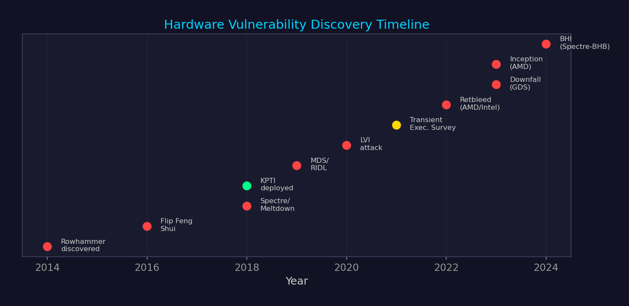
Microarchitectural Attack & Defense Timeline

Slide 23
Cross-Reference Map
▸ Domain 1-2: ELF/PE binary formats → understanding PLT/GOT for RELRO bypass context
▸ Domain 3: Stack/heap corruption → the vulnerability classes these mitigations address
▸ Domain 4A: ROP/JOP/SROP — the code reuse attacks CET/PAC/CFI are designed to stop
▸ Domain 5: Kernel exploitation → SMEP/SMAP/KPTI are the kernel-side mitigations
▸ Domain 6B: Kernel mitigation bypass — extends this presentation with KASLR/kCFI specifics
▸ Domain 11: EDR evasion → attackers bypass these mitigations in practice
▸ Domain 14: Windows enterprise — CFG/XFG are the Windows-specific implementations
▸ Domain 26: Vuln research — exploit developers must defeat these mitigations

