Slide 1
Web Application &
Network Security
Domains 8-9 · OWASP Top 10 · Browser Internals · Protocol Attacks

Slide 2
AGENDA
1. OWASP Top 10 (2021)
2. XSS Types & Attack Flows
3. SQL Injection Mechanics
4. SSRF Attack Chain
5. OAuth 2.0 & JWT Attacks
6. CSP & Browser Security Model
7. V8 Engine & Chrome Sandbox
8. TCP/IP Attack Surface
9. DNS Attack Taxonomy
10. TLS 1.3 Handshake
11. Wireless & SDN Security

Slide 3
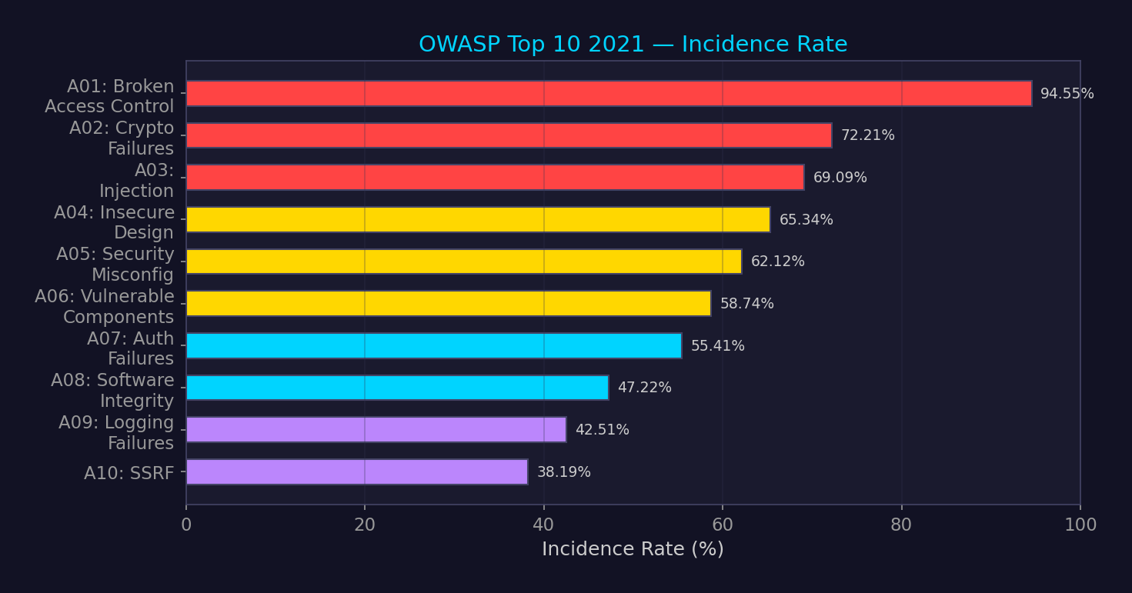
OWASP Top 10 — 2021

Slide 4
Cross-Site Scripting (XSS) — Type Comparison
Reflected XSS
Attacker crafts
malicious URL
Victim clicks
link
Server reflects
input in response
Browser executes
script
Stored XSS
Attacker submits
payload
Server stores
in database
Other users
request page
Payload served
to all victims
DOM-based XSS
Attacker crafts
URL fragment
Client JS reads
location.hash
JS writes to
innerHTML/eval
Script executes
client-side only
Defense: Context-aware output encoding, CSP with nonce, Trusted Types API, DOMPurify for sanitization.
Reflected/Stored: server-side escaping. DOM-based: avoid dangerous sinks (innerHTML, eval, document.write).

Slide 5
SQL Injection — Attack Flow
User Input
' OR 1=1 --
String
Concatenation
Malformed
SQL Query
Database
Exfiltration
Union-Based
UNION SELECT to extract data from other tables
Error-Based
Trigger verbose errors that leak data
Blind Boolean
Infer data from true/false response differences
Blind Time-Based
SLEEP/BENCHMARK to infer data via response timing
Out-of-Band
DNS/HTTP exfiltration via LOAD_FILE, UTL_HTTP
Second-Order
Stored payload triggered in different query context
Defense: Parameterized queries / prepared statements. NEVER string concatenation. WAF as defense-in-depth only.

Slide 6
Server-Side Request Forgery (SSRF) Attack Chain
Attacker sends
URL to app
App fetches
attacker URL
Target:
169.254.169.254
Cloud metadata
credentials
Lateral movement
via stolen creds
Capital One breach (2019): SSRF → EC2 metadata → IAM role credentials → S3 bucket access → 106M records.
SSRF targets beyond cloud metadata:
▸ Internal services (Redis, Elasticsearch, Consul — often no auth on localhost)
▸ File:// protocol → local file read (e.g., /etc/passwd, /proc/self/environ)
▸ Gopher:// → interact with TCP services (memcached, SMTP)
▸ DNS rebinding → bypass allowlist by resolving to internal IP after check
Defense: IMDSv2 (token-required), allowlist outbound URLs, disable unnecessary protocols,
network-level egress filtering, avoid passing raw URLs from user input.

Slide 7
OAuth 2.0 Authorization Code Flow
Client
(App)
Authorization
Server
Resource
Server
1. Auth request + PKCE challenge
2. User authenticates + consents
3. Auth code returned to redirect_uri
4. Exchange code + PKCE verifier for tokens
5. Access token + refresh token
6. API request with Bearer token
Attacks: authorization code interception, redirect_uri manipulation, token leakage via referrer,
state parameter CSRF, implicit flow token exposure, client_secret compromise.
Defense: PKCE (RFC 7636) mandatory, exact redirect_uri match, short-lived access tokens,
token binding, DPoP (RFC 9449), avoid implicit grant entirely.

Slide 8
JWT Structure & Attack Surface
HEADER
{"alg":"RS256",
"typ":"JWT"}
PAYLOAD
{"sub":"1234",
"role":"admin"}
SIGNATURE
HMAC/RSA/ECDSA
over header.payload
Base64url encoded
Claims (not encrypted!)
Integrity verification
alg: none
Set algorithm to 'none' — server accepts unsigned token
Key Confusion
RS256→HS256: use RSA public key as HMAC secret
JWK Header Injection
Embed attacker's public key in JWK/JKU header field
Weak Secret Brute Force
hashcat -m 16500 → crack HS256 shared secrets
Claim Tampering
Modify 'role', 'sub', or 'exp' claims if signature not verified

Slide 9
Content Security Policy (CSP) Architecture
default-src
Fallback for all resource types
script-src
JavaScript execution (most critical)
style-src
CSS stylesheets
img-src
Images
connect-src
XHR, WebSocket, fetch()
frame-src
iframe embedding
object-src
Plugins (Flash, Java — should be 'none')
base-uri
Base URL restriction (prevent base tag injection)
Best practice: nonce-based CSP ('nonce-{random}') over domain allowlists.
Trusted Types API: enforce DOM XSS prevention at the API level (createPolicy).
CSP bypass: JSONP endpoints on allowed domains, angular.js expression injection, base-uri override.

Slide 10
Browser Security Model
Same-Origin Policy (SOP)
scheme + host + port must match for cross-origin access
CORS
Controlled relaxation of SOP via server headers (Access-Control-*)
Process Isolation
Site Isolation: each origin in separate renderer process (Spectre mitigation)
Sandbox
Renderer process has no direct filesystem/network/GPU access
Permissions API
Camera, mic, geolocation, notifications — user opt-in
Certificate Transparency
All TLS certs logged to public CT logs for auditability
SOP exceptions: <script src>, <img src>, <link> — cross-origin embeds allowed by default.
This is why CSP exists: restrict which origins can serve scripts/styles to your page.
Attacks exploiting SOP gaps: DNS rebinding, CORS misconfiguration, postMessage abuse.

Slide 11
V8 Engine & Chrome Sandbox Architecture
V8 JIT Compilation Pipeline
JS Source
Parser
→ AST
Ignition
(Bytecode)
TurboFan
(Optimized)
Maglev
(Mid-tier)
Chrome Multi-Process Sandbox
Renderer Process
Untrusted. Runs JS/HTML. Seccomp-BPF filtered. No direct syscalls.
Broker Process
Mediates all IPC. Validates requests from renderer.
Browser Process
Privileged. File I/O, network, GPU. Minimal attack surface.
GPU Process
Sandboxed. Validates all GPU commands. Separate from renderer.
Exploit chain: JIT type confusion → V8 RCE → sandbox escape (Mojo IPC bug) → browser process code exec.

Slide 12
Network Security

Slide 13
TCP/IP Protocol Attack Surface
SYN Flood
Exhaust server connection table with half-open connections. Defense: SYN cookies.
RST Injection
Send forged RST to tear down active connections. Used by GFW. Defense: TCP-AO.
Session Hijacking
Predict sequence numbers to inject data. Modern: randomized ISN.
IP Spoofing
Forge source IP. UDP easy; TCP requires seq prediction. Defense: BCP38/uRPF.
TCP Reset Attack
Off-path attacker sends RST with guessed seq. BGP sessions vulnerable.
Covert Channels
Data in IP ID, TCP timestamp, TTL fields. Detection: statistical analysis.
Modern mitigations: TCP-AO (RFC 5925) replaces MD5 for BGP, randomized ISN (RFC 6528),
SYN cookies (RFC 4987), RPKI for BGP origin validation, strict uRPF (BCP 38/84).

Slide 14
DNS Attack Taxonomy
Cache Poisoning
Forge DNS responses to redirect queries. Kaminsky attack (2008): birthday attack on TXID.
DNS Tunneling
Encode data in DNS queries/responses (iodine, dnscat2). Exfil over UDP/53.
DNS Rebinding
Switch DNS response from external to internal IP. Bypass SOP/firewall rules.
DDoS Amplification
Open resolvers + spoofed source IP. 50-70x amplification factor. Defense: RRL.
Domain Hijacking
Compromise registrar account or DNS provider. BGP + DNS hijack combo.
NXDOMAIN Attack
Flood random subdomains to exhaust recursive resolver cache.
DNSSEC: cryptographic signatures on DNS records. Prevents cache poisoning.
DoH/DoT: encrypt DNS queries (privacy). DNS over HTTPS (:443), DNS over TLS (:853).
ECH (Encrypted Client Hello): hides SNI from network observers. Requires DoH.

Slide 15
TLS 1.3 Handshake (1-RTT)
Client
Server
→ ClientHello + key_share (ECDHE)
← ServerHello + key_share + EncryptedExtensions + Cert + CertVerify + Finished
→ Finished (encrypted)
↔ Application Data (encrypted)
TLS 1.3 improvements over TLS 1.2:
▸ 1-RTT handshake (vs 2-RTT). 0-RTT for resumption (replay risk).
▸ Removed: RSA key exchange, CBC, RC4, SHA-1, compression, renegotiation.
▸ Only AEAD ciphers: AES-128-GCM, AES-256-GCM, ChaCha20-Poly1305.
▸ Forward secrecy mandatory (ECDHE/DHE only).
▸ Encrypted certificate (server cert hidden from passive observers).
Attacks on TLS: RACCOON (DH timing), Bleichenbacher (RSA PKCS#1 v1.5 — TLS 1.2),
certificate misissuance, CT log monitoring for phishing domains.

Slide 16
BGP Hijacking Attack Flow
Attacker AS
announces prefix
More-specific
route propagates
Internet routes
traffic to attacker
MitM or
black hole
BGP has no built-in authentication — any AS can announce any prefix.
Notable incidents:
▸ Pakistan Telecom → YouTube (2008): /24 more-specific hijacked YouTube's /22
▸ Rostelecom → Mastercard/Visa (2017): financial traffic rerouted
▸ China Telecom → US military prefixes (2018-2019): systematic interception
Defense: RPKI (Resource Public Key Infrastructure) — cryptographically signed ROAs.
BGPsec (path validation) — not widely deployed. IRR filtering. MANRS initiative.
Monitoring: RIPE RIS, RouteViews, BGPStream, Cisco BGPMon.

Slide 17
Layer 2 Network Attacks
ARP Spoofing
Gratuitous ARP → poison ARP cache → MitM. Defense: DAI + DHCP snooping.
VLAN Hopping
Double tagging (802.1Q) or switch spoofing. Defense: native VLAN ≠ user VLAN.
STP Manipulation
Send superior BPDUs → become root bridge → intercept traffic. Defense: BPDU Guard.
MAC Flooding
Overflow CAM table → switch becomes hub. Defense: port security, MAC limiting.
DHCP Starvation
Exhaust IP pool with spoofed MACs. Defense: DHCP snooping + rate limiting.
802.1X Bypass
Hub between supplicant and switch. EAP relay. Defense: MACsec (802.1AE).

Slide 18
Wireless Protocol Attack Taxonomy
WPA3-SAE
Dragonblood (CVE-2019-9494): side-channel on SAE handshake. Defense: updated implementations.
KRACK (WPA2)
Key Reinstallation Attack: replay handshake msg 3 → reset nonce → decrypt. Patched.
Evil Twin
Rogue AP with same SSID. Captive portal credential harvesting. Defense: 802.1X, EAP-TLS.
PMKID Attack
Capture PMKID from first EAPOL frame — no client needed. Offline crack.
Deauth Flood
802.11 management frames unprotected → forge deauth. Defense: MFP (802.11w).
Bluetooth
KNOB: negotiate 1-byte entropy → brute-force. BLURtooth: CTKD cross-transport key derivation.

Slide 19
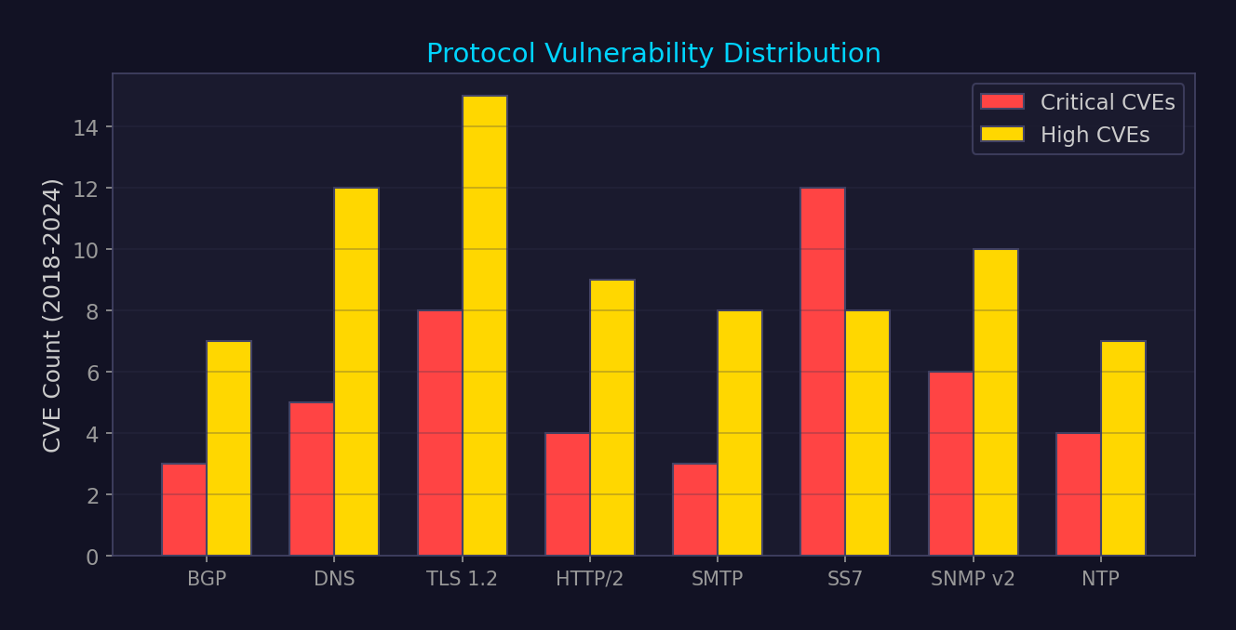
Network Protocol Vulnerability Severity

Slide 20
SS7 / Diameter Telecom Attack Surface
Location Tracking
SendRoutingInfo/PSI → get subscriber's serving cell. Track real-time movement.
SMS Interception
RegisterSS/UpdateLocation → redirect SMS to attacker-controlled MSC.
Call Interception
InsertSubscriberData → set call forwarding to attacker number.
DoS
CancelLocation/PurgeMS → detach subscriber from network.
Fraud
Manipulate charging records. Free calls. Premium-rate fraud.
SS7 designed in 1980s — no authentication between operators. Still used for 2G/3G fallback.
Diameter (4G/LTE): similar attacks via S6a/Cx interfaces. IPX interconnect adds complexity.
Defense: SS7 firewall (Category 1-3 filtering per GSMA FS.11/FS.19),
Diameter Edge Agent, SEPP (Security Edge Protection Proxy) for 5G roaming.

Slide 21
Software-Defined Networking Security
Application Plane
SDN apps (firewall, LB, IDS). Risk: malicious app → full network control.
Northbound API
REST/gRPC. Risk: authentication bypass, API injection.
Control Plane
SDN Controller (ONOS, ODL). Single point of failure. Risk: controller compromise.
Southbound API
OpenFlow, P4, NETCONF. Risk: flow rule injection, MitM.
Data Plane
Switches/routers. Execute flow rules. Risk: flow table overflow DoS.
SDN centralizes control — compromise controller = compromise entire network.
Defense: controller clustering, TLS on southbound, RBAC on northbound, flow rule validation.

Slide 22
Cross-Reference Map
▸ Domain 3: Memory corruption → feeds directly into web browser exploitation (V8/JIT bugs)
▸ Domain 4: Code reuse attacks → ROP used in browser exploit chains after JIT bug
▸ Domain 10: Cloud security → SSRF is the bridge from web vuln to cloud compromise
▸ Domain 11: C2/malware → web shells, DNS tunneling for C2 communication
▸ Domain 13: Cryptography → TLS attacks, JWT crypto, OAuth token security
▸ Domain 14: Windows/AD → web apps as initial access vector for enterprise compromise
▸ Domain 20: RF/SDR → wireless protocol attacks extend the network security surface
▸ Domain 26: Vuln research → browser fuzzing is one of the highest-value targets

