Slide 1
Cloud, Container &
Supply Chain Security
Domains 10 & 19 — Enterprise Security Reference Library
Enterprise Security Reference Library

Slide 2
Agenda
▸ Cloud Security
Shared responsibility, attack surfaces, metadata exploitation, detection
▸ Container & Kubernetes
Architecture, escape techniques, RBAC abuse, serverless risks
▸ Software Supply Chain
SolarWinds, xz, dependency attacks, SLSA, Sigstore, SBOM
▸ Hardware Supply Chain
Counterfeit ICs, hardware Trojans, PUFs, root of trust
▸ Defense & Architecture
CI/CD hardening, provenance, tooling recommendations

Slide 3
Cloud Shared Responsibility Model
CLOUD PROVIDER
CUSTOMER
Physical Infrastructure
Data Classification & Encryption
Network & Hypervisor
Identity & Access Management
Managed Services (RDS, Lambda)
Application Security
Platform Security & Patching
OS, Network, Firewall Config
Key insight: Misconfigurations in the customer space (IAM, S3 bucket policies,
security groups) account for the vast majority of cloud breaches.
The provider secures the infrastructure; YOU secure what you put on it.

Slide 4
AWS Attack Surface
IAM
S3
EC2/VPC
Lambda
• Overprivileged roles
• Access key leaks
• Role chaining
• Public buckets
• ACL misconfig
• Object-level access
• SSRF to IMDS
• SG wide-open
• Unencrypted EBS
• Event injection
• Dep confusion
• Cold-start secrets
EKS/ECS
CloudTrail
RDS/DynamoDB
STS/SSM
• Privileged pods
• RBAC abuse
• Container escape
• Log tampering
• Trail deletion
• Gap exploitation
• Public snapshots
• Weak auth
• Encryption gaps
• Session hijacking
• Role assumption
• Parameter store
169.254.169.254 (IMDS v1) remains the most commonly exploited vector via SSRF chains.

Slide 5
Cloud Metadata Service Exploitation (SSRF)
1. SSRF Vuln
in Web App
2. Request to
169.254.169.254
3. IAM Creds
Returned
4. Lateral Move
via STS
5. Data
Exfiltration
IMDSv2 requires a PUT request with a hop-limit token (X-aws-ec2-metadata-token-ttl-seconds).
This blocks most SSRF because the attacker cannot set custom headers in the reflected request.
Detection: CloudTrail → AssumeRole with unusual source IP. GuardDuty: UnauthorizedAccess:IAMUser/InstanceCredentialExfiltration.
DEFENSES: Enforce IMDSv2 (HttpTokens=required) | Instance metadata endpoint disabled for Lambda | VPC endpoint policies | IAM role least-privilege | SSRF input validation

Slide 6
Kubernetes Architecture & Attack Surface
CONTROL PLANE
API Server
etcd
Scheduler
Controller Mgr
WORKER NODES
kubelet
kube-proxy
Container Runtime
Pod (app)
Pod (db)
⚠ Unauthenticated kubelet API (10250) → pod exec / container escape
⚠ etcd exposed → cluster secrets (service account tokens, TLS certs)
⚠ Privileged pod + hostPID → namespace breakout → node root
⚠ Default ServiceAccount token mounted in every pod (auto-mount)
⚠ Helm Tiller (legacy) ran as cluster-admin

Slide 7
Container Escape Techniques
Privileged Container
hostPID / hostNetwork
Mount host filesystem via /dev/sda
Access to all devices & host kernel
See all host processes / bypass network isolation
Process injection into host PID namespace
CVE-2019-5736 (runc)
CVE-2020-15257
(containerd)
Overwrite host runc binary from within container
Triggered on next container exec
Abstract Unix sockets accessible from
host-network containers → containerd API
Kernel Exploit
Mounted Secrets
Container shares host kernel → kernel vuln =
full host compromise (e.g., DirtyPipe)
Docker socket (/var/run/docker.sock) or
service account tokens in mounted volumes

Slide 8
K8s RBAC Misconfiguration Attack Paths
Compromised
Pod
SA Token
(auto-mount)
K8s API
Server
List Secrets /
Create Pods
Cluster
Admin
⚠ cluster-admin ClusterRoleBinding to default ServiceAccount
⚠ Wildcard verbs: { verbs: ["*"], resources: ["*"] }
⚠ Pods/exec permission → kubectl exec into any pod
⚠ create pods + mount hostPath → escape to node
⚠ Impersonate permission → act as any user/group

Slide 9
Serverless Attack Surface
Event Injection
Dependency Attacks
Cold-Start Secrets
S3 / SNS / API GW events with
malicious payloads in event fields
that reach application code
Malicious packages in Lambda layers
or requirements.txt
+ no lockfile integrity
Environment variables readable
during init phase
Secrets in /tmp persist across invocations
Over-Privileged Role
Shared /tmp
Timeout Abuse
Lambda execution role with
AdminAccess or s3:*
Single function → full account
Sequential invocations share
/tmp — data residue from
previous executions
Long-running functions used for
crypto mining or C2 relay
15 min max (AWS)

Slide 10
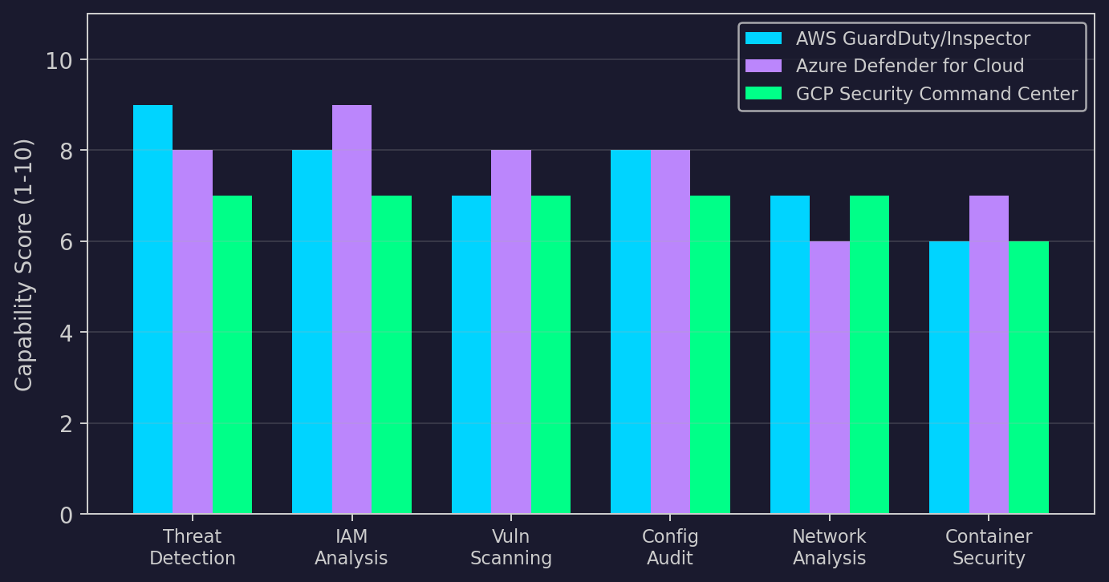
Cloud-Native Security Tool Comparison

Slide 11
II
Supply Chain Security
Dependency confusion, nation-state supply chain attacks,
SLSA, Sigstore, SBOM, CI/CD hardening

Slide 12
Software Supply Chain Attack Taxonomy
Dependency
Confusion
Typosquatting
Compromised
Maintainer
Build System
Compromise
Private package name
claimed on public registry
lodash → lodahs
requests → requets
Legitimate maintainer
account takeover
CI/CD pipeline
injection (SolarWinds)
RepoJacking
Malicious
Commit
Installer
Trojan
Watering
Hole
GitHub username rename
namespace takeover
Backdoor in OSS PR
(xz utils pattern)
Compromised download
site (3CX, Kaseya)
ICS vendor sites
(Havex/Dragonfly)

Slide 13
SolarWinds SUNBURST Attack Chain
1. Compromise
Build System
2. Inject into
Orion DLL
3. Signed
Update
4. 18,000+
Victims
5. Targeted
C2 (CNAME)
▸ Build process modified: SolarWinds.Orion.Core.BusinessLayer.dll backdoored
▸ Two-week dormancy period before C2 activation (anti-sandbox)
▸ DGA-based C2: <victim-hash>.appsync-api.{region}.avsvmcloud.com
▸ SAML token forgery (Golden SAML) for persistent cloud access
▸ Attributed to SVR (Russia) — APT29/Cozy Bear
▸ Detection: anomalous DNS queries to avsvmcloud.com subdomains

Slide 14
xz Utils Backdoor (CVE-2024-3094)
1. Social
Engineering
(2+ years)
2. Gain
Maintainer
Trust
3. Inject via
m4 Macro +
Test File
4. Hook
OpenSSH via
liblzma
5. RSA Key
Auth Bypass
(RCE)
Discovered by Andres Freund: 500ms SSH latency anomaly during PostgreSQL benchmarking.
Mechanism: Binary test file (bad-3-corrupt_lzma2.xz) was actually encrypted payload.
m4 macro in build system extracted and compiled the payload during 'make'.
Payload hijacked ifunc resolver in liblzma → hooked RSA_public_decrypt in libcrypto.
Attacker's RSA public key embedded as trigger — successful verification = RCE.
Implications: Multi-year social engineering of open-source trust model.
Single maintainer projects are critical infrastructure with no oversight.

Slide 15
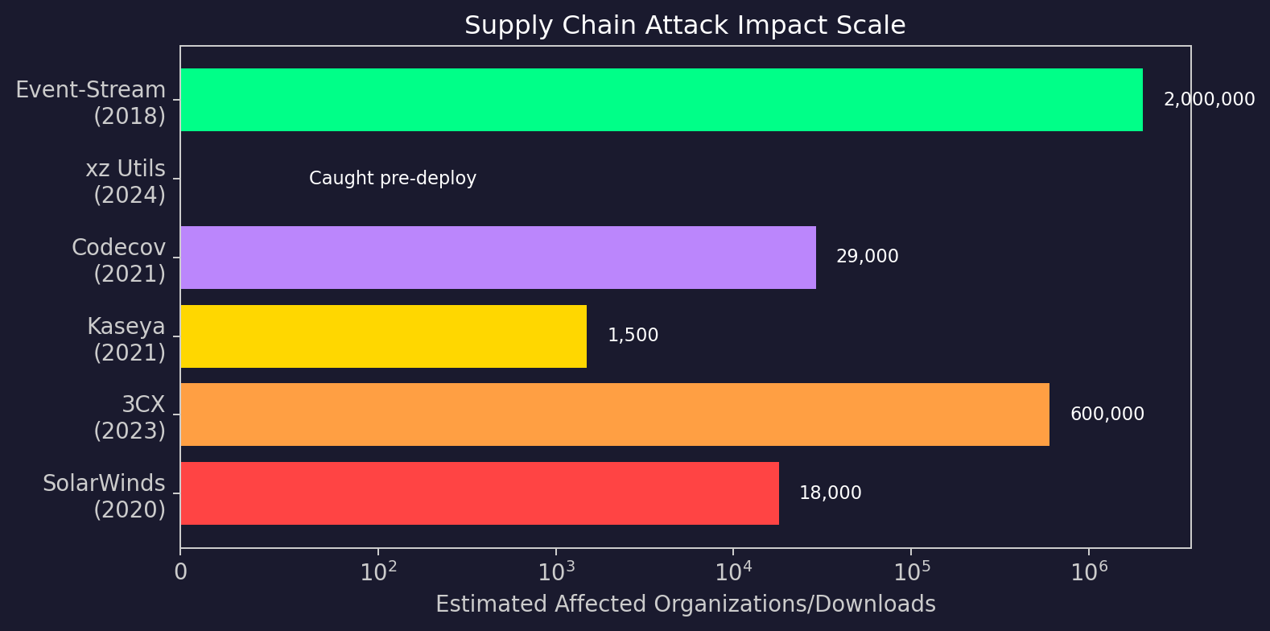
Major Supply Chain Incidents Comparison

Slide 16
SLSA Framework Levels
Level 1: Provenance
Exists
Level 2: Hosted
Build
Level 3: Hardened
Build
Level 4: Deps
Complete
Build process documented
Provenance generated
Build on hosted service
Provenance authenticated
Isolated, ephemeral env
Non-falsifiable provenance
All transitive deps have
SLSA 3+ provenance
SLSA (Supply-chain Levels for Software Artifacts) is a framework by Google/OpenSSF.
Each level builds on the previous, increasing tamper resistance of the build process.
Level 1: Basic hygiene — know what you built and how.
Level 2: Hosted builds prevent developer workstation compromise.
Level 3: Ephemeral build environments + non-falsifiable provenance prevent insider build tampering.
Level 4: Full supply chain — even transitive dependencies are verified.
Adoption: npm provenance (L2), GitHub Artifact Attestations (L2-L3), Sigstore integration.

Slide 17
Sigstore Ecosystem — Keyless Signing
Developer
(OIDC Identity)
Fulcio
(Short-lived Cert)
cosign
(Sign Artifact)
Rekor
(Transparency Log)
Consumer
(Verifier)
cosign verify
(Check Sig)
Rekor
(Inclusion Proof)
Trust Root
(TUF Metadata)
Keyless signing: No long-lived keys to manage or rotate.
Fulcio issues ephemeral X.509 certificates bound to OIDC identity (GitHub Actions, Google, etc.).
Rekor provides an immutable, append-only transparency log (RFC 6962 Merkle tree).
cosign: CLI tool for container image signing and verification.
Adoption: npm (provenance attestations), PyPI (Trusted Publishers), Maven Central,
Kubernetes (image verification policies via Kyverno/OPA Gatekeeper).

Slide 18
SBOM Lifecycle
Generate
Distribute
Ingest
Correlate
syft, cdxgen, trivy
CycloneDX / SPDX
OCI registry, API
SBOM exchange server
Dependency-Track
Grype, OSV-Scanner
CVE/GHSA/OSV match
VEX (exploitability)
SPDX 3.0 (ISO standard) and CycloneDX 1.6 are the two dominant SBOM formats.
US Executive Order 14028 requires SBOM for software sold to the federal government.
EU Cyber Resilience Act (CRA) requires SBOM for products sold in the EU market.
VEX (Vulnerability Exploitability eXchange) enriches SBOM by indicating whether a
known vulnerability is actually exploitable in the specific product configuration.
Status values: not_affected | affected | fixed | under_investigation

Slide 19
CI/CD Pipeline Security Hardening
Source
Build
Test
Package
Deploy
🔒 Gate
🔒 Gate
🔒 Gate
🔒 Gate
🔒 Gate
• Signed commits
• Branch protection
• PR review required
• Hermetic build
• Pinned deps (SHA)
• SLSA provenance
• SAST/DAST
• Dep scanning
• Secret detection
• Image signing
• SBOM generation
• Attestation
• Admission control
• Image verification
• Runtime policy
GitHub Actions hardening: pin actions by SHA (not tag), minimize GITHUB_TOKEN permissions,
use OIDC for cloud auth (no long-lived secrets), environment protection rules.
Secret management: HashiCorp Vault, AWS Secrets Manager, OIDC-based ephemeral credentials.
Build reproducibility: Bazel, ko, apko for hermetic, reproducible container builds.

Slide 20
Hardware Supply Chain Threat Model
Design
Fabrication
Assembly
Distribution
Integration
IP theft
Trojan insertion
Backdoor in HDL
Process variation
exploitation
HW Trojan insertion
Counterfeit ICs
Component swap
PCB implants
Interdiction
(NSA ANT catalog)
Tamper in transit
Firmware backdoor
Debug port left open
Weak secure boot
Countermeasures:
• PUFs (Physically Unclonable Functions) for device authentication
• SAE AS6171/AS6081 standards for counterfeit detection
• X-ray inspection, parametric testing, decapsulation analysis
• OpenTitan: open-source silicon root of trust (design transparency)
• NIST 800-161: Cybersecurity Supply Chain Risk Management
• Split manufacturing / logic locking for IP protection

Slide 21
Defense Recommendations & Tooling
▸ Cloud Security Posture
CSPM (Prisma Cloud, Wiz, Orca), GuardDuty, Defender for Cloud, SCC
▸ Container Security
Falco (runtime), Trivy (image scan), Kyverno (admission), SPIFFE/SPIRE (identity)
▸ Supply Chain Integrity
SLSA Level 3+, Sigstore keyless signing, SBOM with VEX, reproducible builds
▸ CI/CD Hardening
Pin deps by SHA, OIDC auth, ephemeral runners, hermetic builds, secret rotation
▸ Dependency Management
Dependabot/Renovate, OSV-Scanner, Socket.dev (behavior analysis)
▸ Hardware Verification
X-ray inspection, PUF enrollment, trusted foundry programs

Slide 22
Cross-Reference Map
Domain 8
Web App Security
Dependency risks, API supply chain
Domain 10
Cloud & Container
Shared responsibility, K8s security
Domain 16
ICS/OT Security
ICS software supply chain (Havex)
Domain 17
Physical/Hardware
PCB RE, counterfeit IC detection
Domain 19
Supply Chain
SLSA, Sigstore, SBOM, xz backdoor
Domain 24
DFIR
Cloud forensics during incidents
Domain 27
Architecture
Secure build systems, ZTA for CI/CD

