Slide 1
Enterprise Security —
Active Directory, Windows & Mobile
Domains 14-15 · AD Attacks · Kerberos · ADCS · iOS/Android · 5G

Slide 2
AGENDA
1. Active Directory Architecture
2. AD Attack Kill Chain
3. Kerberoasting & AS-REP Roasting
4. AD CS Abuse (ESC1-ESC8)
5. Delegation Attacks
6. NTLM Coercion & Relay
7. Golden/Silver Ticket
8. DCSync
9. Exchange/M365 Attack Surface
10. Android Security Architecture
11. iOS Security Architecture
12. iOS Exploit Chains
13. Mobile Threats & 5G
14. Enterprise Mobile Defense

Slide 3
Active Directory Architecture
Forest: corp.example.com
Domain: na.corp.example.com
Domain: eu.corp.example.com
Child / Trust
Domain Controller
NTDS.dit, SYSVOL, Group Policy, Kerberos KDC, LDAP, DNS
Organizational Units
Hierarchical containers for users, computers, groups. GPO linkage.
Trusts
Parent-child (transitive), forest (selective), external (NTLM). Direction matters.
Group Policy
GPO → SYSVOL → client pull. Attack: GPO abuse, SYSVOL share access.
ADCS / PKI
Enterprise CA, certificate templates, auto-enrollment. ESC1-ESC8 vulns.

Slide 4
AD Attack Kill Chain
Initial Access
Phishing, RDP, VPN
Reconnaissance
BloodHound, LDAP
Privilege Escalation
Kerberoast, ADCS
Lateral Movement
PsExec, WMI, RDP
Domain Dominance
DCSync, Golden Ticket
Tools at each stage:
▸ Initial Access: phishing (Evilginx2, GoPhish), exposed RDP (Shodan), VPN cred stuffing
▸ Recon: BloodHound/SharpHound (graph-based path finding), ADRecon, ldapsearch, PowerView
▸ PrivEsc: Rubeus (Kerberoast/AS-REP), Certify/Certipy (ADCS), PrintSpooler/EfsPotato
▸ Lateral: Impacket (psexec/wmiexec/smbexec), CrackMapExec, Evil-WinRM, PsExec
▸ Dominance: Mimikatz (DCSync, Golden/Silver), Impacket secretsdump, DCShadow
Detection: monitor Kerberos TGS requests (4769), LDAP queries for sensitive attributes,
DRSUAPI replication (4662), lateral movement signatures (4624 type 3/10), honey tokens.

Slide 5
Kerberoasting Attack Flow
Any domain
user
Request TGS
for SPN
KDC returns
RC4/AES ticket
Extract
ticket hash
Offline crack
(hashcat)
Any authenticated domain user can request a TGS ticket for any SPN.
The TGS is encrypted with the service account's NTLM hash → offline crackable.
Tools: Rubeus kerberoast, Impacket GetUserSPNs.py, PowerView Get-DomainSPNTicket
Crack: hashcat -m 13100 (RC4) or -m 19700 (AES256) — RC4 tickets crack ~10x faster.
Defense:
▸ Enforce AES-only encryption (harder to crack, larger key space)
▸ 25+ character random passwords on service accounts
▸ gMSA (Group Managed Service Accounts) — auto-rotated 120+ char passwords
▸ Monitor event 4769 for anomalous TGS request patterns (many SPNs, RC4 downgrade)

Slide 6
AS-REP Roasting Attack Flow
Find users with
DONT_REQ_PREAUTH
Send AS-REQ
without pre-auth
KDC returns
AS-REP
Extract encrypted
timestamp
Offline crack
(hashcat -m 18200)
Kerberos pre-authentication: client proves identity by encrypting timestamp with password hash.
DONT_REQUIRE_PREAUTH flag disables this → KDC sends encrypted data without proof of identity.
Unlike Kerberoasting, requires specific account misconfiguration. Often legacy accounts.
Detection: monitor event 4768 with pre-authentication failure, audit DONT_REQUIRE_PREAUTH flag.
Fix: remove DONT_REQUIRE_PREAUTH from all accounts. Strong passwords on any remaining.

Slide 7
AD CS Abuse — ESC1 through ESC8
ESC1
Template allows SAN (Subject Alt Name) + low-priv enrollment → impersonate any user
ESC2
Template has Any Purpose EKU or SubCA → create arbitrary certificates
ESC3
Certificate request agent template → enroll on behalf of others
ESC4
Template ACL misconfiguration → modify template to add SAN/EKU
ESC6
CA has EDITF_ATTRIBUTESUBJECTALTNAME2 flag → SAN in any request
ESC7
CA ACL allows ManageCA/ManageCertificates → approve pending + ESC6
ESC8
HTTP enrollment endpoint → NTLM relay to CA web enrollment
ESC9-13
Newer variants: CT_FLAG_NO_SECURITY_EXTENSION, schema abuse, OID group link
Tools: Certify (C#), Certipy (Python), ForgeCert. ESC1 = most common and most impactful.
Defense: audit templates (Certify find), remove SAN from unnecessary templates, restrict enrollment.

Slide 8
Kerberos Delegation Attacks
Unconstrained
Service stores user's full TGT. Compromise service → impersonate anyone who connected.
Coerce (PrinterBug/PetitPotam) DC → DC TGT → DCSync.
Constrained (S4U)
msDS-AllowedToDelegateTo specifies target SPNs.
S4U2Self + S4U2Proxy → get ticket for allowed service as any user.
RBCD
msDS-AllowedToActOnBehalfOfOtherIdentity on TARGET (not source).
If you can write this attribute → full S4U chain → access target as any user.
RBCD is the most abused because:
▸ Any user with WriteProperty on a computer's msDS-AllowedToActOnBehalfOfOtherIdentity can set it
▸ Computer accounts created by users (default: 10 per user via ms-DS-MachineAccountQuota)
▸ No need for SeEnableDelegationPrivilege (required for unconstrained/constrained)
Tools: Rubeus s4u, Impacket getST.py, StandIn.exe
Detection: monitor 4662 for writes to msDS-AllowedToActOnBehalfOfOtherIdentity

Slide 9
NTLM Coercion & Relay Attacks
PetitPotam
EfsRpcOpenFileRaw → DC authenticates to attacker. CVE-2021-36942.
PrinterBug
RpcRemoteFindFirstPrinterChangeNotification → force auth callback.
DFSCoerce
NetrDfsRemoveStdRoot → abuse DFS namespace for coercion.
ShadowCoerce
MS-FSRVP FileServerVSSAgent → VSS-based coercion.
Relay chain: Coerce DC → relay NTLM to AD CS (ESC8) → get DC certificate → authenticate as DC → DCSync.
This is a complete domain takeover from any network position that can reach the DC.
Defense:
▸ Enforce EPA (Extended Protection for Authentication) on all services
▸ Require LDAP signing and LDAP channel binding
▸ Disable NTLM where possible (Kerberos only)
▸ Remove HTTP enrollment endpoints from CAs
▸ Monitor 4624 logon events for NTLM from DC computer accounts

Slide 10
Golden Ticket vs Silver Ticket
Golden Ticket (TGT forgery)
Silver Ticket (TGS forgery)
▸ Requires: krbtgt NTLM hash (from DCSync)
▸ Forges TGT for ANY user, ANY group
▸ Valid for 10 years (default TGT lifetime)
▸ Works across entire domain
▸ Survives password resets (except krbtgt 2x)
▸ Detection: TGT with unusual lifetime, no AS-REQ
▸ Remediation: reset krbtgt TWICE (12h apart)
▸ Requires: service account NTLM hash
▸ Forges TGS for specific service only
▸ Never touches KDC → harder to detect
▸ Limited to single service (CIFS, HTTP, etc.)
▸ PAC validation bypass (service trusts TGS)
▸ Detection: TGS without corresponding TGT
▸ Defense: enable PAC validation on services
Diamond Ticket: modify legitimate TGT (Rubeus diamond) — harder to detect than Golden.
Sapphire Ticket: S4U2Self with krbtgt → get legitimate PAC → even stealthier.

Slide 11
DCSync Attack Mechanism
Attacker with
replication rights
DRS GetNCChanges
(DRSUAPI)
DC replicates
NTDS.dit data
Extract all
hashes (krbtgt)
Required privileges: DS-Replication-Get-Changes + DS-Replication-Get-Changes-All
Default holders: Domain Admins, Enterprise Admins, DC computer accounts, replication partners.
Tools: Mimikatz lsadump::dcsync, Impacket secretsdump.py, DSInternals
Detection:
▸ Event 4662: DS-Replication operations from non-DC source
▸ Network: DRSUAPI traffic from workstation IPs
▸ Honey: deploy decoy replication rights → alert on use
DCSync extracts: NTLM hashes, Kerberos keys, password history, supplemental credentials.
Follow-up: forge Golden Ticket (krbtgt), crack passwords offline, access any resource.

Slide 12
Exchange Server & M365 Attack Surface
ProxyLogon (CVE-2021-26855)
SSRF → bypass auth → write webshell. Pre-auth RCE. HAFNIUM campaign.
ProxyShell (CVE-2021-34473)
SSRF + path confusion + PowerShell deserialization. Pre-auth RCE.
ProxyNotShell (CVE-2022-41040)
SSRF + RCE but requires authentication. Abuses Autodiscover.
OWASSRF (CVE-2022-41080)
OWA SSRF → bypass ProxyNotShell patches. Privilege escalation.
M365: Consent Phishing
Trick user into granting app permissions → read mail, files, calendar.
M365: Token Theft
Steal OAuth refresh token → persistent access. AiTM proxy (Evilginx2).
M365: Business Email Compromise
Compromised mailbox → invoice fraud, wire transfer redirect.

Slide 13
Mobile Security

Slide 14
Android Security Architecture
Applications
Each app = unique UID + separate process. Permission model (runtime + install).
Framework
Activity Manager, Package Manager, Content Providers. Intent-based IPC.
ART Runtime
AOT + JIT compilation. Memory safety improvements in each release.
HAL / Native
Camera, Audio, Sensors. Vendor blobs. HIDL/AIDL interfaces.
Linux Kernel
SELinux (mandatory), seccomp-bpf, dm-verity, GKI (Generic Kernel Image).
Security features by version:
▸ Android 10: scoped storage, BiometricPrompt API, TLS 1.3 default
▸ Android 12: approximate location, Rust in platform, Bluetooth privacy
▸ Android 13: photo picker, notification permissions, per-app language
▸ Android 14: credential manager, MTE support, minimum SDK enforcement

Slide 15
Android Application Sandbox Model
Process Isolation
Each app runs in own process with unique Linux UID/GID
SELinux
Mandatory Access Control — app_data_file type for each app
Seccomp-BPF
Restrict available syscalls per process (zygote policy)
App Sandbox
/data/data/<package> — only readable by app's UID
Verified Boot
dm-verity ensures system partition integrity. AVB 2.0.
KeyStore (TEE)
Hardware-backed key storage in TrustZone / StrongBox.
Escape vectors: kernel vuln (dirty pipe/COW), driver bugs (GPU/camera), binder deserialization,
WebView RCE → sandbox escape, accessibility service abuse, device admin abuse.

Slide 16
iOS Security Architecture
Secure Enclave (SEP)
Separate processor. Key management, biometrics, boot verification. Own OS.
KTRR / CTRR
Kernel Text Readonly Region — hardware-enforced kernel code integrity.
PAC (ARMv8.3)
Pointer Authentication — forward/backward edge CFI in kernel + userspace.
PPL (Page Protection Layer)
Protects code signing enforcement. Kernel can't modify code pages.
Sandbox (Seatbelt)
Per-app sandbox profiles. Mandatory for App Store apps.
Data Protection (NSFileProtection)
Per-file encryption classes tied to device passcode + hardware key.
iOS 16+: Lockdown Mode (reduces attack surface), Rapid Security Response,
WebKit JIT disabled in Lockdown Mode, passkeys (FIDO2).

Slide 17
iOS Exploit Chain Structure
WebKit
Type Confusion
Renderer
Sandbox Escape
Kernel
Exploit
PAC
Bypass
Persistence
(rare on iOS)
Notable exploit chains:
▸ FORCEDENTRY (NSO/Pegasus, 2021): zero-click iMessage → CoreGraphics integer overflow
→ JBIG2 Turing-complete sandbox → kernel exploit. No user interaction.
▸ BLASTPASS (2023): zero-click iMessage → PassKit attachment → WebP heap overflow.
▸ Operation Triangulation (2023): iMessage → TrueType font → kernel → hardware feature abuse.
NSO Pegasus: commercial spyware. Full device compromise. Used against journalists, activists.
Pricing: iOS zero-click chain worth $1.5-2M on exploit market (Zerodium, gray market).
Detection: iVerify, Amnesty International MVT, Apple Threat Notifications.

Slide 18
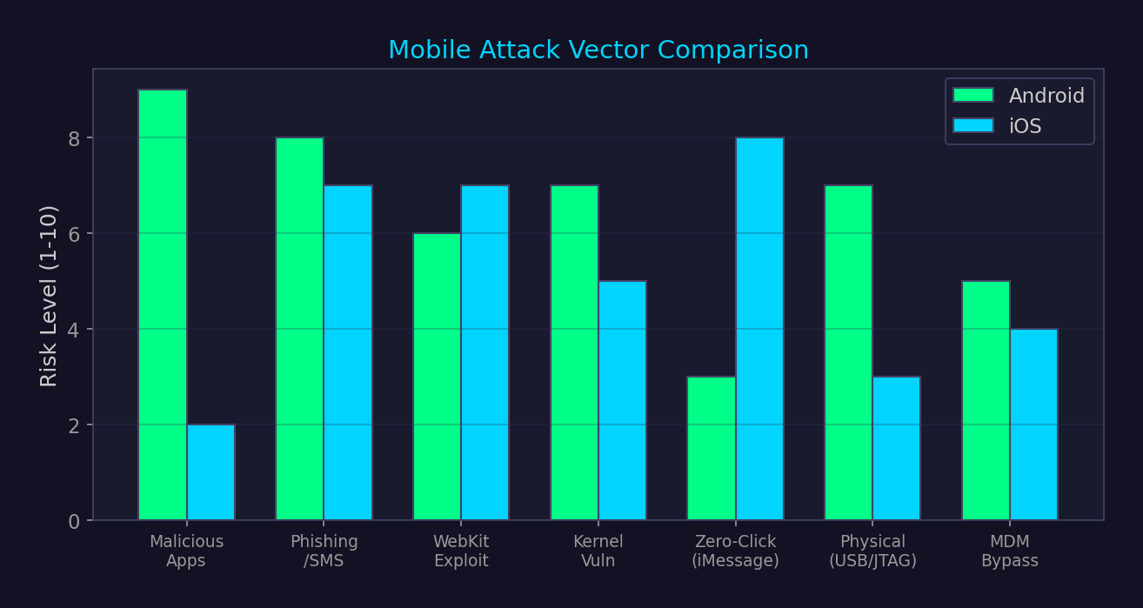
Mobile Attack Vectors — Android vs iOS

Slide 19
5G Security Architecture
SUPI → SUCI
Permanent ID (SUPI) encrypted before transmission → SUCI. Prevents IMSI catching.
Network Slicing
Isolated virtual networks. Risk: slice isolation bypass, resource exhaustion.
SEPP
Security Edge Protection Proxy — replaces SS7 roaming with TLS+JWS. N32 interface.
PRINS/PFCP
User plane function security. GTP-U encapsulation. Risk: UPF bypass.
Edge Computing (MEC)
Compute at network edge. Risk: shared infrastructure, lateral movement.
SBA (Service-Based)
HTTP/2+TLS between NFs. Risk: NF impersonation, API abuse.
5G still vulnerable to: downgrade attacks (force 4G/3G fallback), baseband exploits,
rogue gNB, RAN sharing vulnerabilities, O-RAN open interface attacks.

Slide 20
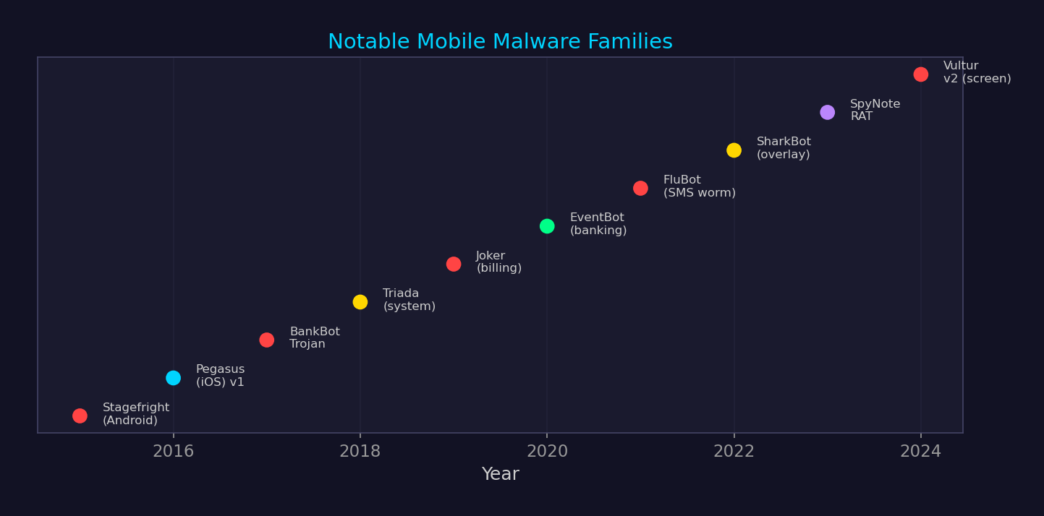
Mobile Malware Family Timeline

Slide 21
Enterprise Mobile Defense Stack
MDM (Mobile Device Management)
Enforce policies, remote wipe, certificate deployment. Intune, JAMF, VMware WS1.
MAM (Mobile App Management)
App-level policies without device enrollment. App protection policies, DLP.
MTD (Mobile Threat Defense)
On-device detection: network MitM, malicious apps, OS exploits. Lookout, Zimperium.
Conditional Access
Require device compliance, MFA, location-based access. Azure AD / Entra ID.
App Vetting
Analyze apps before enterprise deployment. SAST/DAST on mobile apps.
Zero Trust Network Access
Per-app VPN, identity-aware proxy. Replace full-device VPN.

Slide 22
Cross-Reference Map
▸ Domain 8: Web security → Exchange/OWA is primary initial access for AD compromise
▸ Domain 10: Cloud → Azure AD/Entra ID extends AD attack surface to cloud
▸ Domain 11: Malware → Mimikatz, Cobalt Strike used in lateral movement phase
▸ Domain 13: Cryptography → Kerberos, NTLM, certificate-based attacks
▸ Domain 17: Physical security → mobile device hardware attacks (JTAG, chip-off)
▸ Domain 23: Social engineering → phishing is #1 initial access for AD environments
▸ Domain 25: Threat intel → APT groups target AD (APT29, APT41, FIN7)
▸ Domain 27: Detection engineering → AD telemetry is core SOC data source

