Slide 1
ICS/OT Security,
RF/SDR & Automotive
Domains 16, 20-21 · Purdue Model · TRITON · SDR · CAN Bus · V2X

Slide 2
AGENDA
1. Purdue Model Architecture
2. ICS Attack Timeline
3. TRITON Attack Chain
4. Modbus TCP Protocol
5. ICS Defense Architecture
6. ICS Protocol Comparison
7. SDR Architecture
8. RF Signal Processing
9. RF Attack Taxonomy
10. Cellular Attack Surface
11. GPS Spoofing
12. Vehicle Network Architecture
13. CAN Bus Structure & Attacks
14. Keyless Entry Relay
15. ADAS Attack Surface
16. V2X Security

Slide 3
Purdue Model — ICS/OT Network Architecture
Level 5
Enterprise Network
ERP, email, internet access
Level 4
Site Business Planning
Historian mirror, site scheduling
Level 3.5
DMZ / IDMZ
Data diodes, jump servers, unidirectional gateways
Level 3
Site Operations
Historian, OPC server, engineering workstation
Level 2
Area Supervisory
HMI, SCADA server, alarm management
Level 1
Basic Control
PLC, RTU, DCS controllers
Level 0
Process
Sensors, actuators, field devices
Critical boundary: Level 3.5 DMZ separates IT (L4-5) from OT (L0-3).
Attackers cross this boundary via: compromised jump servers, dual-homed hosts, USB drives,
vendor remote access, or exposed OPC/SCADA protocols on IT network.

Slide 4
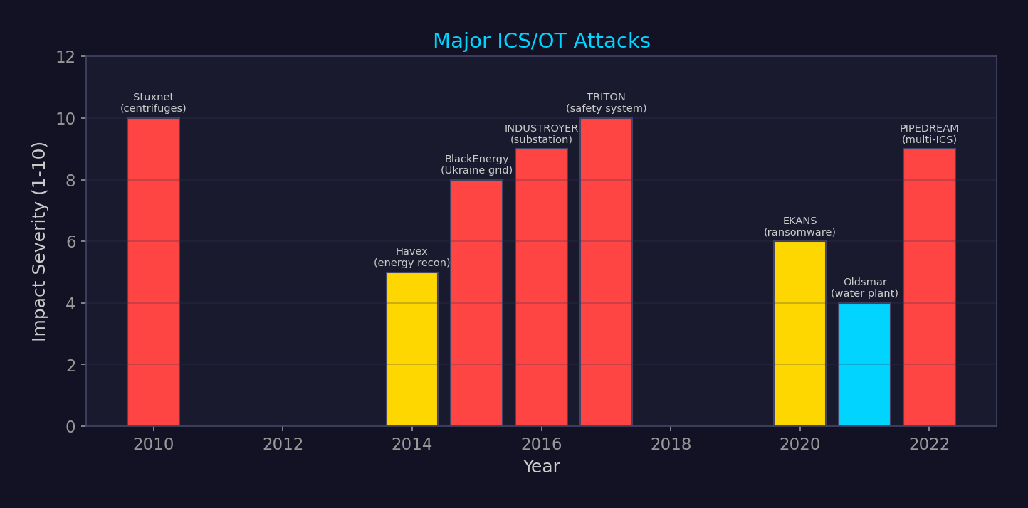
ICS/OT Attack Timeline

Slide 5
TRITON/TRISIS Attack Chain (2017)
IT Network
Initial Access
Pivot to
OT Network
Engineering
Workstation
Triconex SIS
Controller
Safety Logic
Modified
Target: Schneider Electric Triconex Safety Instrumented System (SIS) at Saudi petrochemical plant.
Goal: Disable safety system → allow physical damage to plant. Could cause explosion/release.
Attack details:
▸ Custom framework: TRITON/TriStation protocol reverse-engineered
▸ Injected rogue Triconex program via TriStation protocol (UDP port 1502)
▸ Exploited 0-day in Triconex firmware (CVE-2018-7522)
▸ Failed: logic bug caused SIS to enter safe state → attack detected
Attribution: XENOTIME / TEMP.Veles → linked to Russian Central Scientific Research Institute (TsNIIkhM)
First known attack specifically targeting safety systems — intent was physical harm.

Slide 6
Modbus TCP Protocol Structure
Transaction ID
(2 bytes)
Protocol ID
(2 bytes, 0x0000)
Length
(2 bytes)
Unit ID
(1 byte)
Function Code
(1 byte)
Data
(N bytes)
Common Function Codes:
FC 01
Read Coils
FC 05
Write Single Coil
FC 02
Read Discrete Inputs
FC 06
Write Single Register
FC 03
Read Holding Registers
FC 15
Write Multiple Coils
FC 04
Read Input Registers
FC 16
Write Multiple Registers
Modbus has NO authentication, NO encryption, NO integrity checking.
Any device on the network can read/write any register on any PLC.
Attack: read sensor values (recon), write coils/registers (manipulate process),
DoS via malformed packets, man-in-the-middle to forge responses.
Defense: network segmentation, Modbus-aware IDS (e.g., Suricata), data diodes, allowlisting.

Slide 7
ICS/OT Defense Architecture
Data Diodes
Unidirectional network gateways. Physically prevent inbound traffic to OT. Waterfall, OPSWAT.
IDMZ (Industrial DMZ)
Segmentation between IT/OT. Jump servers, bastion hosts, no direct routing.
OT IDS/IPS
Deep packet inspection for ICS protocols. Claroty, Nozomi Networks, Dragos Platform.
Asset Inventory
Passive discovery of all OT assets. MAC, IP, firmware versions, vulnerabilities.
Allowlisting
Application allowlisting on HMI/EWS. CyberArk, Carbon Black, SELinux.
Patch Management
Vendor-validated patches only. Test in staging OT environment. Scheduled outage windows.
Backup & Recovery
Offline backups of PLC logic, HMI configs, historian data. Air-gapped.

Slide 8
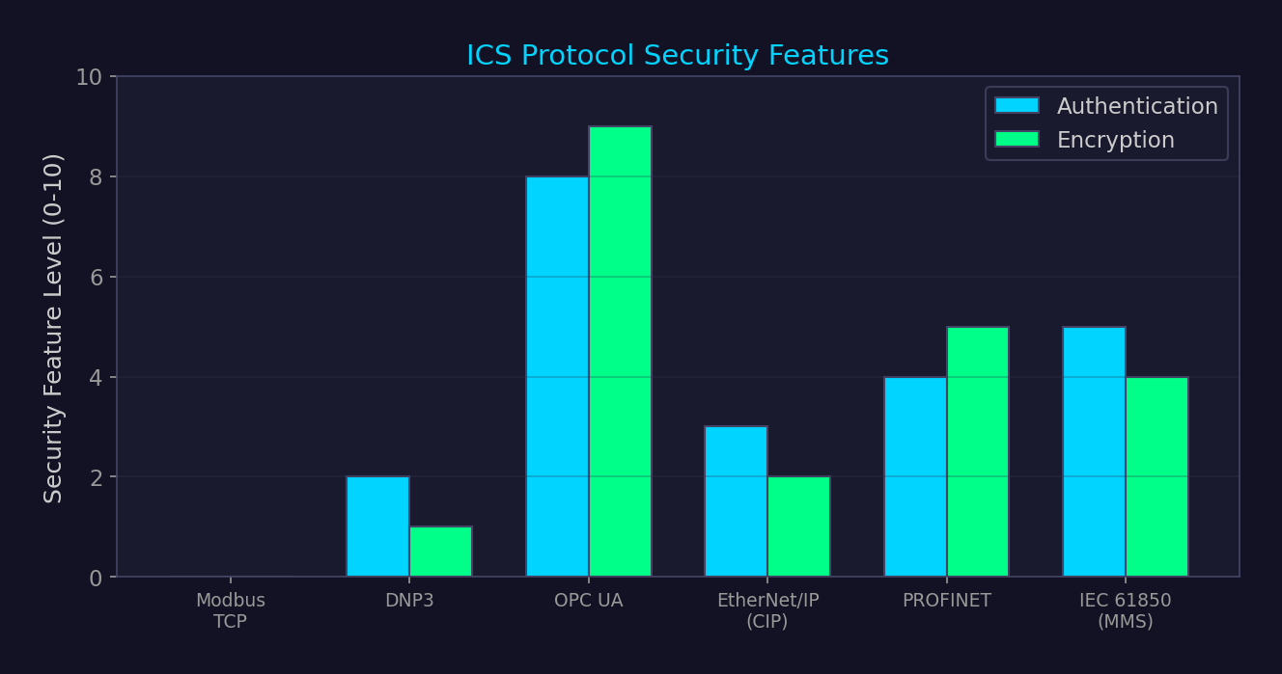
ICS Protocol Comparison

Slide 9
RF and SDR Security

Slide 10
Software Defined Radio Architecture
Antenna
(Rx/Tx)
RF Frontend
(LNA, Filter)
ADC / DAC
Conversion
Digital Signal
Processing (FPGA)
Host Software
(GNU Radio)
RTL-SDR ($25)
Rx only, 24-1766 MHz, 8-bit ADC, 2.4 MSPS. Great for beginners.
HackRF One ($300)
Tx+Rx, 1-6000 MHz, 8-bit, 20 MSPS. Half-duplex. Most popular.
USRP B200 ($1000+)
Full duplex, 70-6000 MHz, 12-bit, 56 MSPS. Professional.
BladeRF 2.0 ($480)
Full duplex, 47-6000 MHz, 12-bit, 61.44 MSPS. FPGA flexibility.
LimeSDR ($300)
Full duplex, 100 kHz-3.8 GHz, 12-bit, 61.44 MSPS. Open source.

Slide 11
RF Signal Processing Pipeline
RF
Capture
IQ
Recording
Demodulation
(AM/FM/PSK)
Protocol
Decoding
Data
Analysis
GNU Radio flow: Source → Channel Filter → Demod → Clock Recovery → Slicer → Decoder
Key analysis tools:
▸ Inspectrum: spectrogram analysis, manual bit extraction
▸ Universal Radio Hacker (URH): automated signal analysis and protocol RE
▸ SigDigger: real-time signal inspection with GNU Radio backend
▸ rtl_433: automated decoding of 400+ IoT protocols (weather stations, TPMS, doorbells)
▸ gr-lora / gr-lorawan: LoRa demodulation and decoding
IQ data: In-phase + Quadrature representation of RF signal. Complex samples.
Sample rate = bandwidth. Nyquist: sample at ≥ 2× signal bandwidth.

Slide 12
RF Protocol Attack Taxonomy
Replay
Record and retransmit valid signal. Effective vs fixed-code systems (garage doors, old car fobs).
Relay
Real-time relay of signal over distance. Keyless entry attack (extends range to 100m+).
Jamming
Overwhelm legitimate signal. Selective jamming (jam response, not request) for stealthiness.
Spoofing
Generate fake signal (GPS, ADS-B, cellular). Can redirect navigation, fake aircraft.
Eavesdropping
Passive interception. Analog: trivial. Digital: depends on encryption (often none).
Protocol Exploitation
Fuzzing wireless protocols. Discover parsing bugs in firmware receivers.

Slide 13
Cellular Network Attack Surface
IMSI Catcher
Fake BTS (Stingray). Phone connects to strongest signal. Intercept calls, SMS, location.
A5/1 Crack
GSM encryption broken. Rainbow tables (Kraken project). Real-time decryption.
Downgrade Attack
Force phone from 4G/5G to 2G (no auth). Then IMSI catch or intercept.
Baseband Exploit
Attack modem processor directly via OTA messages. No user interaction.
SIM Swapping
Social engineer carrier to port number. Bypass SMS 2FA. Account takeover.
TETRA:BURST
TETRA radio encryption broken (2023). Affects police, military, utilities globally.

Slide 14
GPS Spoofing Attack Mechanism
SDR Transmitter
(HackRF/USRP)
Generate Fake
GPS L1 Signal
Overpower Real
Satellite Signal
Victim GPS Lock
on Fake Position
GPS signals are weak (~-130 dBm at surface). A few watts of TX power can overpower them.
Targets: drones (forced landing/redirect), shipping (route manipulation), financial timestamps,
autonomous vehicles, precision agriculture, cellular network timing.
Tools: gps-sdr-sim + HackRF, Spirent (commercial), custom USRP setups.
Defense: multi-constellation (GPS+Galileo+GLONASS+BeiDou), chipset-level spoofing detection,
antenna arrays for direction-of-arrival, authenticated civil signals (Galileo OSNMA).
CAUTION: GPS spoofing transmission is illegal in most jurisdictions (federal offense in US).

Slide 15
Automotive Security

Slide 16
Vehicle Network Architecture
CAN Bus (Classic)
500 kbps, broadcast, no auth. Powertrain, chassis. Dominant bus.
CAN FD
Up to 8 Mbps data phase, 64-byte payload. Backward compatible.
Automotive Ethernet
100BASE-T1/1000BASE-T1. Point-to-point. ADAS, infotainment. TCP/IP stack.
LIN Bus
20 kbps, single-wire. Low-cost: mirrors, seats, windows.
FlexRay
10 Mbps, time-triggered. Safety-critical: steer-by-wire, brake-by-wire.
Central Gateway ECU
Bridges all buses. Firewall rules between domains. Attack bottleneck.
Modern vehicles: 70-150 ECUs, 100M+ lines of code. Attack surface spans OBD-II, Bluetooth,
Wi-Fi, cellular (telematics), USB, TPMS (tire pressure), key fob, and OTA update channels.

Slide 17
CAN Bus Frame Structure
SOF
1 bit
Arb ID
11/29 bit
Control
6 bits
Data
0-8 bytes
CRC
15 bits
ACK
2 bits
EOF
7 bits
CAN bus security problems:
▸ No authentication: any node can send any arbitration ID
▸ No encryption: all data transmitted in plaintext on shared bus
▸ Broadcast: every node sees every message
▸ Priority by ID: lower arbitration ID = higher priority → DoS via ID 0x000
▸ No source identification: impossible to determine which ECU sent a frame
SecOC (Secure Onboard Communication) — AUTOSAR standard:
▸ Adds MAC (Message Authentication Code) to CAN frames
▸ Freshness value prevents replay
▸ Challenge: limited payload space (8 bytes classic CAN), key distribution
▸ Adoption: new vehicles from 2023+, but retrofit impossible for existing fleet

Slide 18
CAN Bus Attack Classification
Replay
Record valid CAN frames → retransmit. Unlock doors, start engine, disable brakes.
Injection
Send crafted CAN messages. Steer, accelerate, apply brakes (Miller & Valasek, 2015 Jeep).
Bus-Off DoS
Trigger error frames → increment error counter → target ECU enters bus-off state.
Fuzzing
Send random CAN IDs/data. Discover undocumented commands. Map ECU responses.
Diagnostic Abuse
UDS (Unified Diagnostic Services) commands: flash ECU, disable immobilizer.
Masquerade
Impersonate legitimate ECU after disabling it. Undetectable without sender ID.
Tools: can-utils (Linux), SavvyCAN, CANtact, PCAN adapters, python-can, caringcaribou.
Access: OBD-II port (physical), compromised telematics unit (remote — Jeep hack 2015).

Slide 19
Keyless Entry Relay Attack (PKES)
Key Fob
(in house)
Relay Device 1
(near key)
RF Signal
Amplified
Relay Device 2
(near car)
Car Unlocks
+ Starts
PKES (Passive Keyless Entry and Start): car sends LF challenge → key responds UHF.
Relay extends the range from ~2m to 100m+. Key thinks it's next to car.
Equipment: ~$50-200 (Bluetooth relay boards, RTL-SDR + amplifier, or commercial kits).
Time to steal: <60 seconds. No forensic evidence on the vehicle.
Defense:
▸ UWB (Ultra-Wideband) ranging — measures actual distance, not just presence. Apple AirTag tech.
▸ Motion sensor in key fob — disable transmission when fob is stationary
▸ Faraday pouch for key storage at home
▸ BLE + UWB combo (BMW Digital Key Plus, Apple Car Key)

Slide 20
ADAS / Autonomous Vehicle Attack Surface
Camera (Vision)
Adversarial patches on signs → misclassify STOP as speed limit. Physical adversarial ML.
LiDAR
Spoofing with IR laser → inject ghost objects. Relay attack → remove real objects.
Radar
Jamming → blind the sensor. Spoofing with signal generator. Less explored.
GPS/GNSS
Position spoofing → incorrect localization. Route manipulation. Drift attacks.
V2X Messages
Forge BSM (Basic Safety Messages) → phantom vehicles, fake hazard warnings.
OTA Updates
Compromise update server or intercept update → flash malicious firmware.
Sensor fusion: combining camera+LiDAR+radar should increase robustness.
But: if attacker can affect multiple sensors consistently, fusion can be fooled.
ISO/SAE 21434: automotive cybersecurity engineering standard. UNECE WP.29 R155/R156.

Slide 21
V2X Communication Security
DSRC (IEEE 802.11p)
5.9 GHz, 10 MHz channels. Low latency. US originally. WAVE/1609.x stack.
C-V2X (3GPP)
PC5 sidelink (direct) + Uu (network-assisted). Cellular ecosystem. Gaining adoption.
PKI (SCMS)
Security Credential Management System. Pseudonym certificates for privacy.
Misbehavior Detection
V2X messages signed but can be semantically false. ML-based detection needed.
Privacy
Rotating pseudonym certificates prevent long-term tracking. Certificate change strategy.
V2X attacks: forge BSM (collision avoidance manipulation), Sybil (fake multiple vehicles),
replay old BSMs, DoS via channel flooding, position falsification.
Challenge: real-time verification. 10 Hz BSM rate × hundreds of vehicles = thousands of
signature verifications per second. Hardware crypto acceleration required (e.g., Infineon SLI 97).

Slide 22
ICS/RF/Automotive Defense Recommendations
▸ ICS: Implement Purdue Model segmentation with IDMZ, deploy OT-specific IDS (Dragos/Claroty)
▸ ICS: Data diodes for historian replication, never allow inbound IT→OT unless through bastion
▸ RF: Monitor spectrum for unauthorized transmissions, use frequency hopping where possible
▸ RF: Encrypt all wireless links, mutual authentication, rolling codes instead of fixed codes
▸ Auto: Implement SecOC on all safety-critical CAN messages, UWB for keyless entry
▸ Auto: Segment vehicle buses via gateway ECU, IDS on CAN bus for anomaly detection
▸ Cross-domain: OT assets should be inventoried and monitored like IT assets
▸ Compliance: IEC 62443 (ICS), ISO/SAE 21434 (auto), ETSI EN 303 645 (IoT)

Slide 23
Cross-Reference Map
▸ Domain 9: Network security → ICS protocols are network protocols with zero security
▸ Domain 12: Reverse engineering → firmware RE is critical for ICS/automotive vuln research
▸ Domain 17: Physical security → fault injection, side channels apply to automotive ECUs
▸ Domain 18: Adversarial ML → ADAS sensor attacks are adversarial ML in the physical world
▸ Domain 20: RF/SDR → GPS spoofing, keyless entry, cellular attacks are RF attacks
▸ Domain 25: Threat intel → ICS-focused APT groups (XENOTIME, SANDWORM, CHERNOVITE)
▸ Domain 27: Defense architecture → ICS requires specialized security architecture
▸ Domain 28: IoT → vehicle telematics units are IoT devices with automotive constraints

