Slide 1
Physical/Hardware Security,
IoT & Payment Systems
Domains 17, 22, 28 · Side Channels · Fault Injection · EMV · IoT Botnets

Slide 2
AGENDA
1. Side-Channel Attack Taxonomy
2. Power Analysis Setup
3. Voltage & EM Fault Injection
4. Laser Fault Injection
5. DFA on AES
6. PCB Reverse Engineering
7. IC Decapsulation
8. JTAG TAP & Debug Interfaces
9. Secure Boot Chain
10. EMV Transaction Flow
11. ATM Attack Taxonomy
12. Blockchain Attack Surface
13. IoT Protocol Stack
14. IoT Device Attack Surface
15. IoT Botnet Lifecycle
16. Defense Architecture

Slide 3
Side-Channel Attack Taxonomy
Side-Channel Attacks
Power Analysis
EM Emanation
Timing
Acoustic
▸ SPA (Simple)
▸ Near-field probe
▸ Cache timing
▸ Coil whine
▸ DPA (Differential)
▸ DEMA
▸ Branch timing
▸ Keyboard acoustic
▸ CPA (Correlation)
▸ SEMA
▸ RSA key recovery
▸ CPU frequency
All exploit information leakage from physical implementation, not algorithm weakness.
Power/EM: most practical against embedded crypto (smartcards, HSMs, secure elements).
Timing: most practical against software implementations (OpenSSL, GnuPG).
Acoustic: demonstrated for RSA key extraction at 4m distance (Genkin et al., 2014).
Countermeasures: constant-time code, masking/blinding, noise injection, shielding.

Slide 4
Power Analysis Attack Setup
Target Device
(smartcard/MCU)
Shunt Resistor
(1-10 Ω)
Oscilloscope
(high bandwidth)
Trace Collection
(10K+ traces)
Statistical
Analysis (CPA)
SPA (Simple Power Analysis): visual inspection of single trace. Identify crypto rounds, branches.
DPA (Differential Power Analysis): statistical correlation over many traces. Recover key bytes.
CPA (Correlation Power Analysis): Hamming weight/distance model. Most efficient.
Equipment:
▸ ChipWhisperer ($50-300): integrated capture + glitch platform. Open source.
▸ PicoScope ($400-2000): general oscilloscope with high sample rate.
▸ Riscure Inspector ($50K+): professional SCA platform.
▸ Langer probes: near-field EM probes for DEMA/SEMA.
Typical attack: CPA on AES-128 → recover 16 key bytes independently → ~10K traces needed.
Time: setup 1-2 days, trace collection ~hours, analysis ~minutes.

Slide 5
Voltage & EM Fault Injection
Voltage Glitching
Brief VCC drop (10-100ns) → skip instruction, corrupt computation.
Crowbar circuit: MOSFET shorts VCC to GND briefly.
Clock Glitching
Extra clock edge or shortened period → setup/hold violation.
Target: clock input of MCU. ChipWhisperer excels here.
EMFI
Electromagnetic pulse via coil → localized fault.
PicoEMP ($50), NewAE ($200), custom coils.
X-Y positioning for spatial targeting.
Laser Fault Injection
IR/UV laser through silicon backside → single-bit flip.
Most precise but requires IC decapsulation. $50K+ setup.
Attack targets: secure boot bypass (skip signature check), PIN verification bypass,
key extraction via DFA, privilege escalation, secure element lockout bypass.
Notable: Starlink terminal rooted via voltage glitch on first boot (2022, Lennert Wouters).
Nintendo Switch: Tegra X1 bootROM bypass via short on USB data pin (Fusée Gelée).

Slide 6
EMFI Attack Setup — Precision Targeting
Trigger
Identification
X-Y Stage
Positioning
Pulse
Calibration
Sweep: Location
+ Timing + Power
Analyze
Fault Effects
EMFI advantages over voltage glitching:
▸ Non-invasive: no physical connection to VCC/GND needed
▸ Spatial selectivity: target specific IC regions (crypto core, CPU, memory)
▸ Works through packaging (BGA, QFN) and PCB layers
▸ Can affect specific operations while leaving others undisturbed
X-Y positioning: CNC stage or 3D printer frame. Step through grid.
For each position: sweep timing (ns resolution) and pulse amplitude.
Output classification: normal, crash, mute (no response), exploitable fault.
Tools: PicoEMP (open source, ~$50 BOM), ChipWhisperer Husky, Riscure EM-FI,
NewAE CW521 (calibrated EM probe).

Slide 7
Laser Fault Injection — Single-Bit Precision
IC Decapsulation
(expose silicon)
IR Laser Source
(1064nm typical)
Optical System
(microscope + stage)
Target: Individual
Transistor / SRAM Cell
Observe:
Bit flip / Skip
Laser FI is the gold standard for precision fault attacks:
▸ Spatial resolution: < 1μm (individual transistor targeting)
▸ Temporal resolution: < 1ns (sub-clock-cycle faults)
▸ Backside attack: through thinned silicon substrate (100-200μm)
▸ Repeatable: same fault location and timing every time
Required: optical bench ($50K-200K), IC prep (decap + thin), high-end XYZ stage.
Typically used by: government labs, high-assurance evaluation (CC EAL5+), well-funded researchers.
Countermeasures: light sensors (on-die), active shields (metal mesh), dual-rail logic,
temporal/spatial redundancy (execute twice, compare), glitch detectors.

Slide 8
Differential Fault Analysis on AES
Encrypt with
correct key
Fault during
round 8 or 9
Get faulty
ciphertext
Compare correct
vs faulty output
Solve key bytes
via equations
Piret-Quisquater DFA (2003): fault in round 8 MixColumns input.
One fault → reduces key space from 2^128 to ~2^32. Two faults → unique key.
How: fault propagates through MixColumns differently than unfaulted computation.
Difference between correct and faulty ciphertexts reveals SubBytes input/output pairs.
Each pair constrains 4 key bytes. With 2+ faults on different columns → full key recovery.
Practical setup: ChipWhisperer + target board. Trigger on AES start. Glitch at round 8.
Success rate depends on fault model (single-byte vs multi-byte, random vs stuck-at).
Countermeasure: AES infective computation (detect fault → randomize output), temporal redundancy.

Slide 9
PCB Reverse Engineering Workflow
High-Res
Photography
Component
Identification
Layer Imaging
(X-ray / delaminate)
Schematic
Reconstruction
Circuit
Analysis
Photography: DSLR macro lens, ring light, calibrated color chart. Multiple angles.
Component ID: read markings, cross-reference datasheets, multimeter verification.
Multi-layer: X-ray (non-destructive) or chemical delamination (destructive).
Tools:
▸ KiCad: open-source schematic + PCB layout (for reconstruction)
▸ OpenBoardView: view board CAD files if available
▸ Multimeter + logic analyzer: trace connections, identify buses
▸ JTAGulator: automated JTAG/UART/SWD pin identification
▸ X-ray: Faxitron (professional), dental X-ray (budget)
Goals: find debug ports (UART, JTAG, SWD), identify flash chips (SPI/NAND),
locate test points, understand power delivery, find unpopulated connectors.

Slide 10
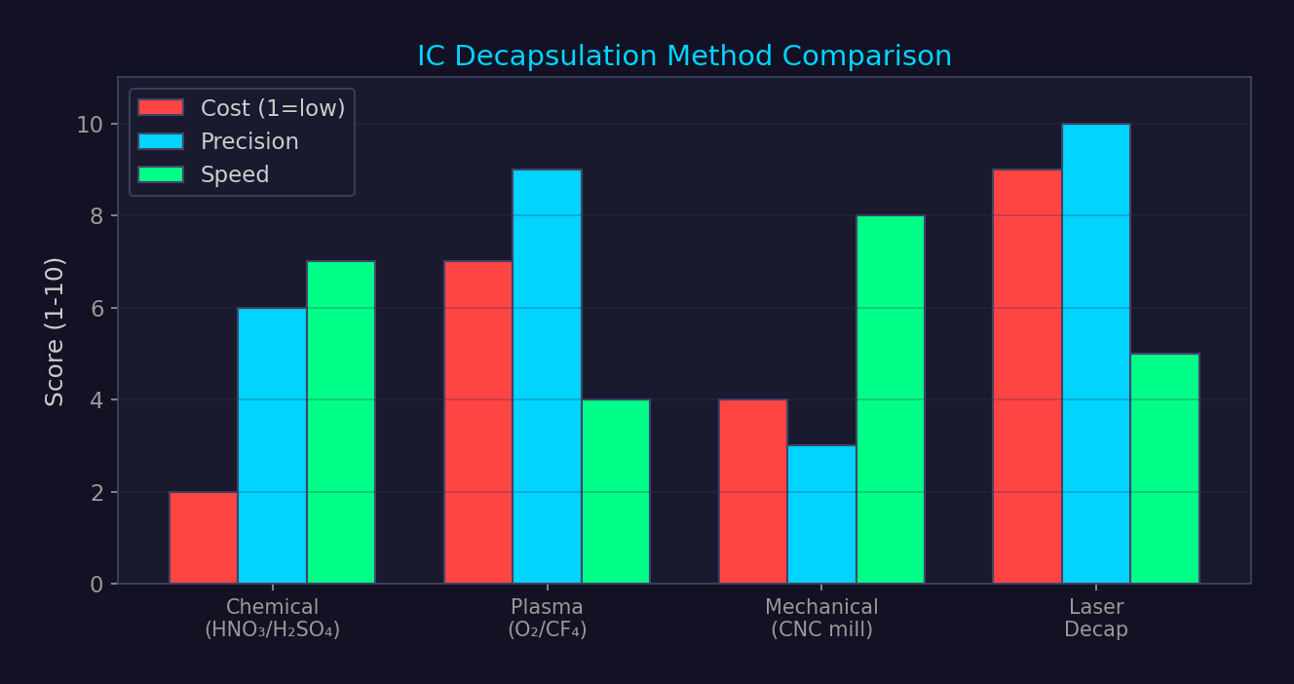
IC Decapsulation Methods

Slide 11
JTAG TAP State Machine & Debug Interfaces
Test-Logic-Reset
Entry state. TMS=1 for 5 clocks returns here from anywhere.
Run-Test/Idle
Idle state between operations.
Shift-DR
Shift data through data register (boundary scan, debug).
Shift-IR
Shift instruction into instruction register.
Update-DR/IR
Latch shifted data/instruction.
JTAG pins: TCK (clock), TMS (mode select), TDI (data in), TDO (data out), TRST (optional reset).
SWD (Serial Wire Debug): ARM alternative. 2 pins only (SWDIO + SWCLK). Same debug features.
Attack uses: read/write memory, extract firmware, bypass secure boot, debug running code,
set hardware breakpoints, single-step execution, read CPU registers.
Finding JTAG: JTAGulator (automated pin identification), multimeter continuity testing,
PCB silkscreen labels, known pinouts for common SoCs, logic analyzer to capture boot activity.
Protection: JTAG lock bits, fuse-based disable, password-protected debug, debug authentication (ARM DAP).

Slide 12
Secure Boot Chain
BootROM
(immutable)
1st Stage
Bootloader
2nd Stage
Bootloader
Kernel
Image
Userspace
Init
Each stage verifies the next stage's signature before executing it.
Root of trust: BootROM. Burned into silicon at manufacturing. Cannot be patched.
Bypass attacks:
▸ Fault injection during signature verification (glitch → skip check)
▸ BootROM vulnerability (checkm8 on Apple A5-A11: buffer overflow in DFU mode)
▸ Key extraction from OTP/fuses (laser fault + readback)
▸ Downgrade attack (load older vulnerable firmware, then exploit)
▸ TOCTOU: modify image between check and use
Measured Boot (TPM): doesn't prevent boot of modified firmware — just records it.
Verified Boot (Android/ChromeOS): actively blocks unverified code from executing.
UEFI Secure Boot: verifies bootloader + kernel signatures against db/dbx keys in firmware.

Slide 13
Payment Systems Security

Slide 14
EMV Transaction Flow
Card
Insertion
Application
Selection
Read Card
Data (GPO)
Cardholder
Verification
Online
Authorization
EMV (Europay, MasterCard, Visa) chip transaction:
1. SELECT: terminal selects payment application (AID: A0000000031010 = Visa)
2. GPO (Get Processing Options): card returns AIP + AFL
3. READ RECORD: terminal reads card data (PAN, expiry, certificates)
4. Data Authentication: SDA (static), DDA (dynamic), or CDA (combined)
5. Cardholder Verification: PIN (online/offline), signature, or CVM bypass (contactless low-value)
6. Generate AC: card generates cryptogram (ARQC for online, TC for offline, AAC for decline)
7. Online Auth: terminal sends ARQC to issuer → issuer validates → returns ARPC
Key vulnerabilities:
▸ PIN bypass: modify CVM list in relay attack (Cambridge research, 2020)
▸ Contactless: Visa PIN bypass via protocol manipulation (ETH Zurich, 2020)
▸ Pre-play: predict unpredictable number (UN) → pre-generate cryptograms

Slide 15
EMV Chip Authentication Methods
SDA (Static Data Auth)
Card signs static data with issuer key. Clone-detectable but not clone-proof.
Vulnerable: attacker can replay signed data to different terminal.
DDA (Dynamic Data Auth)
Card signs dynamic challenge from terminal. Proves card has private key.
Prevents cloning. Requires RSA coprocessor on chip.
CDA (Combined DDA/AC)
Authentication integrated with cryptogram generation.
Strongest: links auth to specific transaction. Prevents relay in some cases.
fDDA (Fast DDA)
Contactless variant. Faster computation for NFC timing constraints.
Used by Visa payWave and MasterCard PayPass.

Slide 16
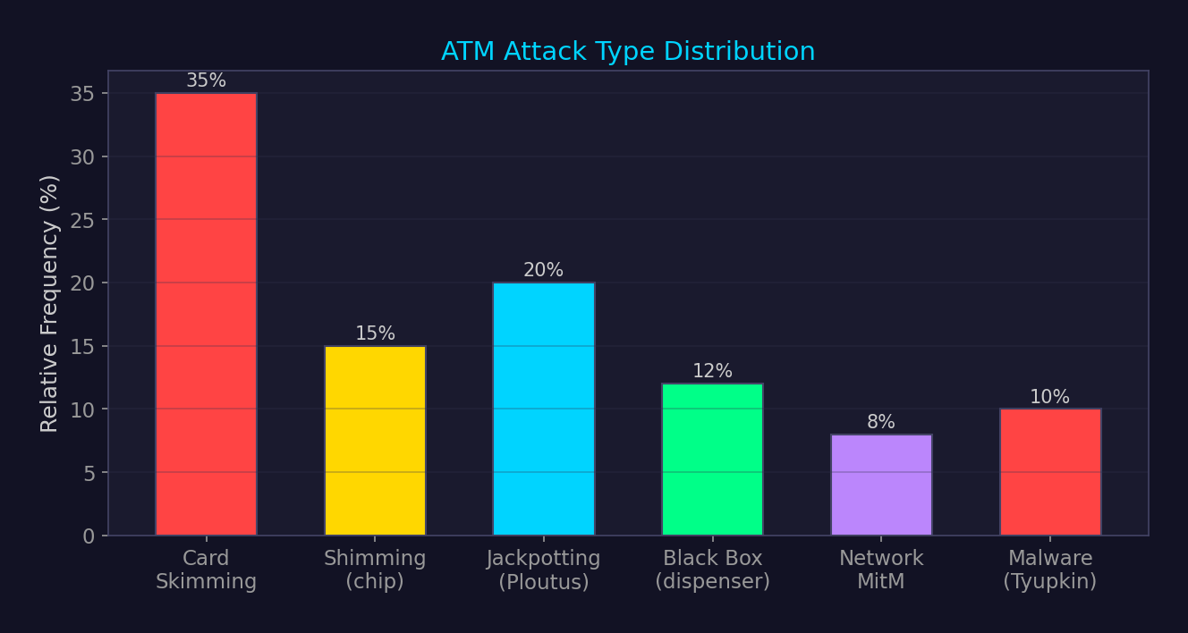
ATM Attack Taxonomy

Slide 17
Blockchain & Smart Contract Attack Surface
Reentrancy
External call before state update → recursive withdrawal. The DAO hack (2016, $60M).
Flash Loan Attack
Uncollateralized instant loan → market manipulation → repay in same tx. DeFi-specific.
51% Attack
Majority hashrate → double-spend. Ethereum Classic attacked multiple times.
Front-Running (MEV)
Observe mempool → insert tx before victim → profit from price movement.
Bridge Exploit
Cross-chain bridge compromise. Ronin ($625M), Wormhole ($325M), Nomad ($190M).
Oracle Manipulation
Corrupt price feed → exploit protocol logic. TWAP vs spot price.
Private Key Compromise
Weak entropy, leaked mnemonic, compromised signer. Ronin: social engineering.
Defense: Slither/Mythril static analysis, formal verification (Certora), audits (Trail of Bits, OpenZeppelin),
bug bounties (Immunefi), timelocks + multisig, oracle diversification.

Slide 18
IoT Security

Slide 19
IoT Wireless Protocol Comparison
Zigbee (802.15.4)
2.4 GHz, 250 kbps, AES-128. Mesh. Home automation. 128-bit network key.
Z-Wave (800/900 MHz)
Sub-GHz, 100 kbps, AES-128 (S2 framework). Mesh. Smart locks/sensors.
BLE (Bluetooth LE)
2.4 GHz, 2 Mbps, AES-CCM. Star topology. Wearables, beacons.
Thread (802.15.4)
2.4 GHz, 250 kbps, AES-128 + DTLS. Mesh. Low-power IPv6. Google/Apple.
Matter (over Thread/Wi-Fi)
Application layer standard. End-to-end encryption. Interoperability.
LoRaWAN
Sub-GHz, 50 kbps, AES-128 (AppSKey + NwkSKey). Star-of-stars. 10 km+ range.
Common weakness: default/hardcoded keys, unencrypted pairing, firmware not signed,
no OTA update capability, cleartext provisioning, weak random number generation.

Slide 20
IoT Device Attack Surface
Firmware
Extract via SPI/JTAG, find hardcoded creds, reverse engineer update protocol.
Debug Ports
UART console (115200 baud), JTAG/SWD access to CPU. Often left enabled.
Wireless Interface
BLE/Wi-Fi/Zigbee: sniff traffic, replay commands, injection attacks.
Cloud API
REST API for device management. Auth bypass, IDOR, excessive data exposure.
Mobile App
Companion app: API keys in APK, insecure storage, certificate pinning bypass.
Physical
Chip-off (flash extraction), bus sniffing (I2C/SPI), tampering detection bypass.
Tools: binwalk (firmware extraction), Ghidra/IDA (RE), Flashrom (SPI read/write),
Saleae logic analyzer, nRF Connect (BLE), Killerbee (Zigbee), Scapy (protocol fuzzing).

Slide 21
IoT Botnet Lifecycle
Internet
Scanning
Exploit / Default
Credentials
Payload
Delivery
C2 Registration
(IRC/HTTP/P2P)
DDoS / Proxy
/ Cryptomining
Notable IoT botnets:
▸ Mirai (2016): 600K+ devices, 1.2 Tbps DDoS on Dyn DNS. Telnet default creds.
▸ Mozi (2019-2023): P2P DHT-based C2. Exploited UPnP, HNAP, TR-069. 1.5M nodes.
▸ Hajime (2017): P2P, no DDoS payload — blocked Mirai. "White hat" botnet.
▸ HEH (2020): wiper botnet — bricked devices instead of DDoS.
▸ RapperBot (2022): SSH brute-force, DDoS. Targeted Linux IoT devices.
Infection vectors: default credentials (admin/admin), known CVEs in UPnP/SOAP,
TR-069 (ISP management protocol) vulnerabilities, exposed telnet/SSH.
Scale: estimated 15-20 billion IoT devices by 2025. Even 0.1% compromise = millions of bots.

Slide 22
IoT / Physical Security Defense Architecture
▸ Physical: tamper-evident enclosures, active mesh shields, fuse-based JTAG disable, secure boot
▸ Hardware: TPM/secure element for key storage, PUF (Physical Unclonable Functions), side-channel countermeasures
▸ Firmware: signed OTA updates, encrypted firmware images, secure bootloader chain, rollback protection
▸ Network: IoT VLAN segmentation, MUD (Manufacturer Usage Description) profiles, DNS-based monitoring
▸ Cloud: device identity certificates (X.509), mTLS for API communication, rate limiting per device
▸ Payment: PCI-DSS compliance, P2PE (Point-to-Point Encryption), tokenization, EMV migration
▸ Standards: ETSI EN 303 645 (IoT baseline), NIST 8259A, IEC 62443, PCI PIN Security

Slide 23
Cross-Reference Map
▸ Domain 6-7: Mitigation bypass & hardware — fault injection bypasses software mitigations
▸ Domain 12: Reverse engineering — firmware RE is prerequisite for IoT/embedded exploitation
▸ Domain 13: Cryptography — side-channel attacks target crypto implementations, not algorithms
▸ Domain 20: RF/SDR — wireless IoT protocols are attacked via SDR
▸ Domain 22: Payment systems — EMV/blockchain are specialized applications of crypto + hardware
▸ Domain 27: Defense architecture — IoT defense requires network segmentation + monitoring
▸ Domain 28: IoT protocols — Zigbee/Z-Wave/Thread/BLE are the wireless layer for IoT

