Slide 1
Threat Intelligence, DFIR &
Security Architecture
Domains 23-27, 29-31 · OSINT · DFIR · ATT&CK · Zero Trust · Detection Engineering

Slide 2
AGENDA
1. OSINT Methodology
2. Social Engineering Kill Chain
3. Phishing Infrastructure
4. DFIR Process (PICERL)
5. Memory Forensics Workflow
6. Cloud Forensics Sources
7. IR Playbook Types
8. Diamond Model
9. MITRE ATT&CK Overview
10. TI-to-Detection Pipeline
11. TLP 2.0 Classification
12. Zero Trust Architecture
13. SIEM/SOAR Architecture
14. Detection Engineering Lifecycle
15. SOC Tier Structure
16. Purple Teaming
17. Defense Maturity Model
18. Cross-Reference Map

Slide 3
OSINT Methodology — Intelligence Cycle
Planning &
Direction
Collection
(Passive/Active)
Processing &
Correlation
Analysis &
Production
Dissemination
& Feedback
Collection sources:
▸ Passive: search engines, social media, public records, breach databases, DNS/WHOIS, CT logs
▸ Semi-passive: web scraping, cached pages, Wayback Machine, Shodan/Censys
▸ Active: port scanning, banner grabbing, social engineering (higher OPSEC risk)
Tools: Maltego (link analysis), SpiderFoot (automated recon), theHarvester (email/domain),
Shodan/Censys (internet-facing assets), Recon-ng (framework), Amass (subdomain enum),
FOCA (metadata extraction), Metagoofil (document metadata), Sherlock (username search).
OPSEC: use VPN/Tor, burner accounts, separate research infrastructure.
Legal: OSINT is generally legal but jurisdiction-specific. GDPR considerations for EU targets.

Slide 4
Social Engineering Kill Chain
Target
Reconnaissance
Pretext
Development
Engagement
& Trust
Exploitation
(Action)
Exit &
Persistence
Attack types by vector:
▸ Phishing: spear-phishing email → credential harvesting or malware delivery
▸ BEC: impersonate executive → wire transfer redirect ($2.7B losses in 2022 — FBI IC3)
▸ Vishing: phone-based social engineering → IT helpdesk password reset
▸ Smishing: SMS-based lure → malicious link / app install
▸ Physical: tailgating, badge cloning, USB drops, impersonation
Advanced techniques:
▸ AiTM (Adversary-in-the-Middle): Evilginx2 → real-time proxy → steal session token post-MFA
▸ QR code phishing (Quishing): bypass email link scanners
▸ Deepfake voice: clone executive voice for vishing (multiple $25M+ incidents in 2023-2024)
▸ Multi-channel: combine email + phone + SMS for higher success rate

Slide 5
Phishing Infrastructure Diagram
Lookalike Domain
(typosquat)
Landing Page
(cloned login)
Credential
Harvesting
Real-Time
Relay (AiTM)
Exfiltration
(Telegram/API)
Modern phishing infrastructure:
▸ Domain: typosquat or homoglyph (Punycode). Bulletproof hosting. Let's Encrypt for HTTPS.
▸ Evilginx2 / Modlishka: reverse proxy → intercepts session cookies → bypasses MFA.
▸ GoPhish: open-source phishing framework for red team campaigns.
▸ Exfil: Telegram bot API, Slack webhook, Google Forms, or custom API endpoint.
Detection:
▸ Certificate Transparency monitoring (CT logs for domain lookalikes)
▸ DMARC/DKIM/SPF enforcement (prevents domain spoofing)
▸ URL reputation + sandbox detonation (clicking link in sandbox)
▸ Phishing-resistant MFA (FIDO2/WebAuthn — immune to AiTM proxy)
▸ Conditional Access policies: device compliance, location, risk level

Slide 6
Digital Forensics &
Incident Response

Slide 7
DFIR Process — PICERL Framework
Preparation
IR plan, playbooks, tooling, retainers, tabletop exercises, logging baseline.
Identification
Detect & triage. Alert validation. Scope assessment. Evidence preservation.
Containment
Short-term: isolate host. Long-term: credential reset, firewall rules.
Eradication
Remove malware, close access vectors, patch vulnerabilities, rebuild systems.
Recovery
Restore from clean backups, monitor for re-compromise, phased service restoration.
Lessons Learned
Post-incident review within 72h. Update playbooks. Track remediation items.
Critical first 24 hours: preserve volatile evidence (memory, network connections, running processes),
establish timeline, determine initial access vector, assess scope of compromise.
Evidence handling: chain of custody, write-blockers, forensic images (dd/FTK Imager), hashing (SHA-256).

Slide 8
Memory Forensics Workflow
Memory
Acquisition
Profile
Identification
Process
Analysis
Network
Artifacts
Malware
Extraction
Acquisition: WinPmem, LiME (Linux), AVML (Azure), DumpIt, Magnet RAM Capture.
Cloud: VM memory snapshot (AWS EC2, Azure VM, GCP).
Analysis tools:
▸ Volatility 3: process list, DLL analysis, network connections, registry, malware detection
▸ Rekall: alternative framework (now largely archived)
▸ MemProcFS: memory as filesystem — browse with standard tools
Key artifacts: injected code (malfind), hidden processes (psxview), API hooks,
network connections (netscan), command history, credential material (hashdump/mimikatz),
encryption keys (aeskeyfind), browser history, clipboard contents.
Memory forensics catches what disk forensics misses: fileless malware, injected shellcode,
decrypted payloads, process hollowing, reflective DLL injection.

Slide 9
Cloud Forensics Evidence Sources
AWS
CloudTrail (API), VPC Flow Logs, GuardDuty, S3 access logs, EBS snapshots, CloudWatch
Azure
Activity Log, NSG Flow Logs, Sentinel, Defender, Disk snapshots, AAD sign-in logs
GCP
Cloud Audit Logs, VPC Flow Logs, SCC, Chronicle, Disk snapshots, IAM logs
Kubernetes
Audit logs, Falco alerts, pod logs, etcd snapshots, network policies
SaaS (M365)
Unified Audit Log, Purview, Defender, Azure AD sign-ins, Mailbox audit
Cloud forensics challenges:
▸ Shared responsibility: provider owns infrastructure logs, customer owns application logs
▸ Ephemeral resources: containers, Lambda, spot instances — evidence vanishes
▸ Log retention: default retention varies (CloudTrail: 90 days without S3 delivery)
▸ Multi-region: attacker may pivot across regions; logs must be centralized
▸ Encryption: EBS snapshots encrypted with customer KMS keys — need key access for analysis
Best practice: centralize all logs to SIEM, enable all audit logging BEFORE incident.

Slide 10
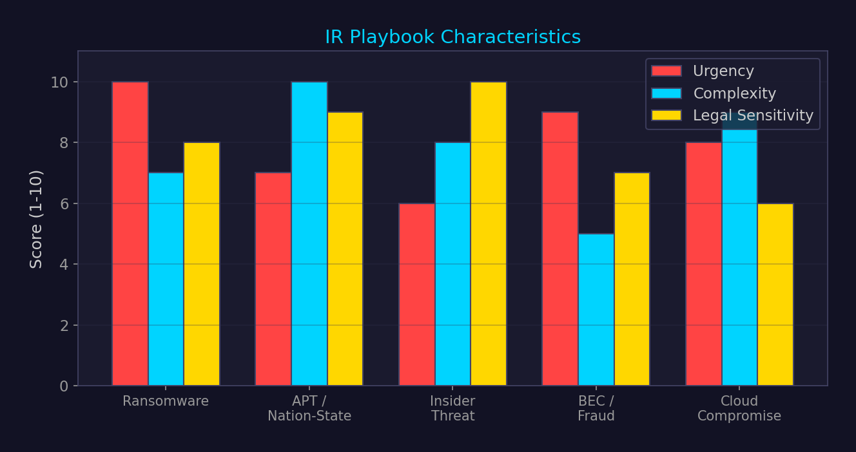
IR Playbook Types — Response Strategy Comparison

Slide 11
Threat Intelligence

Slide 12
Diamond Model of Intrusion Analysis
Adversary
Infrastructure
Capability
Victim
Meta-features: timestamp, phase, result, direction, methodology, resources.
Activity threads: chain events across time. Activity groups: cluster by shared vertices.
Pivot analysis: from IOC (infrastructure) → adversary → capability → other victims.

Slide 13
MITRE ATT&CK Matrix — Simplified
Recon
Resource
Dev
Initial
Access
Execution
Persistence
Priv Esc
Defense
Evasion
Cred
Access
Discovery
Lateral
Movement
Collection
Exfil
Impact
T1595
Scanning
T1583
Domains
T1566
Phishing
T1059
Cmd/Script
T1053
Scheduled
T1068
Exploit
T1070
Log Clear
T1003
Dumping
T1087
Account
T1021
Remote
T1005
Local Data
T1041
C2 Channel
T1486
Encrypt
ATT&CK usage:
▸ Threat profiling: map adversary TTPs to matrix → understand capabilities
▸ Detection gaps: overlay detections on matrix → identify blind spots
▸ Purple teaming: red team emulates specific techniques → blue team validates detection
▸ CTI reporting: standardized language for describing adversary behavior
Matrices: Enterprise (Windows, Linux, macOS, Cloud, Network, SaaS), Mobile, ICS.
14 tactics, 200+ techniques, 400+ sub-techniques (Enterprise v15).
Tools: ATT&CK Navigator (heatmap), CALDERA (automated adversary emulation),
Atomic Red Team (unit tests per technique), MITRE D3FEND (defensive countermeasures).

Slide 14
Threat Intelligence to Detection Pipeline
Raw Intel
(feeds, reports)
Enrichment
(MISP, VirusTotal)
IOC/TTP
Extraction
Detection Rule
(Sigma/YARA)
SIEM Alert
+ Response
Intel feeds: OSINT (abuse.ch, AlienVault OTX), commercial (Recorded Future, Mandiant),
ISAC (sector-specific), government (CISA alerts, FBI Flash).
Processing: STIX 2.1 format → TAXII transport → MISP platform → enrich with context.
IOC types: IP, domain, URL, file hash, certificate fingerprint, YARA rule, Sigma rule.
Rule languages:
▸ Sigma: vendor-agnostic SIEM detection rules → compile to Splunk/Elastic/Sentinel
▸ YARA: file pattern matching rules for malware detection
▸ Snort/Suricata: network-based detection rules
▸ KQL/SPL: SIEM-specific query languages for complex behavioral detection
Maturity: IOC matching (reactive) → TTP detection (proactive) → threat hunting (hypothesis-driven).

Slide 15
TLP 2.0 — Traffic Light Protocol
TLP:RED
Named recipients only. No sharing beyond the conversation/meeting.
TLP:AMBER+STRICT
Organization only. No sharing beyond the recipient's org.
TLP:AMBER
Organization + clients/customers who need-to-know.
TLP:GREEN
Community sharing. Peers, partner orgs, sector. Not public.
TLP:CLEAR
No restrictions. Can be shared publicly.
TLP 2.0 (FIRST, 2022) replaces TLP 1.0. Key change: AMBER+STRICT added.
Used in: CTI sharing, ISAC communications, CERT coordination, vendor advisories.
Violation = loss of trust and future intelligence access. Enforcement is community-based.

Slide 16
Security Architecture &
Detection Engineering

Slide 17
Zero Trust Architecture (NIST SP 800-207)
Policy Engine (PE)
Makes access decisions based on policy + context. Trust score computation.
Policy Administrator (PA)
Establishes/shuts down communication paths. Session management.
Policy Enforcement Point (PEP)
Enables/disables connections. Data plane gateway.
Identity Provider (IdP)
Authenticates subjects. MFA, SSO, certificate-based auth.
Device Trust
MDM compliance, EDR status, patch level, health attestation.
Data Security
Encryption at rest + transit, DLP, classification, access logging.
Core principle: 'Never trust, always verify.' No implicit trust based on network location.
Every access request evaluated: identity, device, context, risk, data sensitivity.
Implementation: microsegmentation, ZTNA (Zscaler, Cloudflare), identity-aware proxy, mTLS.

Slide 18
SIEM / SOAR Architecture
Log Sources
(EDR, firewall, cloud)
Collection
(agents, syslog)
Message Queue
(Kafka)
SIEM
(detection, correlation)
SOAR
(automation, response)
SIEM platforms: Splunk, Microsoft Sentinel, Elastic Security, Chronicle (Google), QRadar.
SOAR platforms: Palo Alto XSOAR, Splunk SOAR, Swimlane, Tines.
Scale for conglomerate (thousands of companies):
▸ Ingestion: 10-100 TB/day. Cost optimization: hot/warm/cold tiers.
▸ Architecture: multi-tenant SIEM with per-company workspaces
▸ Detection: centralized detection rules + company-specific custom rules
▸ SOAR playbooks: auto-enrich, auto-contain, analyst handoff for complex cases
Critical log sources: EDR telemetry, DNS queries, proxy/firewall, authentication events,
email gateway, cloud API audit logs, identity provider (sign-in, MFA), network flow data.

Slide 19
Detection Engineering Lifecycle
Hypothesis
(TI-informed)
Rule
Development
Testing
(Atomic RT)
Deployment
(SIEM/EDR)
Tuning &
Maintenance
Detection-as-Code: detection rules managed in Git, CI/CD pipeline, version controlled.
Testing: Atomic Red Team, CALDERA, or manual emulation → validate detection fires.
Metrics: true positive rate, false positive rate, MTTD (Mean Time to Detect), coverage %.
Detection types:
▸ Signature/IOC: exact match (hash, IP, domain). Fast but fragile — adversary changes IOCs.
▸ Behavioral: patterns of activity (process tree, command-line args). More durable.
▸ Anomaly: deviation from baseline (ML-based). High FP rate but catches novel threats.
▸ Threat hunting: proactive, hypothesis-driven. Human-in-the-loop. ATT&CK-mapped.
Rule quality: Sigma rules for portability, unit tested, versioned, mapped to ATT&CK technique ID.

Slide 20
SOC Tier Structure
L1 — Triage Analyst
Alert triage, initial classification, false positive closure.
24/7 coverage. Follow runbooks. Escalate confirmed incidents.
L2 — Investigation
Deep-dive investigation. Timeline reconstruction. IOC extraction.
Correlate across log sources. Determine scope and impact.
L3 — Hunt / Engineering
Proactive threat hunting. Detection rule development.
Tool development. Malware analysis. Purple teaming.
IR Lead / Manager
Incident coordination. Stakeholder communication.
Escalation to CISO. External coordination (CERT, LE).
Modern trend: flatten tiers. Automation handles L1 triage → analysts start at investigation level.
SOAR reduces toil: auto-enrich, auto-close known FPs, playbook-driven containment.

Slide 21
Ransomware Kill Chain — Detection Opportunities
Initial Access
(phishing/RDP/VPN)
Persistence
(scheduled task, service)
Lateral Movement
(RDP, PsExec, WMI)
Exfiltration
(rclone, megasync)
Encryption
(BitLocker, custom)
DETECT: email gateway, brute-force alerts
DETECT: new services, autoruns, registry
DETECT: 4624 type 3, SMB sessions
DETECT: unusual egress, DLP, proxy logs
DETECT: mass file rename, vssadmin delete
Average dwell time before encryption: 5-21 days (varies by group).
Every stage is a detection opportunity. Best chance: lateral movement phase (noisiest).
Double extortion: exfiltrate data before encrypting. Triple: DDoS victim's customers.
RaaS groups: LockBit, BlackCat/ALPHV, Cl0p, Play, Royal, BianLian, Akira.
Critical controls:
▸ Offline immutable backups (3-2-1 rule: 3 copies, 2 media types, 1 offsite)
▸ EDR on all endpoints (not just servers)
▸ MFA on all remote access (RDP, VPN, email, SaaS)
▸ Network segmentation (limit blast radius)
▸ Disable RDP where not needed. If needed: NLA, MFA, jump server only.

Slide 22
Purple Teaming Methodology
Emulation
Plan (ATT&CK)
Red: Execute
Technique
Blue: Detect
& Respond
Gap
Analysis
Remediation
& Re-test
Purple team ≠ red team + blue team sitting together. It's a structured feedback loop.
Process:
1. Select threat profile (APT29, FIN7, etc.) or specific techniques
2. Red team executes technique in controlled manner (Atomic Red Team / CALDERA)
3. Blue team observes: did detection fire? Was alert actionable? Was response effective?
4. Document gaps: missing log source, no detection rule, alert too noisy, no playbook
5. Build/improve detection → re-execute technique → validate detection
Frameworks: MITRE ATT&CK Evaluations, Atomic Red Team, SCYTHE, AttackIQ, SafeBreach.
Output: ATT&CK coverage heatmap, prioritized detection backlog, improved playbooks.

Slide 23
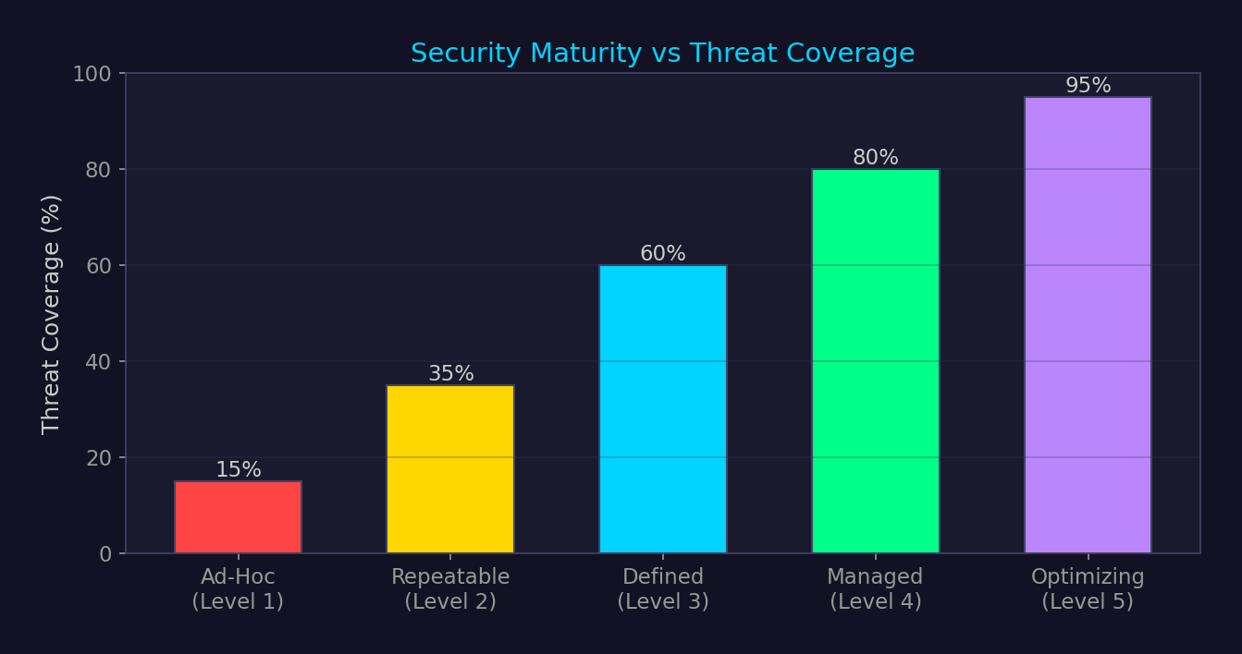
Security Program Maturity Model

Slide 24
Cross-Reference Map — All 31 Domains
▸ All domains: ATT&CK maps techniques from every domain into unified taxonomy
▸ Domain 8-9: Web/network — primary initial access vectors for enterprise compromise
▸ Domain 10: Cloud — cloud forensics requires provider-specific knowledge and tooling
▸ Domain 11: Malware/tradecraft — detection engineering must understand adversary tools
▸ Domain 13: Cryptography — TI sharing relies on STIX/TAXII, detection uses Sigma/YARA
▸ Domain 14: AD/Windows — #1 target for enterprise attacks, richest telemetry source
▸ Domain 22: Payment — financial fraud detection parallels SOC operations
▸ Domains 29-31: New domains extend architecture, AI security, and advanced defense topics

