Slide 1
◆
DOMAIN 1 — BINARY FORMATS
ELF Foundations &
Dynamic Linking Core
File Header · Program Headers · Segments · Sections · Kernel→Loader Handoff
.dynamic · .dynsym · Hash Tables · Relocations · GOT/PLT · Lazy Binding
Chapter 1A · Part 1 of 2 · ELF Structure & Loading

Slide 2
AGENDA
1
ELF Dual-View Architecture (Sections vs Segments)
9
Hash Tables: SysV .hash vs GNU .gnu.hash
2
The ELF File Header (Elf64_Ehdr) — Every Field Explained
10
Relocation Types on x86_64
3
Program Headers & Segment Types (PT_LOAD → PT_GNU_PROPERTY)
11
The Two GOTs: .got vs .got.plt
4
Section Headers & Link-Time Semantics
12
The PLT & Lazy Binding Mechanism
5
Kernel→Loader Handoff & Auxiliary Vector
13
Symbol Resolution Scope & Order
6
The Dynamic Linker (ld.so) Boot Sequence
14
Why Lazy Binding Is Dying: Full RELRO
7
The .dynamic Section — Table of Contents
15
Complete ELF Load Sequence Timeline
8
Symbol Tables (.dynsym) & String Tables (.dynstr)

Slide 3
ELF Format at a Glance
64 B
56 B
64 B
24 B
ELF Header Size (64-bit)
Program Header Entry Size
Section Header Entry Size
Symbol Table Entry Size
24 B
4
16 B
0x7F454C46
Relocation Entry Size (Rela)
Typical PT_LOAD Segments
Elf64_Dyn Entry Size
ELF Magic Number

Slide 4
1
The Dual-View Architecture
Same bytes, two descriptions — the fundamental ELF asymmetry

Slide 5
Sections vs Segments — Two Views of One Binary
Section Headers (Linker View)
Program Headers (Loader View)
Describe what ld needs to combine .o files
Describe what kernel/ld.so needs to mmap & execute
Can be stripped/zeroed — binary still runs
Cannot be removed — binary won't load without them
Carry symbol names, debug info, exception tables
Define memory regions with permissions (R/W/X)
≠
Organize content by purpose: .text, .data, .bss, .rodata
Organize content by runtime behavior: LOAD, DYNAMIC, INTERP
sh_flags: SHF_ALLOC, SHF_WRITE, SHF_EXECINSTR
p_flags: PF_R, PF_W, PF_X (page permissions)
Indexed by e_shoff/e_shnum from ELF header
Indexed by e_phoff/e_phnum from ELF header
Not consulted by kernel binfmt_elf at all
The ONLY thing the kernel reads for execution
Tools relying only on sections are trivially fooled
Load-bearing for execution — everything runs through segments
Section 0 is always the NULL section (reserved)
A byte may belong to 1 segment and 0+ sections

Slide 6
ELF Dual-View Mental Model
Segments are what runs; sections are what the linker arranged for segments to contain
ELF File Header (Elf64_Ehdr)
Entry point to both views: e_phoff → segments, e_shoff → sections
Program Header Table
Array of Elf64_Phdr — kernel reads ONLY this for execution
PT_LOAD Segment 1 (R-X)
Contains .text, .plt, .init, .fini — executable code
PT_LOAD Segment 2 (R--)
Contains .rodata, .eh_frame, .gcc_except_table
PT_LOAD Segment 3 (RW- → R-- after RELRO)
Contains .dynamic, .got, .data.rel.ro — RELRO region
PT_LOAD Segment 4 (RW-)
Contains .data, .got.plt, .bss — writable data
Section Header Table
Array of Elf64_Shdr — optional, analysis-time only

Slide 7
Security Implications of the Dual-View Design
CRITICAL
Section headers can be stripped/forged — tools relying only on sections are trivially fooled
HIGH
YARA rules matching section names miss binaries with stripped section tables
HIGH
Packers routinely zero e_shoff to frustrate disassemblers like IDA/Ghidra
MEDIUM
Section names can lie: a section named .text can contain writable data
MEDIUM
Overlapping sections (same file offset, different attributes) confuse analysis tools
INFO
Detection strategy: always validate program headers first, sections second
INFO
If program headers and section headers disagree, trust program headers

Slide 8
2
The ELF File Header
Elf64_Ehdr — 64 bytes that define everything about the binary's structure

Slide 9
Elf64_Ehdr — The ELF File Header Structure
C (elf.h)
typedef struct {
unsigned char e_ident[16]; // Magic + class + endian + OS/ABI
Elf64_Half e_type; // ET_REL(1) | ET_EXEC(2) | ET_DYN(3) | ET_CORE(4)
Elf64_Half e_machine; // EM_X86_64(62) | EM_AARCH64(183) | ...
Elf64_Word e_version; // EV_CURRENT(1)
Elf64_Addr e_entry; // Virtual address of entry point
Elf64_Off e_phoff; // Program header table file offset
Elf64_Off e_shoff; // Section header table file offset
Elf64_Word e_flags; // Processor-specific flags
Elf64_Half e_ehsize; // Size of this header: 64 for ELF64
Elf64_Half e_phentsize; // Size of one phdr entry: 56 for ELF64
Elf64_Half e_phnum; // Number of program header entries
Elf64_Half e_shentsize; // Size of one shdr entry: 64 for ELF64
Elf64_Half e_shnum; // Number of section header entries
Elf64_Half e_shstrndx; // Section name string table index
} Elf64_Ehdr;
→ First 16 bytes (e_ident): 0x7F 'E' 'L' 'F' + class/endian/version/OS-ABI
→ e_type ET_DYN is ambiguous: shared objects AND PIE executables are both ET_DYN
→ e_entry for PIE: offset from load base (not absolute VA) — kernel adds ASLR base

Slide 10
e_ident[16] — Magic Identification Array
The first 16 bytes of every ELF file
Offset
Name
Size
Value
Purpose
0-3
EI_MAG0-3
4B
0x7F 'E' 'L' 'F'
ELF magic number
4
EI_CLASS
1B
1=32-bit, 2=64-bit
Address size class
5
EI_DATA
1B
1=LSB, 2=MSB
Byte order (endianness)
6
EI_VERSION
1B
1 (EV_CURRENT)
ELF version (always 1)
7
EI_OSABI
1B
0=NONE, 3=GNU
Target OS/ABI
8
EI_ABIVERSION
1B
0 (normally)
ABI version
9-15
EI_PAD
7B
0x00...
Padding — can hide data!

Slide 11
e_type — The ET_DYN Ambiguity Problem
Why PIE and .so are the same e_type — and how to tell them apart
ET_REL (1) — Relocatable Object (.o)
Produced by compiler. Contains unresolved symbols. Input to the linker, never executed directly.
ET_EXEC (2) — Fixed-Address Executable
Traditional non-PIE executable. Absolute virtual addresses. No ASLR for binary base. Legacy.
ET_DYN (3) — Shared Object OR PIE Executable
AMBIGUOUS: both .so libraries and PIE executables use ET_DYN. Distinguishable only by: presence of PT_INTERP, DT_FLAGS_1 containing DF_1_PIE, or non-empty e_entry.
ET_CORE (4) — Core Dump
Produced by kernel on crash. Contains PT_LOAD segments with process memory. Used for post-mortem analysis and malware unpacking (gcore).

Slide 12
Extended Number Encoding — Overflow Workarounds
How ELF handles more than 65534 sections or program headers
e_phnum Overflow (PN_XNUM = 0xFFFF)
When e_phnum == 0xFFFF, real count is in sh_info of section header 0. 16-bit field limit: max 65534 program headers directly.
e_shnum Overflow
When e_shnum == 0 with non-zero e_shoff, real section count is in sh_size of section header 0.
e_shstrndx Overflow (SHN_XINDEX = 0xFFFF)
When e_shstrndx == 0xFFFF, real string table section index is in sh_link of section header 0.
Detection Implication
Anomalous values in these fields can be used to confuse analysis tools that don't handle the extended encoding. Malware sometimes sets these to invalid values deliberately.

Slide 13
ELF Header Anomaly Detection Signals
e_shoff = 0
No section headers — binary still runs but loses analyzability. Strong anomaly signal.
e_phentsize ≠ 56
Invalid program header entry size for 64-bit (should always be 56 bytes).
e_ehsize ≠ 64
Invalid ELF header size for 64-bit (should always be 64 bytes).
e_ident[9-15] ≠ 0
Non-zero padding bytes — potential data smuggling in unused header space.
e_entry → non-X seg
Entry point pointing into a non-executable segment — post-link modification.
e_phoff unusual
Program header table not at offset 64 — custom or modified linker output.
e_type = ET_DYN
Inspect further: is this a PIE (has PT_INTERP) or a shared library?
Missing PT_NOTE
If build-ID section exists but PT_NOTE is gone — possible PT_NOTE→PT_LOAD infection.

Slide 14
3
Program Headers &
Segment Loading
Elf64_Phdr — the kernel's instruction manual for building a process image

Slide 15
Elf64_Phdr — Program Header Structure
C (elf.h)
typedef struct {
Elf64_Word p_type; // PT_LOAD | PT_DYNAMIC | PT_INTERP | ...
Elf64_Word p_flags; // PF_R(4) | PF_W(2) | PF_X(1)
Elf64_Off p_offset; // File offset of segment data
Elf64_Addr p_vaddr; // Virtual address in memory (+ base for PIE)
Elf64_Addr p_paddr; // Physical address (ignored on Linux userspace)
Elf64_Xword p_filesz; // Size of segment data in file
Elf64_Xword p_memsz; // Size in memory (>= p_filesz; excess is BSS)
Elf64_Xword p_align; // Alignment (page-aligned for PT_LOAD)
} Elf64_Phdr;
→ p_memsz - p_filesz = BSS region (zero-filled, takes memory but no file space)
→ p_flags maps to mmap permissions: PF_R→PROT_READ, PF_W→PROT_WRITE, PF_X→PROT_EXEC
→ For PIE (ET_DYN): p_vaddr is offset from load base, not absolute address

Slide 16
PT_LOAD Segment Loading — File → Memory Mapping
A modern binary typically has 4 PT_LOAD segments with distinct permissions
Kernel reads
p_offset, p_filesz
mmap at p_vaddr
(+ ASLR base)
Set permissions
from p_flags
Zero-fill BSS
(memsz - filesz)
Segment
ready

Slide 17
Modern 4-Segment Layout (Post-Hardening Linker)
The 4-segment split enables RELRO: segment 3 is mprotect'd read-only after relocation
Segment
Permissions
Contents
Security Role
PT_LOAD #1
R-- (read-only)
.note, .gnu.hash, .dynsym, .dynstr, .rela.dyn
Headers & metadata
PT_LOAD #2
R-X (exec)
.text, .plt, .plt.got, .plt.sec, .init, .fini
Executable code
PT_LOAD #3
R-- (after RELRO)
.dynamic, .got, .data.rel.ro, .init_array, .fini_array
RELRO-protected data
PT_LOAD #4
RW- (writable)
.data, .got.plt, .bss
Writable data + lazy GOT

Slide 18
Complete Program Header Type Reference
p_type
Value
Purpose
Security Relevance
PT_LOAD
1
Map file region into memory
RWX check: both W+X is anomalous
PT_DYNAMIC
2
Points to .dynamic array
Mandatory for dynamic linking
PT_INTERP
3
Path to dynamic linker
Absent = static binary (no LD_PRELOAD)
PT_NOTE
4
Build ID, ABI tags, CET/BTI
Target of PT_NOTE→PT_LOAD infection
PT_PHDR
6
Self-describes phdr table
Used by ld.so to find own headers
PT_TLS
7
Thread-local storage template
Per-thread .tdata/.tbss init image
PT_GNU_STACK
0x6474e551
Stack permissions
PF_X = executable stack (anomalous)
PT_GNU_RELRO
0x6474e552
RELRO region bounds
mprotect'd R-- after relocation
PT_GNU_EH_FRAME
0x6474e550
Unwind table index
Points to .eh_frame_hdr
PT_GNU_PROPERTY
0x6474e553
CET/BTI/PAC properties
Enables HW control-flow integrity

Slide 19
W^X Violation: PF_W + PF_X on PT_LOAD
CRITICAL
A static PT_LOAD with both PF_W and PF_X = writable AND executable code
HIGH
Almost always indicates: packer, JIT self-modification, or malicious binary
HIGH
Normal compiled binaries NEVER have W+X segments statically
MEDIUM
Cheap detection: iterate PT_LOAD entries, flag any with (p_flags & 3) == 3
INFO
Legitimate exception: JIT engines (V8, LuaJIT) create RWX pages at runtime via mmap
INFO
Static W^X check should be in every binary intake pipeline

Slide 20
PT_GNU_STACK — Executable Stack Detection
Executable Stack (PF_X set)
Non-Executable Stack (no PF_X)
▸ Kernel allocates stack with PROT_EXEC
▸ Kernel allocates stack with PROT_READ|PROT_WRITE only
▸ Enables classic stack-based shellcode execution
▸ CPU hardware enforces NX (Intel: XD bit, AMD: NX bit)
▸ Caused by: old assembly without .note.GNU-stack
▸ Blocks trivial stack-based code execution
▸ Caused by: -z execstack linker flag
▸ Attacker must use code-reuse (ROP/JOP) instead
▸ Some legacy JITs require it
▸ Default on all modern Linux toolchains
▸ Almost always anomalous in modern binaries
▸ Requires: all linked objects to have .note.GNU-stack
▸ Detection: readelf -l | grep GNU_STACK | check flags
▸ One missing .note.GNU-stack → entire binary gets exec stack

Slide 21
4
Section Headers &
Link-Time Semantics
Elf64_Shdr — organizing content for the linker, debugger, and analyst

Slide 22
Elf64_Shdr — Section Header Structure
C (elf.h)
typedef struct {
Elf64_Word sh_name; // Index into section name string table
Elf64_Word sh_type; // SHT_PROGBITS | SHT_SYMTAB | SHT_RELA | ...
Elf64_Xword sh_flags; // SHF_ALLOC | SHF_WRITE | SHF_EXECINSTR | ...
Elf64_Addr sh_addr; // Virtual address if SHF_ALLOC
Elf64_Off sh_offset; // File offset
Elf64_Xword sh_size; // Section size in bytes
Elf64_Word sh_link; // Type-dependent link (e.g., strtab index)
Elf64_Word sh_info; // Type-dependent info (e.g., last local sym)
Elf64_Xword sh_addralign; // Alignment constraint
Elf64_Xword sh_entsize; // Entry size for fixed-size tables
} Elf64_Shdr;
→ sh_link/sh_info meaning changes per sh_type (symtab→strtab, rela→target section)
→ SHF_ALLOC = section occupies memory at runtime (contained in a PT_LOAD segment)
→ Section 0 is always NULL (reserved) — sh_info/sh_size/sh_link used for overflow encoding

Slide 23
Section Flags (sh_flags) — Permission & Behavior Bits
SHF_ALLOC
Section occupies memory at runtime (inside a PT_LOAD segment)
SHF_WRITE
Section is writable at runtime (maps to PF_W)
SHF_EXECINSTR
Section contains executable instructions (maps to PF_X)
SHF_MERGE
Entries can be merged/deduplicated by linker (string pooling)
SHF_STRINGS
Section contains NUL-terminated strings (enables dedup)
SHF_TLS
Section holds thread-local storage (.tdata/.tbss)
SHF_GROUP
Section belongs to a COMDAT group (C++ ODR compliance)
SHF_COMPRESSED
Section data is compressed (ELFCOMPRESS_ZLIB)

Slide 24
sh_link and sh_info — Context-Dependent Semantics
The same fields carry different information depending on section type
sh_type
sh_link meaning
sh_info meaning
SHT_SYMTAB / SHT_DYNSYM
Index of associated string table
Index of first non-local symbol
SHT_REL / SHT_RELA
Index of associated symbol table
Index of section being relocated
SHT_HASH / SHT_GNU_HASH
Index of symbol table being indexed
(unused)
SHT_DYNAMIC
Index of string table for DT entries
(unused)
SHT_GROUP
Index of associated symbol table
Symbol table index of group signature
SHT_SYMTAB_SHNDX
Index of associated symbol table
(unused)

Slide 25
Special Section Indices (SHN_*)
SHN_UNDEF (0)
Symbol not defined in this object — must be resolved by linker/loader
SHN_ABS (0xFFF1)
Symbol value is absolute, not relative to any section (e.g., __bss_start)
SHN_COMMON (0xFFF2)
Tentative definition — C 'common' semantic, allocated by linker
SHN_XINDEX (0xFFFF)
Real index exceeds 16 bits — look in SHT_SYMTAB_SHNDX section

Slide 26
Which Sections Matter at Runtime?
SHF_ALLOC is the dividing line between runtime and analysis-time sections
A section is 'interesting at runtime' exactly when sh_flags includes SHF_ALLOC
Runtime sections: .text, .rodata, .data, .bss, .got, .got.plt, .plt, .dynamic, .dynsym, .dynstr
Analysis-only sections: .symtab, .strtab, .debug_*, .comment, .shstrtab
Stripping removes analysis-only sections; binary functionality is unchanged
'strip --strip-all' removes .symtab + debug sections but keeps .dynsym (needed at runtime)
'strip --strip-unneeded' is more conservative — keeps symbols referenced by relocations
A fully stripped binary with no section headers is still fully functional
Detection engineers: always check SHF_ALLOC to separate runtime from metadata sections

Slide 27
5
Kernel → Loader Handoff
From execve() to the first userspace instruction — the auxiliary vector bridge

Slide 28
load_elf_binary() — Kernel Loading Sequence
fs/binfmt_elf.c — kernel reads ONLY program headers, never section headers
execve()
syscall
Parse Ehdr
& Phdr table
mmap PT_LOAD
segments
Pick ASLR
base (PIE)
Load PT_INTERP
(ld.so)
Build auxv
on stack
Jump to
ld.so _start

Slide 29
Auxiliary Vector (auxv) — Kernel → Userspace Data Channel
Elf64_auxv_t { a_type, a_un.a_val } — the kernel's out-of-band channel
AT_* Tag
Value
Purpose
Security Impact
AT_PHDR
3
VA of program header table
ld.so uses to find PT_DYNAMIC
AT_PHENT
4
Size of one phdr entry
Always 56 for ELF64
AT_PHNUM
5
Number of phdr entries
AT_BASE
7
Load base of ld.so itself
Needed for self-relocation
AT_ENTRY
9
Program entry point (relocated)
Where ld.so transfers control
AT_RANDOM
25
16 bytes of kernel randomness
Seeds stack canary & libc PRNG
AT_SYSINFO_EHDR
33
Address of vDSO
Fast syscalls without kernel entry
AT_HWCAP / AT_HWCAP2
16/26
CPU feature bitmask
IFUNC resolver selection
AT_SECURE
23
1 if setuid/setgid/fscaps
Disables LD_PRELOAD, LD_LIBRARY_PATH

Slide 30
AT_SECURE — The Linchpin of Setuid Safety
What AT_SECURE Does
When AT_SECURE=1, the dynamic linker ignores: LD_PRELOAD, LD_LIBRARY_PATH, LD_AUDIT, LD_DEBUG, and all other dangerous environment variables.
When AT_SECURE Is Set
Kernel sets AT_SECURE=1 for: setuid binaries, setgid binaries, and binaries with file capabilities (e.g., cap_net_raw). Checked in security_bprm_set_creds().
Why It Matters
Without AT_SECURE, any user could LD_PRELOAD a malicious library into a setuid binary and gain root. AT_SECURE is the ONLY defense against this attack vector.
Historical Bypass: CVE-2010-3856
$ORIGIN expansion in DT_RPATH bypassed AT_SECURE checks in older glibc versions, allowing LD_AUDIT code execution in setuid binaries. Fixed in glibc 2.12.2.
Forensics: Reading Another Process's auxv
/proc/PID/auxv exposes the auxiliary vector — reveals vDSO address, program headers, AT_RANDOM seed location. Readable by same-user processes.

Slide 31
6
The Dynamic Linker
(ld-linux.so)
The most privileged userspace component in an ELF process's early life

Slide 32
Dynamic Linker Boot Sequence — _dl_start → _dl_main
_start (ld.so entry point)
Self-relocate via R_X86_64_RELATIVE
(bootstrap: PC-relative, no GOT/PLT)
Find program's PT_DYNAMIC
via AT_PHDR from auxv
Walk DT_NEEDED entries
Open each library via search path
mmap each DSO's PT_LOAD segments
at random base addresses
Resolve relocations across all objects
(.rela.dyn eager, .rela.plt lazy/eager)
mprotect RELRO regions read-only
(_dl_protect_relro)
Run constructors in dependency order
pre-init → init → init_array
Transfer to program e_entry
_start → __libc_start_main → main()

Slide 33
Library Search Path — DT_NEEDED Resolution Order
For each DT_NEEDED library, ld.so searches in this order:
1. DT_RPATH (if DT_RUNPATH absent)
Embedded in binary. Legacy. Searched before LD_LIBRARY_PATH. Dangerous if pointing to world-writable directory.
2. LD_LIBRARY_PATH
Environment variable. Prepends to search path. IGNORED when AT_SECURE=1 (setuid/setgid/fscaps binaries).
3. DT_RUNPATH
Modern replacement for DT_RPATH. Embedded in binary. Searched AFTER LD_LIBRARY_PATH.
4. /etc/ld.so.cache
Precomputed cache from ldconfig. Maps library names to paths. Updated by 'ldconfig' scanning /etc/ld.so.conf.d/*.conf.
5. Default: /lib, /usr/lib (/lib64, /usr/lib64)
Fallback paths. Hardcoded in ld.so. Last resort.

Slide 34
Dynamic Linker Environment Variables
Most variables are ignored when AT_SECURE=1 (setuid/setgid binaries)
Variable
Function
AT_SECURE
Security Note
LD_PRELOAD
Inject libraries before DT_NEEDED
Ignored
Primary hooking vector
LD_LIBRARY_PATH
Prepend search directories
Ignored
Library replacement attacks
LD_AUDIT
Load auditor callbacks
Ignored
Symbol-level interception
LD_DEBUG=all
Print diagnostic output
Ignored
Invaluable for debugging
LD_BIND_NOW=1
Disable lazy binding
Honored
Same as -z now (RELRO)
LD_TRACE_LOADED_OBJECTS
Print deps and exit (ldd)
Honored
What ldd(1) sets
LD_SHOW_AUXV=1
Print auxiliary vector
Ignored
Debug auxv contents

Slide 35
7
The .dynamic Section
Elf64_Dyn array — the dynamic linker's table of contents

Slide 36
Elf64_Dyn — Dynamic Section Entry
C (elf.h)
typedef struct {
Elf64_Sxword d_tag; // Tag type (DT_NEEDED, DT_STRTAB, ...)
union {
Elf64_Xword d_val; // Integer value
Elf64_Addr d_ptr; // Virtual address pointer
} d_un;
} Elf64_Dyn;
// The .dynamic section is an array of these entries,
// terminated by DT_NULL (d_tag == 0).
// Every dynamic-linking structure is referenced from here.
→ 16 bytes per entry: 8-byte tag + 8-byte value/pointer
→ .dynamic lives in RELRO region — writable during load, read-only after
→ DT_DEBUG is written by ld.so at load time (points to r_debug → link_map chain)

Slide 37
Key .dynamic Tags — Complete Reference
Tag
d_un
Purpose
DT_NEEDED
d_val → .dynstr offset
Name of required shared library
DT_STRTAB / DT_STRSZ
d_ptr / d_val
Address & size of .dynstr
DT_SYMTAB / DT_SYMENT
d_ptr / d_val
Address of .dynsym & entry size (24)
DT_GNU_HASH
d_ptr
Address of .gnu.hash (fast lookup)
DT_HASH
d_ptr
Address of .hash (SysV, legacy)
DT_RELA / DT_RELASZ
d_ptr / d_val
Main relocation table (.rela.dyn)
DT_JMPREL / DT_PLTRELSZ
d_ptr / d_val
PLT relocations (.rela.plt)
DT_PLTGOT
d_ptr
Address of .got.plt
DT_INIT_ARRAY / DT_INIT_ARRAYSZ
d_ptr / d_val
Constructor function pointer array
DT_FINI_ARRAY / DT_FINI_ARRAYSZ
d_ptr / d_val
Destructor function pointer array
DT_FLAGS / DT_FLAGS_1
d_val
DF_BIND_NOW, DF_TEXTREL, DF_1_PIE, etc.
DT_DEBUG
d_ptr
→ r_debug (link_map chain for debuggers)

Slide 38
DT_FLAGS and DT_FLAGS_1 — Behavioral Flags
DT_FLAGS (d_val)
DT_FLAGS_1 (d_val)
▸ DF_BIND_NOW (0x8): resolve all symbols at load time
▸ DF_1_NOW (0x1): alias for DF_BIND_NOW
▸ DF_SYMBOLIC (0x2): prefer own definitions over global scope
▸ DF_1_PIE (0x8000000): this ET_DYN is a PIE executable
▸ DF_TEXTREL (0x4): has relocations in read-only segments (bad)
▸ DF_1_NODELETE (0x8): object cannot be dlclose'd
▸ DF_STATIC_TLS (0x10): uses static TLS (limits dlopen)
▸ DF_1_INITFIRST (0x20): run constructors before others
▸ DF_1_NOOPEN (0x40): cannot be dlopen'd
▸ DF_1_INTERPOSE (0x400): interpose all symbols

Slide 39
DT_DEBUG → r_debug → link_map Chain
DT_DEBUG Written at Load Time
ld.so writes the address of its r_debug structure into this .dynamic entry during startup — BEFORE RELRO locks .dynamic to read-only.
r_debug Structure
Contains r_version (always 1), r_map (pointer to head of link_map linked list), r_brk (address of _dl_debug_state — debugger breakpoint), r_state (RT_CONSISTENT/ADD/DELETE).
link_map Linked List
One node per loaded object. Fields: l_addr (load base), l_name (path string), l_ld (pointer to object's .dynamic), l_next/l_prev (list links).
Offensive Use
Walking DT_DEBUG → r_debug → link_map reveals every loaded library's base address — including libc. Used to compute gadget addresses during exploitation.
Forensic Use
Core dump analysis reconstructs loaded objects via the same r_debug → link_map walk. Tools: GDB 'info shared', Volatility linux_liblist plugin, custom r_debug parsers.

Slide 40
8
Symbol Tables &
String Tables
.dynsym / .dynstr — the runtime symbol namespace

Slide 41
Elf64_Sym — Dynamic Symbol Table Entry
C (elf.h)
typedef struct {
Elf64_Word st_name; // Index into .dynstr
unsigned char st_info; // (binding << 4) | type
unsigned char st_other; // Visibility in low 2 bits
Elf64_Half st_shndx; // Section index, or SHN_UNDEF / SHN_ABS
Elf64_Addr st_value; // Virtual address (or offset for relocatables)
Elf64_Xword st_size; // Symbol size in bytes
} Elf64_Sym; // 24 bytes total
// st_info packing:
// ELF64_ST_BIND(info) = (info) >> 4
// ELF64_ST_TYPE(info) = (info) & 0xF
// ELF64_ST_INFO(bind, type) = ((bind) << 4) | ((type) & 0xF)
→ st_shndx == SHN_UNDEF (0): unresolved reference — must be resolved by dynamic linker
→ Local symbols precede globals; partition point is sh_info of .dynsym section header
→ .dynstr index 0 is always an empty string (NUL byte)

Slide 42
Symbol Binding (STB_*) — Who Can Override
STB_LOCAL (0)
Not visible outside this object. Never in .dynsym. Fastest resolution.
STB_GLOBAL (1)
Visible to all objects. Must be unique (or error). Standard export.
STB_WEAK (2)
Visible but overridable. If unresolved, value is 0 (no error). Optional deps.
STB_GNU_UNIQUE (10)
GNU extension for C++ template dedup. Like global but exactly one instance.

Slide 43
Symbol Type (STT_*) — What the Symbol Represents
STT_NOTYPE (0)
Unspecified type. Common for labels and assembly symbols.
STT_OBJECT (1)
Data object: variable, array, structure. st_size = object size.
STT_FUNC (2)
Function entry point. st_value = address, st_size = function length.
STT_SECTION (3)
Section symbol. Used internally for relocation against section base.
STT_FILE (4)
Source file name. For debugger convenience only.
STT_COMMON (5)
Tentative definition. Linker allocates space in .bss.
STT_TLS (6)
Thread-local storage symbol. Value is offset into TLS block.
STT_GNU_IFUNC (10)
Indirect function: st_value is a RESOLVER, not the final address.

Slide 44
Symbol Visibility (STV_*) — Interposition Control
STV_HIDDEN and STV_PROTECTED are key for controlling what LD_PRELOAD can hook
Visibility
Value
Exported?
Interposable?
Use Case
STV_DEFAULT
0
Yes
Yes
Standard: LD_PRELOAD can override
STV_INTERNAL
1
No
N/A
Implementation detail — rarely used
STV_HIDDEN
2
No
N/A
Library internal: not in .dynsym at link time
STV_PROTECTED
3
Yes
No
Exported but self-references bind locally

Slide 45
9
Hash Tables:
SysV .hash vs GNU .gnu.hash
Accelerating symbol lookup — from O(n) chain walks to Bloom-filtered O(1)

Slide 46
SysV .hash vs GNU .gnu.hash — Performance & Design
SysV .hash (Legacy)
GNU .gnu.hash (Modern)
Layout: nbuckets + nchain + bucket[] + chain[]
Layout: header + Bloom filter + bucket[] + chain[]
nchain = total number of dynamic symbols
Bloom filter (64-bit words) for fast negative lookup
Hash function: rotate-and-XOR (elf_hash)
Hash function: DJB2 variant (h = h*33 + c)
<<
Every probe touches the symbol table (cold cache)
Bloom probe eliminates absent symbols WITHOUT touching symtab
Missing symbol → must walk chain to end
Chain stores HASH VALUES, not symbol indices
No early termination for absent symbols
Most chain walks reject without symbol table access
O(n/nbuckets) average lookup
Symbols sorted by bucket — contiguous in .dynsym
Still generated for compatibility with old loaders
O(1) average for absent symbols (Bloom filter)

Slide 47
SysV Hash Function — elf_hash()
C
uint32_t elf_hash(const char *name) {
uint32_t h = 0, g;
while (*name) {
h = (h << 4) + (unsigned char)*name++;
if ((g = h & 0xF0000000))
h ^= g >> 24;
h &= ~g; // clear the high nibble
}
return h;
}
// Lookup:
// bucket_idx = elf_hash(name) % nbuckets
// i = bucket[bucket_idx]
// while (i != STN_UNDEF) {
// if (strcmp(dynsym[i].name, name) == 0) return &dynsym[i];
// i = chain[i]; // follow chain
// }
→ Rotate-left-4 with high-nibble XOR — designed in the 1990s
→ Every chain step touches .dynsym (cache-hostile for large symbol tables)
→ Missing symbol requires full chain traversal — O(chain_length)

Slide 48
GNU Hash Function & Bloom Filter Lookup
C
uint32_t gnu_hash(const char *name) {
uint32_t h = 5381;
while (*name)
h = (h * 33) + (unsigned char)*name++;
return h;
}
// 3-stage lookup:
// Stage 1: Bloom filter (fast negative)
// word = bloom[(h / 64) % bloom_size]
// bit1 = (h) % 64
// bit2 = (h >> bloom_shift) % 64
// if (!(word & (1ULL << bit1)) || !(word & (1ULL << bit2)))
// return NULL; // DEFINITELY not in this DSO
//
// Stage 2: Bucket probe
// i = bucket[h % nbuckets]
// if (i < symoffset) return NULL;
//
// Stage 3: Chain walk (compares hash values, not names)
// while (true) {
// if ((chain[i - symoffset] | 1) == (h | 1)) // hash match
// if (strcmp(dynsym[i].name, name) == 0) return &dynsym[i];
// if (chain[i - symoffset] & 1) break; // end of chain
// i++;
// }
→ Bloom filter eliminates absent symbols without any .dynsym access
→ Chain stores hash values — most rejections avoid strcmp entirely
→ DJB2 variant: better distribution than SysV hash, fewer collisions

Slide 49
GNU Hash Bloom Filter — Fast Negative Lookup
The dominant performance win: skipping entire DSOs for absent symbols
Compute
gnu_hash(name)
Test bit 1:
h % 64
Test bit 2:
(h >> shift) % 64
Either 0?
→ NOT HERE
Both 1?
→ Check bucket

Slide 50
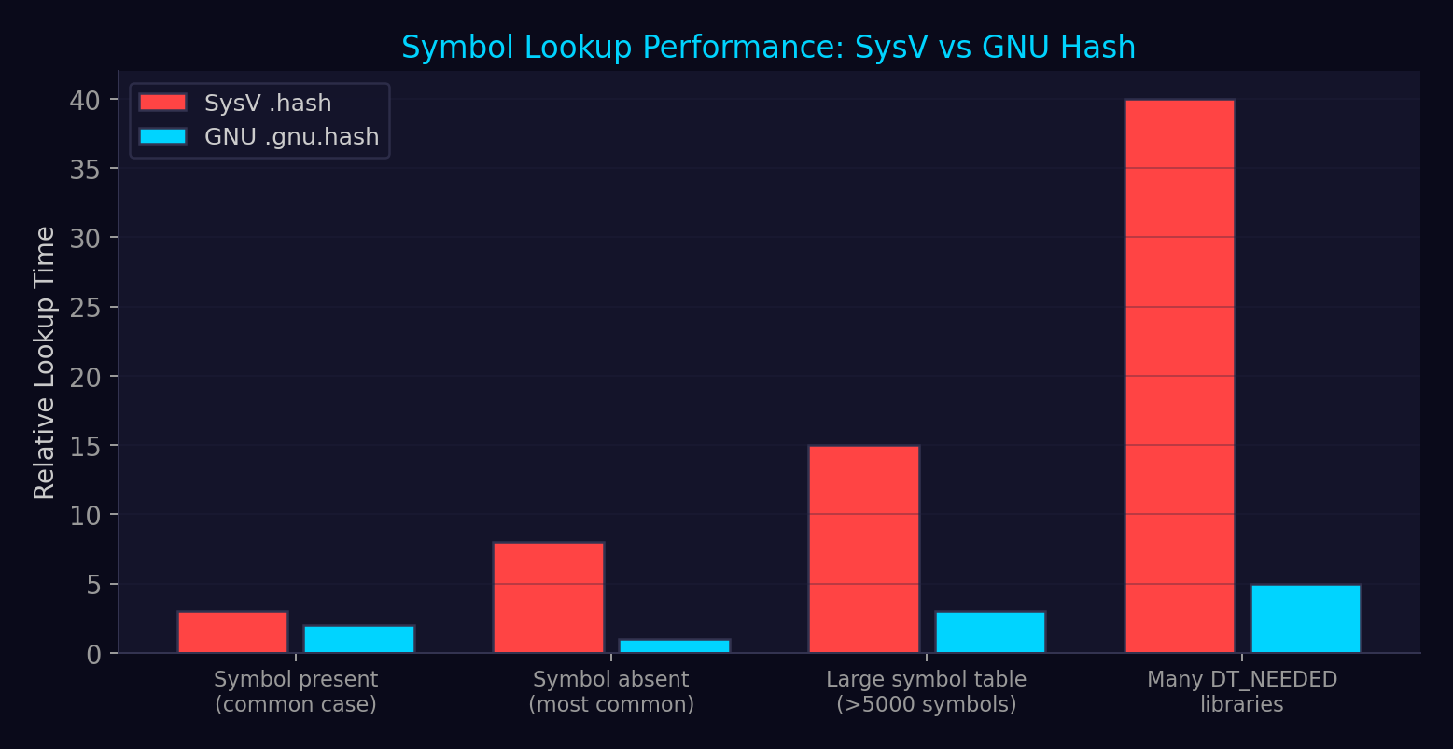
Hash Table Performance Comparison
▸ GNU .gnu.hash is 5-10x faster for absent symbols
▸ Bloom filter eliminates most lookups without touching .dynsym
▸ Chain stores hash values — strcmp avoided for mismatches
▸ Impact: process startup time significantly reduced
▸ Build systems: both can coexist; loader prefers .gnu.hash
▸ If only DT_GNU_HASH present, old loaders fail

Slide 51
10
Relocations
The dynamic linker's patching instructions — from RELATIVE to JUMP_SLOT

Slide 52
Elf64_Rela — Relocation Entry with Explicit Addend
C (elf.h)
typedef struct {
Elf64_Addr r_offset; // Virtual address to be patched
Elf64_Xword r_info; // (sym_index << 32) | type
Elf64_Sxword r_addend; // Explicit addend
} Elf64_Rela; // 24 bytes
// Extract fields:
// ELF64_R_SYM(info) = (info) >> 32 // symbol table index
// ELF64_R_TYPE(info) = (info) & 0xFFFFFFFF // relocation type
// ELF64_R_INFO(sym, type) = ((sym) << 32) | (type)
// Two relocation tables in a typical binary:
// .rela.dyn — relocations applied eagerly at load time
// .rela.plt — PLT relocations (lazy unless BIND_NOW)
→ r_offset: where to write the computed value (GOT slot, data pointer, etc.)
→ r_info packs both the symbol index AND the relocation type
→ x86_64 uses RELA (explicit addend); ARM32 uses REL (implicit addend in target)

Slide 53
x86_64 Relocation Types — Complete Reference
The relocation type determines the formula for computing the patched value
Type
Value
Formula
Use Case
R_X86_64_RELATIVE
8
*offset = base + addend
Self-refs in PIE (most common)
R_X86_64_GLOB_DAT
6
*offset = sym_addr
GOT entries for global variables
R_X86_64_JUMP_SLOT
7
*offset = sym_addr
PLT GOT entries (lazy binding)
R_X86_64_64
1
*offset = sym + addend
Direct 64-bit absolute (non-PIE)
R_X86_64_PC32
2
*offset = sym + add - off
PC-relative 32-bit
R_X86_64_COPY
5
memcpy from DSO to exe
Non-PIC exe refs DSO global var
R_X86_64_IRELATIVE
37
*offset = resolver()
IFUNC within same object
R_X86_64_TPOFF64
18
*offset = sym - TP
TLS: offset from thread pointer
R_X86_64_DTPMOD64
16
*offset = module_id
TLS: module ID for dlopen'd libs

Slide 54
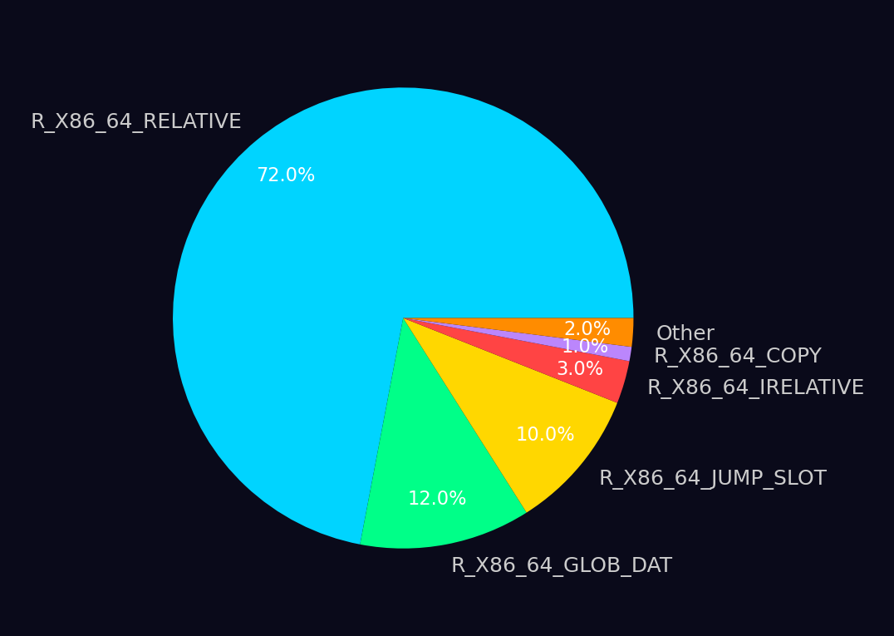
Relocation Type Distribution in a Typical PIE Binary
RELATIVE dominates: every self-referencing pointer in a PIE needs one

Slide 55
DT_TEXTREL — The Dangerous Relocation Flag
CRITICAL
DT_TEXTREL means relocations target READ-ONLY segments (text-segment relocations)
CRITICAL
Loader must mprotect text WRITABLE → apply relocs → mprotect back → DANGEROUS
HIGH
Writable .text during load = window for code injection if another thread races
HIGH
Extra mprotect syscalls = measurable performance penalty
MEDIUM
Modern toolchains: -z text makes DT_TEXTREL a hard linker error
INFO
Cause: non-PIC code in shared libraries (historical, e.g., old assembly)
INFO
Detection: readelf -d binary | grep TEXTREL — strong negative quality signal

Slide 56
11
The GOT, the PLT &
Lazy Binding
The mechanism that makes dynamic linking work — and the #1 exploit target in ELF

Slide 57
.got vs .got.plt — Two Global Offset Tables
.got (Data GOT)
.got.plt (Function GOT)
Holds imported global VARIABLE addresses
Holds imported FUNCTION pointer slots
Populated by R_X86_64_GLOB_DAT relocations
Populated by R_X86_64_JUMP_SLOT relocations
Resolved EAGERLY at load time (always)
Lazy binding: resolved on FIRST CALL
≠
Contains _GLOBAL_OFFSET_TABLE_ symbol
Eager binding (BIND_NOW): resolved at load time
Under full RELRO: read-only after relocation
Entries [0-2] reserved: .dynamic, link_map, _dl_runtime_resolve
Under partial RELRO: ALSO read-only (protected)
Under partial RELRO: WRITABLE (exploit target!)
Not a direct exploit target (already protected)
Under full RELRO: read-only after relocation

Slide 58
.got.plt Reserved Entries (Indices 0-2)
.got.plt[0]
Address of .dynamic — PLT trampolines can find .dynamic via PC-relative load
.got.plt[1]
Address of link_map for this object — populated by ld.so at load time
.got.plt[2]
Address of _dl_runtime_resolve — the lazy binding resolver entry point
.got.plt[3+]
Per-imported-function slots — initially point back to PLT stub push instruction

Slide 59
PLT Entry — 16 Bytes Per Imported Function
x86asm
// PLT0 (header stub):
PLT0:
push QWORD PTR [rip + got_plt_1] // push link_map
jmp QWORD PTR [rip + got_plt_2] // jmp _dl_runtime_resolve
nop; nop; nop; nop // padding to 16 bytes
// Per-function PLT stub (e.g., puts@plt):
puts@plt:
jmp QWORD PTR [rip + GOT_OFFSET] // 6 bytes: indirect jmp via GOT
push <reloc_index> // 5 bytes: push .rela.plt index
jmp PLT0 // 5 bytes: relative jmp to header
// First call: GOT entry → second instruction (push + jmp PLT0)
// After resolution: GOT entry → actual puts() in libc
→ First call path: PLT stub → push reloc_index → PLT0 → _dl_runtime_resolve → puts()
→ Subsequent calls: PLT stub → GOT already resolved → puts() directly (no resolver)
→ CET-aware .plt.sec: starts with endbr64 for indirect branch tracking

Slide 60
Lazy Binding — First Call Resolution Flow
First call: 7-step resolution. Second call: 1-step direct jump via GOT.
Program calls
puts@plt
jmp [GOT]
→ self-loop
push reloc_index
jmp PLT0
push link_map
jmp _dl_runtime_resolve
_dl_fixup
resolves symbol
GOT updated
→ libc puts()
Tail-jump
to puts()

Slide 61
_dl_fixup() — The Lazy Binding Resolver
_dl_fixup(struct link_map *l, ElfW(Word) reloc_arg)
Step 1: Read relocation entry
Reads .rela.plt[reloc_arg] → extracts r_info (symbol index + type) and r_offset (GOT slot).
Step 2: Look up symbol
Extracts symbol index from r_info, reads .dynsym[sym_idx], gets name from .dynstr.
Step 3: Search global scope
Walks the scope chain: executable → LD_PRELOAD → DT_NEEDED (BFS order). First match wins.
Step 4: Write to GOT
Writes resolved address to *r_offset (the .got.plt slot). GOT now points to actual function.
Step 5: Return address
Returns resolved address to _dl_runtime_resolve, which restores registers and tail-jumps to it.

Slide 62
Symbol Resolution — Scope & Order
The global scope is an ordered list — position determines priority
1. The Executable
Searched first. Symbols defined in the main binary take precedence over everything.
2. LD_PRELOAD Objects
Searched second, in the order specified. This is WHY LD_PRELOAD hooking works — preloaded definitions shadow later-loaded ones.
3. DT_NEEDED Libraries (BFS order)
Breadth-first traversal of the dependency graph. First definition found wins. libc is typically last because everything depends on it.
STV_PROTECTED Exception
Protected symbols bind locally within the defining object — immune to LD_PRELOAD interposition. Used inside libc to prevent internal calls from being redirected.
DF_SYMBOLIC / -Bsymbolic
Makes the object prefer its own definitions over global scope. Similar effect to making all symbols STV_PROTECTED. Changes LD_PRELOAD semantics for that DSO.

Slide 63
12
Why Lazy Binding
Is Increasingly Disabled
Full RELRO closes the GOT as an exploit target — at a small startup cost

Slide 64
Lazy Binding vs Full RELRO (Eager Binding)
Lazy Binding (Partial RELRO)
Full RELRO (-z relro -z now)
Resolves symbols on FIRST CALL only
Resolves ALL symbols at LOAD TIME
Skips unused symbols → saves startup time
Slight startup penalty (microseconds for most binaries)
.got.plt remains WRITABLE at runtime
.got.plt mprotect'd READ-ONLY after relocation
→
GOT overwrite = classic exploit primitive
GOT overwrite → SIGSEGV (attack fails)
Non-deterministic memory image (changes at each first call)
Deterministic memory image from first instruction
Default on older toolchains without -z now
Standard on all modern hardened toolchains
Unpredictable resolution latency at call sites
Predictable performance: no lazy resolution spikes

Slide 65
Detecting RELRO Posture — Quick Checks
bash
# Check with checksec (pwntools)
$ checksec --file=./binary
Arch: amd64-64-little
RELRO: Full RELRO # ← what you want
Stack: Canary found
NX: NX enabled
PIE: PIE enabled
# Check with readelf
$ readelf -d ./binary | grep -E 'BIND_NOW|FLAGS'
0x000000000000001e (FLAGS) BIND_NOW
0x000000006ffffffb (FLAGS_1) Flags: NOW PIE
# Check for GNU_RELRO segment
$ readelf -l ./binary | grep GNU_RELRO
GNU_RELRO 0x002d90 0x0000000000003d90 ...
# Compile with full RELRO
$ gcc -Wl,-z,relro,-z,now -o binary source.c
→ BIND_NOW in FLAGS or FLAGS_1 = eager binding = full RELRO possible
→ GNU_RELRO segment present = some RELRO protection (could be partial)
→ Both BIND_NOW + GNU_RELRO = full RELRO (GOT is read-only after load)

Slide 66
Three Forces Killing Lazy Binding
🔒
📐
⚡
Security
Determinism
PGO
Writable .got.plt = classic exploit target. Full RELRO + BIND_NOW makes GOT overwrite produce SIGSEGV instead of code execution.
Lazy binding creates non-deterministic memory images. Memory forensics, snapshots, and fingerprinting tools prefer deterministic state.
Profile-Guided Optimization reorders code and pre-resolves hot symbols. Lazy binding savings are smaller than they used to be.

Slide 67
13
Complete ELF
Load Sequence
From execve() to main() — every step in order

Slide 68
ELF Load Sequence — Phase 1: Kernel
execve()
mmap LOAD
Load ld.so
jmp ld.so
User calls execve() syscall
Kernel maps PT_LOAD segments
Kernel maps PT_INTERP interpreter
Transfer to interpreter _start
binfmt_elf
ASLR base
Build auxv
Kernel parses ELF header + phdr table
Kernel picks random base for PIE
Kernel builds aux vector on stack

Slide 69
ELF Load Sequence — Phase 2: Dynamic Linker → main()
_dl_start
DT_NEEDED
RELRO
main()
ld.so self-relocates (RELATIVE)
Walk deps, open + mmap each DSO
mprotect RELRO regions read-only
_start → __libc_start_main → main
Find DYNAMIC
Relocate
Constructors
Locate program's PT_DYNAMIC via AT_PHDR
Apply .rela.dyn (eager) + .rela.plt
Run init_array in dependency order

Slide 70
Complete Load Sequence — Detailed
Phase 1: Kernel (fs/binfmt_elf.c)
execve() → kernel validates ELF magic and header
Walk PT_LOAD segments → mmap each with permissions from p_flags
For PIE (ET_DYN): pick ASLR'd base (ELF_ET_DYN_BASE + randomization)
For ET_EXEC: honor absolute p_vaddr addresses (no ASLR for binary)
If PT_INTERP exists: open ld.so, mmap its PT_LOAD at separate random base
Build stack: argc, argv, envp, auxiliary vector (AT_PHDR, AT_BASE, AT_RANDOM, etc.)
Transfer control to interpreter _start (or program e_entry if no PT_INTERP)
Phase 2: Dynamic Linker (_dl_start → _dl_main)
_dl_start: self-relocate via R_X86_64_RELATIVE (bootstrap, no GOT/PLT yet)
Find program's PT_DYNAMIC via AT_PHDR/AT_PHNUM
Walk DT_NEEDED → open each library → mmap PT_LOAD segments at random bases
Build global scope: executable → LD_PRELOAD → DT_NEEDED (BFS order)
Phase 3: Relocation & Protection
For each DSO: resolve R_X86_64_RELATIVE, GLOB_DAT in .rela.dyn (eager)
For each DSO: resolve JUMP_SLOT in .rela.plt (lazy unless DT_BIND_NOW)
Run IRELATIVE resolvers → apply COPY relocations
_dl_protect_relro → mprotect PT_GNU_RELRO ranges read-only
Phase 4: Constructors & Handoff
Run pre-init array (program only)
Run init/init_array per DSO in dependency order (deps before dependents)
Transfer to program e_entry → _start → __libc_start_main → main()

Slide 71
Process Exit Sequence
Reverse of construction order — exploitation target via .fini_array overwrite
1. main() returns (or exit() called)
Return value from main becomes the process exit status.
2. atexit handlers
Called in reverse registration order. Registered by atexit() and on_exit().
3. fini_array per DSO
Destructor arrays called in REVERSE dependency order (dependents before deps).
4. DT_FINI per DSO
Legacy single-function destructors. Called after fini_array for each DSO.
5. _exit() syscall
Kernel terminates the process. All memory mappings released.

Slide 72
14
Detection & Forensics at
the GOT/PLT Layer
Turning the loader's mechanics into defensive instrumentation

Slide 73
GOT/PLT Detection & Forensics Opportunities
🔍
📋
⚠️
GOT Integrity Check
PLT Auditing
Resolver Hijack
Compare GOT entries against expected resolved addresses (walk link_map + symbol resolution rules). Finds GOT overwrites.
LD_AUDIT la_pltenter/la_pltexit callbacks observe every PLT call. Useful for tracing in controlled environments.
Check .got.plt[2] against expected _dl_runtime_resolve address. Replacement redirects ALL lazy resolutions.
🔗
📊
🛡️
link_map Walk
Relocation Audit
Static Binary Note
Enumerate loaded objects via DT_DEBUG → r_debug → link_map. Unexpected libraries = injection detection.
Compare .init_array/.fini_array entries against known function addresses in .text. Entries outside .text are anomalous.
Static binaries skip ALL dynamic linking. No GOT, no PLT, no LD_PRELOAD. Detection must move to seccomp/kernel level.

Slide 74
Runtime GOT Integrity Check (dl_iterate_phdr)
C
#define _GNU_SOURCE
#include <link.h>
#include <stdio.h>
static int callback(struct dl_phdr_info *info, size_t size, void *data) {
printf("%-40s base=0x%lx phnum=%d\n",
info->dlpi_name[0] ? info->dlpi_name : "[main]",
(unsigned long)info->dlpi_addr,
info->dlpi_phnum);
for (int i = 0; i < info->dlpi_phnum; i++) {
const Elf64_Phdr *ph = &info->dlpi_phdr[i];
if (ph->p_type == PT_LOAD) {
printf(" PT_LOAD vaddr=0x%lx memsz=0x%lx flags=%c%c%c\n",
(unsigned long)(info->dlpi_addr + ph->p_vaddr),
(unsigned long)ph->p_memsz,
ph->p_flags & PF_R ? 'R' : '-',
ph->p_flags & PF_W ? 'W' : '-',
ph->p_flags & PF_X ? 'X' : '-');
}
}
return 0;
}
int main(void) {
dl_iterate_phdr(callback, NULL);
return 0;
}
→ dl_iterate_phdr: canonical way to enumerate loaded objects from within a process
→ Each callback receives load base + full program header table per DSO
→ Compare against baseline to detect injected libraries (dlopen, LD_PRELOAD)

Slide 75
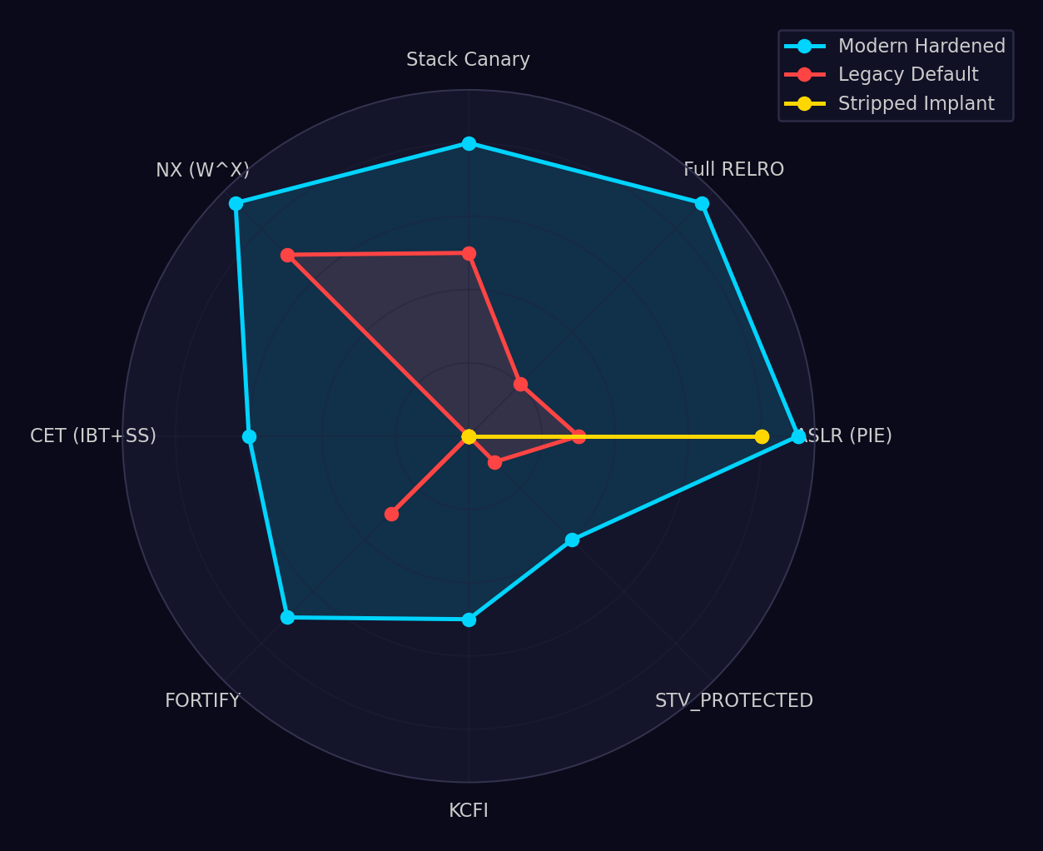
ELF Hardening Feature Coverage — Radar Analysis
Higher = better protection. Legacy defaults leave major gaps.

Slide 76
ELF Attack Surface Risk Matrix
IMPACT →
Negligible
Minor
Moderate
Major
Critical
Almost Certain
LD_PRELOAD
Hijack
GOT Overwrite
(Partial RELRO)
Likely
DT_RPATH
Abuse
ret2PLT
LIKELIHOOD →
Possible
ret2dlresolve
Unlikely
.init_array
Tampering
Rare

Slide 77
ELF Hardening Checklist — Binary Intake Pipeline
☐ Full RELRO: readelf -d | grep BIND_NOW → must be present
☐ PIE enabled: readelf -h | e_type == ET_DYN + has PT_INTERP
☐ NX stack: readelf -l | grep GNU_STACK → must NOT have E flag
☐ Stack canary: checksec shows 'Canary found'
☐ No DT_TEXTREL: readelf -d | grep TEXTREL → must be absent
☐ No W+X segments: no PT_LOAD with both PF_W and PF_X
☐ No world-writable DT_RPATH/DT_RUNPATH paths
☐ .init_array/.fini_array entries point into .text segment only
☐ Section headers present (e_shoff ≠ 0) for analyzability
☐ Build ID note present (NT_GNU_BUILD_ID) for debuginfo correlation
☐ CET/BTI properties present (PT_GNU_PROPERTY) if supported
☐ No anomalous e_ident padding (bytes 9-15 should be zero)

Slide 78
Cross-Reference Map
Ch 1A Part 2
GOT/PLT exploitation techniques, ret2dlresolve, LD_PRELOAD attacks, YARA rules
Ch 1B
TLS, IFUNC, RELRO internals, eh_frame, symbol versioning, init/fini arrays
Ch 2 (PE/COFF)
Windows binary format — analogous structures: IAT/EAT, delay imports
Domain 2
Process memory layout — where segments map in virtual address space
Domain 3
Memory corruption — the vulnerabilities that enable GOT overwrites
Domain 4
Code reuse attacks — ROP/JOP through PLT and gadgets in .text
Domain 6
Mitigation bypass — KASLR/ASLR defeat using ELF info leaks
Domain 11
Malware analysis — ELF packing, section manipulation, PT_NOTE infection
Domain 12
Reverse engineering — static/dynamic analysis of ELF binaries

Slide 79
Key Takeaways
1
ELF has TWO views: segments (runtime, kernel reads) vs sections (link-time, optional for execution)
2
Program headers are load-bearing; section headers are analysis-friendly but strippable
3
The auxiliary vector (auxv) is the kernel's primary data channel to userspace at process start
4
AT_SECURE is THE defense against LD_PRELOAD/LD_LIBRARY_PATH in setuid binaries
5
The dynamic linker is the most privileged early-life userspace component
6
.got.plt under partial RELRO is writable — THE classic ELF exploit target
7
Full RELRO (-z relro -z now) closes GOT overwrite attacks at negligible startup cost
8
Symbol resolution order: executable → LD_PRELOAD → DT_NEEDED (BFS) — order = priority
9
GNU .gnu.hash Bloom filter makes absent-symbol lookup effectively O(1)
10
Every binary intake pipeline should check: Full RELRO, PIE, NX, no TEXTREL, no W+X segments

Slide 80
Part 1 Summary — ELF Structure & Loading
This presentation covered the foundational ELF structures that every security engineer must internalize: the dual-view architecture (sections vs segments), the complete file header and program header specification, the kernel-to-loader handoff via the auxiliary vector, the dynamic linker's boot sequence and library search path, the .dynamic table of contents, the symbol resolution machinery (hash tables, relocation types), and the GOT/PLT lazy binding mechanism that remains the most exploited feature of the ELF format.
Key Points:
Segments are what runs; sections are what the linker arranged
Full RELRO is the single most impactful ELF hardening flag
Part 2 covers: exploitation techniques, malware analysis, YARA rules, defensive tooling

Slide 81
End of Part 1
Domain 1 · Chapter 1A · ELF Foundations & Dynamic Linking Core
Continue to Part 2: ELF Security & Exploitation

