Slide 1
Adicionando alertas ao Grafana

Slide 2
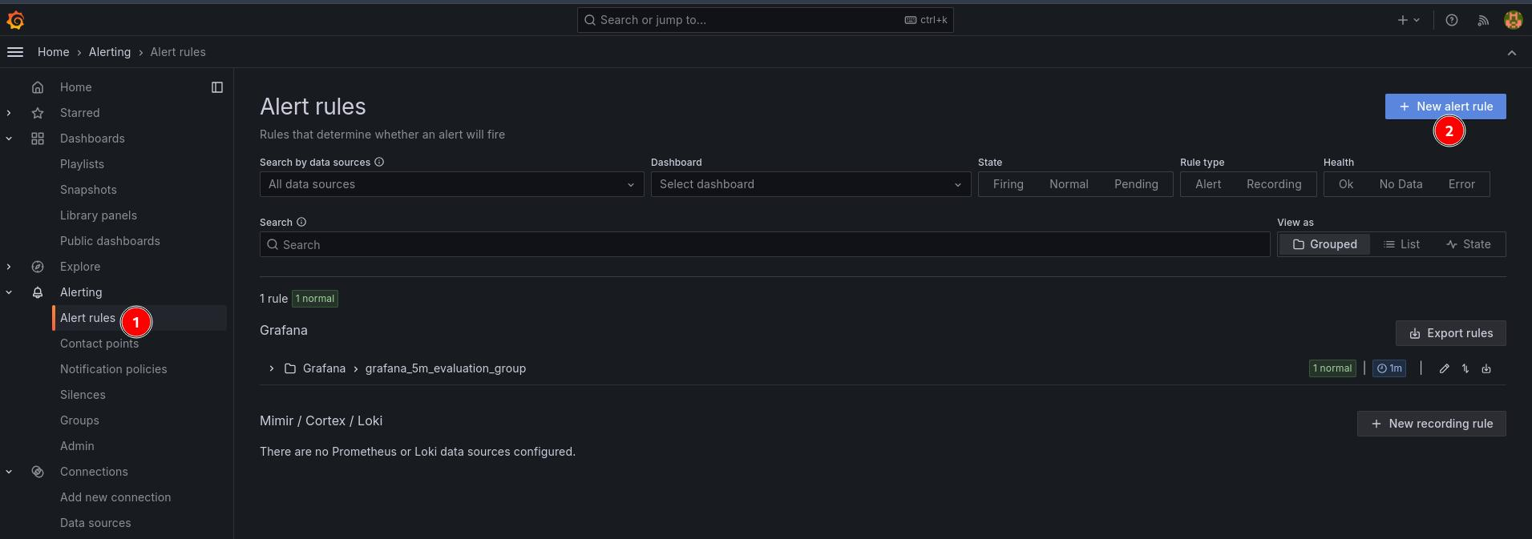

Slide 3
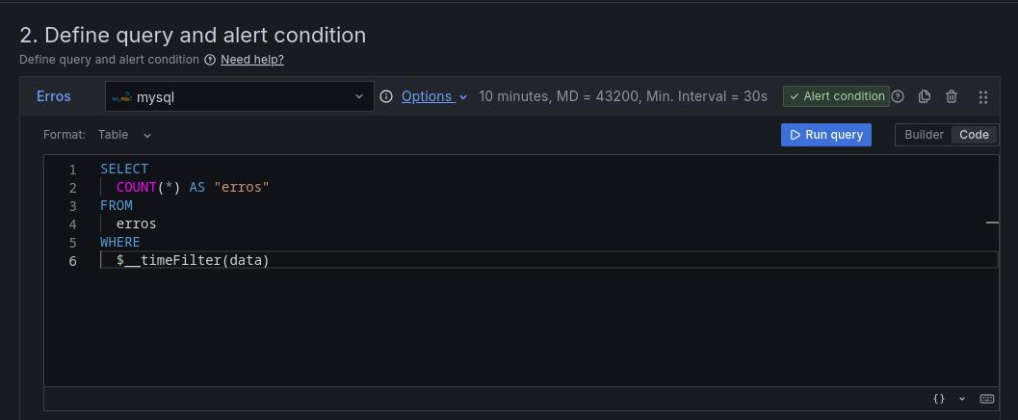

Slide 4
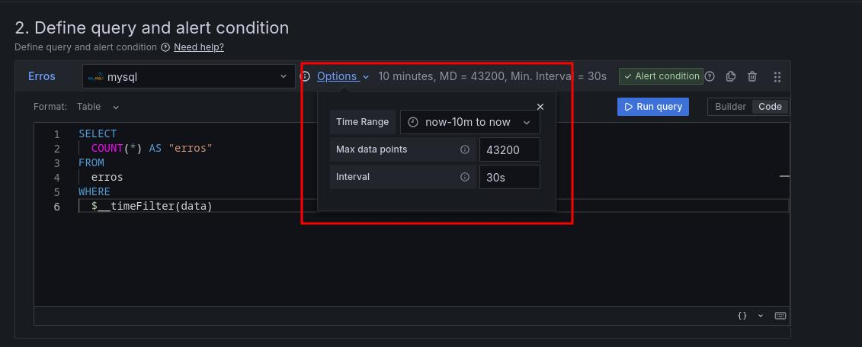

Slide 5
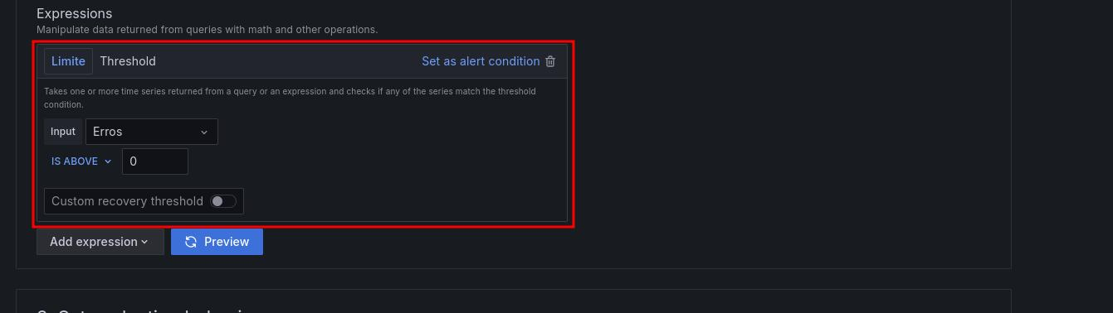

Slide 6
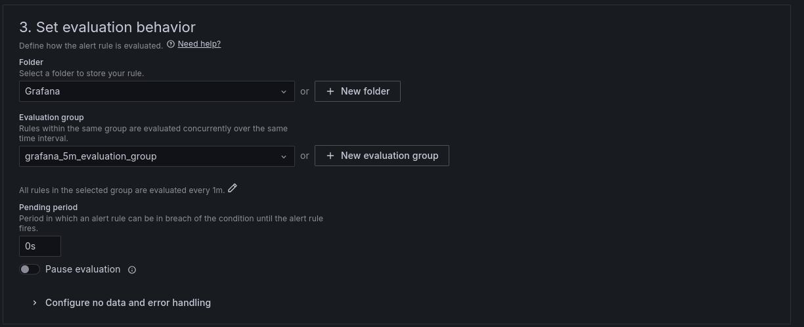

Slide 7
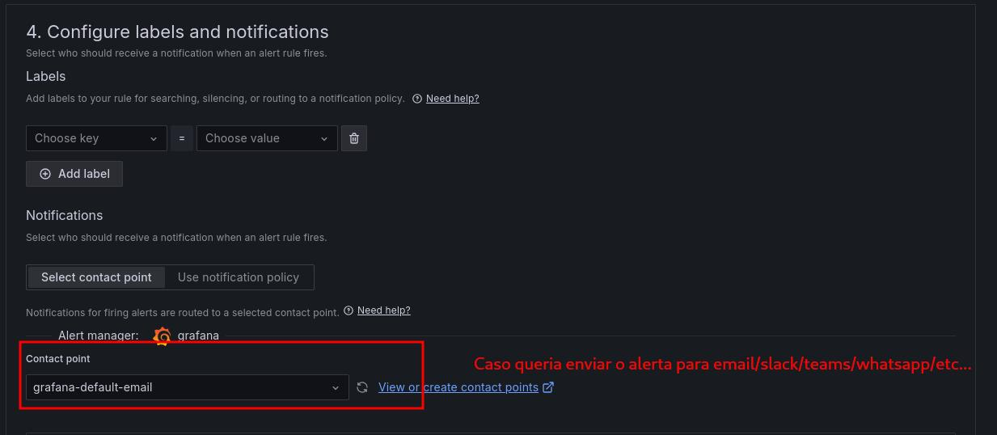

Slide 8
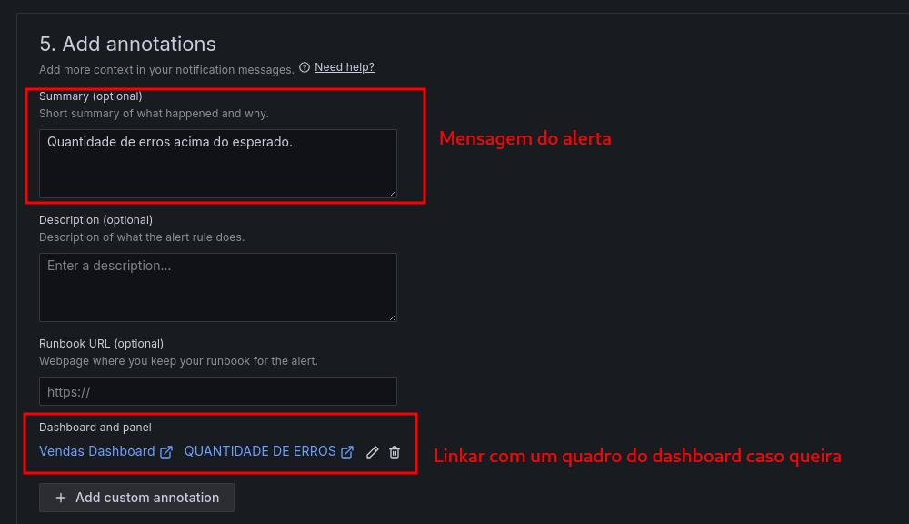

Slide 9
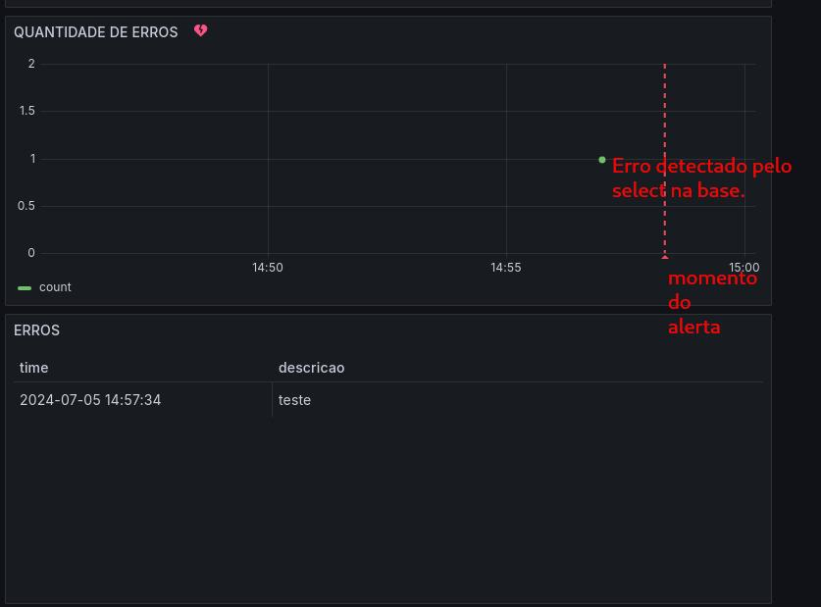

Slide 10
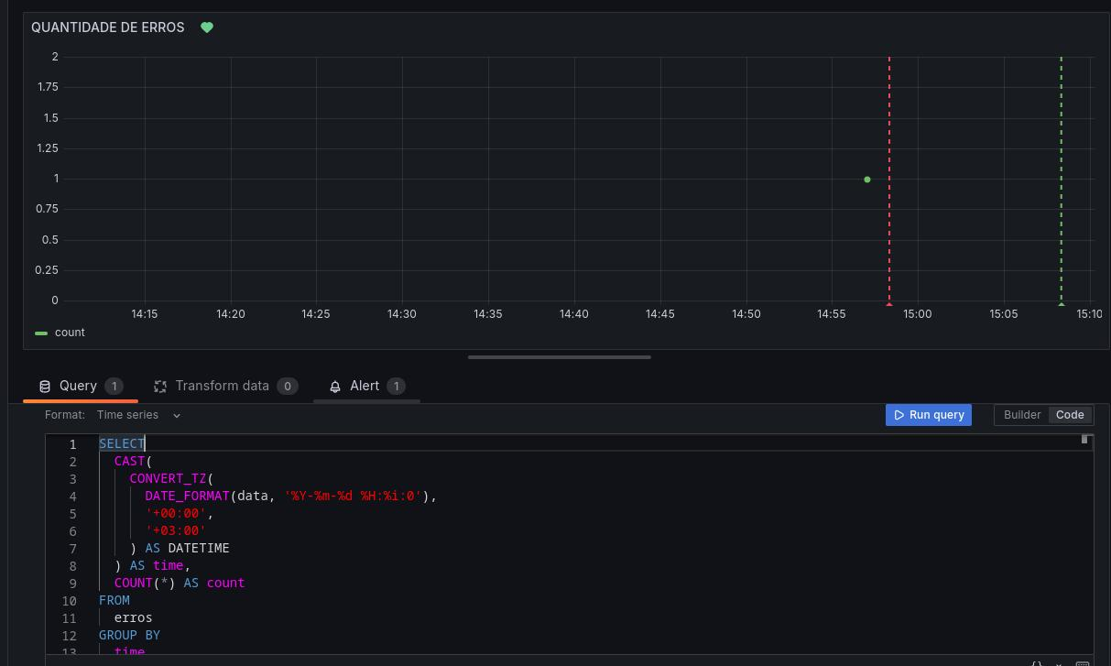
Exemplo de query para mostrar o gráfico daquela forma:
SELECT CAST( CONVERT_TZ( DATE_FORMAT(data, '%Y-%m-%d %H:%i:0'), '+00:00', '+03:00' ) AS DATETIME ) AS time, COUNT(*) AS countFROM errosGROUP BY timeORDER BY time desc;

Slide 11
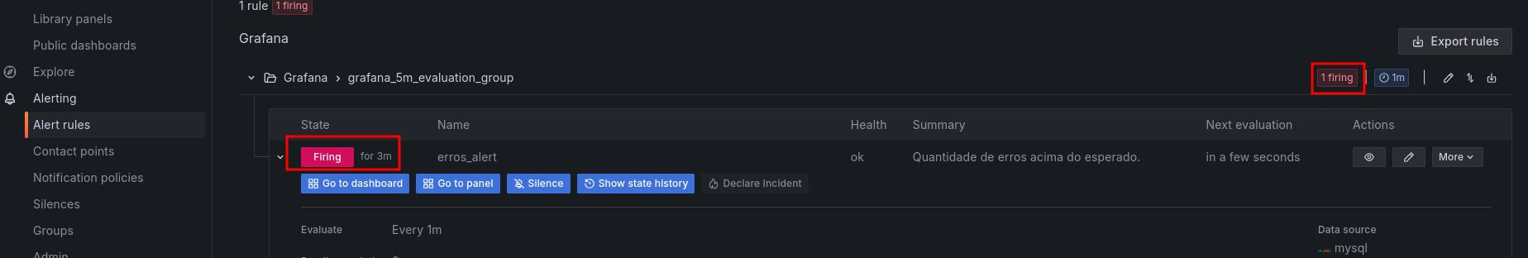

Slide 12
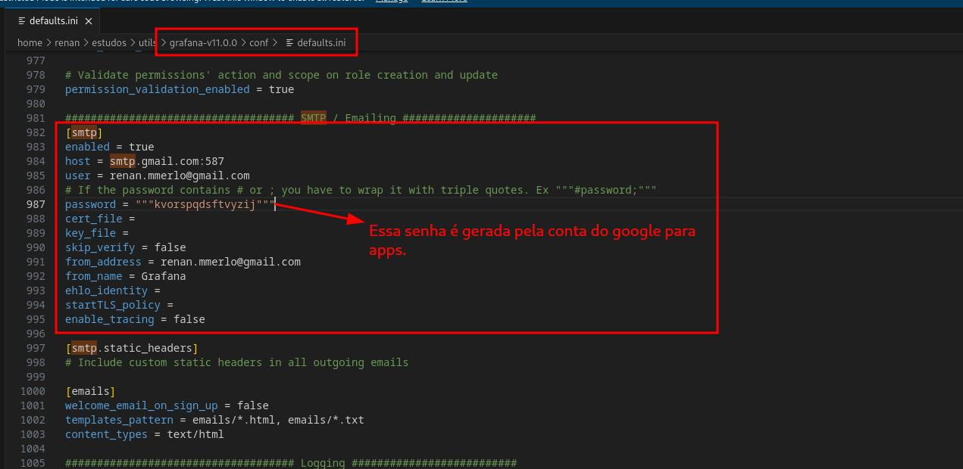

Slide 13
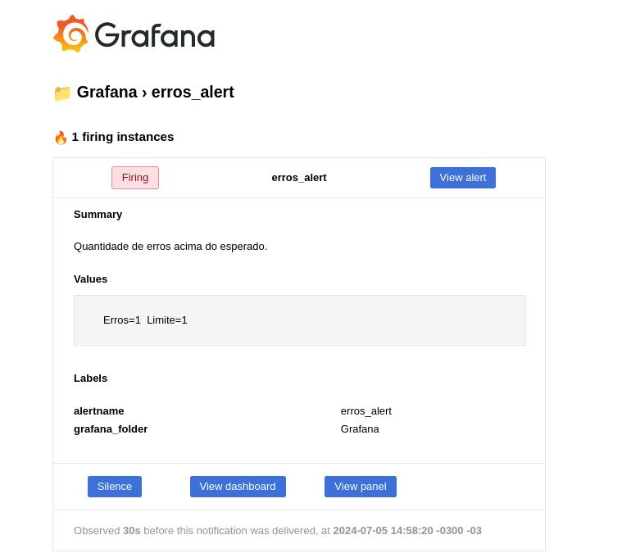
Email enviado pelo alerta

