Slide 1



A Framework for Aspatial and Spatial Residential Segregation Measures: The PySAL segregation Module with Evidence from Brazil
Prof. Renan Xavier Cortes

Slide 2
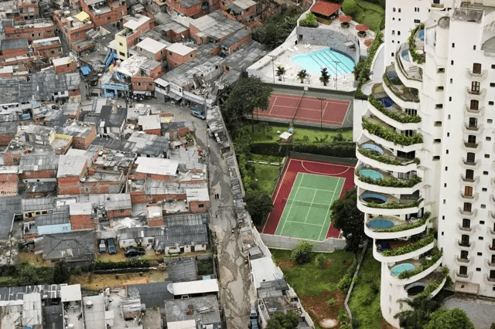
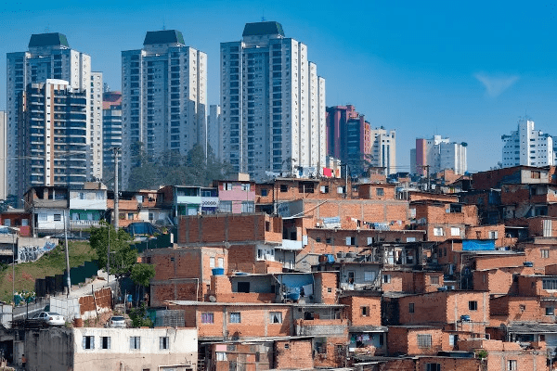
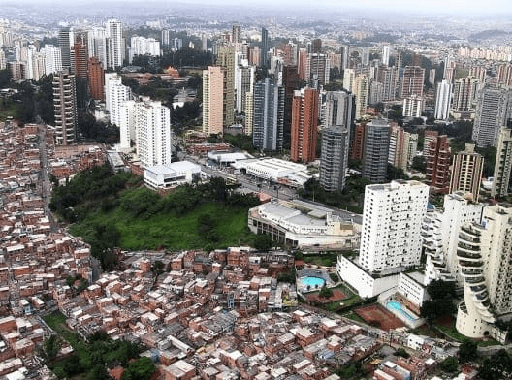
Segregation matters

Slide 3
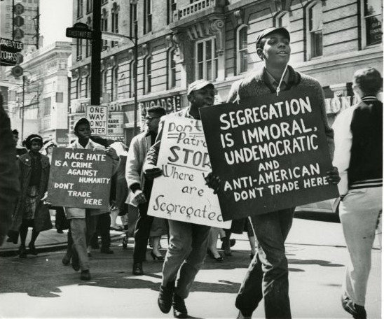

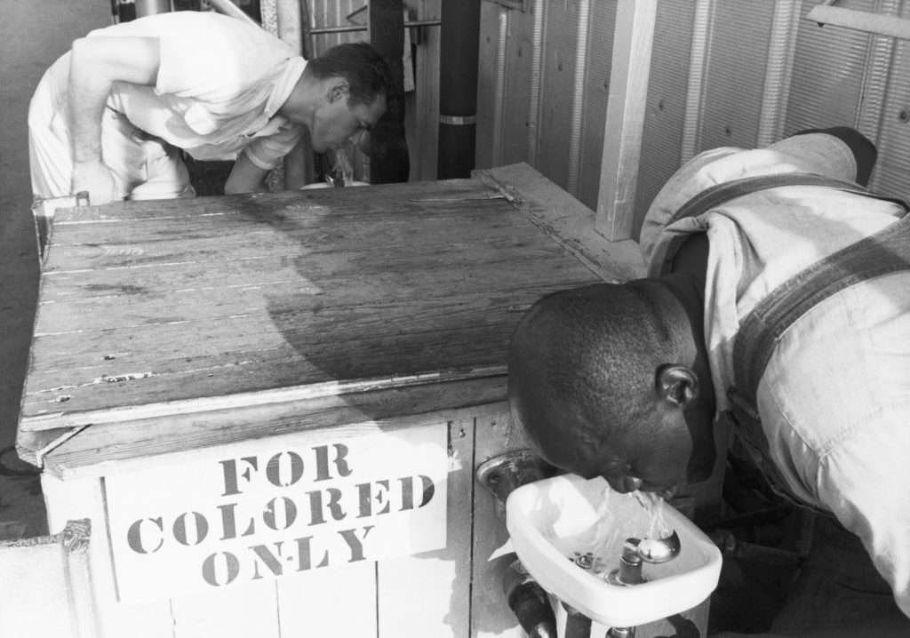
Racial Segregation matters

Slide 4
Residential Segregation in Brazil
In 2022, 87% of Brazil's population lived in urban areas (IBGE, 2024).
Brazilian cities with higher levels of income inequality tend to be more segregated. For example, nine of the ten most segregated cities in Brazil are located in the Northeast—the region with the highest levels of poverty and income inequality (Sousa Filho et al., 2022).
Racial segregation in Brazil is more pronounced in cities in the South and Southeast, primarily affecting the self-identified Black population (Souza Filho et al., 2023).

Slide 5
Residential Segregation in Brazil
According to Barros (2024), the global literature tends to focus on different dimensions of residential segregation across regions:
Brazil (and Latin America): income-based segregation
United States: racial segregation
Europe: ethnic segregation, particularly the spatial concentration and settlement patterns of immigrant groups

Slide 6
Dimensions of Segregation
Evenness
Centralization
Isolation
Segregation
Indexes can be Aspatial or Spatial
Clustering
Concentration

Slide 7
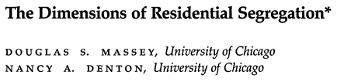
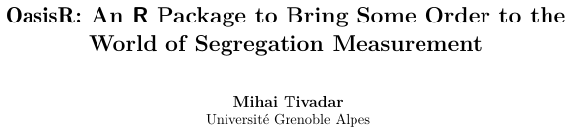
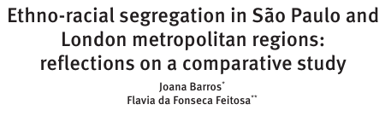
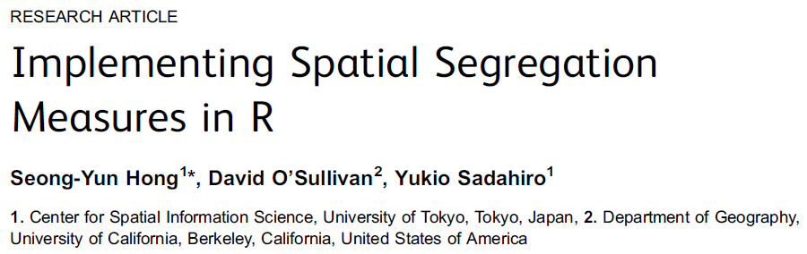
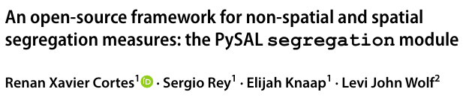
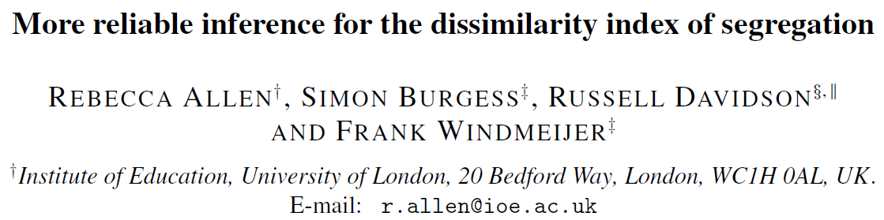
Literature of Segregation and its software implementations

Slide 8
But before... Let’s talk a little bit about the Python Spatial Analysis Library (PySAL)...

Slide 9

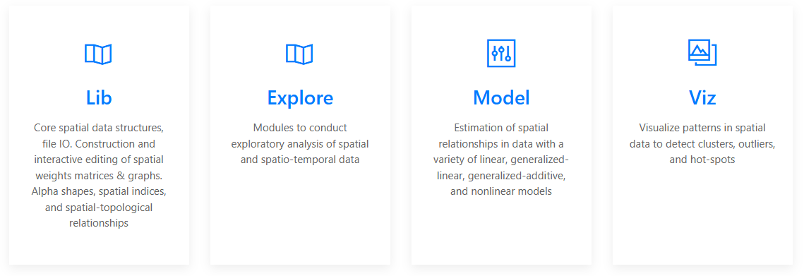
The PySAL ecosystem

Slide 10
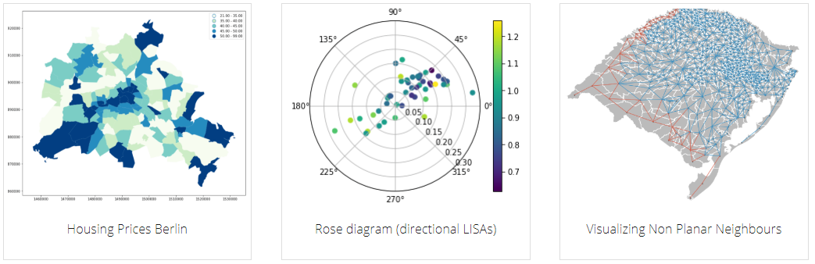
The PySAL ecosystem

Slide 11
The PySAL segregation module
https://github.com/pysal/segregation

Slide 12
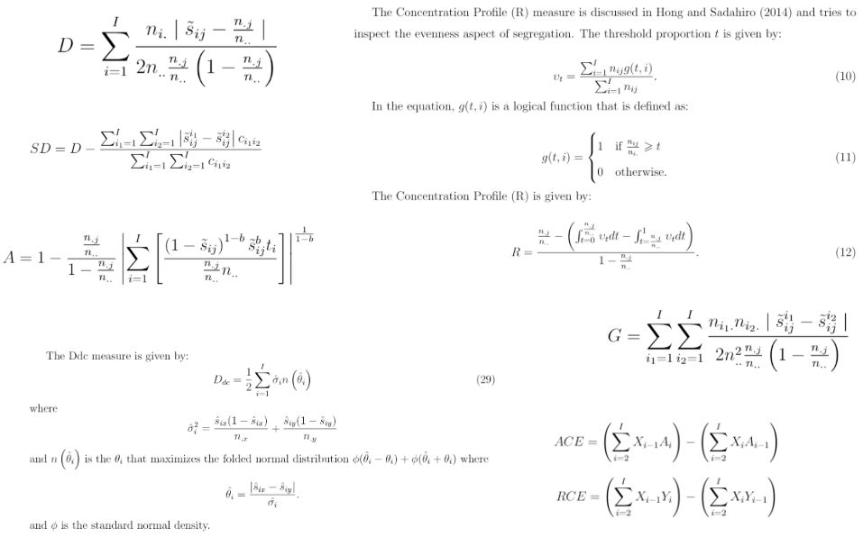
Challenge 1: point estimation of several measures

Slide 13
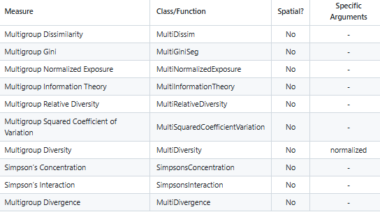
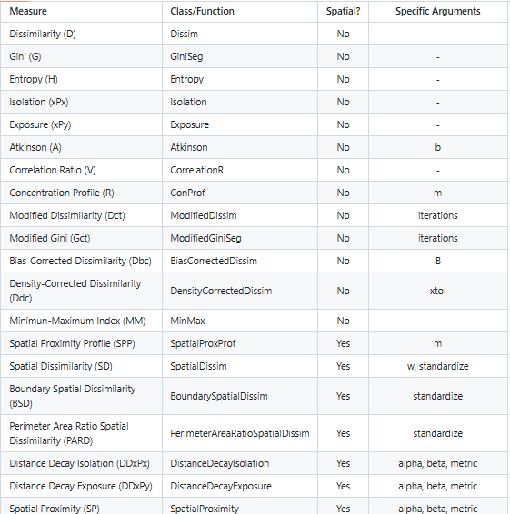
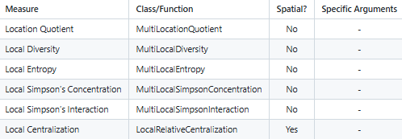
Challenge 1: point estimation of several measures
Multi Group Measures
Single Group Measures
Local Measures

Slide 14
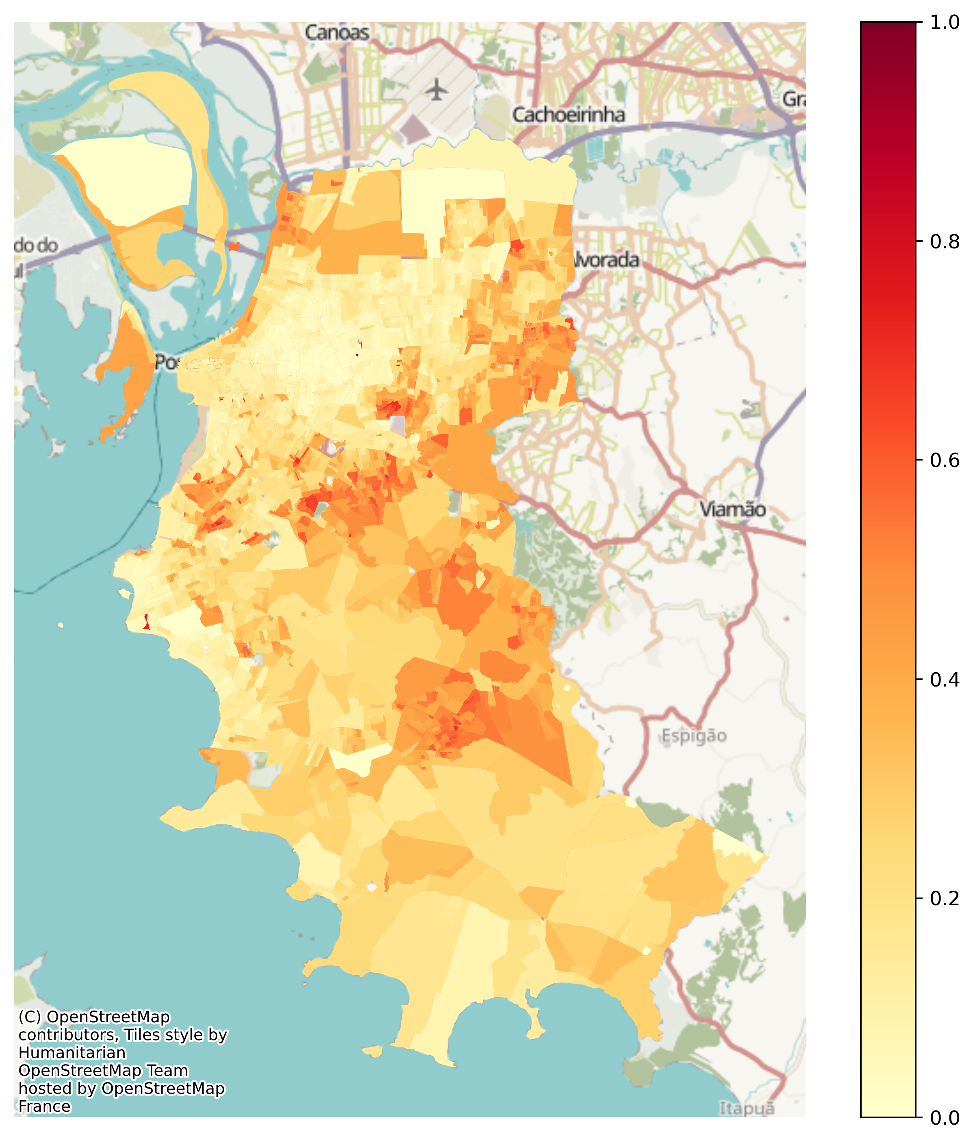
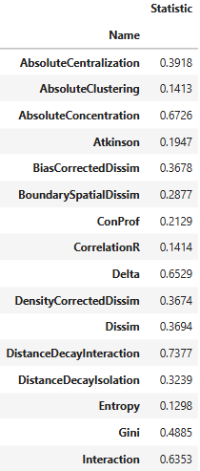

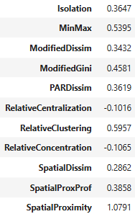
Application: black+brown population in Porto Alegre using census tracts in 2022

Slide 15
Challenge 2: inference framework for hypothesis test
from segregation import inference.SingleValueTest
“systematic”
“bootstrap”
“evenness”
Single Value Test
“person_permutation”
Different Specifications of the Null Hypothesis
“geographic_permutation”
“systematic_permutation”
“even_systematic”

Slide 16
Challenge 2: inference framework for hypothesis test
from segregation import inference.TwoValueTest
“random_label”
Comparative Test
“bootstrap”
Main Different Specifications of the Null Hypothesis
“composition”

Slide 17
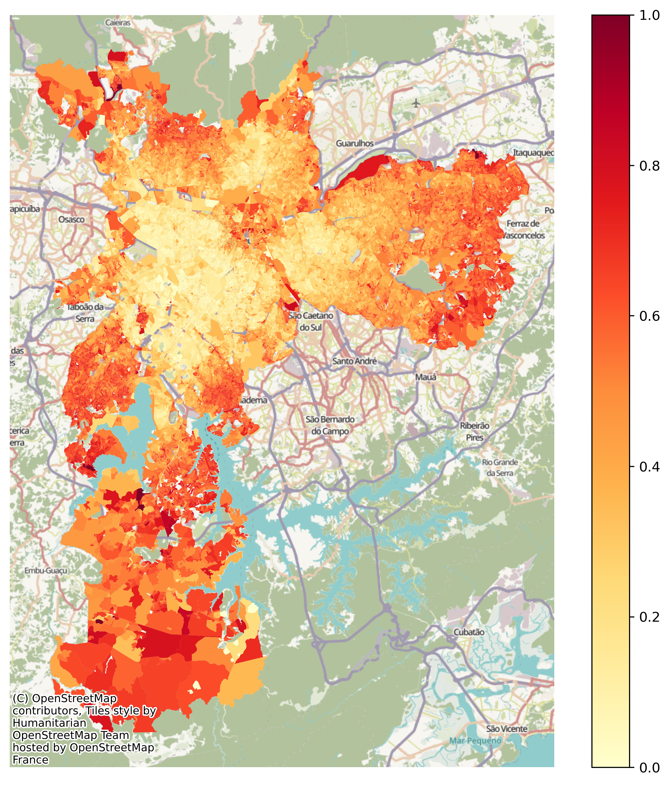
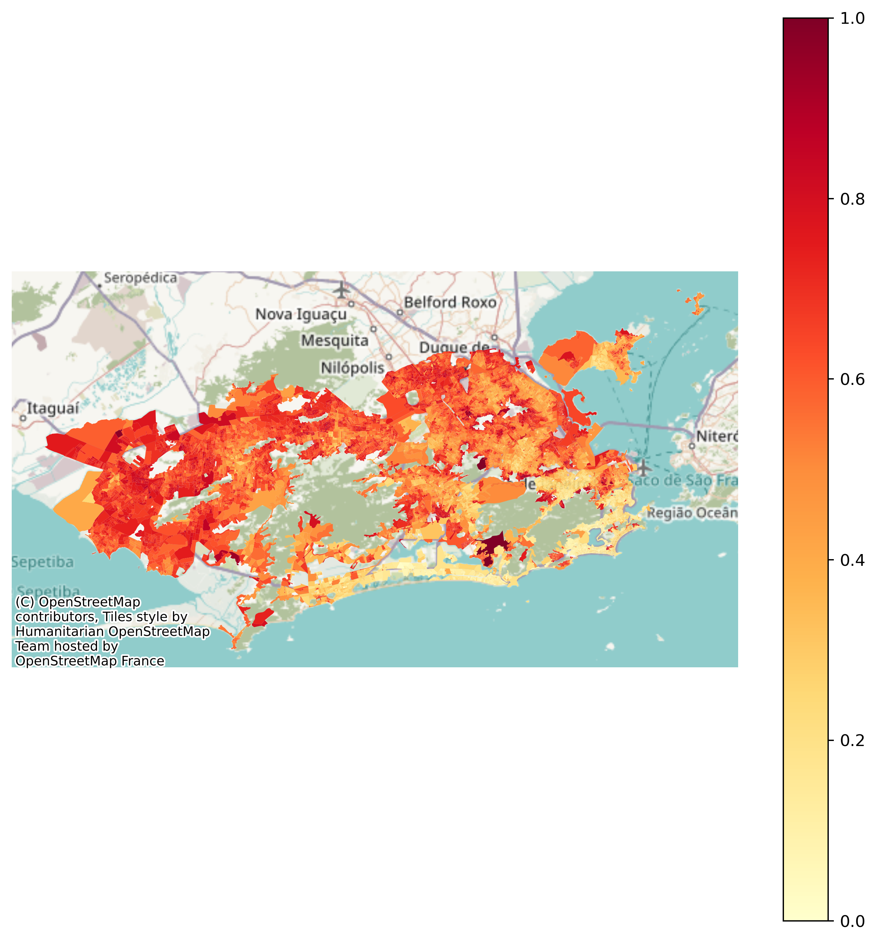
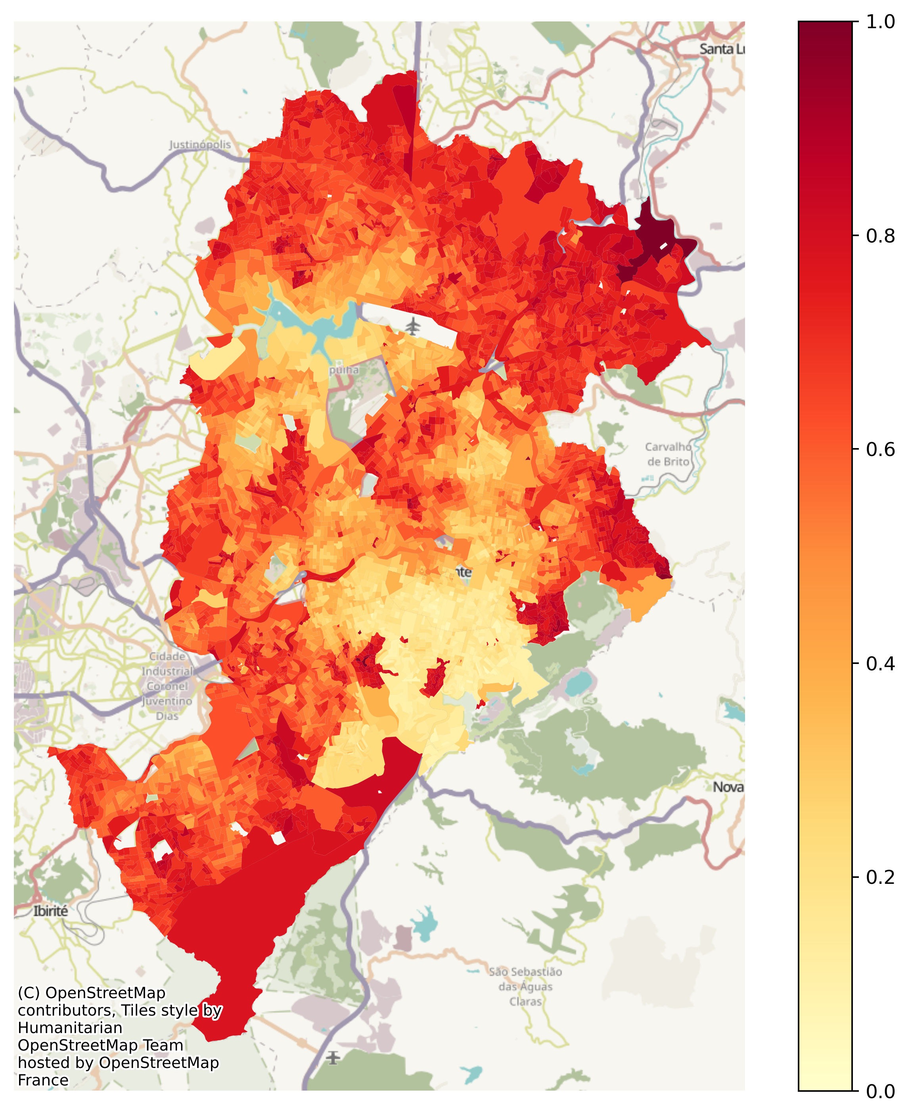
Application: four major Brazilian cities — São Paulo, Rio de Janeiro, Belo Horizonte and Porto Alegre
Porto Alegre, RS
São Paulo, SP
Rio de Janeiro, RJ
Belo Horizonte, MG

Slide 18
Key findings
A clear visual synthesis reveals a consistent pattern of socio-spatial segregation, characterized by a "center-periphery" racial gradient.
In Belo Horizonte and São Paulo there a stark concentration of the Black and Brown population in the distal peripheral zones.
In São Paulo, the central "expanded center" appears in light yellow (indicating a lower share, often below 20%), while the far eastern and southern outskirts transition into deep reds, exceeding 60-80%.
Rio de Janeiro reveals a unique topographical dimension to urban segregation. Unlike the traditional "center-periphery" model seen in other Brazilian cities, Rio de Janeiro displays a more fractured pattern where high-density pockets of the Black and Brown population are often situated in the immediate vicinity of the city's central and coastal hills. This is primarily due to the historical development of favelas (slums) on steep. Consequently, while the map shows lighter tones in the wealthy South Zone, the intermittent dark red clusters adjacent to these areas signify the precarious, hill-based settlements that characterize Rio’s distinct socio-spatial landscape.
In Porto Alegre, while the overall gradient is lighter compared to the northern cities, reflecting regional demographic variations in Southern Brazil, the map still identifies localized clusters of higher concentration in the northern and eastern peripheries, maintaining the structural trend of racialized urban space.

Slide 19
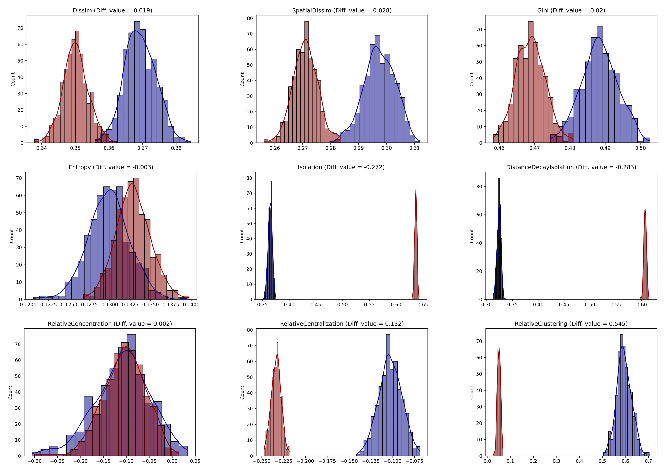
Application: Porto Alegre vs. Belo Horizonte comparative analysis
Porto Alegre (blue) vs. Belo Horizonte (red) distributions under bootstrap simulation

Slide 20
Key findings
For global indices such as Dissimilarity (Dissim), Spatial Dissimilarity, and the Gini index, the non-overlapping distributions indicate that Porto Alegre exhibits statistically higher levels of unevenness in population distribution compared to Belo Horizonte.
Conversely, the Isolation and Distance Decay Isolation metrics show a dramatic reversal; Belo Horizonte (red) displays significantly higher isolation values (concentrated above 0.60) than Porto Alegre (blue, approximately 0.37), suggesting that despite lower overall dissimilarity, Black and Brown residents in Belo Horizonte are much more likely to live in tracts with high intra-group exposure.
Furthermore, the stark divergence in Relative Clustering where Porto Alegre’s distribution is shifted significantly to the right suggests a more intense spatial aggregation of minority groups into contiguous clusters in the southern capital.
Measures like Entropy and Relative Concentration show considerable distributional overlap, indicating that for these specific dimensions of segregation, the differences between the two cities may not reach statistical significance.

Slide 21
Final Remarks
Segregation is not a monolithic phenomenon, and conclusions regarding its presence or evolution depend critically on the chosen dimension and metric.
Residential racial segregation remains a pervasive feature of major Brazilian metropolitan areas, although its spatial expression varies substantially across cities.
Brazilian segregation cannot be characterized by a single urban model. While São Paulo and Belo Horizonte exhibit a pronounced peripheral concentration of Black and Brown residents, Rio de Janeiro reflects a more fragmented spatial structure shaped by the historical development of hillside favelas adjacent to affluent neighborhoods. Porto Alegre presents a similar, although less pronounced, peripheral pattern.
The PySAL segregation module represents a significant advancement in the computational analysis of segregation. By integrating a wide array of indices with flexible and robust inferential tools, it addresses longstanding limitations in the field and opens new avenues for empirical investigation.

