Slide 1
Software Development on Linux Systems
4002-XXX-XX
By
Cody Van De Mark
This work is licensed under the Creative Commons Attribution-ShareAlike 3.0 Unported License. To view a copy of this license, visit http://creativecommons.org/licenses/by-sa/3.0/ or send a letter to Creative Commons, 444 Castro Street, Suite 900, Mountain View, California, 94041, USA.

Slide 2
Today
Version Control
Project Planning

Slide 3
Version Control
Version control is a very important part of development that is used in virtually every place in industry
Version control is the processing of storing code by each update (version) so that all developers can work on the same code at the same time
Historically, it was difficult for developers to work on similar files at the same time unless they would copy all of the code each developer changed into a single new file

Slide 4
Version Control
Version control allows developers to commit their code to each other without overwriting other developers' code
Version control branches back to the 70s/80s in its infancy
Concurrent Version Control (CVS) was released as open source in 1990 and served as the leader in version control for the 1990s
In 2000, another open source version control system launched, Subversion (SVN), which solved many problems that CVS faced

Slide 5
Version Control
Subversion is still the standard of the industry, but like CVS required a central server for all of the code
Version control in open source tends to be a decade ahead of industry
The open source community thrives on new distributed version control systems, such as git, mercurial and bazaar
While CVS and SVN hold a central version control server, distributed version control systems do not have any centralized location and can't fail unless every developer's machine died

Slide 6
Centralized Version Control
Centralized version control has a main (central) server that everyone commits code to and pulls code from
Server holds main trunk and people checkout the branches they need onto their local machine
People usually do not have the entire trunk on their machine, unless the specifically pull everything
Code needs to be up to date with the main server to commit or else it will prevent a commit or overwrite other users' code

Slide 7
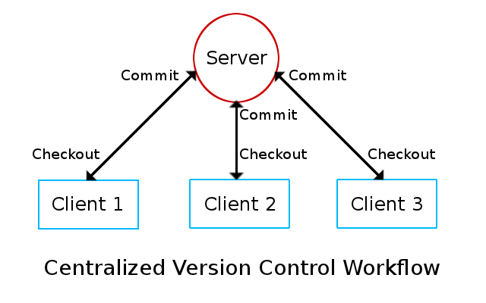
Centralized Version Control

Slide 8
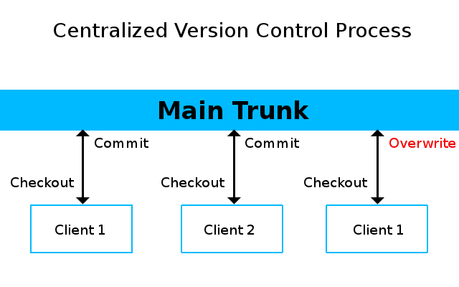
Centralized Version Control

Slide 9
Distributed Version Control
Decentralized version control can have many work flows, including a centralized approach
Decentralized version control allows users to push and pull from any other user or machine
Users may push and pull from one specific machine taking a centralized approach

Slide 10
Distributed Version Control
In a decentralized system, your branch does not need a central server and keeps the entire code base locally unless specified not to
Because there is no central or master in a decentralized system, your code does not need to be up to date with any other user to commit;
Instead, decentralized systems use a merging technique that merges your code with another user's, and lets you modify any conflicts that may have existed
It does not matter how out of date your code is, as the merging technique has a fast-forward option which lets you merge, push or pull from anyone with the same code base

Slide 11
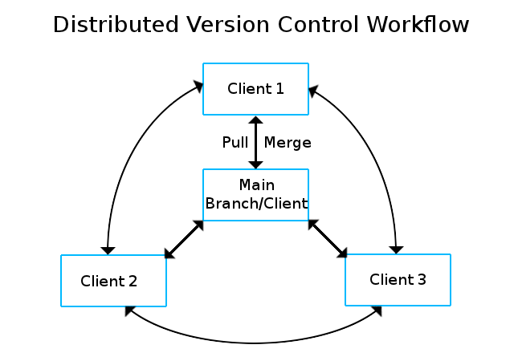
Distributed Version Control

Slide 12
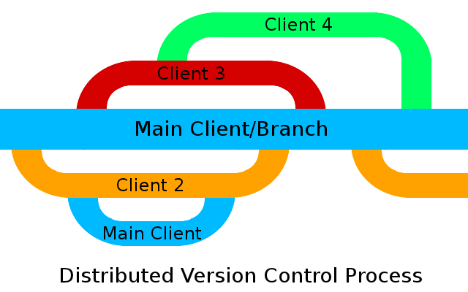
Distributed Version Control

Slide 13
Distributed Version Control
In a distributed version control, the maintainer(s) of the project usually have a master branch which they accept or reject code that was pushed to them;
In an open source project, the master branch is publicly available and anyone can grab a copy to use for their own projects or the existing one
They can code with others and merge together for the existing project or a new project;
If modifying the existing code, the collective code can be pushed back to the master when ready

Slide 14
Distributed Version Control
Advantages:
  Group can set up virtually any kind of work flow model
  No centralized system to fail
  If using a centralized system or main branch, code can be restored by any user if the main fails (IE: hard drive failure)
  Users can work with any other users directly and/or privately
  Any number of branches can exist, including main development, testing, experimental, redesign or any other branch
  Users may also have any number of branches on their local machines for the same purposes
  Code can be updated/merged at any time, regardless of version

Slide 15
Distributed Version Control
Disadvantages
  The only real disadvantage to distributed version control is that it is more complex and harder to understand

Slide 16
Version Control
Your projects requires you to use open source version control software
  It is suggested you use distributed version control software (DVCS)
  DVCS:
    git - http://git-scm.com/
    bazaar (bzr) - http://bazaar.canonical.com/en/
    mercurial (hg) - http://mercurial.selenic.com/
  You may alternatively use subversion (svn) as a centralized system
  http://subversion.apache.org/

Slide 17
Project Planning
Version control is only aspect of project planning, but it is a major aspect of the development process
You also need to be able to plan ahead and manage the development process
You need:
  Planning
  Tracking
  Scheduling
  Communication

Slide 18
Project Planning
For planning and tracking you may want to use a free project organization website
http://bettermeans.com
http://trello.com
http://corkboard.me
http://asana.com
Alternatively, you may want to just plan in more simplistic ways, such as Google docs or spreadsheets
If you want to jump ahead in the course, you can use Launchpad or Github for tracking (bugs, issues, features, etc)
*Note: You can plan with these also, but it is less clear

Slide 19
Project Planning
For scheduling and progress tracking, you may want to use scheduling software like openproj
http://sourceforge.net/projects/openproj/files/
*Note: Look in binaries for Deb and RPM installers
Again, you may want to take the classic approach and track scheduling and progress through Google calendar or some other system

Slide 20
Project Planning
Finally, you will need to communicate very often for your project
You are probably already using mailing lists to communicate, but it is highly recommended your use IRC as it is very fast and easy to setup for logging
You may also want to consider Google Hangout, Ekiga (open source video/voip conferencing) or Skype
Of course, it is suggested you meet in person as well, both for administrative and coding sessions

Slide 21
Project Planning
Every one in the group should always blog about the results of their meetings, code sessions, developments, scheduling, etc
Remember, just because another member in your group blogged about a topic does not mean you should not
You need to blog your results regardless for this class
Exposure is good; Employers will be impressed by your blog, and the more people blogging about your project, the more popular it gets

