Slide 1
Dating Skeleton Project
Renata Rybarova

Slide 2
Dataset exploration
Length of the dataset
59946
List of columns
'age' 'body_type' 'diet' 'drinks' 'drugs' 'education' 'essay0' 'essay1’ 'essay2' 'essay3' 'essay4' 'essay5’ 'essay6' 'essay7' 'essay8' 'essay9’ 'ethnicity' 'height' 'income' 'job' 'last_online' 'location' 'offspring’ 'orientation' 'pets' 'religion' 'sex' 'sign' 'smokes' 'speaks' 'status’
Unique values in columns
'a little extra' 'average' 'thin' 'athletic' 'fit' nan 'skinny' 'curvy’ 'full figured' 'jacked' 'rather not say’ ‘ ‘used up' 'overweight'

Slide 3
Dataset exploration
Count values in columns
smokes column
no 43896
sometimes 3787
when drinking 3040
yes 2231
trying to quit 1480

Slide 4
Exploration and Questions
During the exploration of the dataset I focused on two groups of features:
Bad habits features (smokes, drinks, drugs)
Essays features – the style of writing
Based on this two groups of features I formulated my hypothesis/questions. I wanted to see, if I can estimate age, income or sex from these features

Slide 5
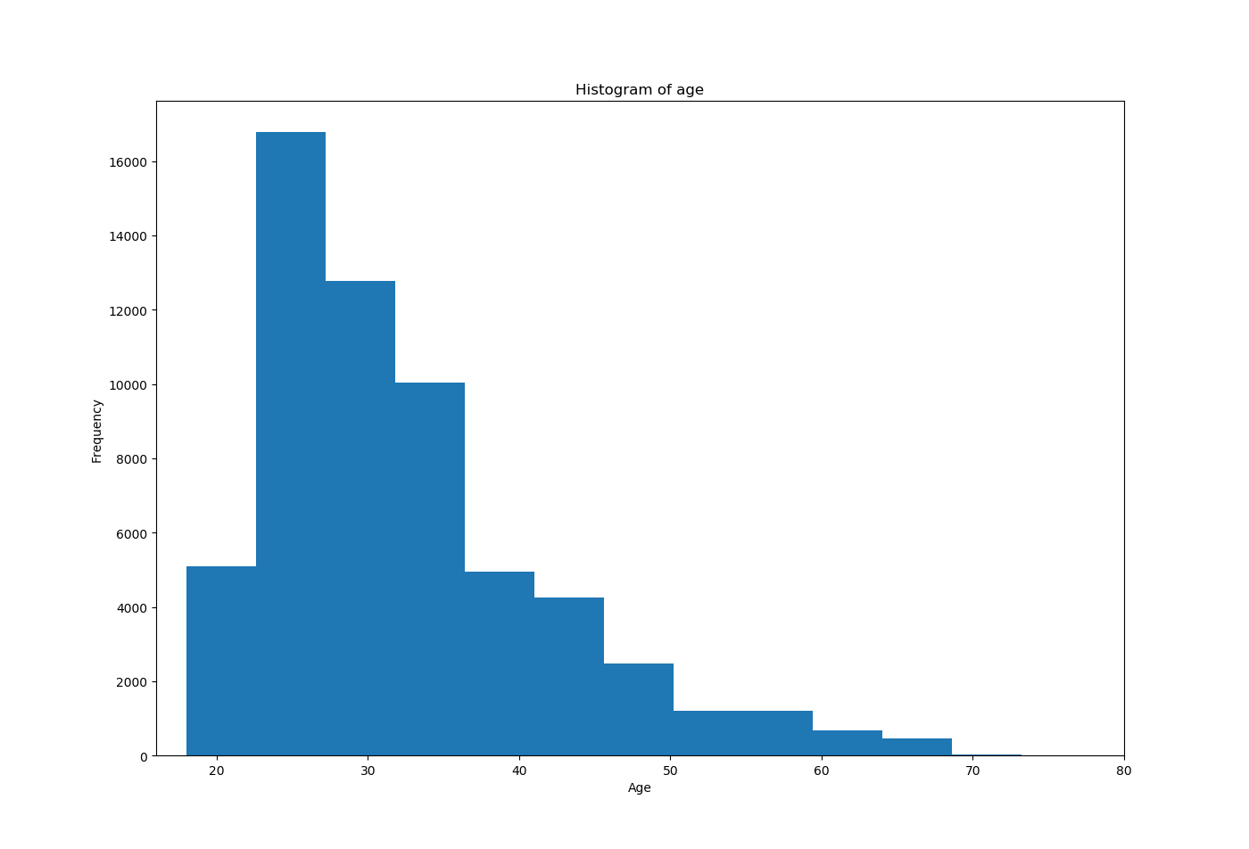
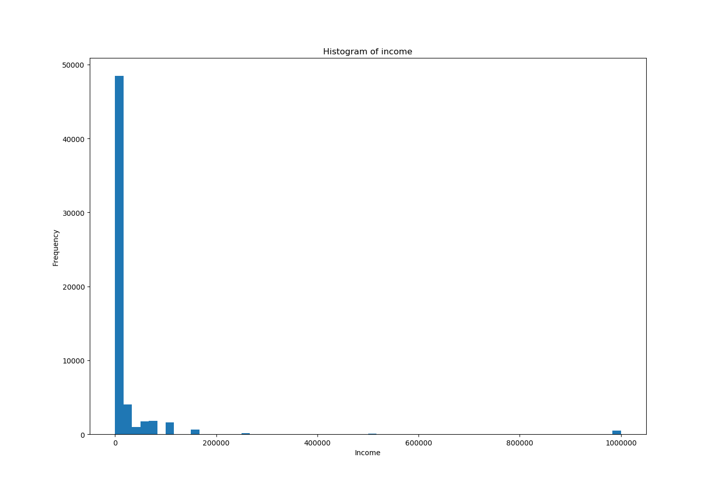
Dataset exploration – age and income histograms

Slide 6
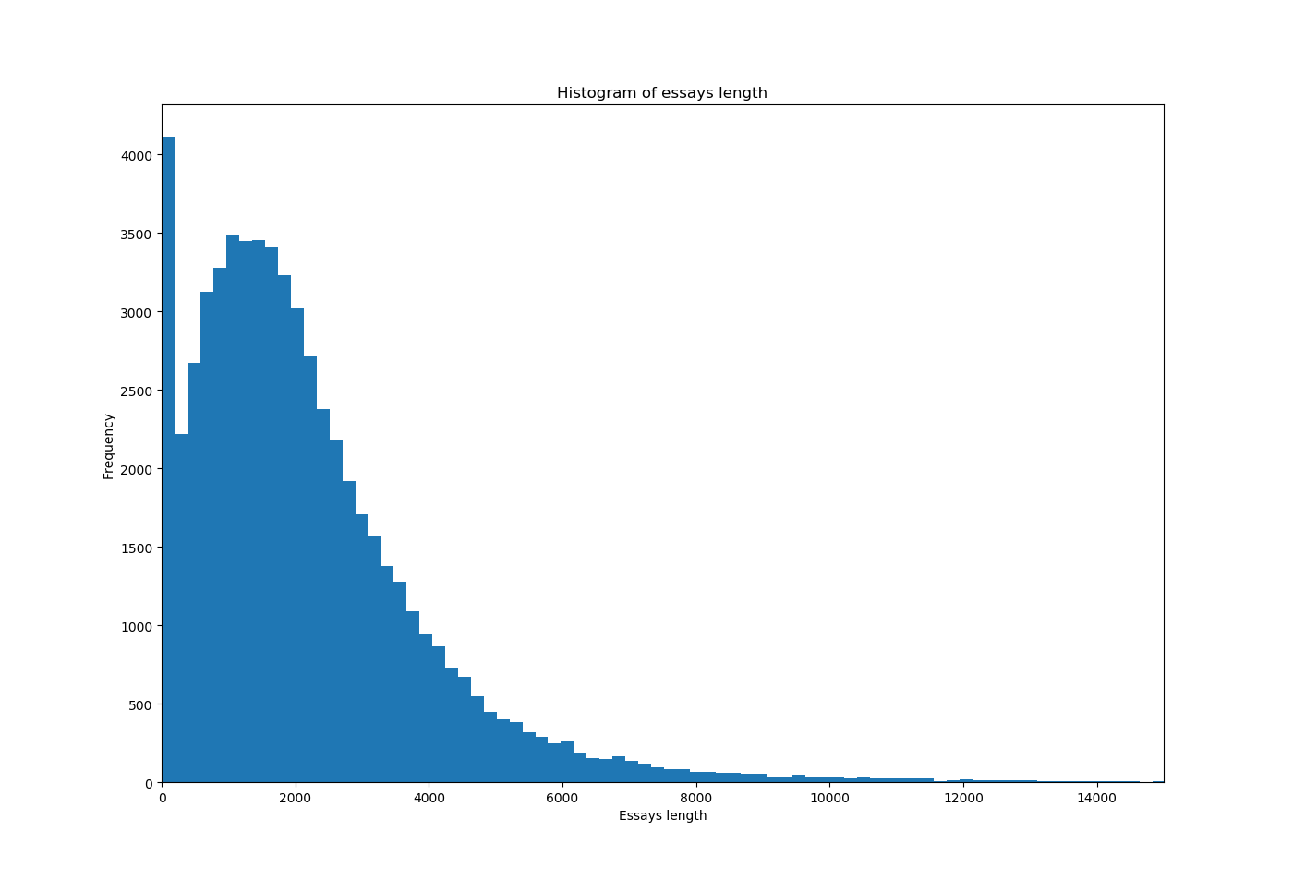
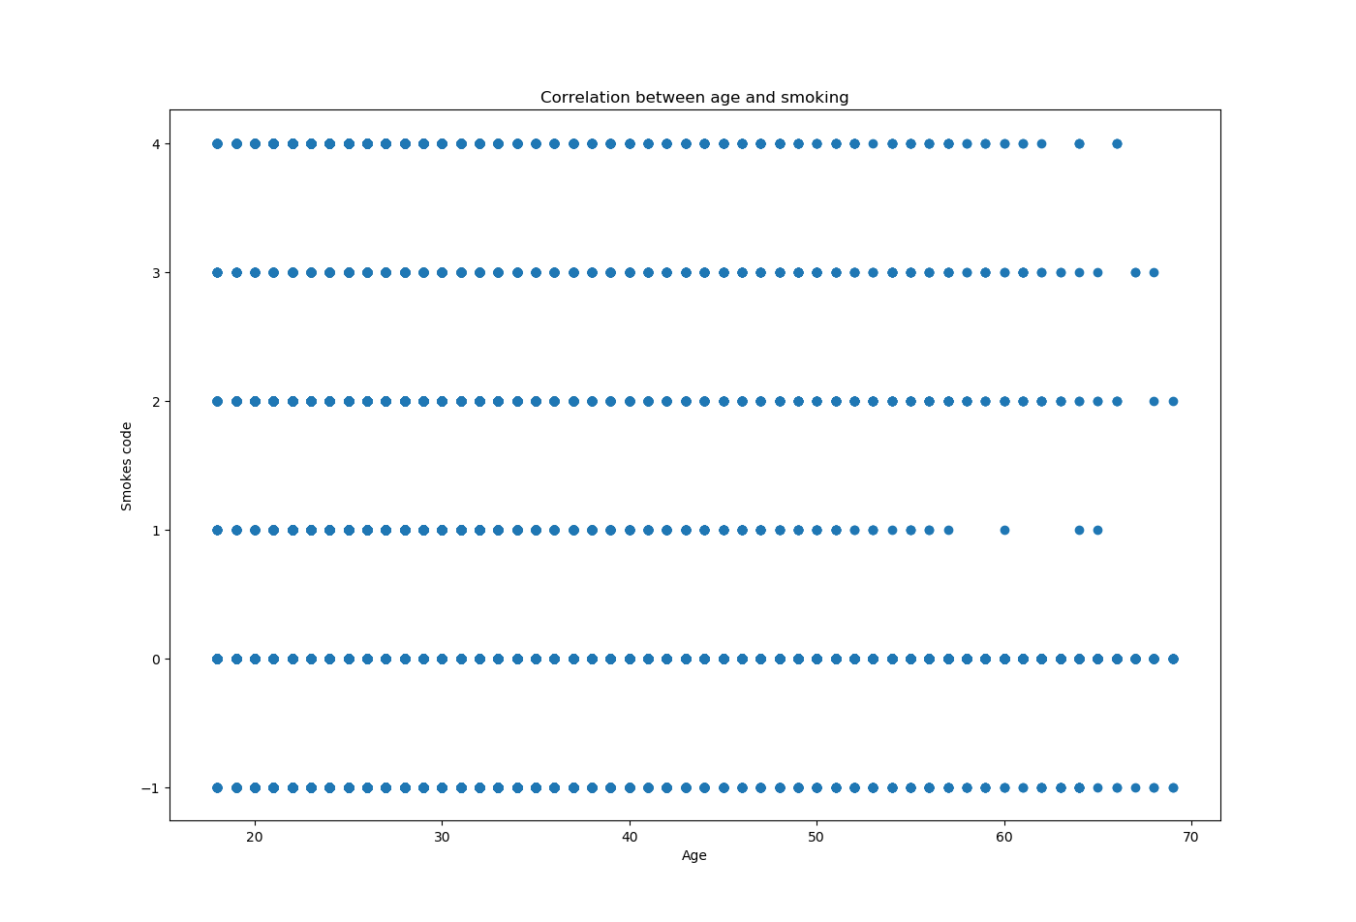
Dataset exploration – essay length histogram and age/smoking correlation
0 = no, 1 = when drinking, 2 = sometimes, 3 = trying to quit, 4 = yes, -1 = not defined

Slide 7
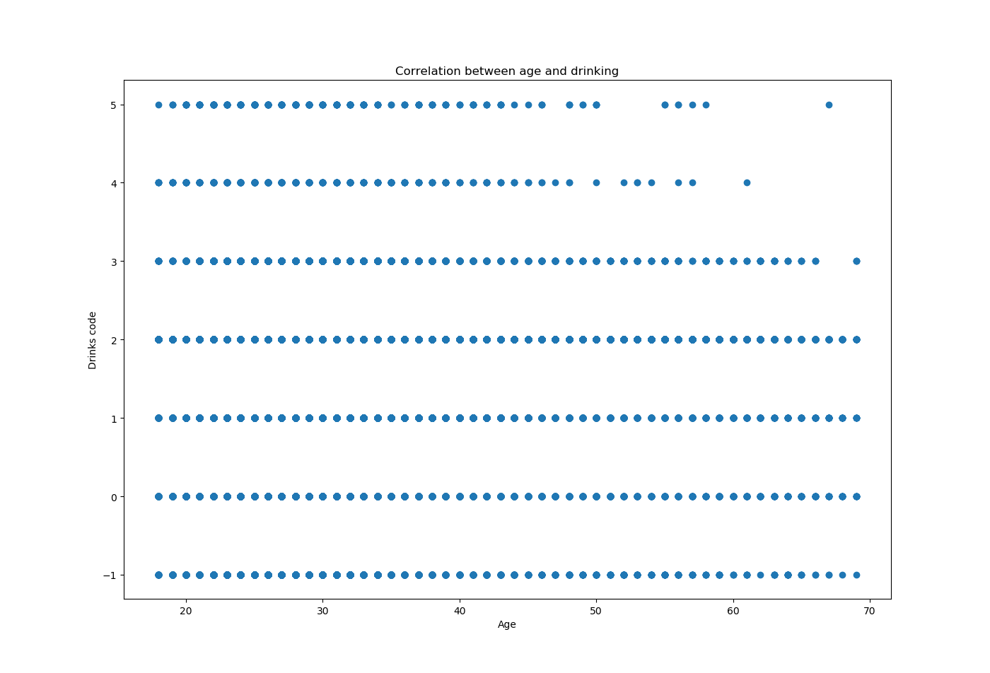
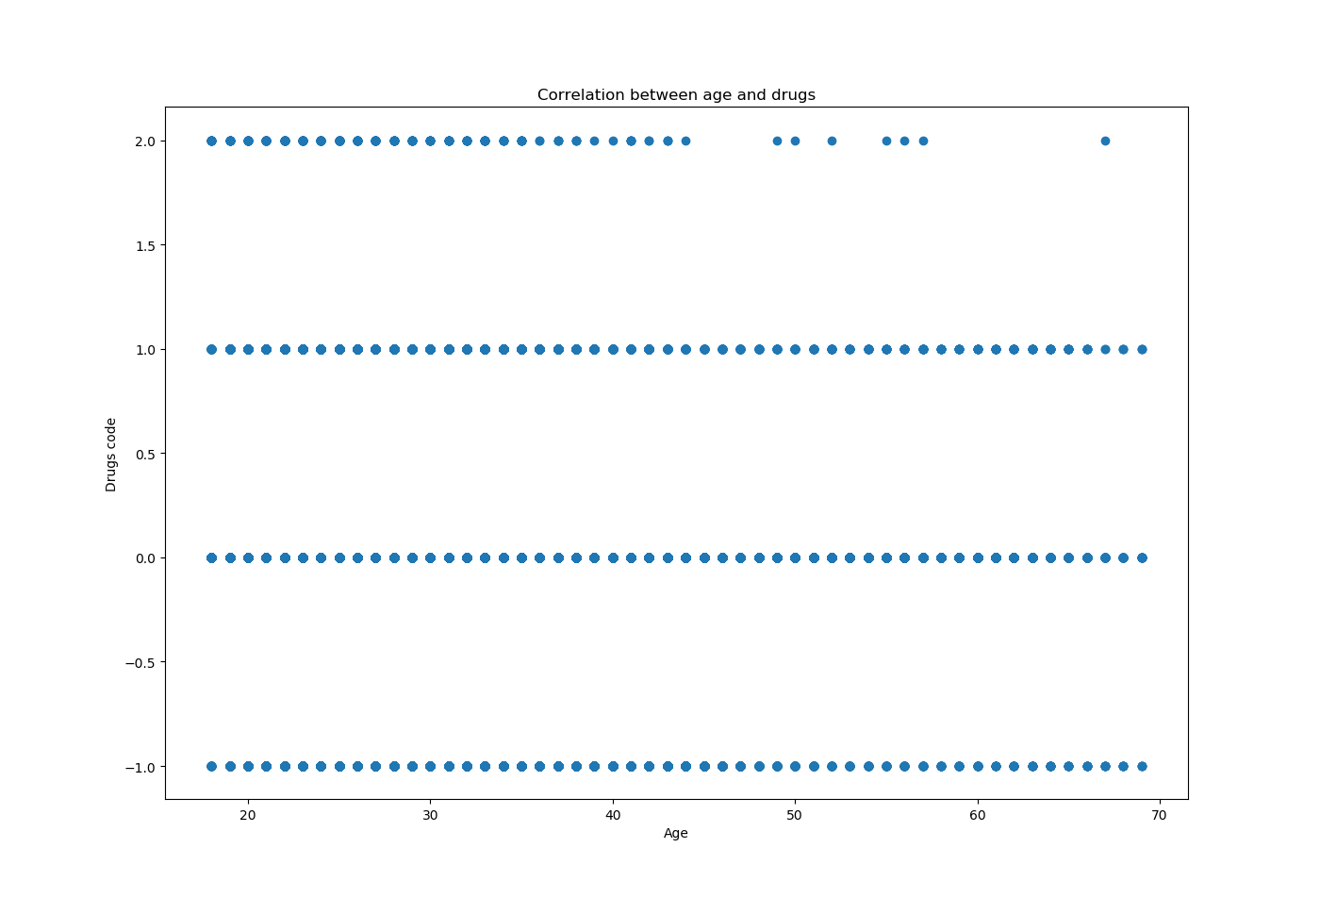
Dataset exploration – age/drinking and age/drugs correlations
0 = not at all, 1= rarely, 2 = socially, 3 = often, 4 = very often, 5 = desperately, -1 = not defined
0 = never, 1 = sometimes, 2 = often, -1 = not defined

Slide 8
Questions
Q1: Can we predict income based on age using regression?
Q2: Can we derive age from bad habits (smoking, drinking, drugs) or from the style of writing (essays in our dataset)?
Q3: Can we predict body type based on bad habits (smoking, drinking, drugs), age and sex?
Q4: Can we predict income based on the style of writing (essays in our dataset) and sex?
Q5: Can we predict sex based on the style of writing (essays in our dataset)?

Slide 9
Data preprocessing 1
To answer listed questions it was necessary to create new columns
age_binned, age_code
sex_code
body_type_code
drinks_code, drugs_code, smokes_code
essay_len, I_count, avg_word (length of the essay; count number of I, I'm or me; average length of words in the essay)
exclamation_count, articles_count, quant_count (count number of ! – mostly used by women; count number of a, the; count number of like, a lot of – mostly used by men [https://debuk.wordpress.com/tag/gender-genie/]

Slide 10
Data preprocessing 2
Example how I created smokes_code column
Find out the values in the smokes columns: print(df.smokes.unique())
Create mapping: smokes_mapping = {"no": 0, "when drinking": 1, "sometimes": 2, "trying to quit":3, "yes":4}
Map it into the new column called sex_code: df["smokes_code"] = df.smokes.map(smokes_mapping)
Example how I created I_count column
Count number of ‘I’, ‘I’m’ and ‘me’: df["I_count"]= all_essays.apply(lambda x: sum(s in {"i", "i'm", "me"} for s in nltk.wordpunct_tokenize(x)))
Natural Language Toolkit function is used

Slide 11
Data preprocessing 3
In essays columns all NaN values were replaced by a space character. All essays column were than combined into one column.
In case of mapping text values into numerical values the NaN values were replaced by -1.
Example of body type mapping:
"thin": 0, "skinny": 0, "a little extra": 0, "fit": 1, "jacked": 1, "athletic": 1,"average": 2, "curvy": 3, "full figured": 3, "used up": 3, "overweight": 3, "rather not say": 3
I used only 4 categories for body type, 0 - skinny type, 1 – sporty type, 2 – average type, 3 - others

Slide 12
Data preprocessing 4 - normalization
Before using classification techniques we must ensure the data have the same weight, otherwise we do not to achieve accurate result
In this project MinMaxScaler() was used for this purpose

Slide 13
Regression techniques – income based on age 1
Q1: Can we predict income based on age using regression?

Slide 14
Regression techniques - income based on age 2
From the income histogram we can see that one value has the majority. It is value -1, so the most of the people did not fill their income. I decided to remove all rows with this value to avoid unwanted impact. The disadvantage of this aspect is loss of the all rows corresponding to this value (49011rows).
Also outliers with too high income were removed (income higher than 500000).
In spite the results were not satisfactory.

Slide 15
Regression techniques – income based on age 3
Results for Linear Regression:
Regression coefficients: [[1416.85264658]]
Regression intercept: [13641.88086181]
RMSE value= 40900.24183628699
Age v. Income LR Score for train set: 0.10910080535023725
Age v. Income LR Score for test set:: 0.09073992035848577

Slide 16
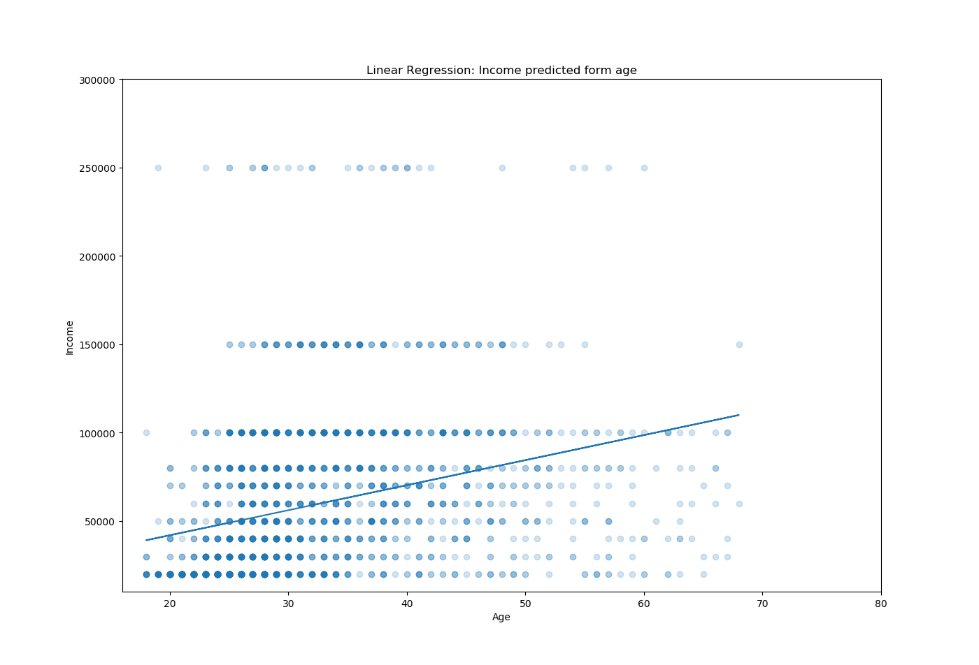
Regression techniques - income based on age 4

Slide 17
Regression techniques – income based on age 5
Results for KNN Regression:
k = 61 (best score for k from interval 1 to 100)
Age v. Income KNN Regression Score for train set: 0.31412894375857336
Age v. Income KNN Regression Score for test set: 0.3342478280749886
The best score is for k=61 but the lowest RMSE = 45479.71203378284 is for k=1
Age v. Income KNN Regression Score for k=1: 0.22496570644718794

Slide 18
Regression techniques – income based on age 6
RMSE values for k: [45479.71203378284, 48250.60324292225, 52177.11036371827, 55281.21564262478, 54094.78717108983, 49228.61759305716, 53198.990608258166, 53228.205717074175, 53724.98514052226, 53184.37703571159, 50402.13232437769, 50561.0949798373, 50886.067454626515, 50404.400269515085, 50291.786921255516, 47754.803548991214, 48708.04562160319, 47860.01153531987, 48658.2663701185, 49198.88623688711, 50263.5941615185, 49808.04488395748, 49802.07740225549, 49846.12811784072, 49762.58218974503, 49876.390416585426, 48981.39396477513, 49024.31672694811, 48298.435914129324, 49614.42553179952, 49022.91766442381, 48865.969187902825, 49968.89750513185, 49918.54361656866, 47724.15403995598, 48590.560029757704, 48581.61950780269, 48589.148477764444, 48596.67628128042, 48011.677439486215, 47613.84451291884, 47951.64078194657, 48316.420104974684, 47922.07132399131, 48242.54753612719, 47882.935285349035, 47902.03003030492, 47981.19201708074, 47228.15261720706, 47560.03594139877, 47563.881429544876, 47553.78635992161, 47751.93099320955, 48542.07325697948, 48653.09768182797, 48374.58624548206, 48291.80847133496, 47094.35605462039, 47481.13479968196, 47523.48828451939, 47137.05706832622, 47201.0361576689, 47235.89731790354, 47296.84251934747, 47289.107799858415, 47642.165660140745, 47654.161069264075, 47682.45827034557, 47732.29723530865, 47726.07021092118, 47726.07021092118, 47610.96345252756, 47598.95715717778, 47205.39521062516, 47275.08539528226, 47275.08539528226, 47403.066930929286, 47225.24802700041, 47225.24802700041, 47225.24802700041, 47162.27131289317, 47902.984567753185, 47902.984567753185, 47895.34773550637, 47895.34773550637, 47211.206655160866, 47186.987581134774, 47167.118660797736, 47191.34793175453, 47215.56476915267, 47203.45790345217, 47203.45790345217, 47215.56476915267, 47203.45790345217, 47215.56476915267, 47203.45790345217, 47203.45790345217, 47203.45790345217, 47247.99587130226]

Slide 19
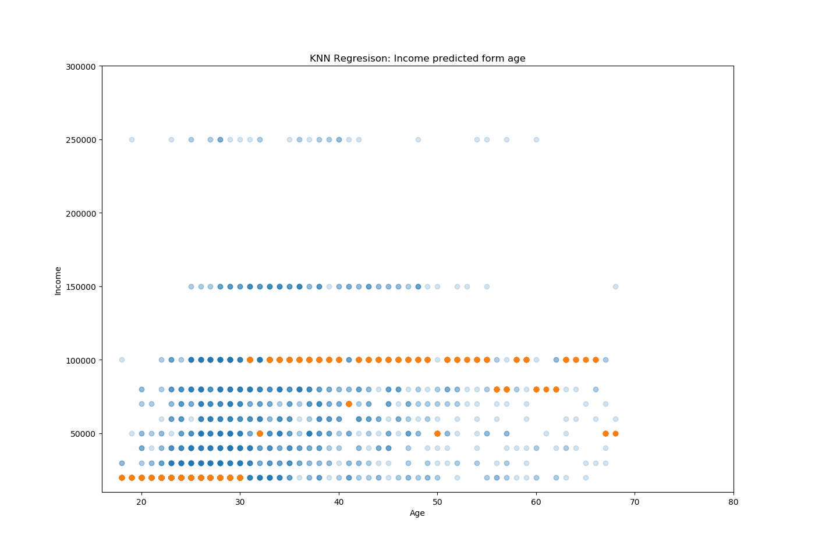
Regression techniques – income based on age 7
Orange dots are predicted values

Slide 20
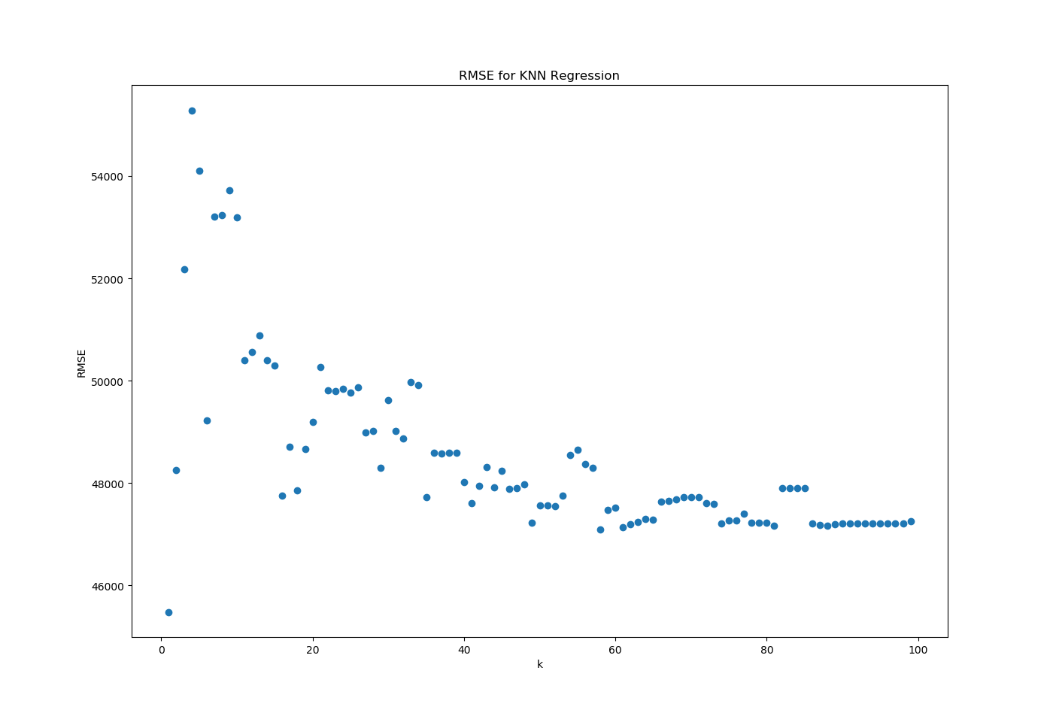
Regression techniques – income based on age 8

Slide 21
Regression techniques – income based on age 9
Comparison of both approaches:
Linear regression (LR) is simpler and thus easier to understand than KNN
LR Score is lower than KNN Score, but the RMSE value is lower for LR
The results for KNN Regression are questionable: is it better to have model with the best score or the lowest RMSE? Having best score with k=1 means having income values only in one cluster, which is not very useful.
Problem can be that we did not have enough data (there was lot of -1 values). The other options than remove the rows with missing data could be to put there mean value or some random values. It can be scope of future work to see how this can influence our model.
Conclusion – the income is not linearly dependent from age

Slide 22
Classification techniques – age from bad habits 1
Q2: Can we derive age from bad habits (smoking, drinking, drugs) or from the style of writing (essays in our dataset)?

Slide 23
Classification techniques – age from bad habits 2
To answer the Q2 I used two classification models: KNN and SVC
Three sets of features for KNN:
1. Bad habits features (drugs, drinks and smokes)
2. Essays features (length of features, count of I, me in the text and average length of words in the essay)
3. Combination of both groups of features
One set of features for SVC:
Bad habits features (drugs, drinks and smokes)
Outliers from age were removed (people older than 80 years)

Slide 24
Classification techniques – age from bad habits 3
Results for KNN (1. set of features):
k=16 – the best score
Confusion matrix:
[[ 1 375 11 4 0 0]
[ 2 5713 264 11 0 0]
[ 0 3356 169 9 0 0]
[ 0 1314 57 7 0 0]
[ 0 493 19 3 0 0]
[ 0 170 10 1 0 0]]
Accuracy score 0.4976228209191759
Recall score [0.00255754 0.95375626 0.04782117 0.00507983 0. 0. ]
Precision score [0.33333333 0.5002189 0.31886792 0.2 0. 0. ]
F1 score [0.00507614 0.65625179 0.08316929 0.009908 0. 0. ]

Slide 25
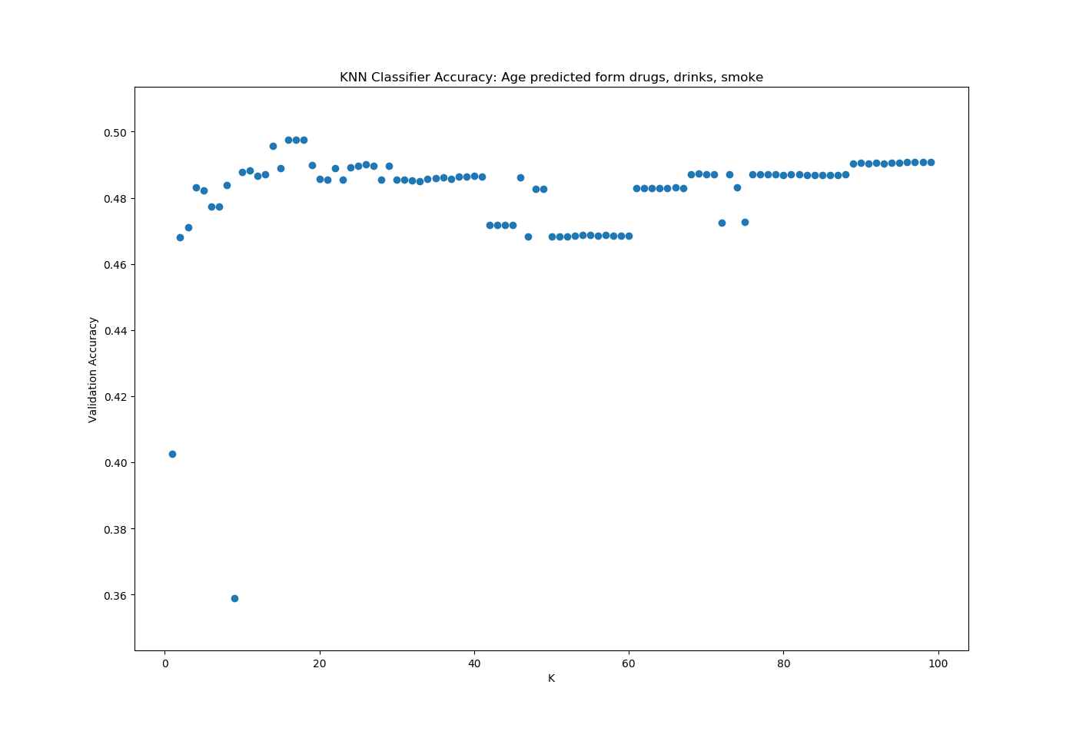
Classification techniques – age from bad habits 4

Slide 26
Classification techniques – age from bad habits 5
Results for KNN (2. set of features):
k=83 – the best score
Confusion matrix:
[[ 0 285 3 0 0 0]
[ 0 5624 260 0 0 0]
[ 0 3166 216 0 0 0]
[ 0 1201 99 0 0 0]
[ 0 473 38 0 0 0]
[ 0 189 11 0 0 0]]
Accuracy score 0.5049718979680069
Recall score [0. 0.95581237 0.06386753 0. 0. 0. ]
Precision score [0. 0.51417078 0.34449761 0. 0. 0. ]
F1 score [0. 0.6686482 0.10775755 0. 0. 0. ]

Slide 27
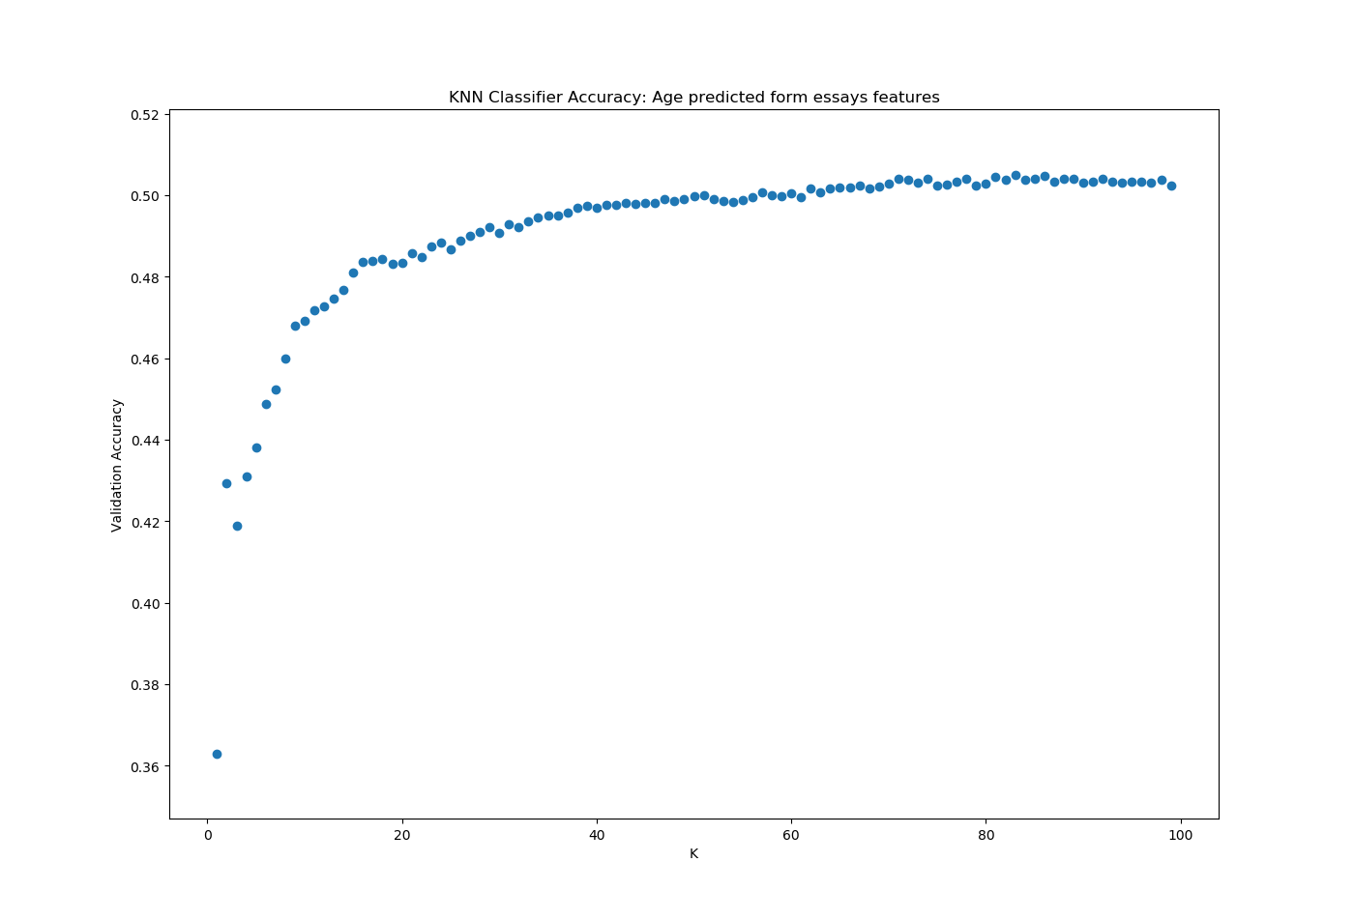
Classification techniques – age from bad habits 6

Slide 28
Classification techniques – age from bad habits 7
Results for KNN (3. combined sets of features):
k=99 – the best score
Confusion matrix:
[[ 0 279 9 0 0 0]
[ 0 5596 283 5 0 0]
[ 0 3103 276 3 0 0]
[ 0 1160 138 2 0 0]
[ 0 441 69 1 0 0]
[ 0 179 21 0 0 0]]
Accuracy score 0.5079118028534371
Recall score [0. 0.9510537 0.08160852 0.00153846 0. 0. ]
Precision score [0. 0.52017104 0.34673367 0.18181818 0. 0. ]
F1 score [0. 0.67251532 0.13212063 0.00305111 0. 0. ]

Slide 29
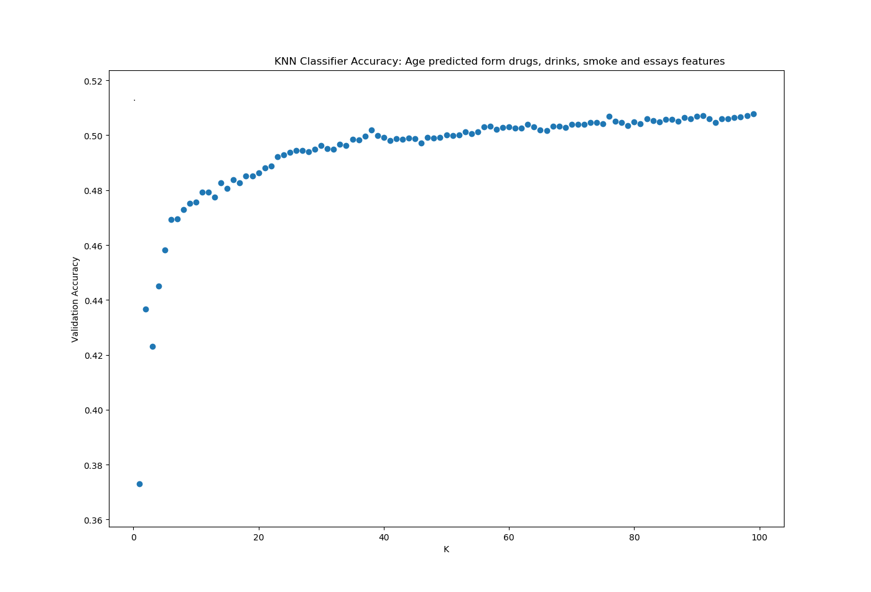
Classification techniques – age from bad habits 8

Slide 30
Classification techniques – age from bad habits 9
Results for SVC (1. set of features):
Best model parameters:
{'C': 0.9, 'gamma': 10}
Confusion matrix:
[[ 0 385 6 0 0 0]
[ 0 5931 59 0 0 0]
[ 0 3480 54 0 0 0]
[ 0 1352 26 0 0 0]
[ 0 506 9 0 0 0]
[ 0 176 5 0 0 0]]
Accuracy score 0.5087764807609165
Recall score [0. 1. 0. 0. 0. 0.]
Precision score [0. 0.50877648 0. 0. 0. 0. ]
F1 score [0. 0.6744226 0. 0. 0. 0.]

Slide 31
Classification techniques – age from bad habits 10
Conclusion:
The algorithm for finding the SVC best model parameters ran approximately 4 times longer than KNN (that’s why I tested SVC only for one set of features).
KNN model achieved the same accuracy score for all sets of features
From confusion matrix we can see that model using bad habits features handled better imbalanced number of samples for age class, but not as I expected (the biggest values on diagonal)

Slide 32
Classification techniques – age from bad habits 11
Conclusion:
SVC achieved almost the same score as KNN model with the same set of features
Confusion matrix shows as that this model classified everything into only one age category (bin)
It would be interesting to see also how other values: Recall, Precision and F1 change in relation to k or gamma. But as the output for them was multidimensional, I did not know how to handle it – to make average, median, addition…?
The KNN model is better to predict age from bad habits than SVC.
Conclusion – there is just small dependency between age and bad habits. The tested KNN and SVC models can derive age with 50% accuracy, which is still not enough to have precise model.

Slide 33
Classification techniques – body type from bad habits, age and sex 1
Q3: Can we predict body type based on bad habits (smoking, drinking, drugs), age and sex?

Slide 34
Classification techniques – body type from bad habits, age and sex 2
To answer the Q3 I used two classification models: KNN and SVC
One sets of features for KNN and SVC:
Bad habits features (drugs, drinks and smokes)
Age (age binned)
Sex
Outliers from age were removed (people older than 80 years)

Slide 35
Classification techniques – body type from bad habits, age and sex 3
Results for KNN:
k=43 – the best score
Confusion matrix:
[[ 89 1459 161 84]
[ 68 4647 221 86]
[ 74 2508 241 105]
[ 40 844 175 128]]
Accuracy score 0.4670631290027447
Recall score [0.04963748 0.92532855 0.08230874 0.10783488]
Precision score [0.32841328 0.49133009 0.30200501 0.31761787]
F1 score [0.08624031 0.64185083 0.12936125 0.16100629]

Slide 36
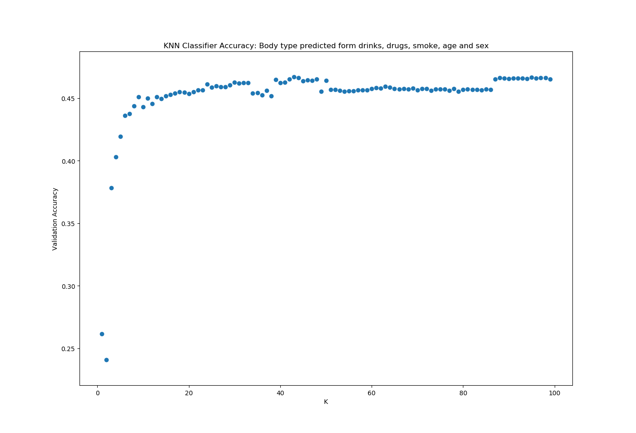
Classification techniques – body type from bad habits, age and sex 4

Slide 37
Classification techniques – body type from bad habits, age and sex 5
Results for SVC:
Best model parameters:
{'C': 0.9, 'gamma': 7}
Confusion matrix:
[[ 32 1507 166 88]
[ 16 4769 149 88]
[ 23 2611 165 129]
[ 6 939 104 138]]
Accuracy score 0.466971637694419
Recall score [0.01784718 0.94962166 0.05635246 0.11625948]
Precision score [0.41558442 0.485345 0.28253425 0.31151242]
F1 score [0.0342246 0.64237608 0.09396355 0.16932515]

Slide 38
Classification techniques – body type from bad habits, age and sex 6
Conclusion:
The both algorithms ran approximately the same time
Both model achieved almost the same accuracy score
There aren’t big differences between confusion matrixes, but there is still a problem with imbalanced dataset
Again, it would be interesting to see also how other values: Recall, Precision and F1 change in relation to k or gamma. It can help to improve model and maybe find better parameters (k, gamma or C).
Conclusion – there is some dependency between body type and bad habits, age and sex. The tested KNN and SVC models can derive age with 46% accuracy, which is still not enough to have precise model. Maybe adding additional features as diet type and high can improve models.

Slide 39
Classification techniques – income based on writing style 1
Q4: Can we predict income based on the style of writing (essays in our dataset) and sex?

Slide 40
Classification techniques – income based on writing style 2
To answer the Q4 I used two classification models: KNN and SVC
One sets of features for KNN and SVC:
Essays features (length of features, count of I, me in the text and average length of words in the essay)
Sex
Rows where income was not filled (-1) were removed. If not removed the KNN model would classify everything into this one category of income (the input set of income data was extremely unbalanced).

Slide 41
Classification techniques – income based on writing style 3
Results for KNN:
k=57 – the best score
Confusion matrix:
[[508 2 1 3 0 0 2 66 0 0 0 1]
[169 2 1 1 0 1 2 36 0 0 0 0]
[142 0 0 0 0 0 1 30 0 0 0 0]
[147 2 1 3 0 0 2 26 0 0 0 0]
[106 0 1 1 1 0 3 25 0 0 0 1]
[107 0 0 1 0 0 2 20 0 0 0 0]
[167 0 2 0 0 0 2 37 0 0 0 0]
[264 1 0 6 1 0 3 65 1 0 0 0]
[ 91 1 0 1 0 0 0 28 0 0 0 0]
[ 26 0 0 0 0 0 2 4 0 0 0 0]
[ 5 0 0 0 0 0 1 2 0 0 0 0]
[ 83 1 1 1 0 1 1 11 0 0 0 0]]

Slide 42
Classification techniques – income based on writing style 4
Results for KNN:
Accuracy score 0.2610062893081761
Recall score [0.87135506 0.00943396 0. 0.01657459 0.00724638 0. 0.00961538 0.19061584 0. 0. 0. 0.]
Precision score [0.27988981 0.22222222 0. 0.17647059 0.5 0. 0.0952381 0.18571429 0. 0. 0. 0.]
F1 score [0.42368641 0.01809955 0. 0.03030303 0.01428571 0. 0.01746725 0.18813314 0. 0. 0. 0.]

Slide 43
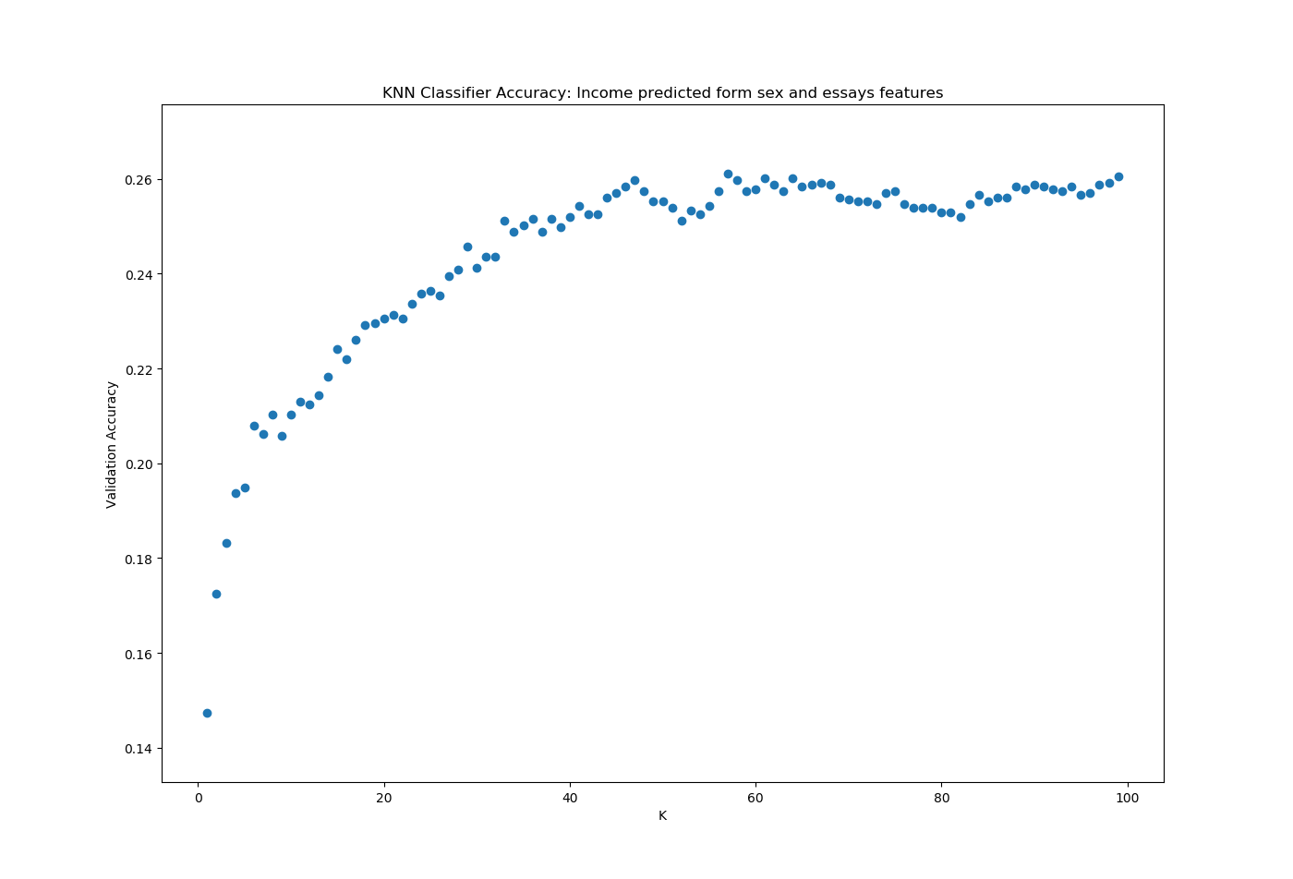
Classification techniques – income based on writing style 5

Slide 44
Classification techniques – income based on writing style 6
Results for SVC:
Best model parameters:
{'C': 0.9, 'gamma’: 1}
Confusion matrix:
[[583 0 0 0 0 0 0 0 0 0 0 0]
[212 0 0 0 0 0 0 0 0 0 0 0]
[173 0 0 0 0 0 0 0 0 0 0 0]
[181 0 0 0 0 0 0 0 0 0 0 0]
[138 0 0 0 0 0 0 0 0 0 0 0]
[130 0 0 0 0 0 0 0 0 0 0 0]
[208 0 0 0 0 0 0 0 0 0 0 0]
[341 0 0 0 0 0 0 0 0 0 0 0]
[121 0 0 0 0 0 0 0 0 0 0 0]
[ 32 0 0 0 0 0 0 0 0 0 0 0]
[ 8 0 0 0 0 0 0 0 0 0 0 0]
[ 99 0 0 0 0 0 0 0 0 0 0 0]]

Slide 45
Classification techniques – income based on writing style 7
Results for SVC:
Accuracy score 0.2619047619047619
Recall score[1 0. 0. 0. 0. 0. 0. 0. 0. 0. 0. 0.]
Precision score [0.26190476 0. 0. 0. 0. 0. 0. 0. 0. 0. 0. 0.]
F1 score [0.41509434 0. 0. 0. 0. 0. 0. 0. 0. 0. 0. 0.]

Slide 46
Classification techniques – income based on writing style 8
Conclusion:
The algorithm for finding the SVC best model parameters ran approximately 2 times longer than KNN
Both model achieved almost the same accuracy score
Confusion matrix of KNN model has better results than for SVC (but not significantly and still it’s not as expected – the highest values on the diagonal)
Again, it would be interesting to see also how other values: Recall, Precision and F1 change in relation to k or gamma. But there was problem how to deal with their multidimensionality.
Conclusion – there is only small correlation between essays features and income. It is difficult to say if the models (both KNN and SVC have accuracy 26%) could be better if we have more samples with income in our dataset. Or if we apply some methodology how to fill in missing inputs for income.

Slide 47
Classification techniques – sex based on writing style 1
Q5: Can we predict sex based on the style of writing (essays in our dataset)?

Slide 48
Classification techniques – sex based on writing style 2
To answer the Q5 I used two classification models: KNN and Naive Bayes Classifier
One sets of features for KNN which combined artificial properties of the essay, some of which were created based on quick research on writing style differences between sexes:
All essays features (length of features,
count of I, me in the text and average length of words in the essay, count of used ! – typical for women,
count of used articles a, the – typical for men, count of like, a lot of – typical for men)
For Naive Bayes Classifier the complete essays were used

Slide 49
Classification techniques – sex based on writing style 3
Results for KNN:
k=99 – the best score
Confusion matrix:
[[6227 670]
[3863 805]]
Accuracy score 0.608041504539559
Recall score 0.17245072836332476
Precision score 0.5457627118644067
F1 score 0.2620869282109718
Almost the same results were achieved for k=43

Slide 50
Classification techniques – sex based on writing style 4
Results for KNN:
k=42 – almost the same score as for 99
Confusion matrix:
[[6029 868]
[3727 941]]
Accuracy score 0.6026805015131863
Recall score 0.2015852613538989
Precision score 0.5201768933112216
F1 score 0.290566620348927

Slide 51
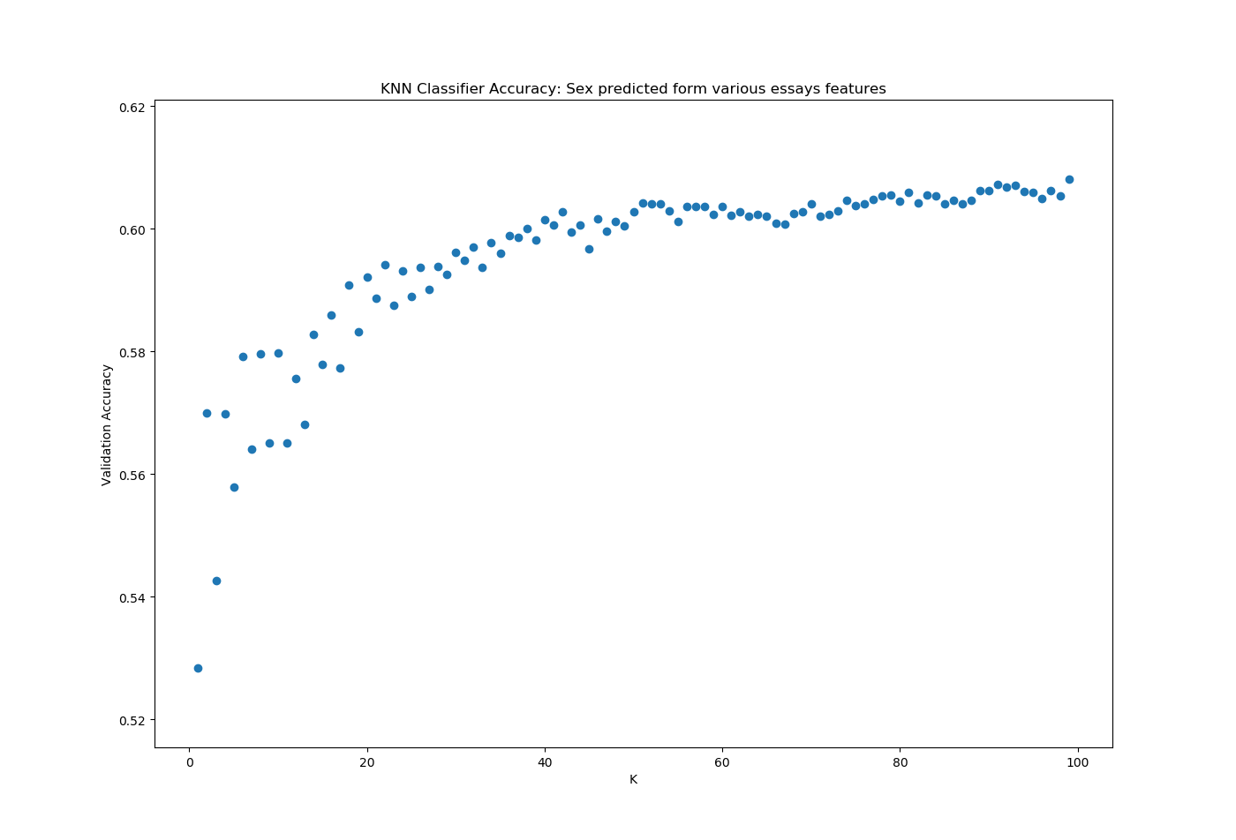
Classification techniques – sex based on writing style 5

Slide 52
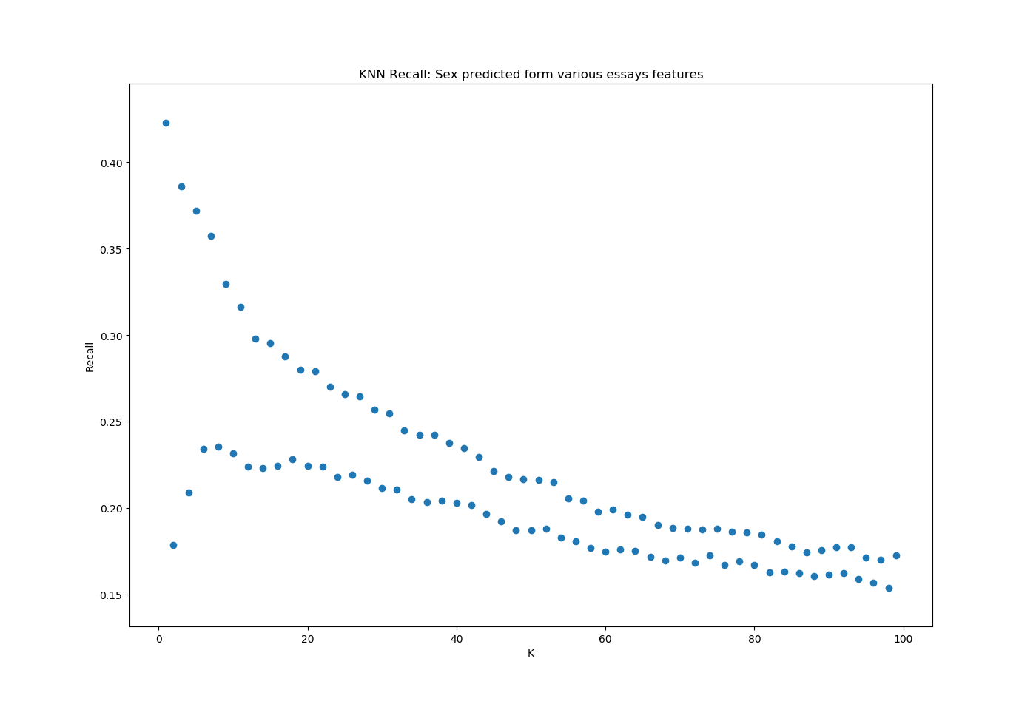
Classification techniques – sex based on writing style 6

Slide 53
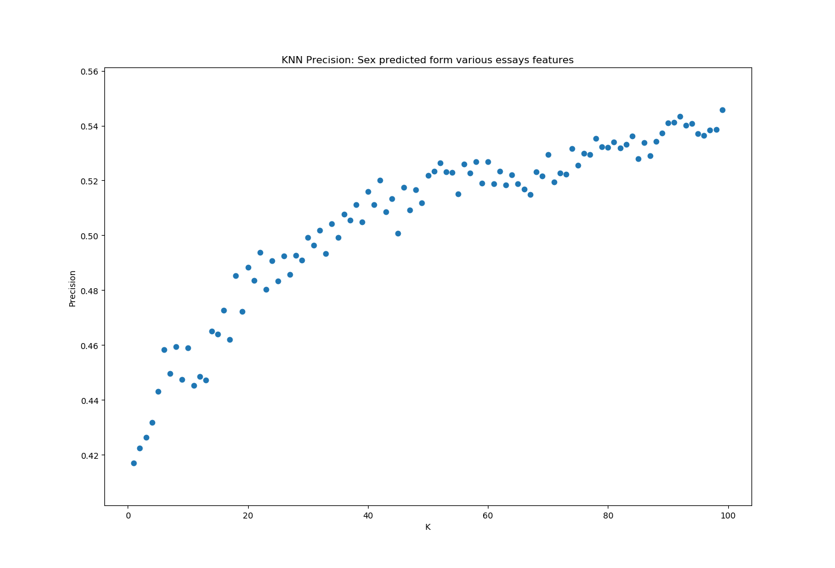
Classification techniques – sex based on writing style 7

Slide 54
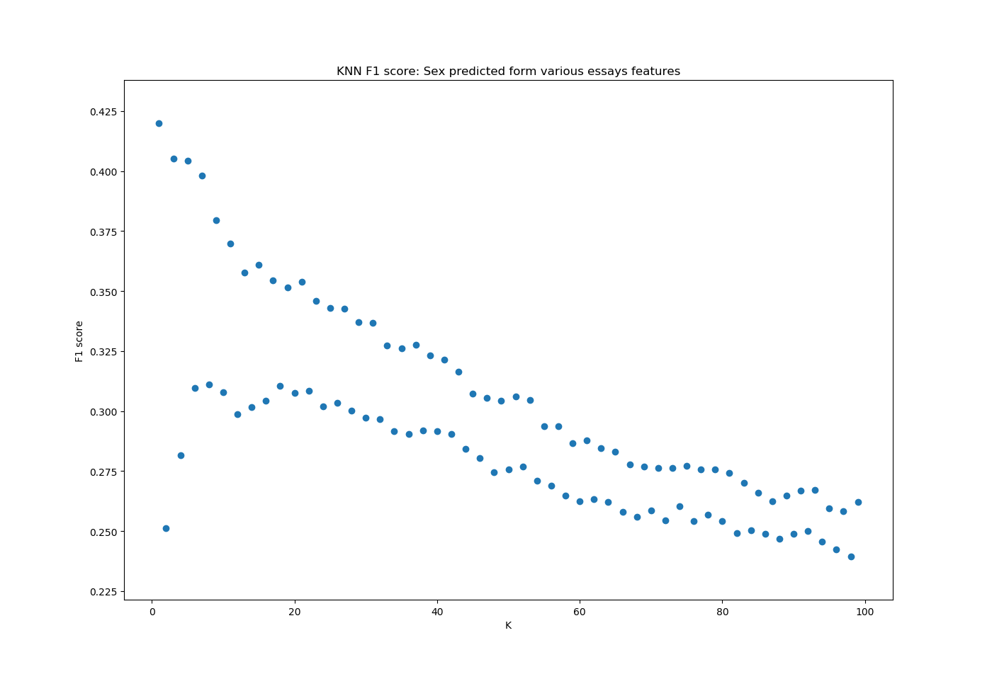
Classification techniques – sex based on writing style 8

Slide 55
Classification techniques – sex based on writing style 9
Results for Naïve Bayes Classifier:
Confusion matrix:
[[4894 2336]
[ 892 3868]]
Accuracy score 0.7307756463719767
Recall score 0.8126050420168067
Precision score 0.6234687298517085
F1 score 0.7055819044144472

Slide 56
Classification techniques – sex based on writing style 10
Conclusion:
The Naïve Bayes Classifier (NBC) ran 3 times faster than KNN
NBC achieved much better results than KNN
Confusion matrix of NBC is as expected – the highest values on diagonal
For KNN classifier it is possible to see how the recall, precision and f1 score change in dependency from k. In our case is recall more interesting, because we want to know how many of the women were classified correctly. Recall value is significantly better for NBC.
For KNN would be good to fined optimal k not only based on score but also consider recall value.
Conclusion – age can be predicted from style of writing (essays). The best model to do it was Naïve Bayes Classifier with accuracy 73%.

Slide 57
Final conclusion
Q1: It is not possible to predict income only from age using LR. In our dataset the income values were given only for 1/6 of users. Maybe adding another feature as education can improve LR model. And to have more samples for income.
Q2 – Q4: for all three questions KNN model was better than SVC. In all cases the big problem was unbalanced data. Some improvements dealing with this problem can improve the models.
In SVC when searching optimal parameters gamma was from interval (1,20). Extend this interval can lead to better model, but it will require my HW update.

Slide 58
Final conclusion
Q5: Naïve Bayes classifier achieved the best results to answer this question.
Generally all models achieved better results than a random guess, but the accuracy score and other metrics were far from conclusional.
Possible future work: apply some modification to our dataset dealing with unbalance can help to improve the model.

