Slide 1
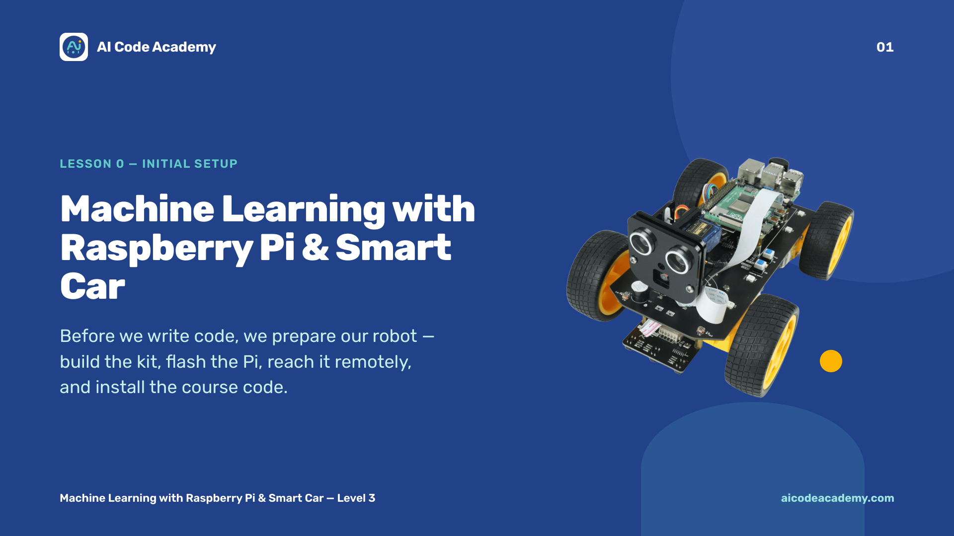
Notes:
Title — ~2 min. Welcome everyone to the course. This session is about getting set up: patience pays off, because every later lesson depends on it. Site: https://aicodeacademy.com

Slide 2
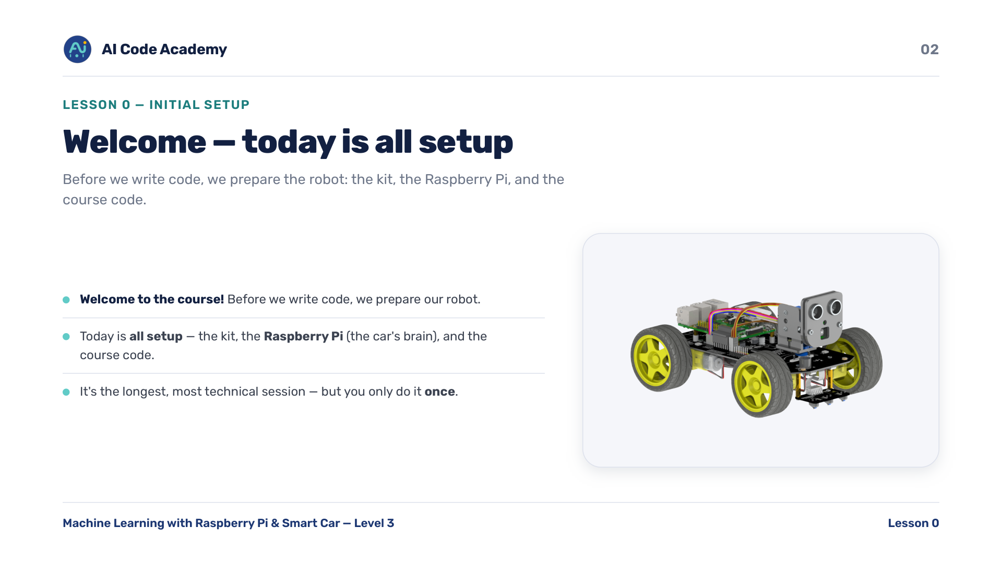
Notes:
Introduction — reassure students that setup is fiddly for everyone. We go step by step and help each other. It's the longest, most technical session, but you only do it once.

Slide 3
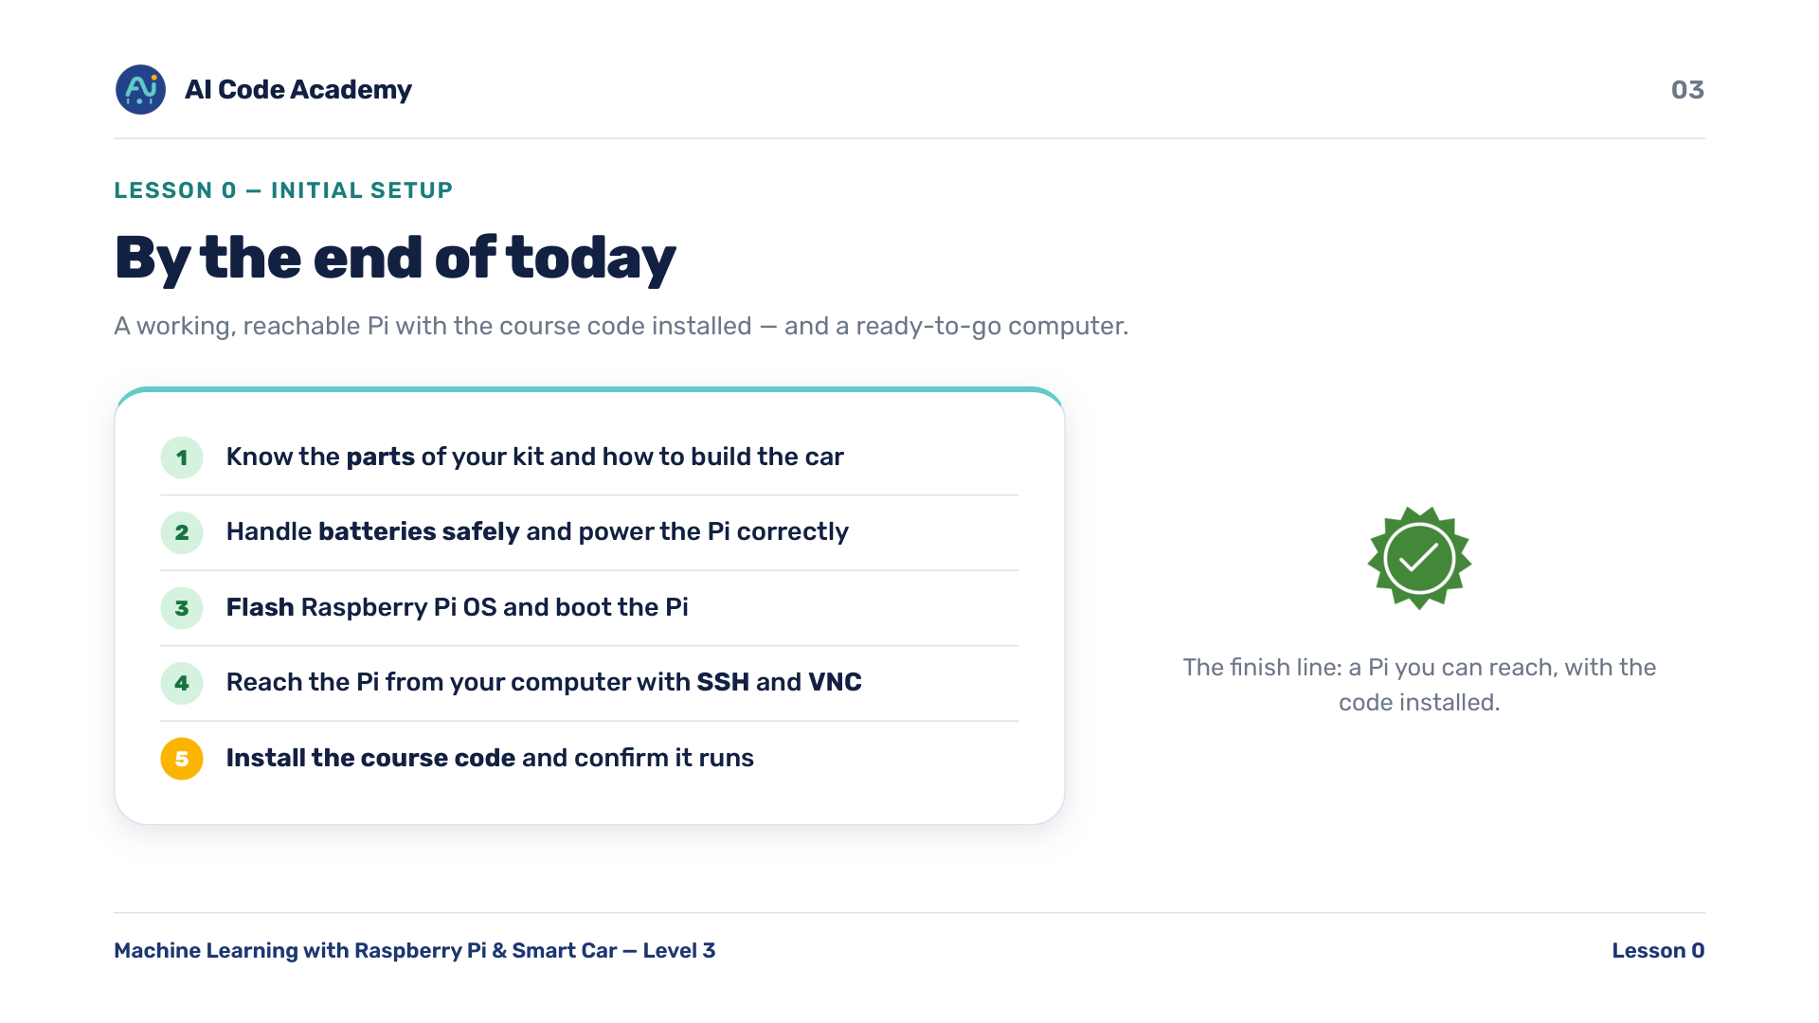
Notes:
Our goals — set the finish line clearly: a working, reachable Pi with the course code installed, plus a ready-to-go computer. Read the five goals aloud.

Slide 4
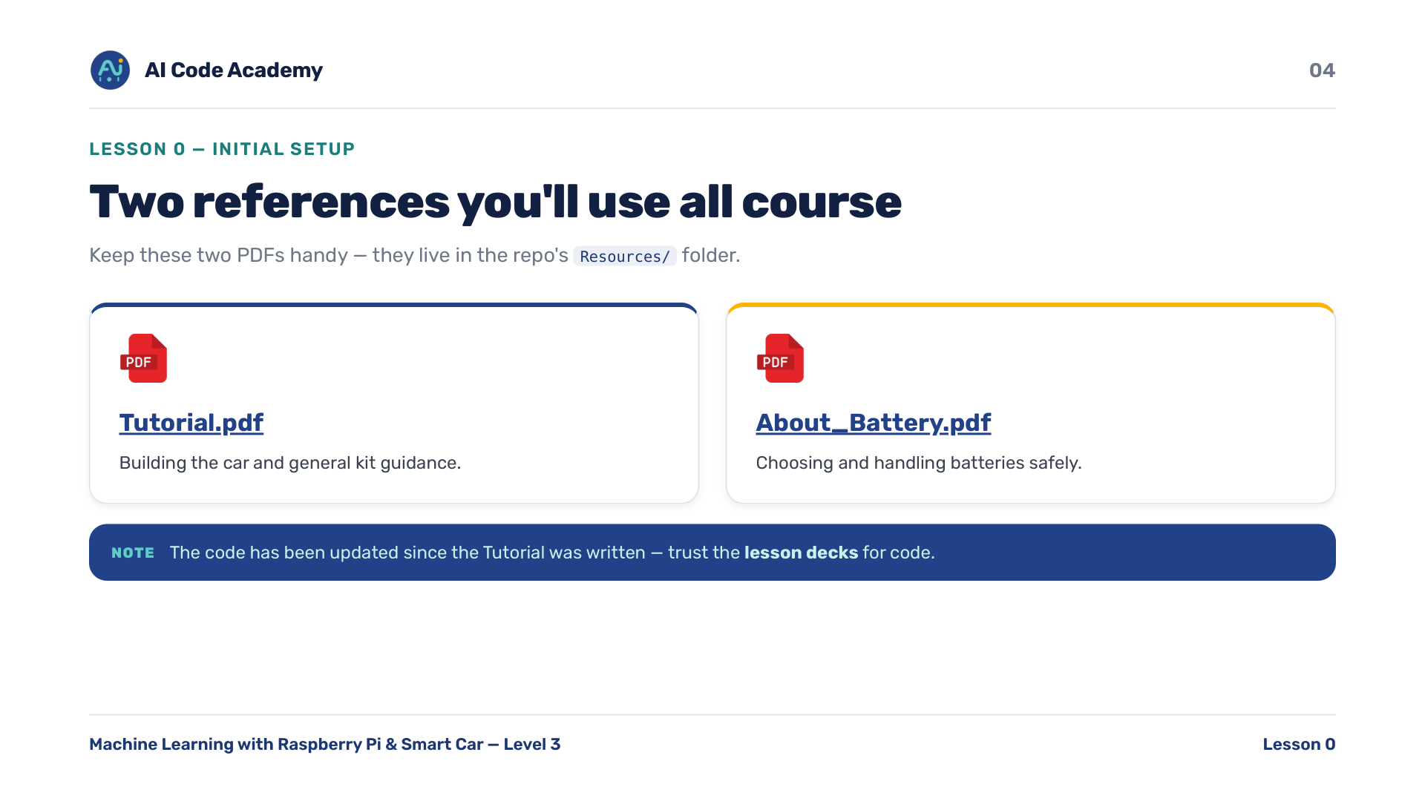
Notes:
Two references — point students to Resources/Tutorial.pdf (https://github.com/renashall/Smart-Car-Level-3/blob/main/Resources/Tutorial.pdf) and Resources/About_Battery.pdf (https://github.com/renashall/Smart-Car-Level-3/blob/main/Resources/About_Battery.pdf). Flag the Tutorial-vs-current-code caveat now to avoid confusion later: trust the lesson decks for code.

Slide 5
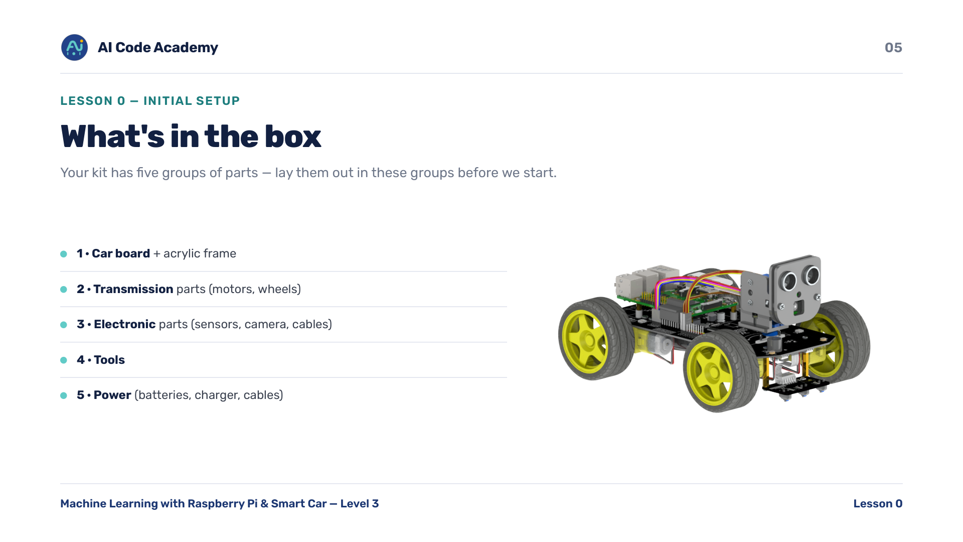
Notes:
What's in the box — have students open their kits and lay parts out in these five groups. Budget about 5 min to inventory before moving on.

Slide 6
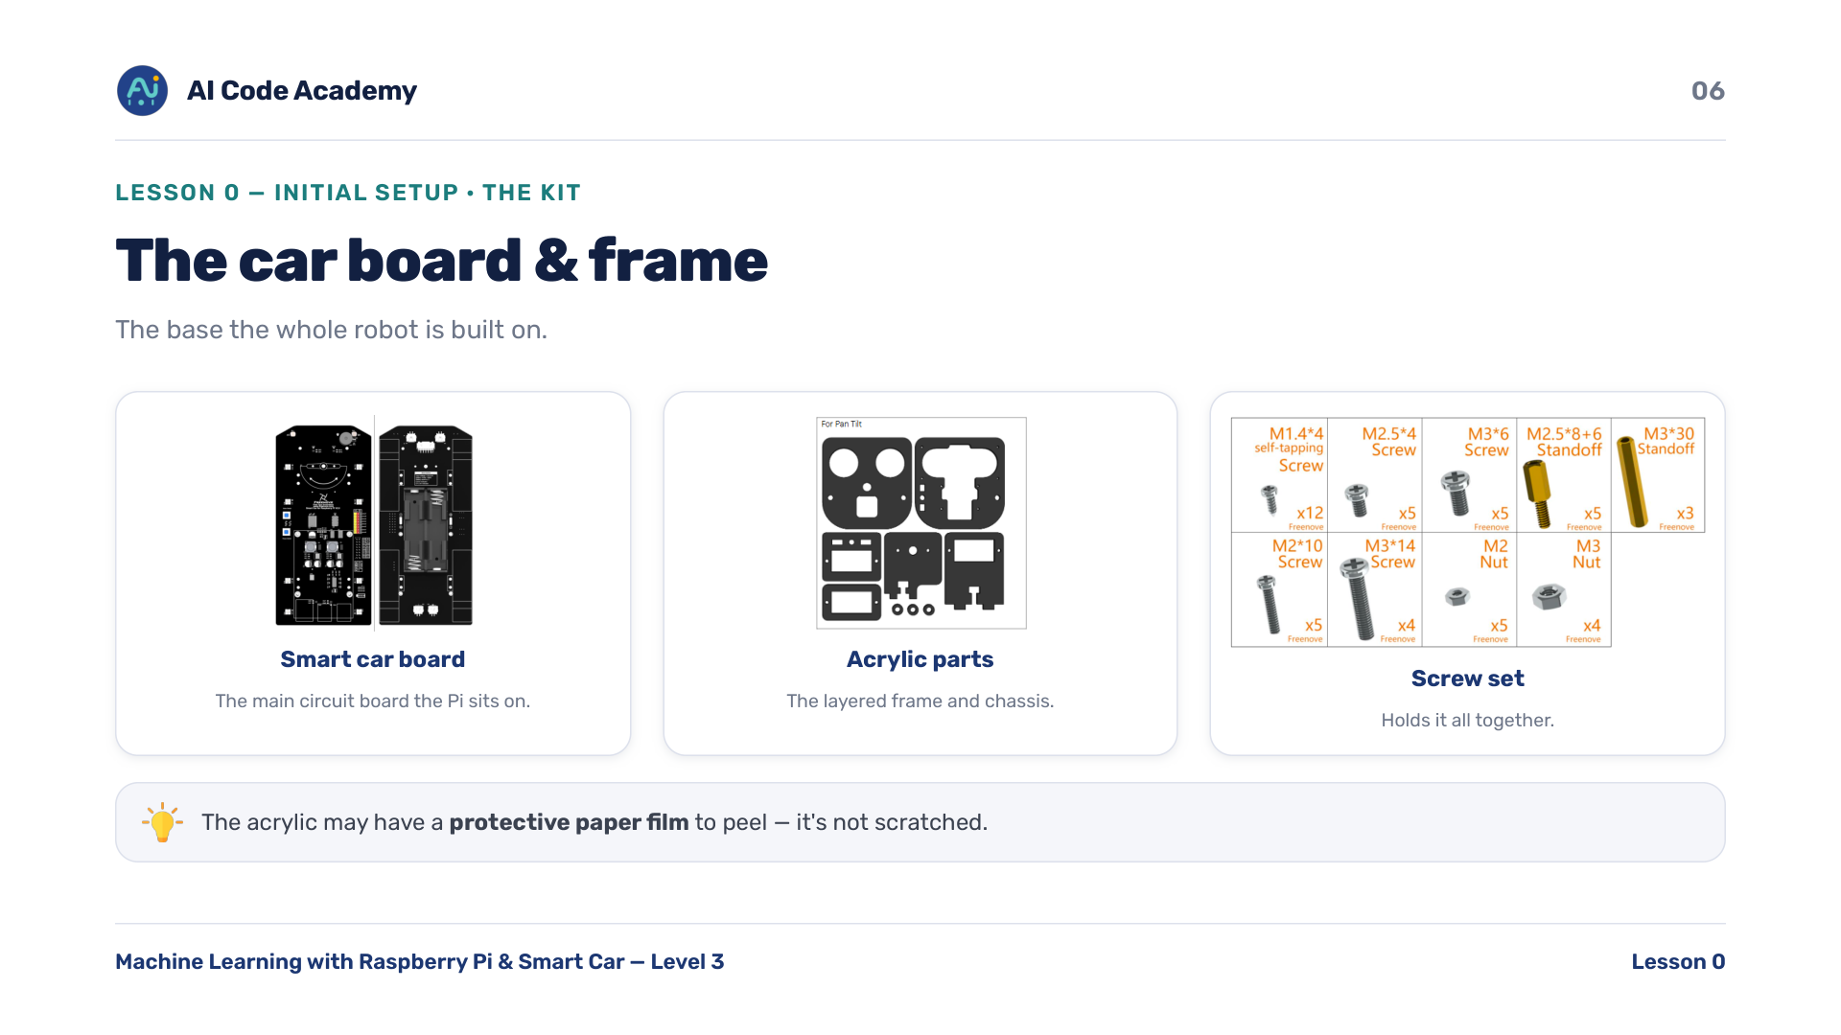
Notes:
Car board & frame — acrylic may have a protective paper film to peel. Mention it so students don't think it's scratched.

Slide 7
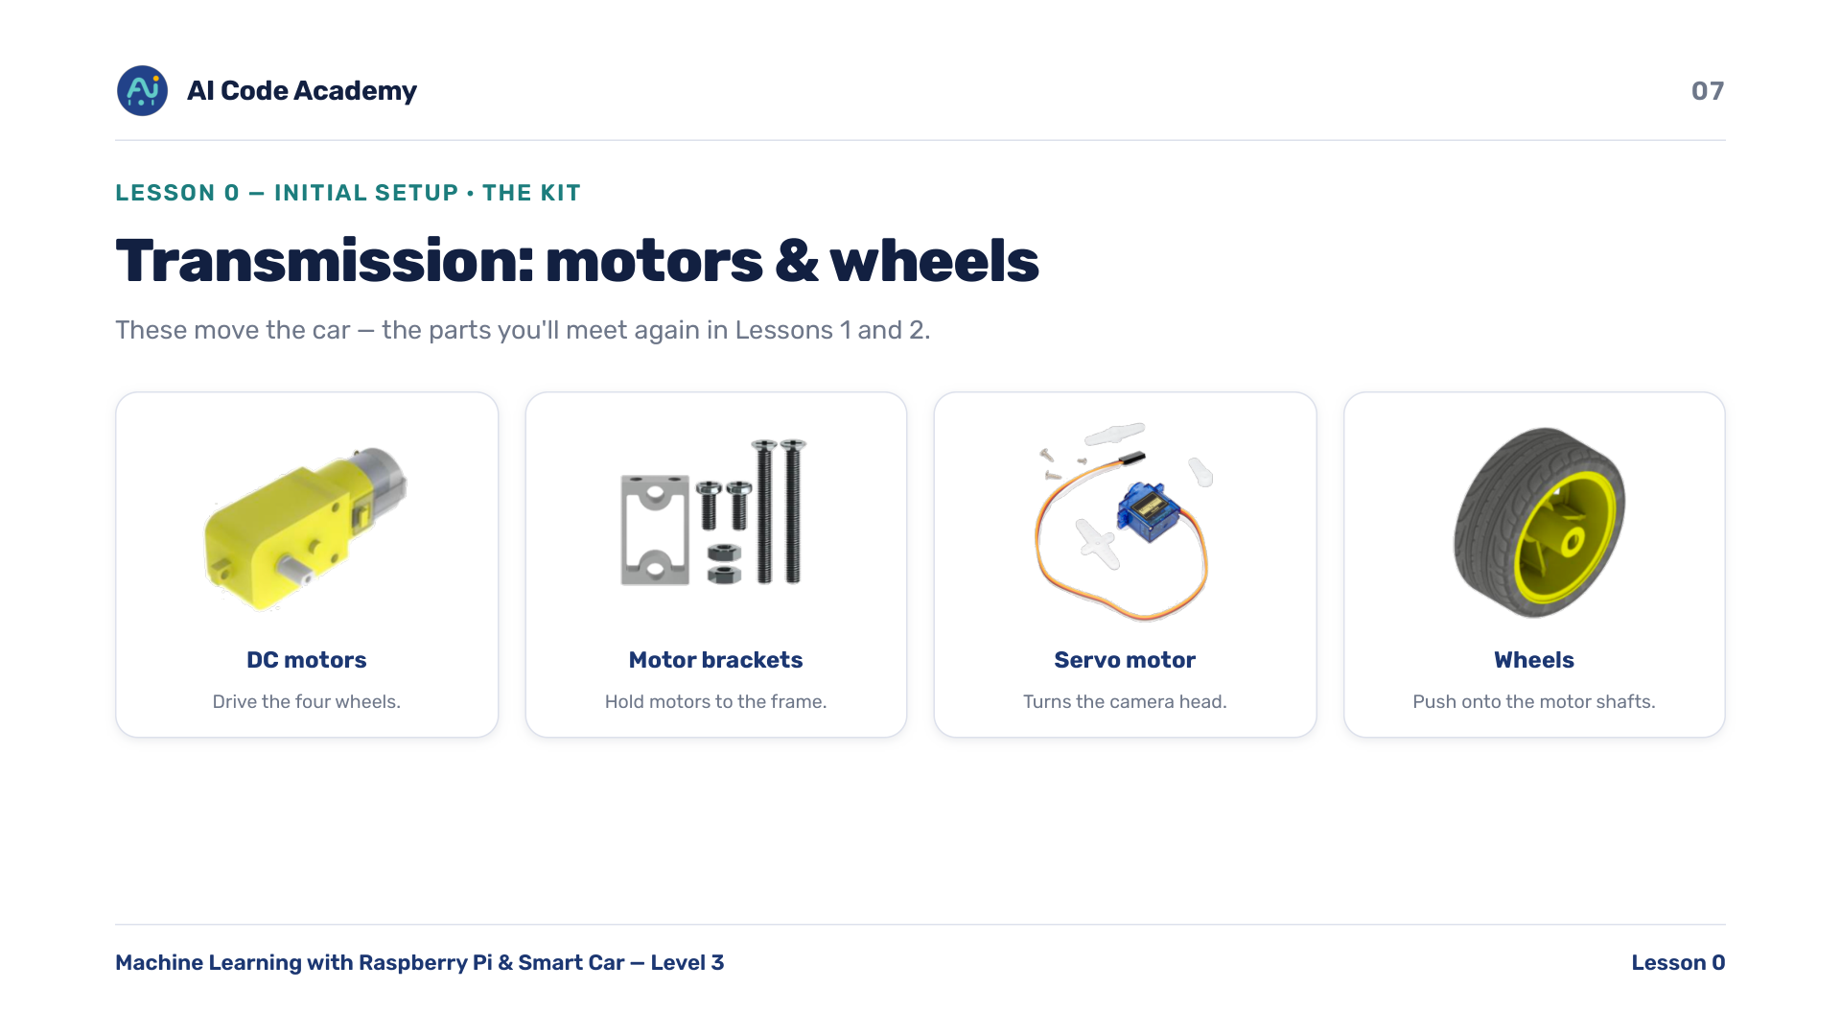
Notes:
Transmission parts — these are the parts from Lessons 1-2 (servo turns the head, motors drive the wheels). Preview that connection.

Slide 8
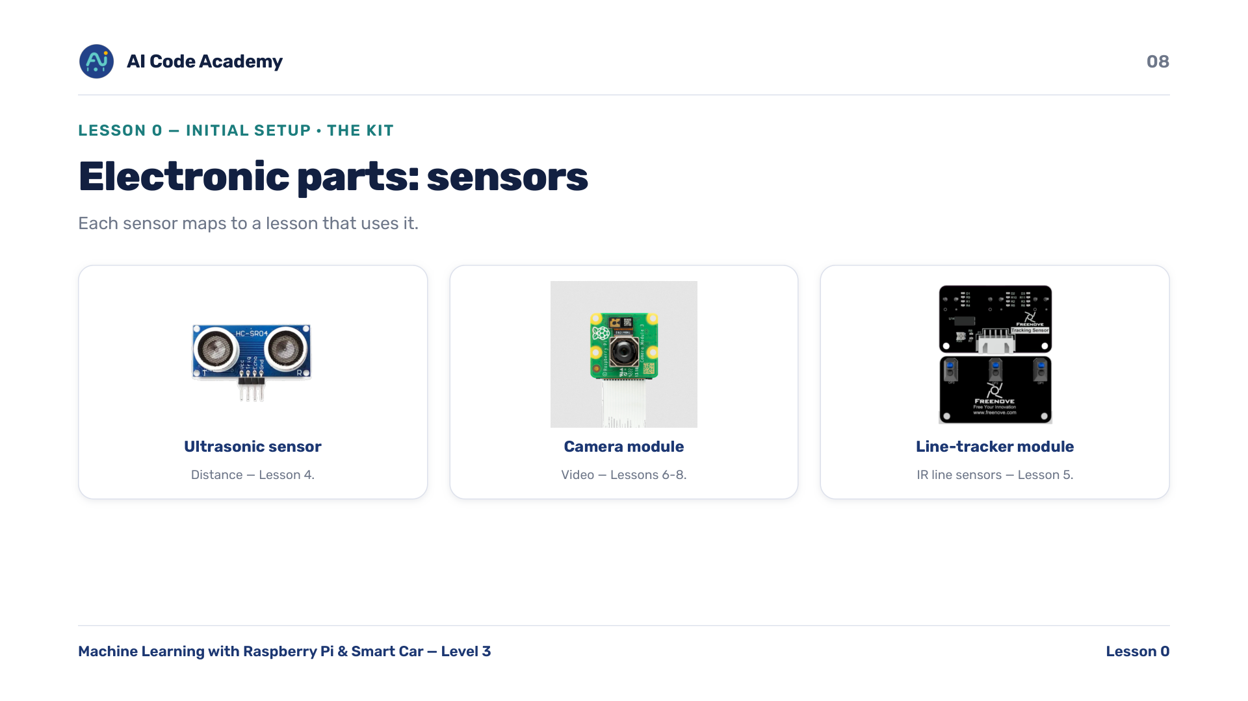
Notes:
Electronic parts (sensors) — each sensor maps to a lesson: ultrasonic distance (4), camera video (6-8), line tracker (5). It makes the kit feel purposeful.

Slide 9
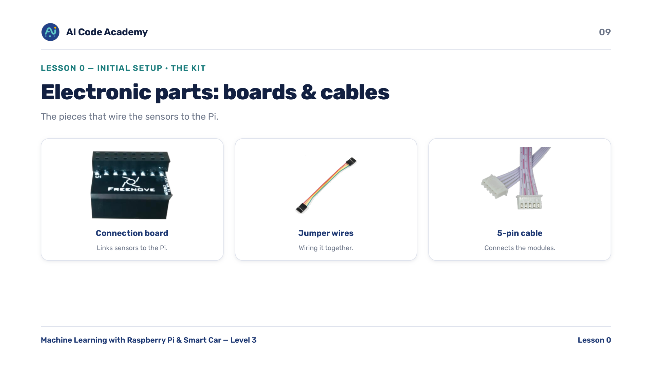
Notes:
Electronic parts (connections) — the connection board links the sensors to the Pi; the jumper wires and 5-pin cable wire everything together.

Slide 10
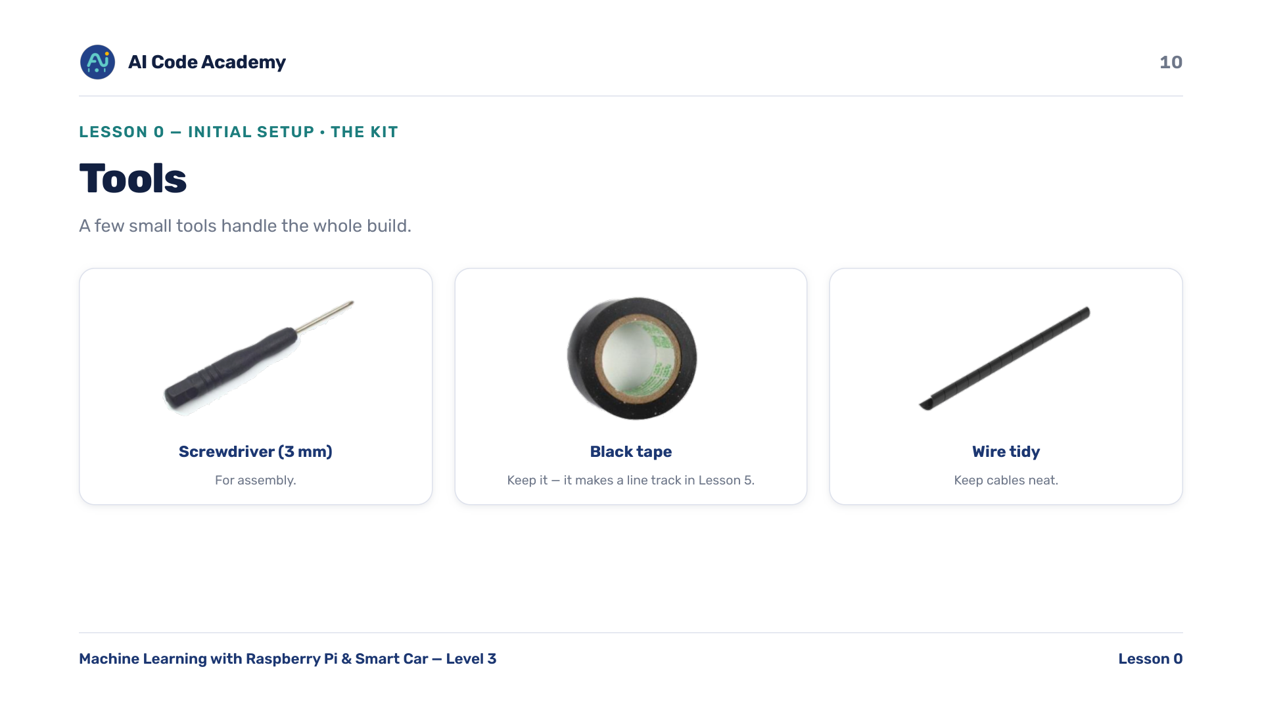
Notes:
Tools — tell students to keep the black tape: they'll build a line track with it in Lesson 5.

Slide 11
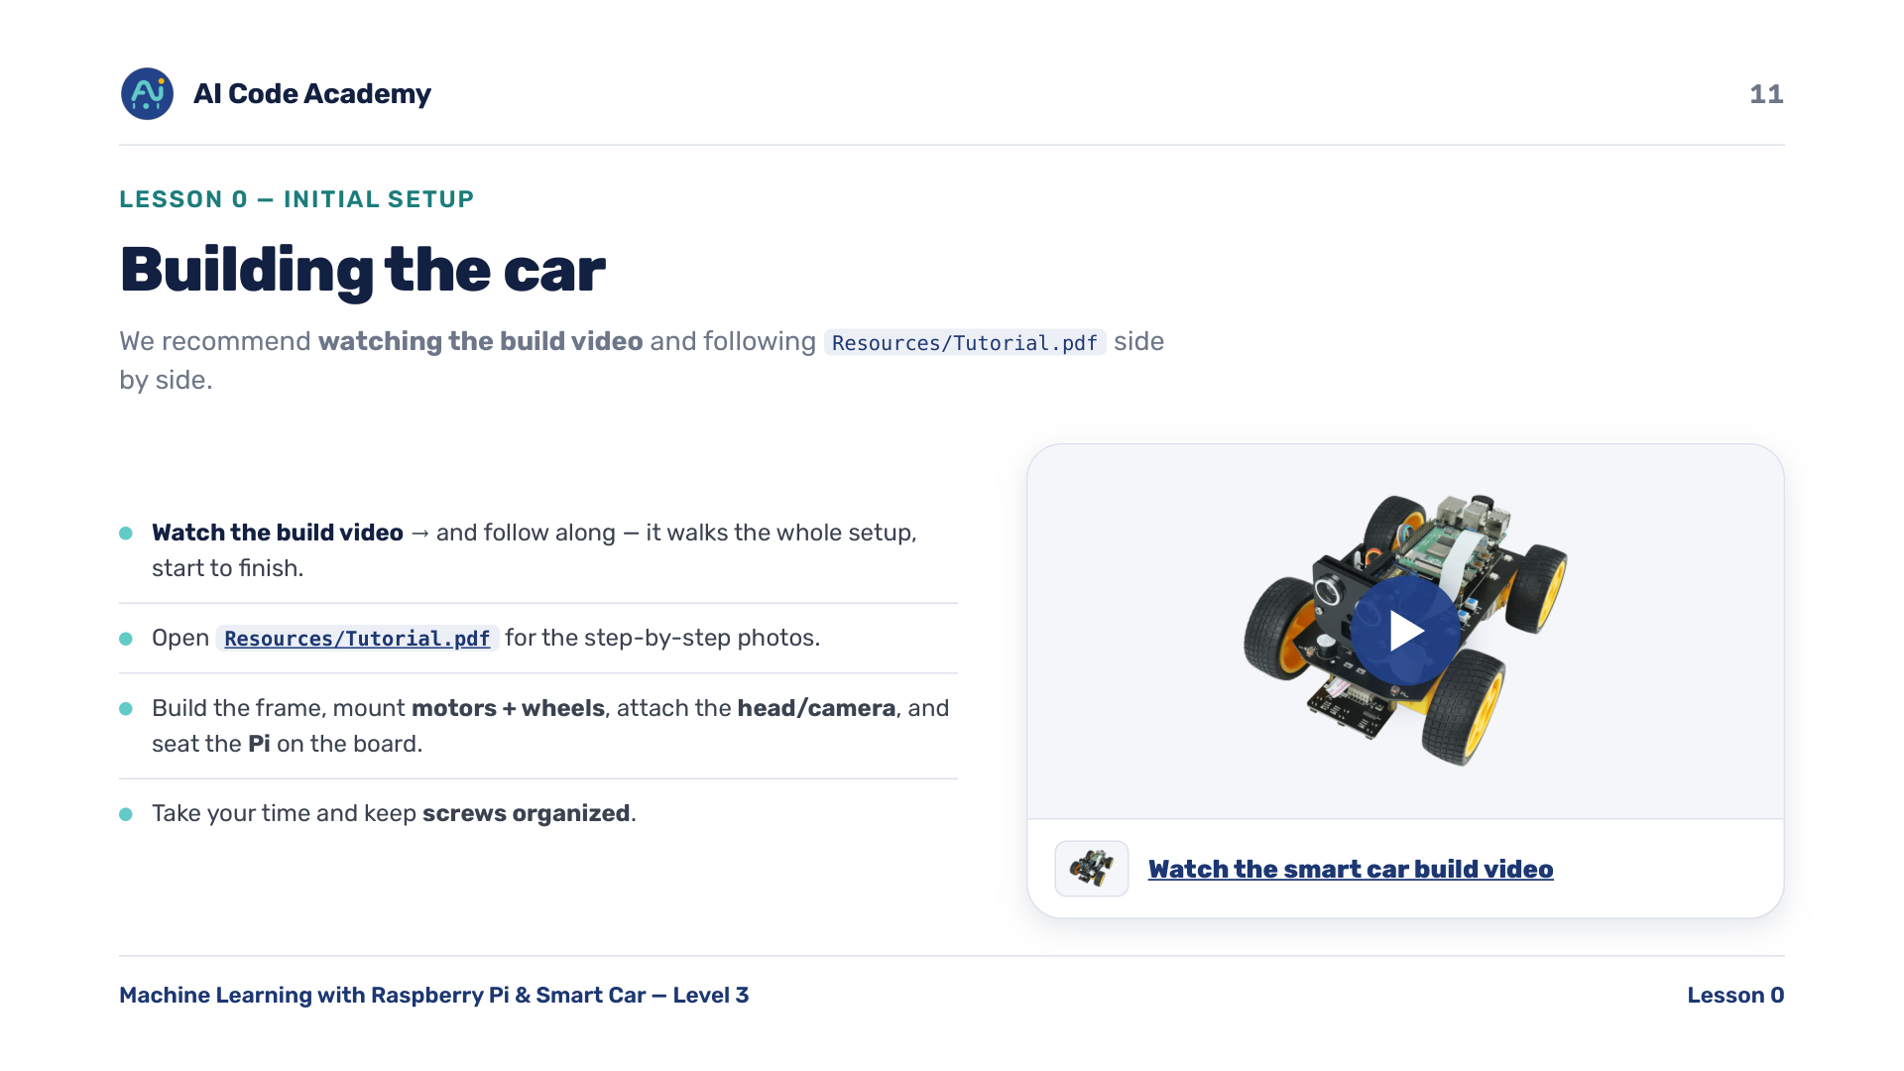
Notes:
Building the car — recommend students watch the build video and follow along: Smart car build video on Google Drive (https://drive.google.com/file/d/1fl8dAGgtttkPZFmboovwltMmlfYszNP7/view?usp=share_link). The full step-by-step assembly photos are in Resources/Tutorial.pdf (https://github.com/renashall/Smart-Car-Level-3/blob/main/Resources/Tutorial.pdf). The video card on this slide is clickable. Decide whether assembly happens in class or as homework; budget time accordingly. Keep screws organized.

Slide 12
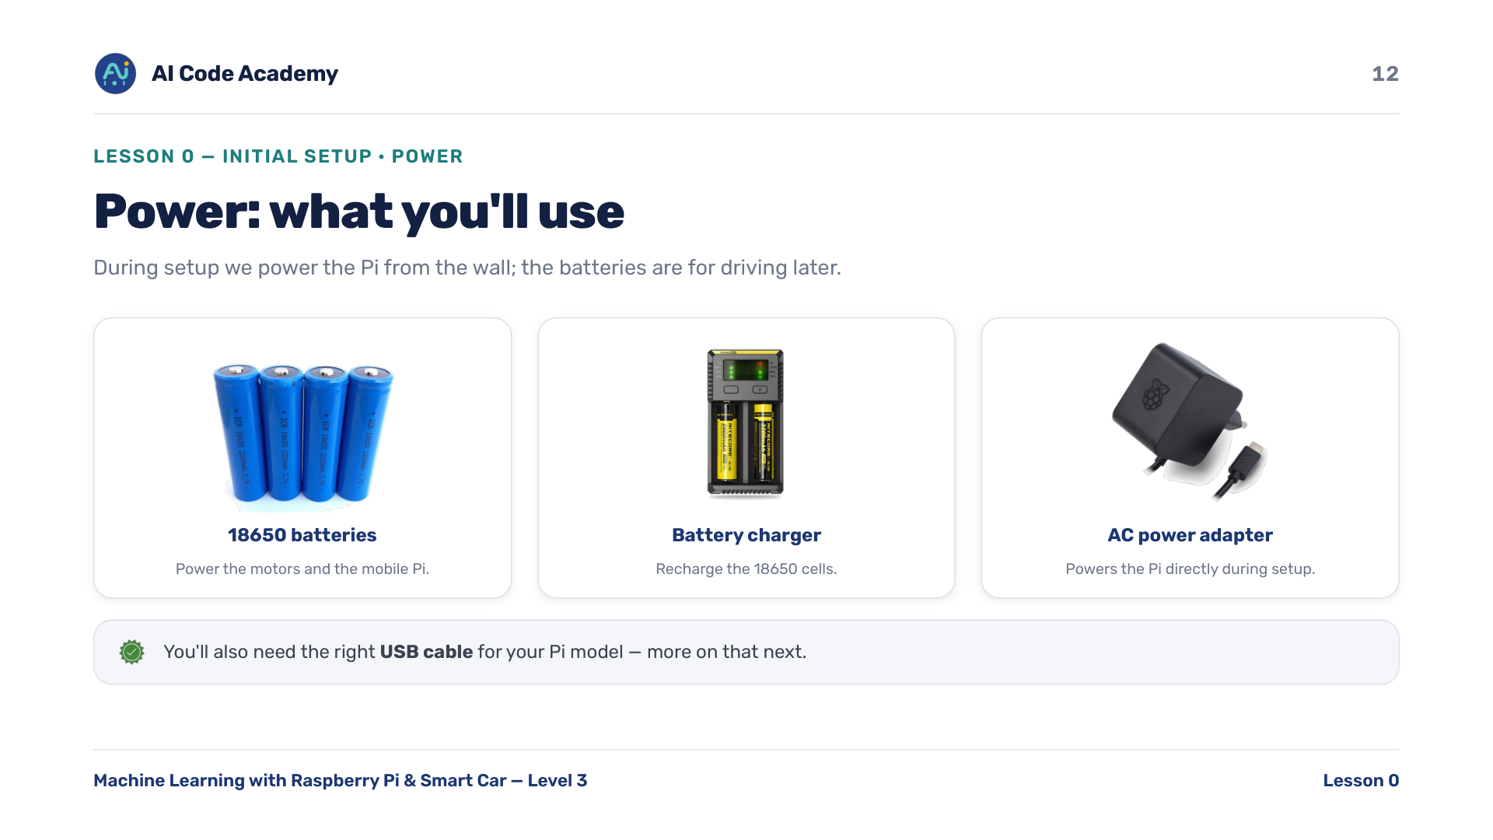
Notes:
Power overview — during setup we usually power the Pi from the wall adapter; the 18650 batteries are for driving later.

Slide 13
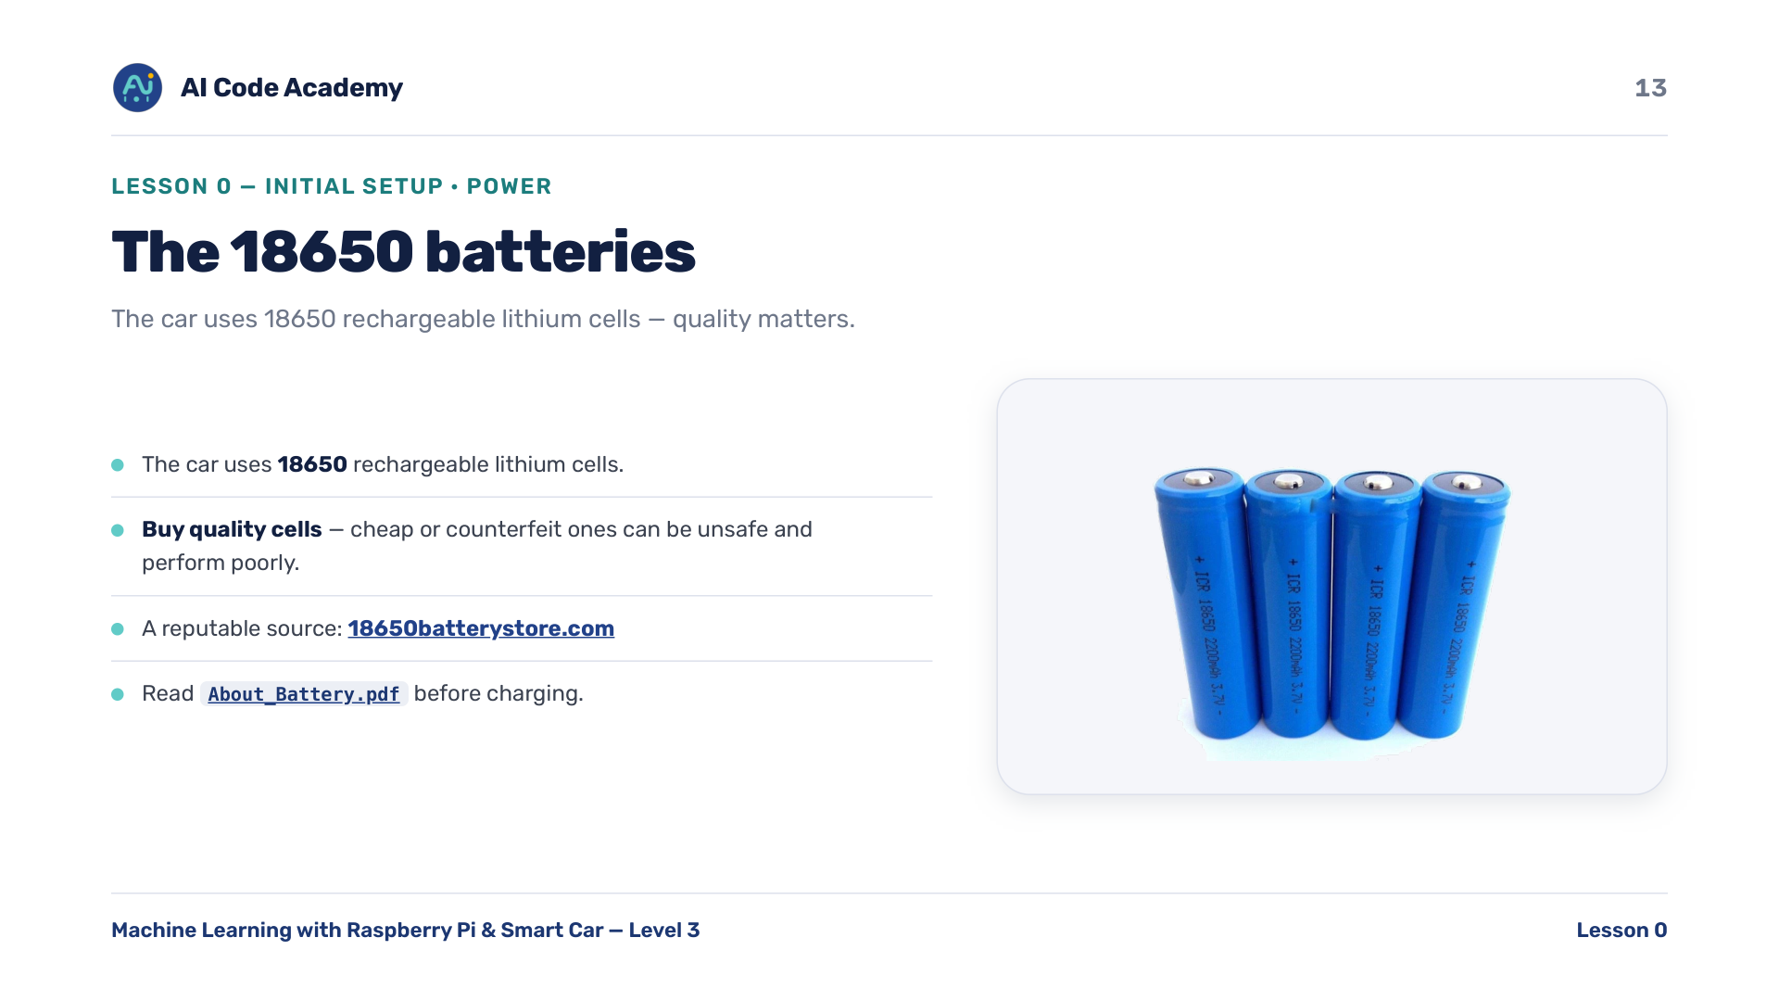
Notes:
The 18650 batteries — emphasize buying correct, genuine cells; cheap/counterfeit ones can be unsafe. A reputable source is 18650batterystore.com (https://www.18650batterystore.com/). Full specs in About_Battery.pdf (https://github.com/renashall/Smart-Car-Level-3/blob/main/Resources/About_Battery.pdf).

Slide 14
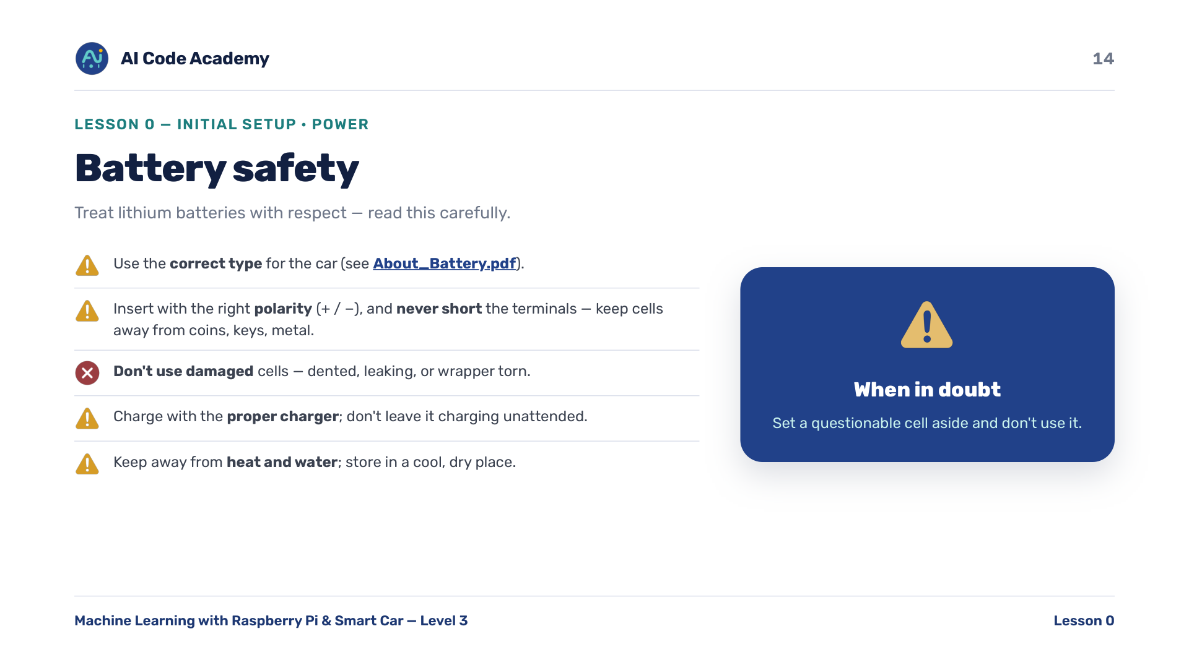
Notes:
Battery safety — do this slide seriously and slowly. Stop and answer questions. When in doubt, set a bad cell aside and don't use it. Details in About_Battery.pdf (https://github.com/renashall/Smart-Car-Level-3/blob/main/Resources/About_Battery.pdf).

Slide 15
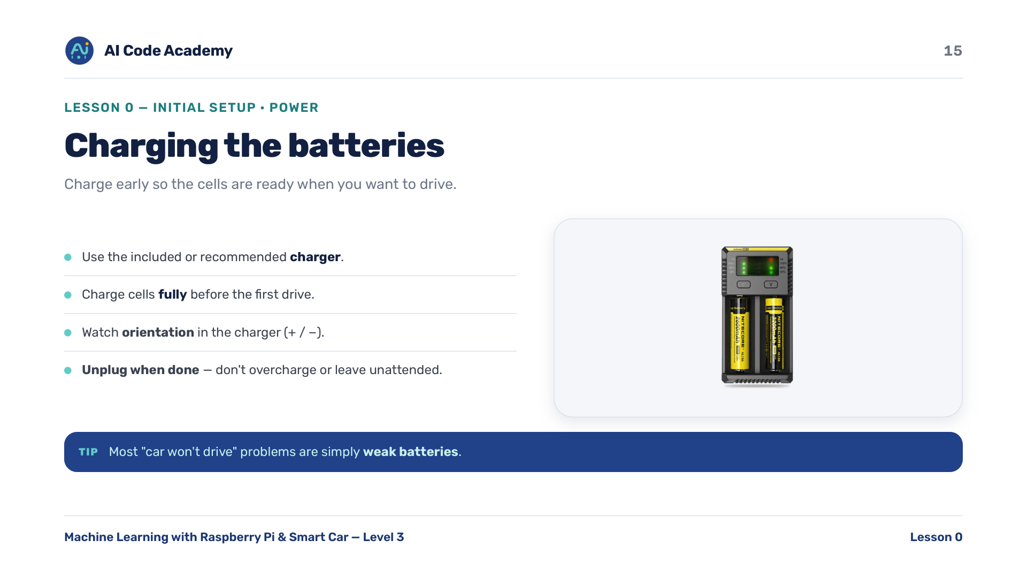
Notes:
Charging — start charging early in the session so cells are ready for later lessons. Most 'car won't drive' issues are weak batteries. Unplug when done; don't leave unattended.

Slide 16
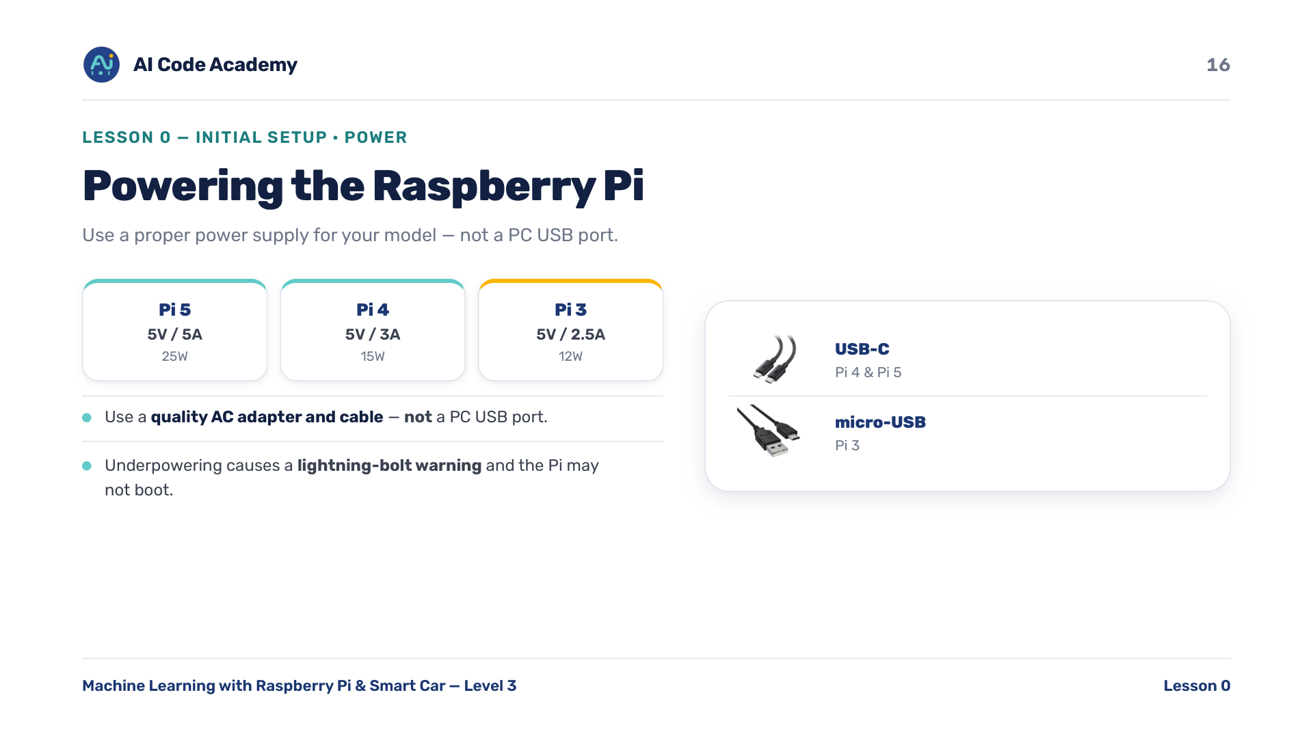
Notes:
Powering the Pi — Pi 4/5 use USB-C; Pi 3 uses micro-USB. Wrong or weak adapters are a top cause of boot and stability problems. Under-power shows a lightning-bolt warning on screen.

Slide 17
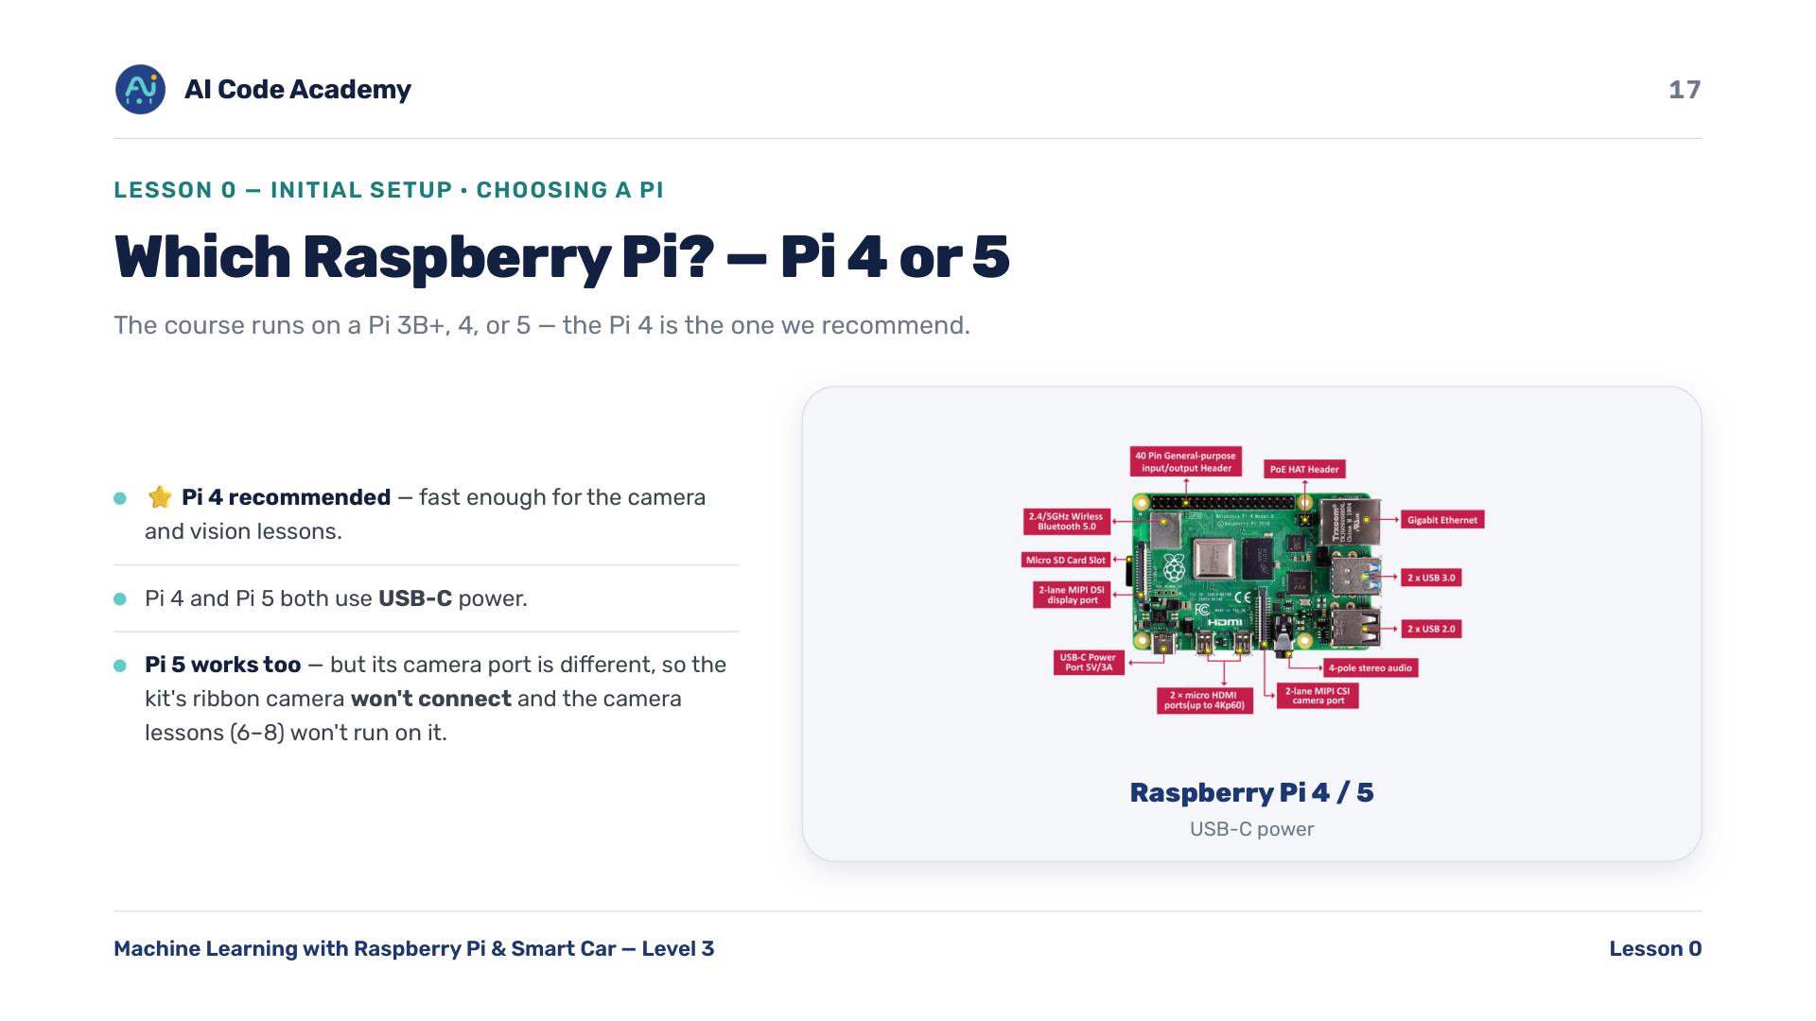
Notes:
Which Raspberry Pi, part 1 (Pi 4 / 5) — the Pi 4 is the recommended board: fast enough for the camera and vision lessons, and it uses USB-C power (shared with the Pi 5). The Pi 5 works for everything EXCEPT the camera/vision lessons (6-8): its camera connector is different, so the kit's ribbon camera won't plug in unless students source a Pi 5 adapter cable. Lessons 7-8 (face detection) are CPU-heavy and run best on a Pi 4 or a laptop.

Slide 18
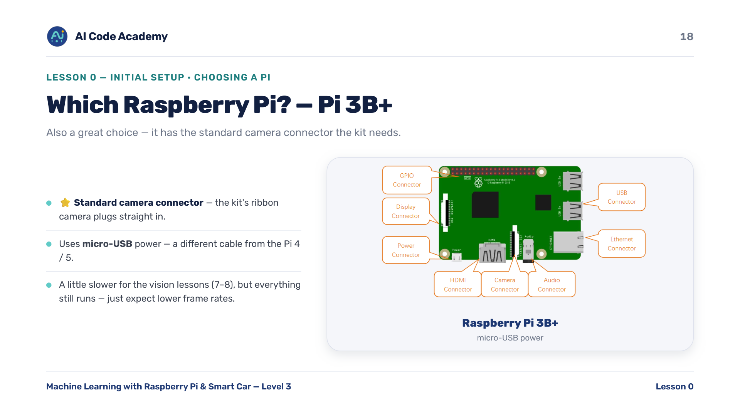
Notes:
Which Raspberry Pi, part 2 (Pi 3B+) — the Pi 3B+ also runs the whole course, camera included, because it has the standard ribbon camera connector. It uses micro-USB power, a different cable from the Pi 4/5. It's slower than a Pi 4, so expect lower frame rates on the vision lessons, but everything works. The board a student has decides the power cable and adapter.

Slide 19
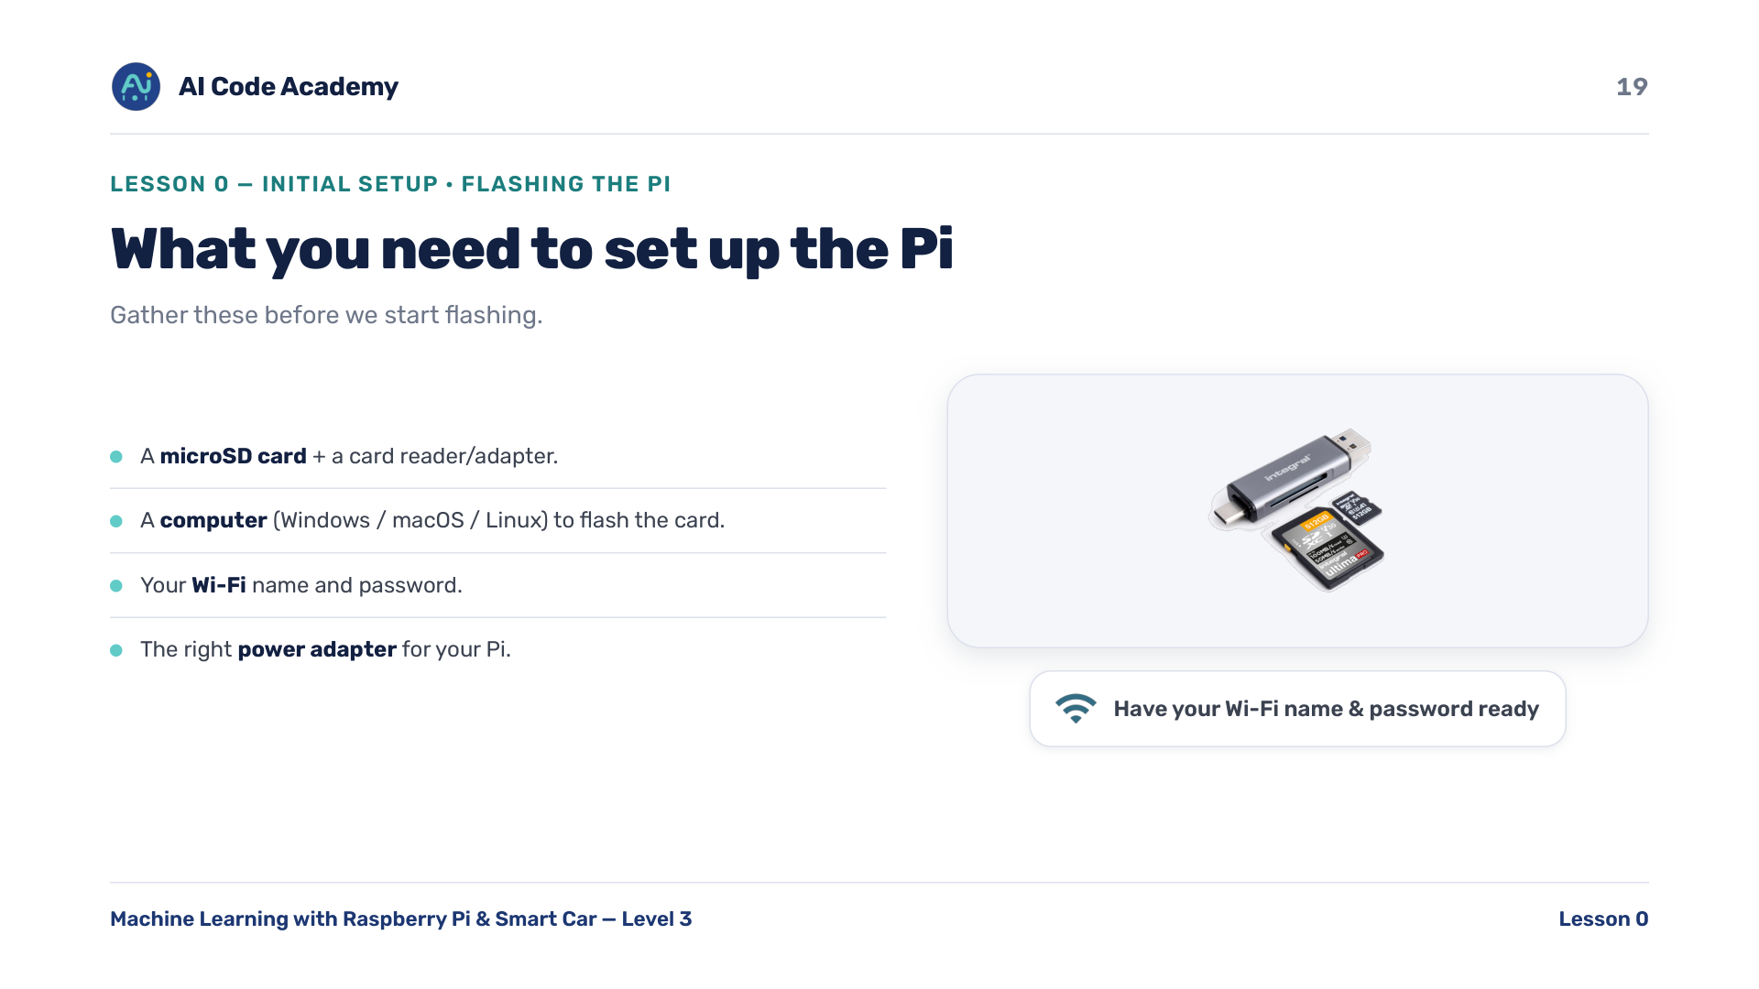
Notes:
What you need — make sure each student has a card reader that fits their computer. Have Wi-Fi name and password ready, or a hotspot.

Slide 20
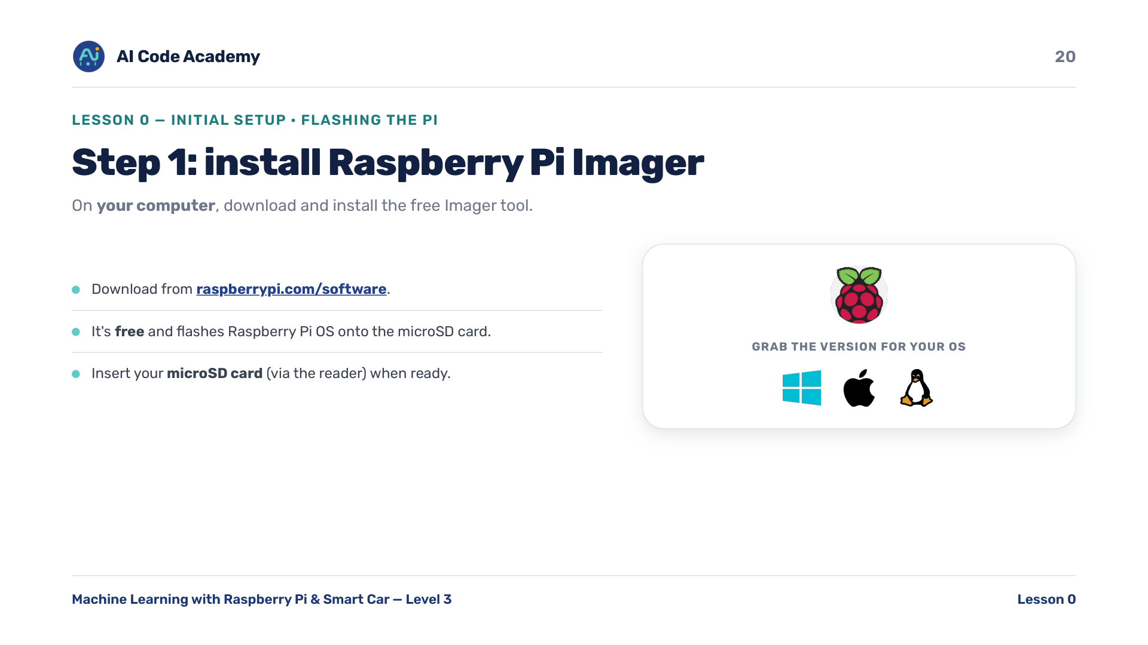
Notes:
Step 1: Imager — on YOUR computer, download Raspberry Pi Imager for your OS from https://www.raspberrypi.com/software/. It's free and flashes Raspberry Pi OS onto the microSD card.

Slide 21
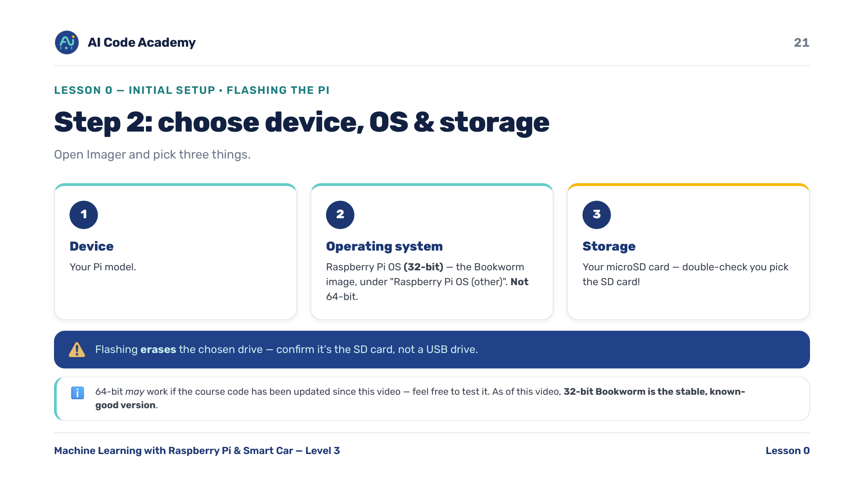
Notes:
Step 2: device, OS, storage — flashing ERASES the chosen drive. Have students confirm it's the SD card, not a USB drive. For the OS, pick Raspberry Pi OS (32-bit), the Bookworm image, under 'Raspberry Pi OS (other)' — NOT the default 64-bit. 64-bit may work if the course code has been updated since this video, so feel free to test it, but 32-bit Bookworm is the stable, known-good version as of this video.

Slide 22
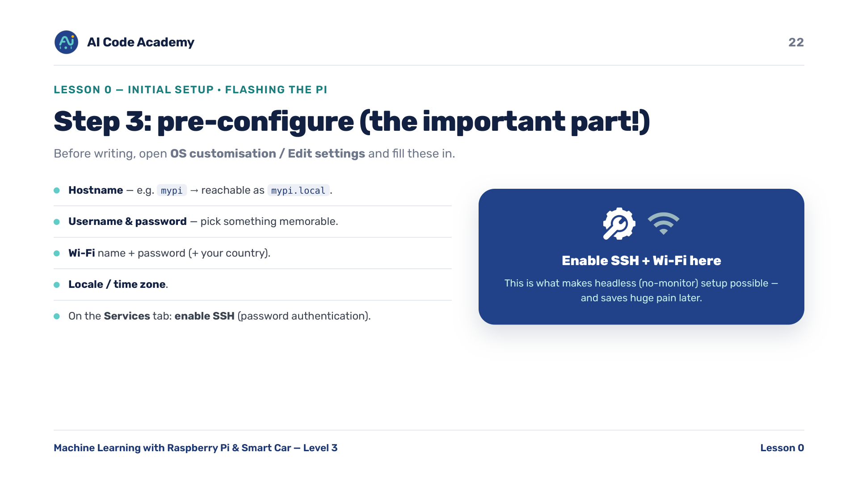
Notes:
Step 3: pre-configure — this is the step that makes headless (no-monitor) setup possible. Enabling SSH + Wi-Fi here saves huge pain later. Write down each student's hostname / username / password.

Slide 23
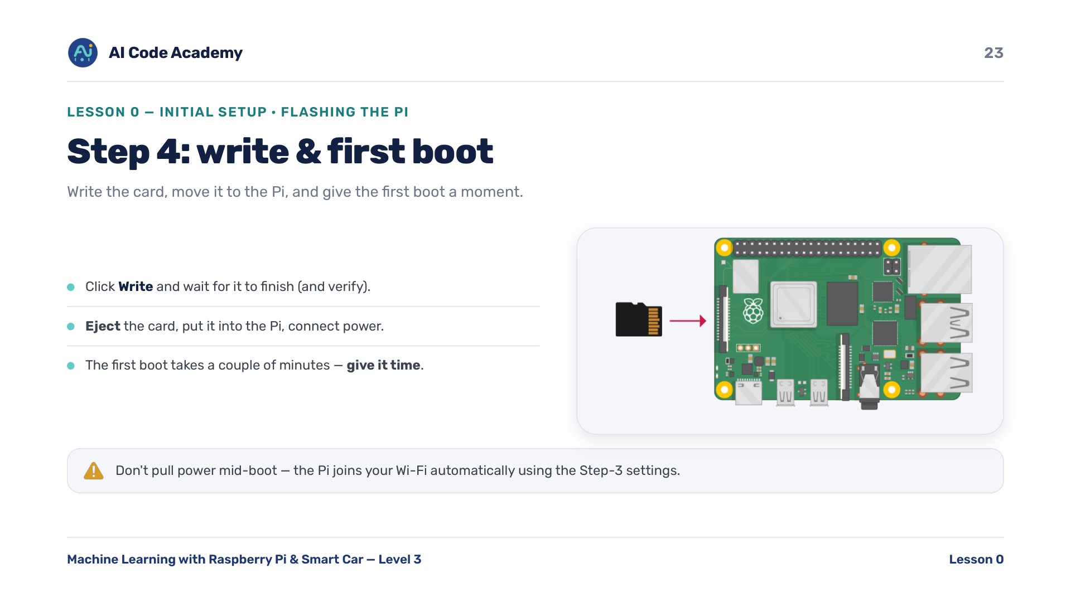
Notes:
Step 4: write & first boot — first boot can be slow and may reboot itself once. Don't pull power mid-boot. The Pi joins Wi-Fi automatically using the Step-3 settings.

Slide 24
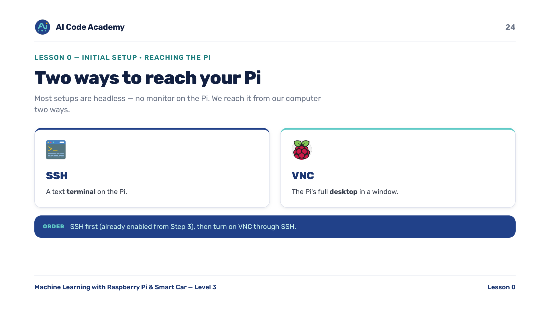
Notes:
Two ways to reach the Pi — most setups are headless. SSH gives a text terminal; VNC gives the full desktop. SSH first (already enabled from Step 3), then turn on VNC through SSH.

Slide 25
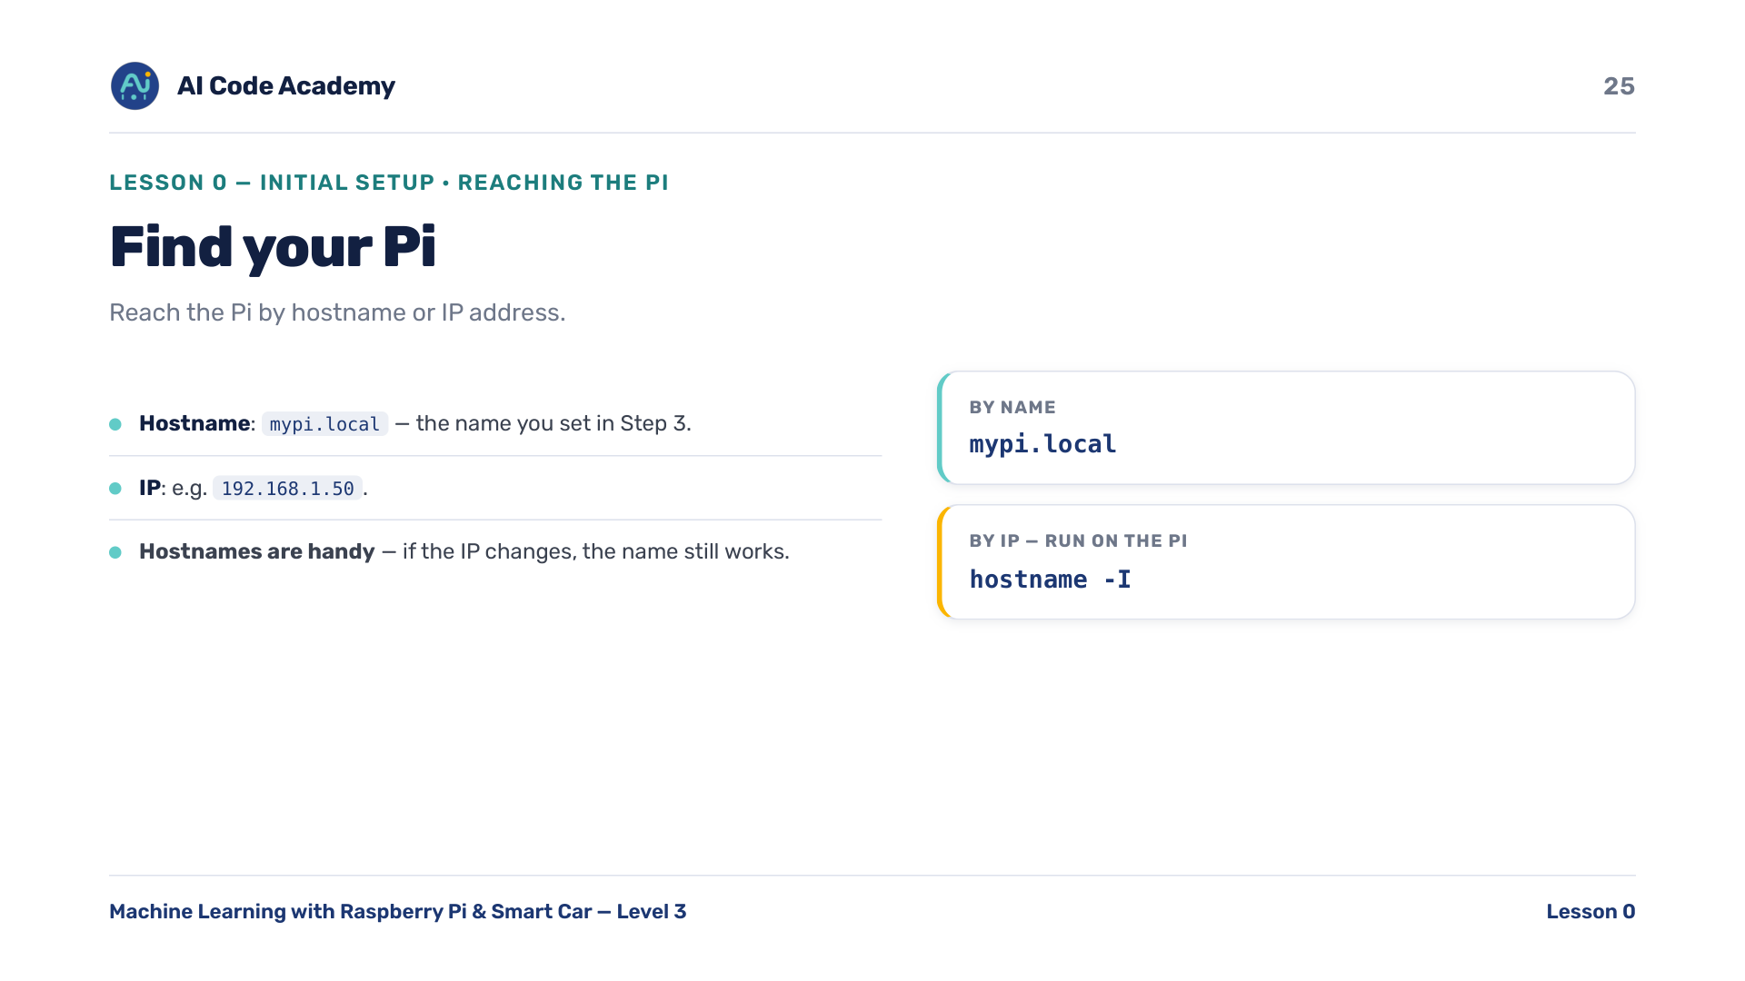
Notes:
Find your Pi — reach it by hostname (mypi.local) or IP. On the Pi or via your router, 'hostname -I' shows the IP. The .local name needs Bonjour/mDNS (built into macOS; usually works on Windows, install Bonjour if not).

Slide 26
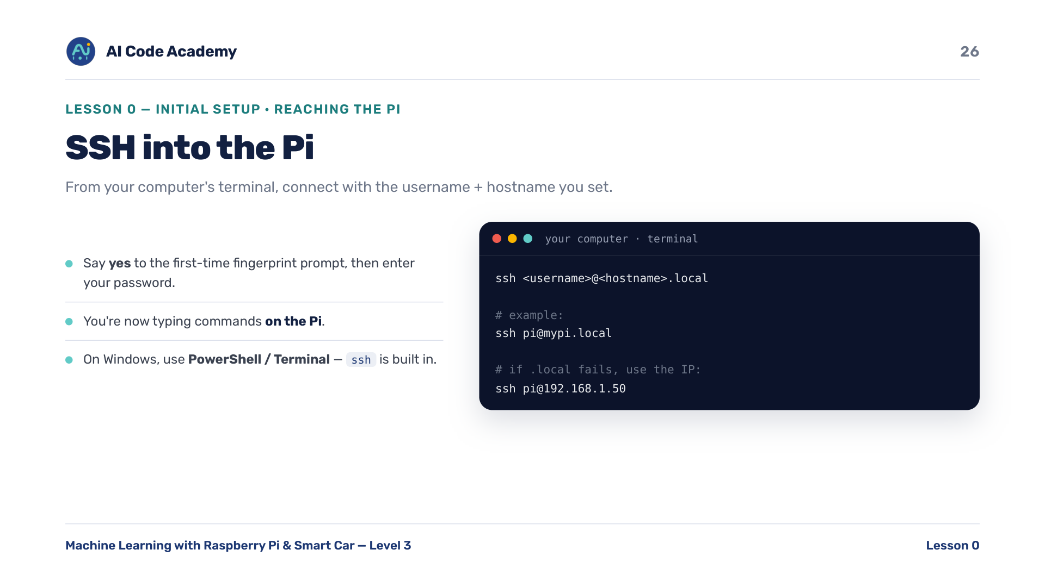
Notes:
SSH in — on Windows use PowerShell or Terminal; ssh is built in. Say yes to the first-time fingerprint prompt, then enter the password. If .local fails, use the IP: ssh pi@192.168.1.50.

Slide 27
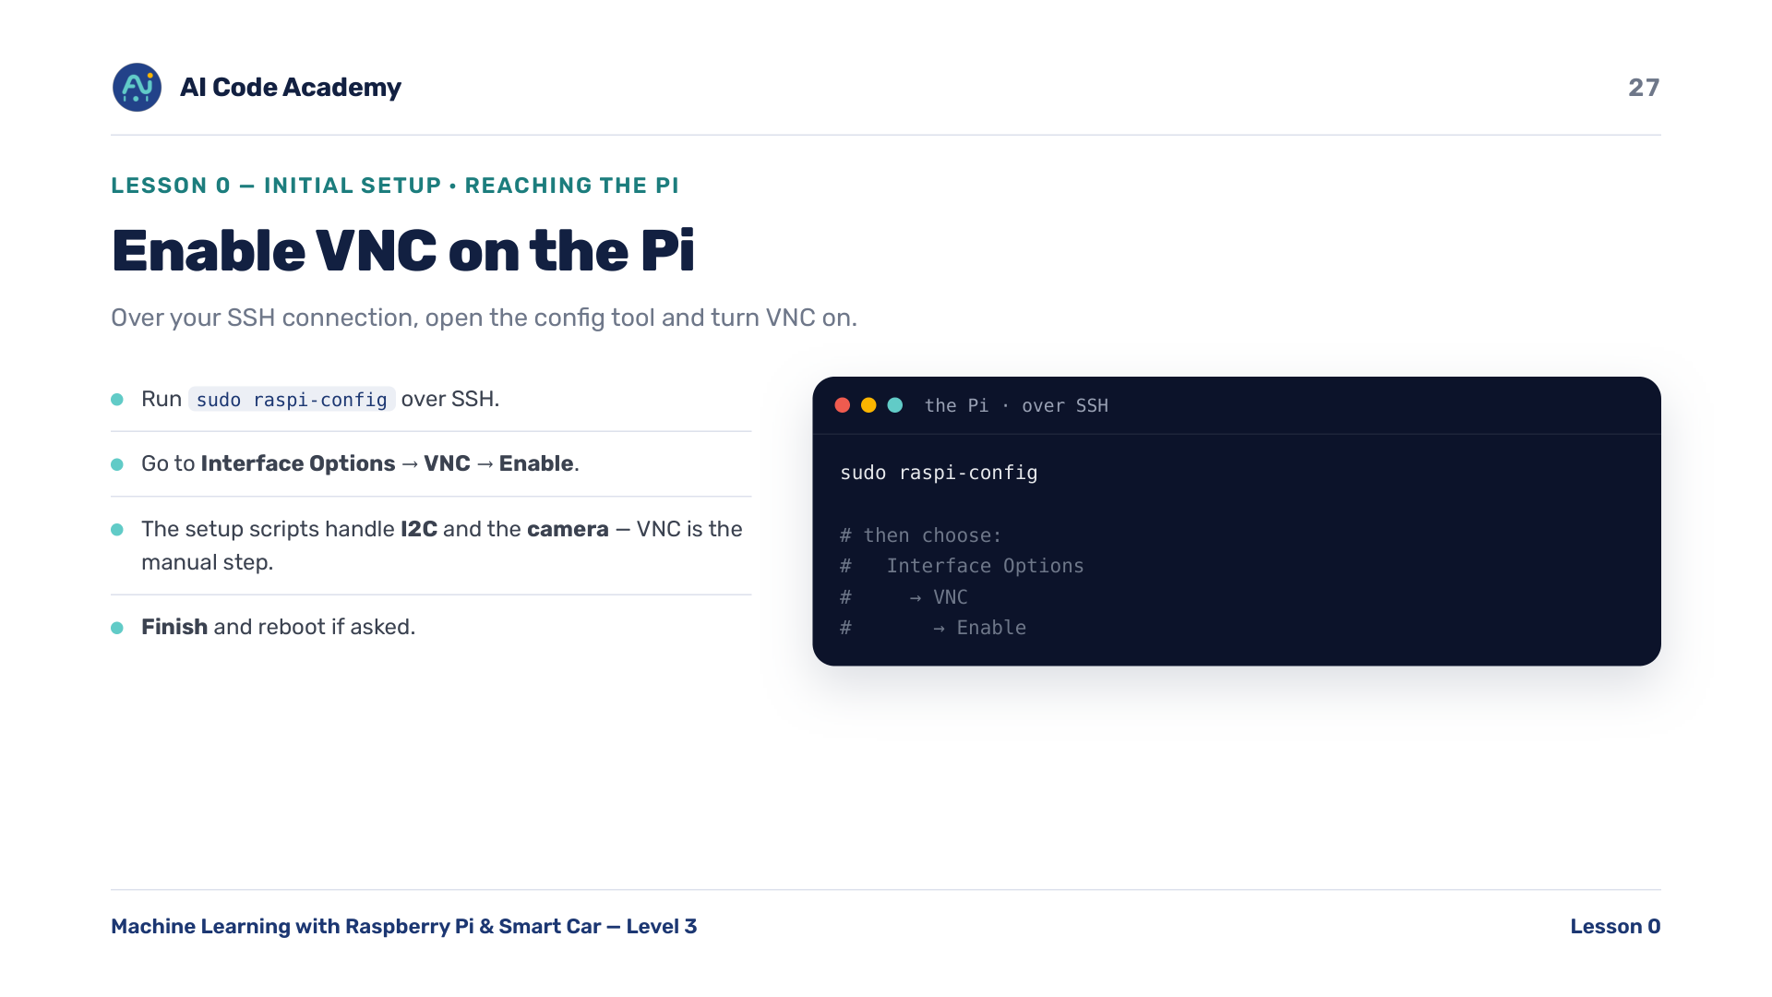
Notes:
Enable VNC — over SSH run 'sudo raspi-config', then Interface Options -> VNC -> Enable. The setup scripts handle I2C and the camera; VNC is the manual step. If a student has a monitor, use Preferences -> Raspberry Pi Configuration -> Interfaces instead.

Slide 28
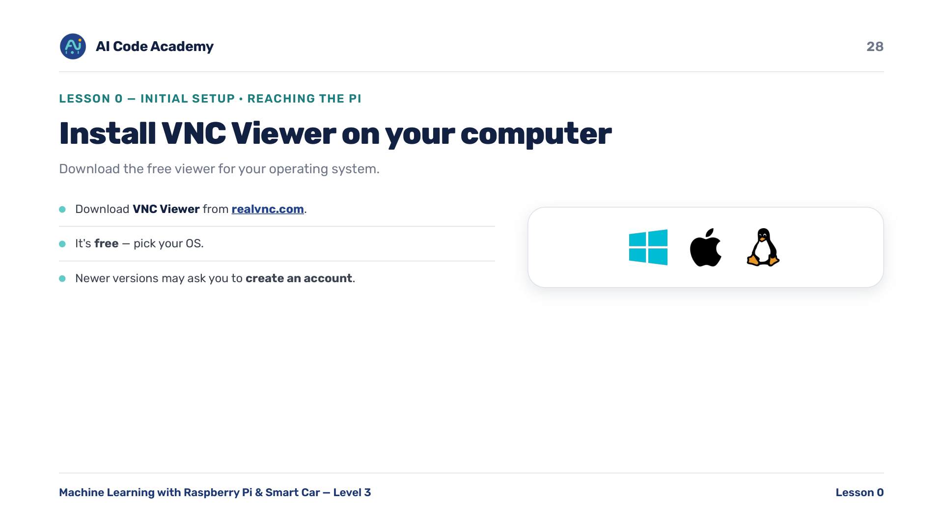
Notes:
Install VNC Viewer — on your computer, download VNC Viewer from https://www.realvnc.com/en/connect/download/viewer/. Free; pick your OS. Newer versions may ask you to create an account.

Slide 29
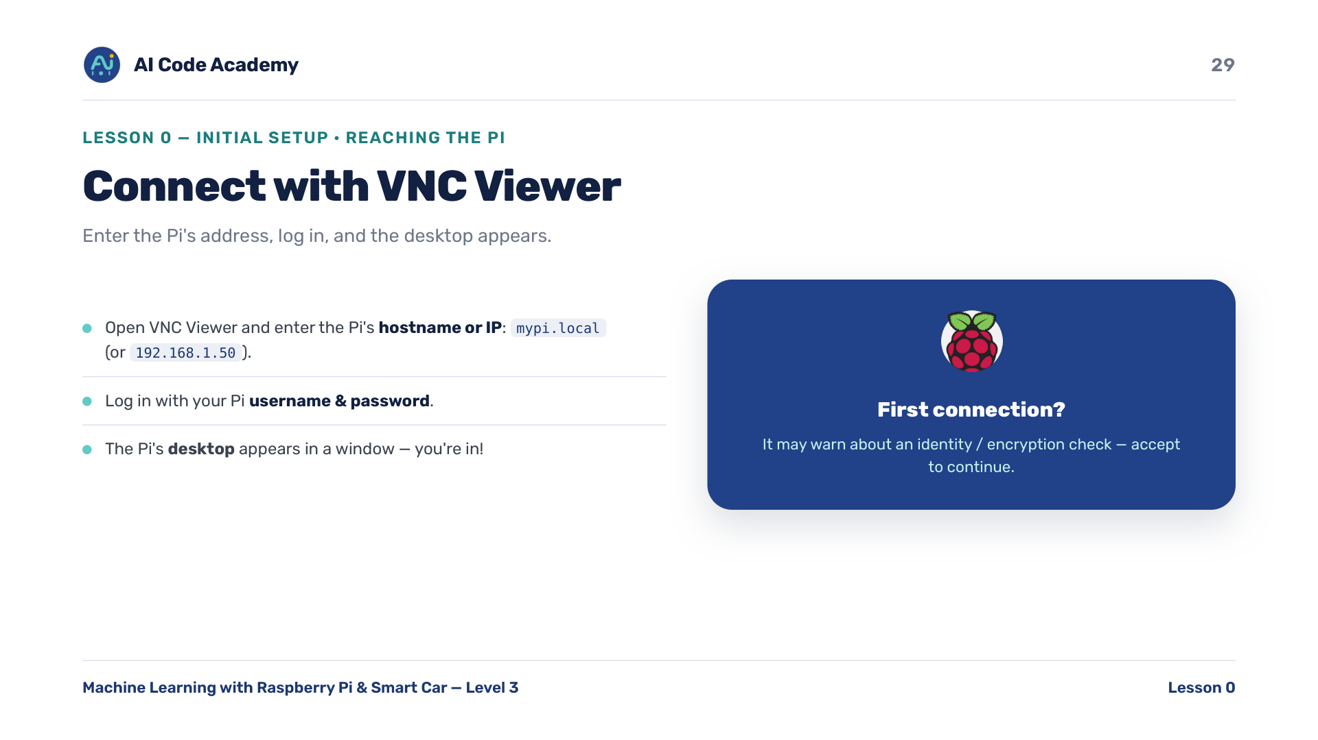
Notes:
Connect with VNC — enter the Pi's hostname or IP, log in with the Pi username and password. First connection may warn about identity/encryption: accept to continue. Tiny/black screen -> see troubleshooting (resolution).

Slide 30
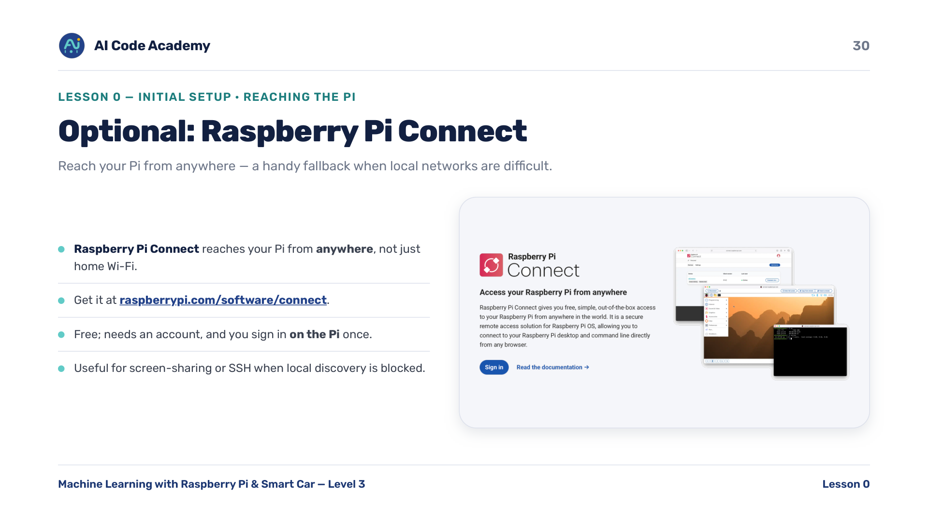
Notes:
Optional: Raspberry Pi Connect — reach your Pi from anywhere, not just home Wi-Fi: https://www.raspberrypi.com/software/connect/. Needs an account and a one-time sign-in on the Pi. Good fallback when a school/home network blocks local discovery.

Slide 31
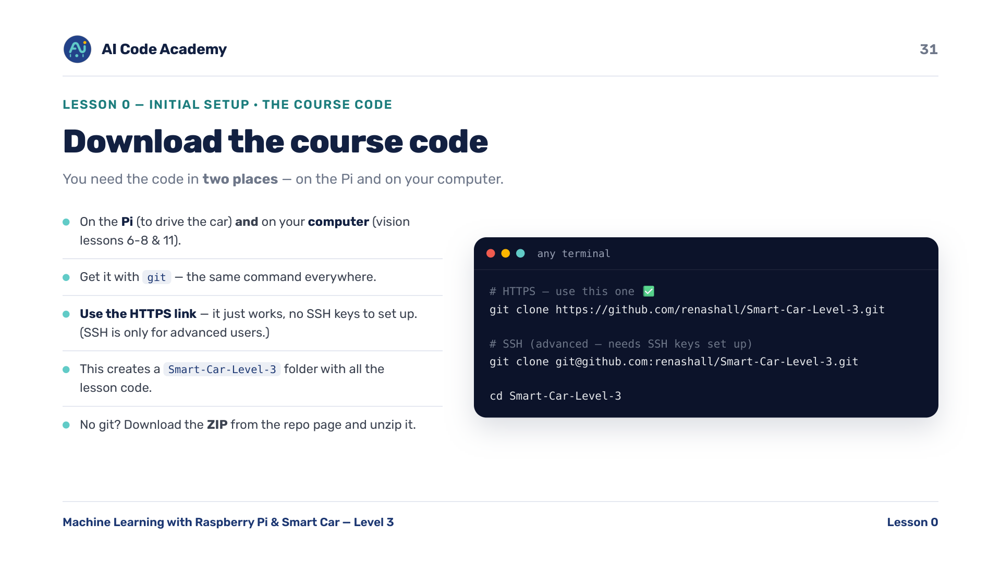
Notes:
Download the course code — needed in TWO places: on the Pi (to drive the car) and on your computer (camera/vision lessons 6-8 & 11). The clone link is https://github.com/renashall/Smart-Car-Level-3.git (HTTPS) or git@github.com:renashall/Smart-Car-Level-3.git (SSH), also posted on the class page / Discord. No git? Download the ZIP from the repo page.

Slide 32
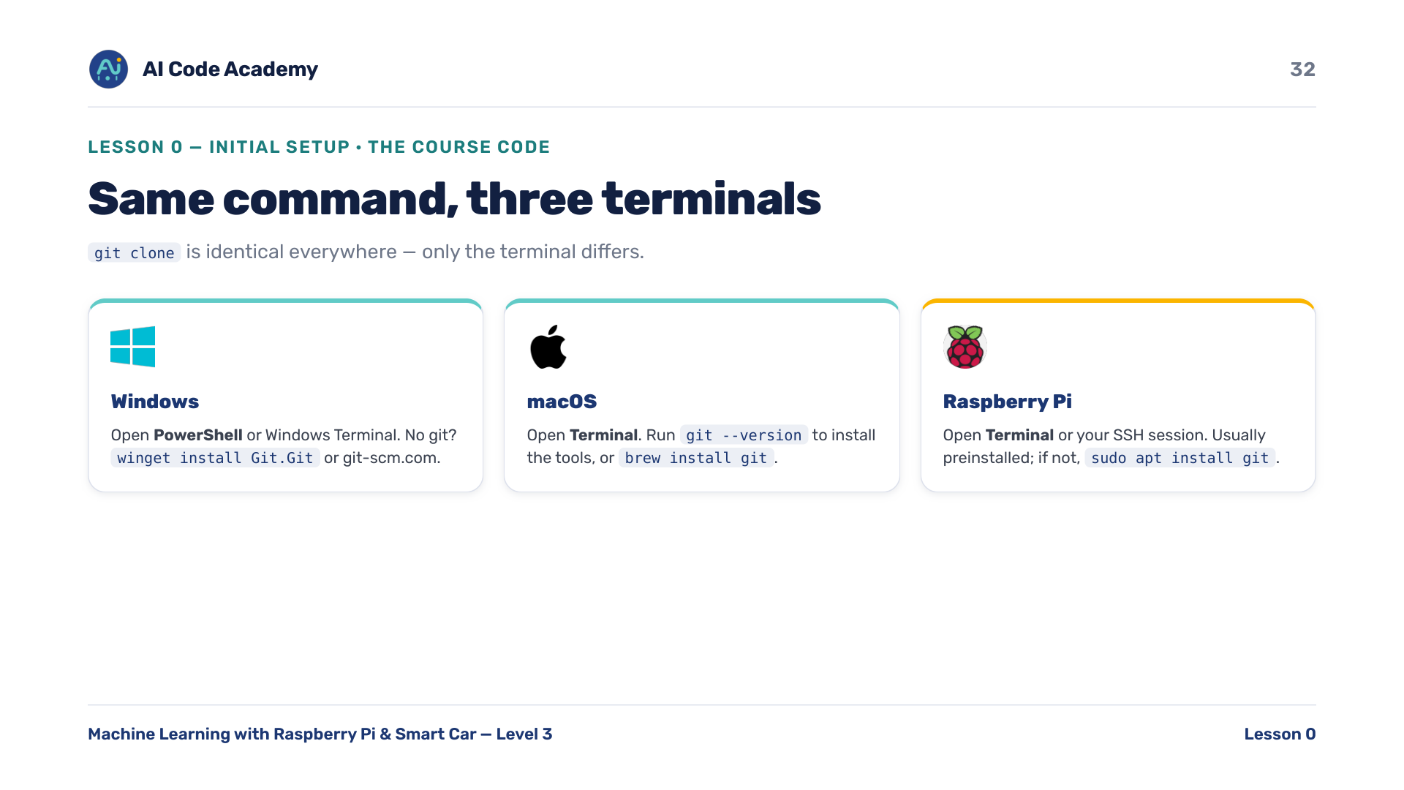
Notes:
Cloning everywhere — the git clone command is identical on every system; only the terminal differs. Windows: PowerShell. macOS: Terminal. Pi: Terminal or your SSH session. On the Pi git is normally already there.

Slide 33
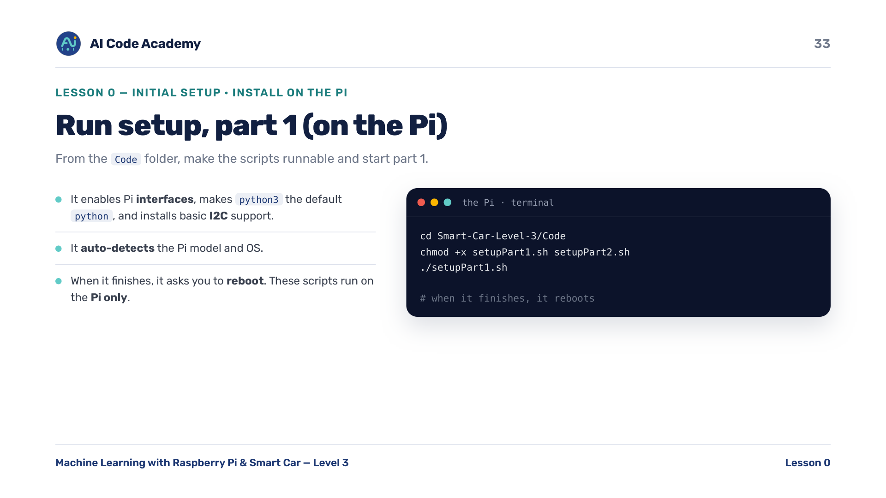
Notes:
Setup Part 1 (Pi) — it auto-detects the Pi model/OS, enables interfaces, makes python3 the default python, and installs I2C support. These scripts run on the Pi ONLY. Let it reboot before Part 2. If SSH drops on reboot, reconnect after a minute.

Slide 34
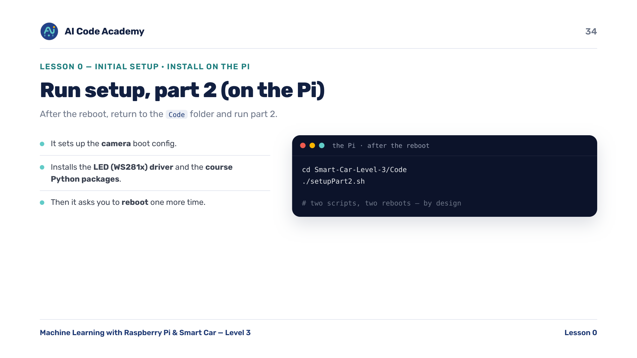
Notes:
Setup Part 2 (Pi) — after the reboot, run part 2. It sets up the camera boot config, installs the WS281x LED driver, and the course Python packages. Two scripts, two reboots, by design. After this the Pi has all the hardware libraries the lessons need.

Slide 35
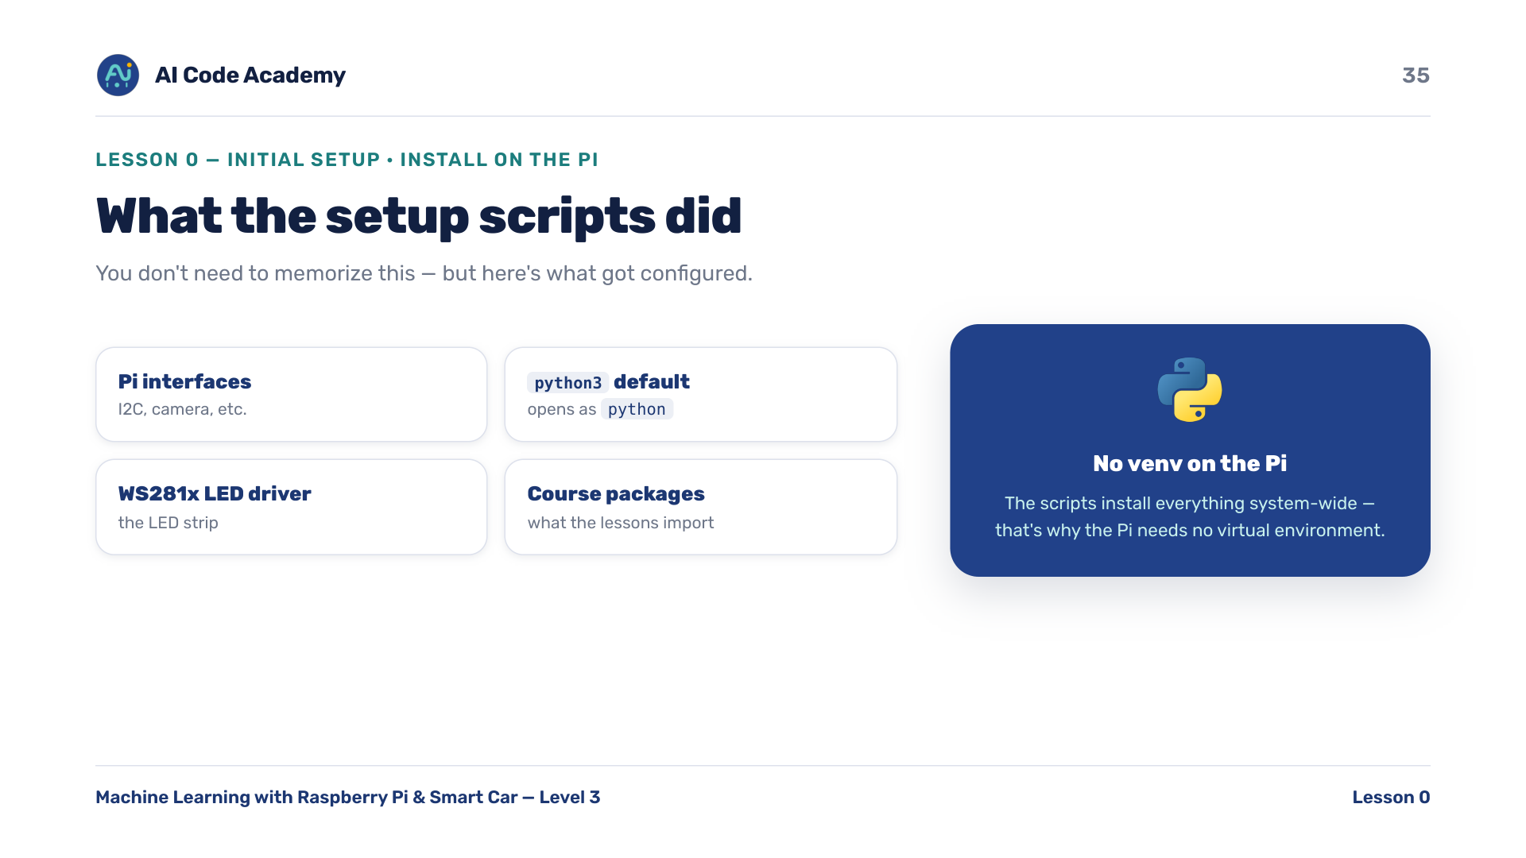
Notes:
What the scripts did — reassure: the scripts replace a lot of manual fiddling. That's why on the Pi you do NOT need a virtual environment. If one failed, re-run it and read the last error line.

Slide 36
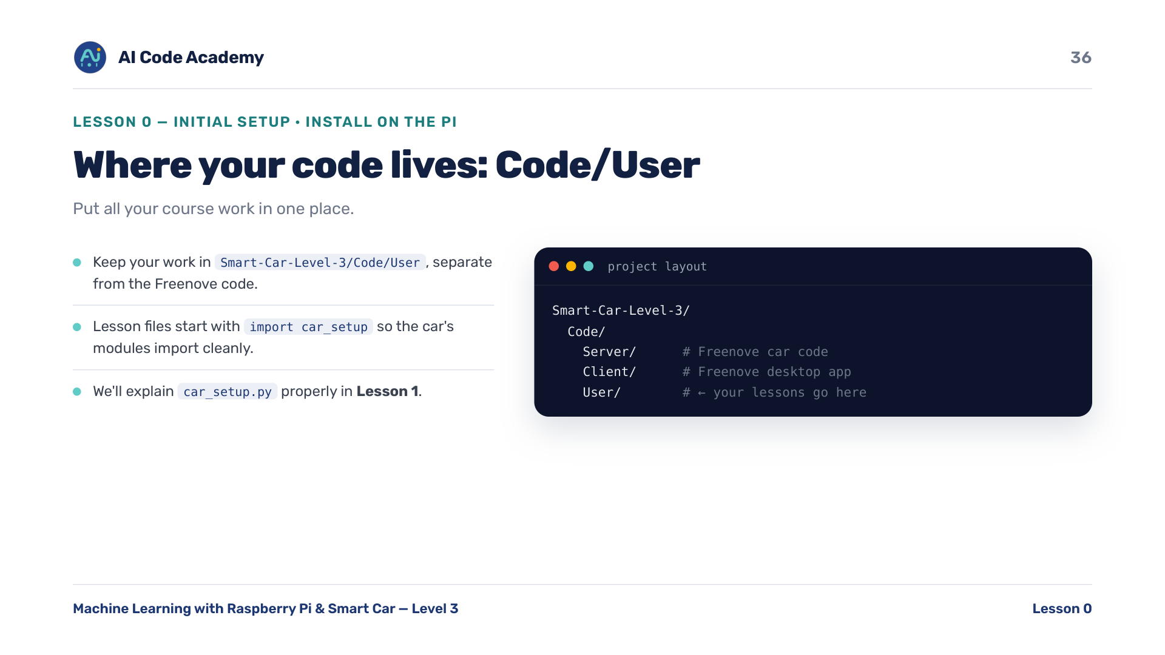
Notes:
Where your code lives — put all your course work in Smart-Car-Level-3/Code/User. Lesson files start with 'import car_setup' so the car's modules import cleanly. We explain car_setup.py properly in Lesson 1.

Slide 37
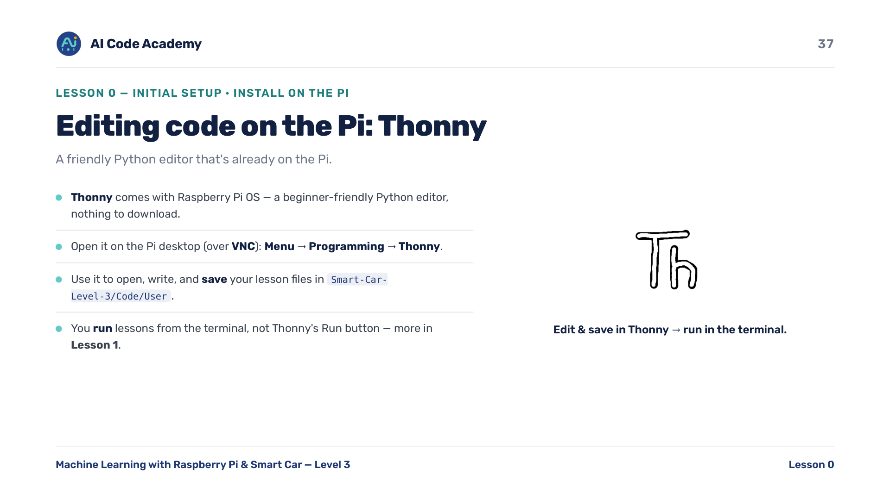
Notes:
Editing code on the Pi: Thonny — Thonny ships with Raspberry Pi OS and runs on the Pi desktop (reach it over VNC); no install needed. Students open, edit and SAVE lesson files into Code/User here, but RUN lessons from the terminal (the LED lessons need sudo) — we explain that split in Lesson 1.

Slide 38
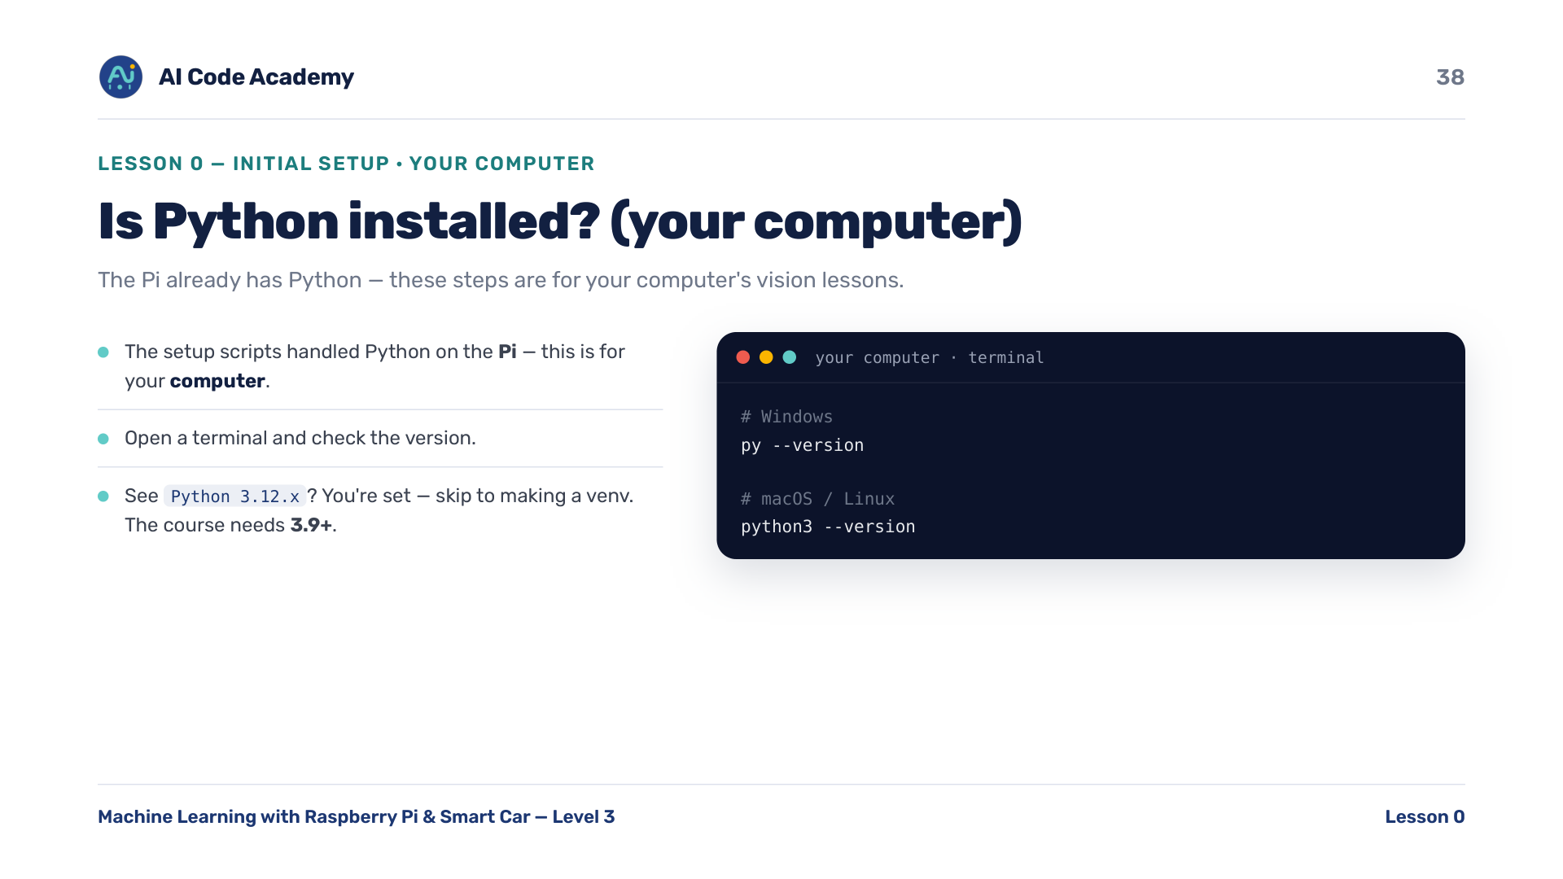
Notes:
Is Python installed (computer) — the Pi already has Python. These next steps are for YOUR computer, for the vision lessons. On Windows, 'py' is the most reliable launcher; if 'python' opens the Microsoft Store, use 'py'. The course needs Python 3.9+.

Slide 39
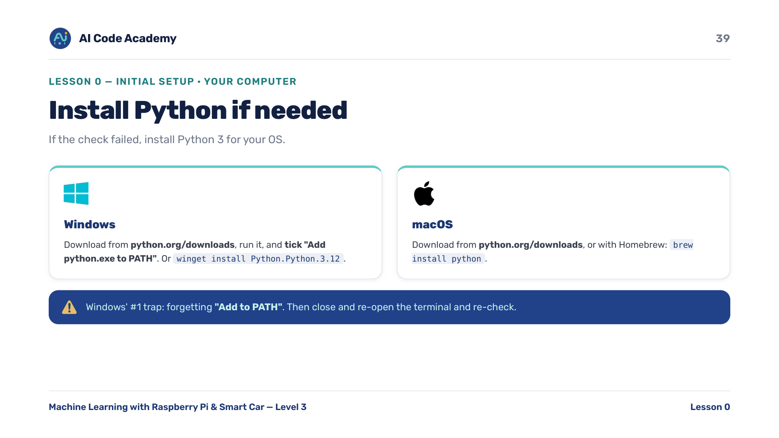
Notes:
Install Python if needed — the #1 Windows mistake is forgetting 'Add python.exe to PATH' (then python/py isn't found). Re-running the installer and ticking it fixes it. macOS: python.org or 'brew install python'. Close and reopen the terminal, then re-check.

Slide 40
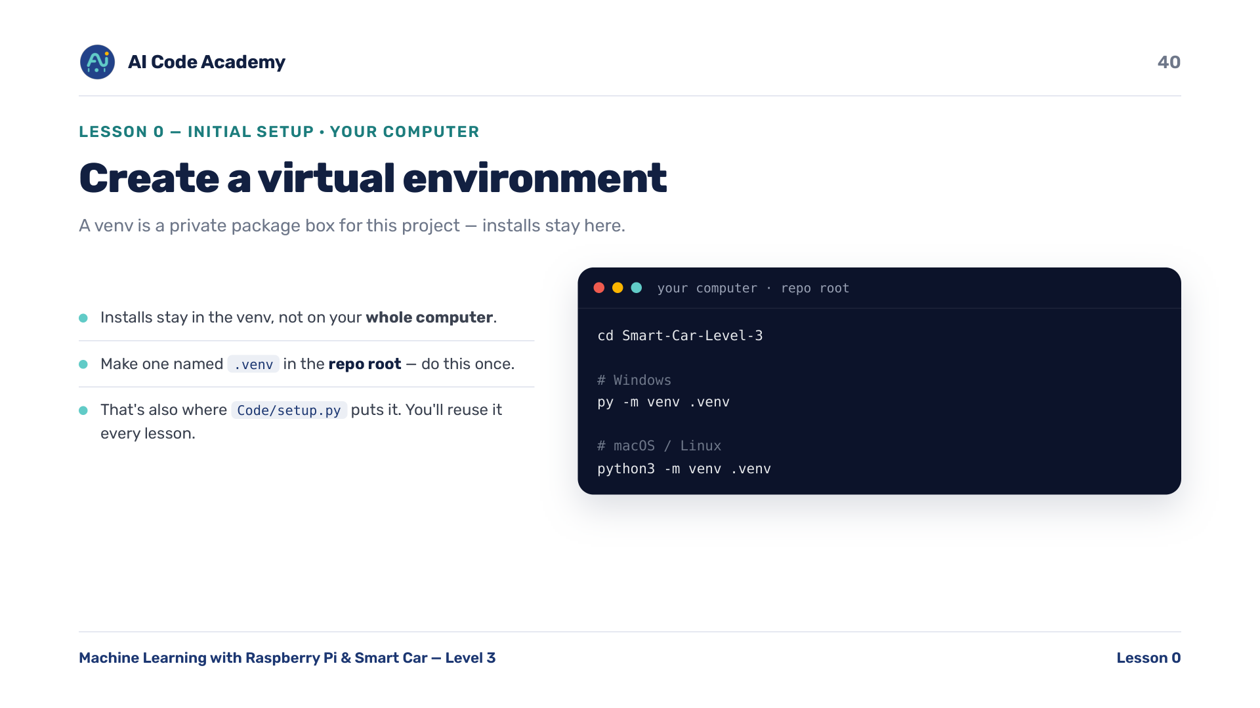
Notes:
Create a venv — a venv is a private package box for this project. Always put it at the repo root as .venv (that's also where Code/setup.py puts it). One venv per project keeps versions clean. Do this once.

Slide 41
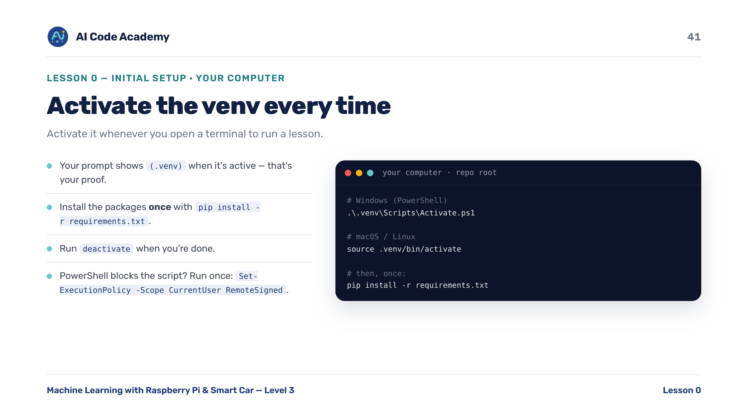
Notes:
Activate the venv — stress: activate first, EVERY session, before running any lesson. The (.venv) tag is proof it worked. Packages only need installing once per venv. PowerShell blocks the script? Run once: Set-ExecutionPolicy -Scope CurrentUser RemoteSigned.

Slide 42
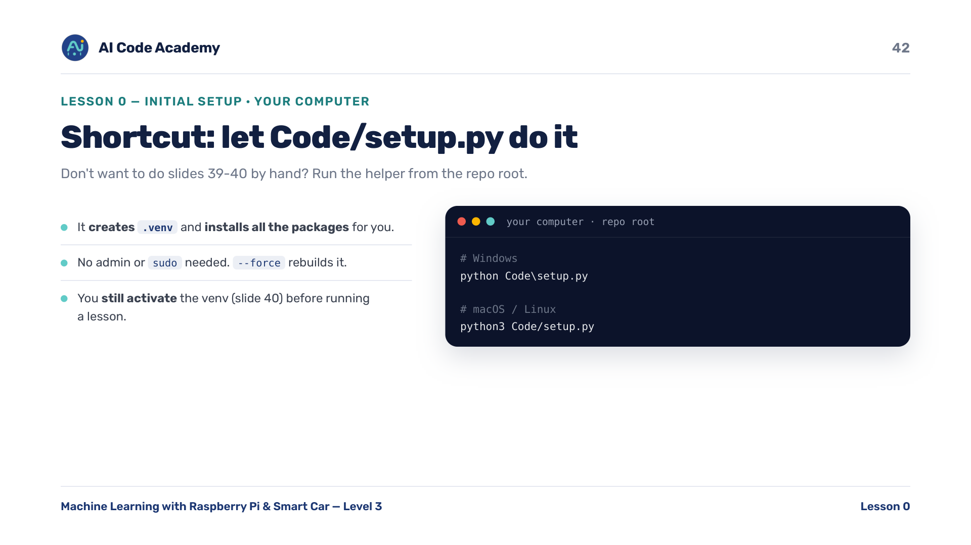
Notes:
Shortcut: Code/setup.py — this is slides 39-40's create+install in one step. No admin/sudo needed; --force rebuilds it. It's the easy path; the manual steps teach what it's doing. Either way, you still activate the venv to run a lesson.

Slide 43
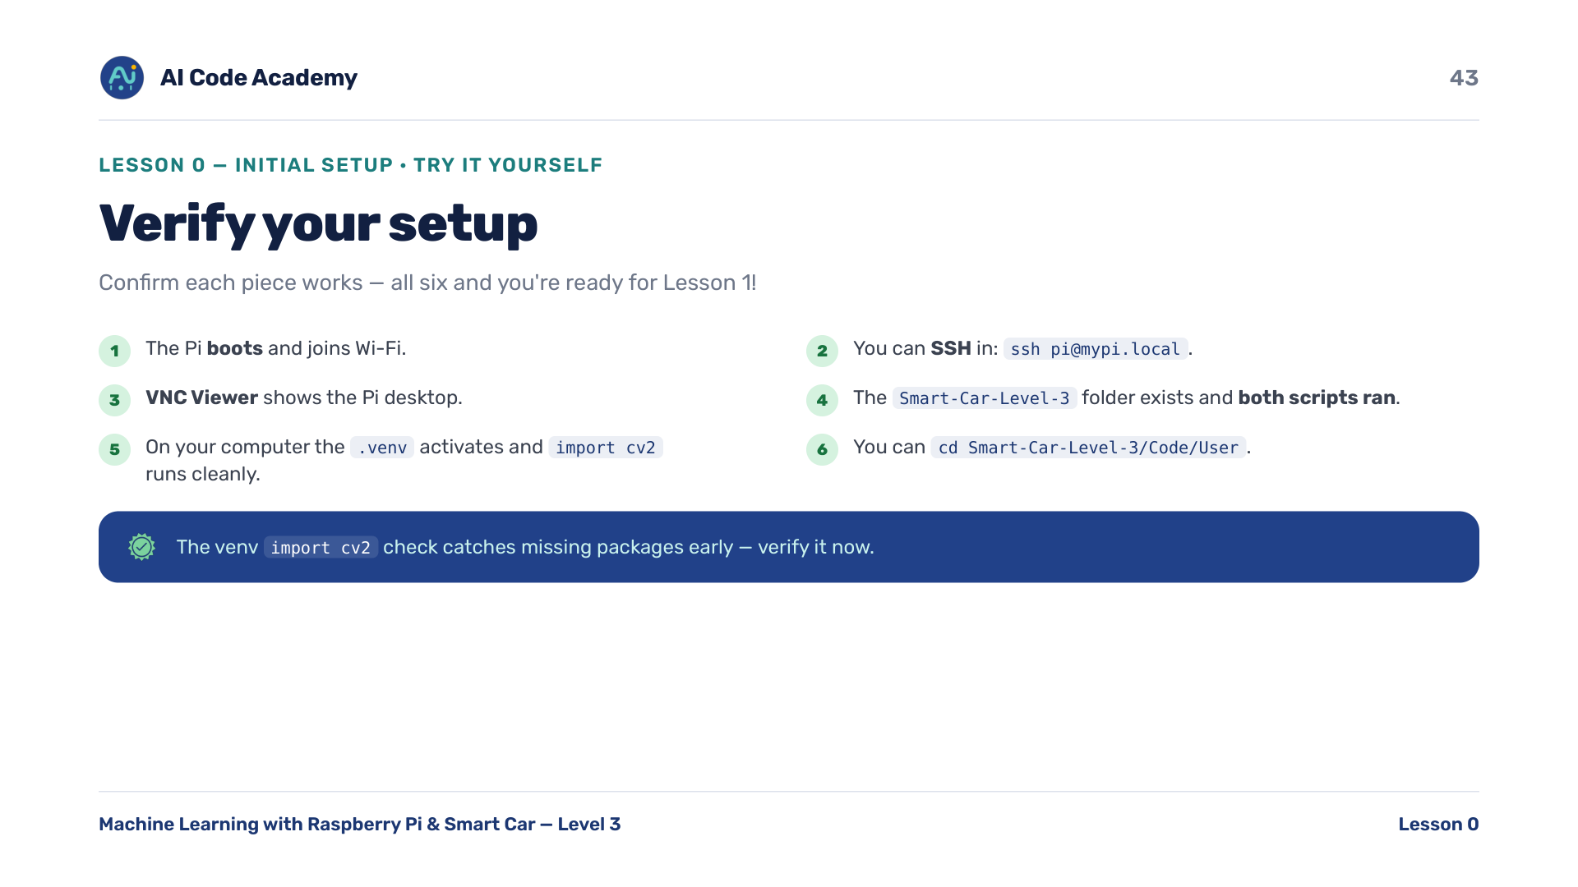
Notes:
Try it yourself — walk the room and tick these six checks off per student. Don't move to Lesson 1 until everyone clears the checklist. The venv 'import cv2' check catches missing packages early.

Slide 44
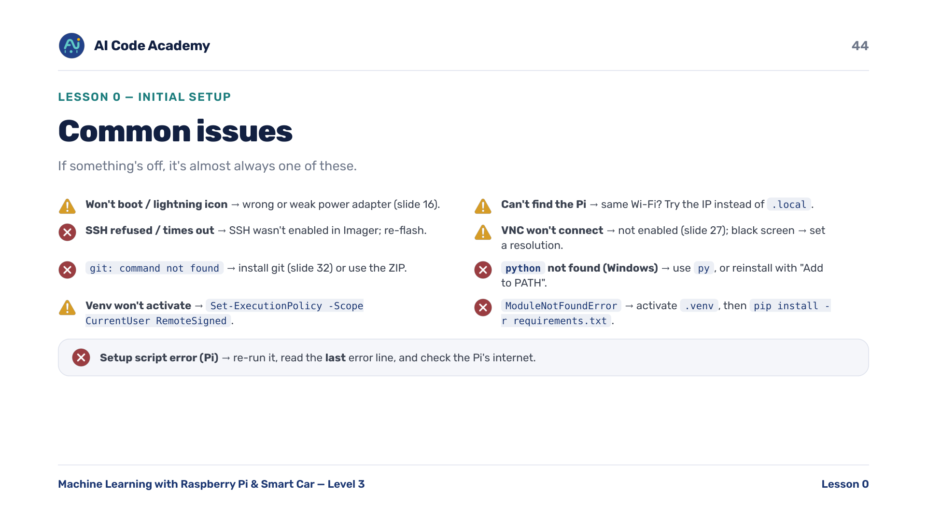
Notes:
Troubleshooting — power, 'SSH not enabled in Imager', and Windows 'Add to PATH' are the biggest time-sinks. Keep a known-good adapter and a spare flashed SD card handy.

Slide 45
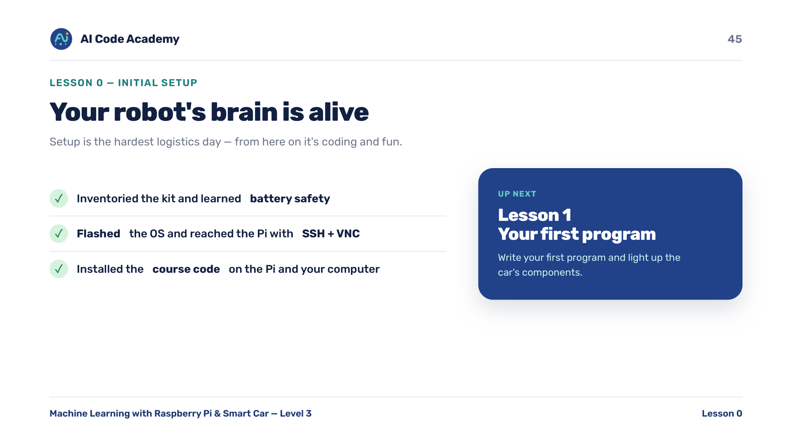
Notes:
Recap & what's next — congratulate them; setup is the hardest logistics day. From here on it's coding and fun. Next, Lesson 1: write your first program and light up the car's components.

Slide 46
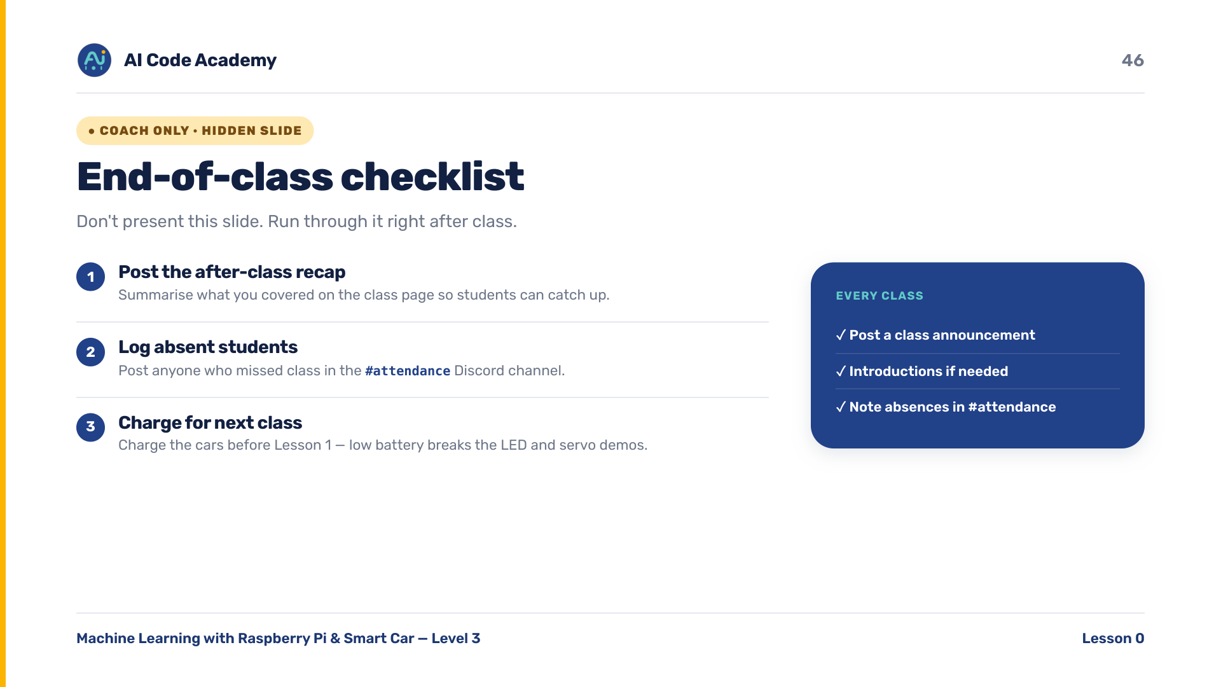
Notes:
COACH (hidden) — do not present. After class: post the recap, log absent students in the Discord #attendance channel, and charge the cars for Lesson 1.

Slide 47
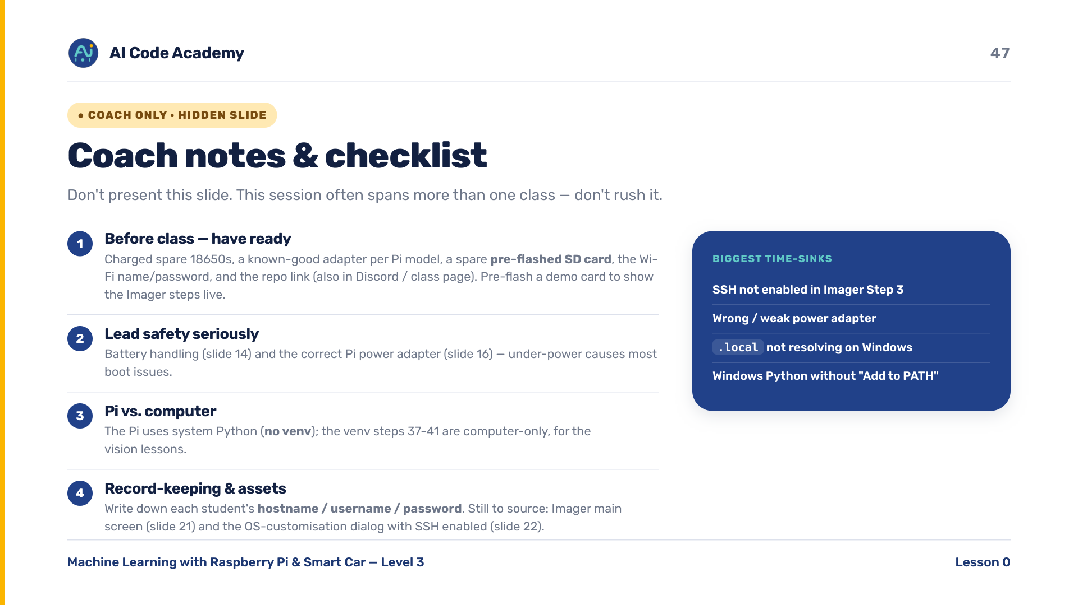
Notes:
COACH (hidden) — do not present. Timing: this often spans more than one session. Before class have ready: charged spare 18650s, a known-good adapter per Pi model, a spare pre-flashed SD card, the Wi-Fi name/password, and the repo link (also in Discord / class page). Pre-flash a demo card to show the Imager steps live. Lead the battery and power-adapter safety seriously. Pi uses system Python (no venv); the venv steps are computer-only. Write down each student's hostname / username / password. Assets still to source: Imager main screen (slide 21) and the OS-customisation dialog with SSH enabled (slide 22).

