Slide 1
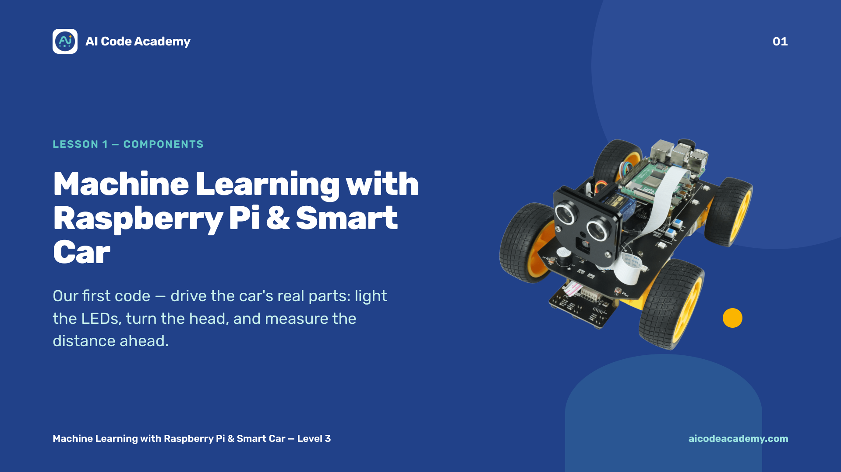
Notes:
Title — ~1 min. Welcome students; confirm every car is powered and they can open a terminal on the Pi. Site: https://aicodeacademy.com

Slide 2
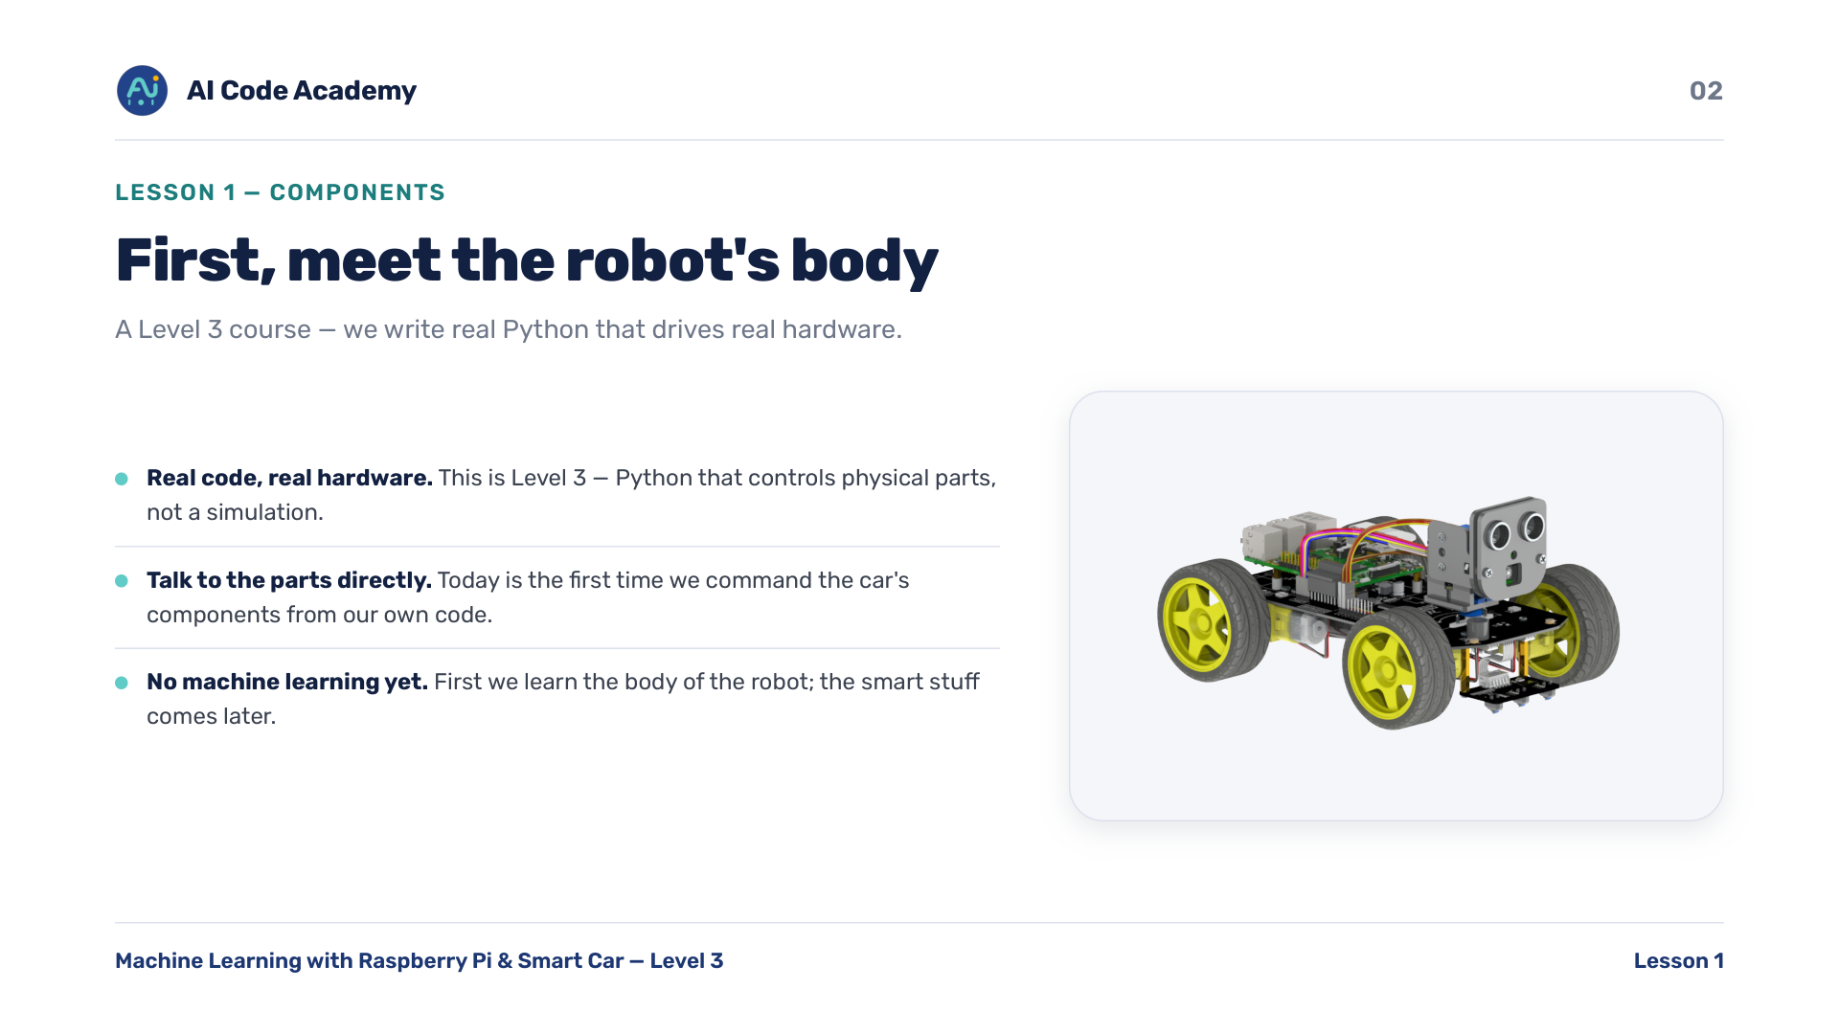
Notes:
Introduction — set expectations: by the end of today they run their own program that lights up, moves the head, and measures distance.

Slide 3
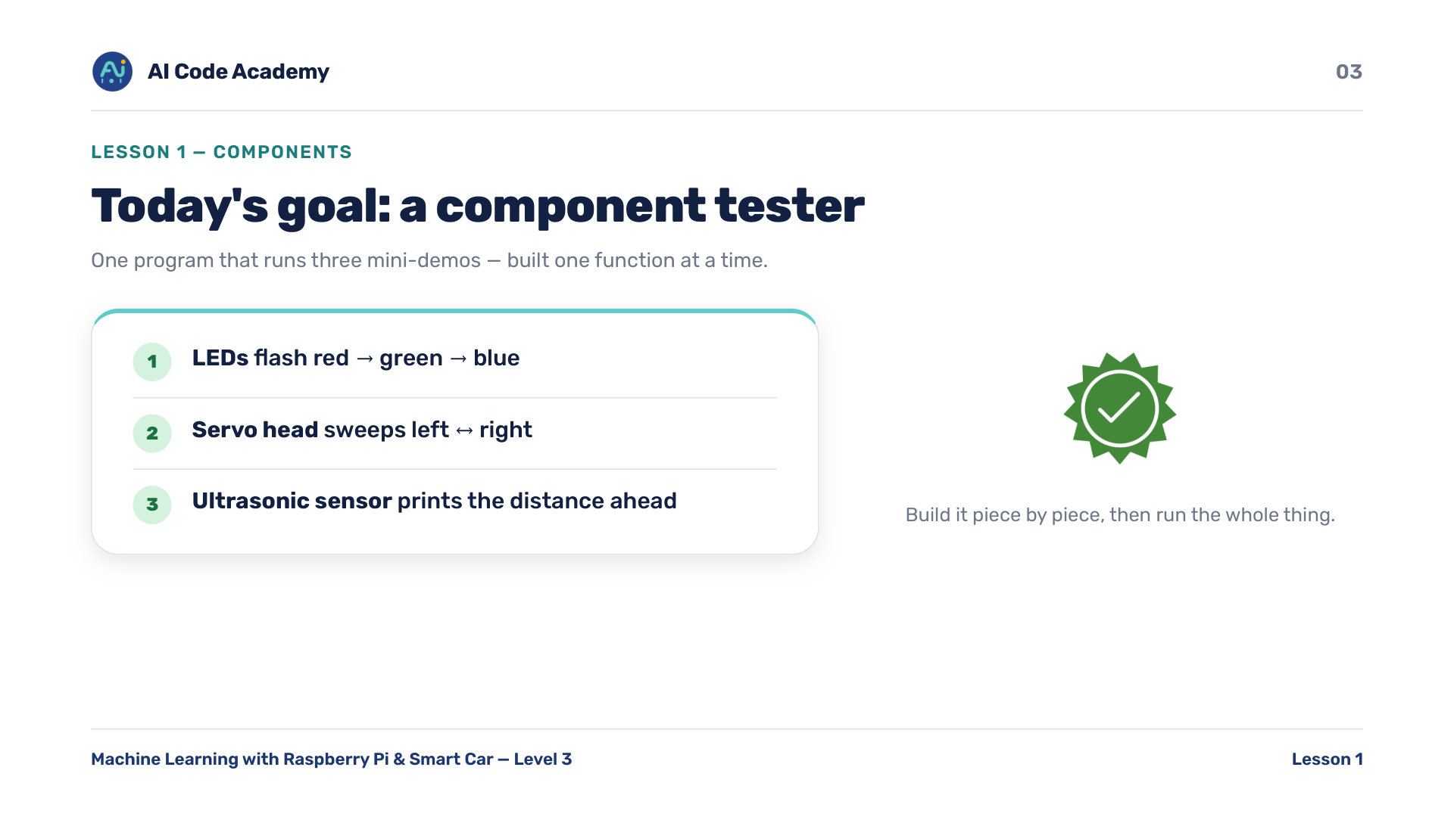
Notes:
Goals — show the finished demo running first if time, so they know the target.

Slide 4
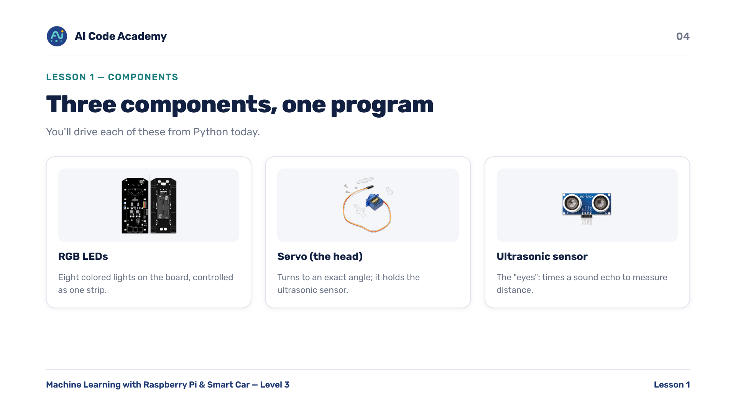
Notes:
Meet the components — have students physically point to each part on their own car.

Slide 5
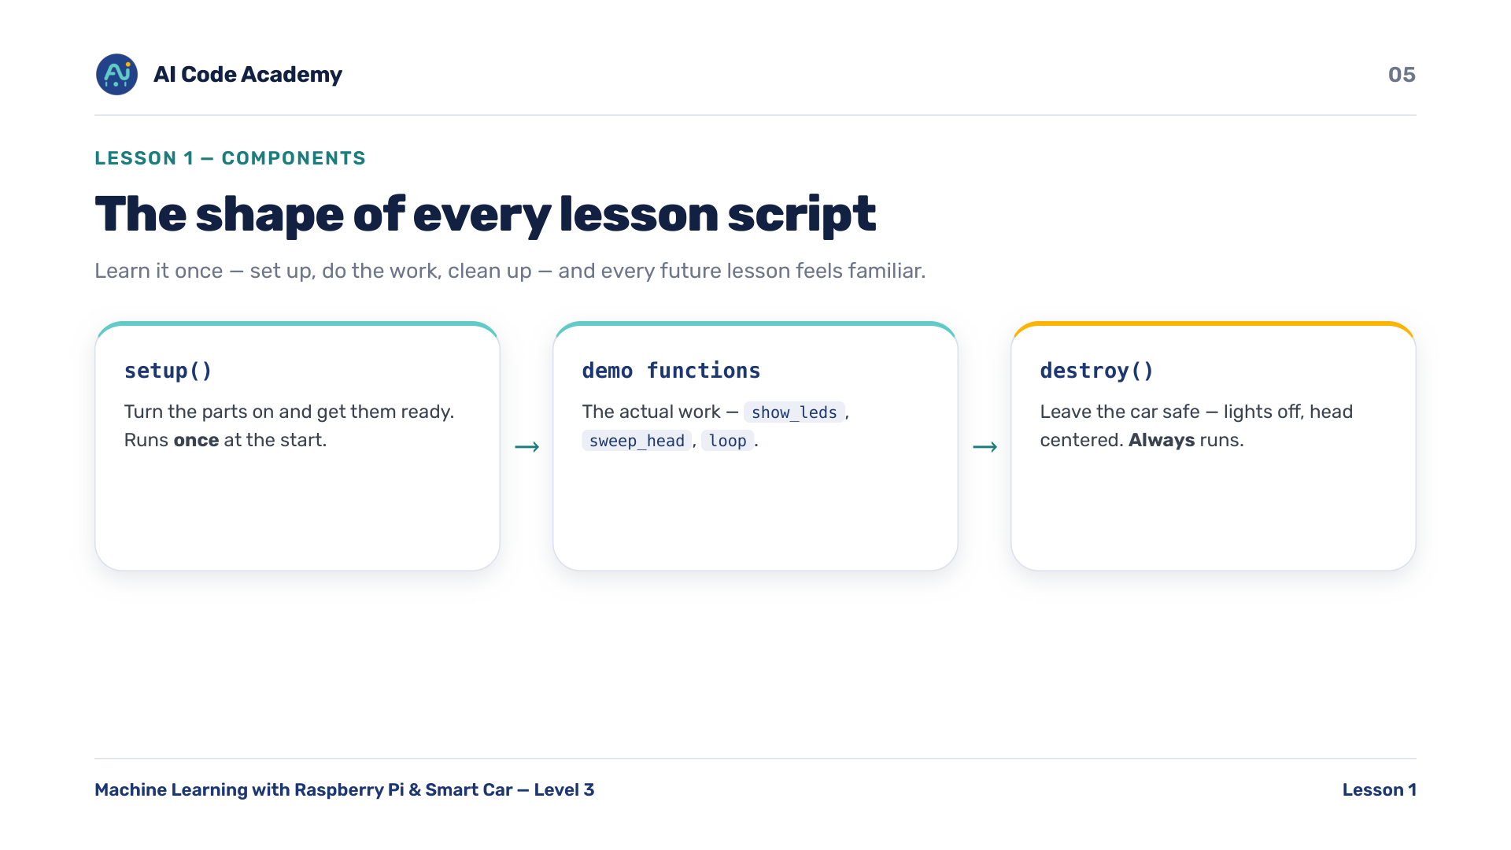
Notes:
Script shape — setup -> do work -> destroy repeats in Lessons 2 and 3; call it out now.

Slide 6
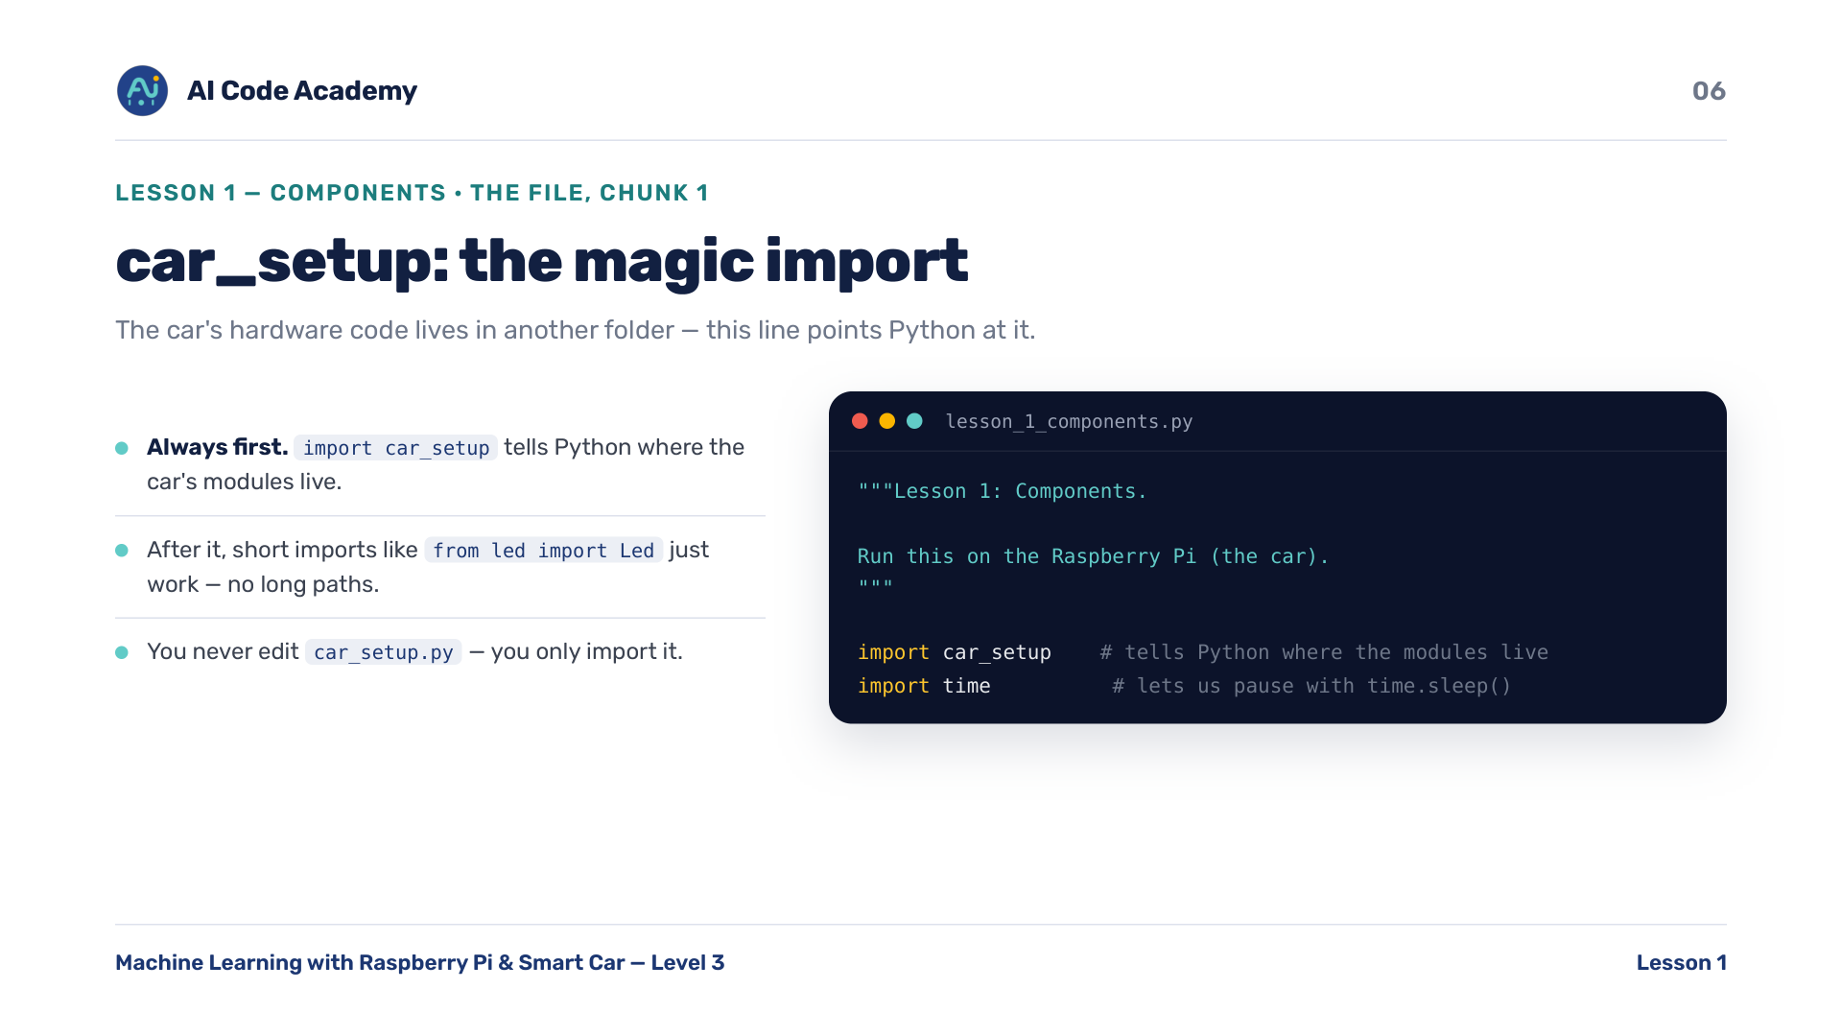
Notes:
car_setup — reassure them this is plumbing they type once. It must come BEFORE the hardware imports.

Slide 7
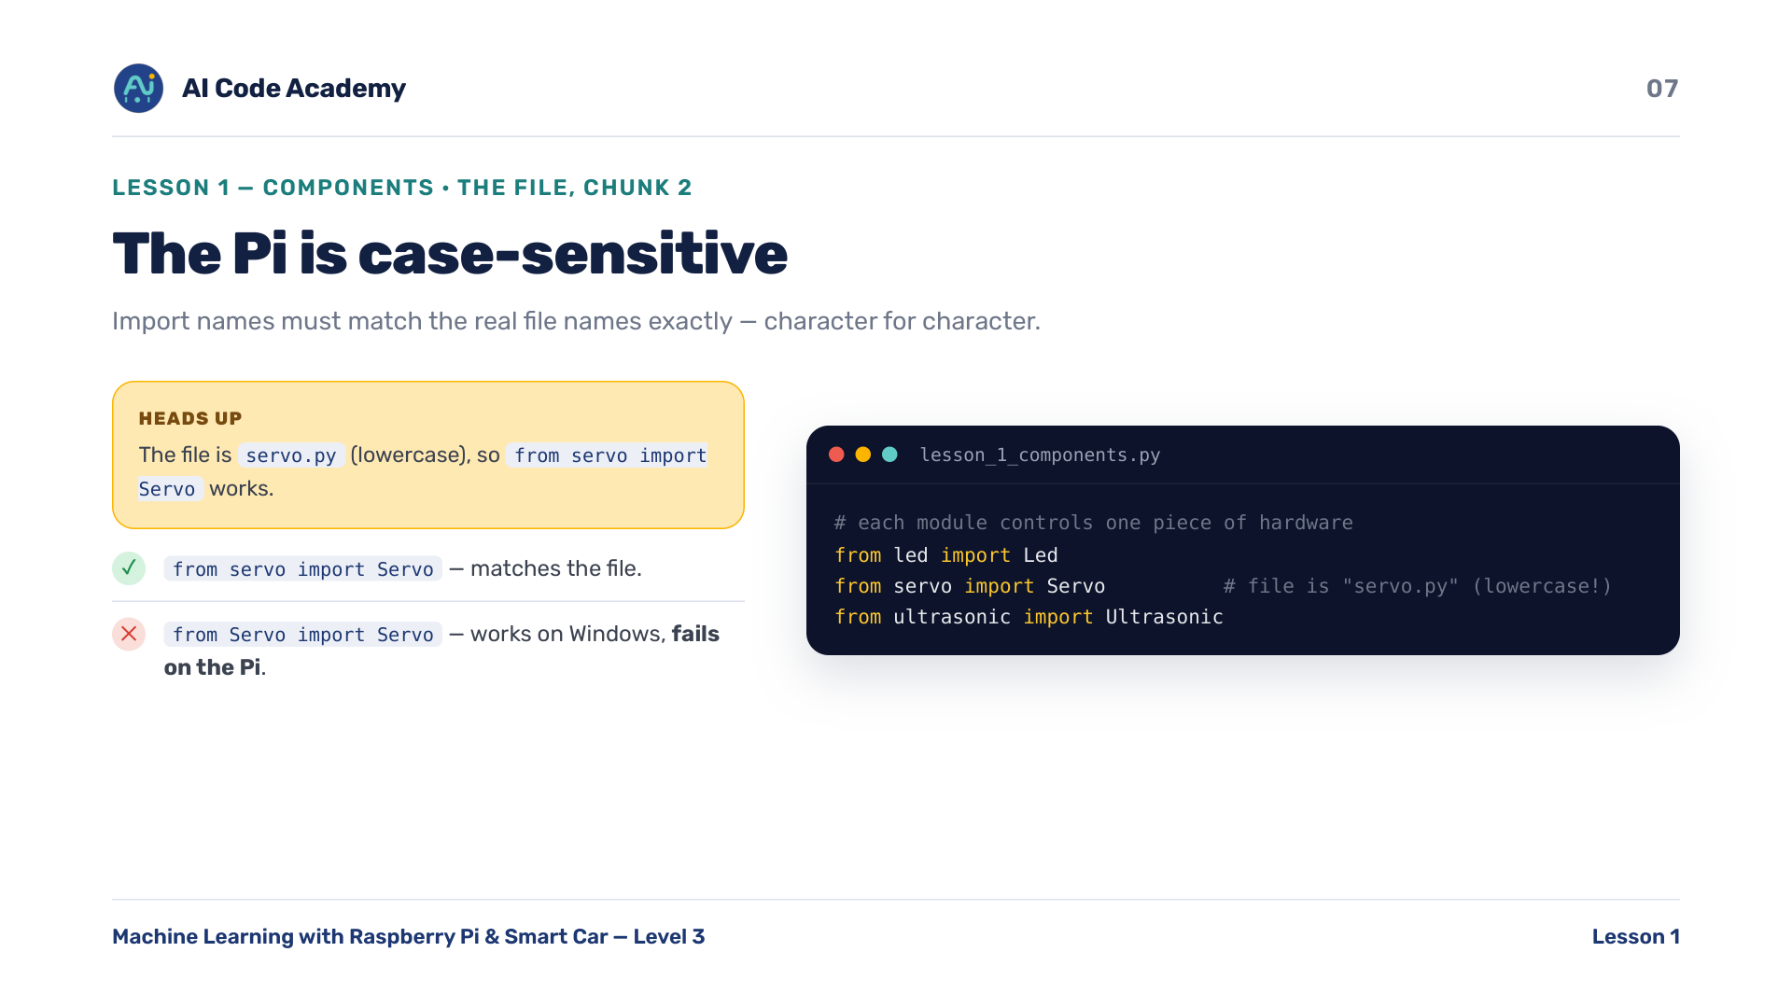
Notes:
Case-sensitivity — the #1 'works on my laptop, breaks on the Pi' bug. Make them notice the lowercase servo.

Slide 8
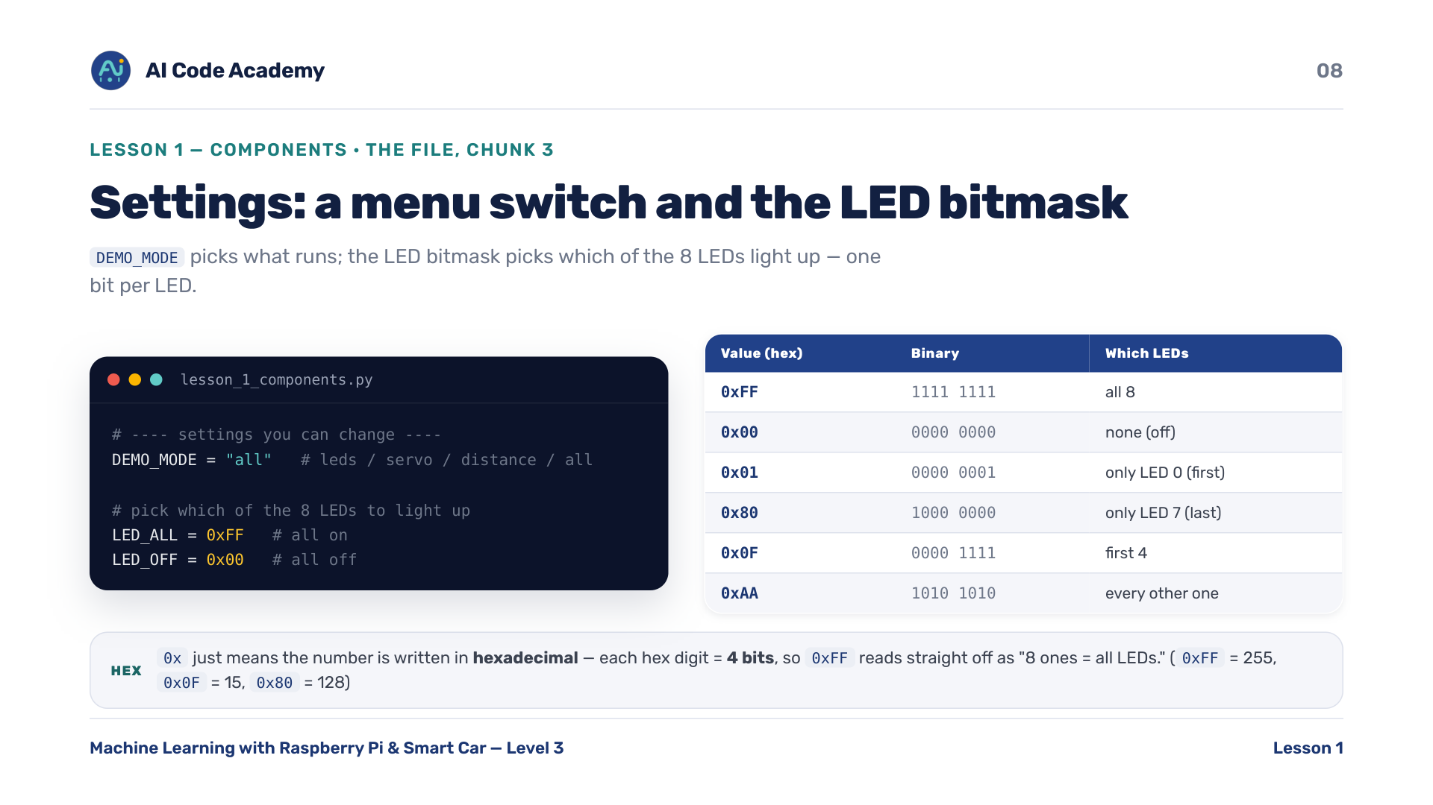
Notes:
Settings: bitmask — the hex table is a reference, not a lecture. '0xFF means all of them' is enough for most students; point out that each hex digit = 4 bits, so 0xFF = 8 ones = all LEDs, and let the keen ones read the rest of the table.

Slide 9
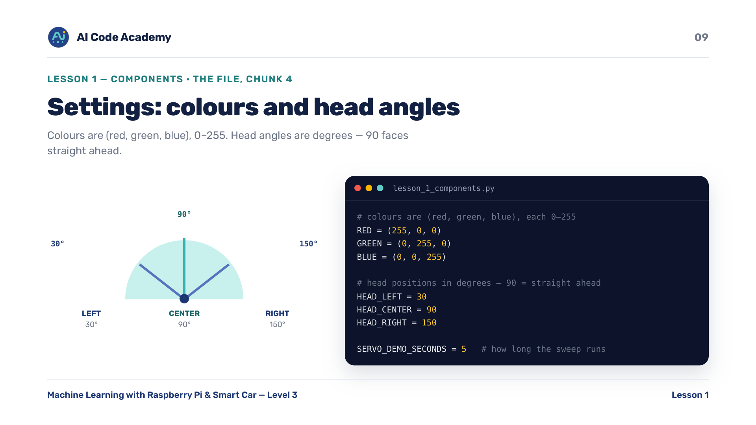
Notes:
Settings: colours/angles — tie colours back to the (R,G,B) idea from art/screens. Asset to source: head-angle diagram.

Slide 10
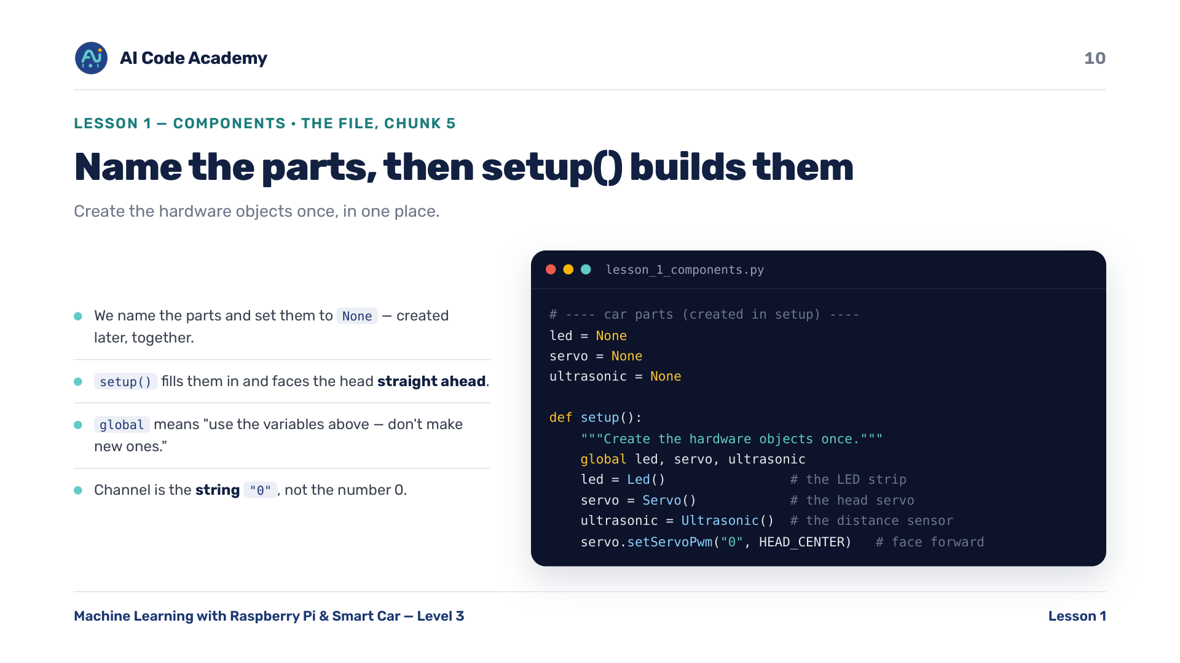
Notes:
setup() — point out setServoPwm("0", ...): the channel is the STRING "0", not the number 0.

Slide 11
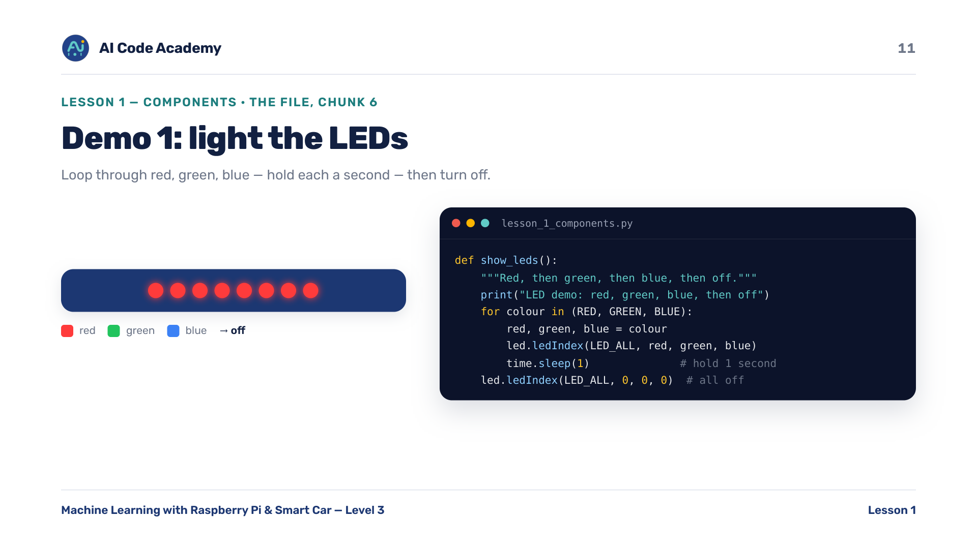
Notes:
Demo 1 LEDs — run just this part live (DEMO_MODE = "leds") for an instant payoff. Asset to source: LED close-up photo.

Slide 12
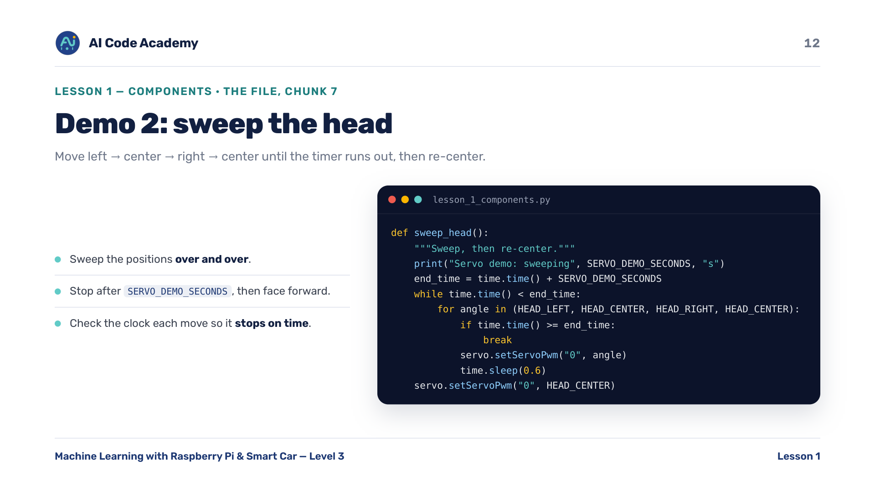
Notes:
Demo 2 servo — warn that the servo can buzz/jitter if power is low; covered in troubleshooting.

Slide 13
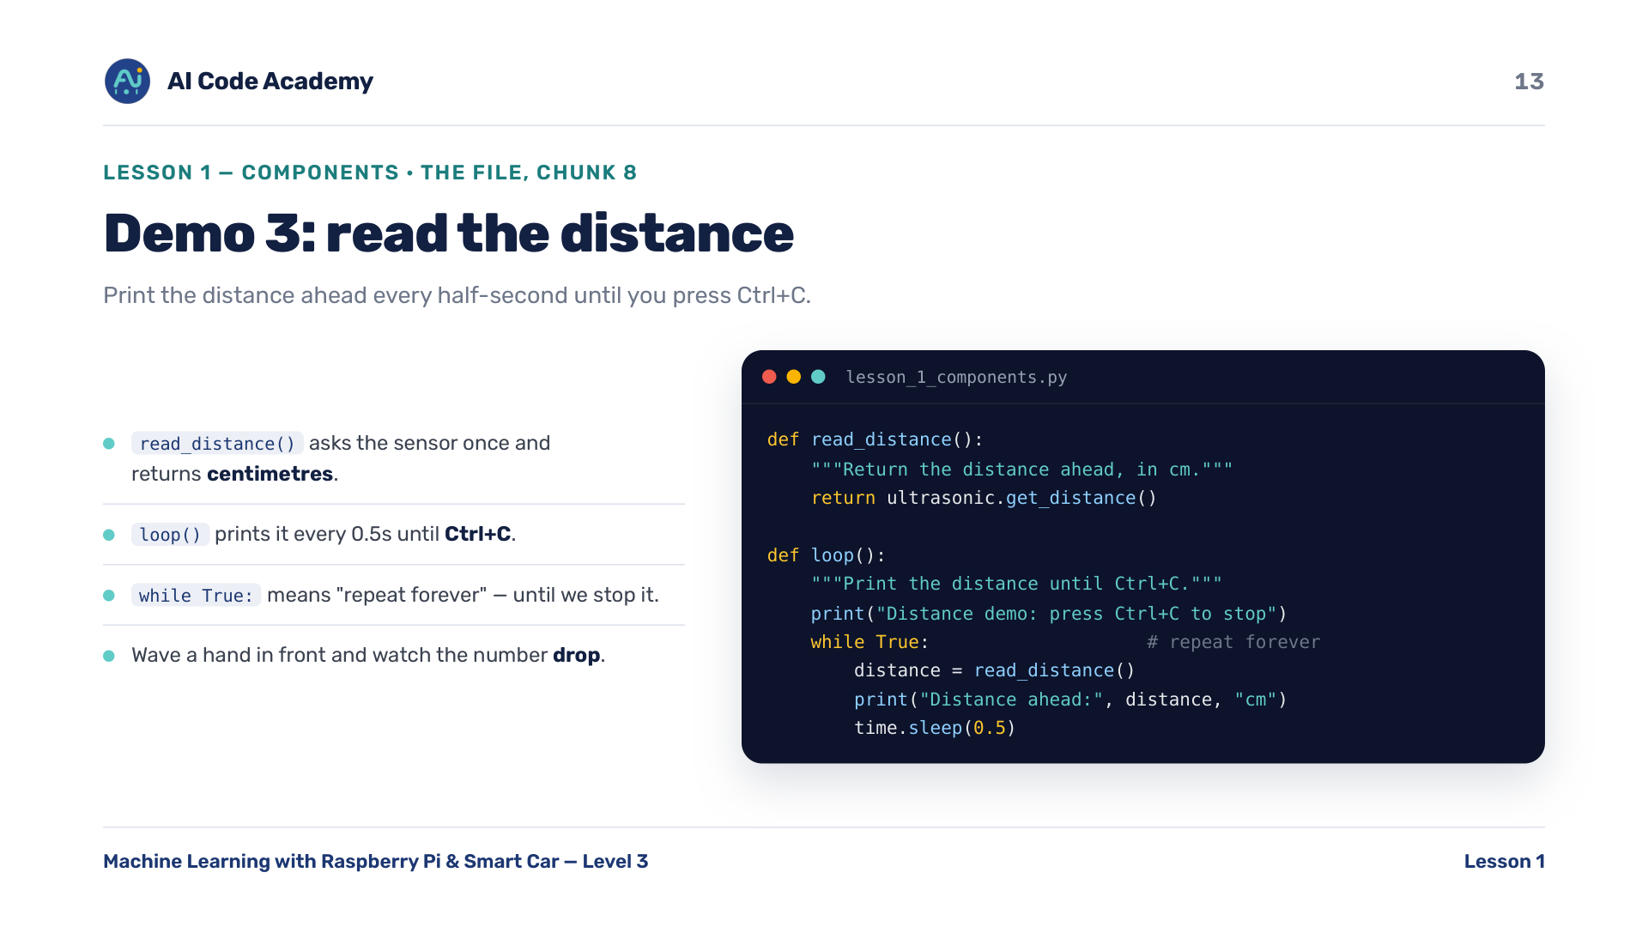
Notes:
Demo 3 distance — have students wave a hand in front of the sensor and watch the number drop.

Slide 14
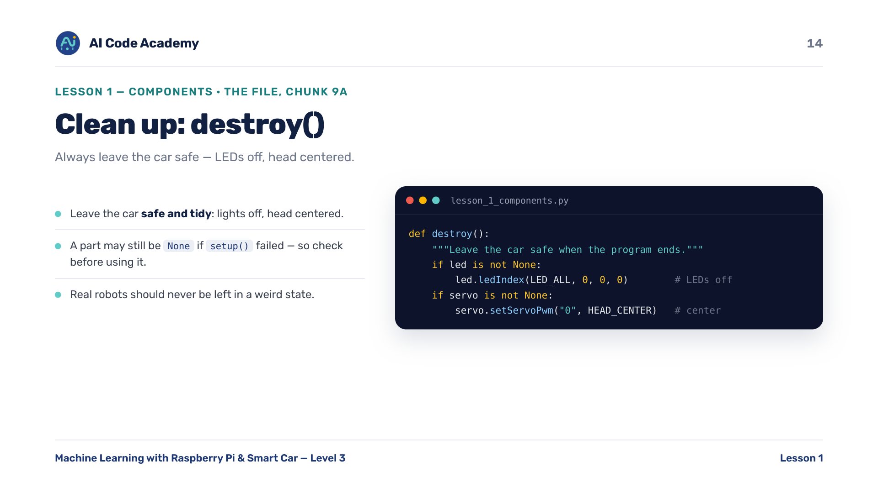
Notes:
destroy() — connect 'clean up' to real robots: never leave hardware in a weird state.

Slide 15
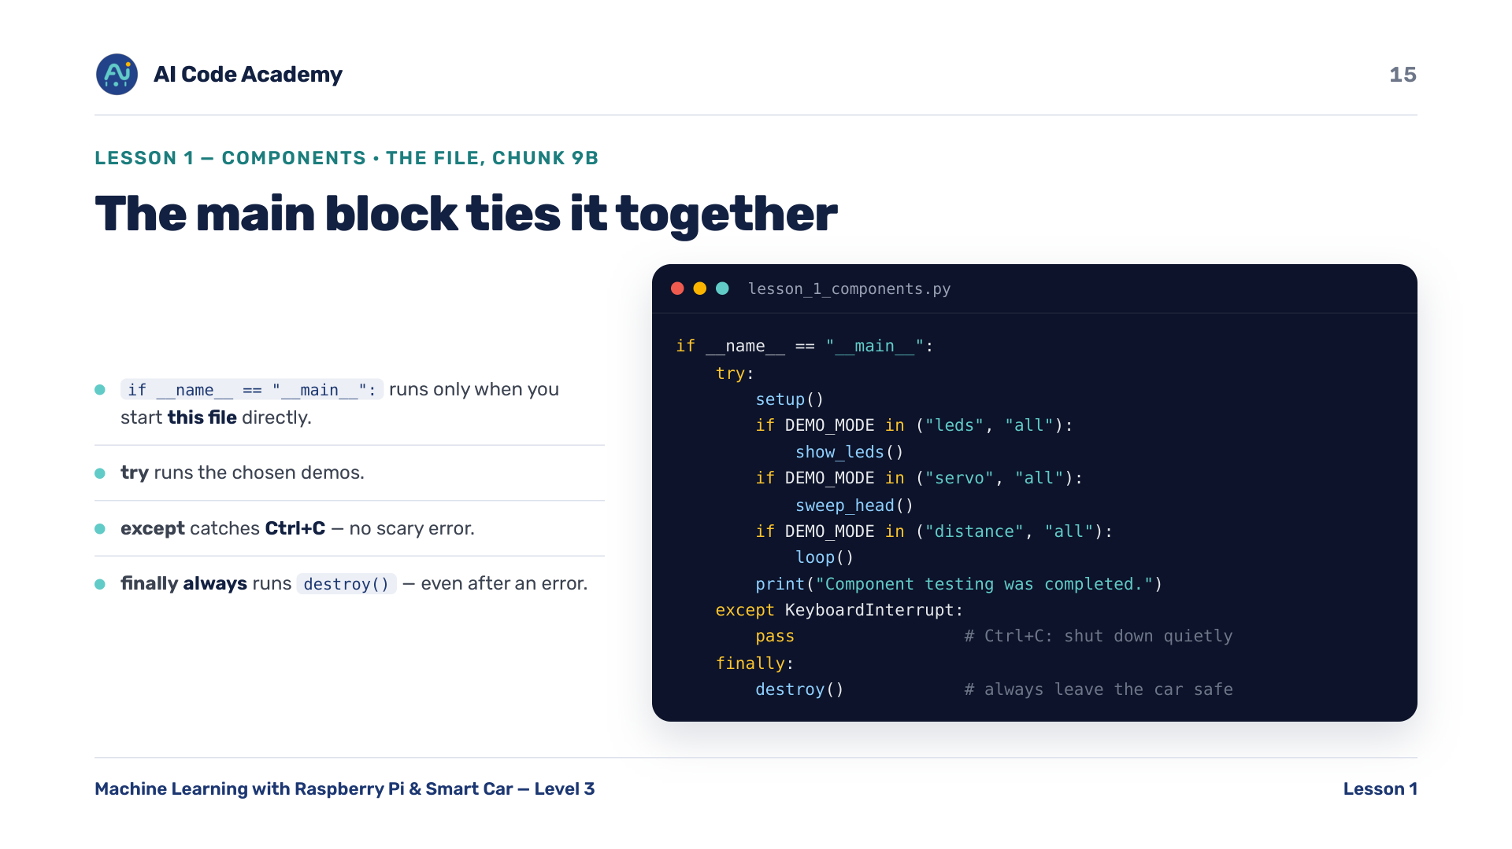
Notes:
Main block — 'finally' is the key idea: clean-up runs no matter how the program ends.

Slide 16
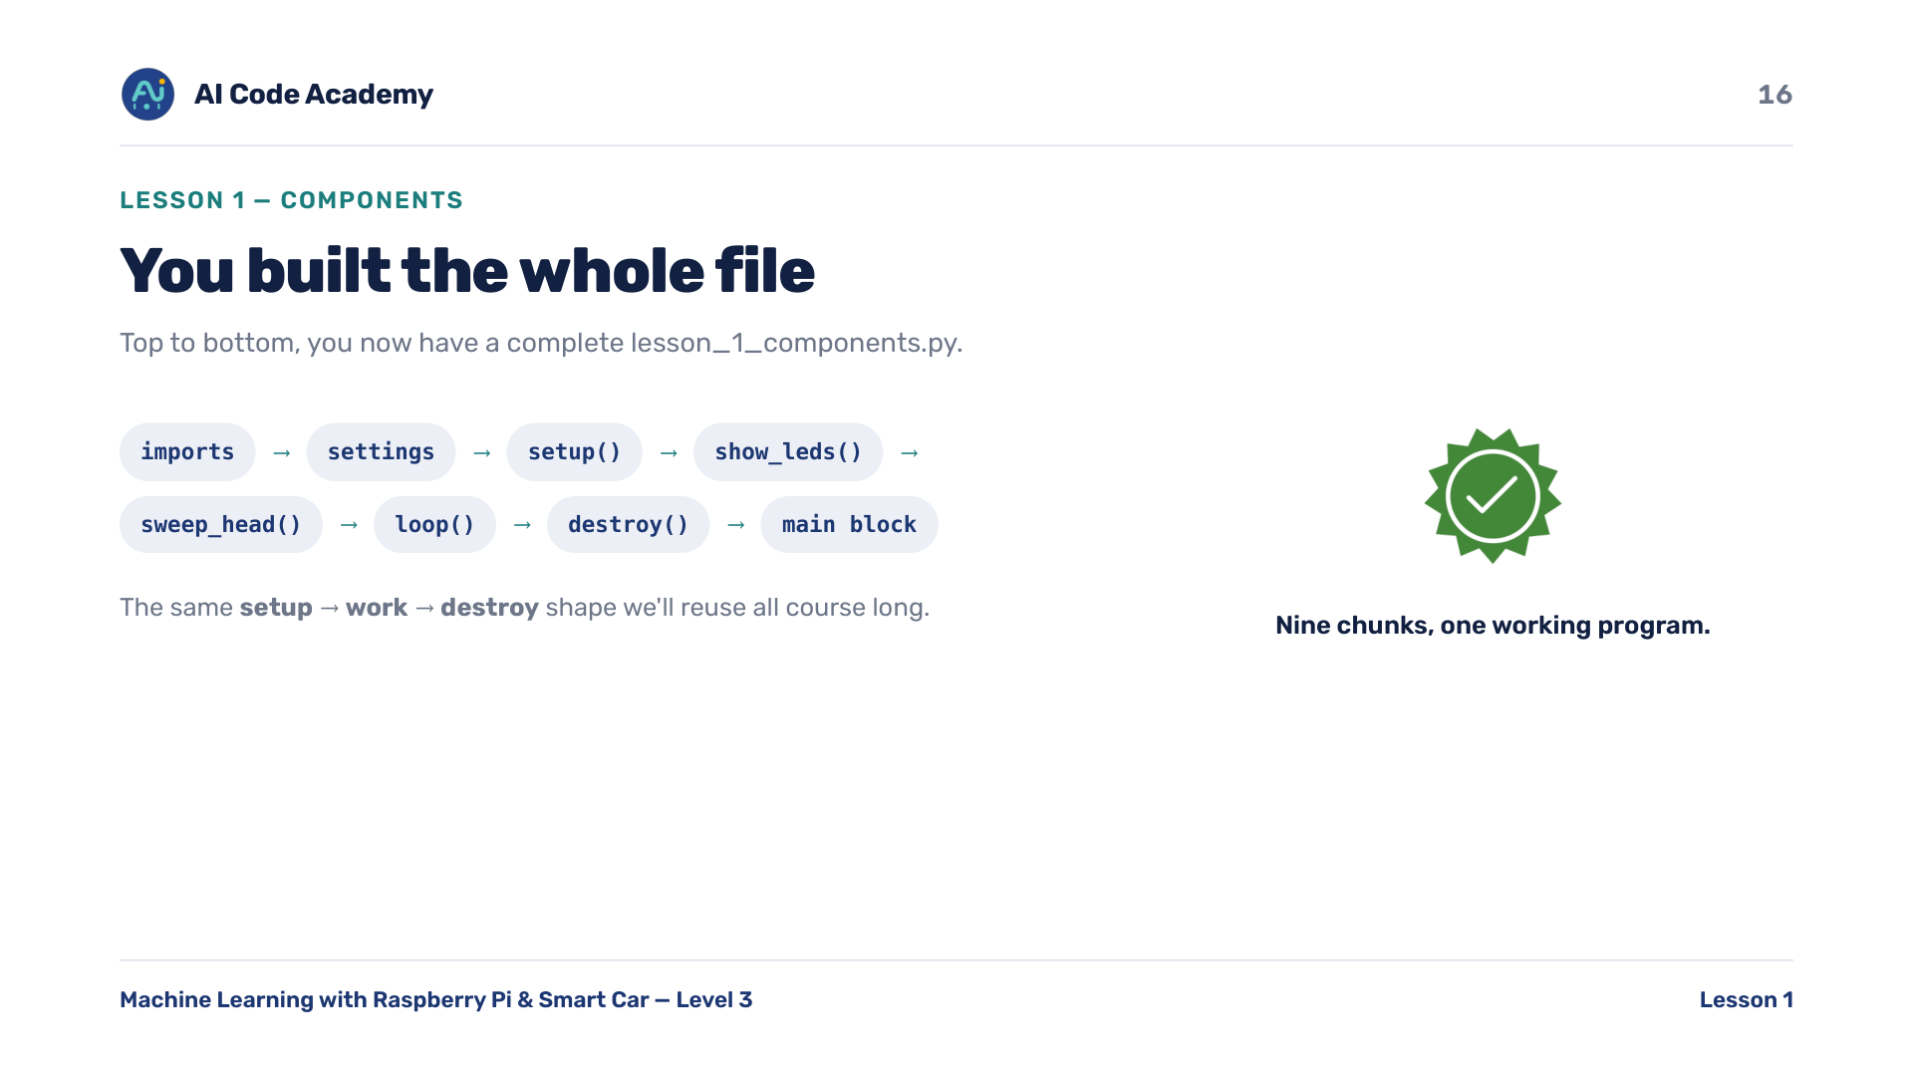
Notes:
Whole file — quick scroll through the full assembled file so they see the result.

Slide 17
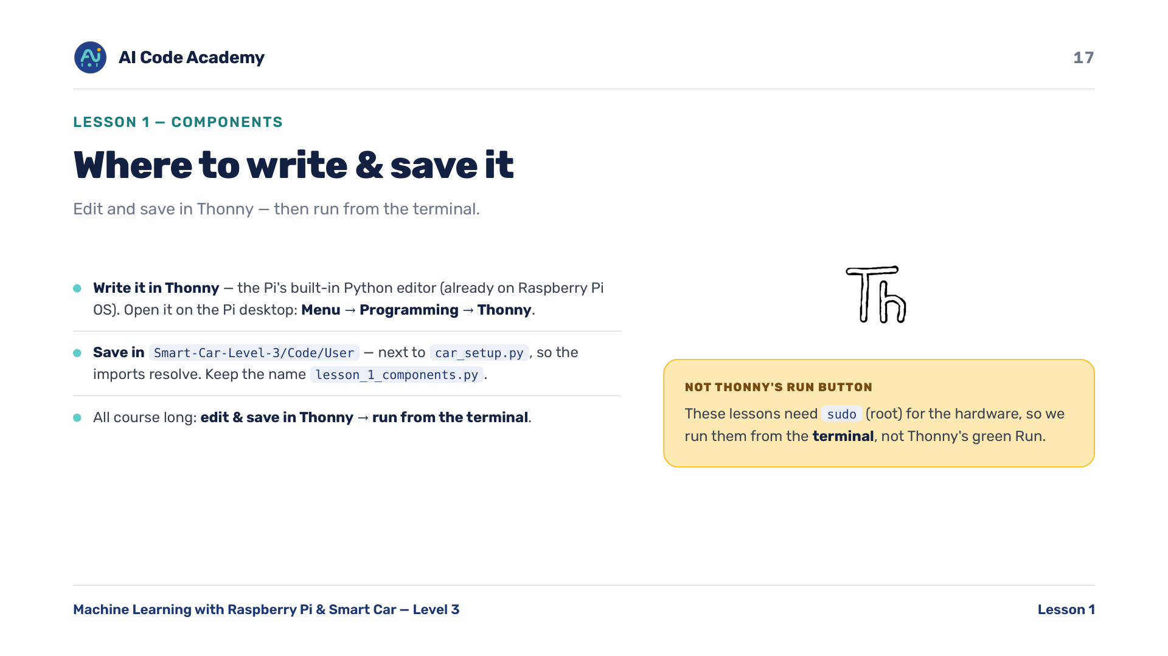
Notes:
Where to write & save — Thonny is pre-installed on Raspberry Pi OS and runs on the Pi desktop (reach it over VNC). Students EDIT and SAVE in Thonny but RUN from the terminal, because the LED strip needs sudo. Stress saving into Code/User next to car_setup.py — saving elsewhere is why imports fail. This edit-in-Thonny / run-in-terminal split repeats every Pi lesson.

Slide 18
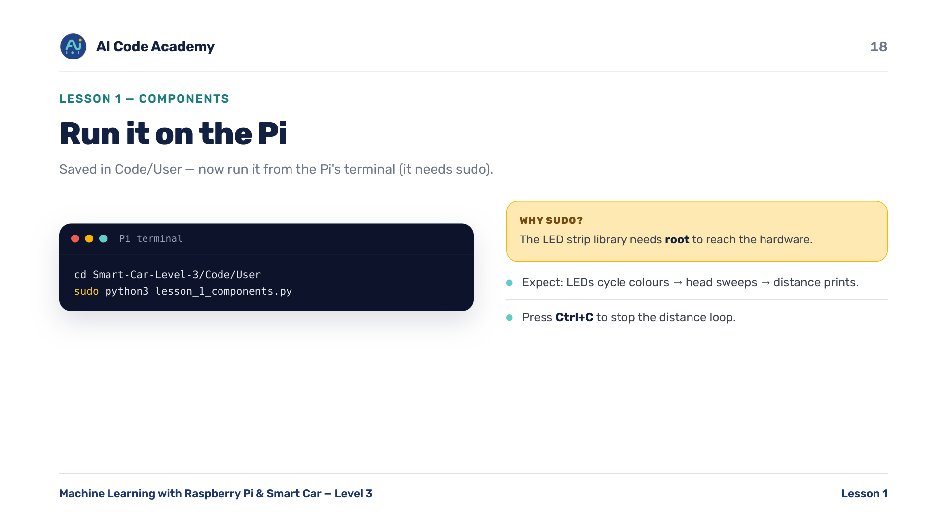
Notes:
Run it — ~5 min hands-on. Circulate; everyone should see at least the LEDs change. sudo is needed because the LED strip library needs root.

Slide 19
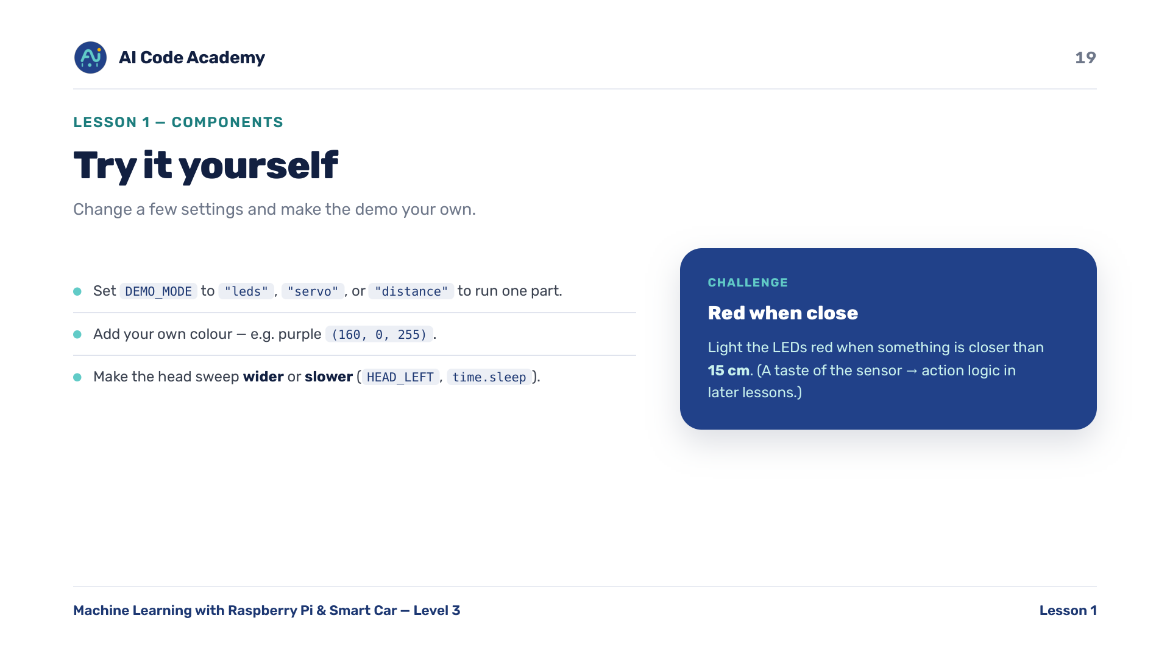
Notes:
Try it yourself — the red-when-close challenge previews sensor->action logic in later lessons.

Slide 20
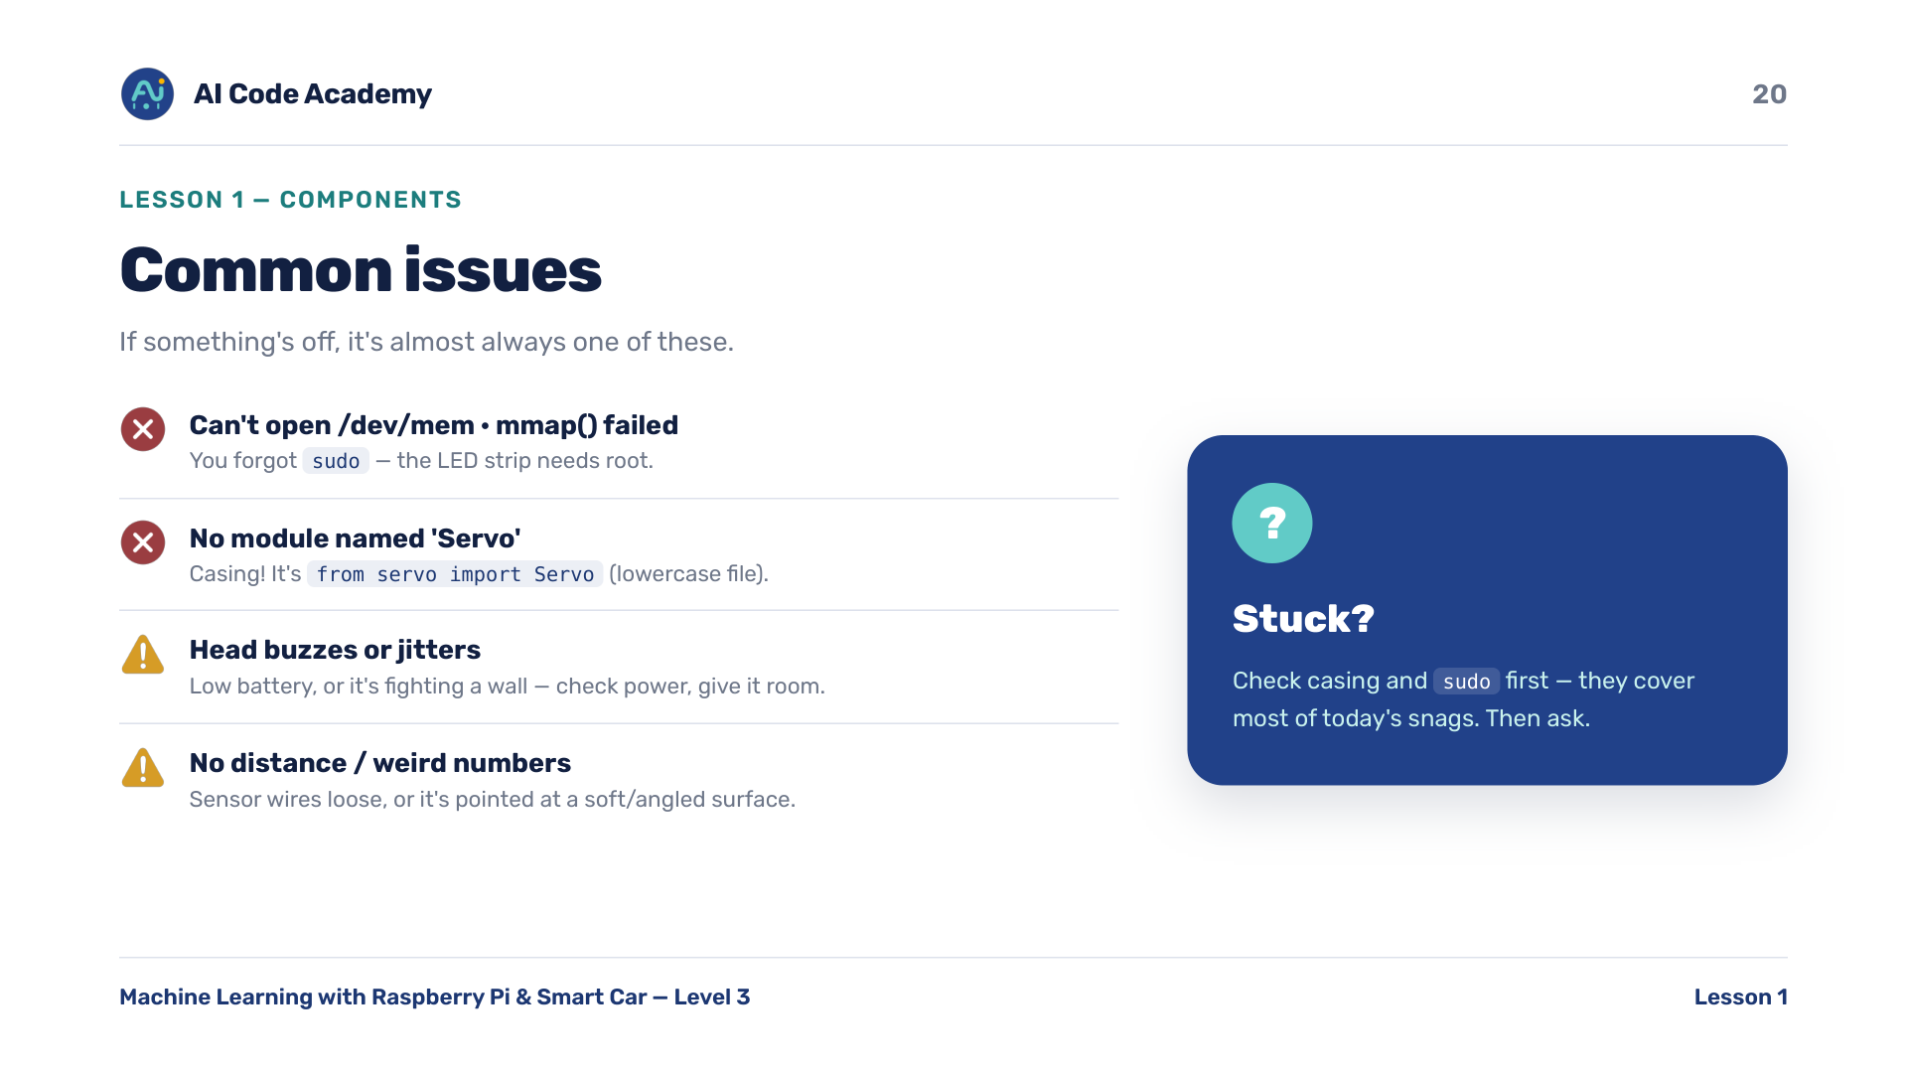
Notes:
Troubleshooting — casing and missing sudo cover ~90% of failures today; check those first.

Slide 21
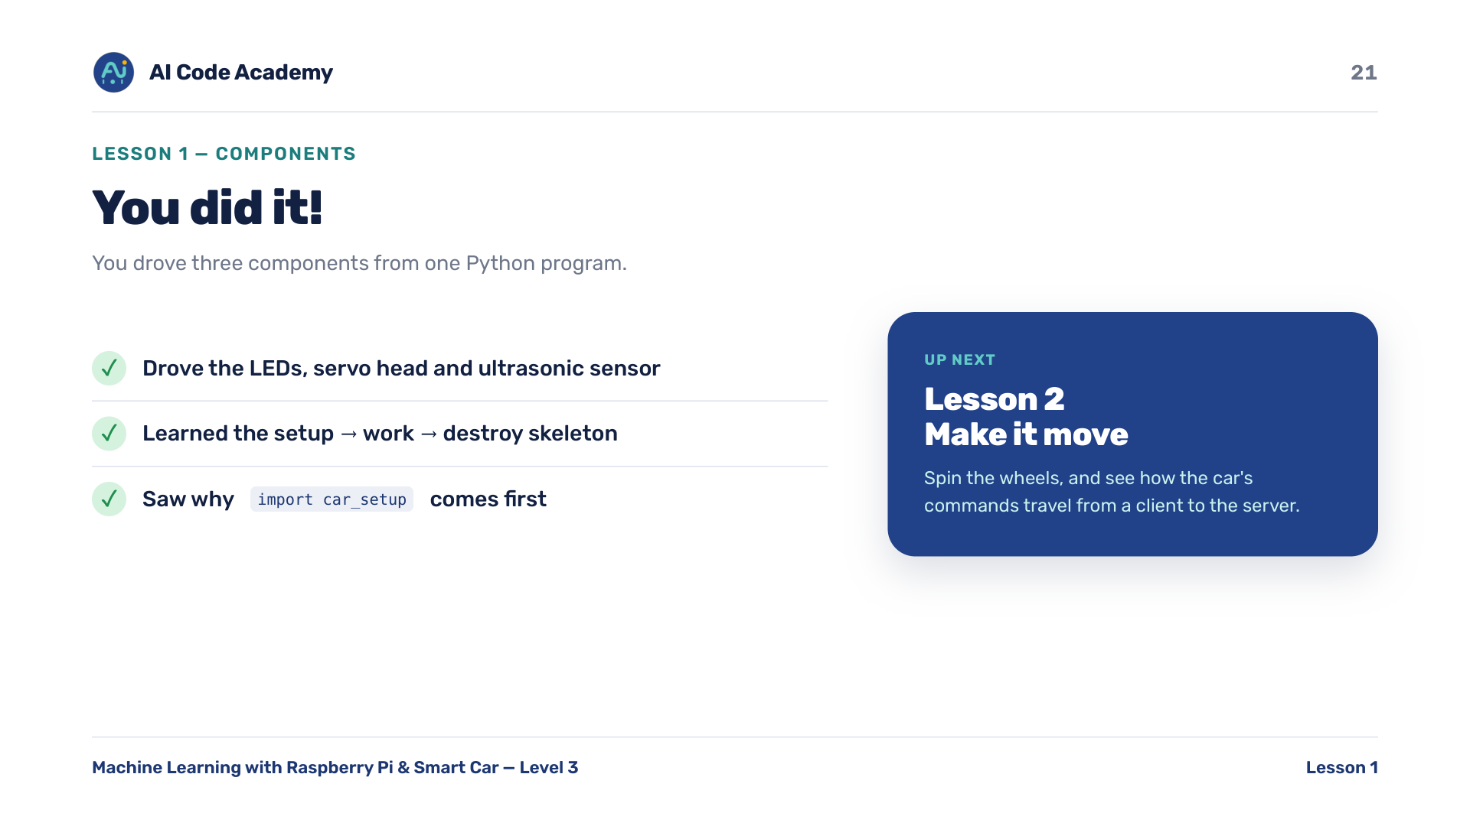
Notes:
Recap — end on energy: next lesson it actually drives. Remind students to power down safely.

Slide 22
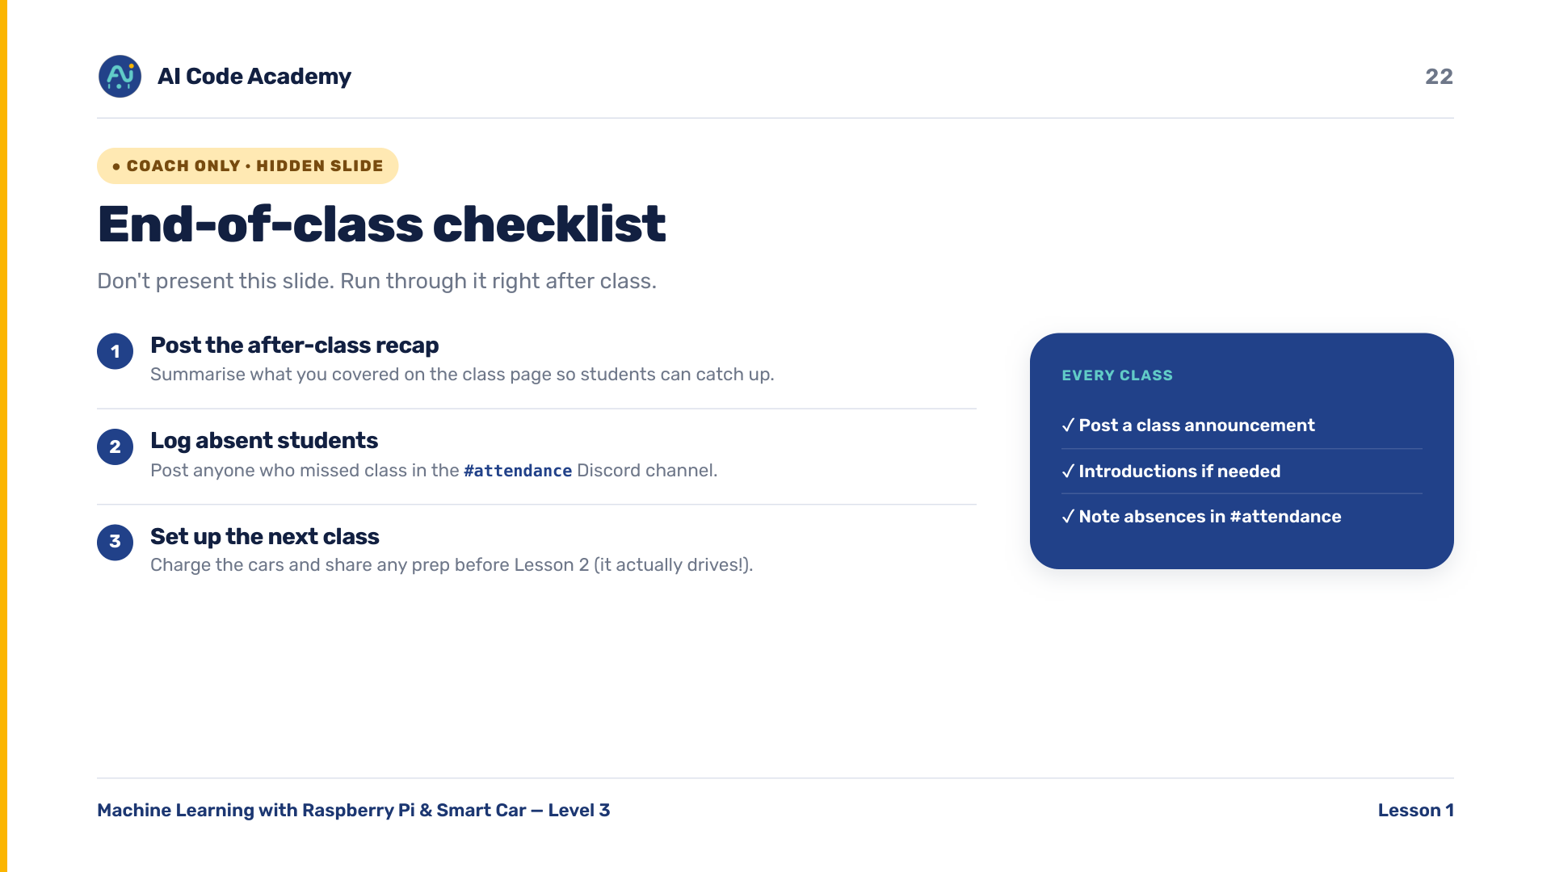
Notes:
COACH (hidden) — do not present. After class: post the meeting recap, log absent students in the Discord #attendance channel, and share any prep for next class.

