Slide 1
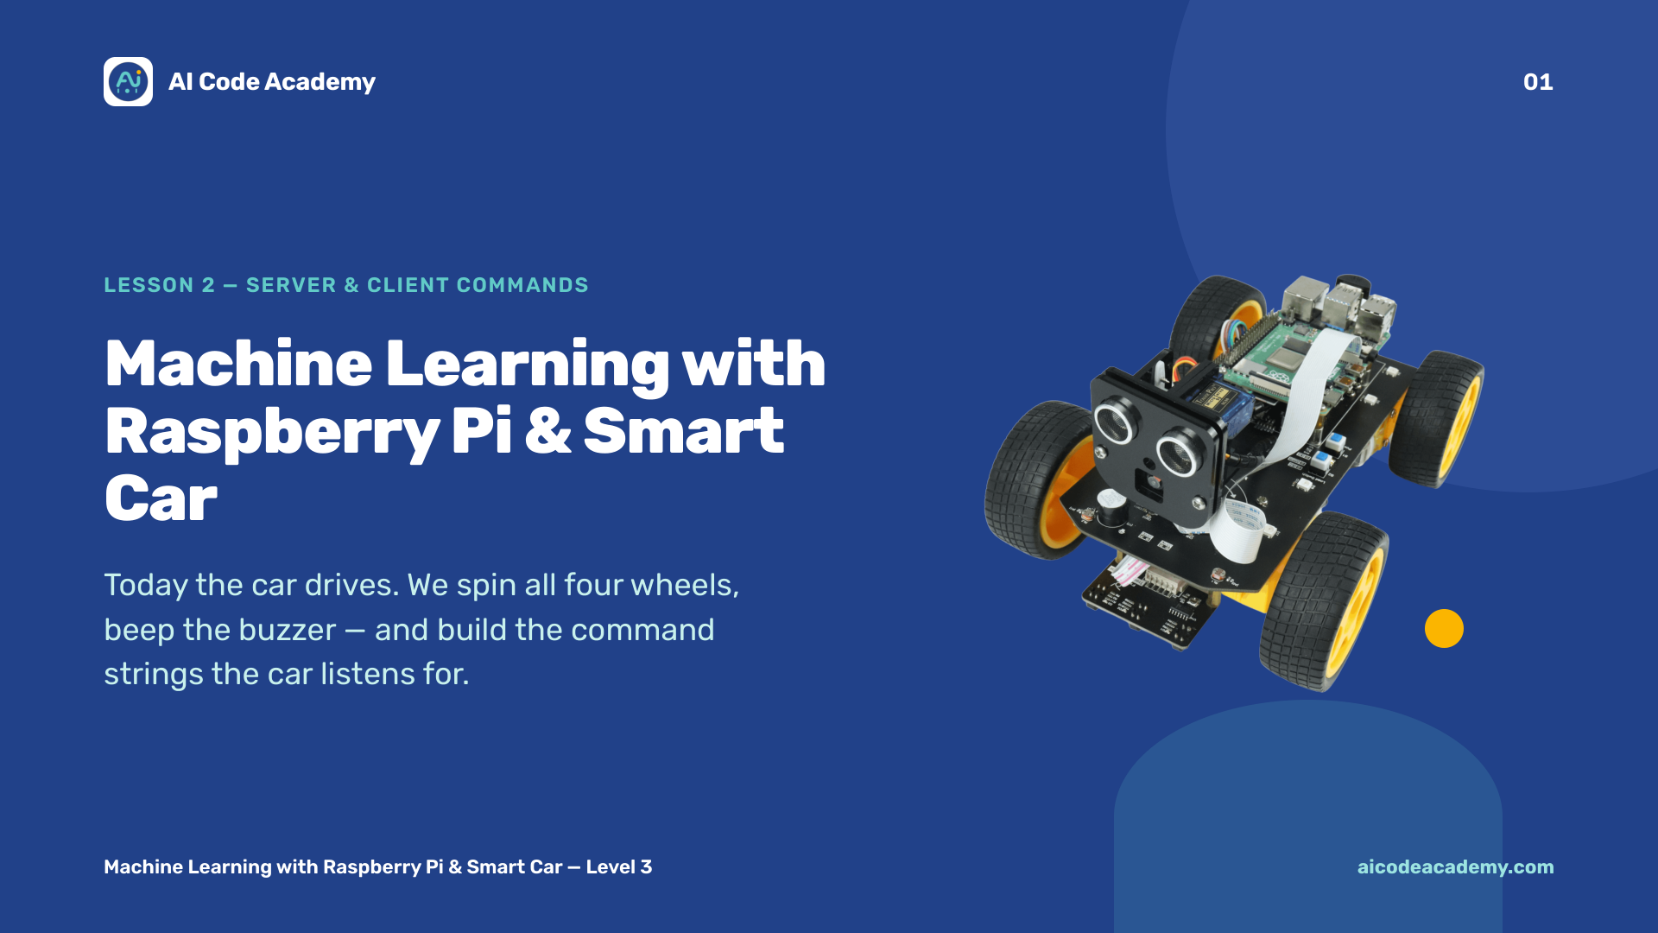
Notes:
Title — ~1 min. Today the car actually moves. Set the room up so cars can't drive off tables, and keep charging cables out of the driving area. Site: https://aicodeacademy.com

Slide 2
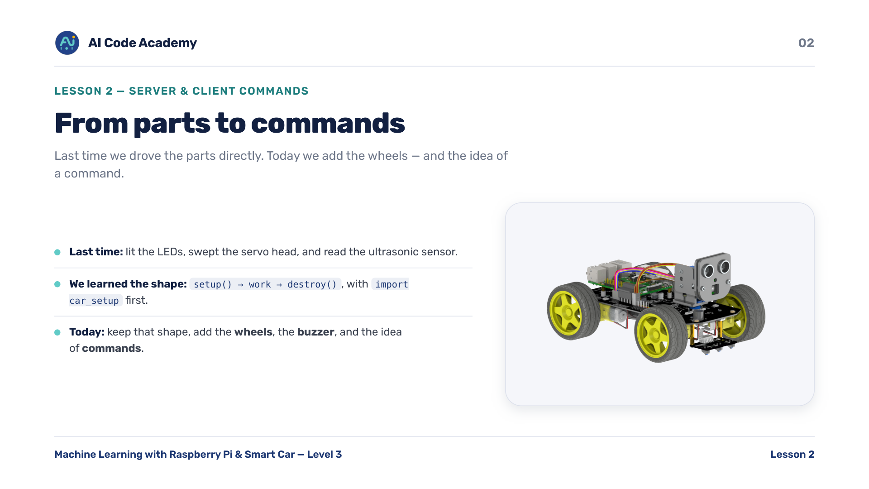
Notes:
Introduction — quick verbal check before moving on: 'what does destroy() do, and why does it matter?' Reuse Lesson 1's setup -> work -> destroy framing.

Slide 3
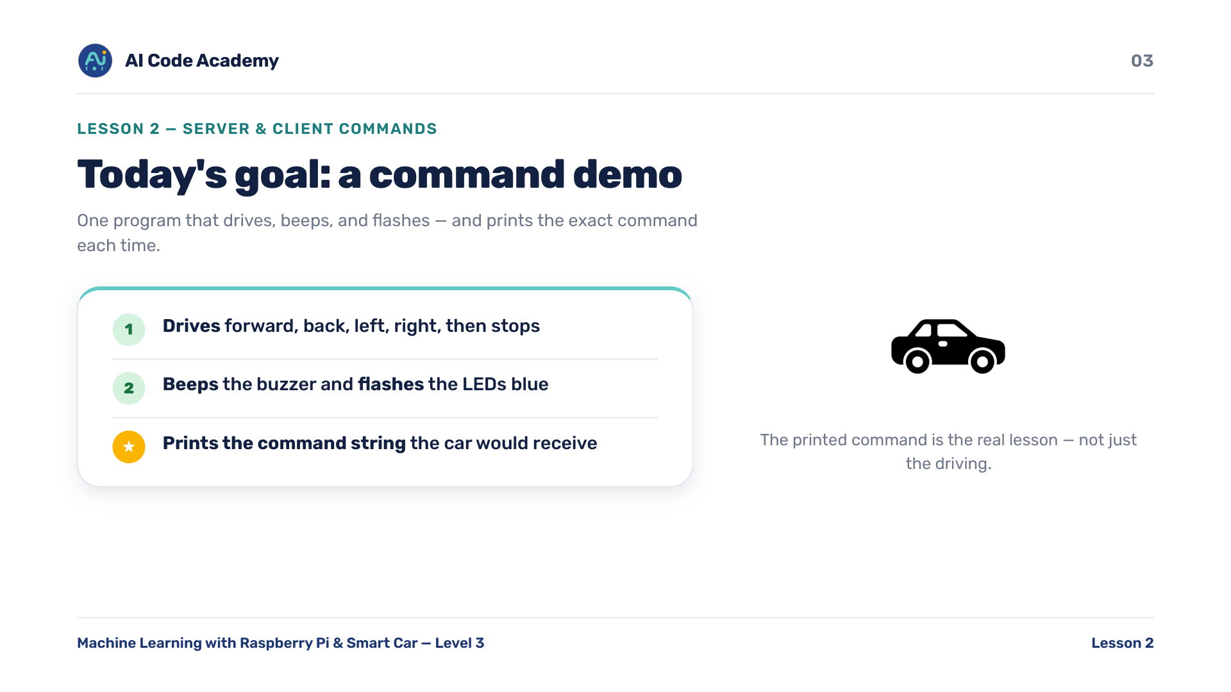
Notes:
Goals — the real teaching goal is 'print the command', not just driving. Show the finished demo once if you can so they know the target.

Slide 4
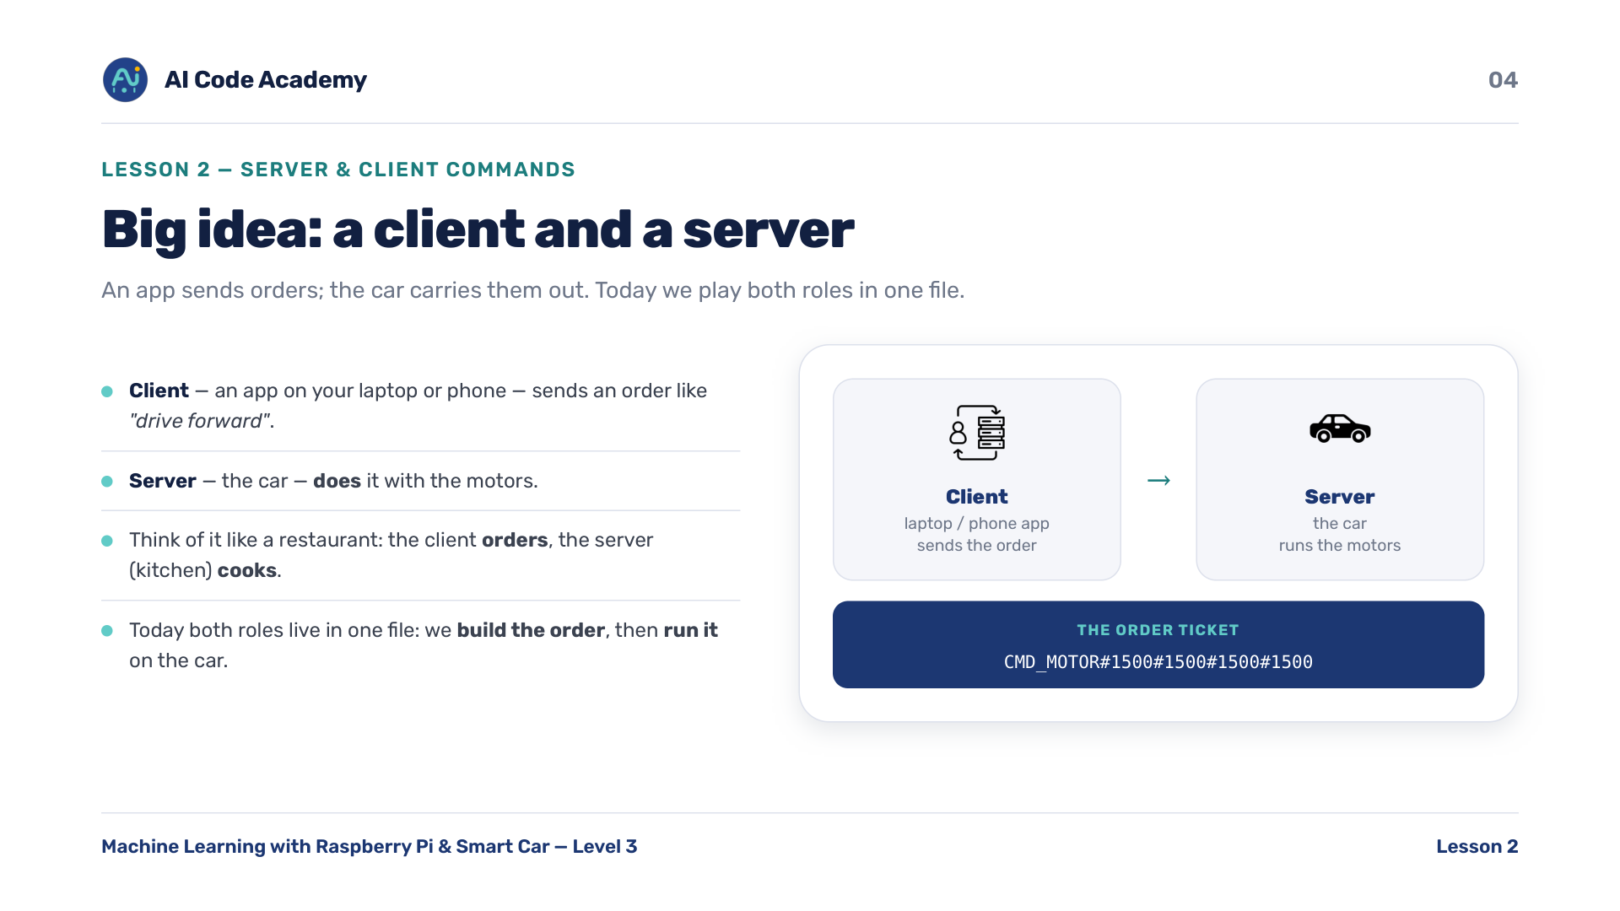
Notes:
Server & client — analogy: client = the customer ordering, server = the kitchen cooking. The order ticket is the command. Today we play both roles in one file.

Slide 5
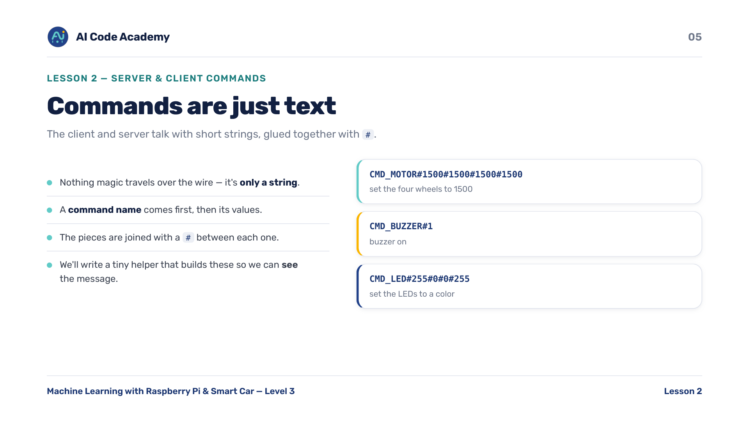
Notes:
Commands are text — stress that it's JUST text. Nothing magic travels over the wire, only a string glued together with #. Asset to source: a client -> command -> Pi flow diagram.

Slide 6
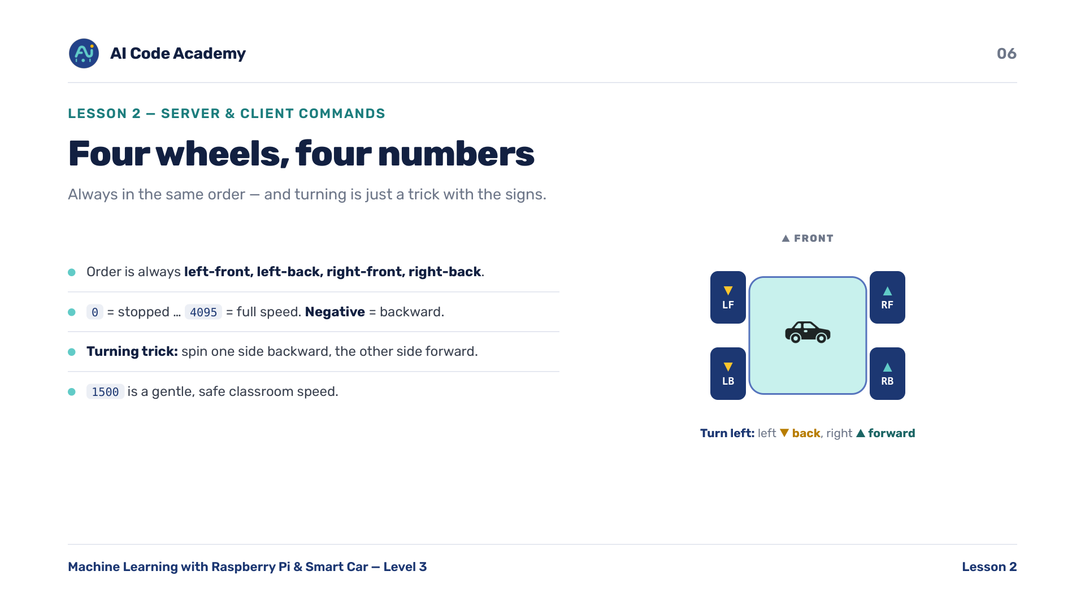
Notes:
Four wheels — have students predict which wheels reverse for a left turn BEFORE you reveal the tuple. Asset to source: top-down 4-wheel diagram labeled LF/LB/RF/RB.

Slide 7
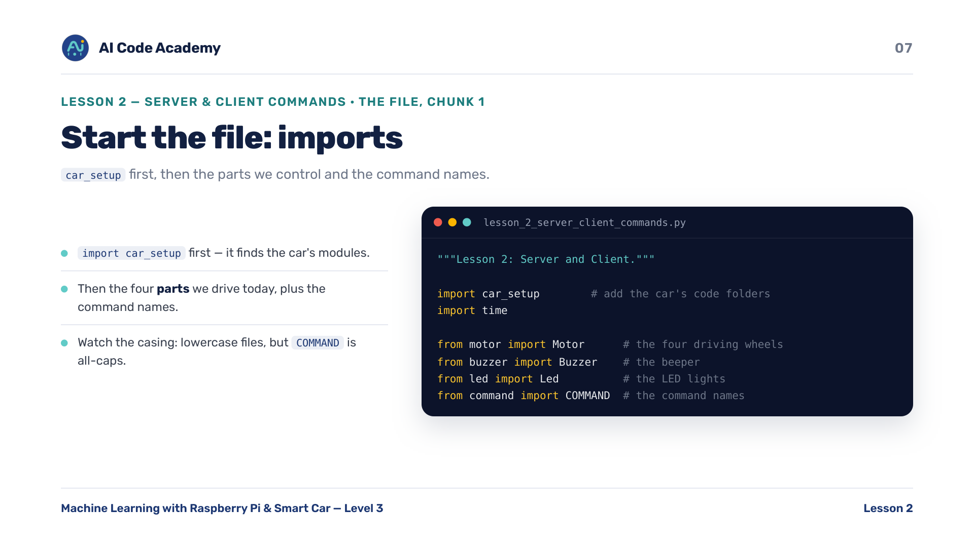
Notes:
Imports — point at COMMAND (all caps) vs Motor/Led (PascalCase): both come from lowercase files. car_setup must be imported first.

Slide 8
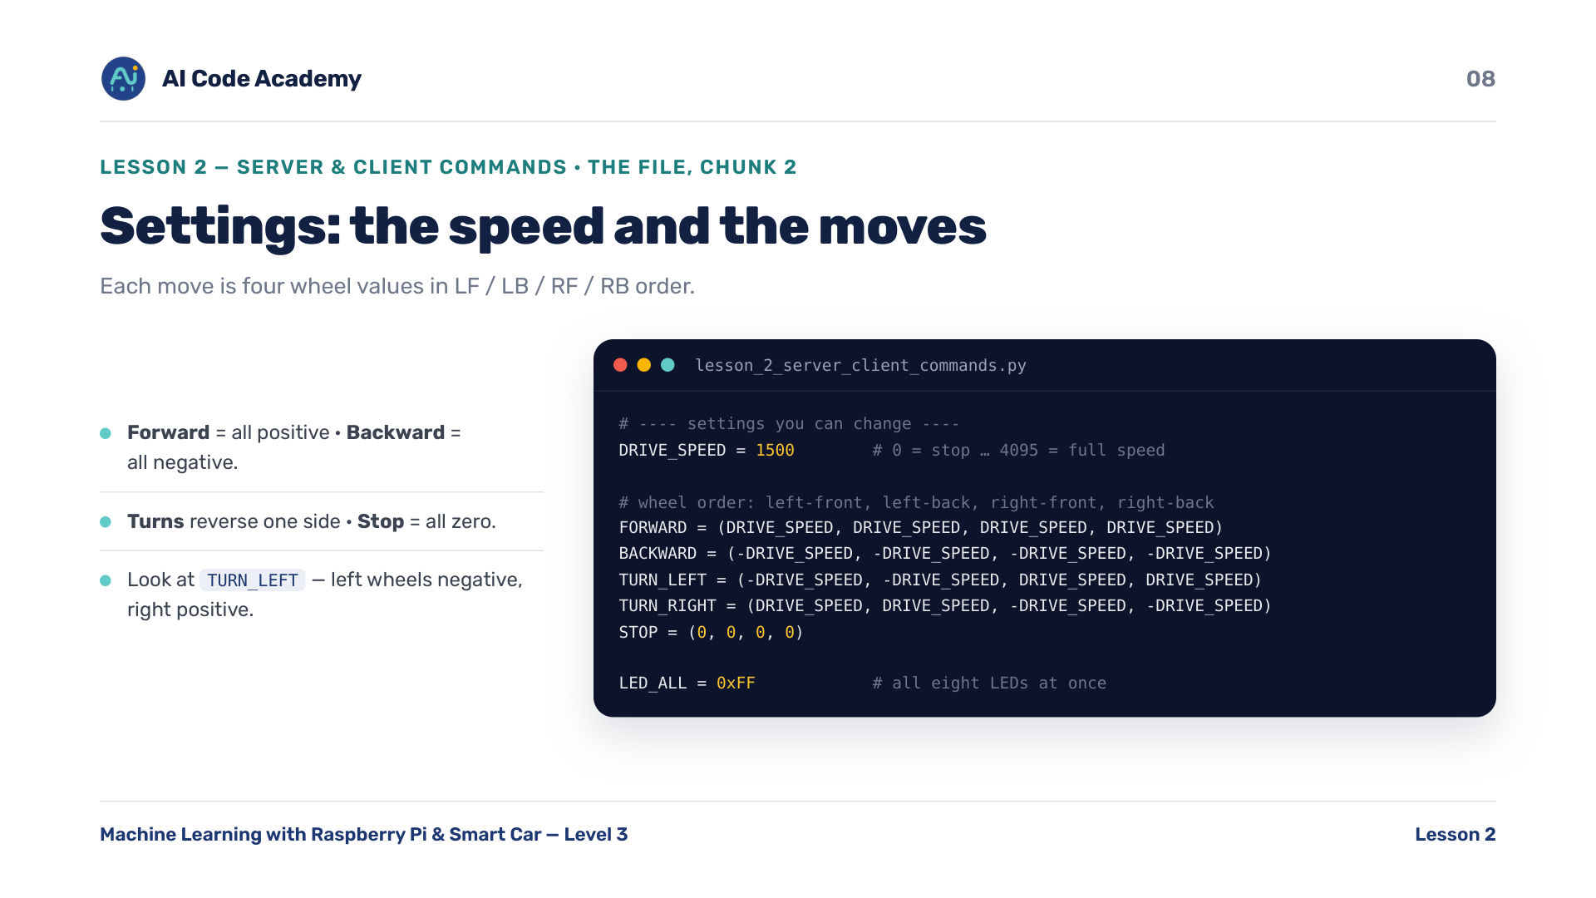
Notes:
Settings — look at TURN_LEFT: left wheels negative, right wheels positive — that's the turning trick from the wheels slide.

Slide 9
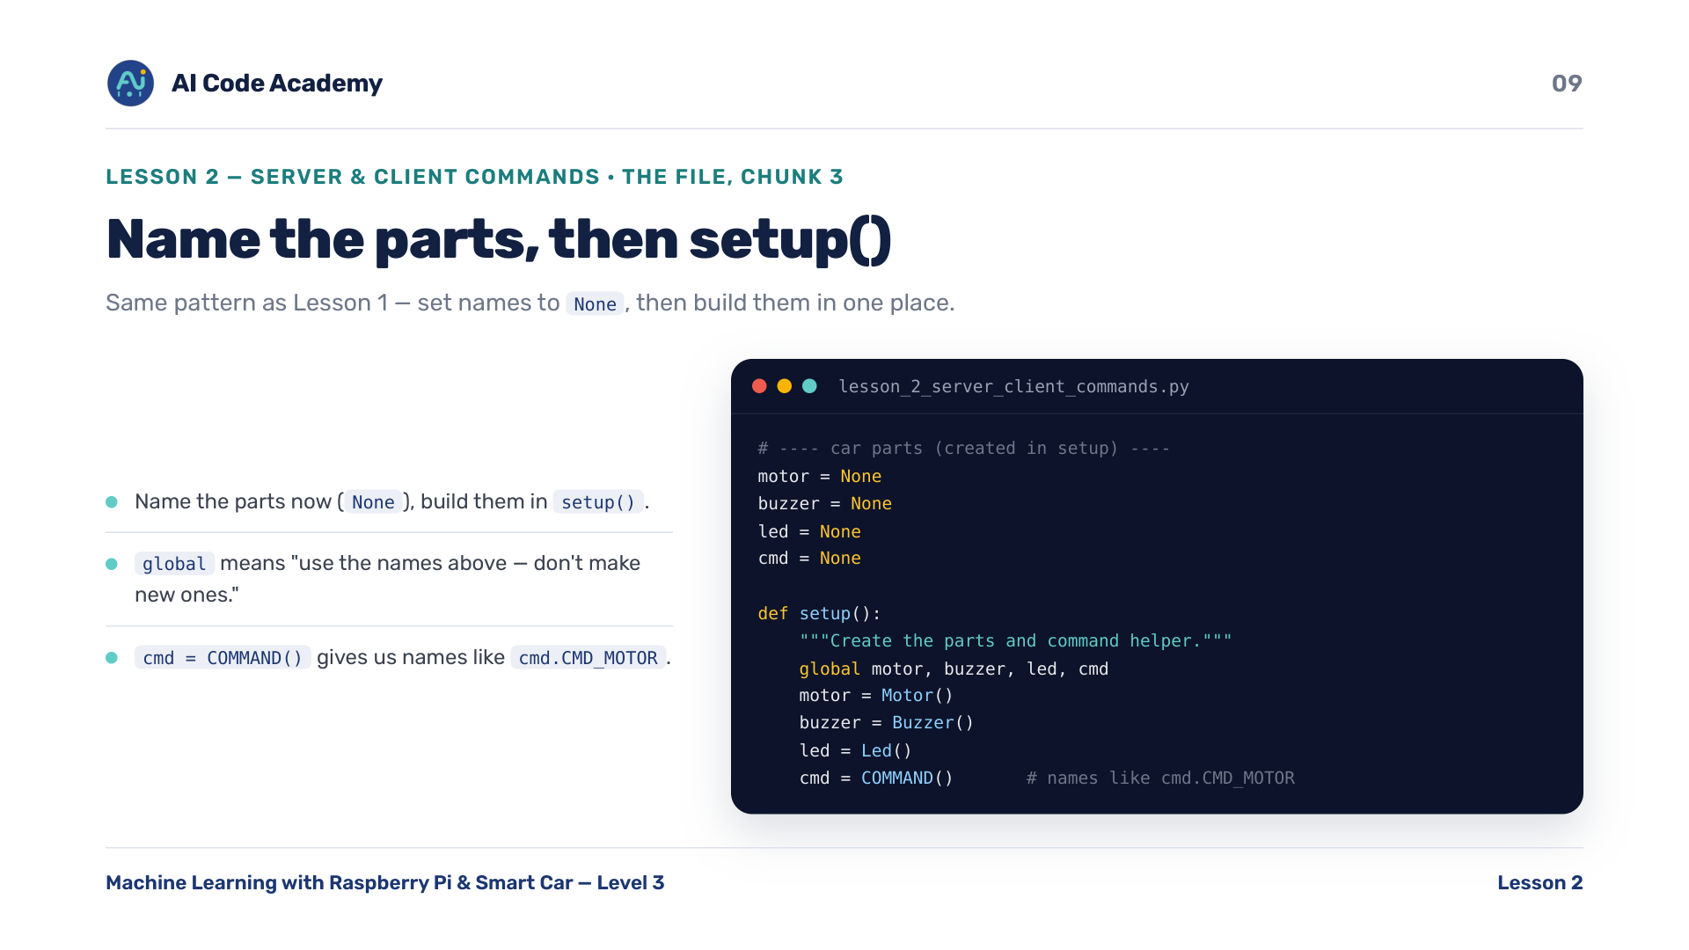
Notes:
setup() — same None -> setup() pattern as Lesson 1. Reinforce the habit. cmd = COMMAND() just holds the command names.

Slide 10
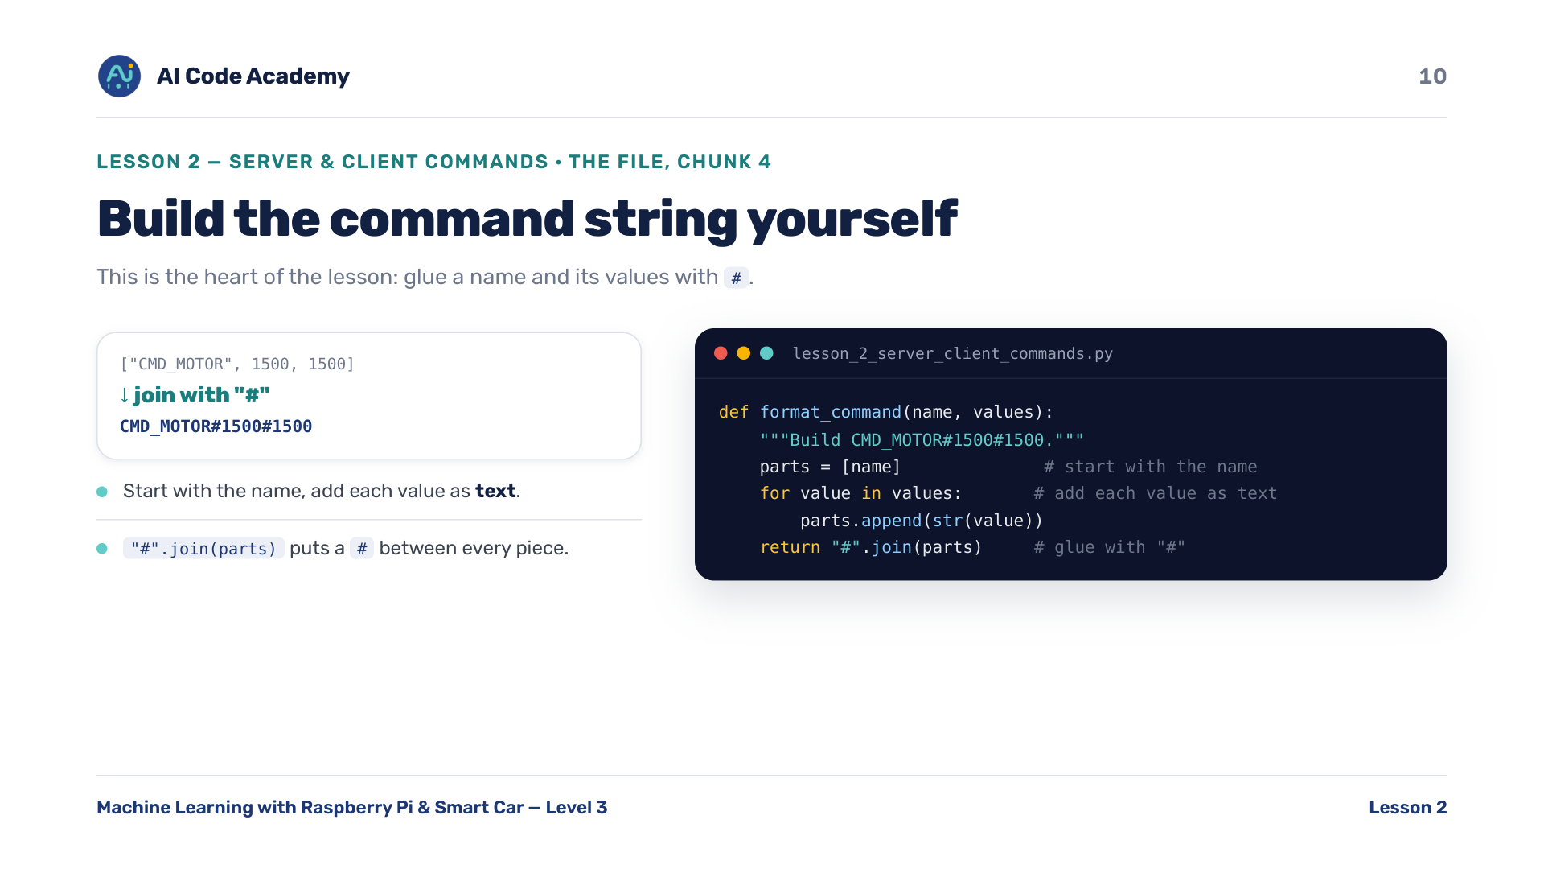
Notes:
format_command — this is the conceptual heart of the lesson. Walk through one example by hand: name first, then each value as text, joined with #.

Slide 11
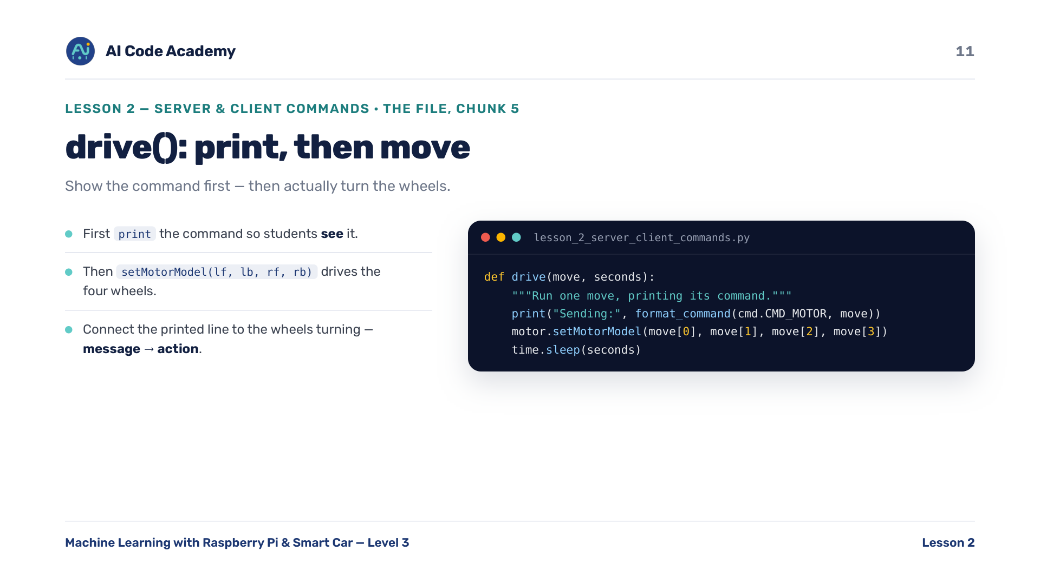
Notes:
drive() — tie the printed 'Sending: CMD_MOTOR#...' line directly to the wheels turning. Message -> action.

Slide 12
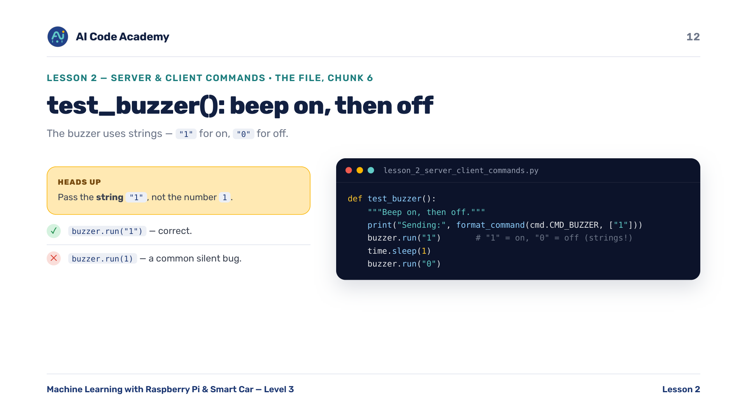
Notes:
test_buzzer() — common bug: buzzer.run(1) (int) instead of buzzer.run("1") (string). Call it out. Asset to source: close-up photo of the buzzer on the board.

Slide 13
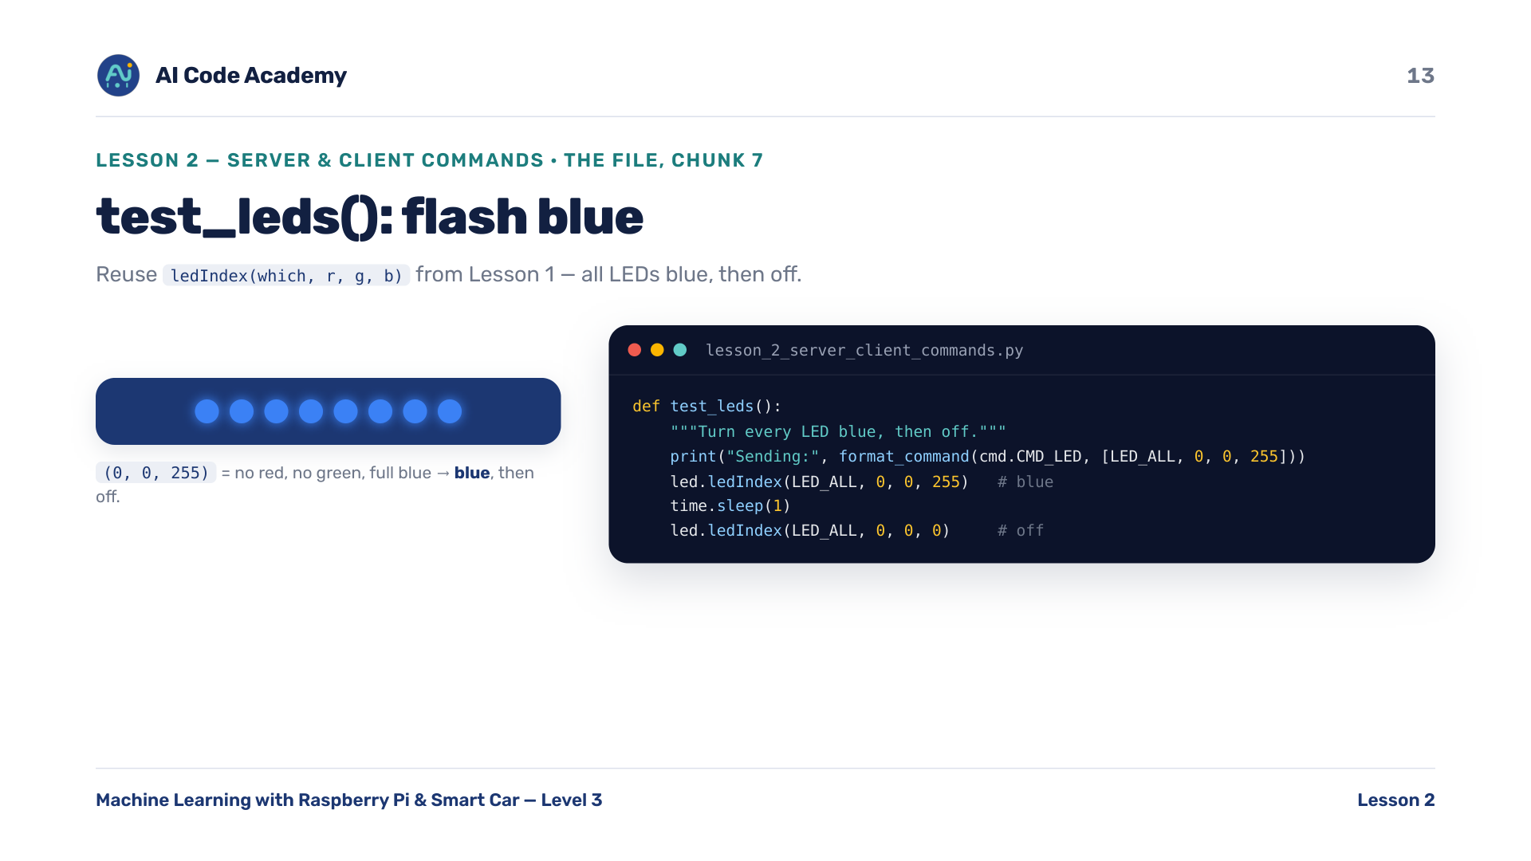
Notes:
test_leds() — callback to Lesson 1: they already know ledIndex(which, r, g, b). Confidence boost.

Slide 14
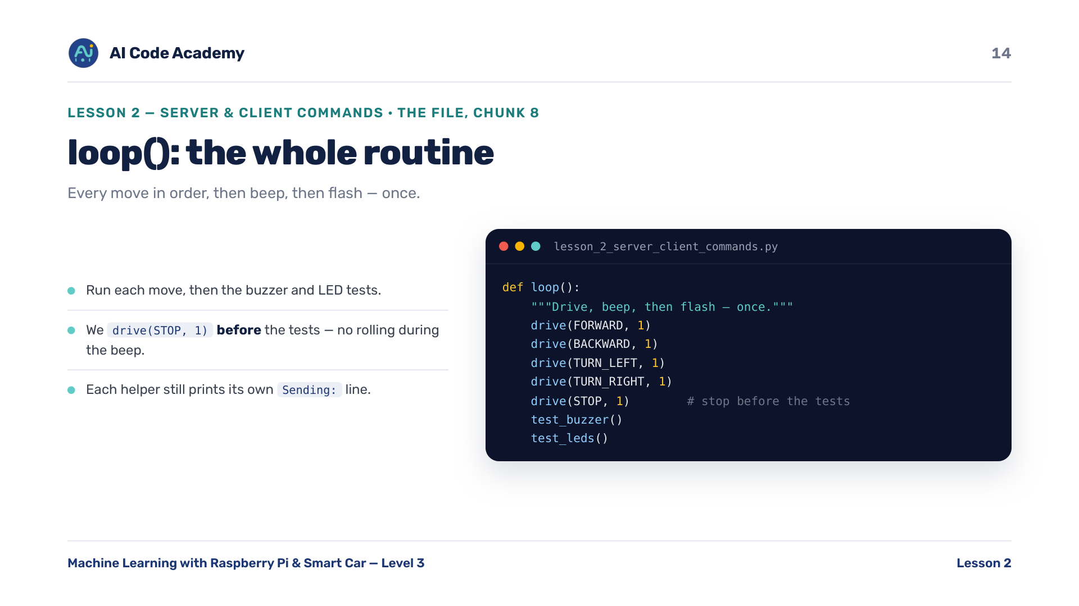
Notes:
loop() — ask why drive(STOP, 1) matters: you don't want the car rolling during the beep and LED flash.

Slide 15
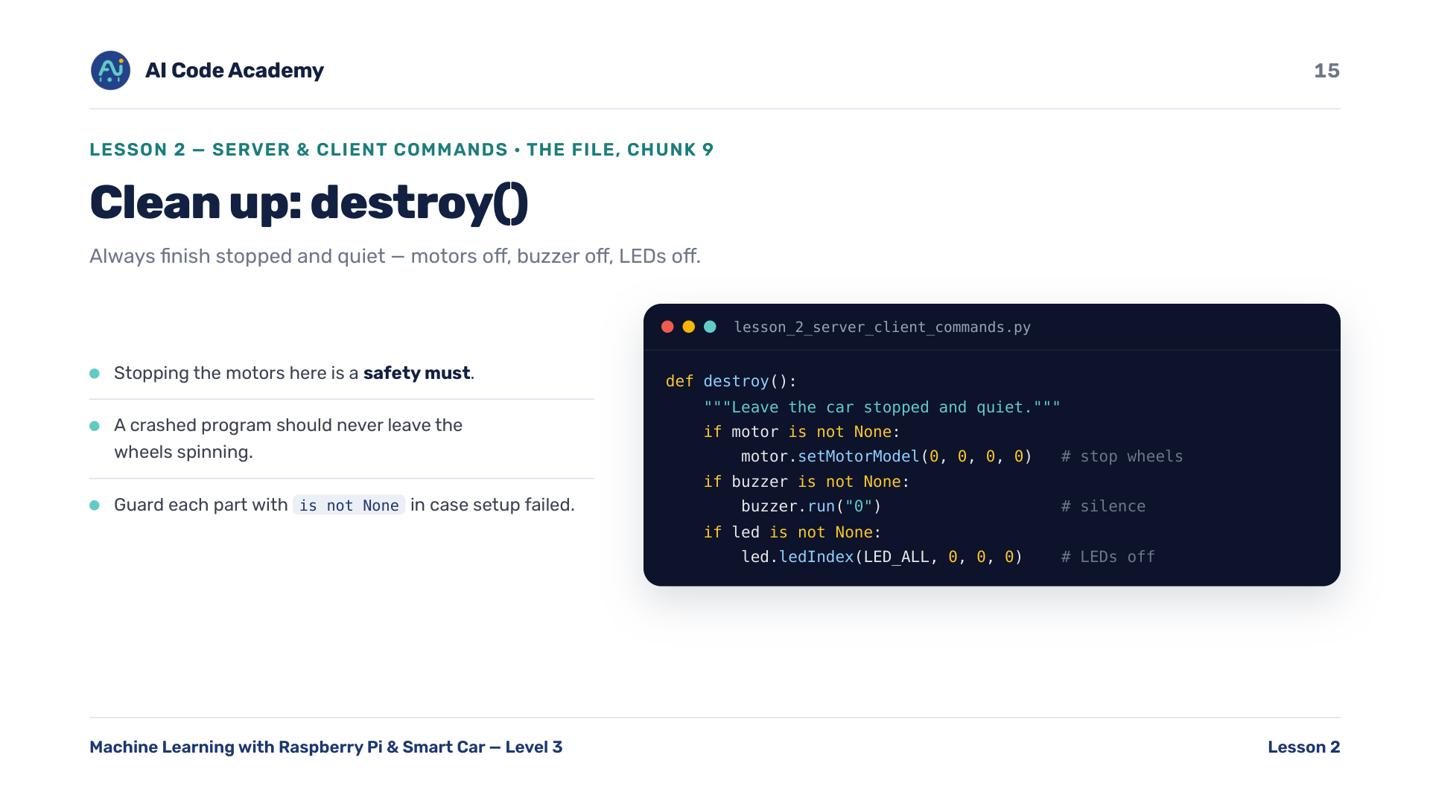
Notes:
destroy() — stopping the motors here is a safety must. A crashed program should never leave wheels spinning. Guard each part with 'is not None'.

Slide 16
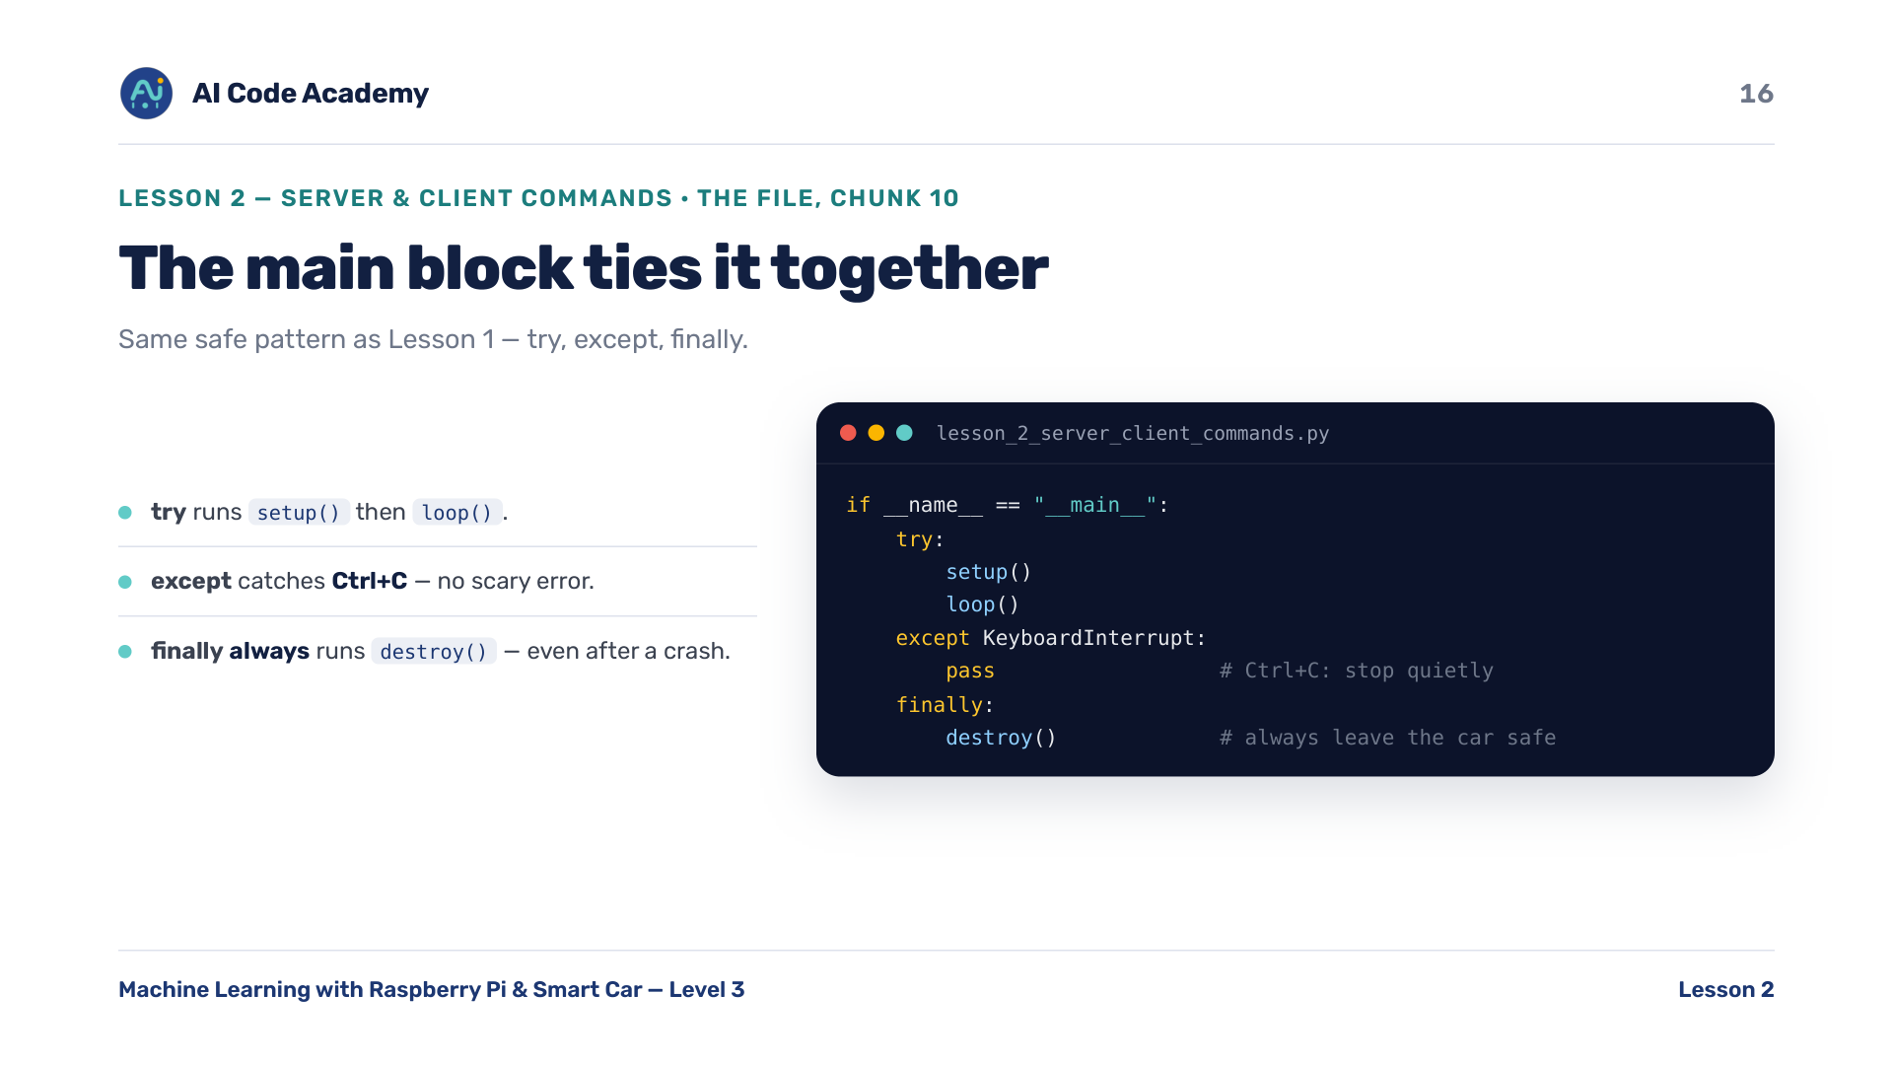
Notes:
Main block — same safe pattern as Lesson 1. 'finally' guarantees destroy() runs no matter how the program ends.

Slide 17
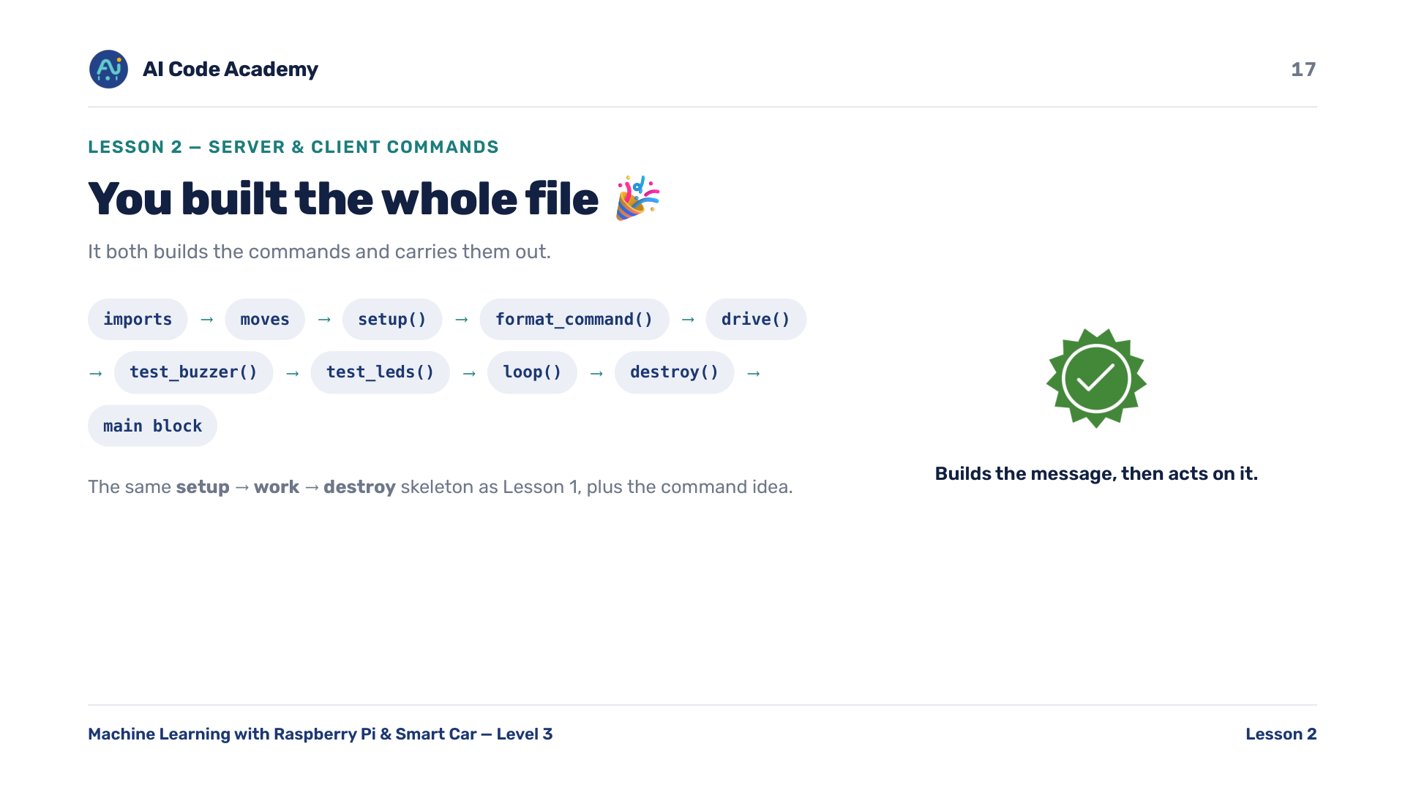
Notes:
Whole file — scroll the assembled file. Point out it's the same skeleton as Lesson 1 plus the command idea.

Slide 18
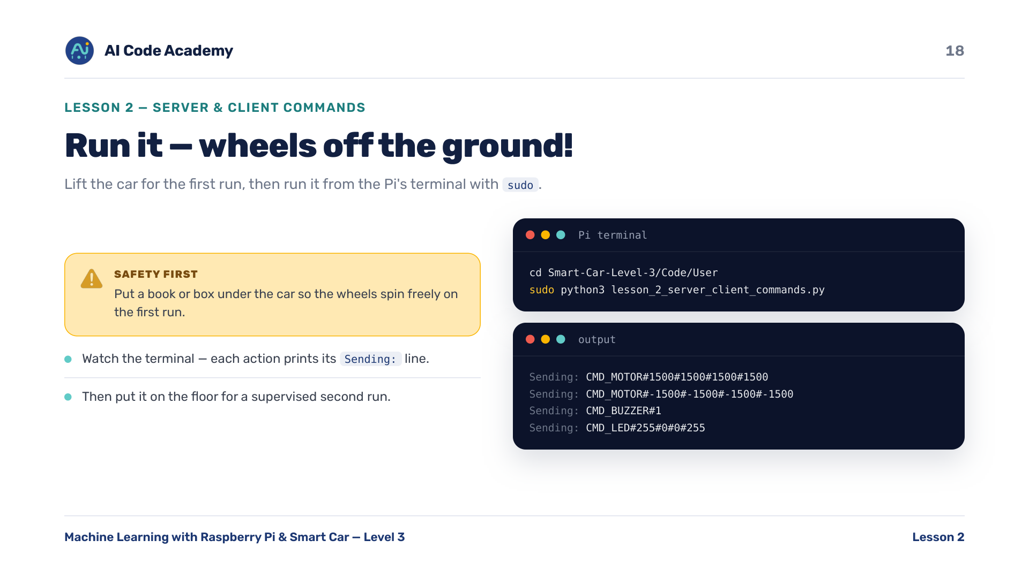
Notes:
Run it — ENFORCE wheels-off-the-ground before anyone runs. Then allow a supervised wheels-down run on the floor. sudo is needed because the motors and LED strip need hardware access.

Slide 19
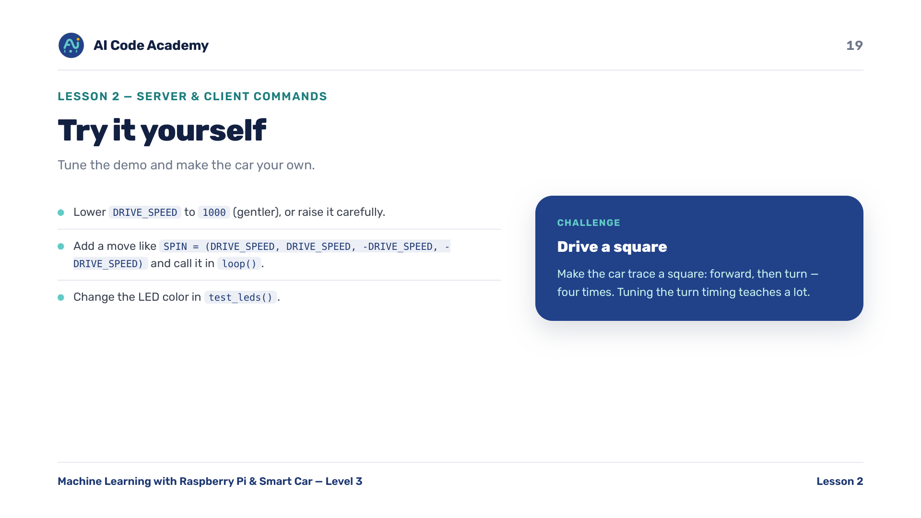
Notes:
Try it yourself — the 'drive a square' challenge is great for fast finishers; tuning the turn timing teaches a lot.

Slide 20
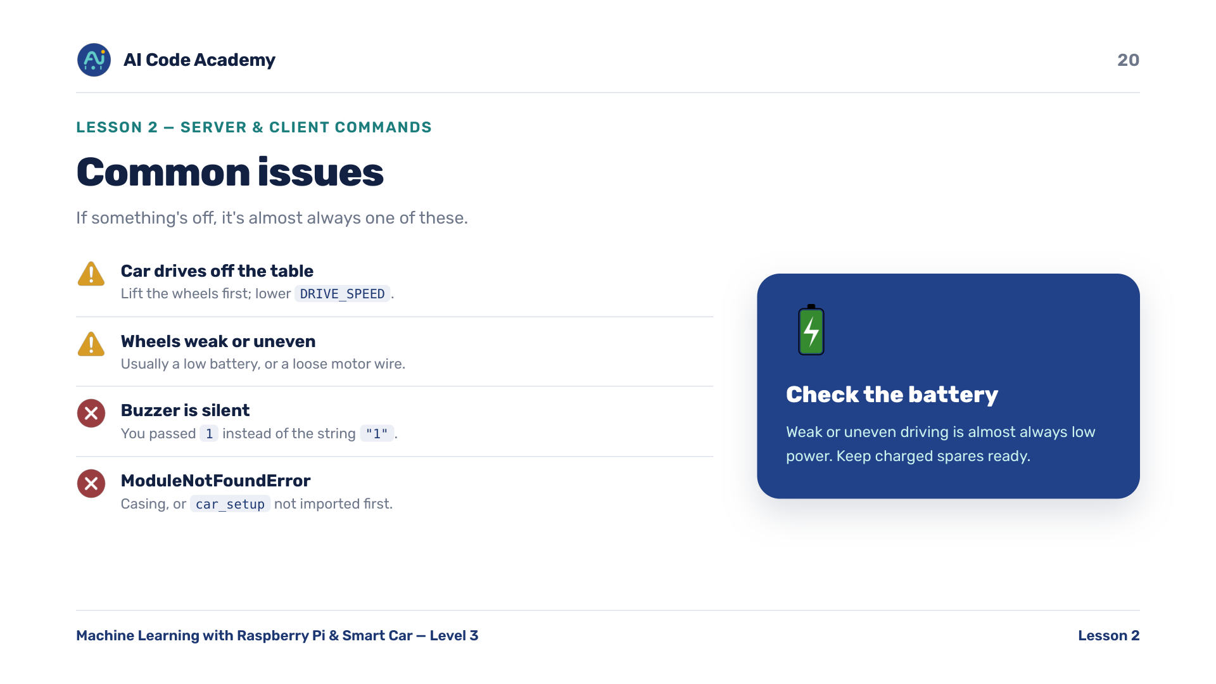
Notes:
Troubleshooting — low battery is the usual culprit for weak or uneven motors. Have charged spares ready. Check casing / car_setup-first for import errors.

Slide 21
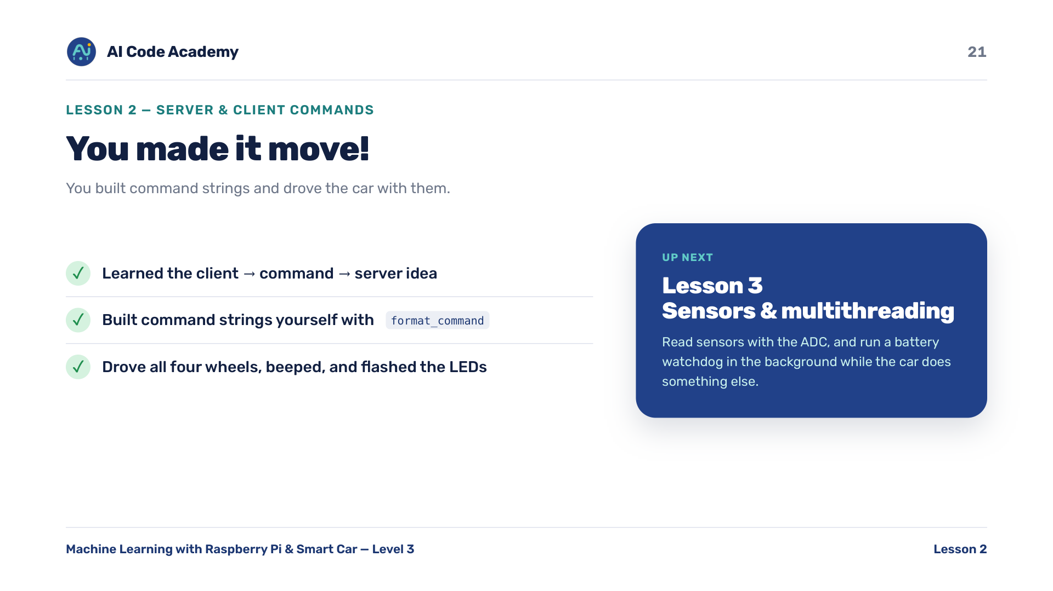
Notes:
Recap — tease Lesson 3: 'the car will watch its own battery while doing something else at the same time' (ADC + multithreading).

Slide 22
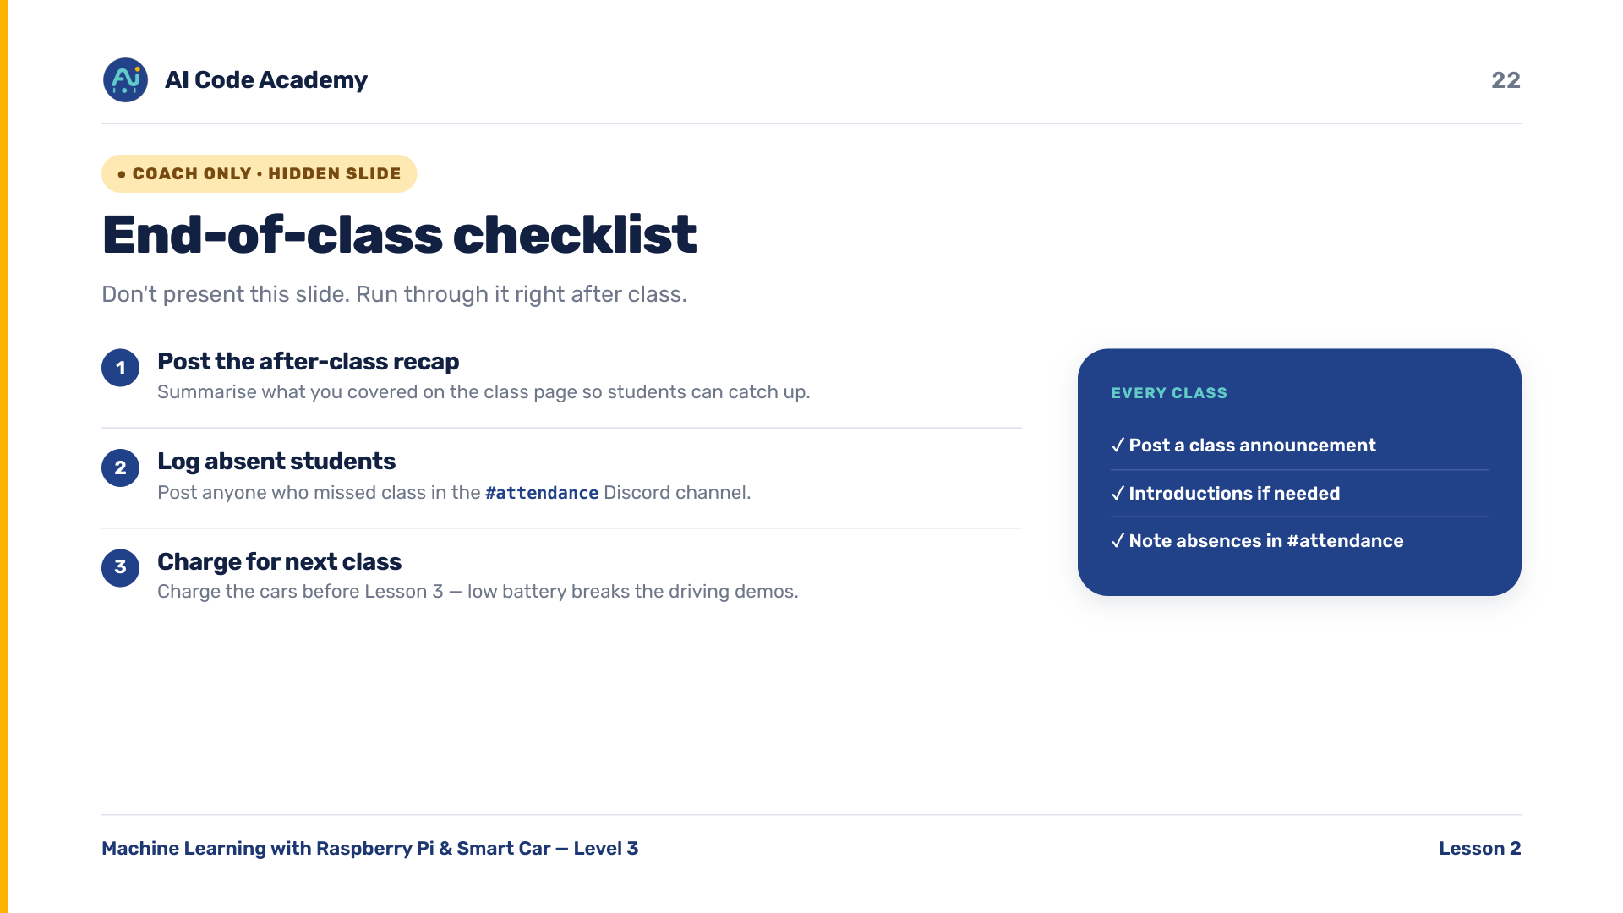
Notes:
COACH (hidden) — do not present. After class: post the recap, log absent students in the Discord #attendance channel, and charge the cars for Lesson 3.

