Slide 1
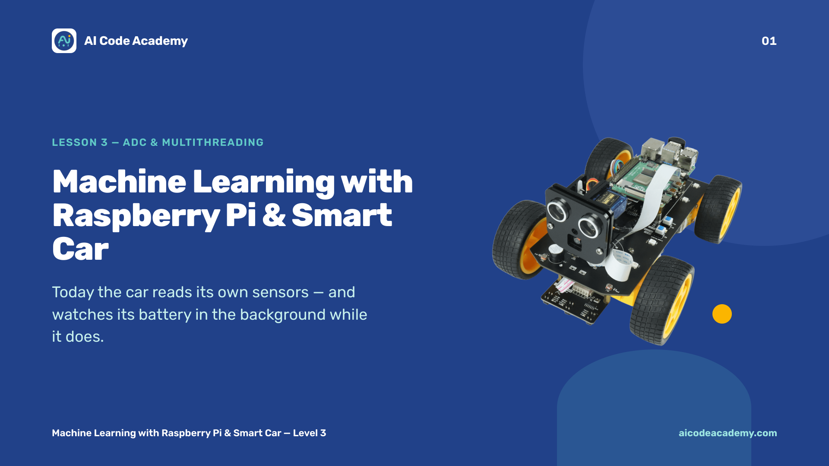
Notes:
Title — ~1 min. Two big ideas today: reading analog sensors, and doing two things at once. Site: https://aicodeacademy.com

Slide 2
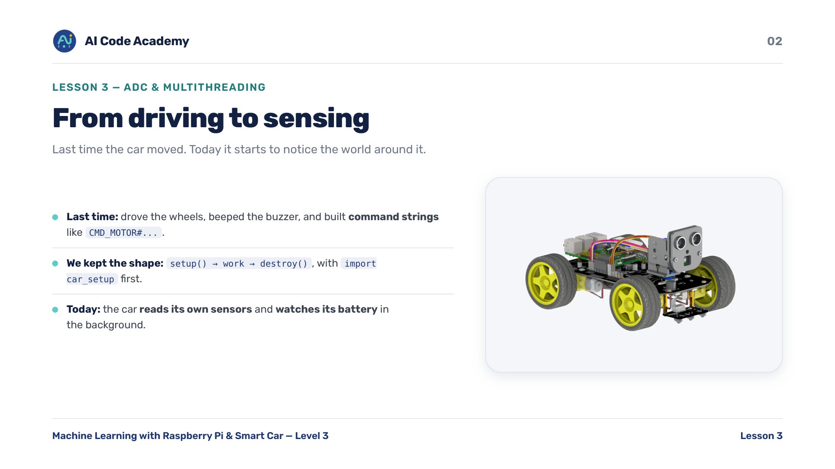
Notes:
Introduction — quick verbal check before moving on: 'what does the # do in a command string?' Reuse the setup -> work -> destroy framing from Lessons 1 and 2.

Slide 3
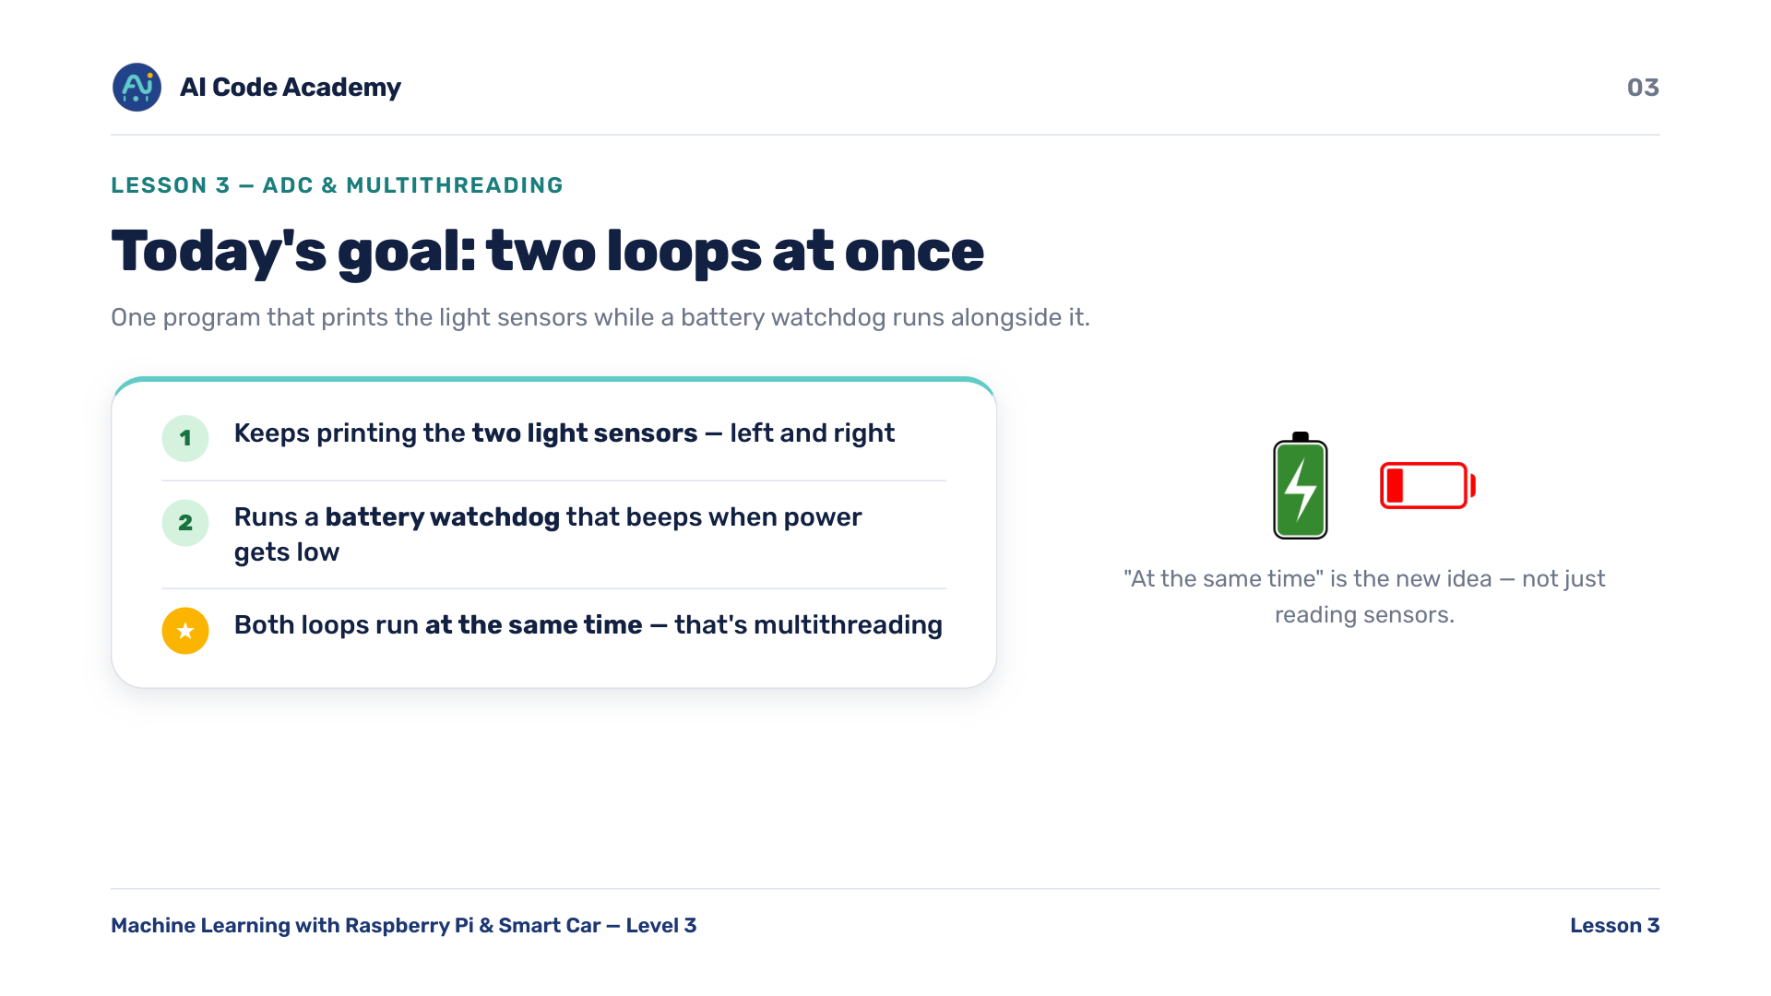
Notes:
Goals — emphasise 'at the same time'. That's the new concept, not just reading sensors. Show the finished demo once if you can so they know the target.

Slide 4
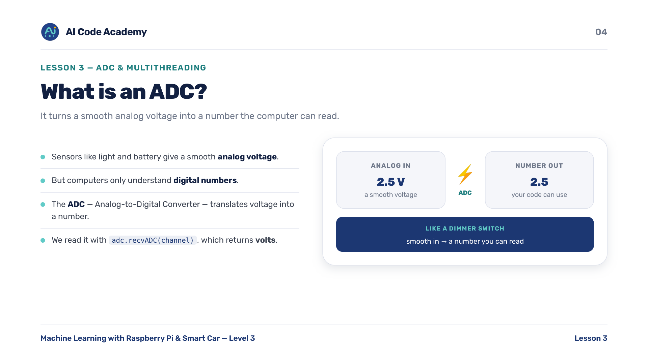
Notes:
What is an ADC — analogy: a dimmer switch (smooth) vs a light switch (on/off). The ADC reads the dimmer's position as a number. adc.recvADC(channel) returns volts.

Slide 5
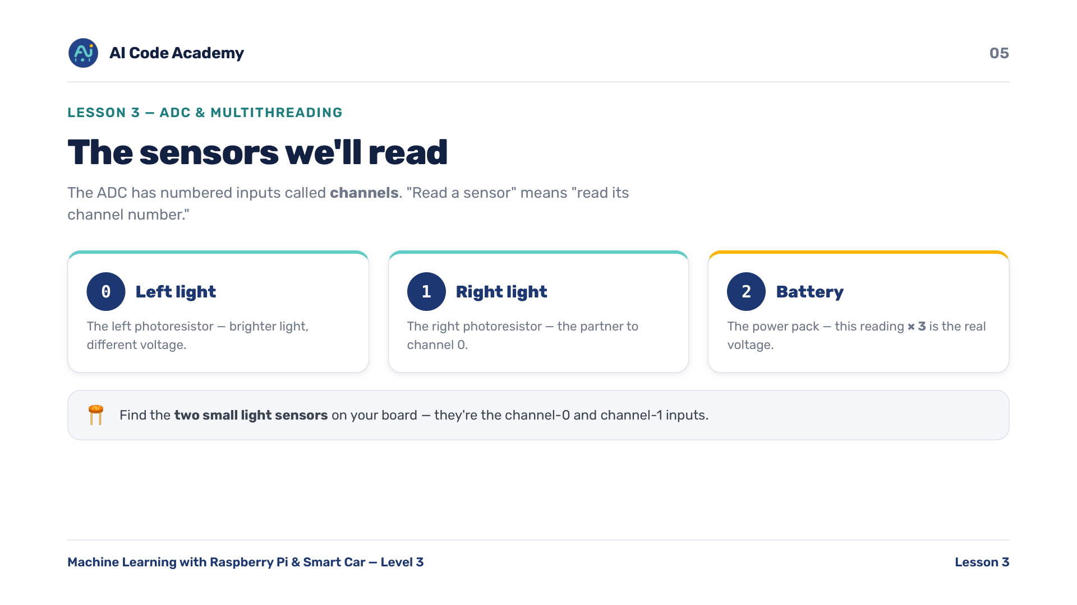
Notes:
The sensors — have students physically find the two little light sensors (photoresistors) on their board. 'Read a sensor' = 'read its channel number'. Asset to source: close-up photo of the two photoresistors.

Slide 6
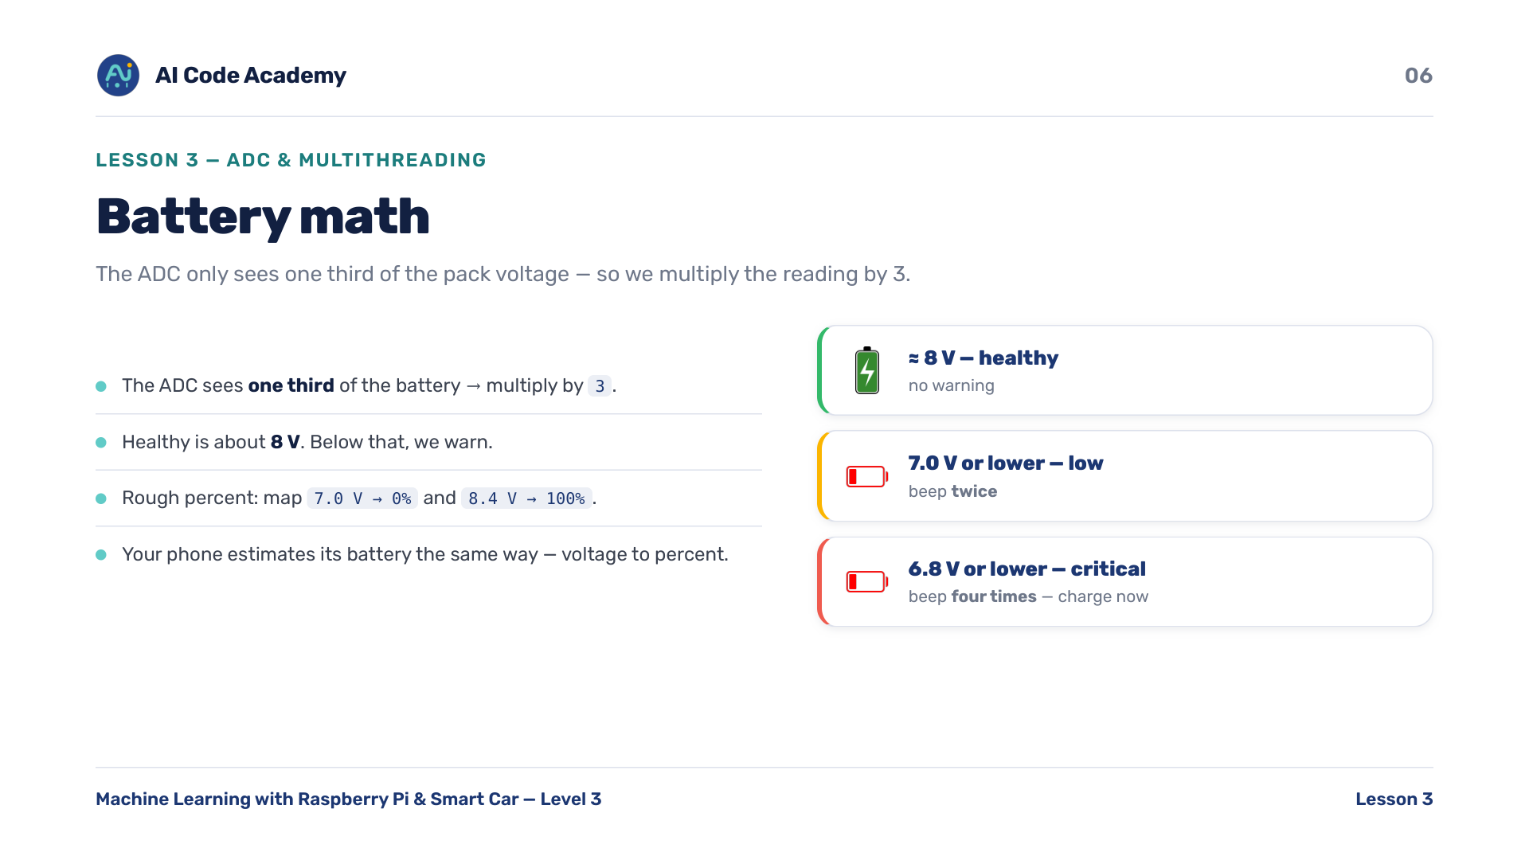
Notes:
Battery math — the ADC sees one third of the pack voltage, so multiply by 3. Tie to real life: phones do the same voltage -> percent estimate.

Slide 7
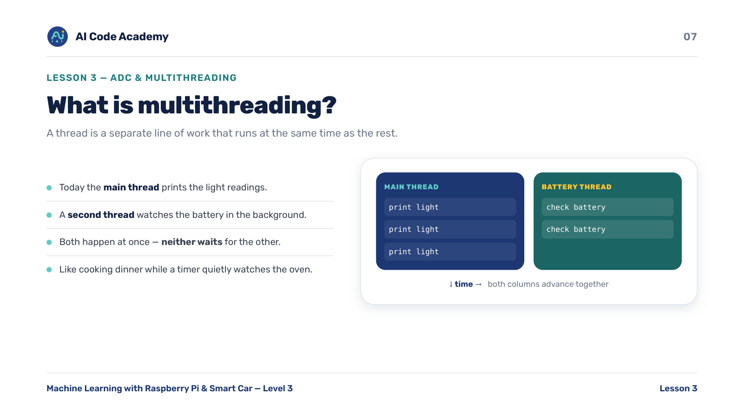
Notes:
What is multithreading — analogy: cooking dinner (main thread) while a timer watches the oven (background thread). Both happen at once. Asset to source: a simple two-threads-side-by-side diagram.

Slide 8
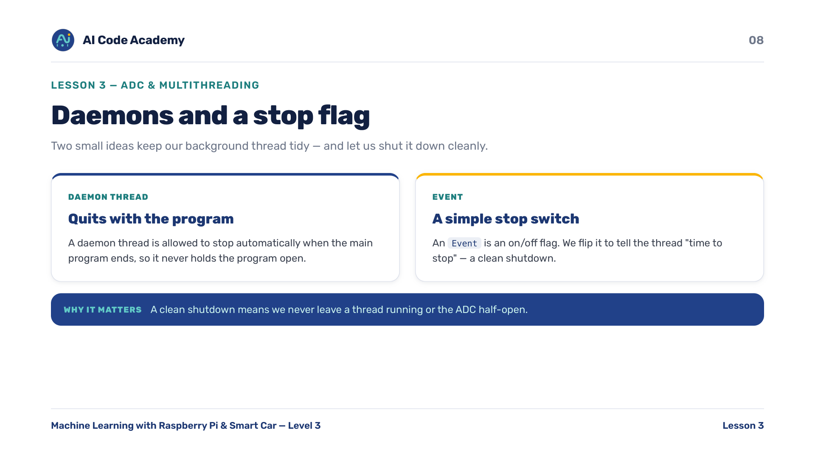
Notes:
Threads, daemons & the stop flag — keep it light. 'daemon = quits with the program' and 'Event = a stop switch' is enough. Don't go deep on OS theory.

Slide 9
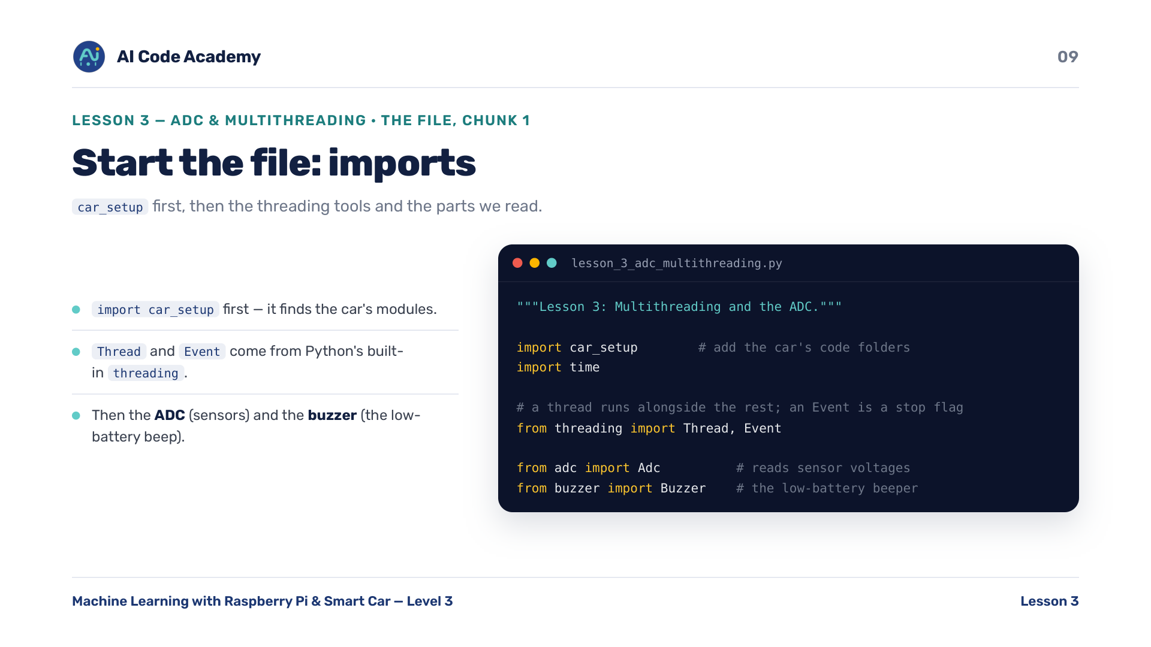
Notes:
Imports (chunk 1) — point out that Thread and Event are standard Python, not car-specific. car_setup must be imported first.

Slide 10
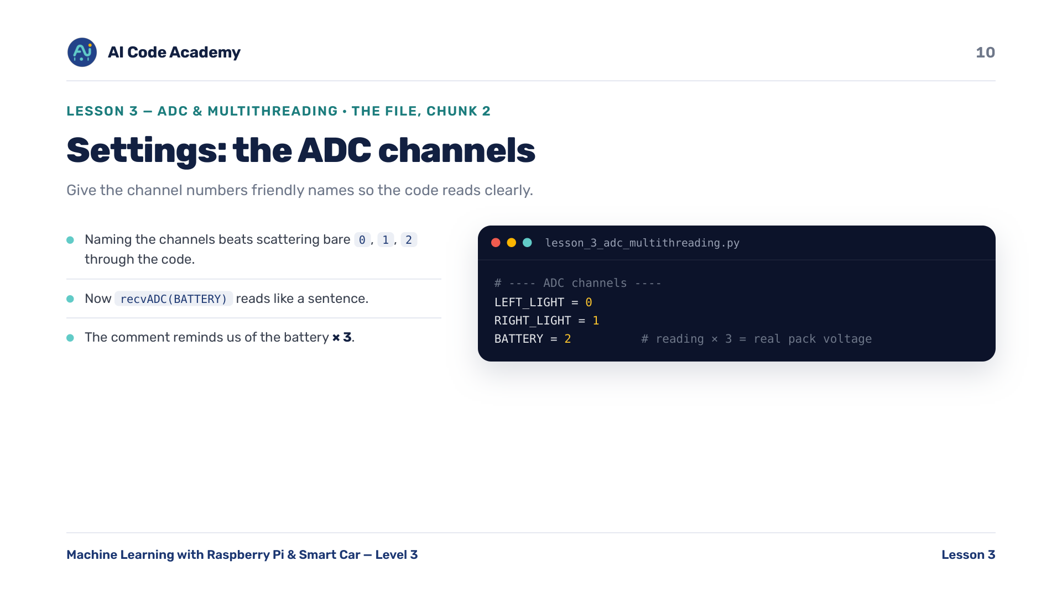
Notes:
ADC channels (chunk 2) — naming the channels instead of bare 0/1/2 is a good-code habit worth praising.

Slide 11
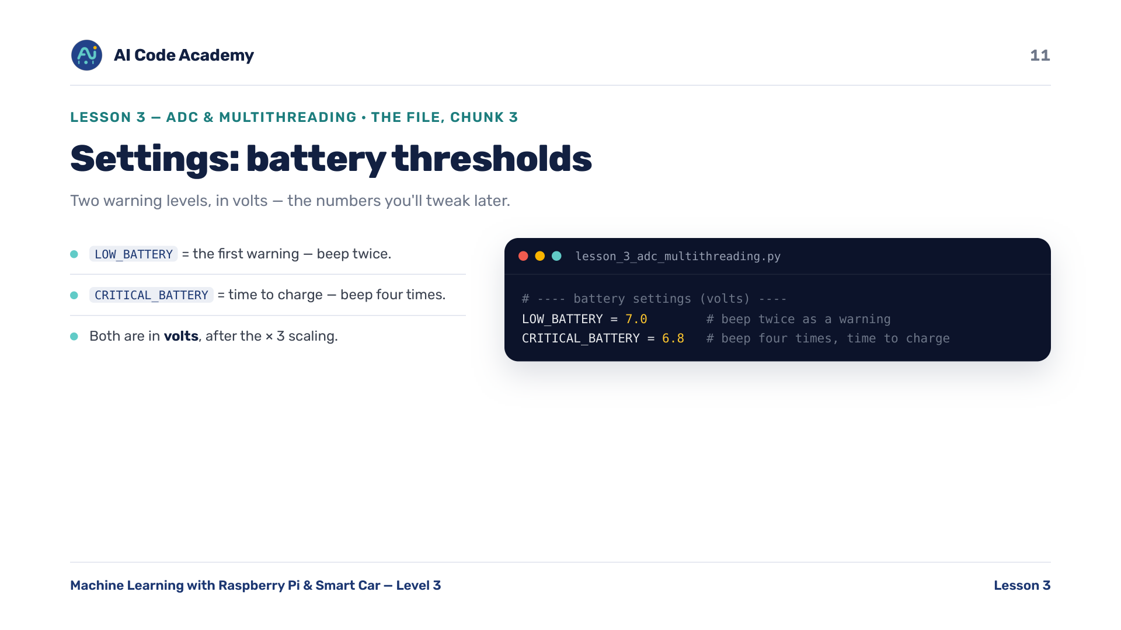
Notes:
Battery thresholds (chunk 3) — these are the numbers students will tweak on the 'try it yourself' slide.

Slide 12
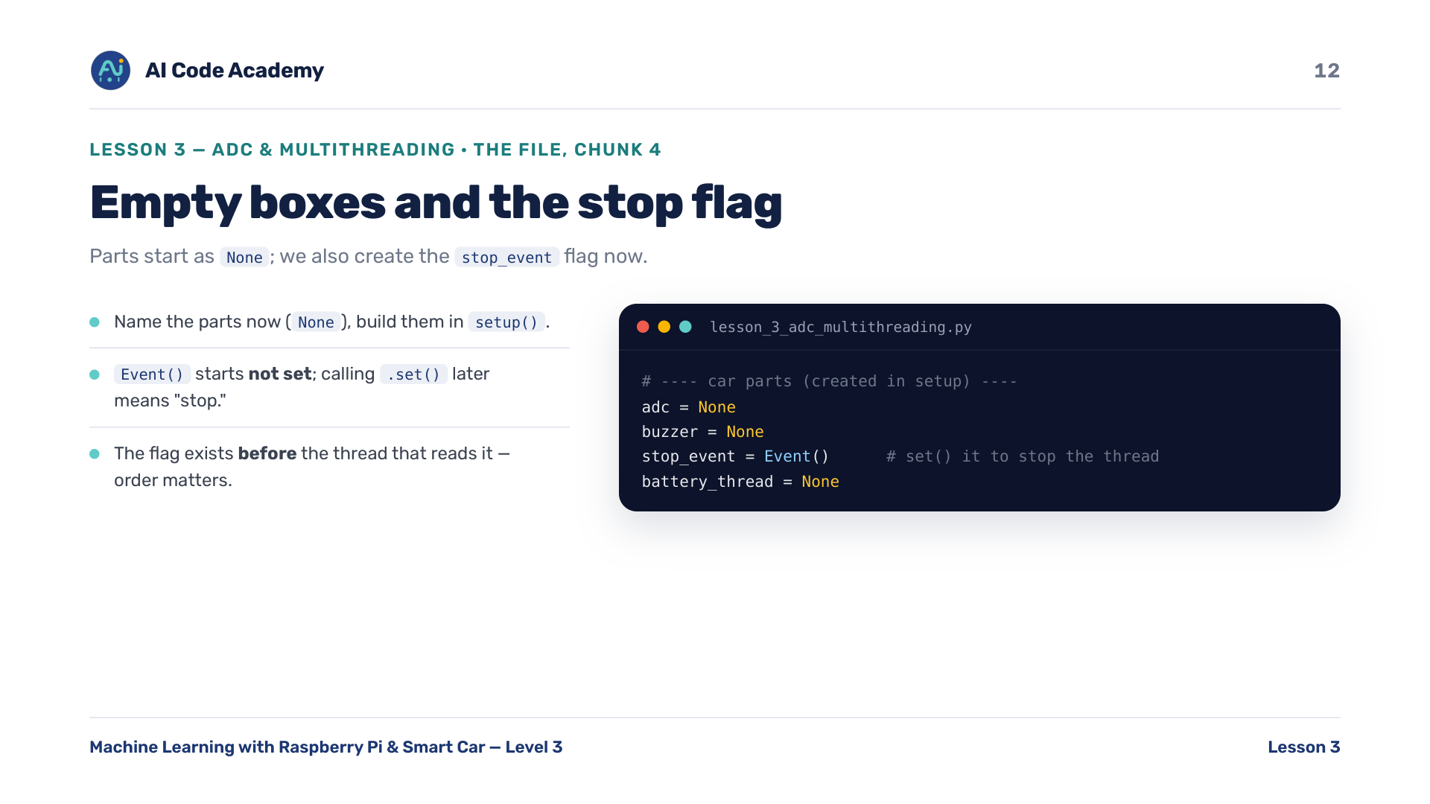
Notes:
Empty boxes + the stop flag (chunk 4) — the flag exists BEFORE the thread that reads it. Order matters. Event() starts 'not set'; we call set() to stop.

Slide 13
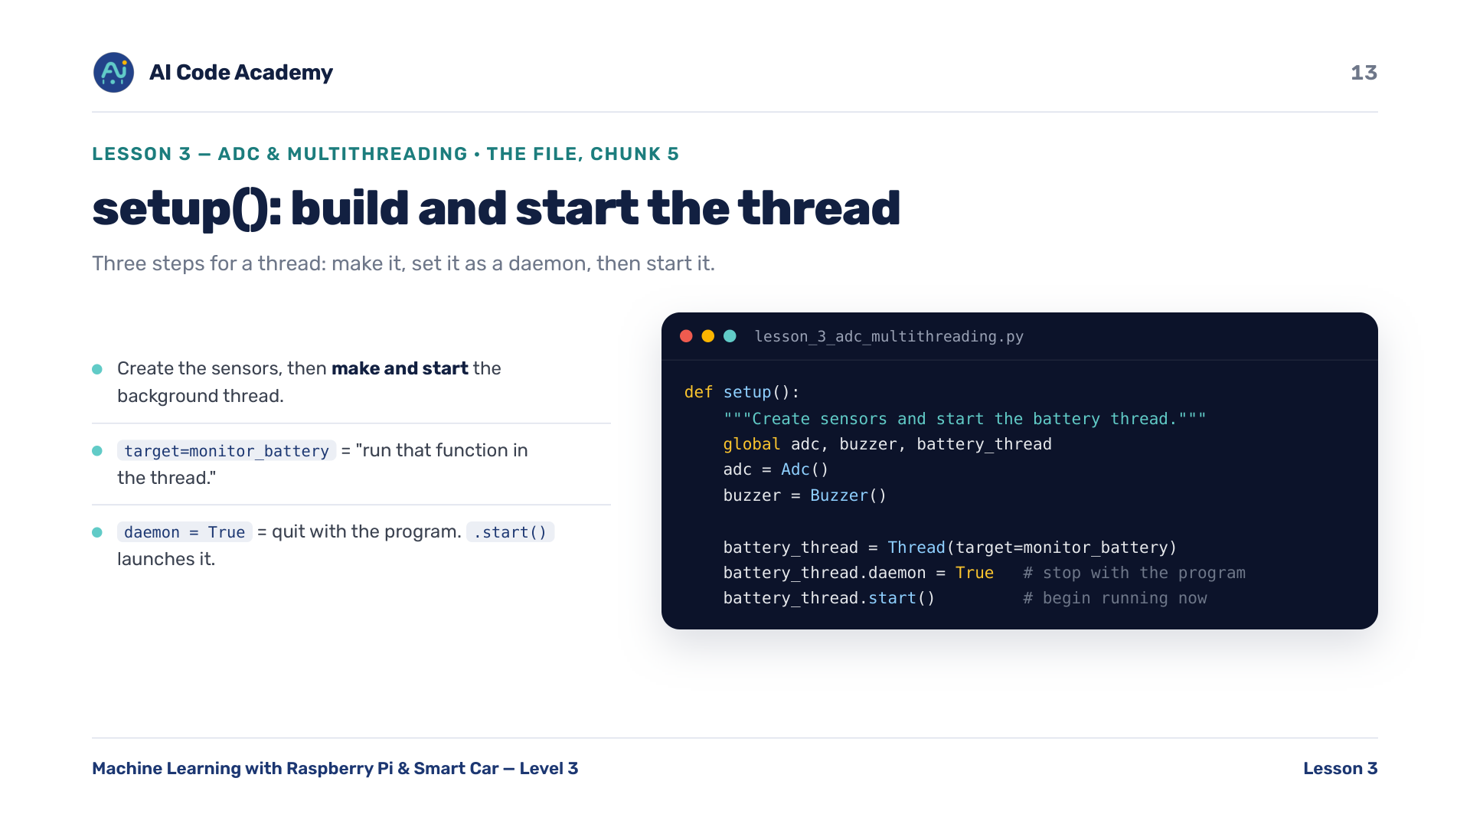
Notes:
setup() starts the thread (chunk 5) — three steps for a thread: make it (Thread(...)), set daemon, start it. We write monitor_battery next.

Slide 14
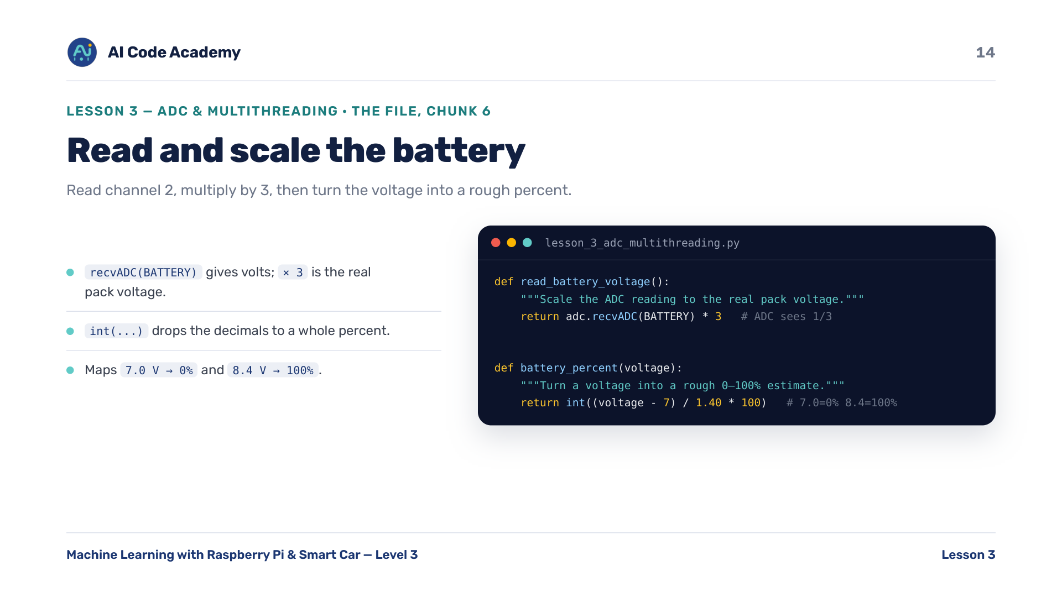
Notes:
Reading & scaling the battery (chunk 6) — optional: ask what int(7.6 V) maps to (~42%) to check understanding. Remember the x3.

Slide 15
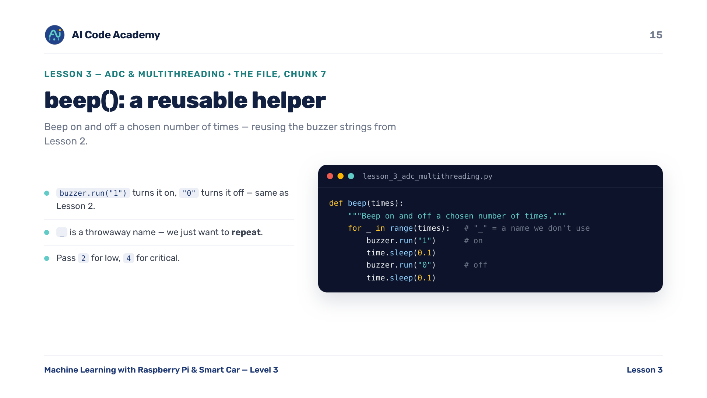
Notes:
beep() helper (chunk 7) — reuses the buzzer '1'/'0' string idea from Lesson 2 — quick callback. '_' is a throwaway counter.

Slide 16
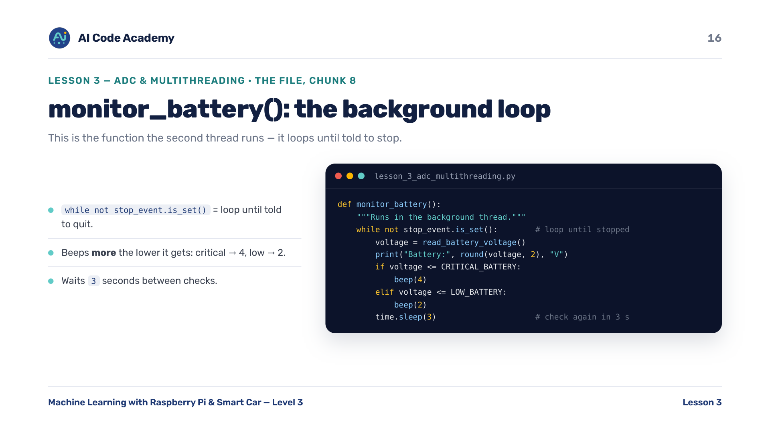
Notes:
monitor_battery() (chunk 8) — 'while not stop_event.is_set()' is how the thread knows when to quit. Link it forward to destroy(). Beeps more the lower it gets.

Slide 17
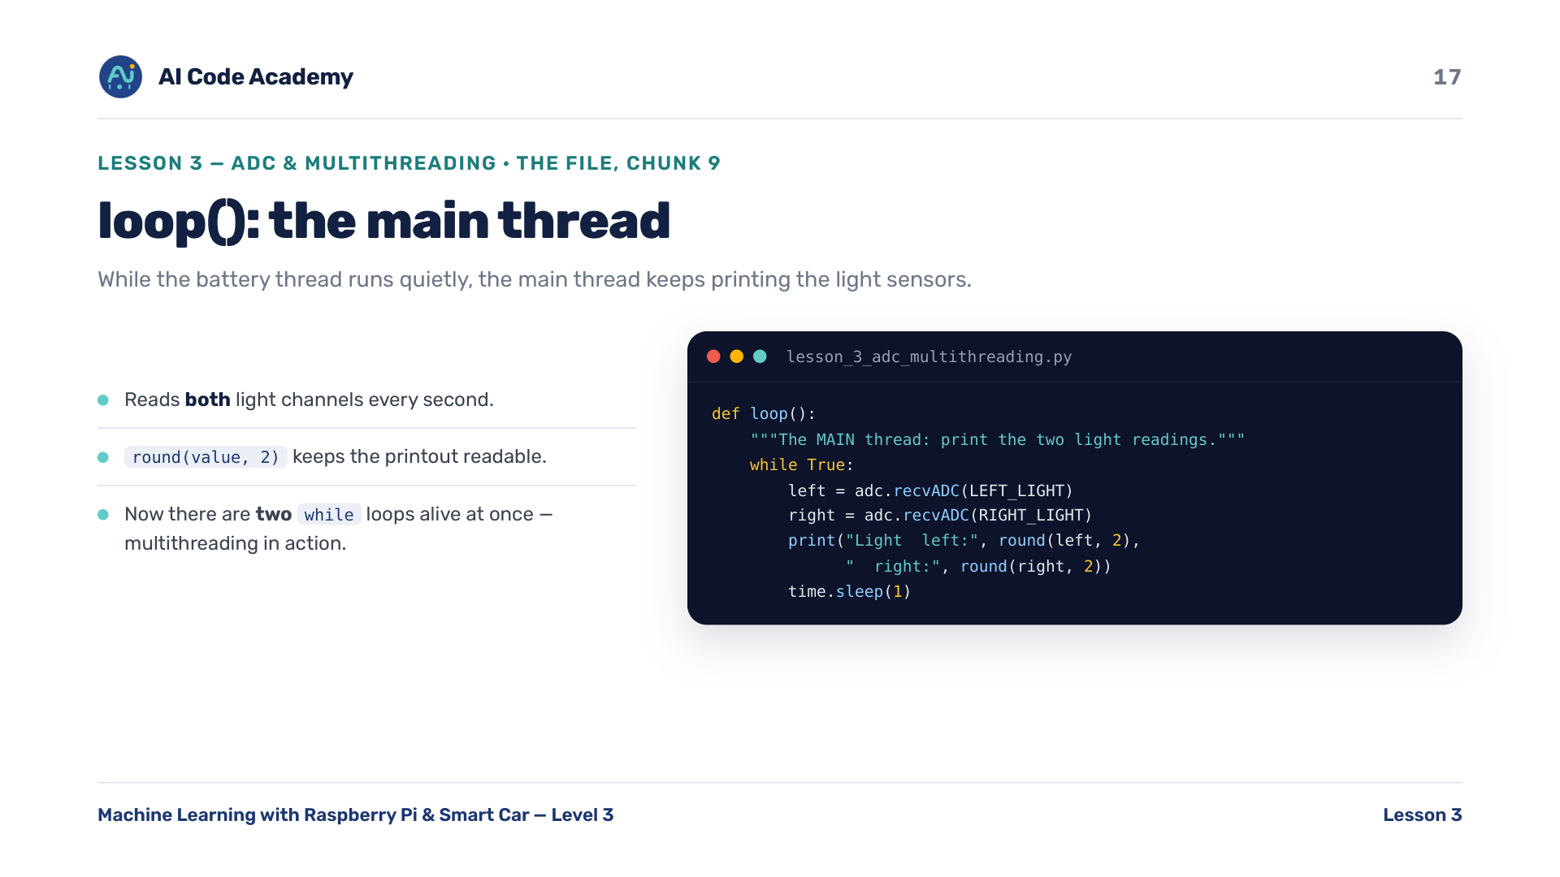
Notes:
loop() the main thread (chunk 9) — now there are TWO while loops alive at once (this one + monitor_battery). That's multithreading in action.

Slide 18
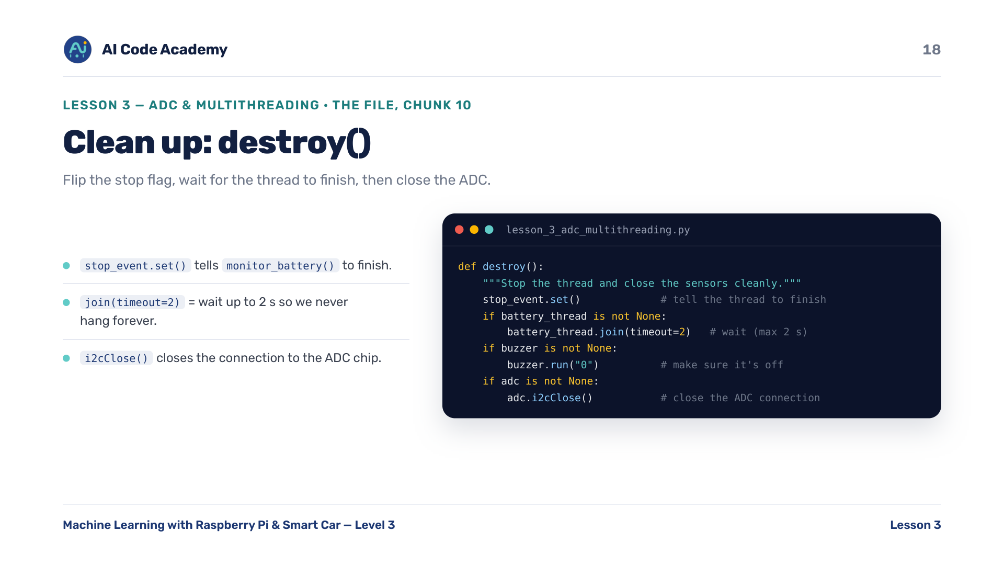
Notes:
destroy() (chunk 10) — the payoff for the daemon/Event slide: set the flag, join(timeout=2) so we never hang, then i2cClose() to close the ADC.

Slide 19
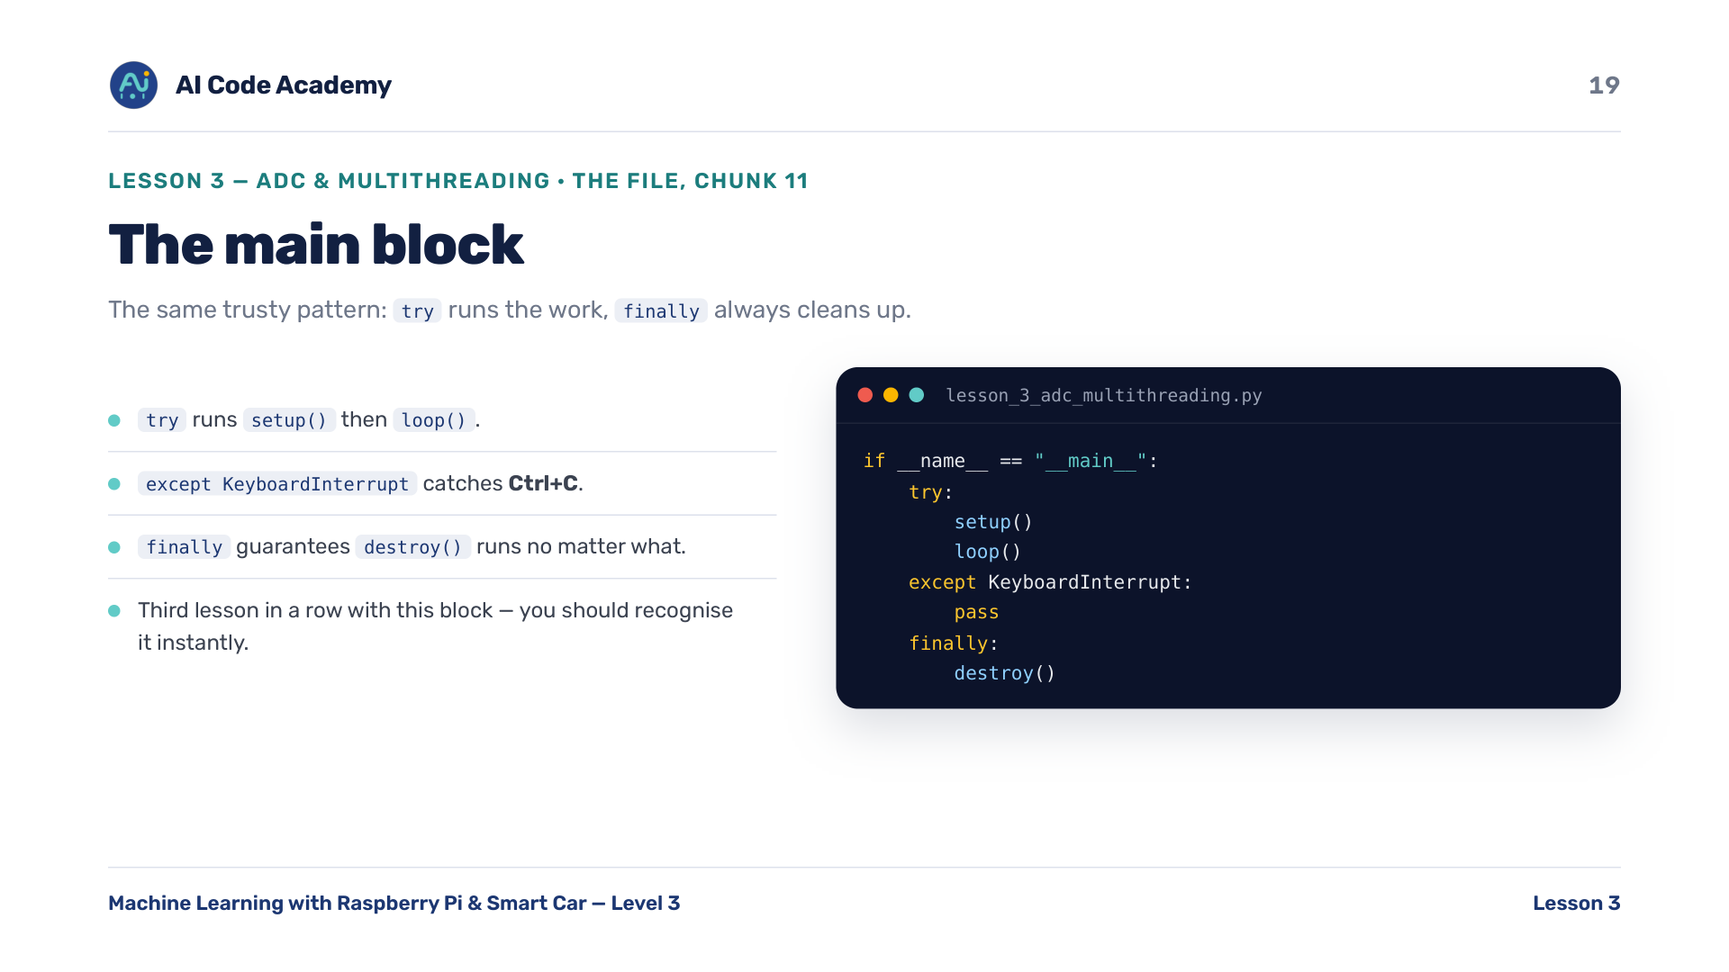
Notes:
Main block (chunk 11) — third lesson in a row with this try / except / finally block. Students should recognise it instantly now.

Slide 20
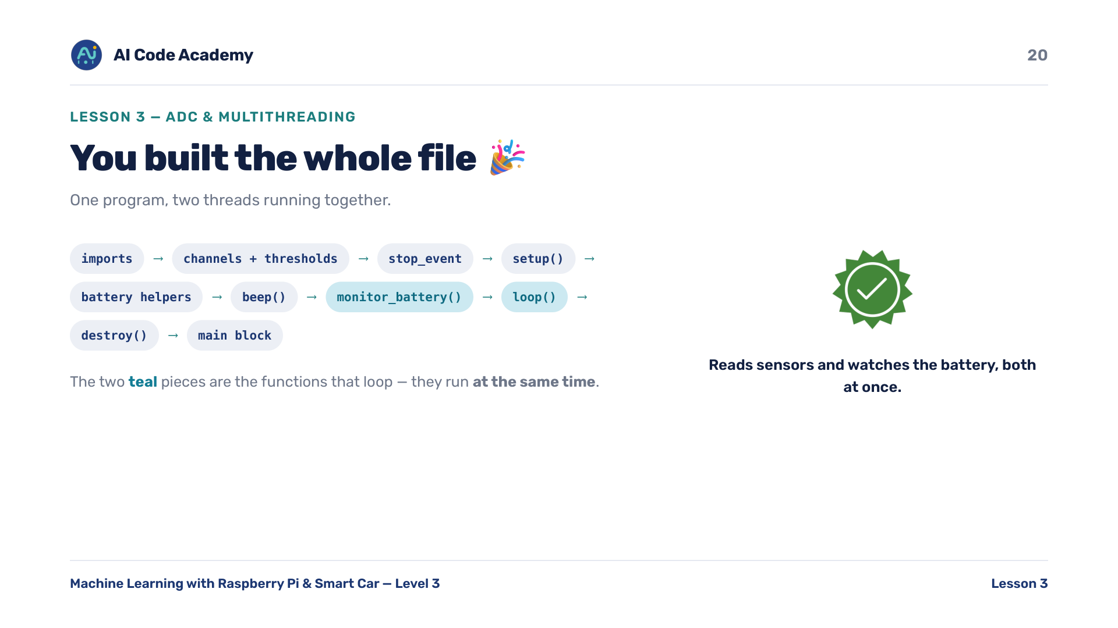
Notes:
Whole file (chunk 12) — scroll the assembled file; highlight the TWO functions that loop (loop and monitor_battery).

Slide 21
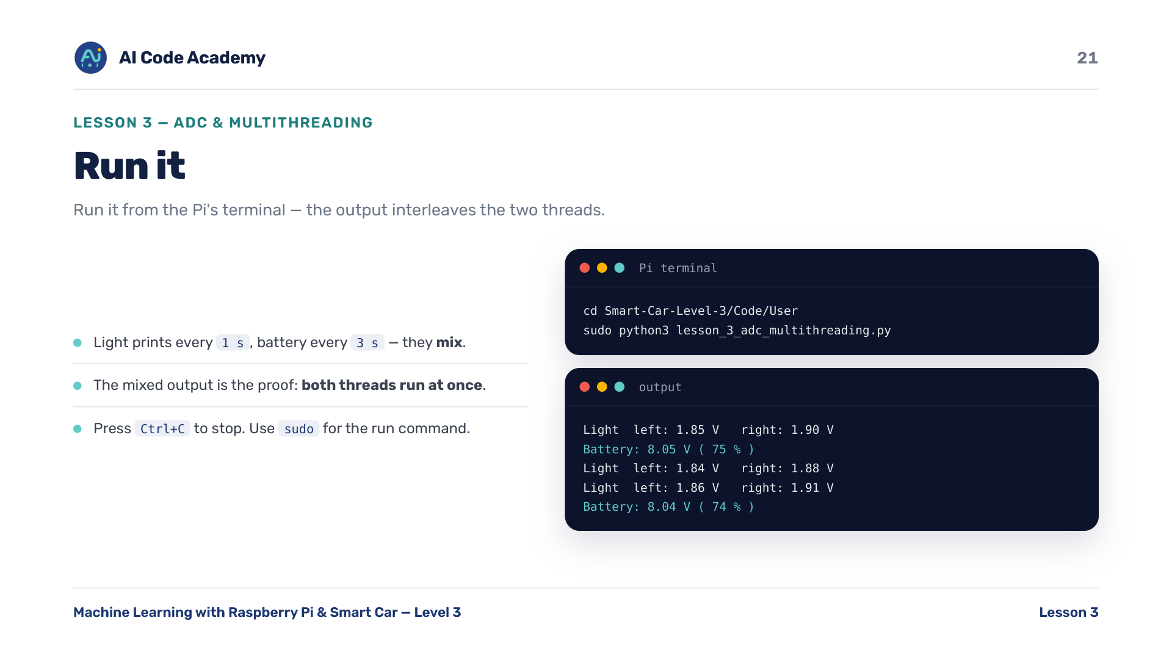
Notes:
Run it — point at the mixed output: proof both threads run at once. Light prints every 1 s, battery every 3 s. Use sudo for consistency across the course. Ctrl+C to stop.

Slide 22
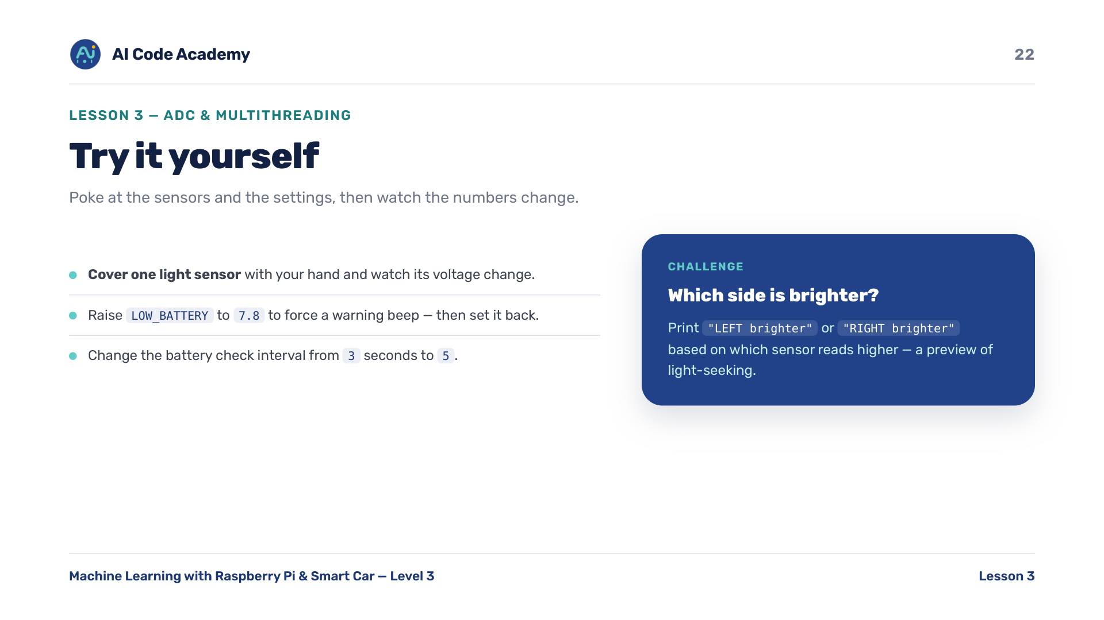
Notes:
Try it yourself — demo 'cover the sensor' early; it's the most tangible moment. The brighter-side challenge previews line-following / light-seeking logic.

Slide 23
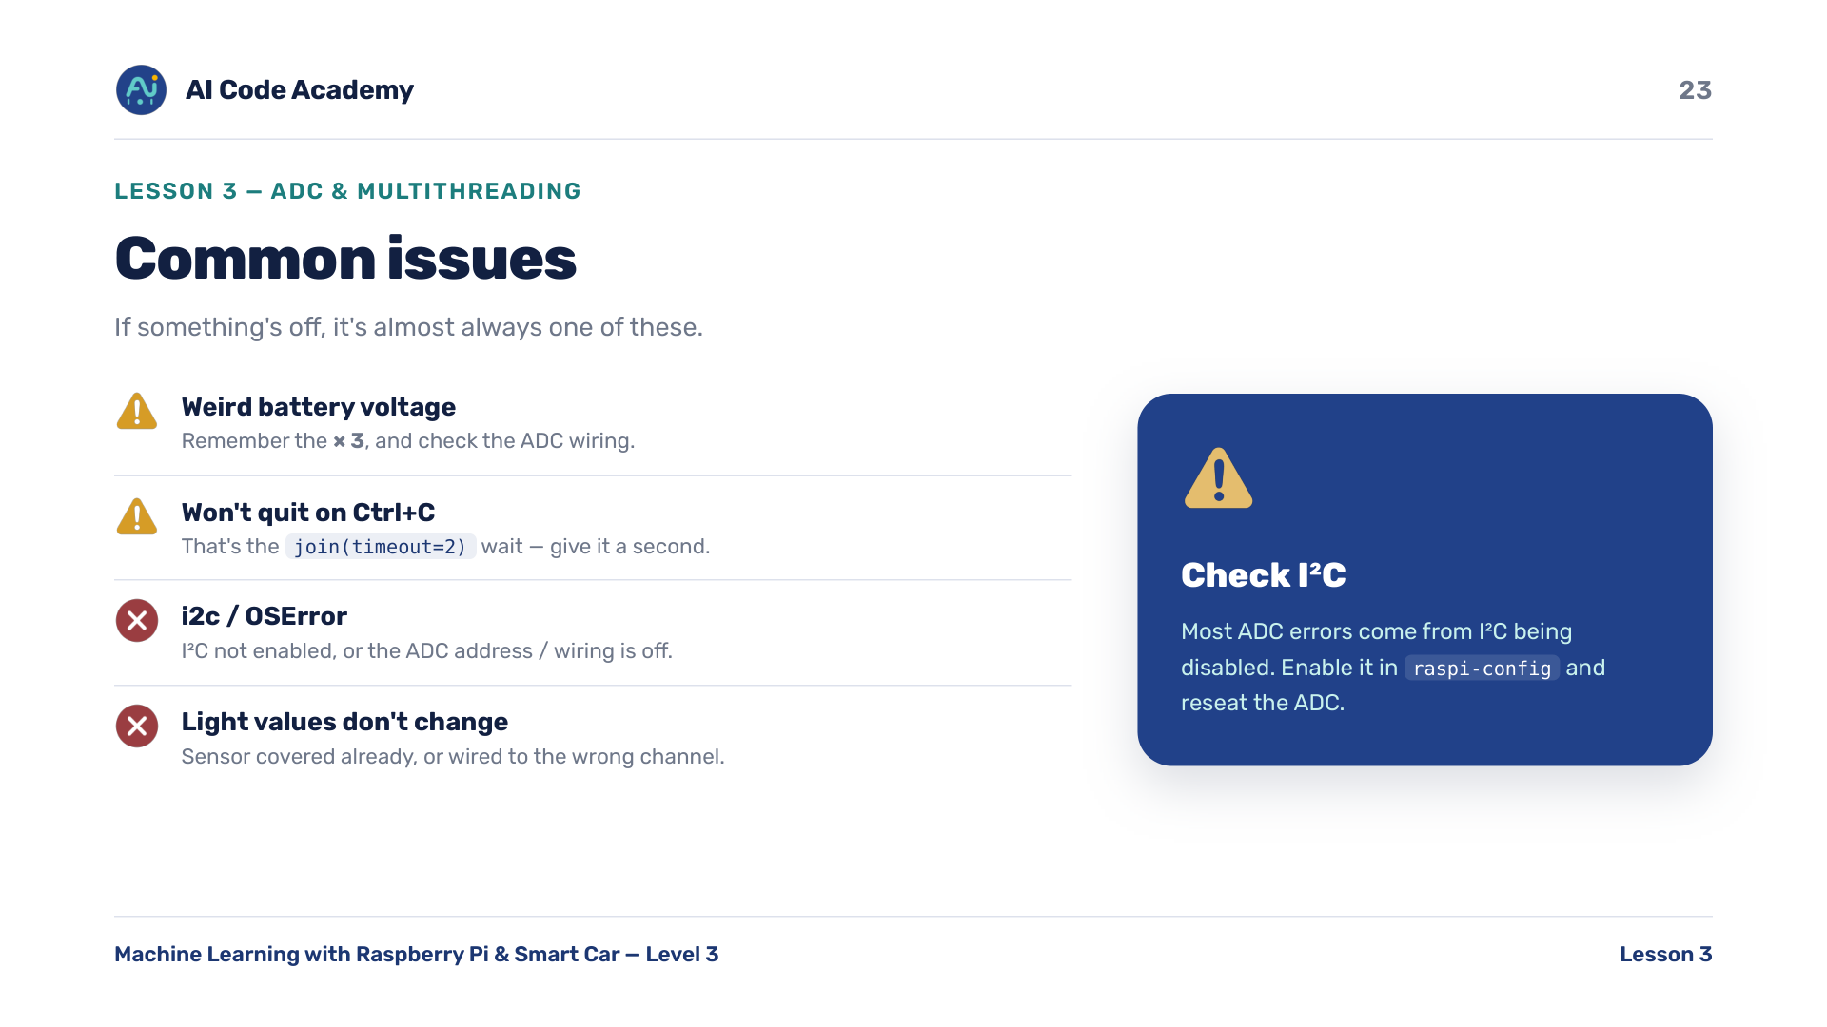
Notes:
Troubleshooting — if I2C errors appear, check raspi-config (I2C enabled) and the ADC seating. Remember the battery x3. Give Ctrl+C a second to join the thread.

Slide 24
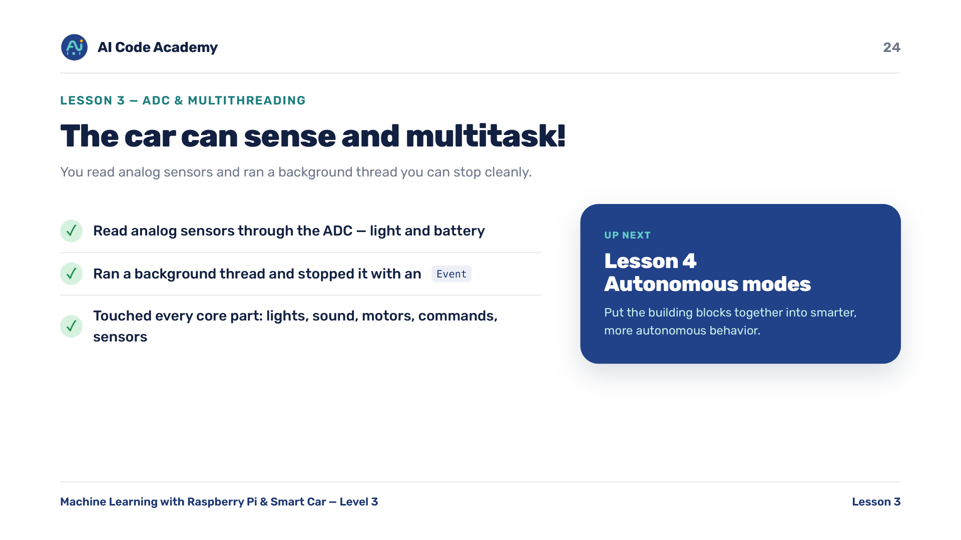
Notes:
Recap — celebrate: they've now touched every core subsystem of the car (lights, sound, motors, commands, sensors). Next: smarter, more autonomous behavior.

Slide 25
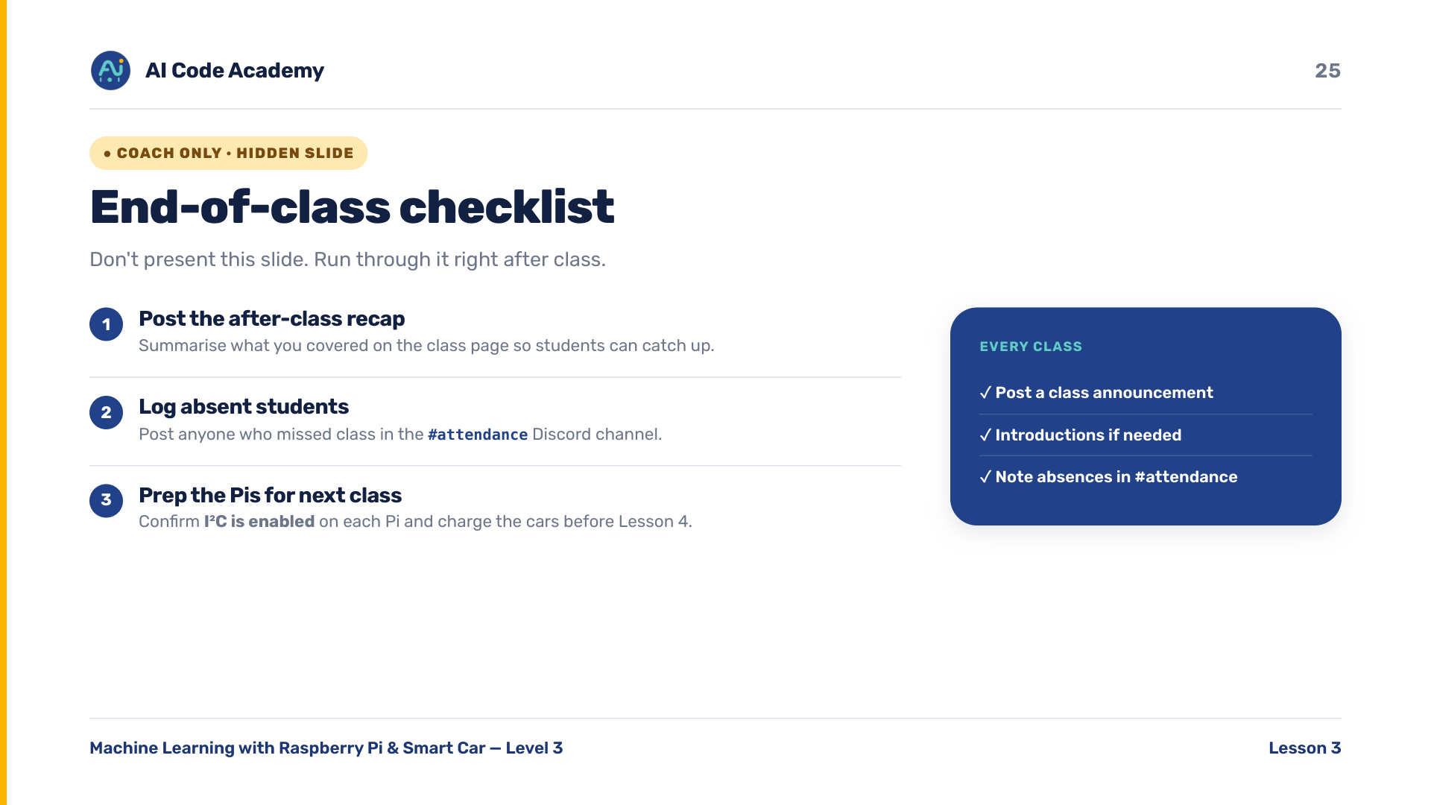
Notes:
COACH (hidden) — do not present. After class: post the recap, log absent students in the Discord #attendance channel. Before next class confirm I2C is enabled on each Pi and charge the cars.

