Slide 1
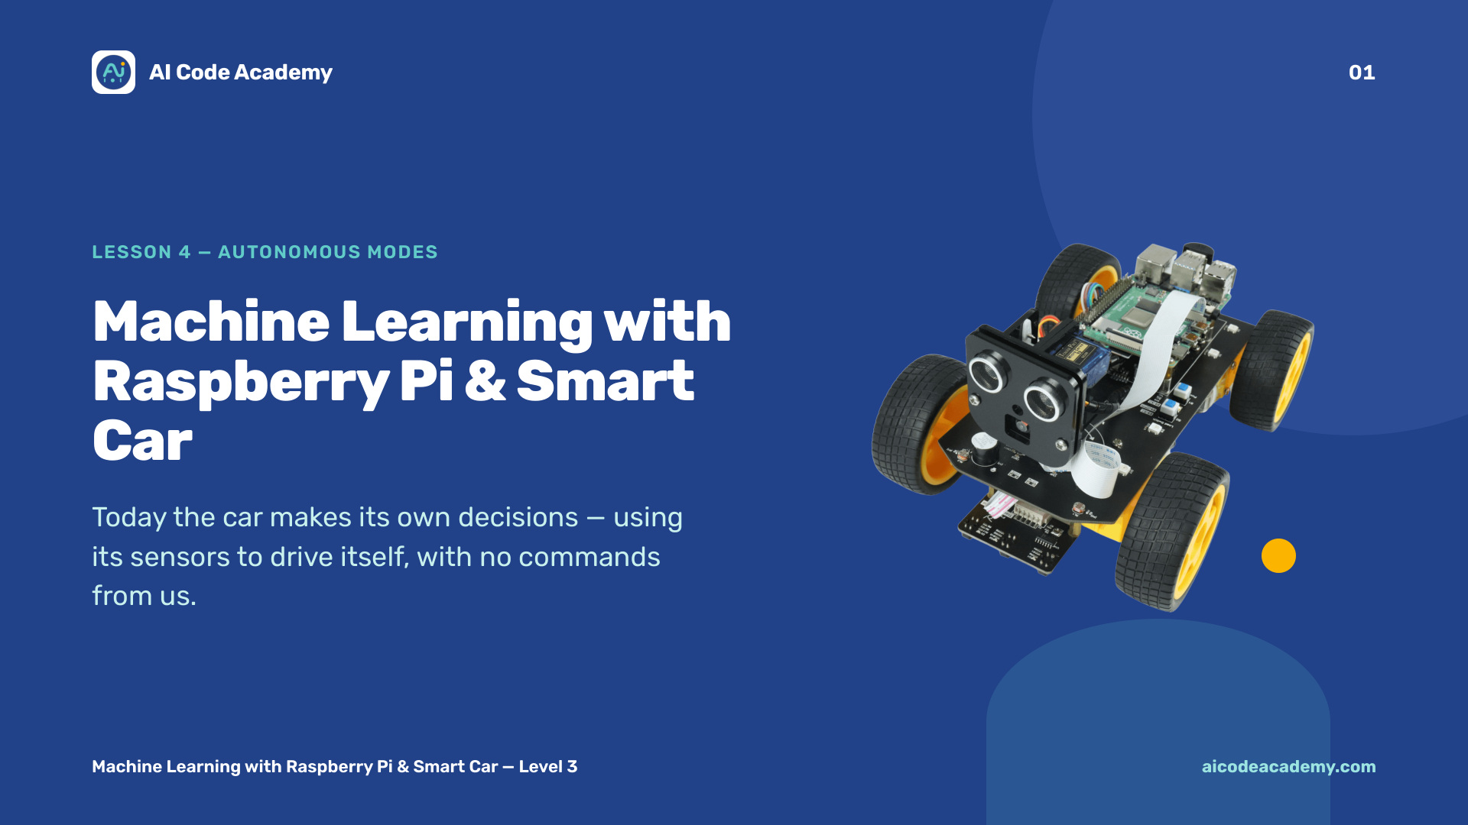
Notes:
Title — ~1 min. Today the car makes its own decisions. Make sure there's floor space to drive. Run the lesson command with sudo. Site: https://aicodeacademy.com

Slide 2
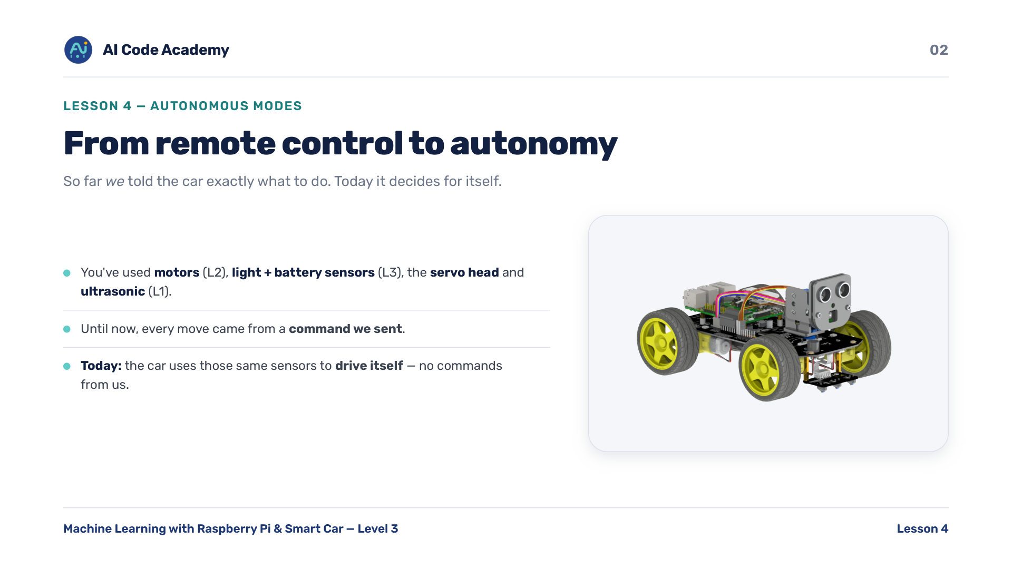
Notes:
Introduction — frame the jump: from remote control to autonomy. Quick recall of which sensor does what — motors (L2), light + battery sensors (L3), servo head + ultrasonic (L1).

Slide 3
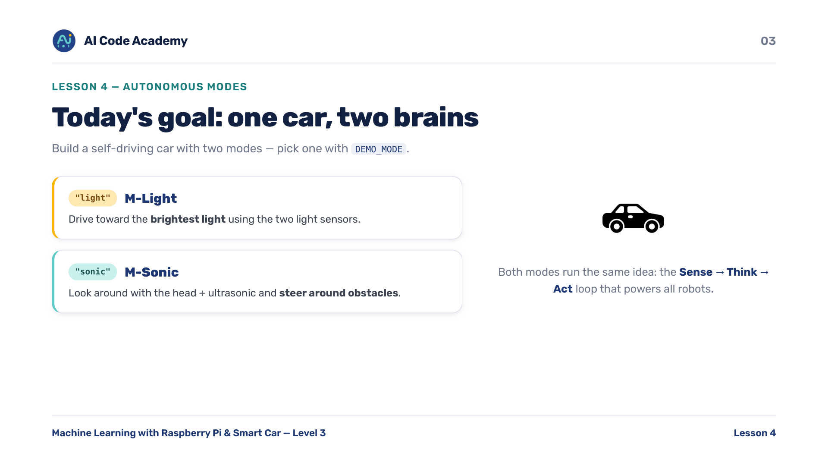
Notes:
Goals — decide as a class which mode to demo first; sonic is usually more reliable indoors. DEMO_MODE picks the brain that runs. Light = drive toward brightest light; Sonic = look around and dodge.

Slide 4
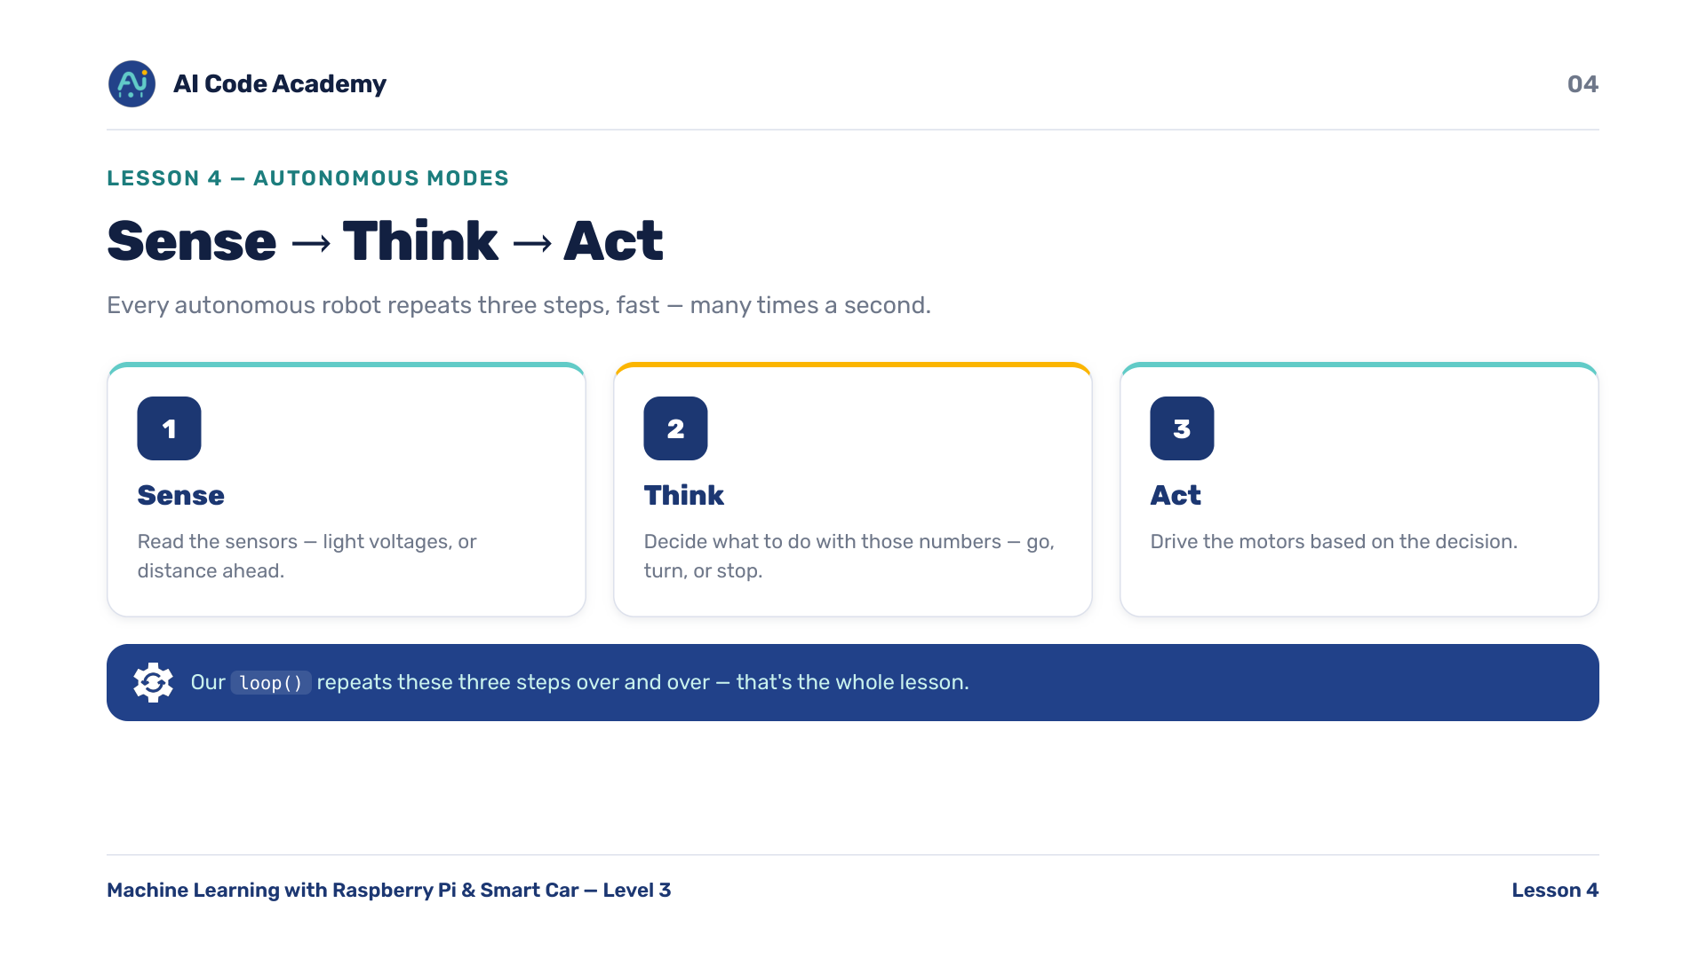
Notes:
Sense -> Think -> Act — this is the key idea of the whole lesson. Everything below is just filling in these three steps. The loop repeats them many times a second.

Slide 5
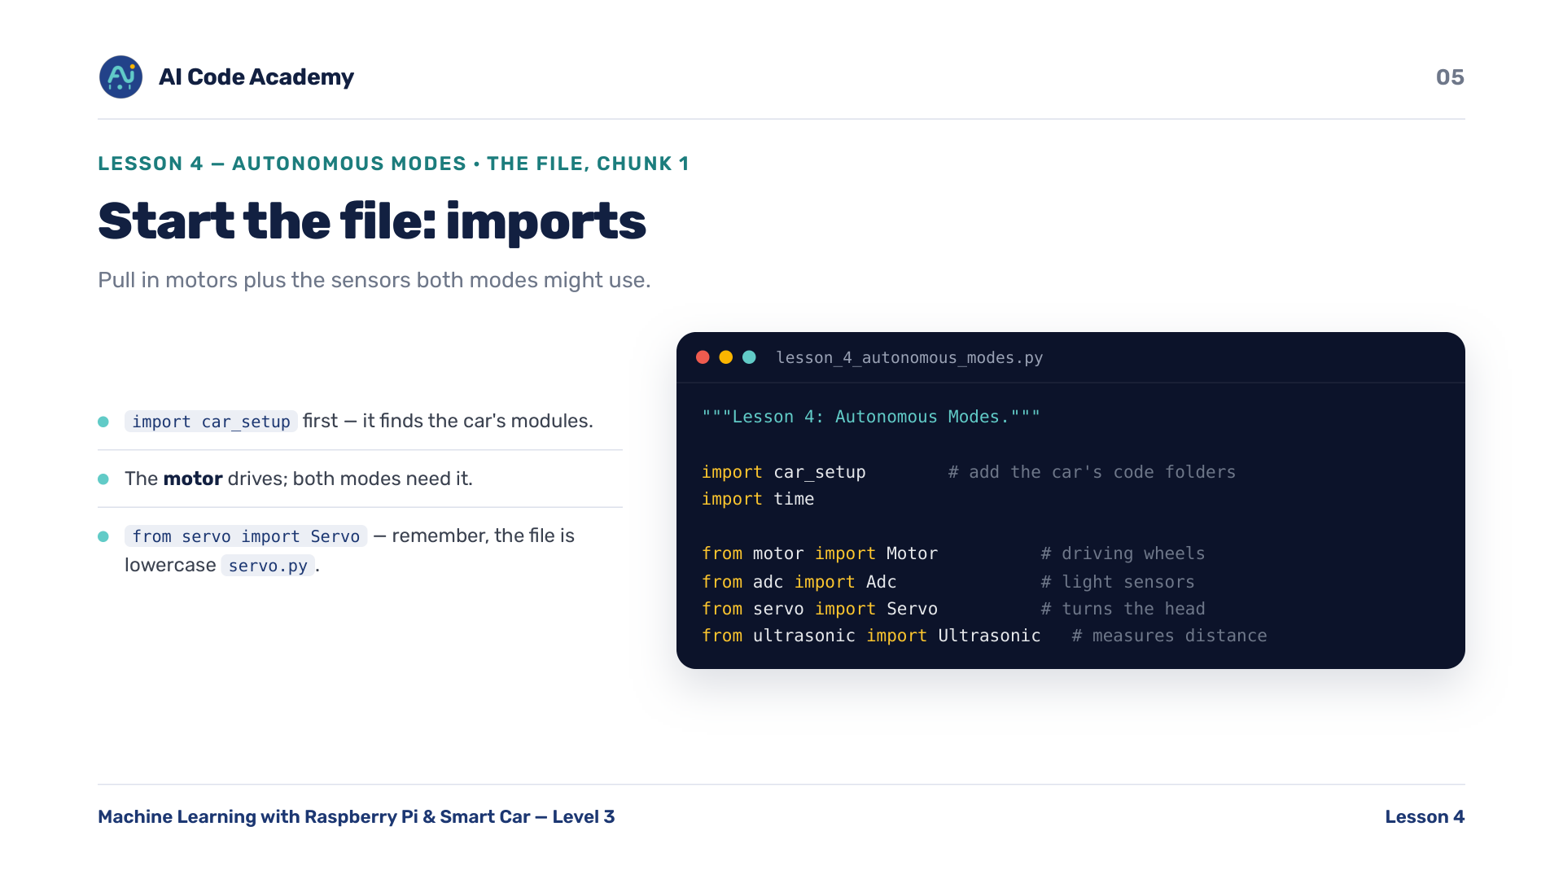
Notes:
Imports (chunk 1/11) — callback to L1-L3: they've met every one of these modules already. Note the lowercase 'from servo import Servo' — file is servo.py.

Slide 6
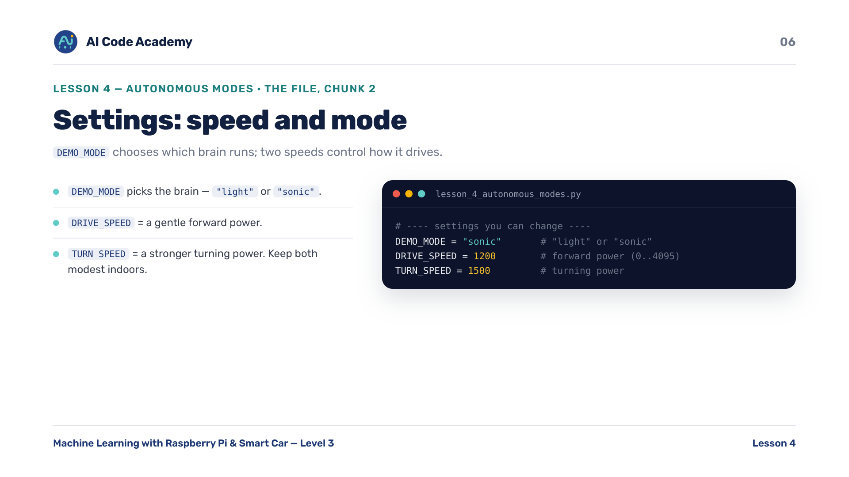
Notes:
Settings: speed & mode (chunk 2/11) — keep speeds modest indoors. DEMO_MODE chooses the brain. They'll tune DRIVE_SPEED / TURN_SPEED in 'try it yourself'.

Slide 7
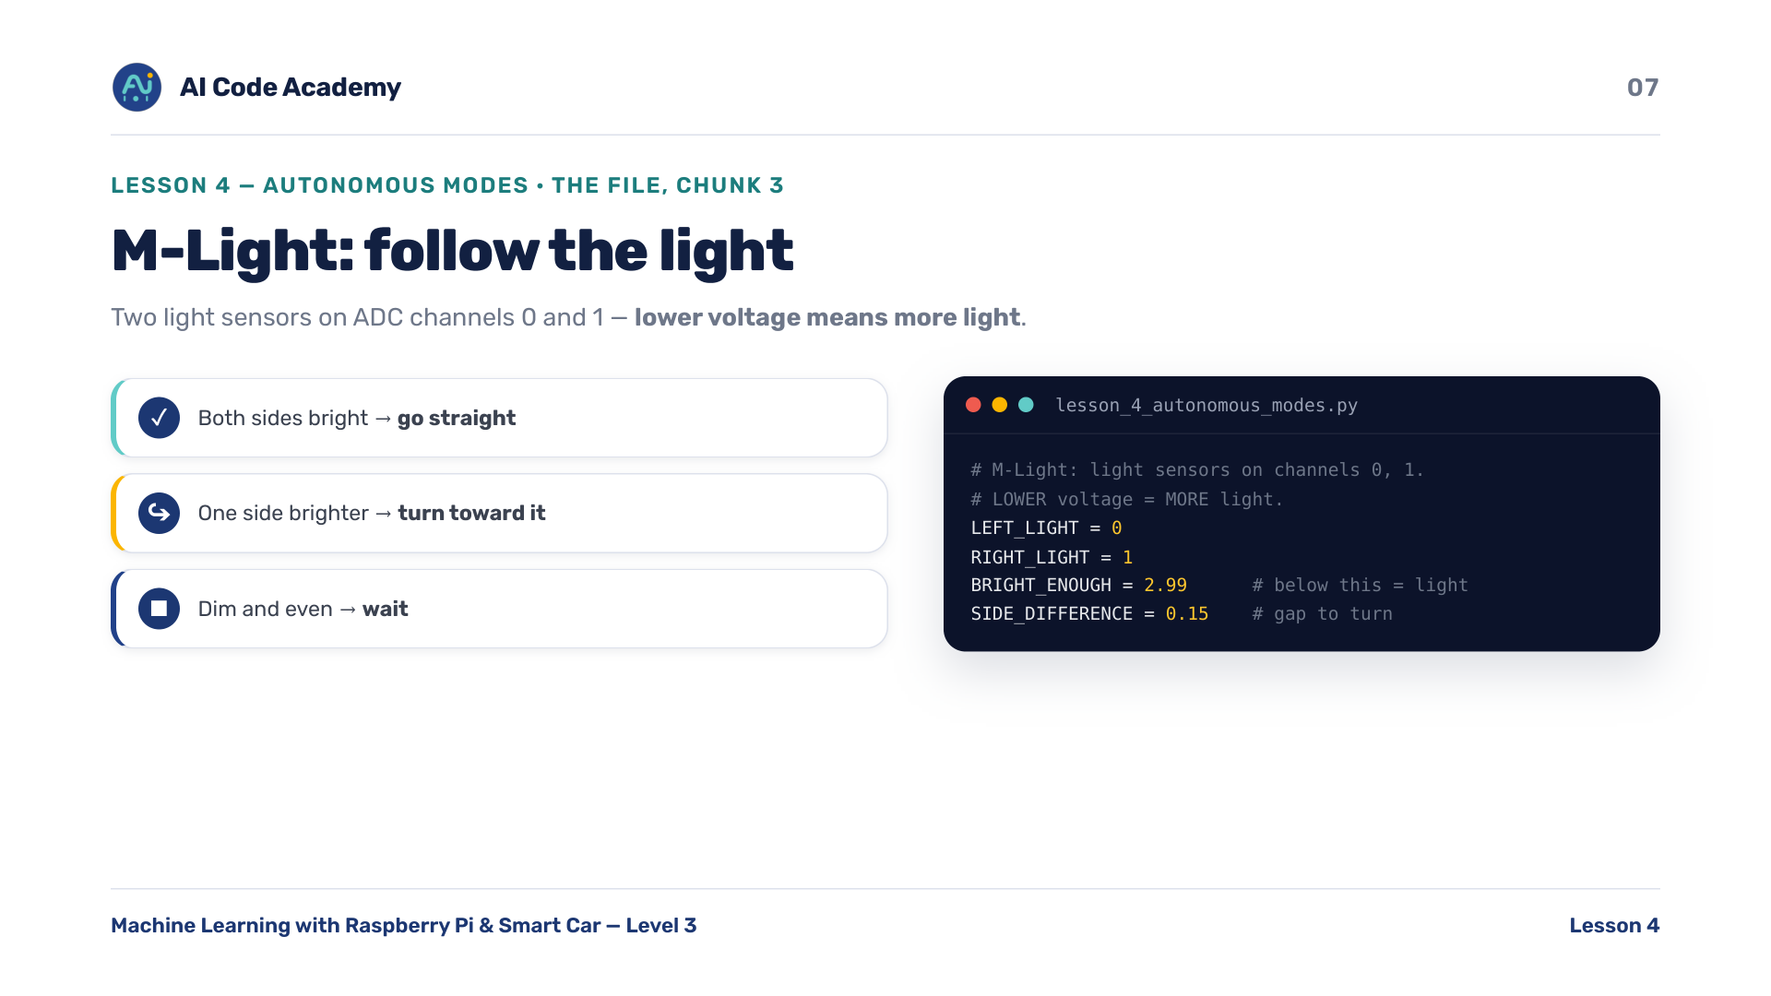
Notes:
M-Light settings (chunk 3/11) — the 'lower voltage = brighter' rule trips everyone up. Say it twice. Two light sensors on ADC channels 0 and 1.

Slide 8
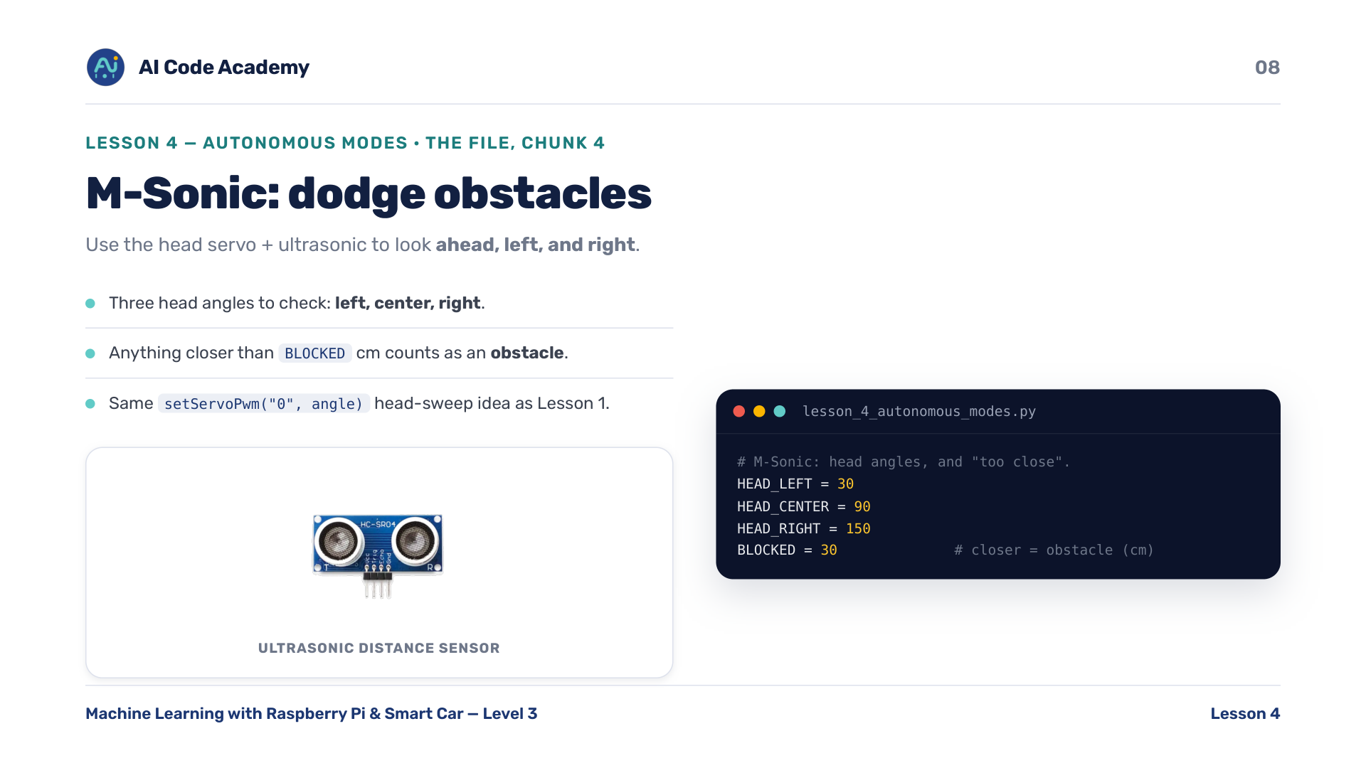
Notes:
M-Sonic settings (chunk 4/11) — connect head angles back to L1's servo sweep, same setServoPwm('0', angle) idea. BLOCKED cm is what counts as an obstacle.

Slide 9
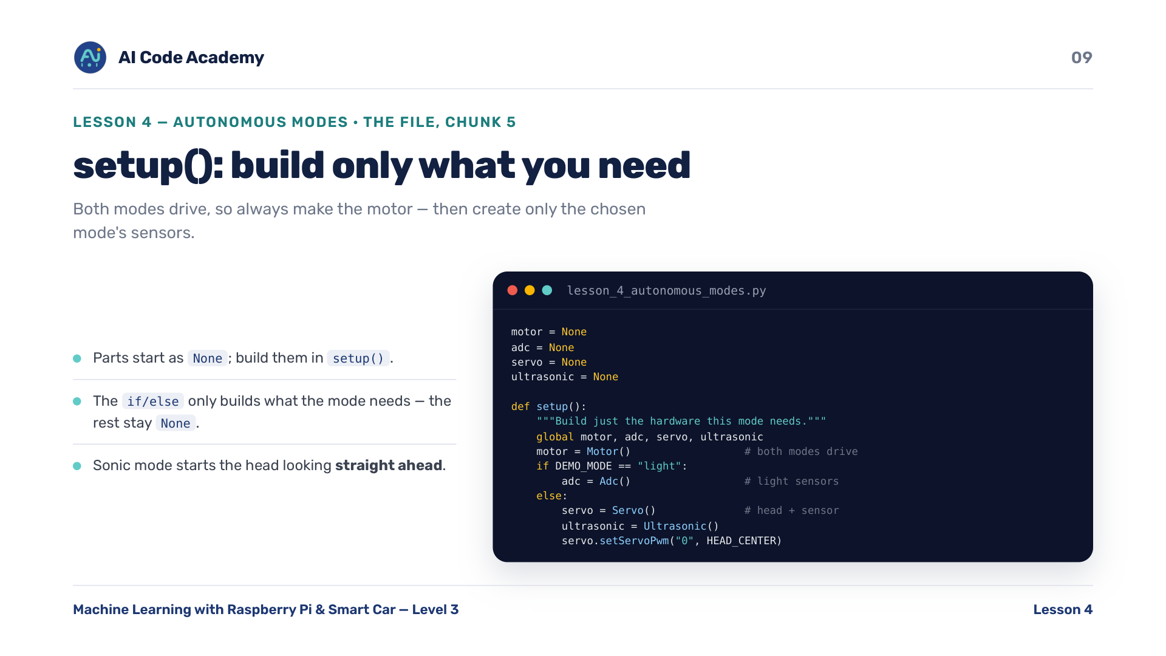
Notes:
setup() (chunk 5/11) — point out the if/else: clean code only builds what it needs. Both modes drive, so the motor is always made; the rest stay None.

Slide 10
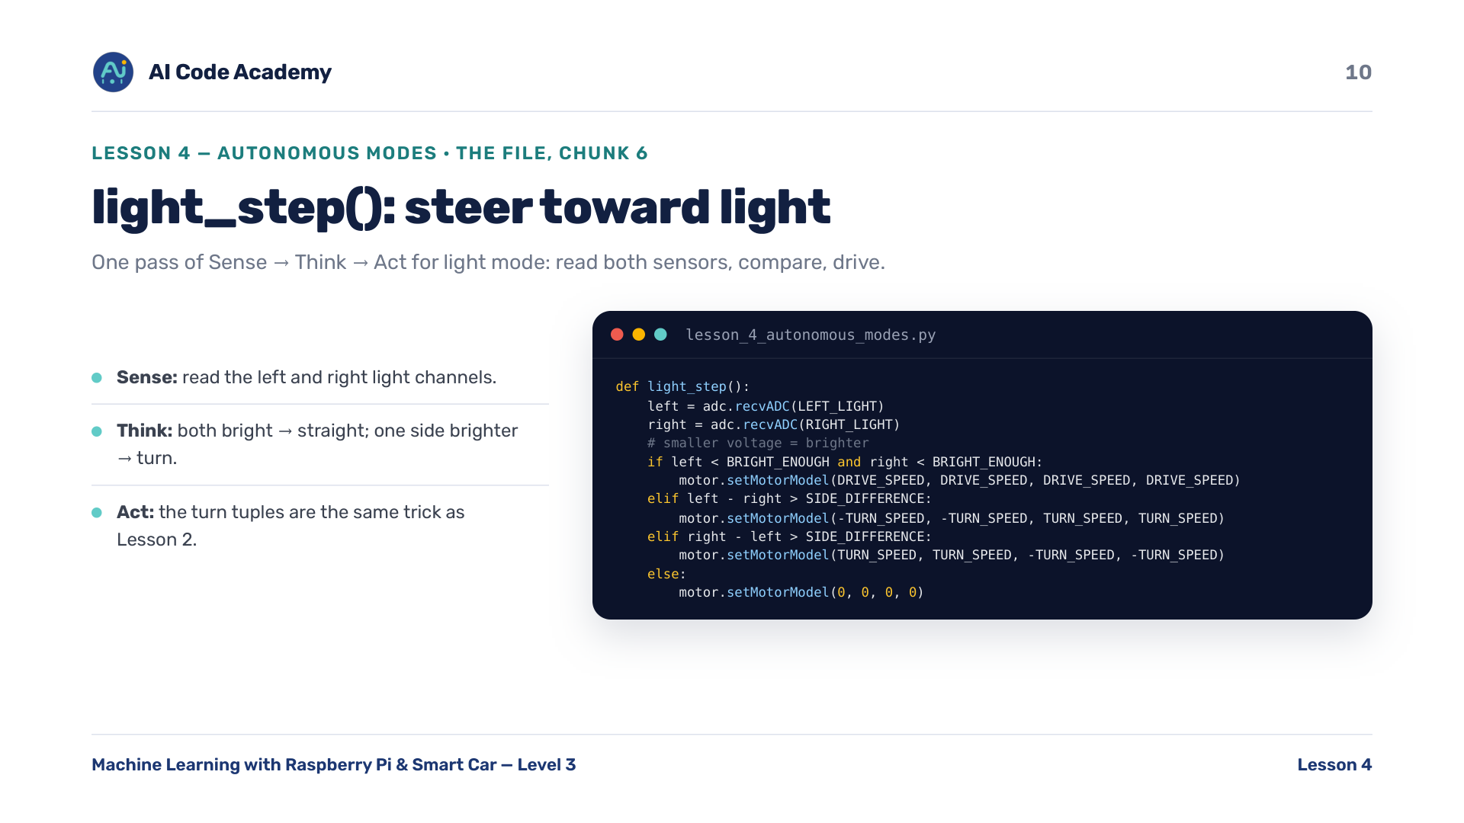
Notes:
light_step() (chunk 6/11) — walk through each branch as Sense/Think/Act. The turn tuples are the same trick as Lesson 2. Remember: smaller voltage = brighter.

Slide 11
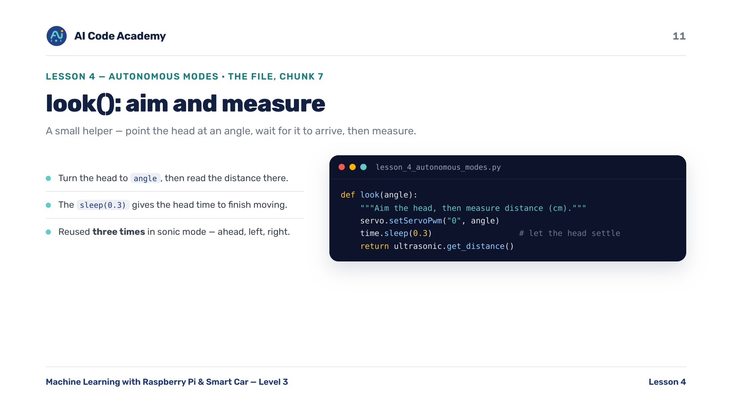
Notes:
look() (chunk 7/11) — helper functions keep the next step short and readable; good habit to highlight. Reused three times in sonic mode (ahead, left, right).

Slide 12
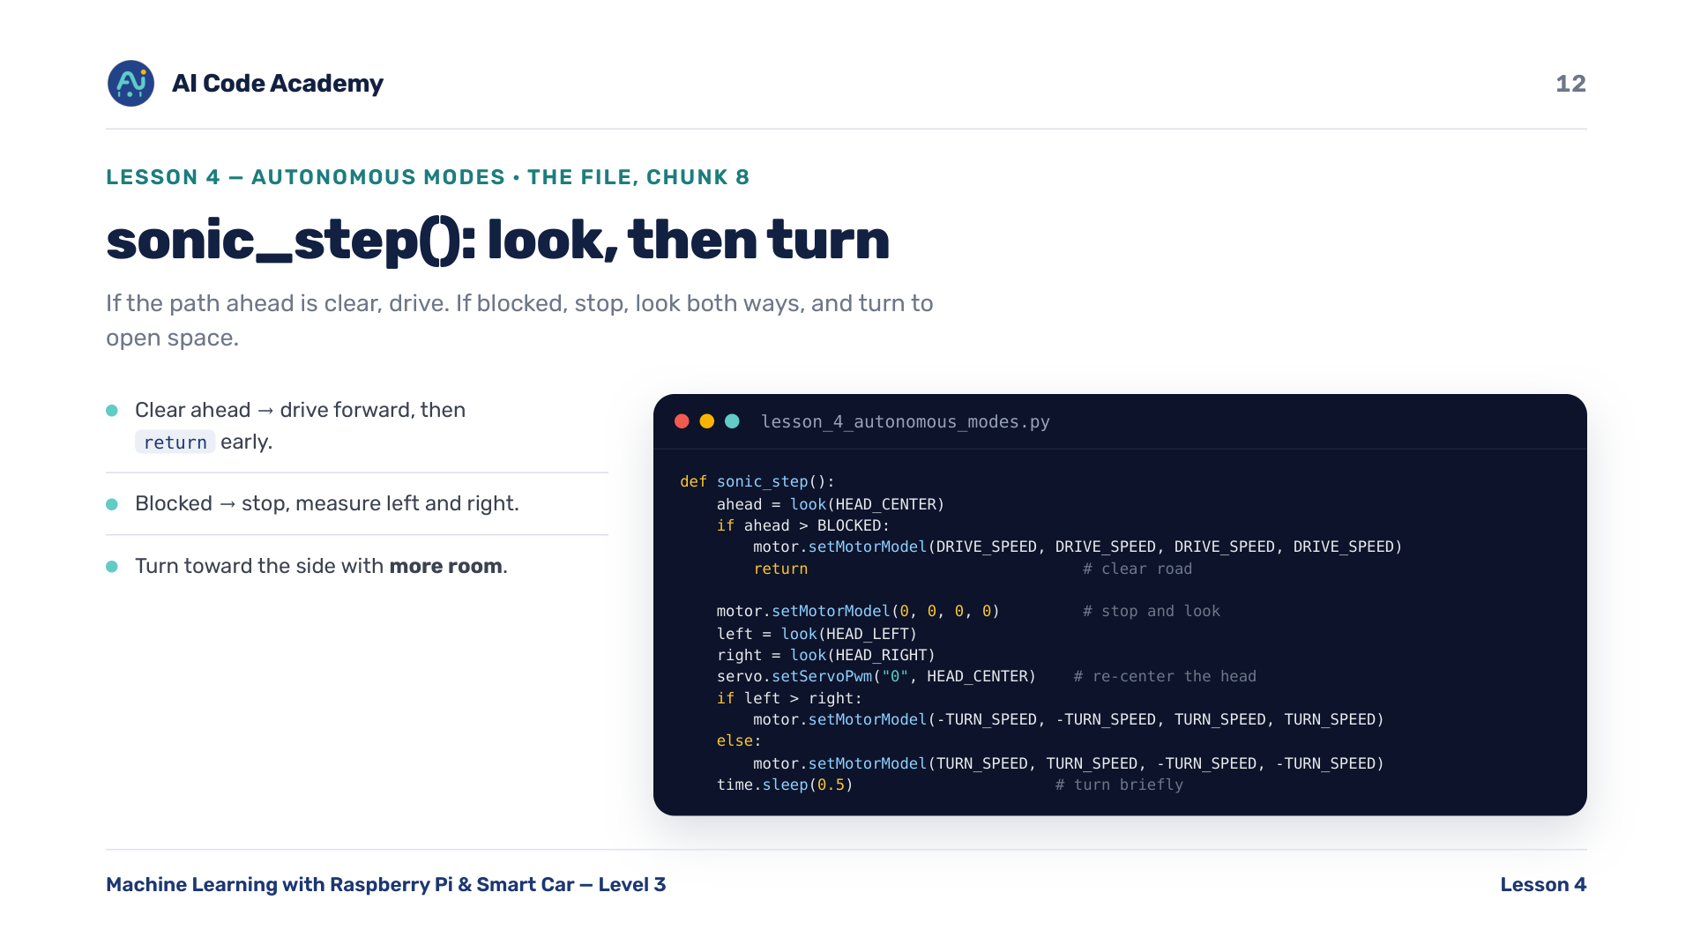
Notes:
sonic_step() (chunk 8/11) — the early 'return' = 'clear road, nothing else to do.' Highlight that pattern. If blocked: stop, look left & right, turn toward more room.

Slide 13
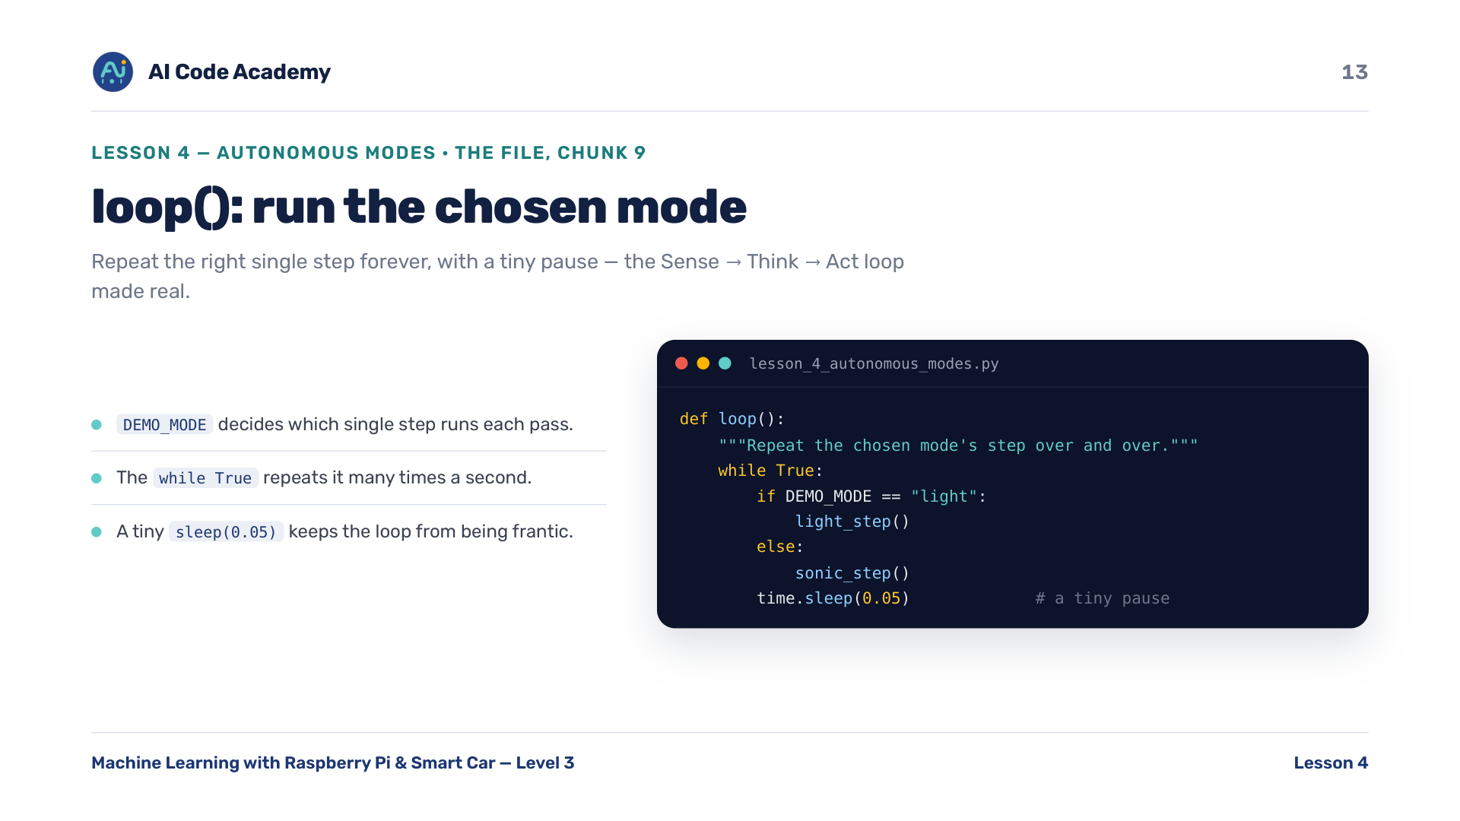
Notes:
loop() (chunk 9/11) — this is the Sense -> Think -> Act loop made real. Connect back to the concept slide. The tiny sleep keeps the loop from being frantic.

Slide 14
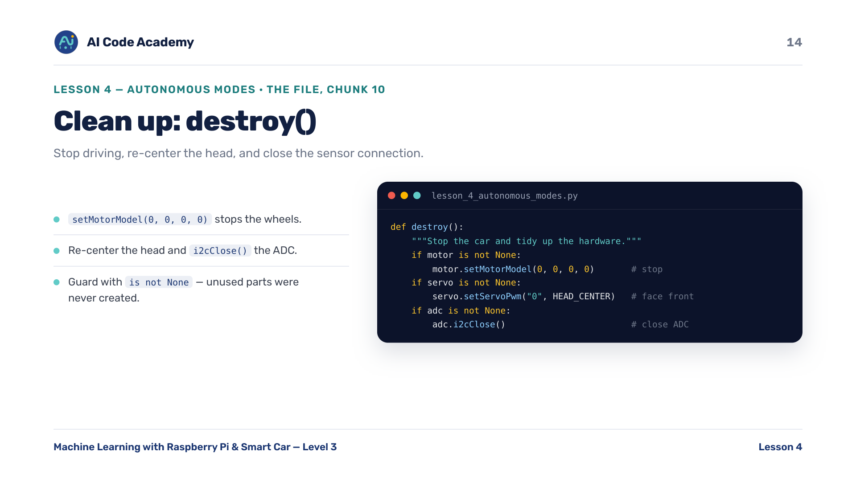
Notes:
destroy() (chunk 10/11) — same safety habit as every lesson: leave the car stopped. The 'is not None' guards matter because unused parts were never created.

Slide 15
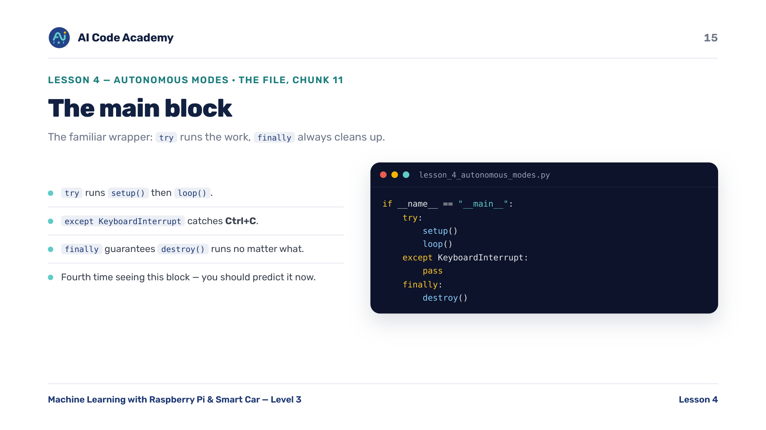
Notes:
Main block (chunk 11/11) — fourth time seeing this try / except KeyboardInterrupt / finally: destroy() wrapper. Students should predict it now.

Slide 16
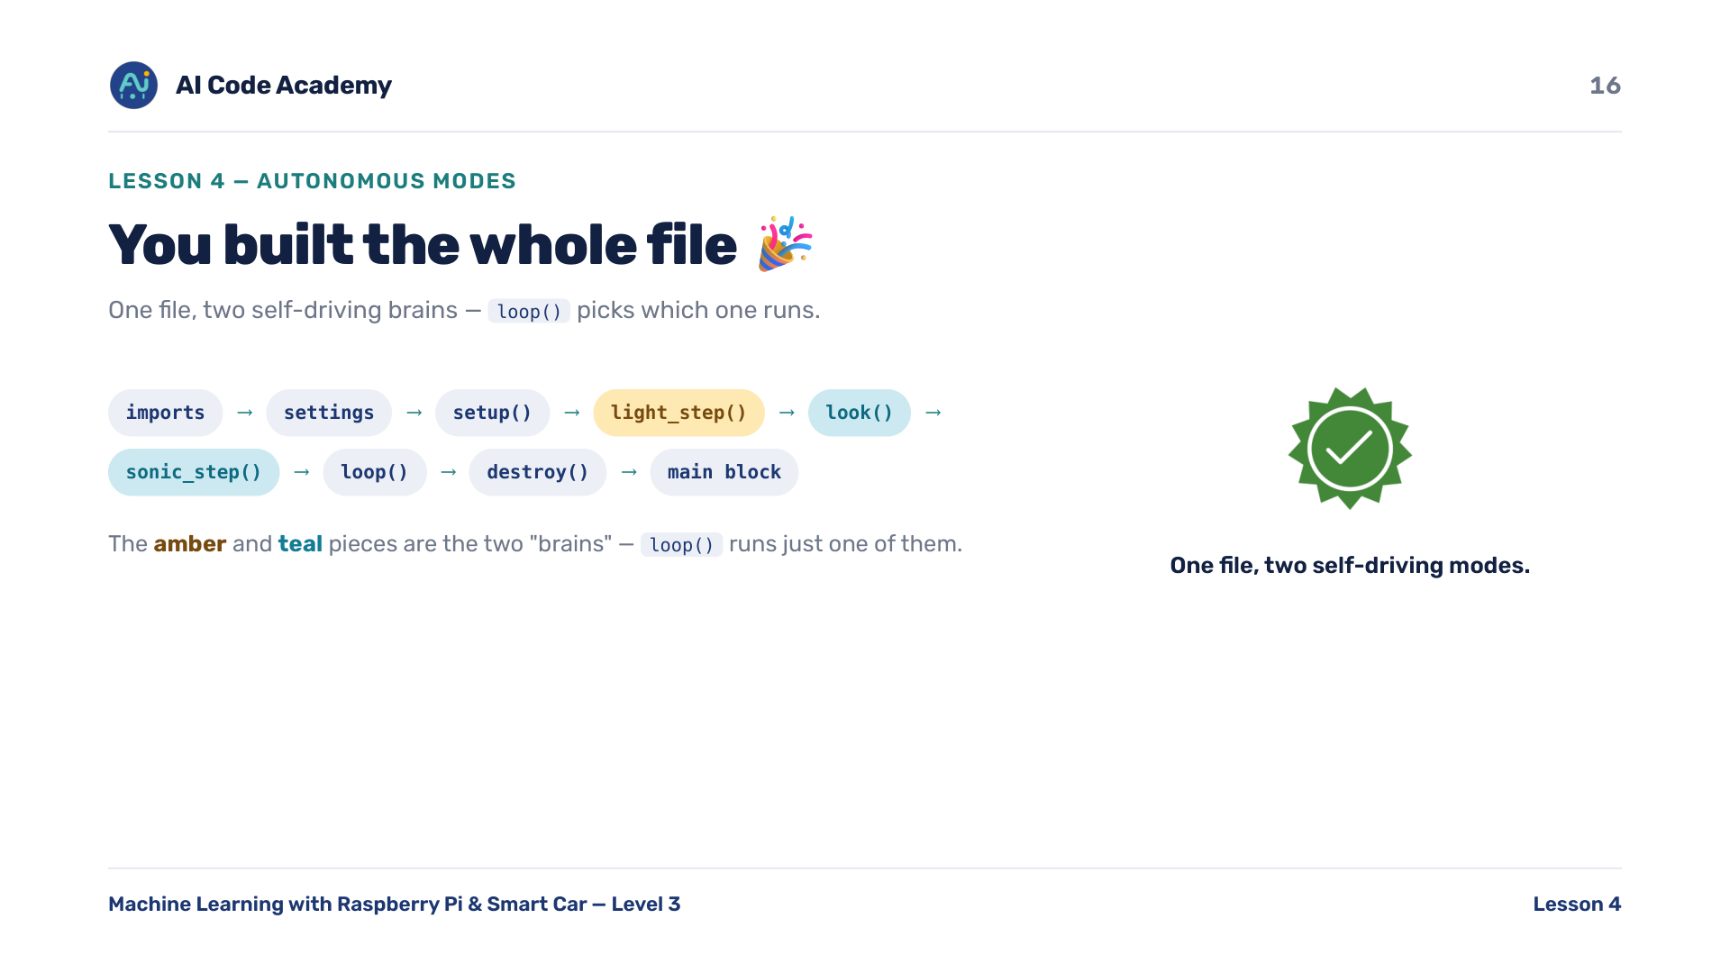
Notes:
Whole file — scroll the assembled file; point out how loop() picks which 'brain' runs. One file, two self-driving modes.

Slide 17
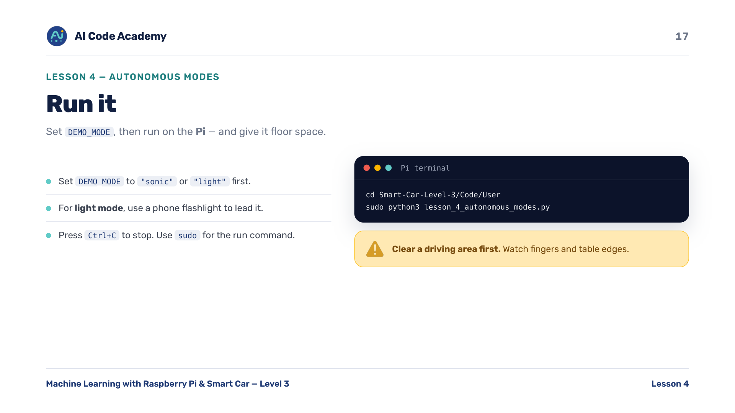
Notes:
Run it — clear a driving area first. Set DEMO_MODE to 'sonic' or 'light'. Give it floor space; for light mode use a phone flashlight. Run with sudo. Watch fingers and table edges. Ctrl+C to stop.

Slide 18
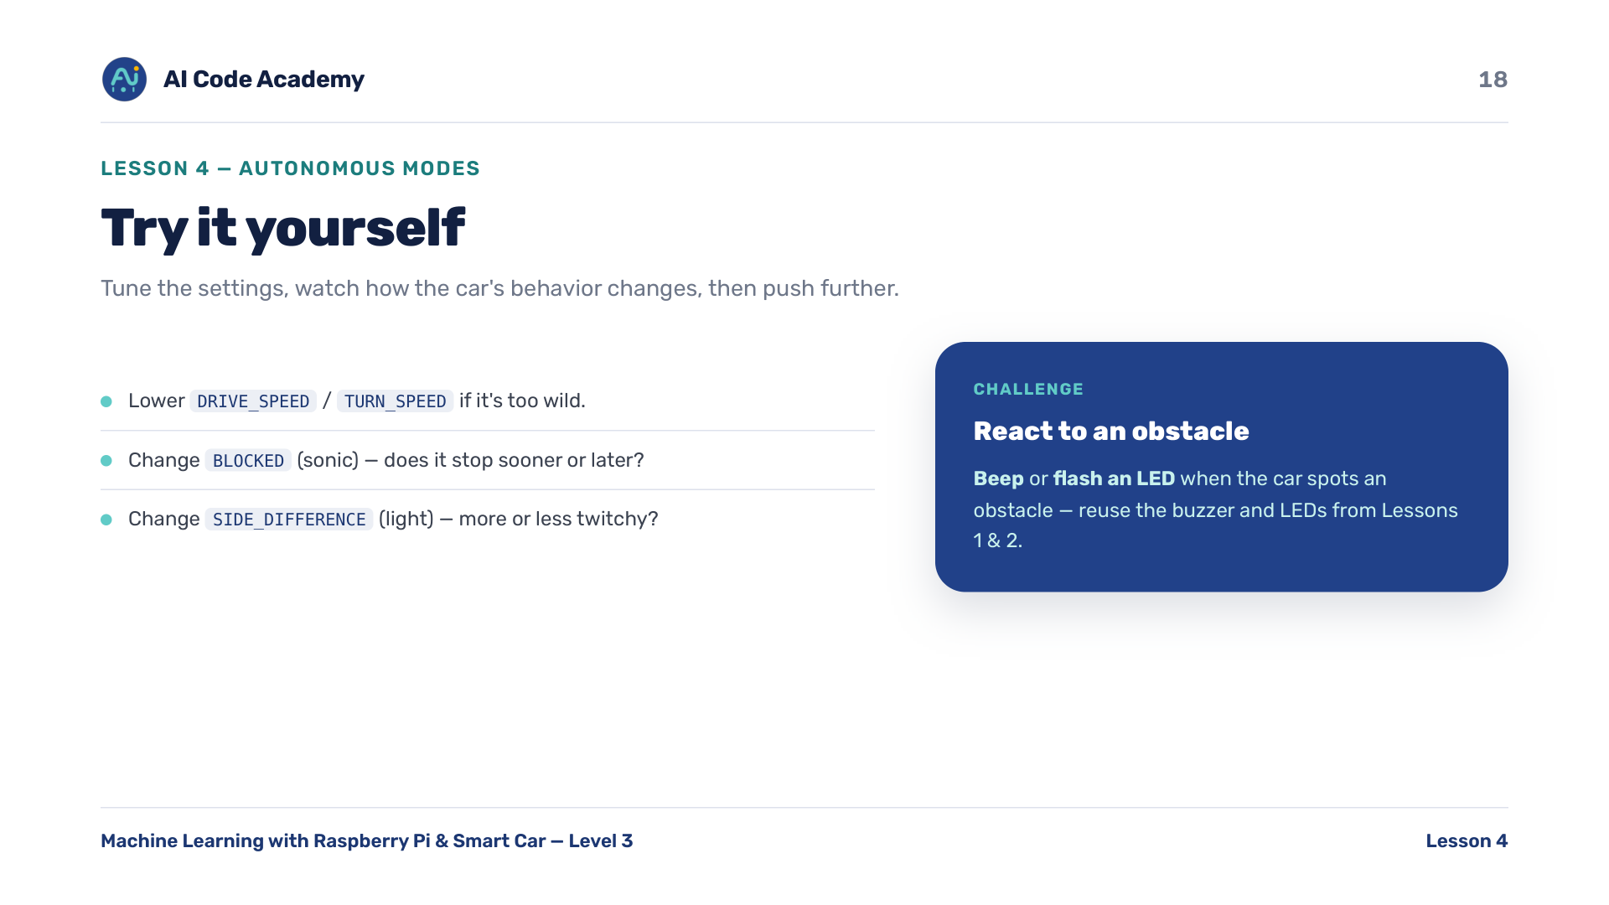
Notes:
Try it yourself — the LED/beep challenge connects back to Lessons 1 & 2; great for fast finishers. Lower speeds if it's too wild; tweak BLOCKED and SIDE_DIFFERENCE.

Slide 19
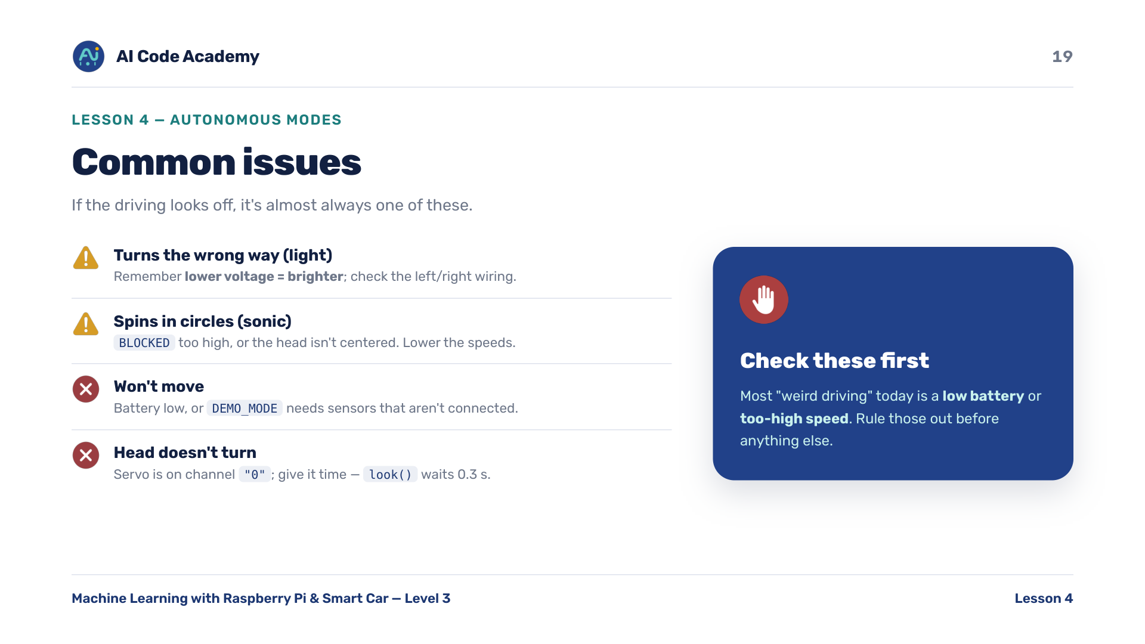
Notes:
Troubleshooting — most 'weird driving' today is low battery or too-high speed. Check those first. Light mode wrong way = remember lower voltage = brighter; check wiring.

Slide 20
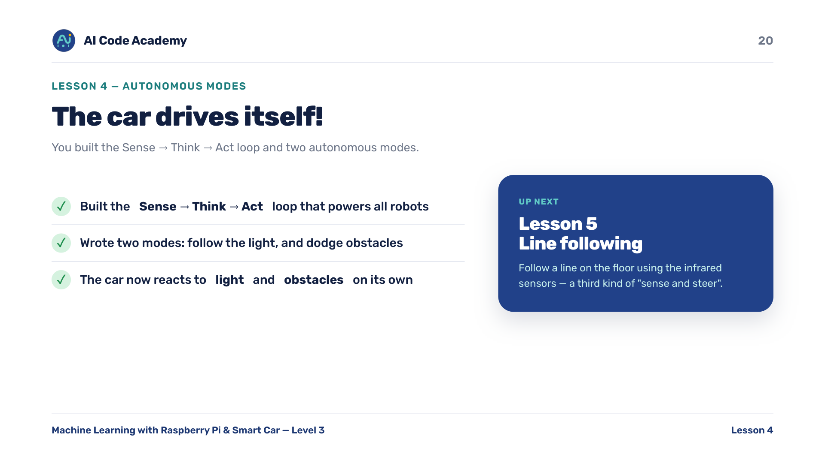
Notes:
Recap — celebrate the Sense -> Think -> Act loop and two autonomous modes. Tease Lesson 5: line following, a third kind of 'sense and steer' using the infrared sensors.

Slide 21
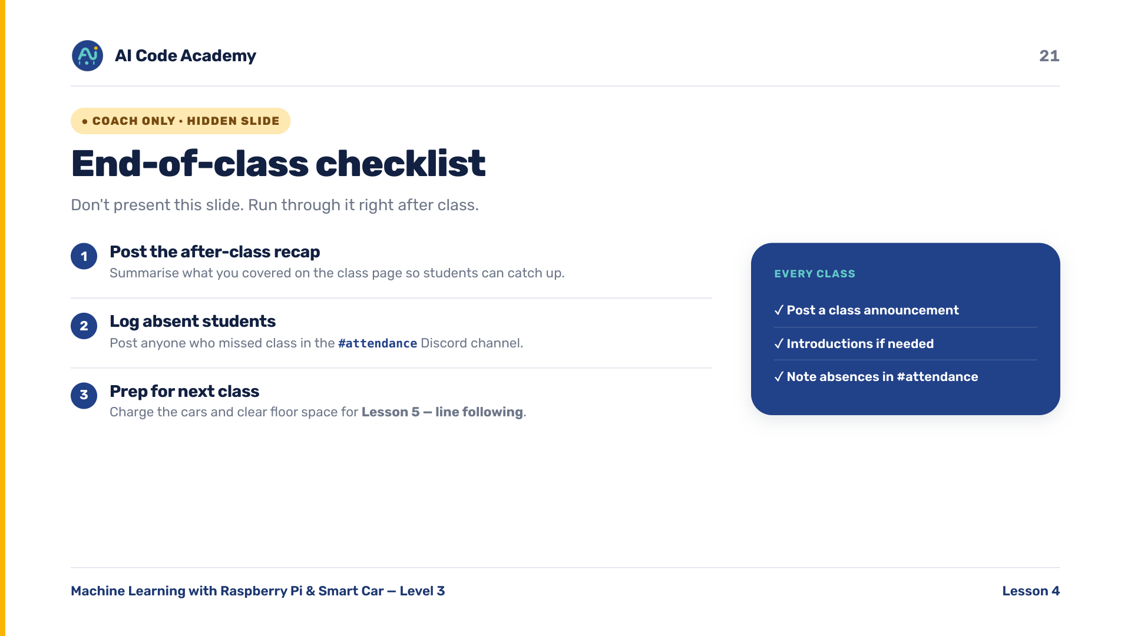
Notes:
COACH (hidden) — do not present. After class: post the recap, log absent students in the Discord #attendance channel. Before next class charge the cars and clear floor space for Lesson 5.

