Slide 1
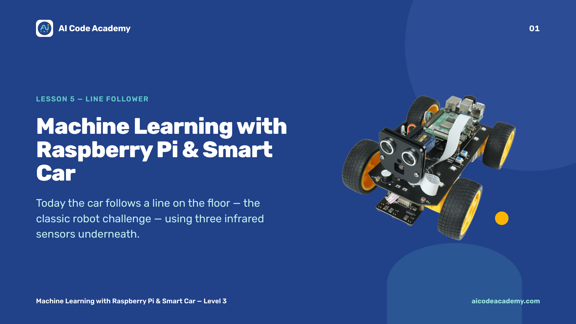
Notes:
Title — ~1 min. Today the car follows a line on the floor. Have a line track (black tape on a light floor) ready to demo. Run the lesson command with sudo. Site: https://aicodeacademy.com

Slide 2
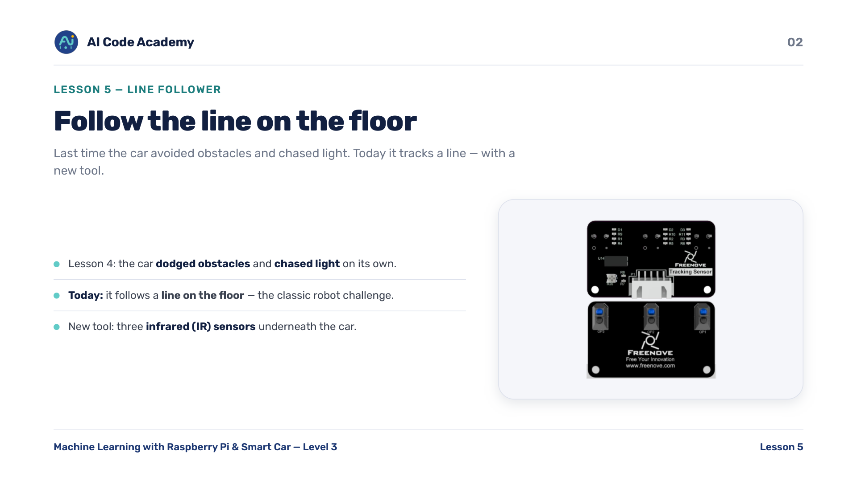
Notes:
Introduction — last lesson the car avoided obstacles and chased light. Today it follows a line, the classic robot challenge. New tool: three infrared (IR) sensors underneath the car. Show the underside so students see the three sensors.

Slide 3
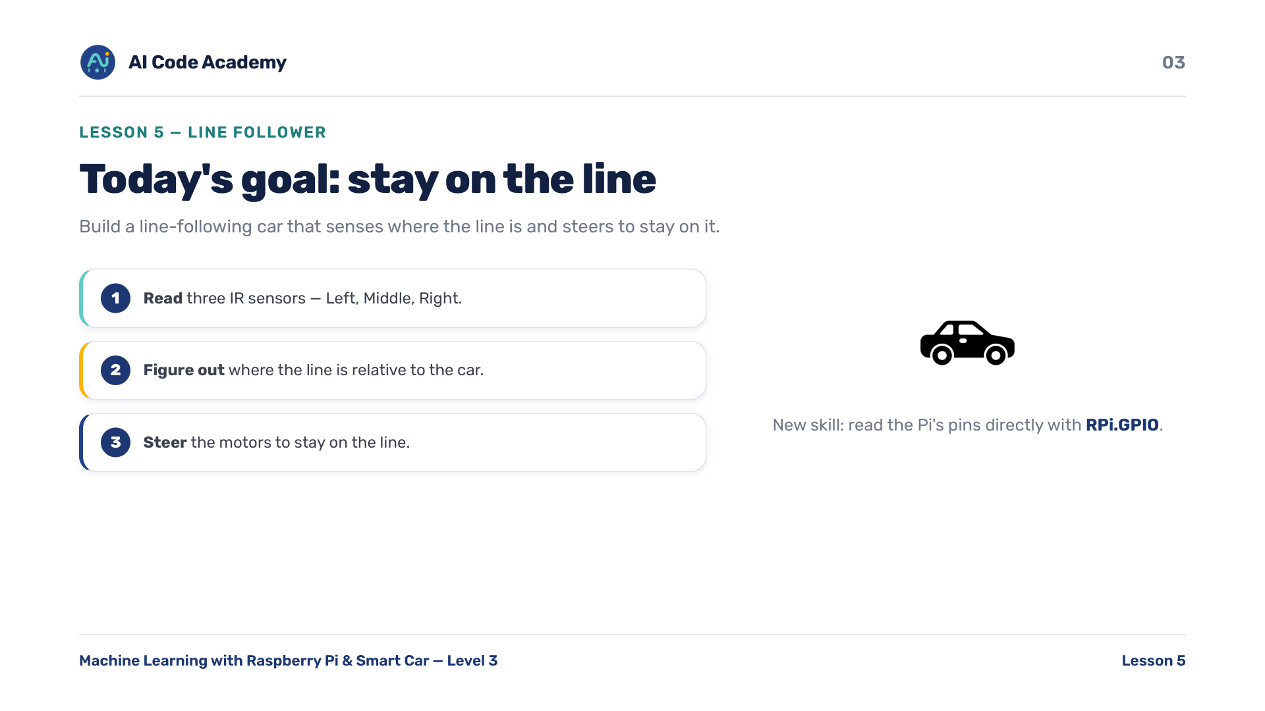
Notes:
Goals — set the goal: smooth following around a loop of tape. Three IR sensors (Left, Middle, Right) decide where the line is and how to steer. New skill: reading the Pi's pins directly with RPi.GPIO.

Slide 4
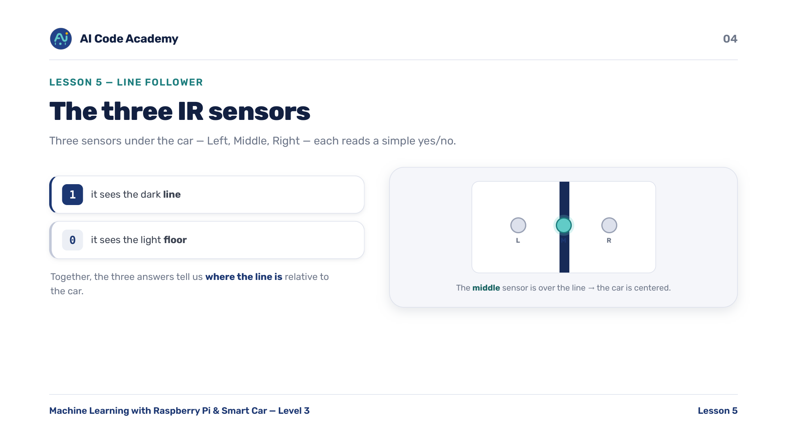
Notes:
The three IR sensors — each reads a simple yes/no: 1 = sees the dark line, 0 = sees the light floor. Together they tell us where the line is. Demo by hand: slide the car so only the middle/left/right sensor is over the tape.

Slide 5
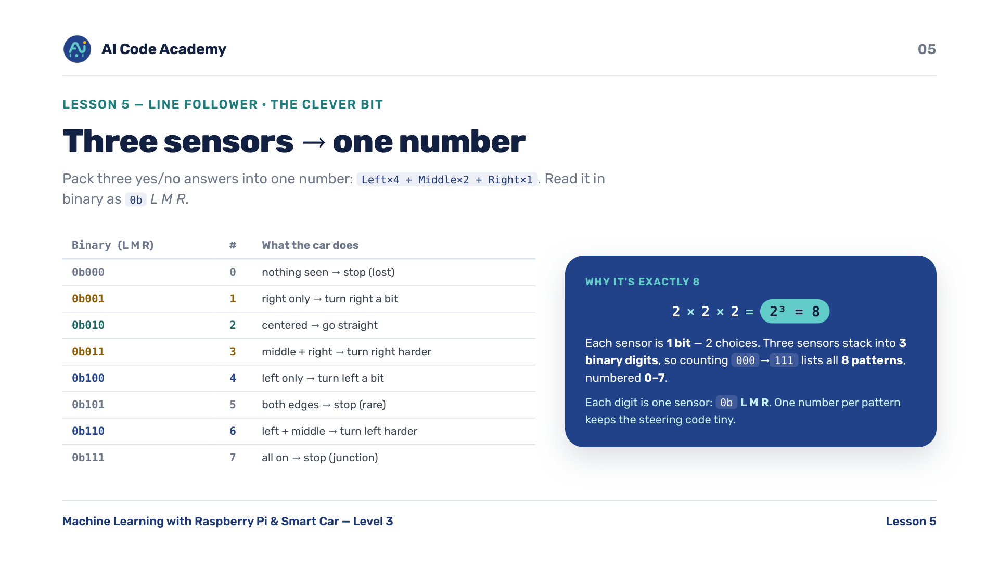
Notes:
Three sensors -> one number — the clever bit. Pack three yes/no answers into one number: Left x4 + Middle x2 + Right x1. Read it in binary as L M R. Spend a minute here; it makes the code tiny.

Slide 6
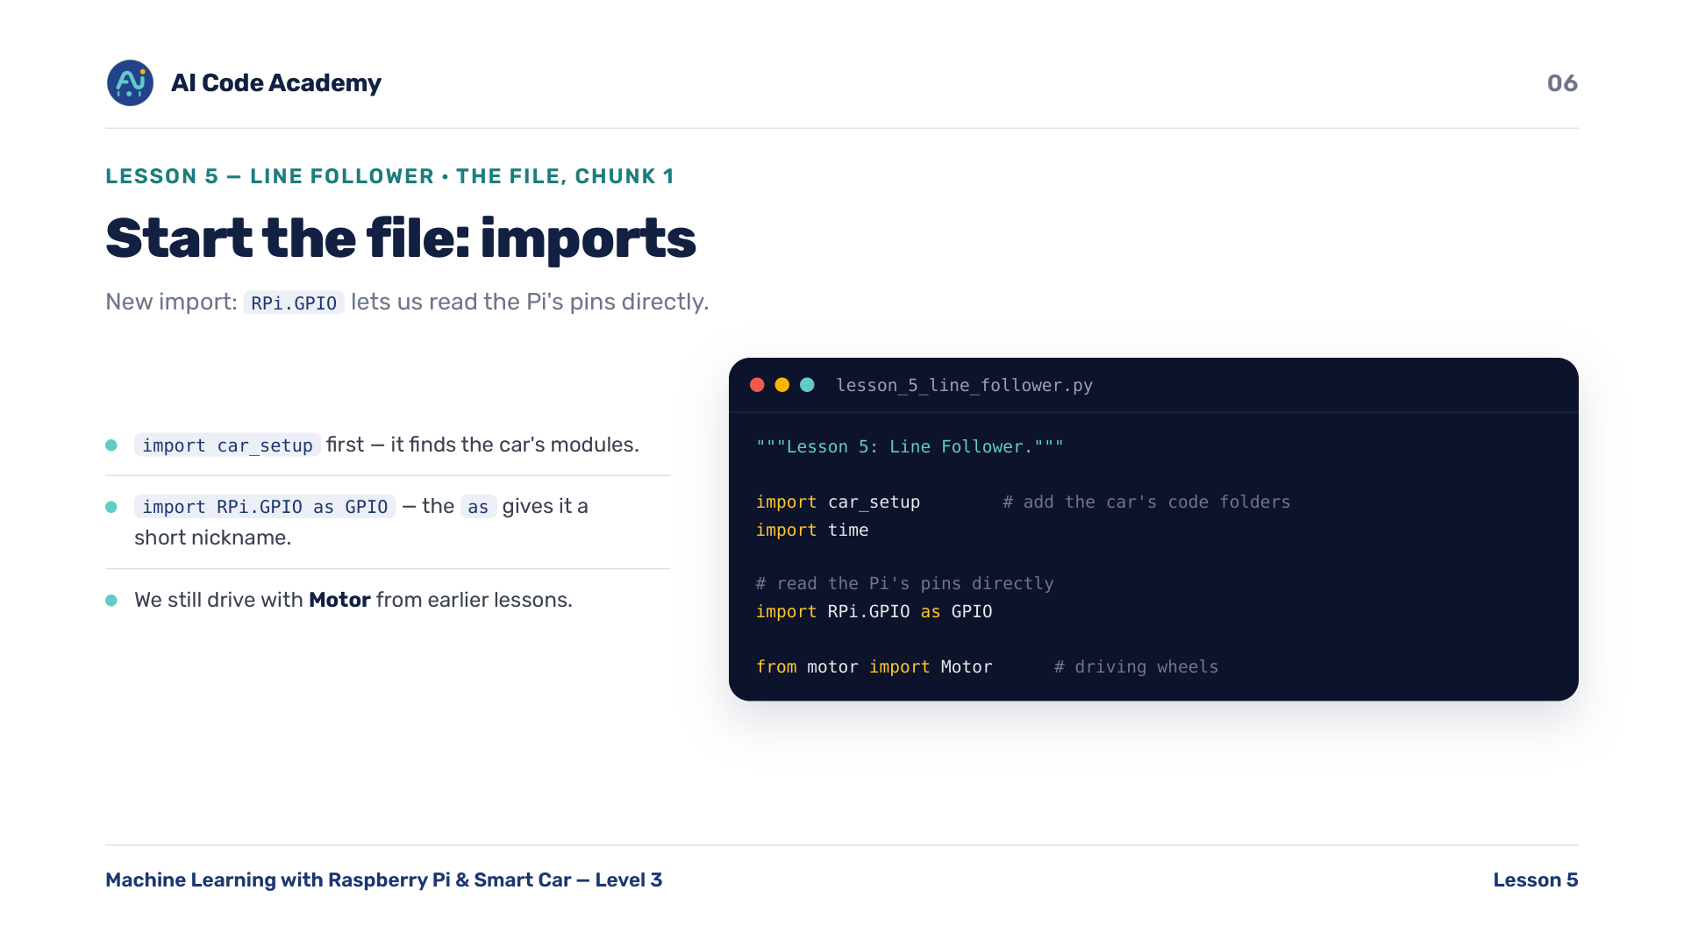
Notes:
Imports (chunk 1/9) — new import: RPi.GPIO lets us read the Pi's pins directly. 'import RPi.GPIO as GPIO' — the 'as' gives it a short nickname. We still drive with Motor from earlier lessons.

Slide 7
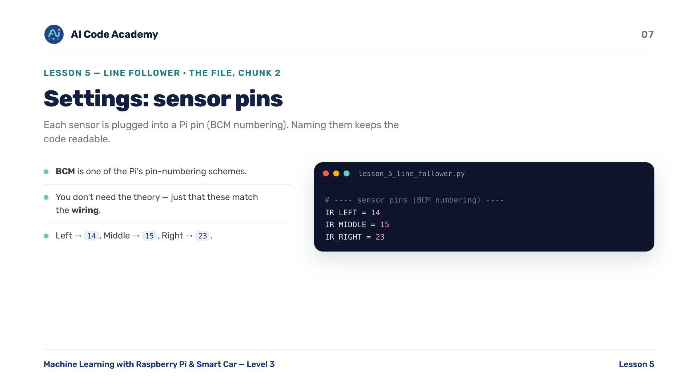
Notes:
Sensor pins (chunk 2/9) — each sensor plugs into a Pi pin in BCM numbering. BCM is one of the Pi's pin-numbering schemes; students just need that these match the wiring: 14, 15, 23.

Slide 8
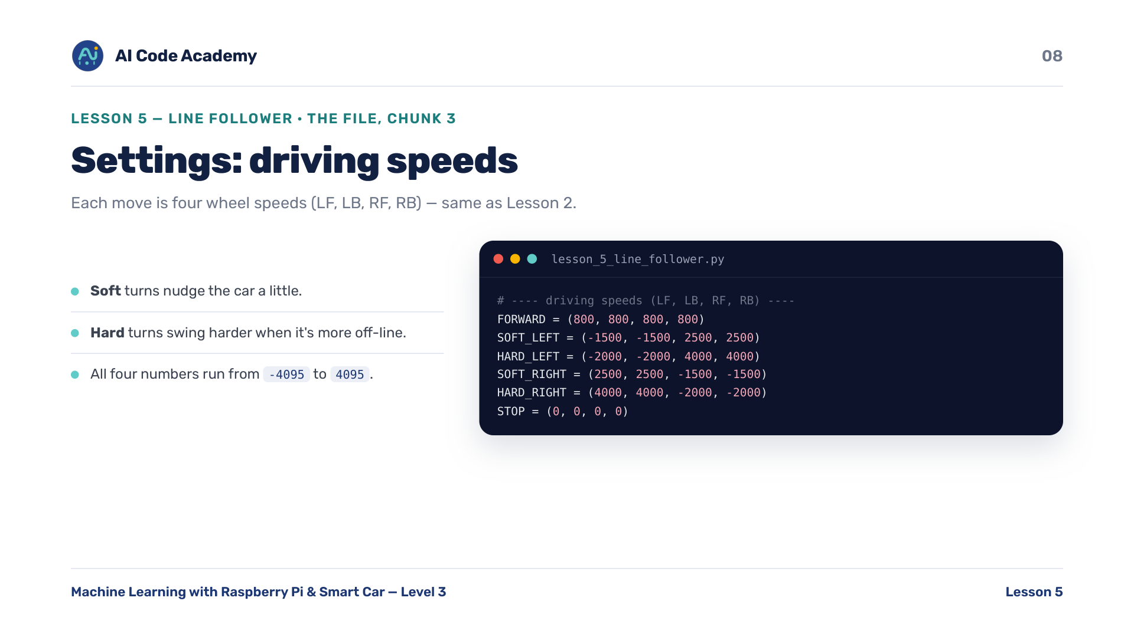
Notes:
Driving speeds (chunk 3/9) — each move is four wheel speeds (LF, LB, RF, RB), same as Lesson 2. Soft turns nudge; hard turns swing harder when the car is more off-line. Tunable in 'try it yourself'.

Slide 9
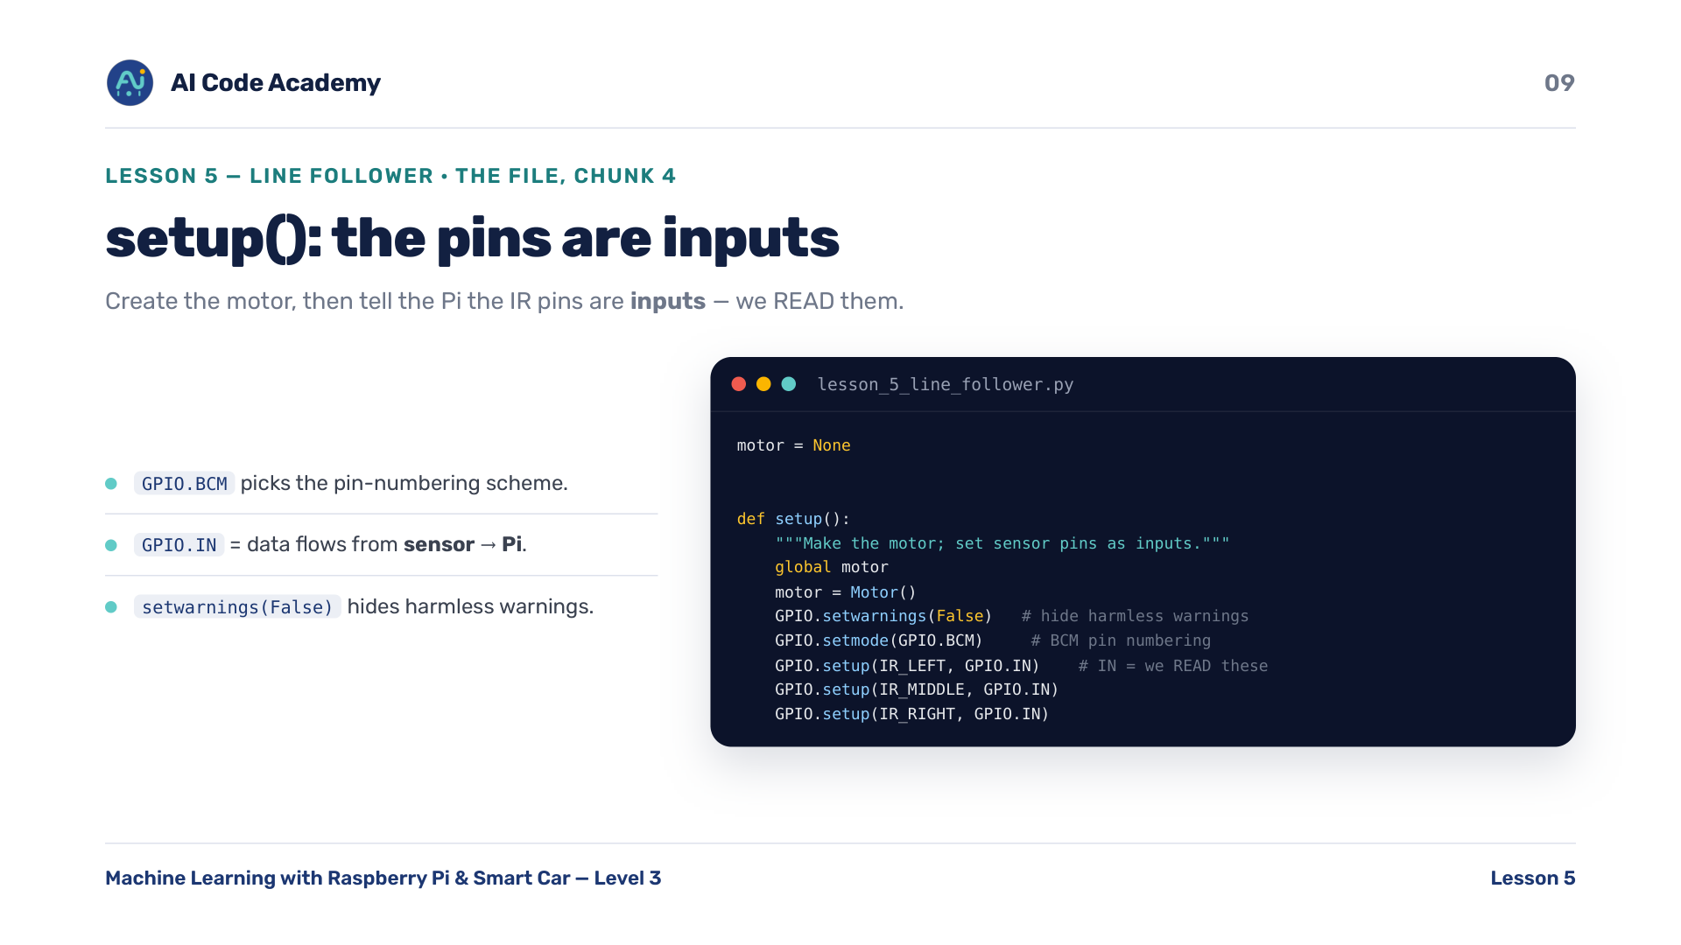
Notes:
setup() (chunk 4/9) — create the motor, then set the IR pins as inputs because we READ them. GPIO.IN = data flows from sensor to Pi. GPIO.BCM picks the pin-numbering scheme. setwarnings(False) hides harmless warnings.

Slide 10
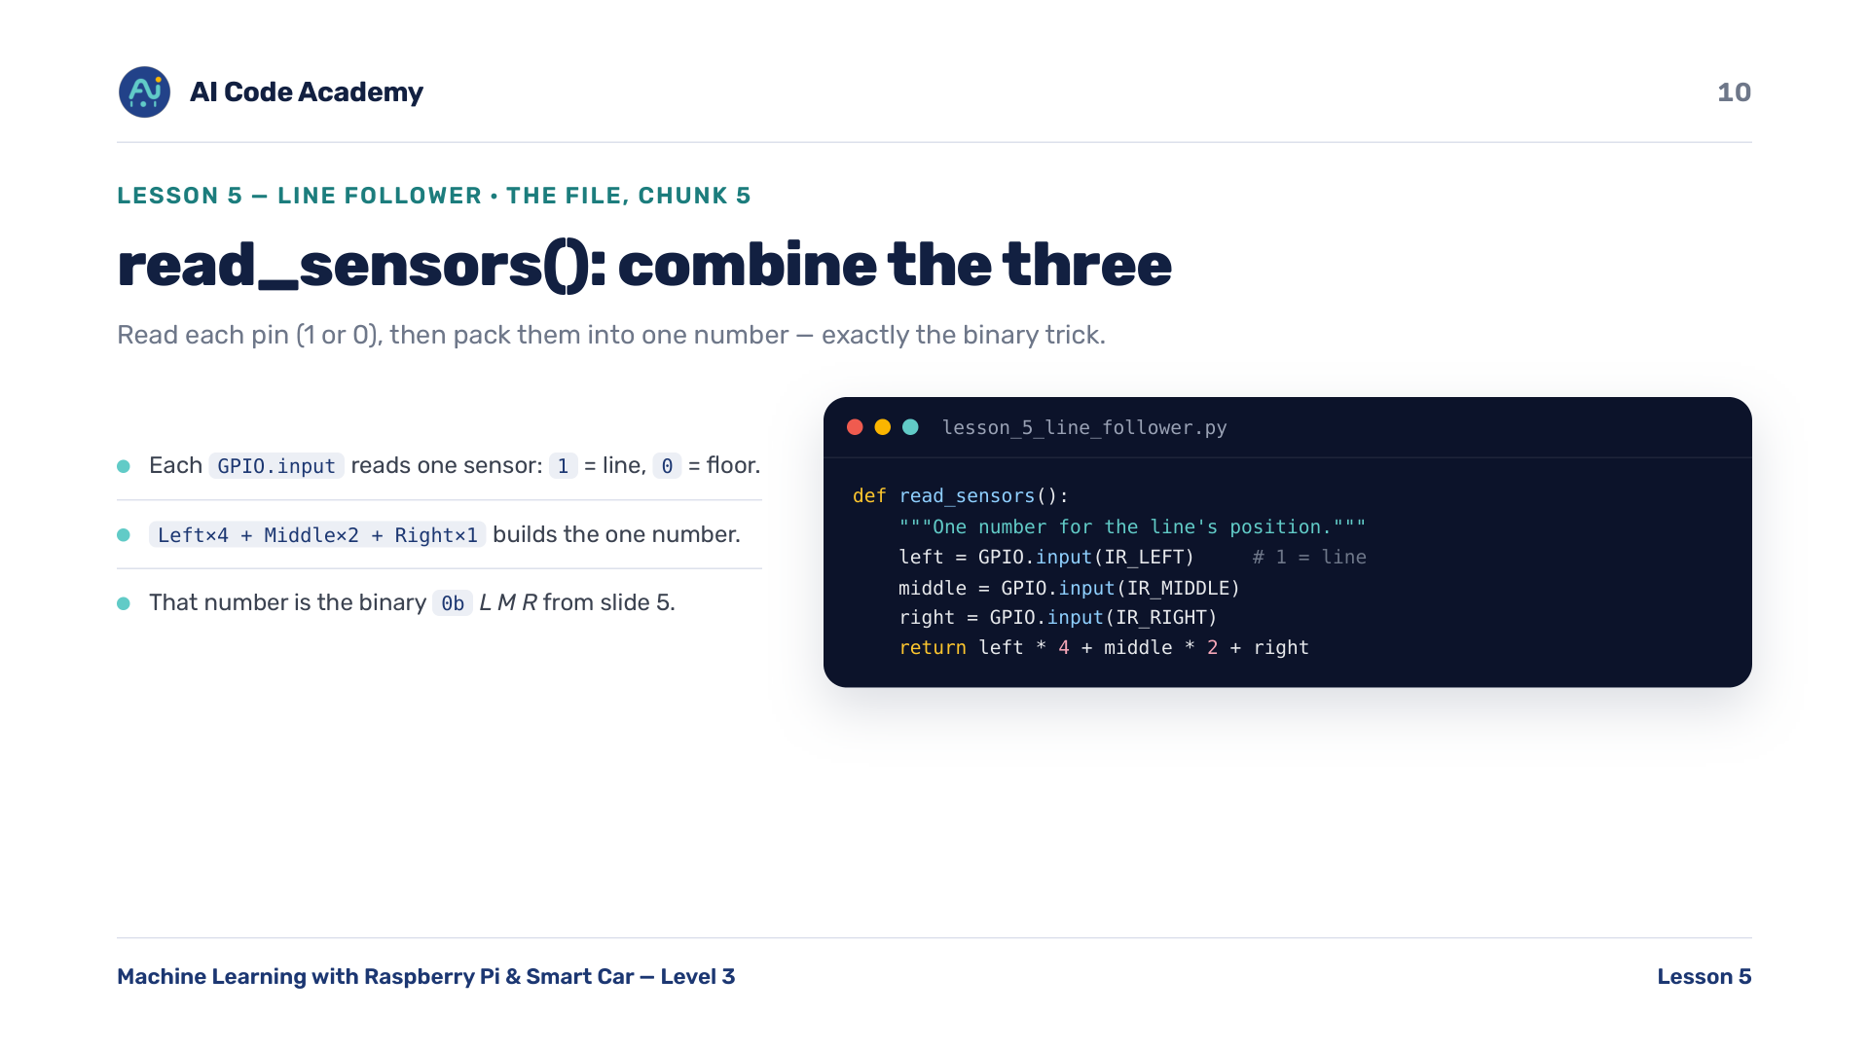
Notes:
read_sensors() (chunk 5/9) — read each pin (1 or 0), then pack them into one number with Left x4 + Middle x2 + Right x1 — exactly the binary trick. Tie each GPIO.input back to a sensor under the car.

Slide 11
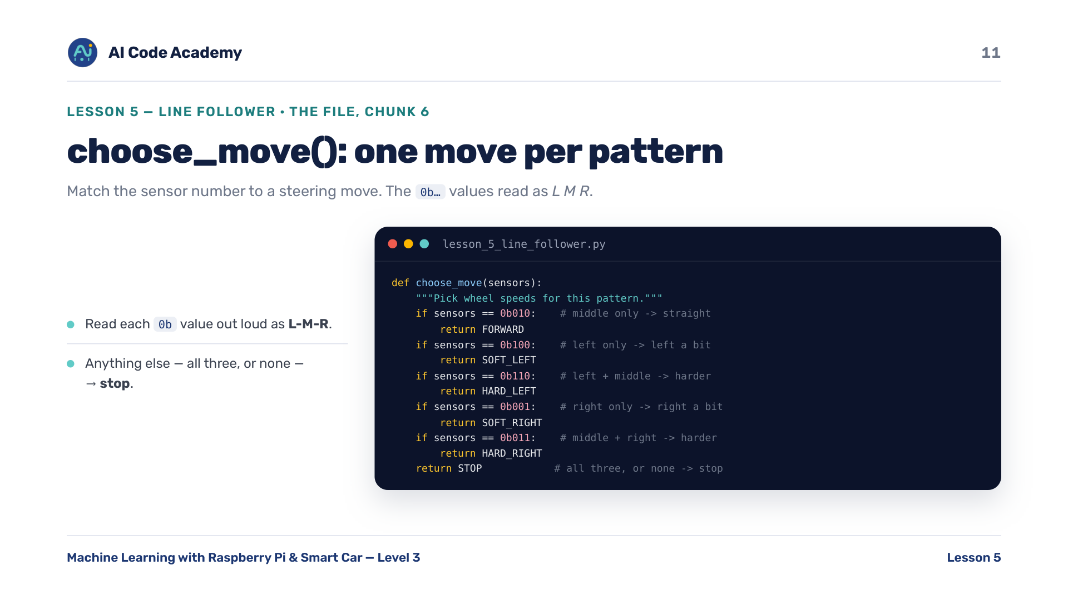
Notes:
choose_move() (chunk 6/9) — match the sensor number to a steering move. Read each 0b value out loud as L-M-R so the pattern clicks. Anything else (all three, or none) -> stop.

Slide 12
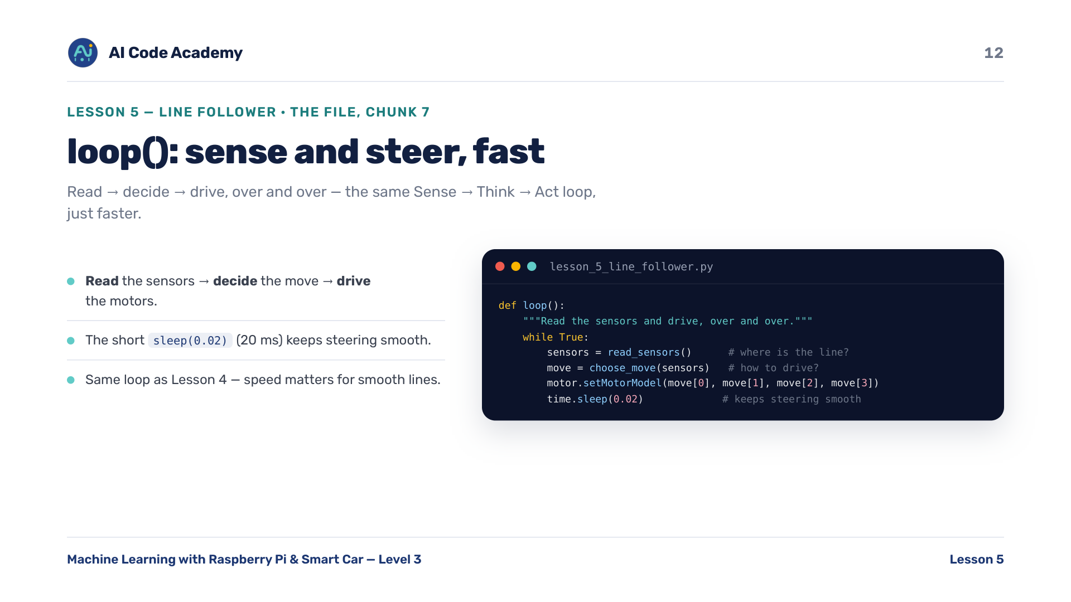
Notes:
loop() (chunk 7/9) — read, decide, drive, over and over, very quickly. Same Sense -> Think -> Act loop as Lesson 4, just faster (20 ms). Speed matters for smooth lines.

Slide 13
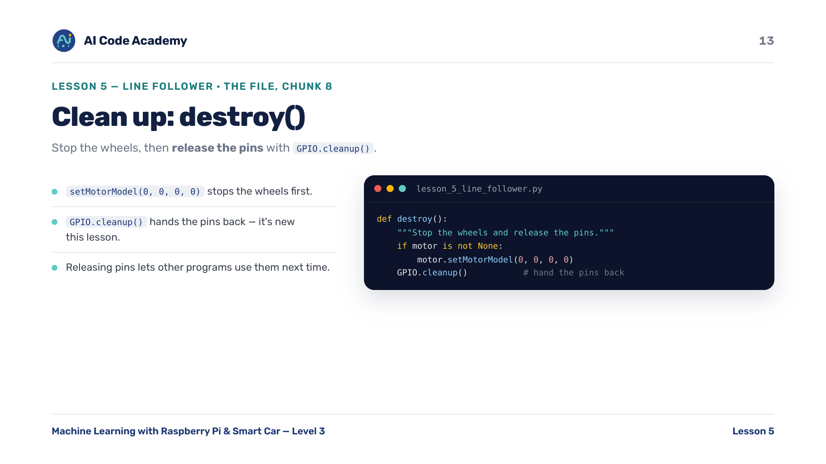
Notes:
destroy() (chunk 8/9) — stop the wheels, then release the pins with GPIO.cleanup(). cleanup() is new — the polite 'I'm done with the pins' step so other programs can use them next time.

Slide 14
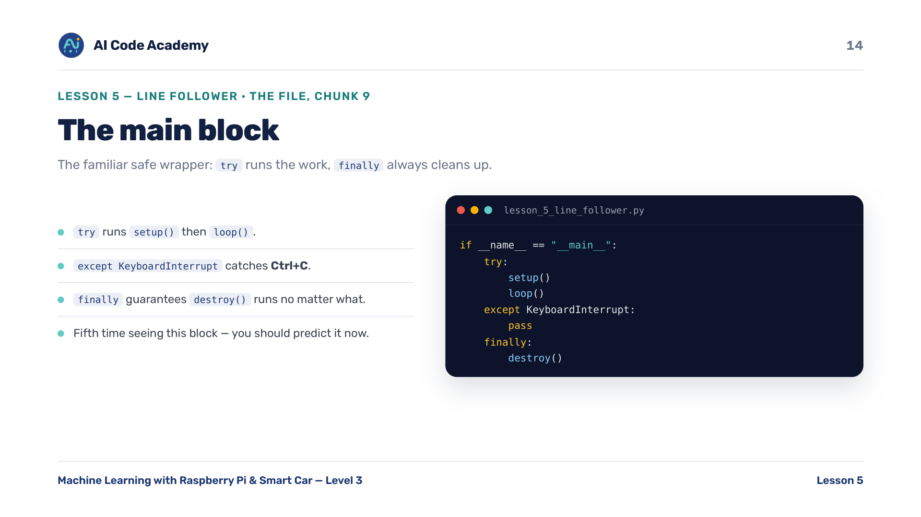
Notes:
Main block (chunk 9/9) — the same safe wrapper: setup, loop, and always destroy(). Students should recognize this instantly by now.

Slide 15
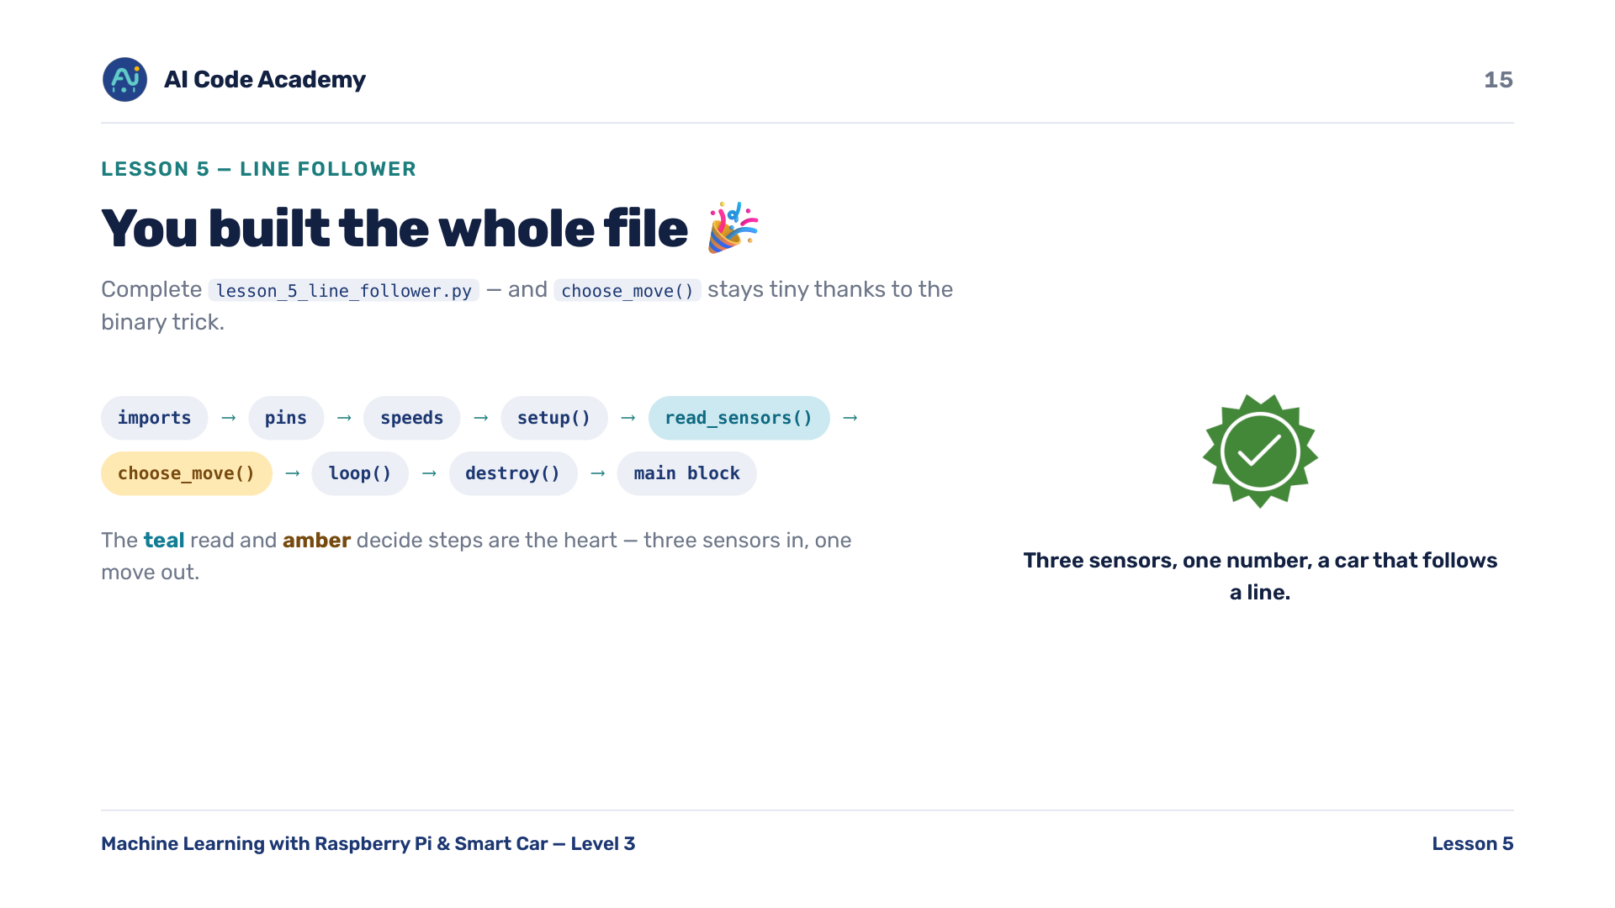
Notes:
Whole file — complete lesson_5_line_follower.py: imports -> pins -> speeds -> setup() -> read_sensors() -> choose_move() -> loop() -> destroy() -> main. Highlight how small choose_move is thanks to the binary trick.

Slide 16
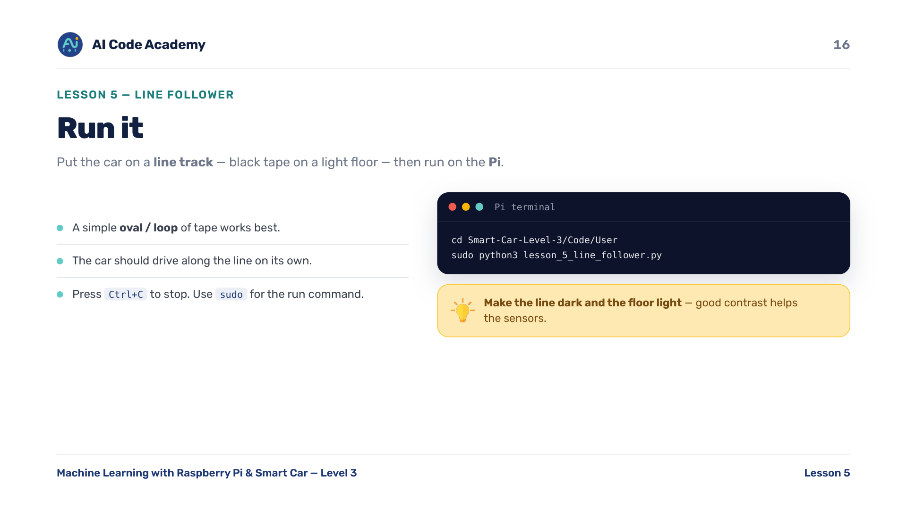
Notes:
Run it — put the car on a line track (black tape on a light floor), then on the Pi: cd Smart-Car-Level-3/Code/User then sudo python3 lesson_5_line_follower.py. A simple oval/loop of tape works best. Ctrl+C to stop.

Slide 17
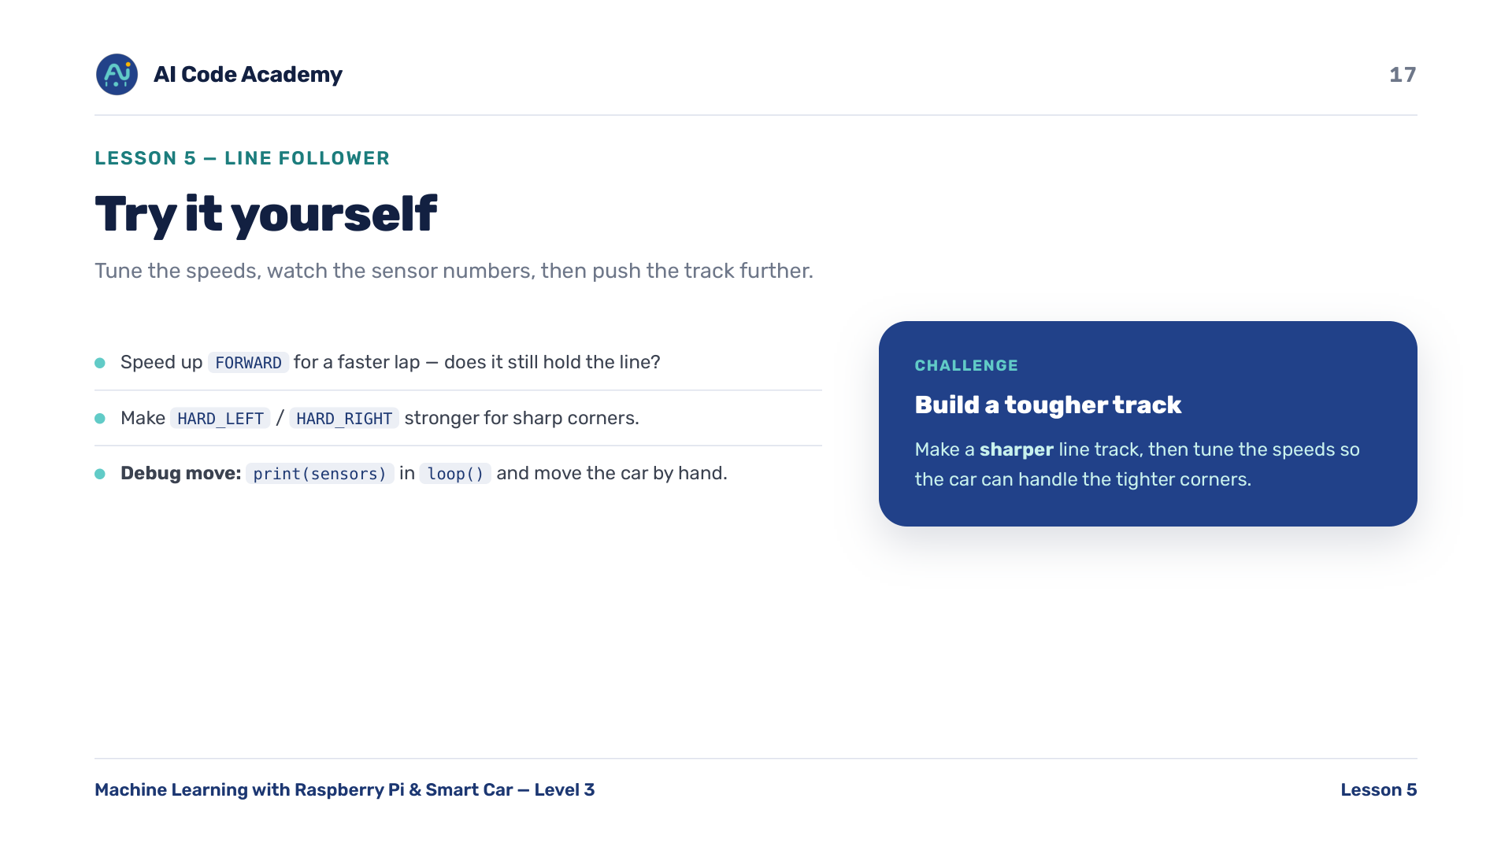
Notes:
Try it yourself — the print(sensors) tip is the best way for students to SEE the binary numbers change as they move the car by hand. Speed up FORWARD for a faster lap; strengthen HARD_LEFT/HARD_RIGHT for sharp corners.

Slide 18
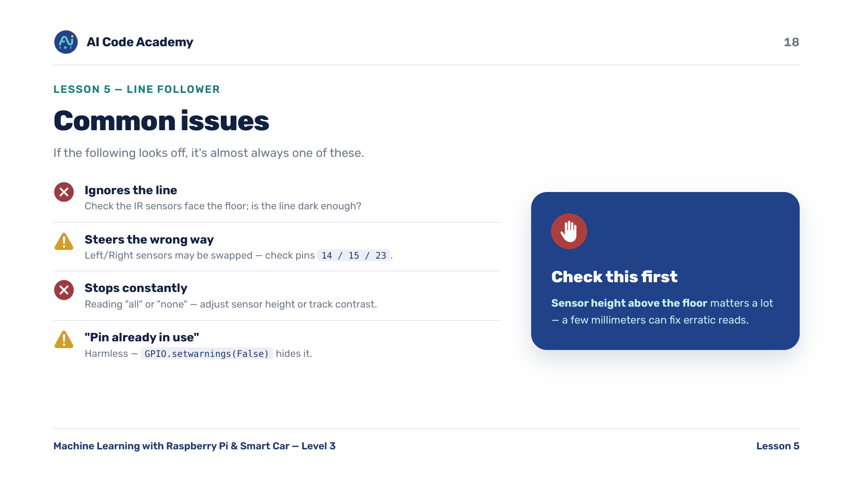
Notes:
Troubleshooting — sensor height above the floor matters a lot; a few millimeters can fix erratic reads. Steers the wrong way -> Left/Right may be swapped; check pins 14 / 15 / 23. 'Pin already in use' is harmless.

Slide 19
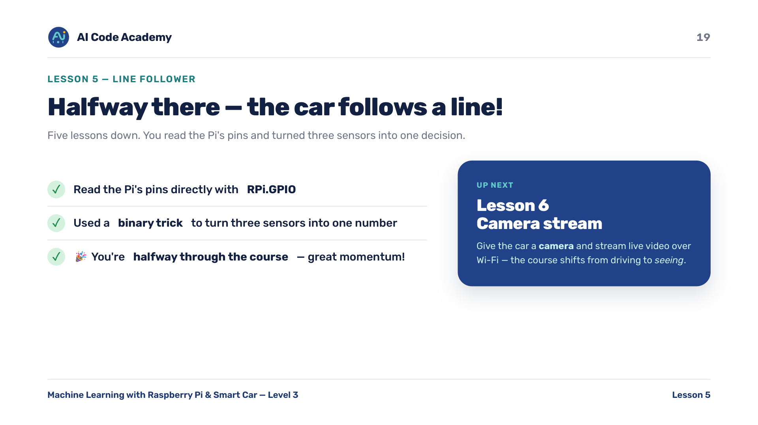
Notes:
Recap — celebrate the halfway milestone: five lessons down. You read the Pi's pins with RPi.GPIO and used a binary trick to turn three sensors into one decision. Next: Lesson 6 gives the car a camera and live video over Wi-Fi.

Slide 20
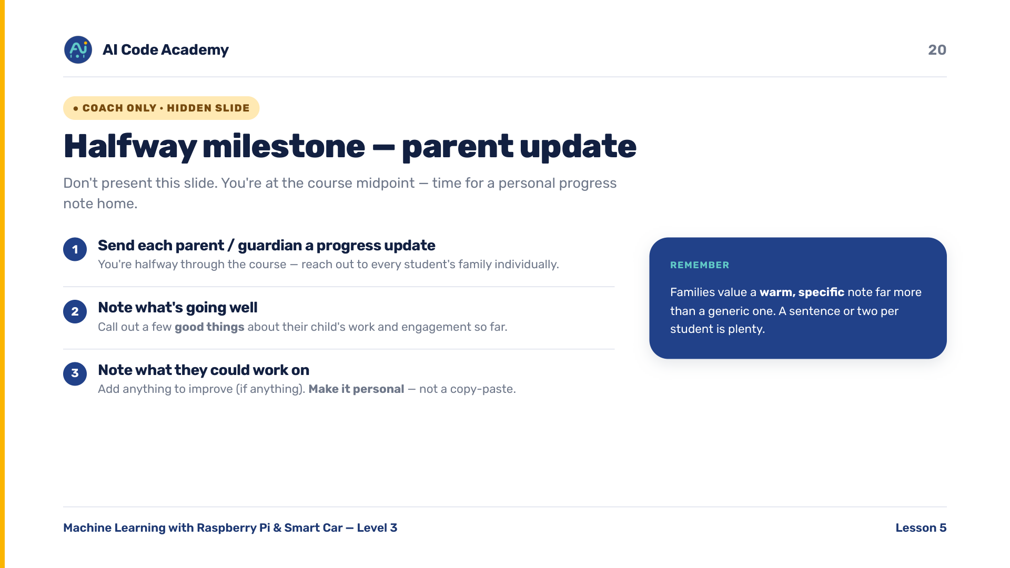
Notes:
COACH (hidden) — do not present. HALFWAY MILESTONE: send each student's parents/guardians a personal progress update — good things about their child and what they could work on. Template lives in your coach resources.

Slide 21
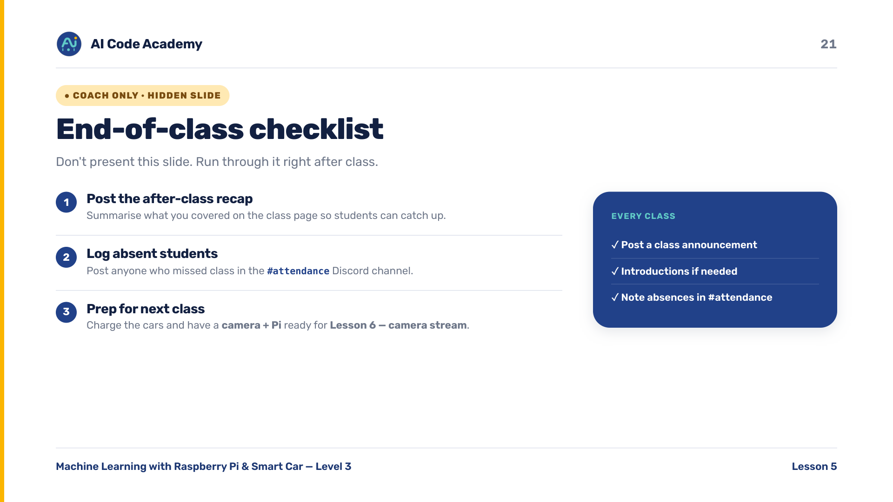
Notes:
COACH (hidden) — do not present. After class: post the recap, log absent students in the Discord #attendance channel. Before next class charge the cars and have a camera/Pi ready for Lesson 6.

