Slide 1
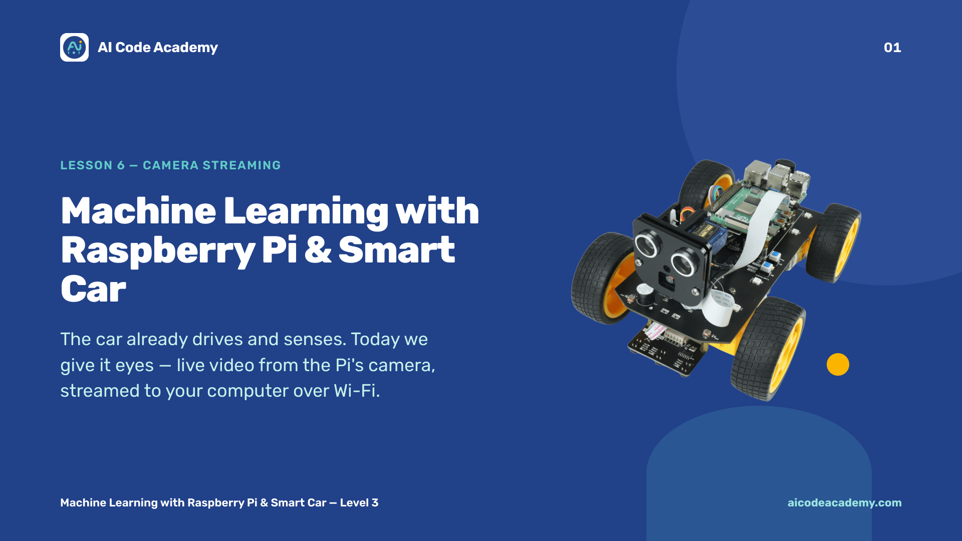
Notes:
Title — ~1 min. So far the car drives and senses; today we give it eyes. Make sure each car's camera module is connected and enabled before class. Site: https://aicodeacademy.com

Slide 2
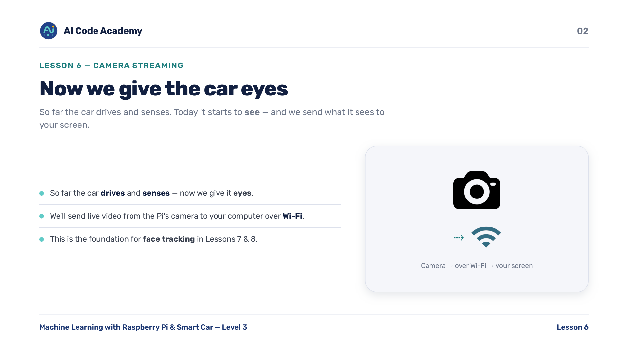
Notes:
Introduction — frame this as the bridge into the machine-learning / vision half of the course. We send live video from the Pi's camera to a computer over Wi-Fi. This is the foundation for face tracking in Lessons 7 and 8.

Slide 3
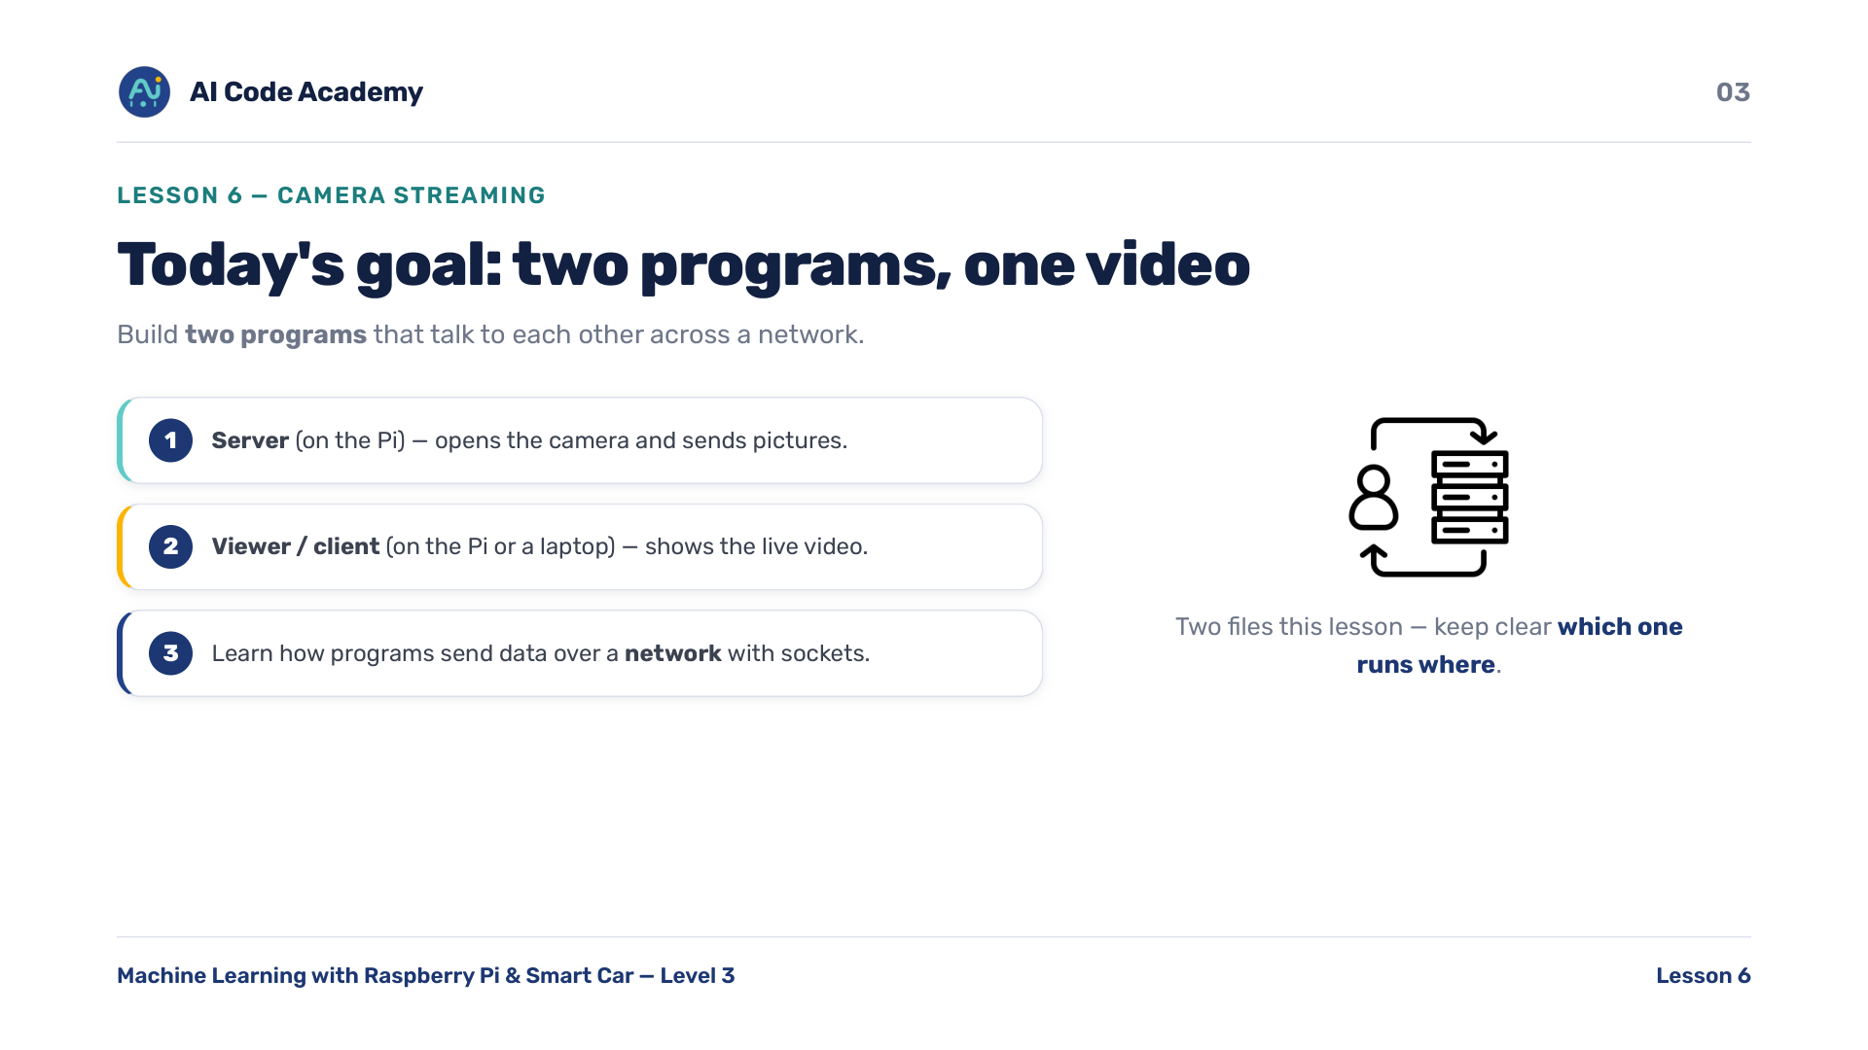
Notes:
Goals — two programs this lesson that talk to each other: a server on the Pi that opens the camera and sends pictures, and a viewer/client on the Pi or a laptop that shows the live video. New idea: programs sending data over a network with sockets. Keep clear which file runs where.

Slide 4
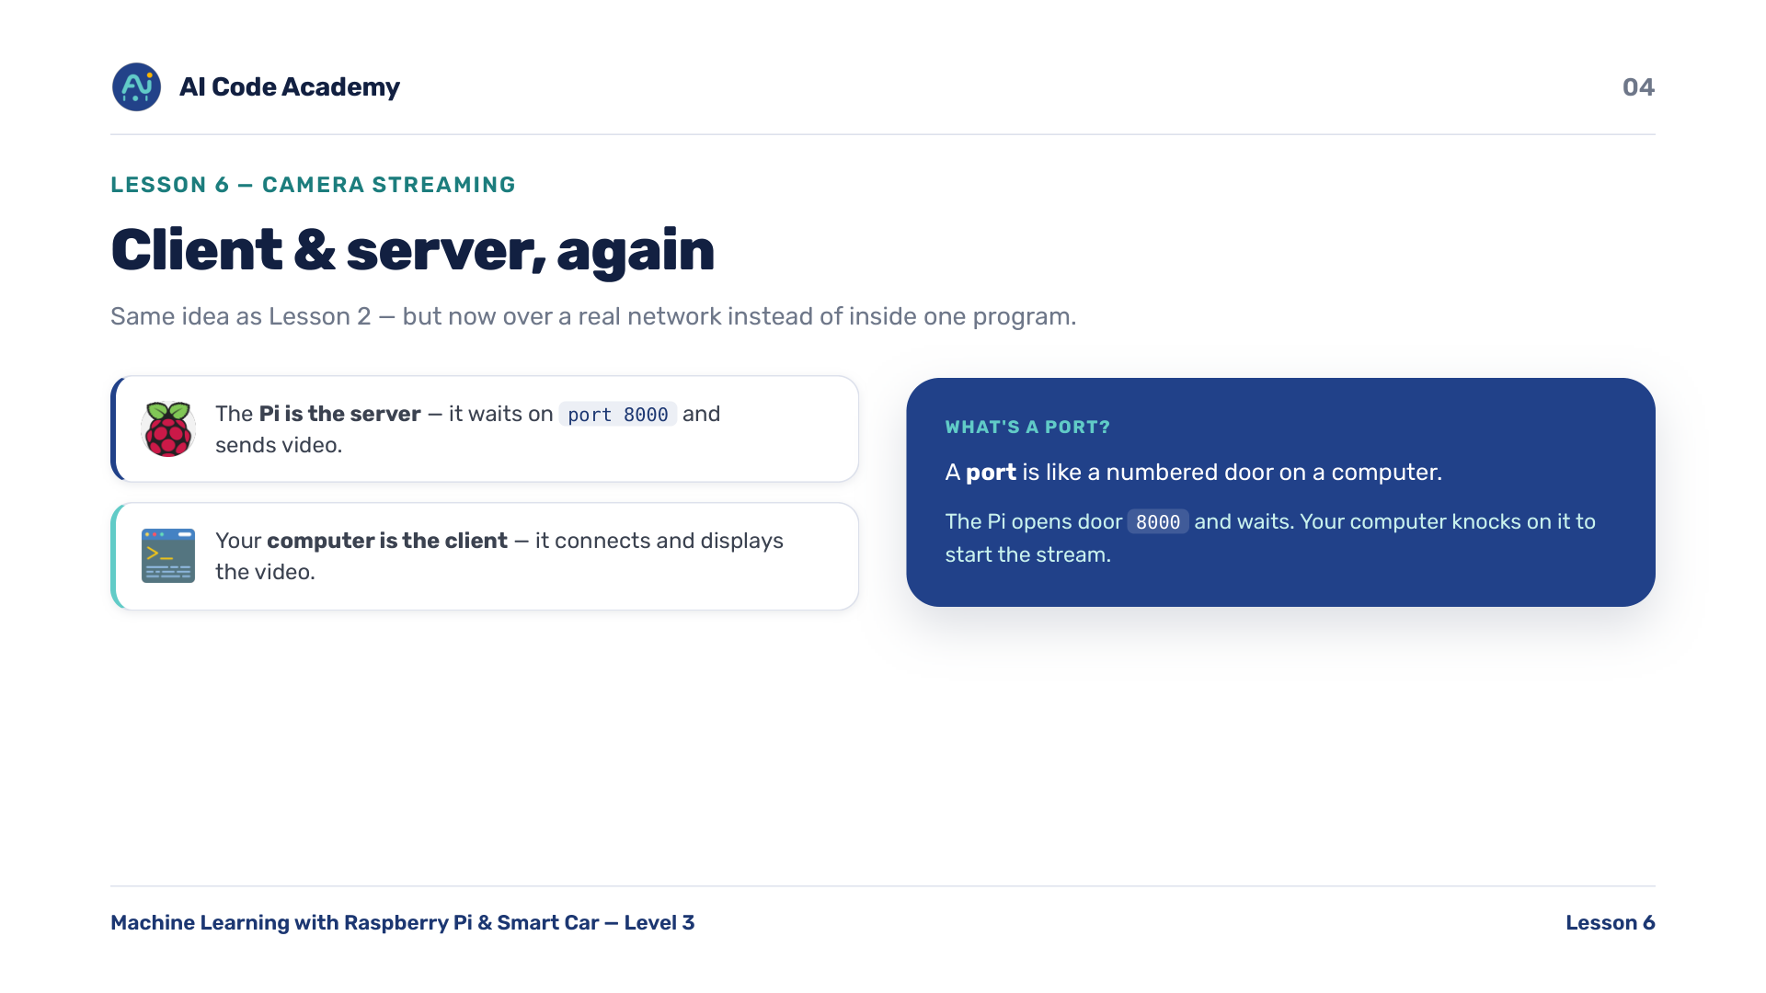
Notes:
Client & server, again — same idea as Lesson 2, but now over a real network. The Pi is the server: it waits on port 8000 and sends video. Your computer is the client: it connects and displays. A port is like a numbered door on a computer. Reuse the customer/kitchen analogy; the order is now a stream of pictures.

Slide 5
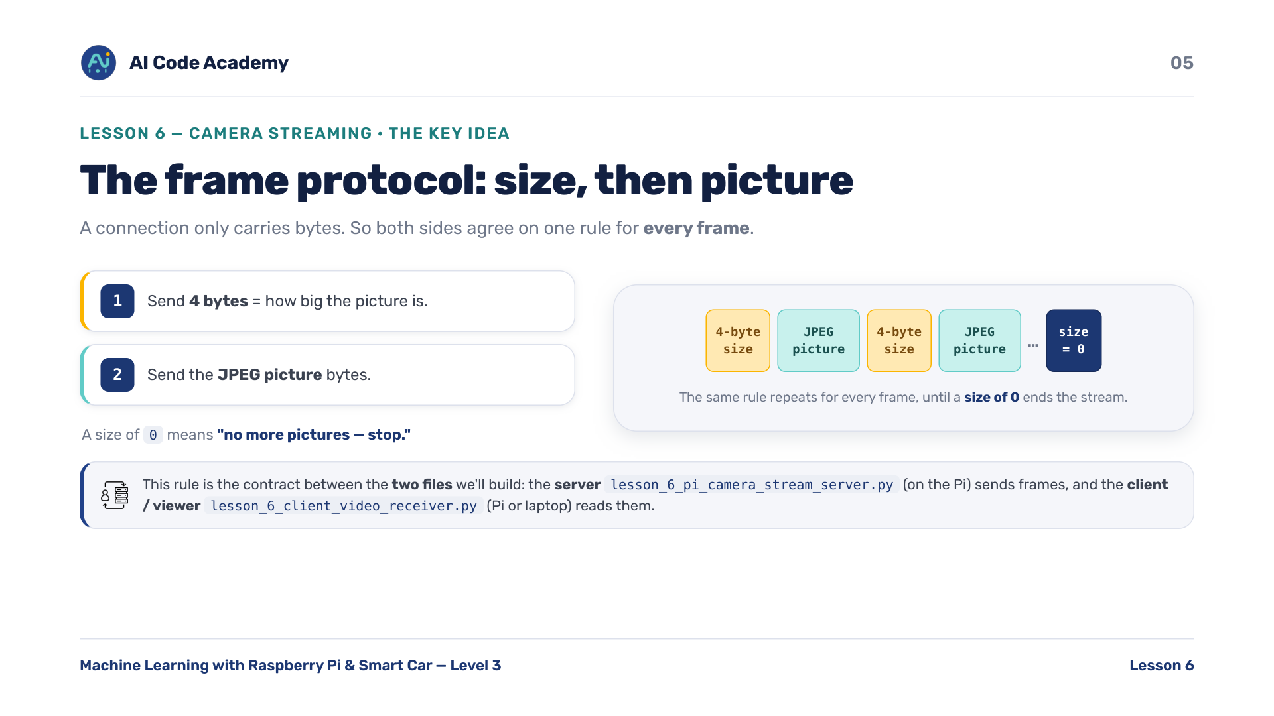
Notes:
The frame protocol — this size-then-data rule is the heart of the lesson. A connection only carries bytes, so for every frame both sides agree: send 4 bytes for the picture size, then the JPEG picture bytes. A size of 0 means no more pictures, stop. The viewer reads it back the exact same way. It's the contract between the two files we'll build: the server lesson_6_pi_camera_stream_server.py on the Pi sends frames, and the client/viewer lesson_6_client_video_receiver.py (Pi or laptop) reads them.

Slide 6
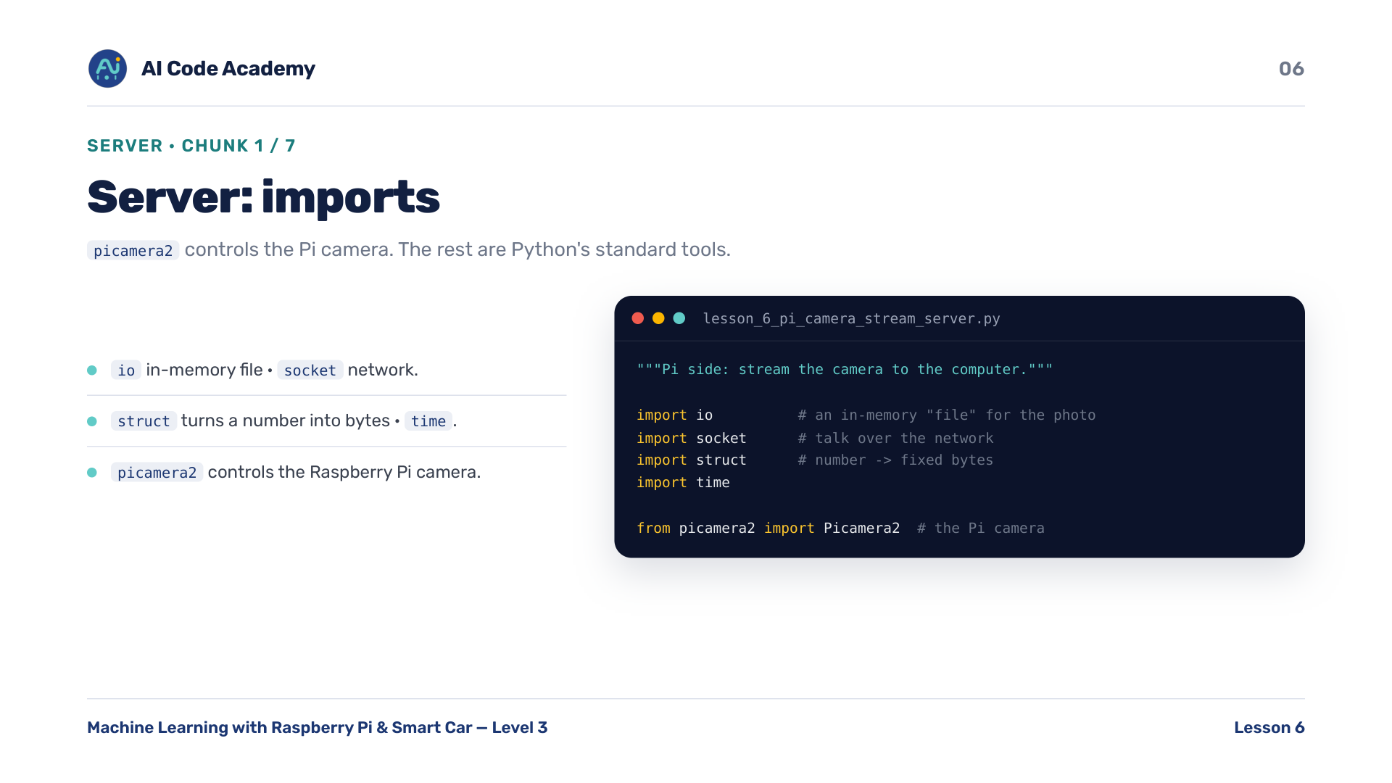
Notes:
Server imports (chunk A1/7) — io is an in-memory file, socket is the network, struct turns a number into a fixed set of bytes, time for the warm-up. picamera2 controls the Pi camera. No car_setup here: this file uses only standard libraries plus the camera, not the motor/sensor modules.

Slide 7
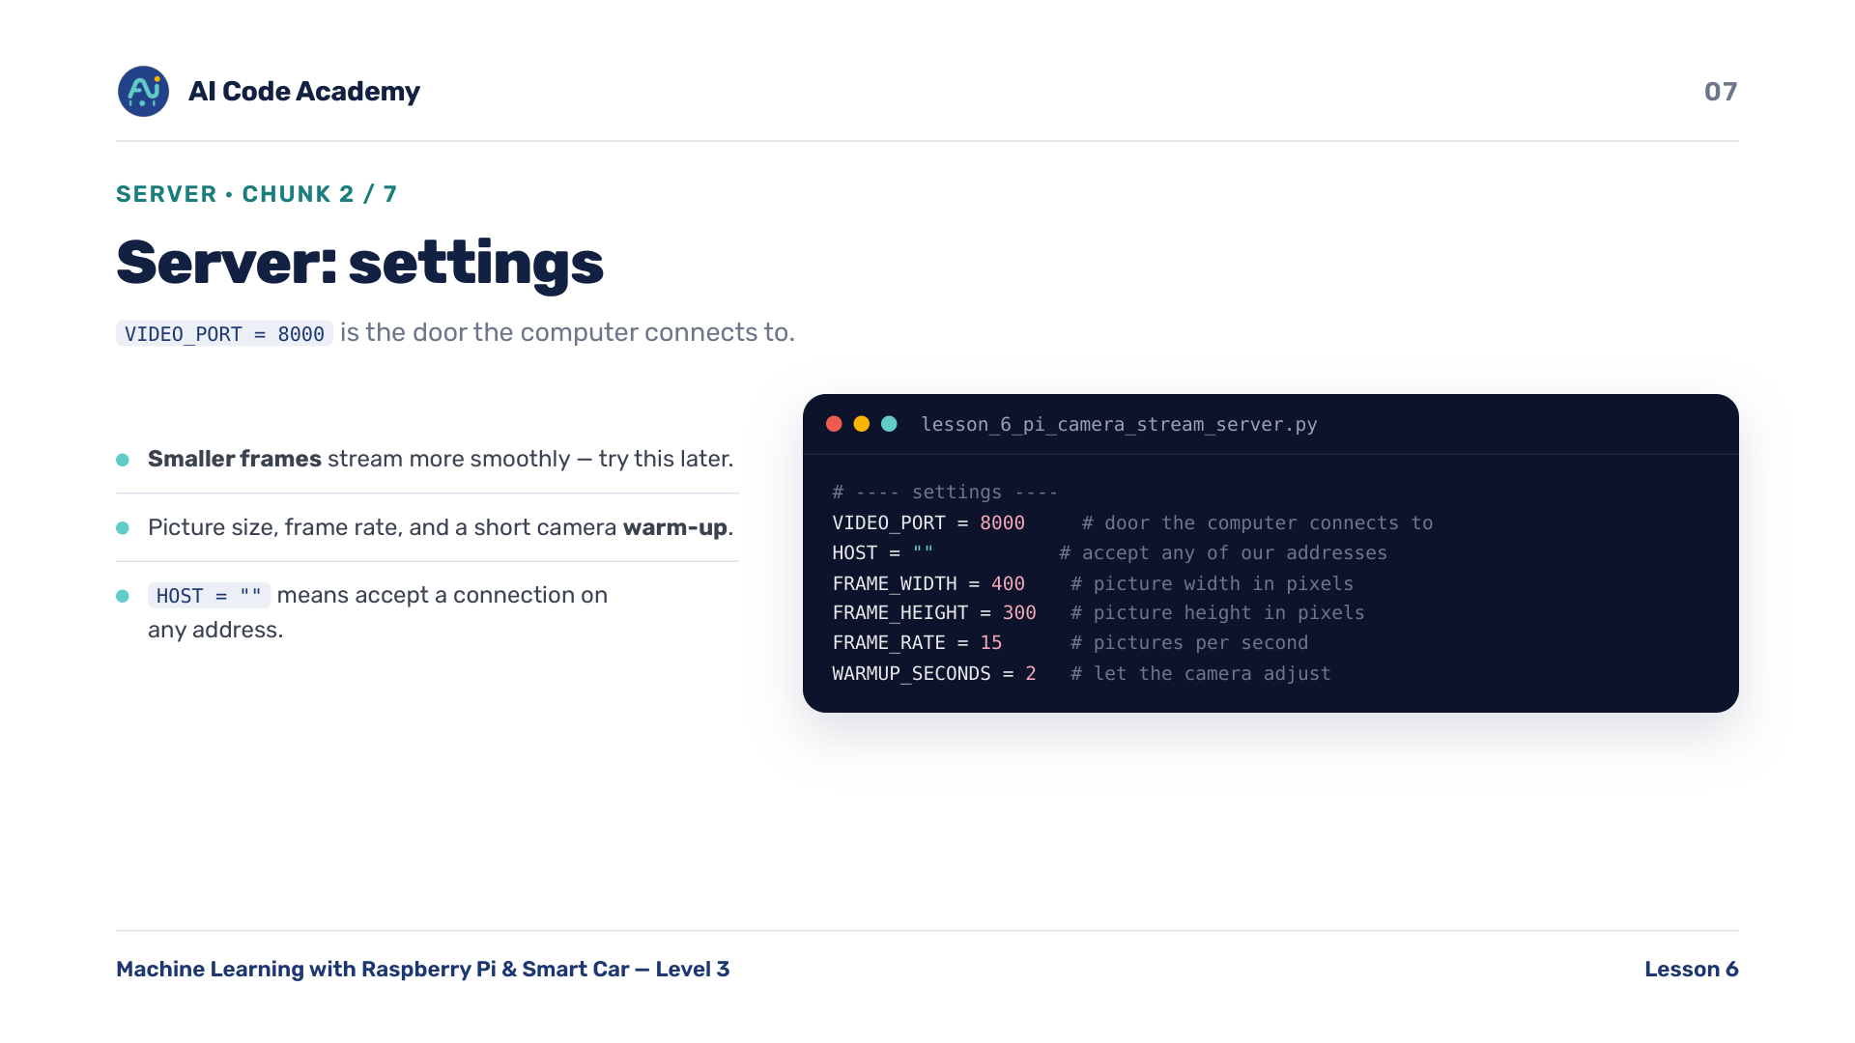
Notes:
Server settings (chunk A2/7) — VIDEO_PORT 8000 is the door the computer connects to. Smaller frames stream more smoothly; they'll experiment with FRAME_WIDTH / HEIGHT / RATE later. WARMUP_SECONDS lets the camera adjust before streaming.

Slide 8
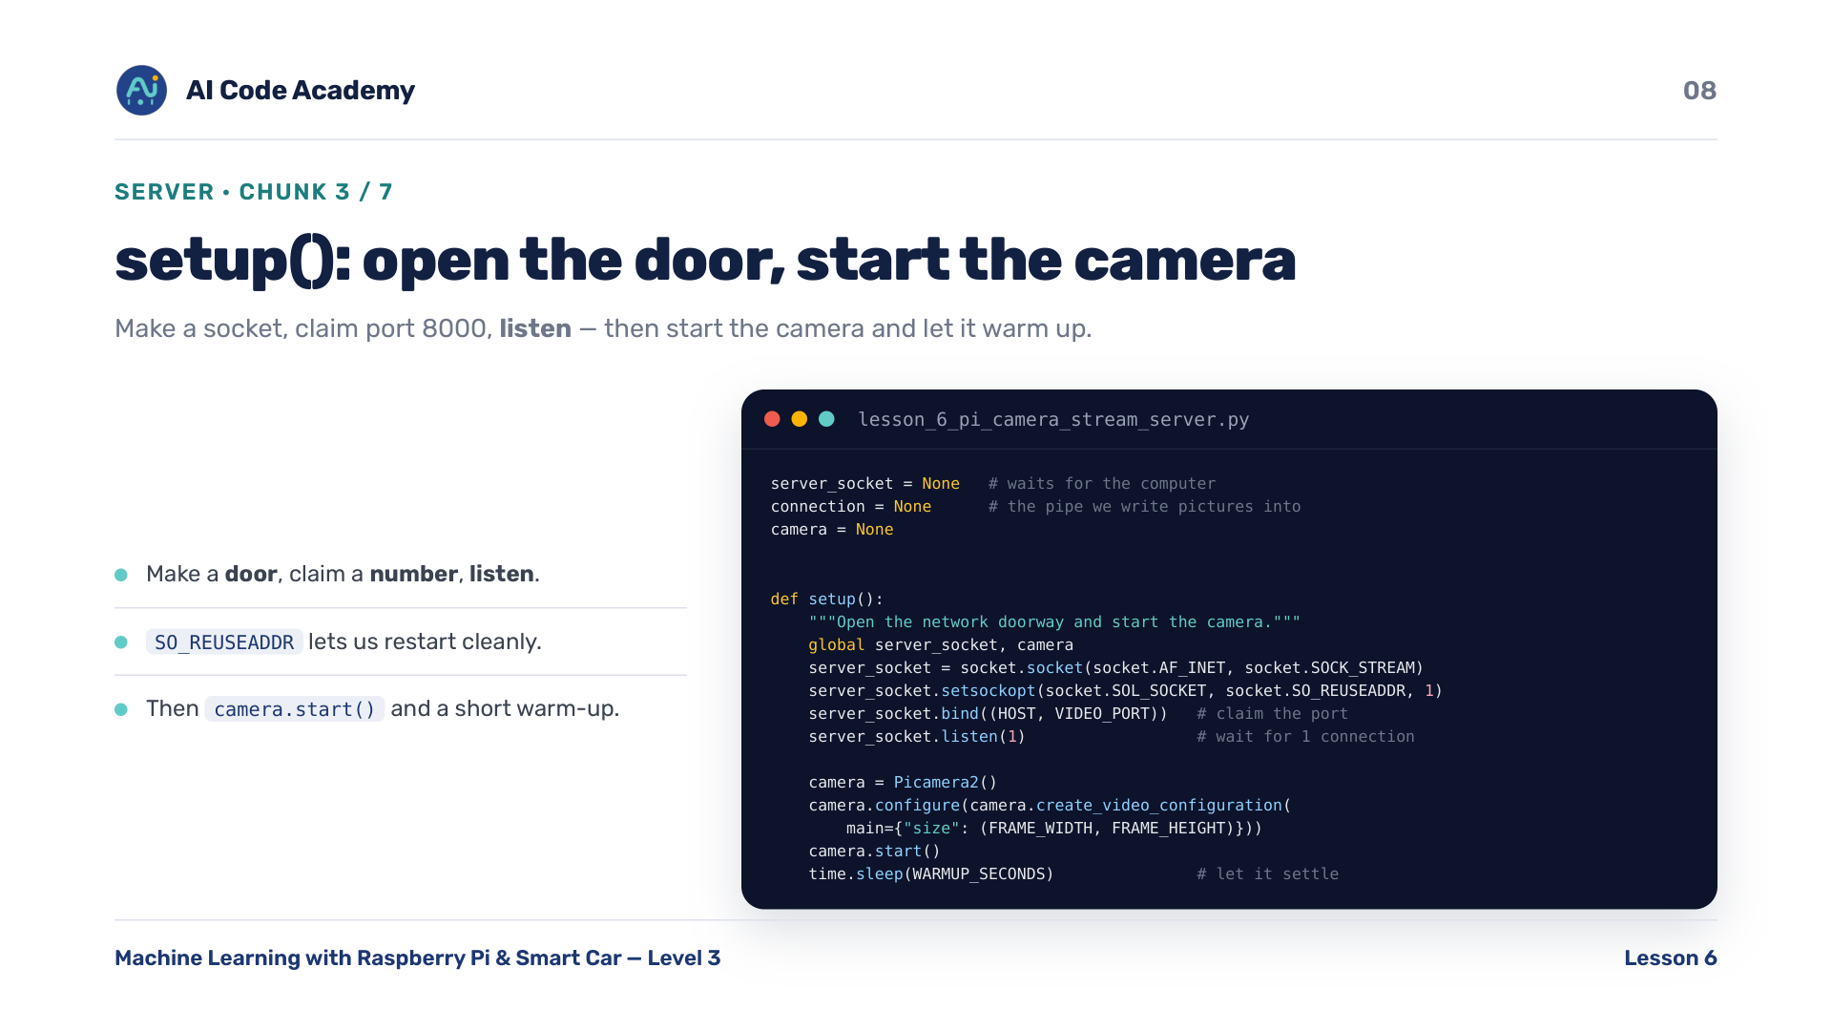
Notes:
Server setup() (chunk A3/7) — make a socket, claim port 8000, listen for one connection, then start the camera and let it warm up. Don't dwell on socket details: make a door, claim a number, listen is enough. SO_REUSEADDR just lets us restart cleanly. AF_INET = internet addresses, SOCK_STREAM = a reliable TCP connection.

Slide 9
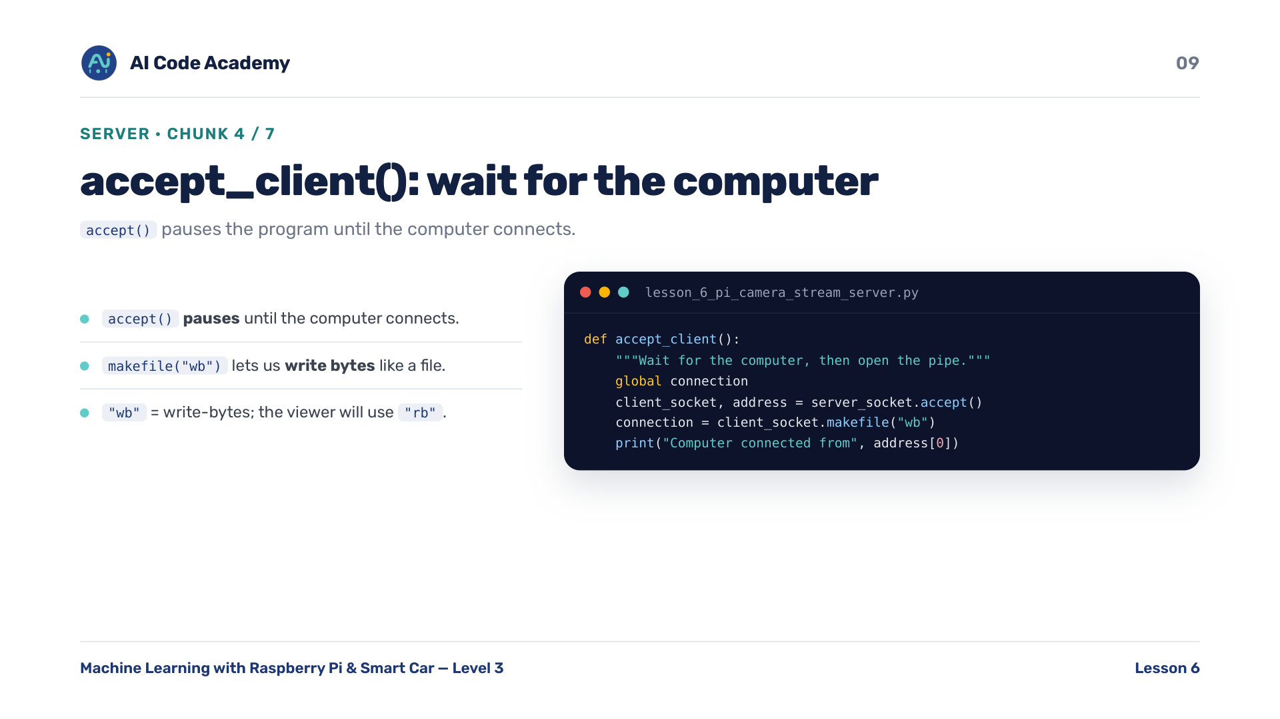
Notes:
Server accept_client() (chunk A4/7) — accept() pauses the program until the computer connects. makefile('wb') lets us write bytes to the connection like a file. wb = write-bytes; the matching viewer will use rb = read-bytes.

Slide 10
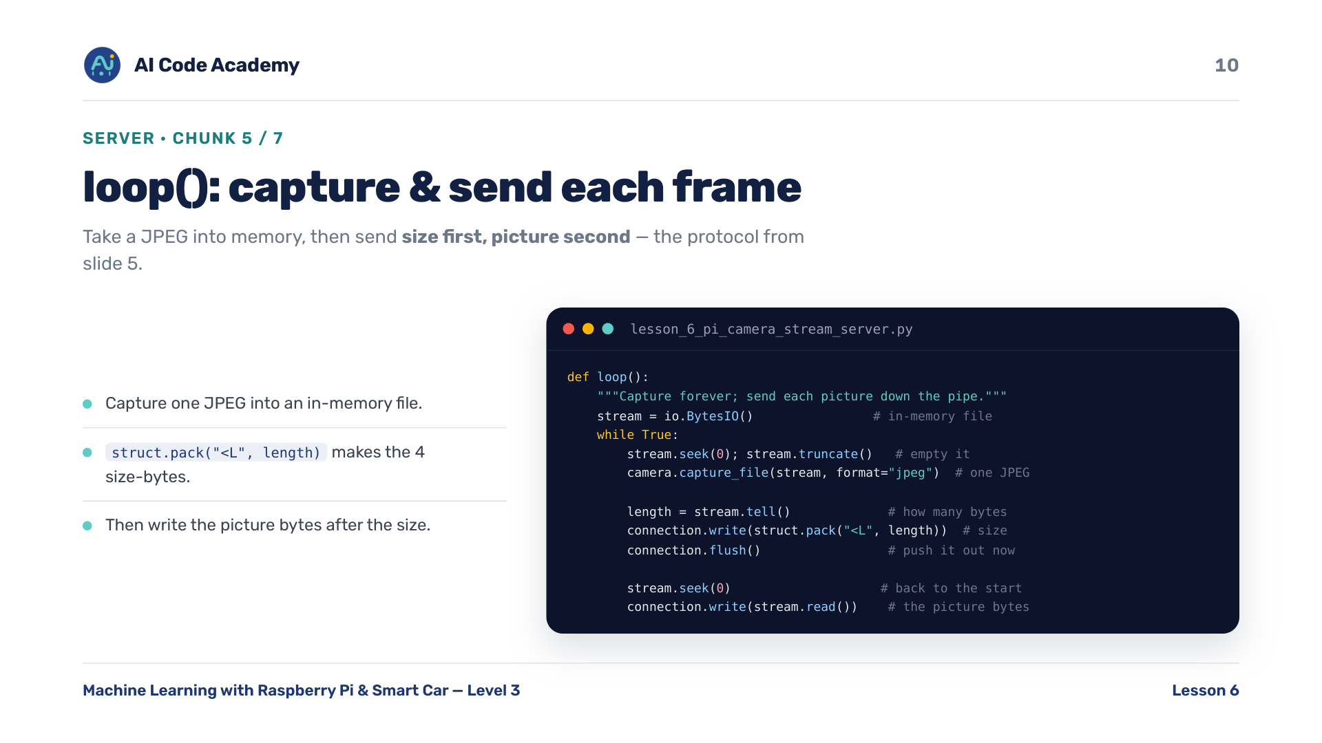
Notes:
Server loop() (chunk A5/7) — take a JPEG into an in-memory file, then send size first, picture second: exactly the protocol from slide 5. struct.pack('<L', length) makes the 4 size-bytes; the viewer's struct.unpack reverses it. flush() pushes the size out right away.

Slide 11
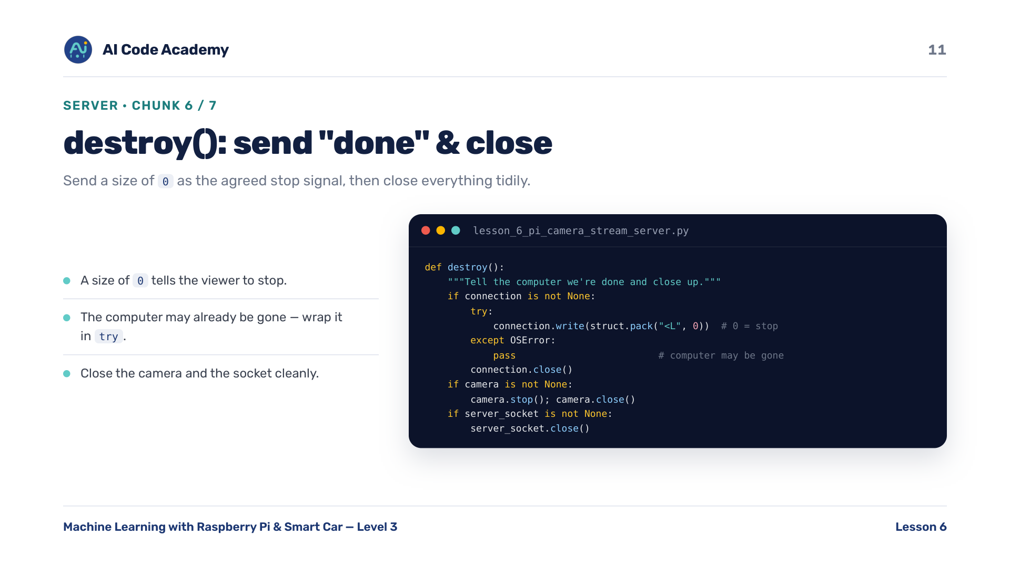
Notes:
Server destroy() (chunk A6/7) — send a size of 0 as the agreed stop signal, then close the camera and the socket tidily. The length == 0 signal is how the viewer knows to stop cleanly. The computer may already be gone, so the write is wrapped in try/except.

Slide 12
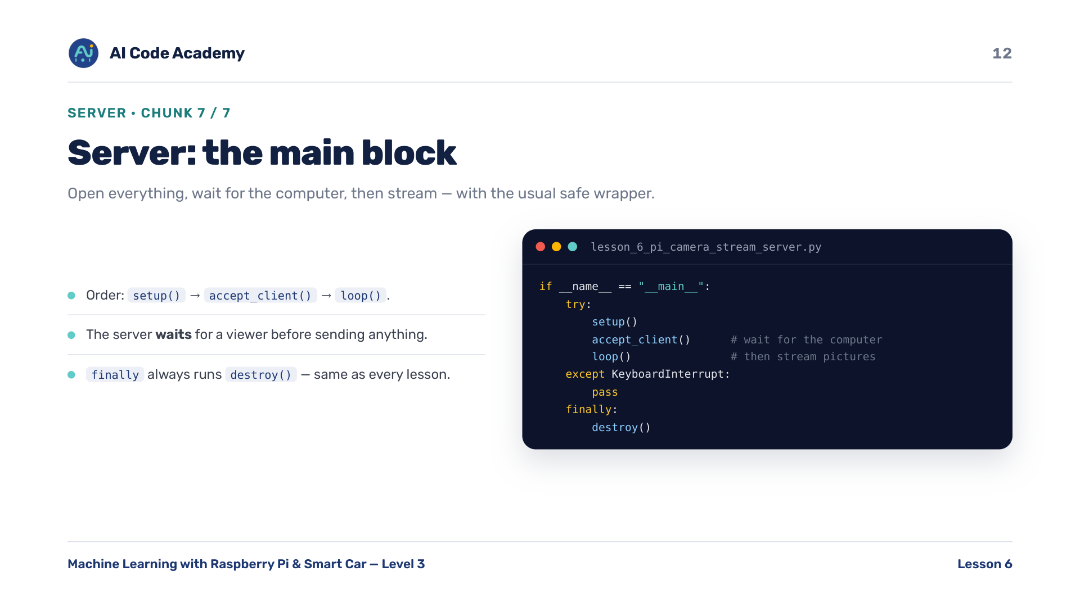
Notes:
Server main block (chunk A7/7) — open everything, wait for the computer, then stream, with the usual safe wrapper. Note the order: setup, then accept, then loop. The server waits for a viewer before sending anything.

Slide 13
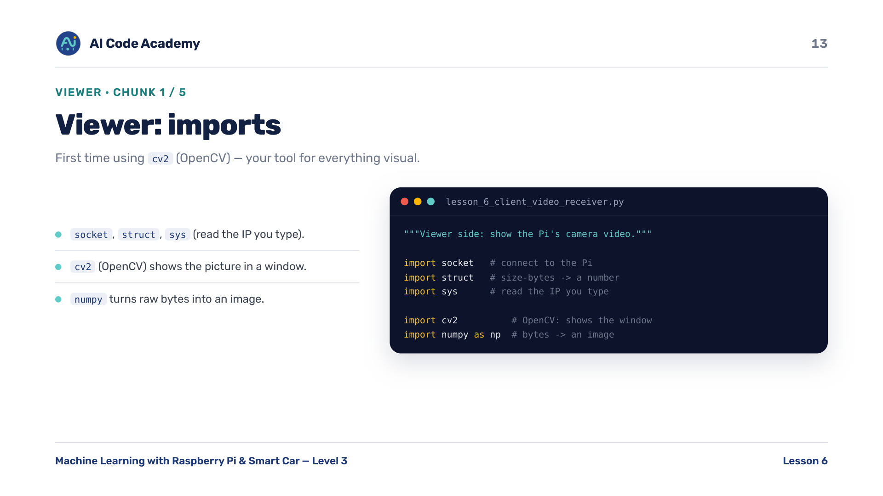
Notes:
Viewer imports (chunk B1/5) — socket, struct, and sys to read the IP you type. First time using OpenCV (cv2): it does the heavy lifting of showing images. numpy turns raw bytes into an image.

Slide 14
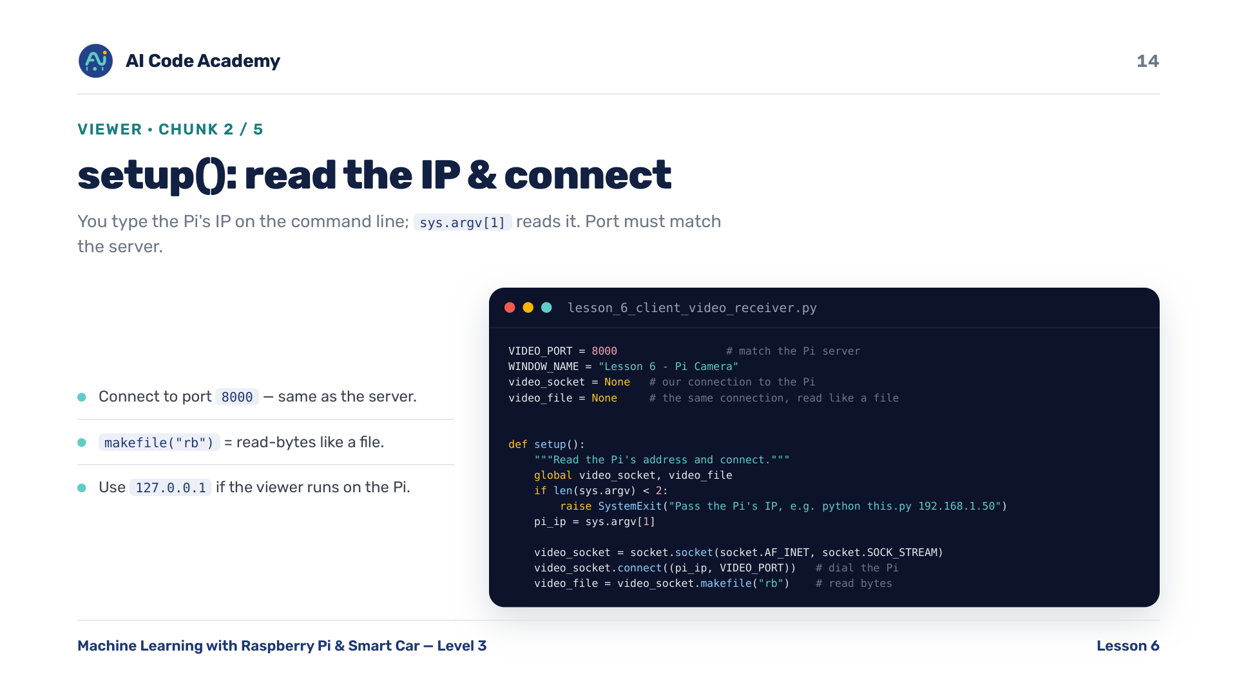
Notes:
Viewer settings + setup() (chunk B2/5) — you type the Pi's IP on the command line; sys.argv[1] reads it. Connect to port 8000 (must match the server) and read it like a file with makefile('rb'). Use 127.0.0.1 if running the viewer on the Pi itself.

Slide 15
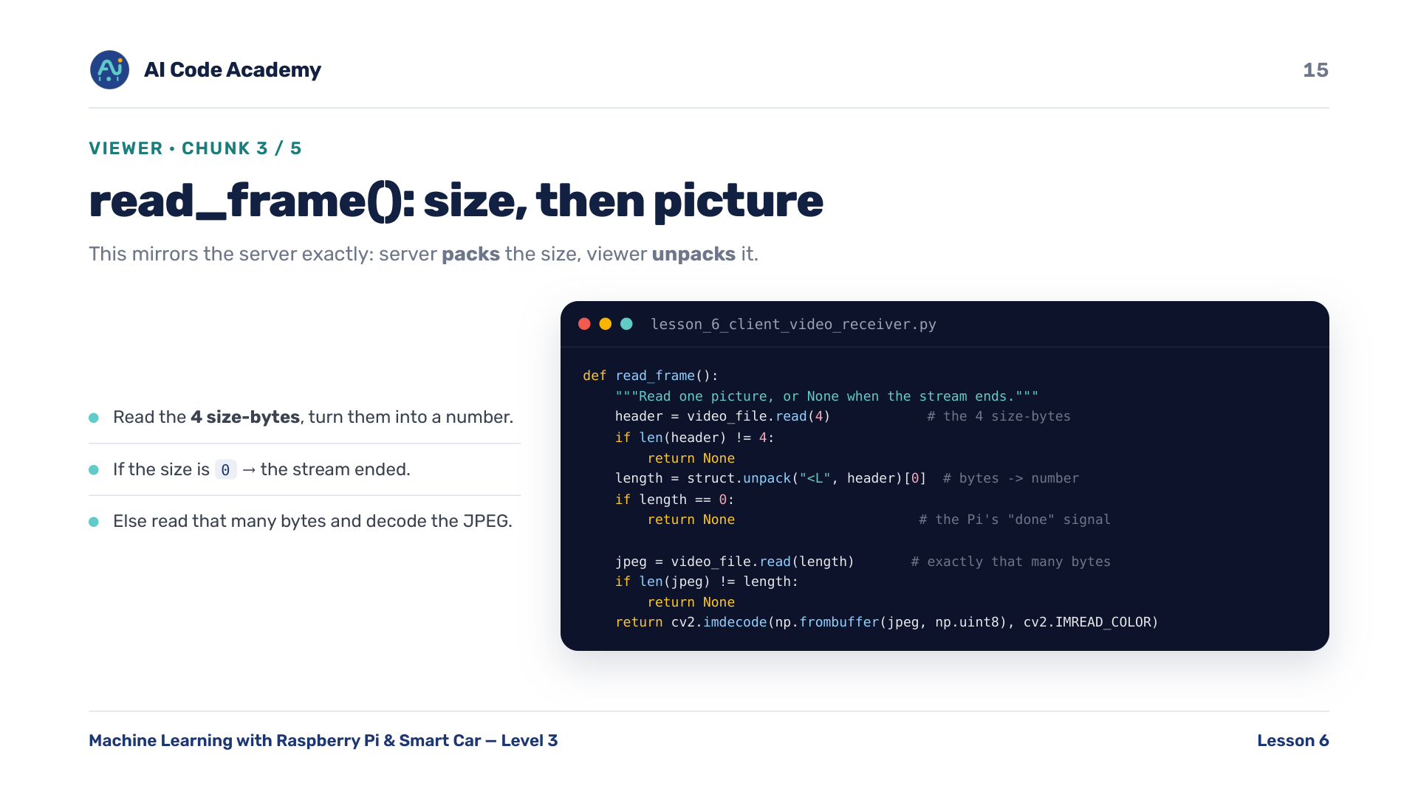
Notes:
Viewer read_frame() (chunk B3/5) — read the 4 size-bytes, turn them into a number. If the size is 0, the stream ended. Otherwise read exactly that many bytes and decode the JPEG. This mirrors the server exactly: server packs the size, viewer unpacks it. [0] because unpack returns a tuple.

Slide 16

Notes:
Viewer loop() (chunk B4/5) — read a frame, show it, repeat. Press q to quit. waitKey(1) lets the window refresh and checks for a key. q to quit is an OpenCV convention used in every vision lesson from here on.

Slide 17
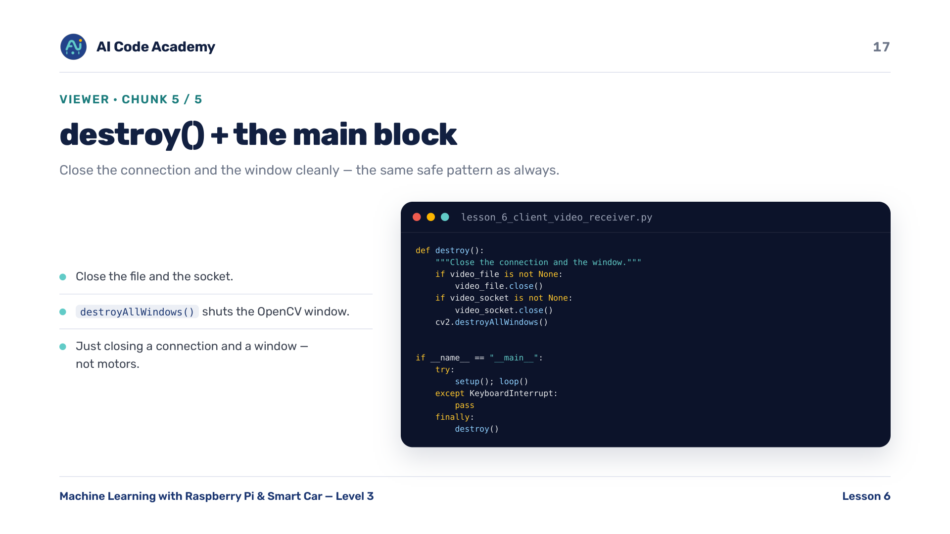
Notes:
Viewer destroy() + main block (chunk B5/5) — close the connection and the window cleanly. Same safe pattern as every lesson, just closing a network connection and a window instead of motors.

Slide 18
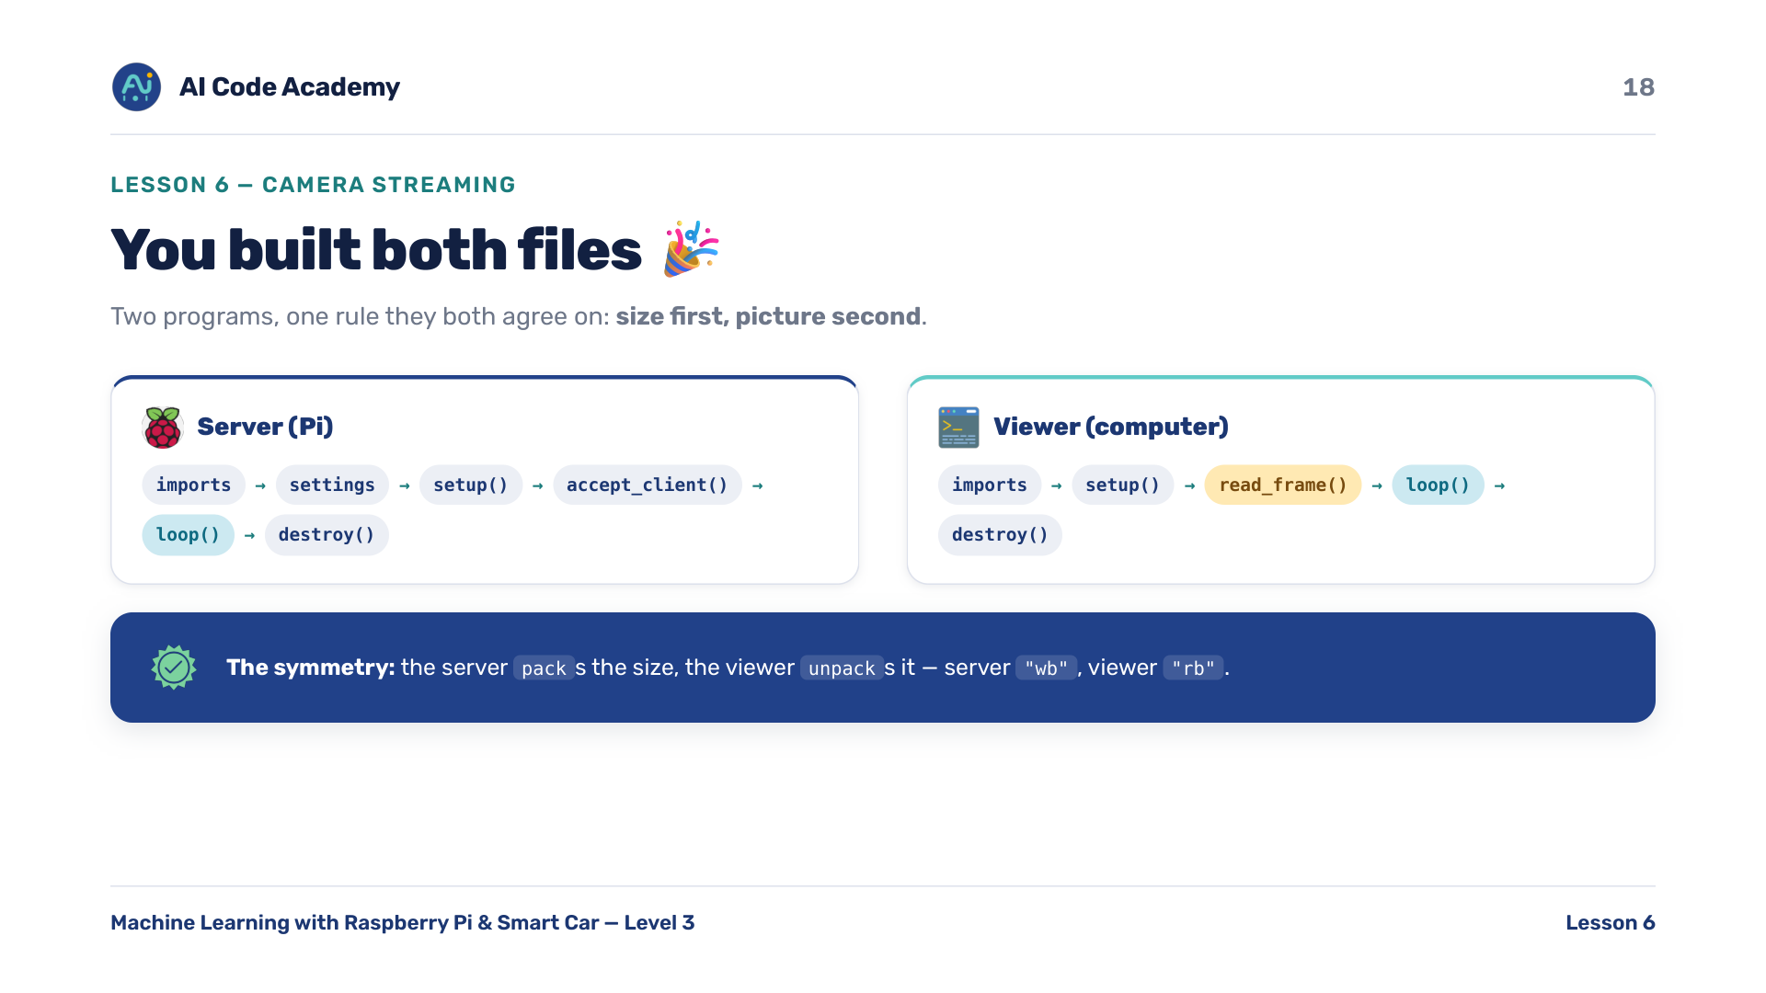
Notes:
We built both files — stress the symmetry. Server (Pi): imports, settings, setup(), accept_client(), loop(), destroy(), main. Viewer (computer): imports, setup(), read_frame(), loop(), destroy(), main. They agree on one rule: size first, picture second. Server packs the size, viewer unpacks it; server wb, viewer rb.

Slide 19
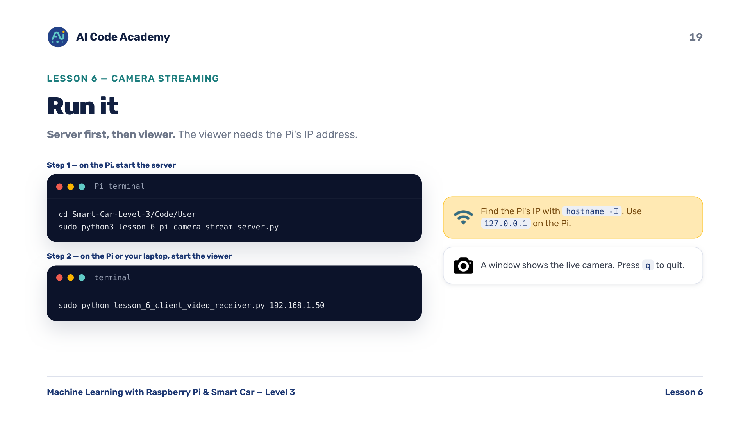
Notes:
Run it — server first, then viewer. On the Pi: cd Smart-Car-Level-3/Code/User then sudo python3 lesson_6_pi_camera_stream_server.py. On the Pi or a laptop: sudo python lesson_6_client_video_receiver.py 192.168.1.50 (use the Pi's real IP). Help students find the Pi's IP with hostname -I. Use 127.0.0.1 if the viewer runs on the Pi. Press q to quit.

Slide 20
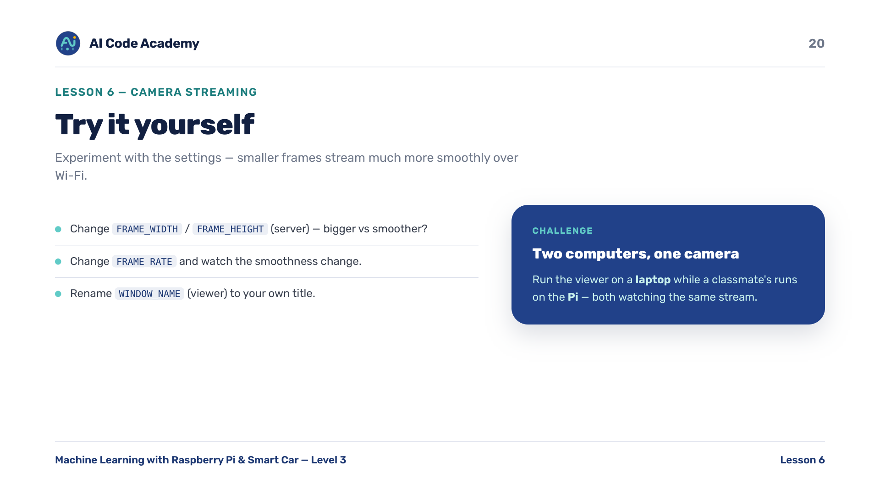
Notes:
Try it yourself — smaller frames stream much more smoothly over Wi-Fi, a good thing to discover by experiment. Change FRAME_WIDTH / HEIGHT and FRAME_RATE on the server; rename WINDOW_NAME on the viewer. Challenge: run the viewer on a laptop while a classmate's runs on the Pi.

Slide 21
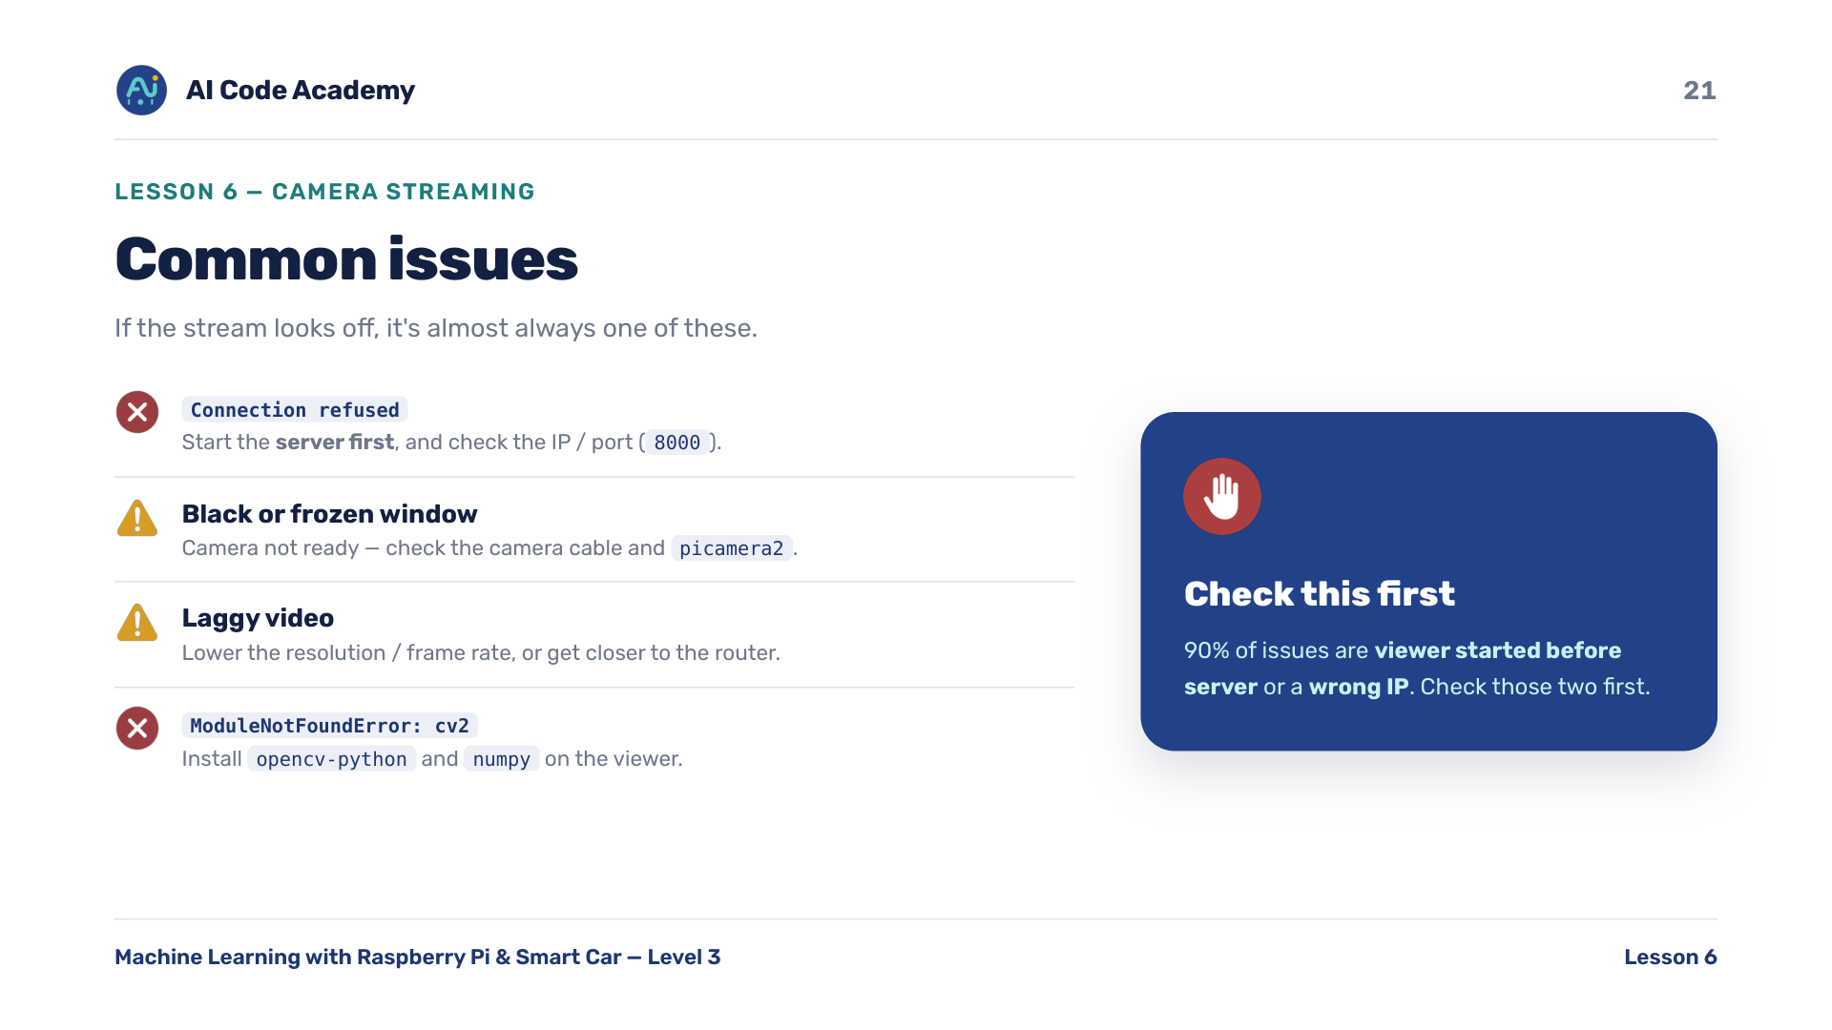
Notes:
Troubleshooting — 90% of issues are viewer started before server, or wrong IP. Check those first. Connection refused: start the server first and check the IP/port 8000. Black/frozen window: camera not ready, check the cable and picamera2. Laggy: lower resolution / frame rate or move closer to the router. cv2 not found: install opencv-python and numpy on the viewer.

Slide 22
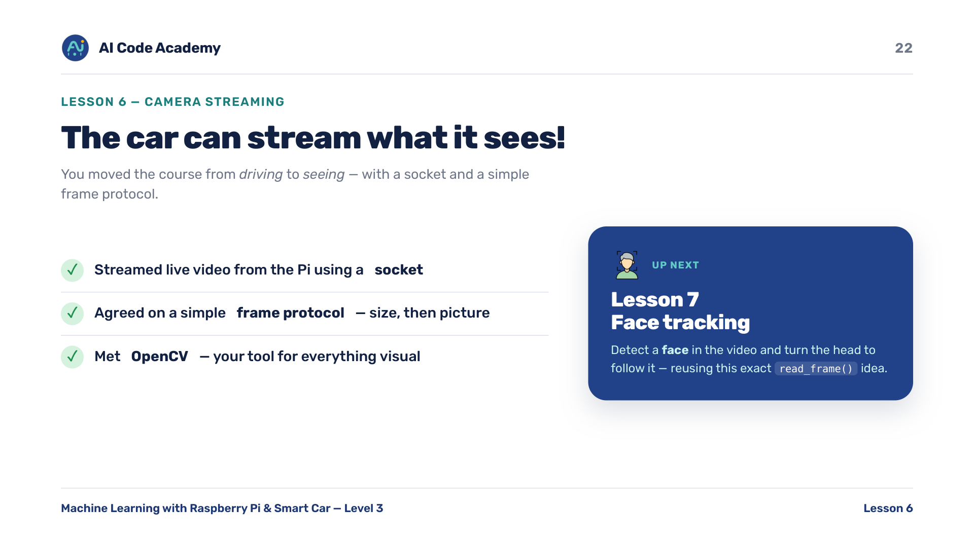
Notes:
Recap — you streamed live video from the Pi to a computer using a socket and a simple frame protocol, and you met OpenCV, your tool for everything visual. Next, Lesson 7: detect a face in the video and turn the head to follow it. It reuses this exact read_frame() idea.

Slide 23
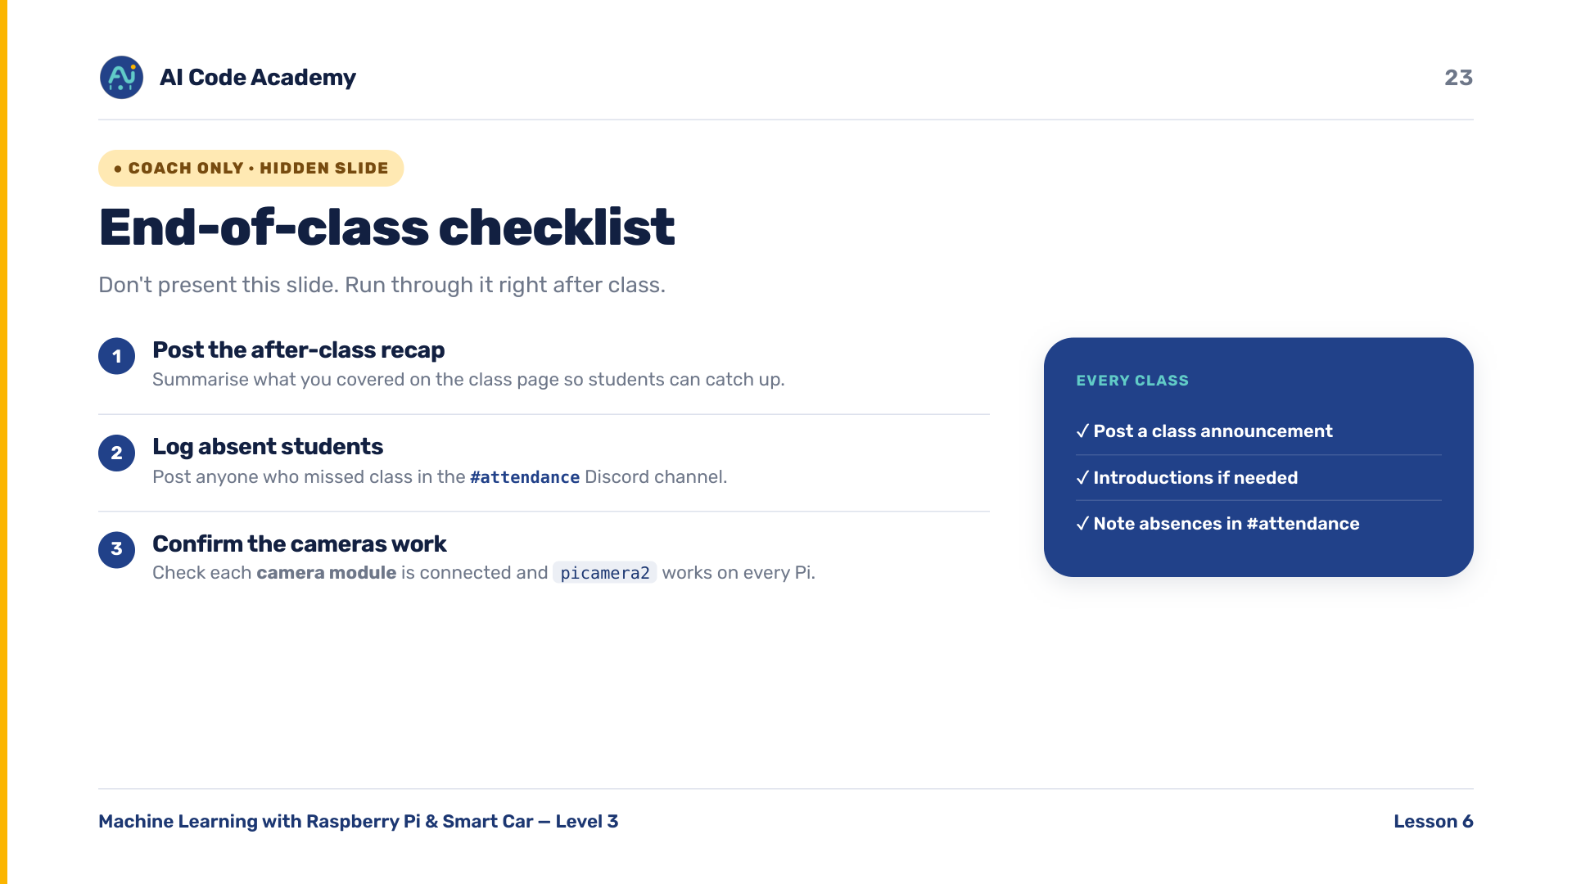
Notes:
COACH (hidden) — do not present. After class: post the recap on the class page, log absent students in the Discord #attendance channel. Confirm each camera module is connected and picamera2 works on every Pi before next class.

