Slide 1
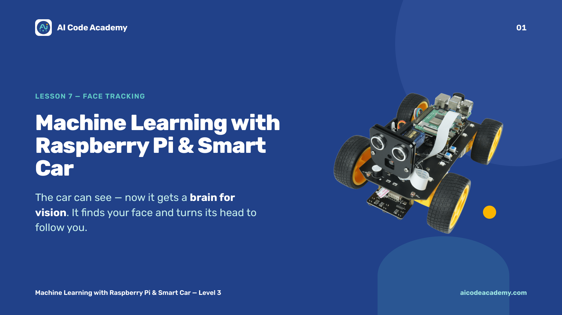
Notes:
Title — ~1 min. This is the wow lesson: the car will follow your face. Build excitement. It reuses Lesson 6's video stream and adds a brain for vision plus servo steering. Make sure each Pi runs the full server (sudo python3 main.py) before class. Site: https://aicodeacademy.com

Slide 2
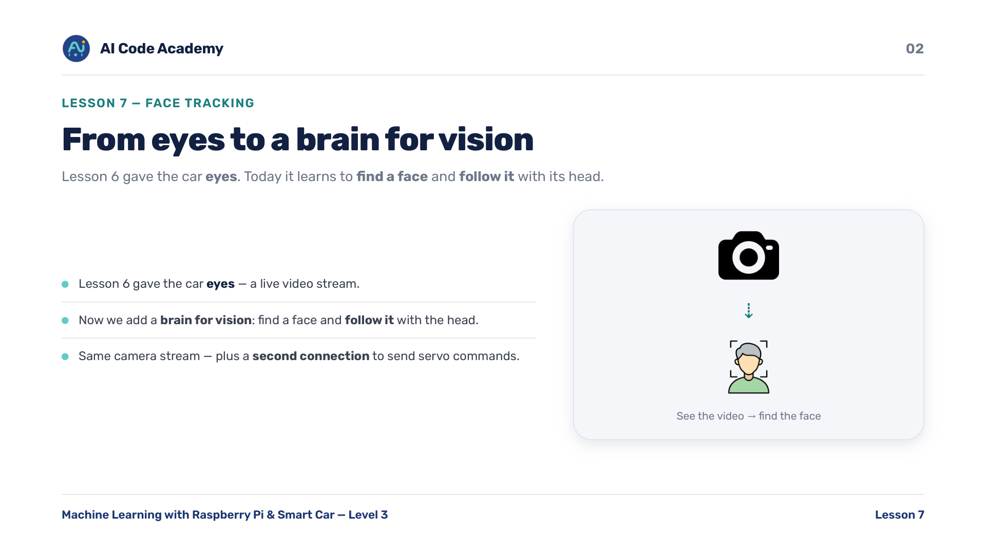
Notes:
Introduction — Lesson 6 gave the car eyes (a live video stream). Now we add a brain for vision: find a face and follow it with the head. Same camera stream as before, plus a second connection to send servo commands. Recall L6's read_frame() — we reuse that exact idea here.

Slide 3
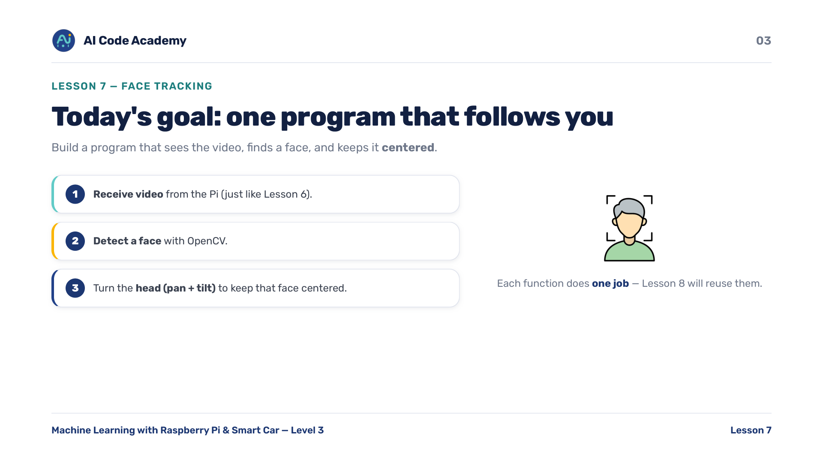
Notes:
Our goals — build one program that receives video from the Pi, detects a face with OpenCV, and turns the head (pan + tilt) to keep that face centered. Write each function to do one job, because Lesson 8 will import this file and reuse them. Mention that single-purpose functions matter up front.

Slide 4
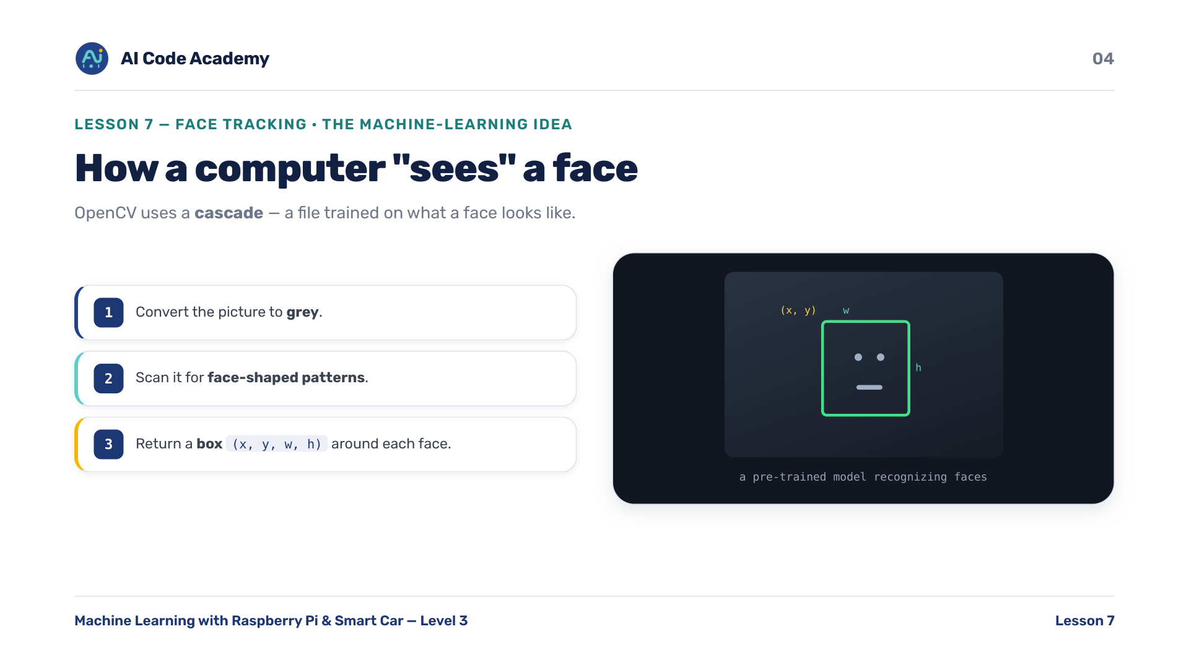
Notes:
How a computer sees a face — OpenCV uses a cascade: a file trained on what a face looks like. Steps: convert the picture to grey, then scan it for face-shaped patterns. It returns a box (x, y, w, h) around each face found. This is the lesson's machine-learning tie-in: a pre-trained model recognizing faces.

Slide 5
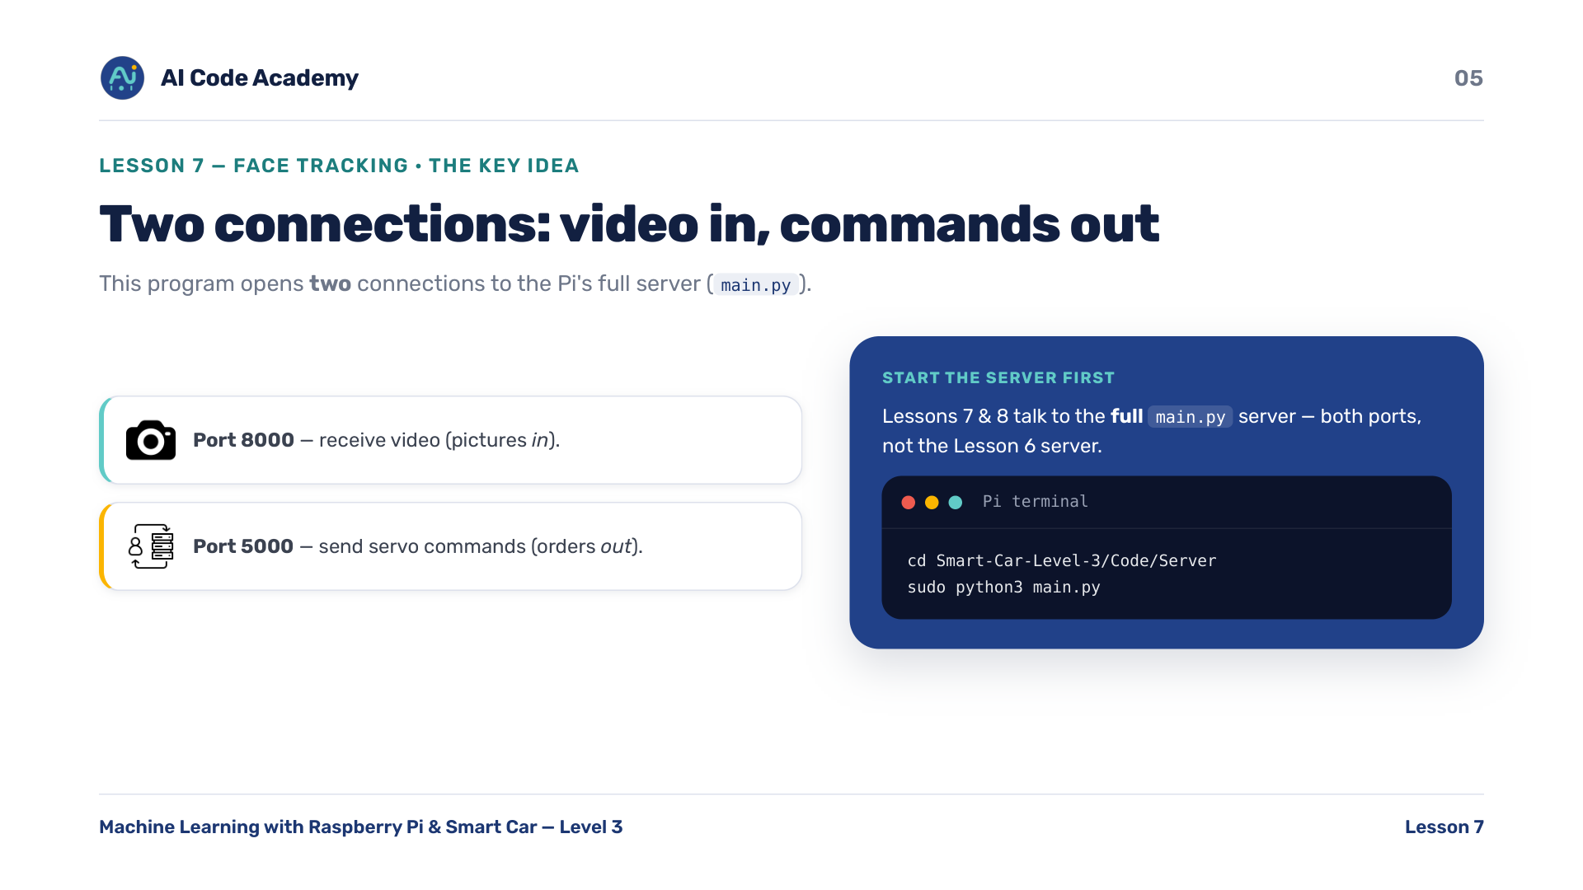
Notes:
Two connections — this program opens TWO connections to the Pi's server (main.py): port 8000 receives video (pictures in), port 5000 sends servo commands (orders out). So start the car's server first: sudo python3 main.py on the Pi. Clarify: Lessons 7/8 talk to the full main.py server (both ports), not the Lesson 6 server.

Slide 6
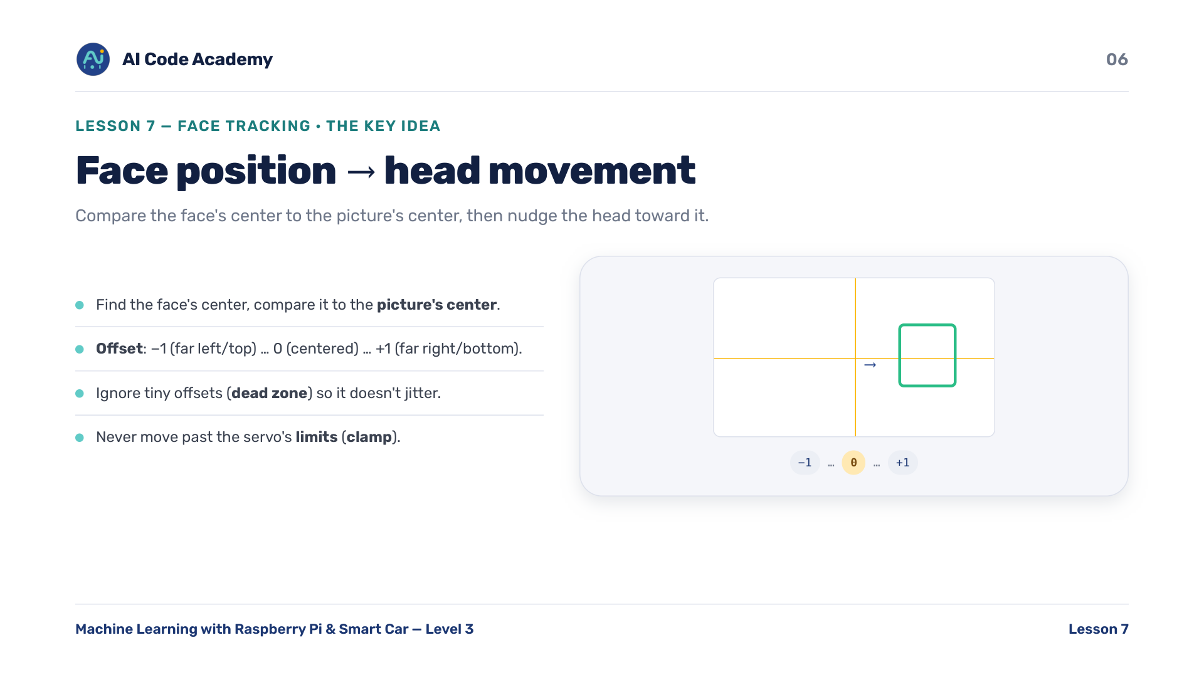
Notes:
Face position to head movement — find the face's center, compare it to the picture's center. Offset is -1 (far left/top) to 0 (centered) to +1 (far right/bottom). Nudge the head a few degrees toward the face, but ignore tiny offsets (dead zone) so it doesn't jitter, and never move past the servo's limits (clamp). Dead zone + clamp make tracking smooth instead of twitchy.

Slide 7
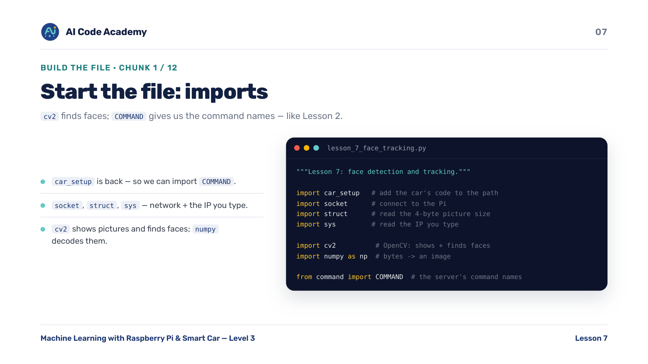
Notes:
Imports (chunk 1/12) — network + system imports, plus OpenCV and NumPy. car_setup is back so we can import COMMAND from the car's code. socket connects over the network, struct reads the 4-byte picture size, sys reads the IP you type. cv2 shows pictures and finds faces; numpy turns raw bytes into an image.

Slide 8
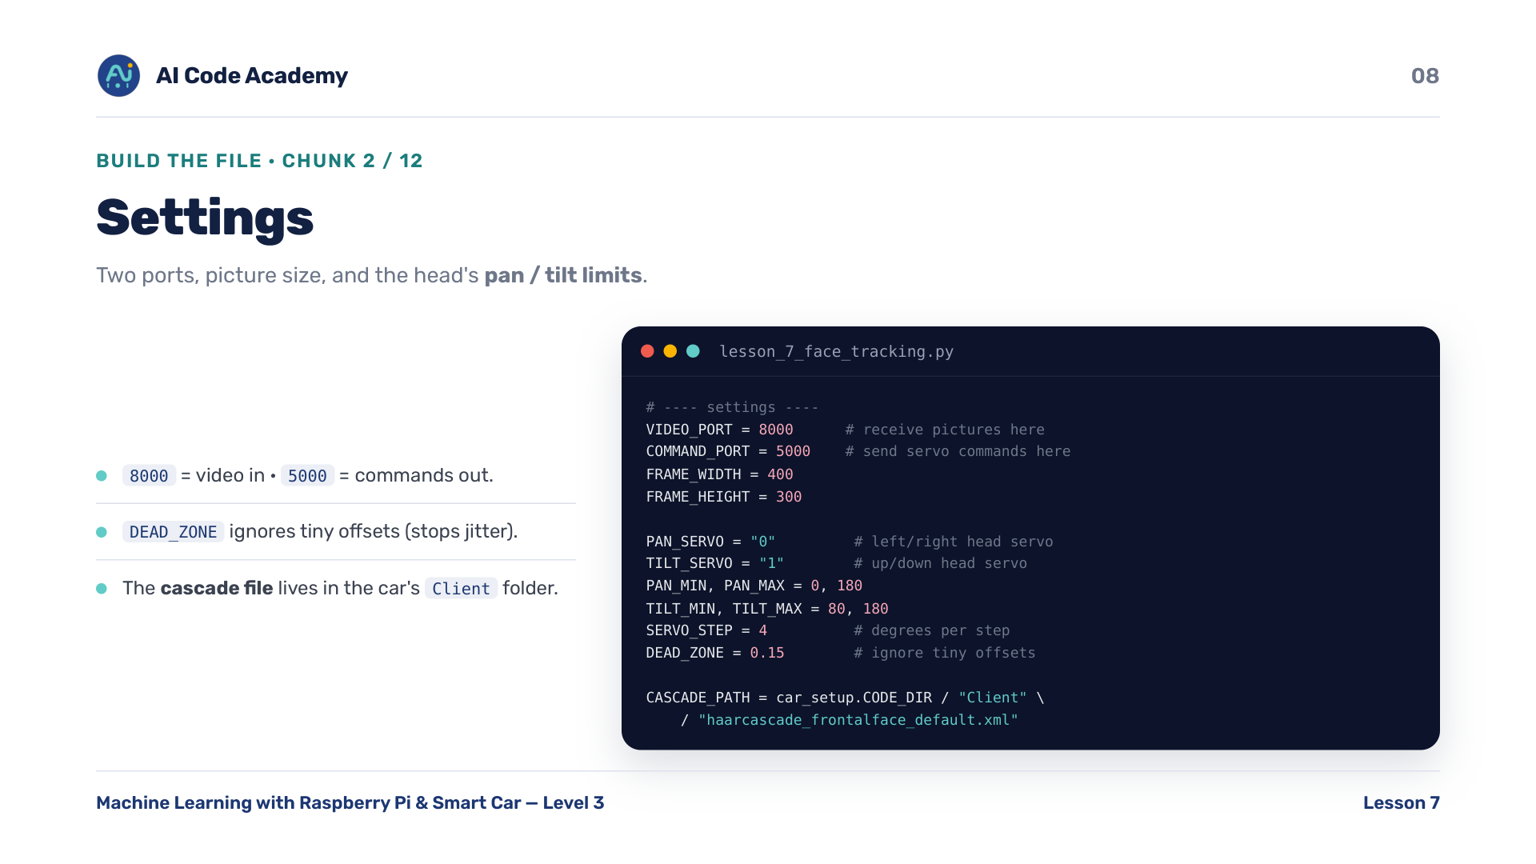
Notes:
Settings (chunk 2/12) — two ports, picture size, and the head's pan/tilt limits. The cascade file lives in the car's Client folder, found reliably via car_setup.CODE_DIR. SERVO_STEP is how many degrees to move per step; DEAD_ZONE ignores tiny offsets to stop jitter. car_setup.CODE_DIR is the same helper from L1 — here it locates the face-detector file.

Slide 9
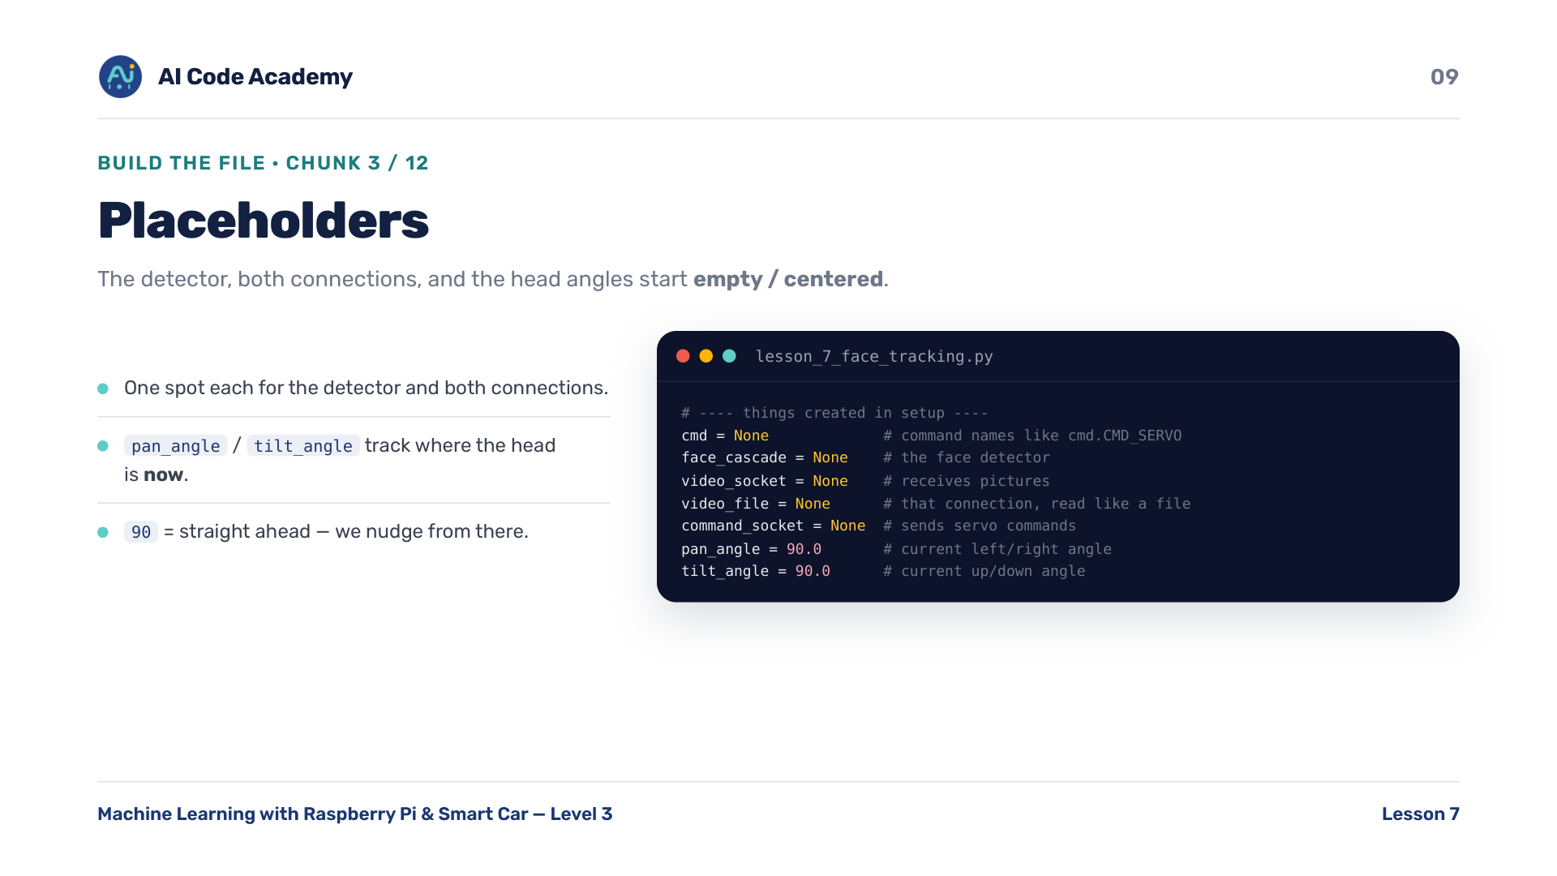
Notes:
Placeholders (chunk 3/12) — the detector, both connections, and the current head angles start empty / centered. pan_angle and tilt_angle track where the head is now, so we can nudge from there. 90 means straight ahead.

Slide 10
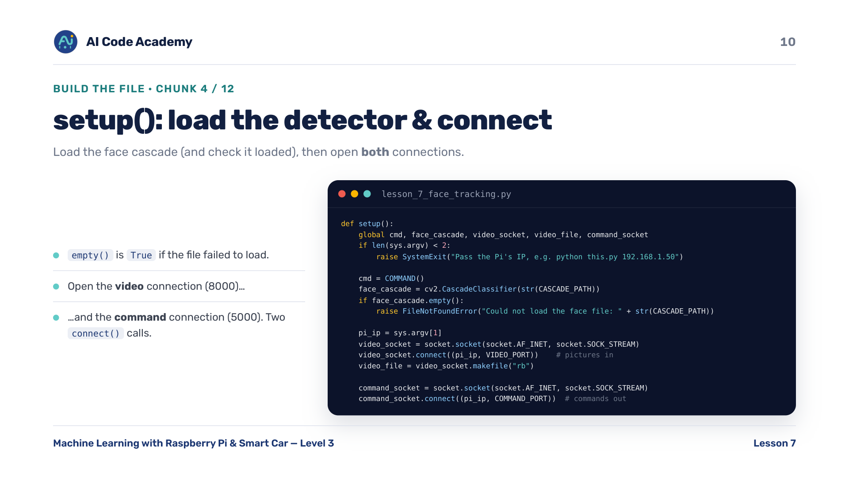
Notes:
setup() (chunk 4/12) — load the face cascade and check it actually loaded (empty() is True if the file failed to load — saves a confusing crash later). Then open the video connection (8000) and the command connection (5000). Two connect() calls = two ports.

Slide 11
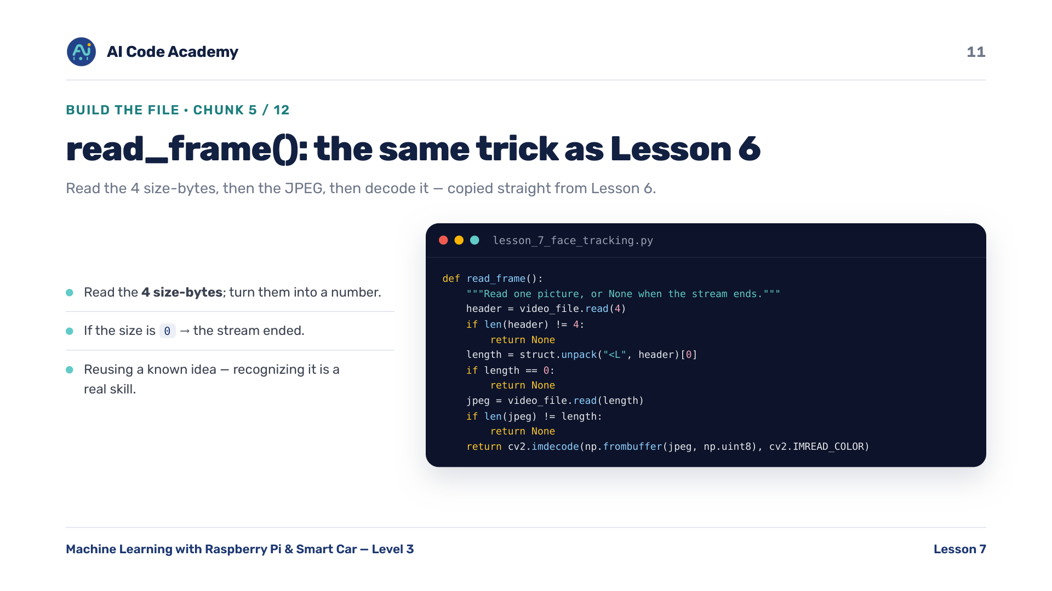
Notes:
read_frame() (chunk 5/12) — identical to Lesson 6: read the 4 size-bytes, then the JPEG, then decode it. Point out this is copied from L6 — recognizing reusable code is a real skill. Reuse a known idea, no need to reinvent it.

Slide 12
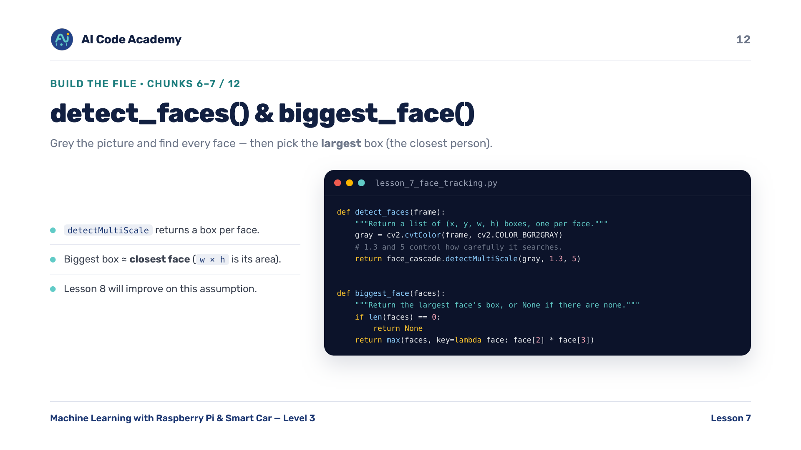
Notes:
detect_faces() and biggest_face() (chunks 6-7/12) — detect: grey the picture, then detectMultiScale returns a box per face (1.3 and 5 control how carefully it searches). biggest: the closest person is usually the largest box (width x height). Biggest box approx closest face is an assumption worth saying out loud; L8 will improve on it.

Slide 13
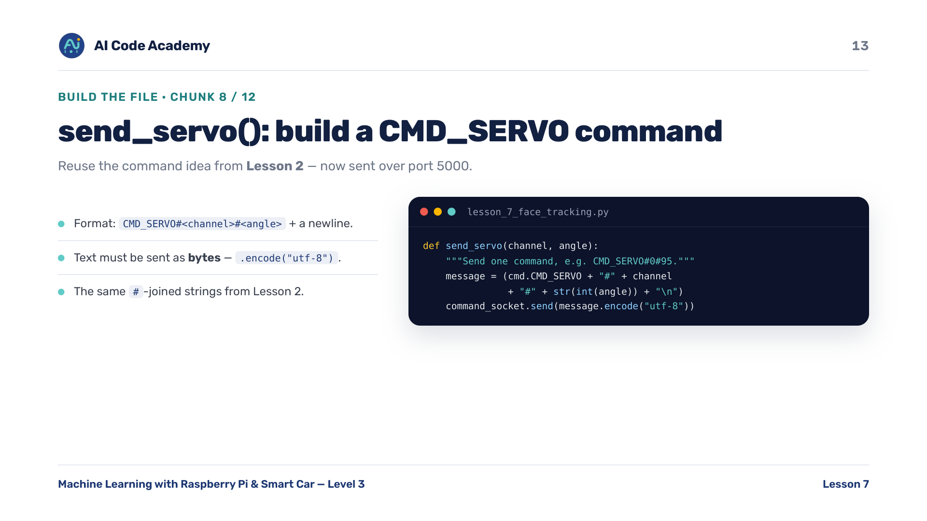
Notes:
send_servo() (chunk 8/12) — reuse the command idea from Lesson 2, now sent over the network. Format: CMD_SERVO#channel#angle plus a newline; text must be sent as bytes (.encode). Direct callback to L2's #-joined command strings, now actually travelling over port 5000.

Slide 14
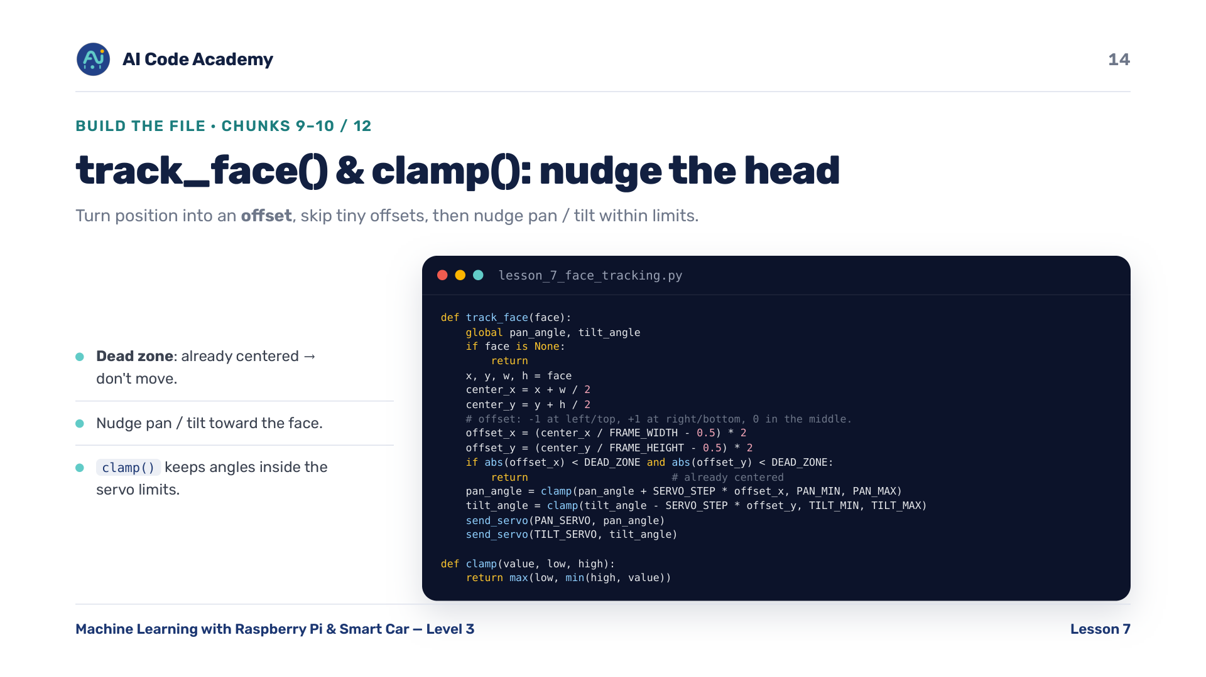
Notes:
track_face() and clamp() (chunks 9-10/12) — turn the face's position into an offset, skip tiny offsets (dead zone). Nudge pan/tilt toward the face, kept inside limits by clamp(). Walk through one offset by hand. clamp protects the servos from impossible angles. Offset is -1 at left/top edge, +1 at right/bottom edge, 0 in the middle.

Slide 15
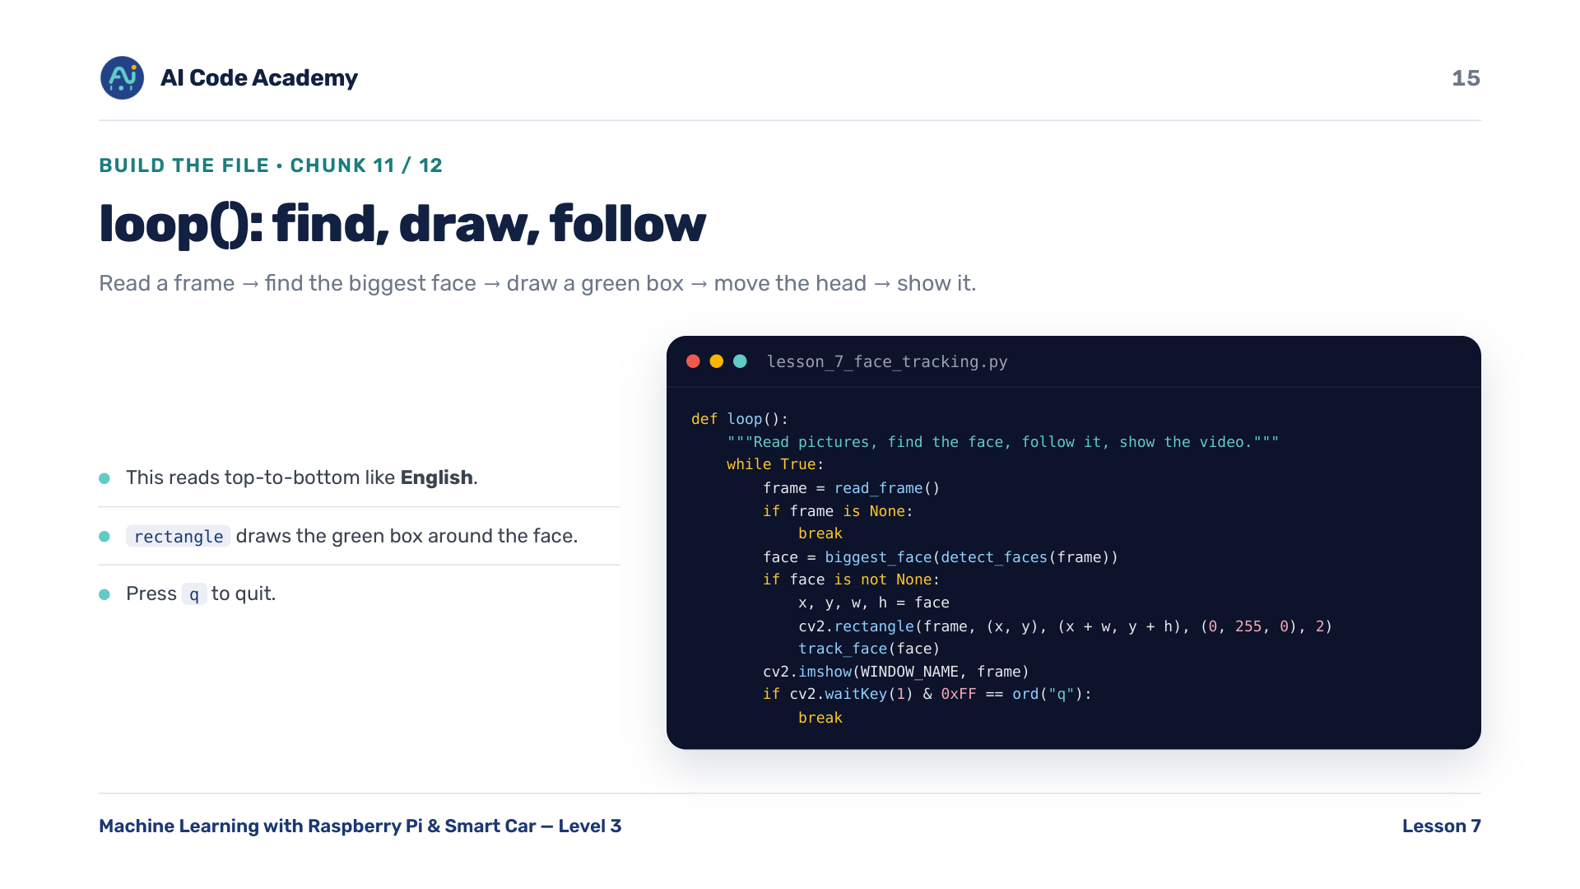
Notes:
loop() (chunk 11/12) — read a frame, find the biggest face, draw a green box, move the head, show it. Press q to quit. This reads top-to-bottom like English: read, detect, draw, track, show. Highlight that clarity.

Slide 16
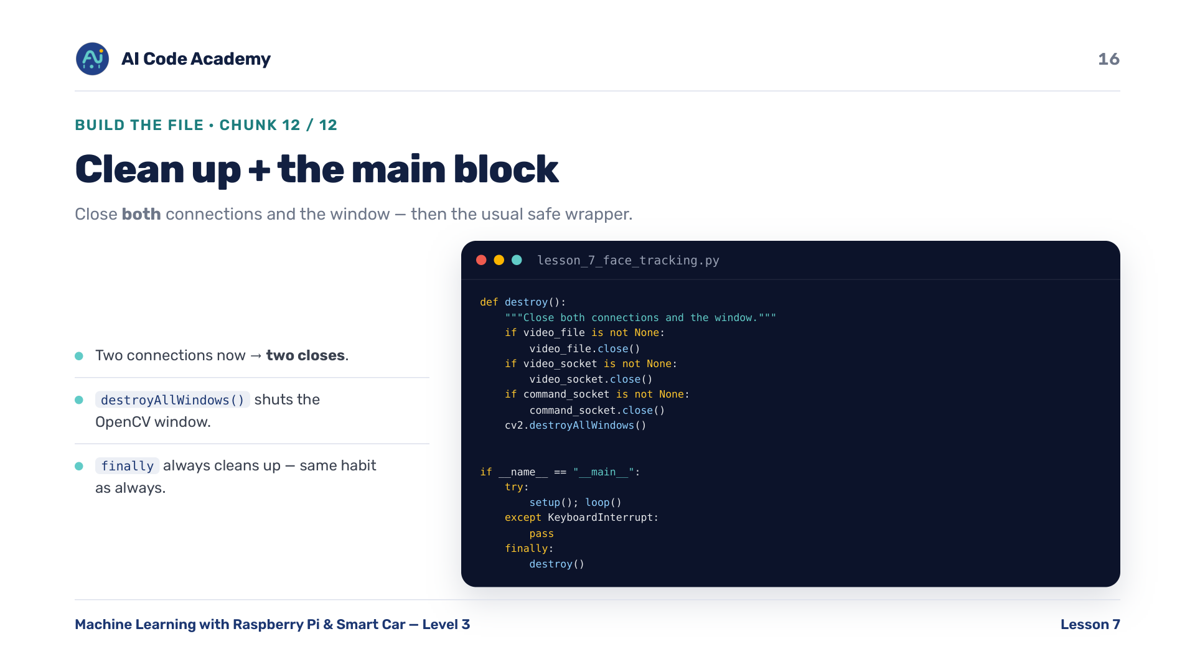
Notes:
destroy() + main block (chunk 12/12) — close BOTH connections and the window, then the usual safe wrapper. Two connections now, so two closes. Same finally-always-cleans-up habit from every lesson.

Slide 17
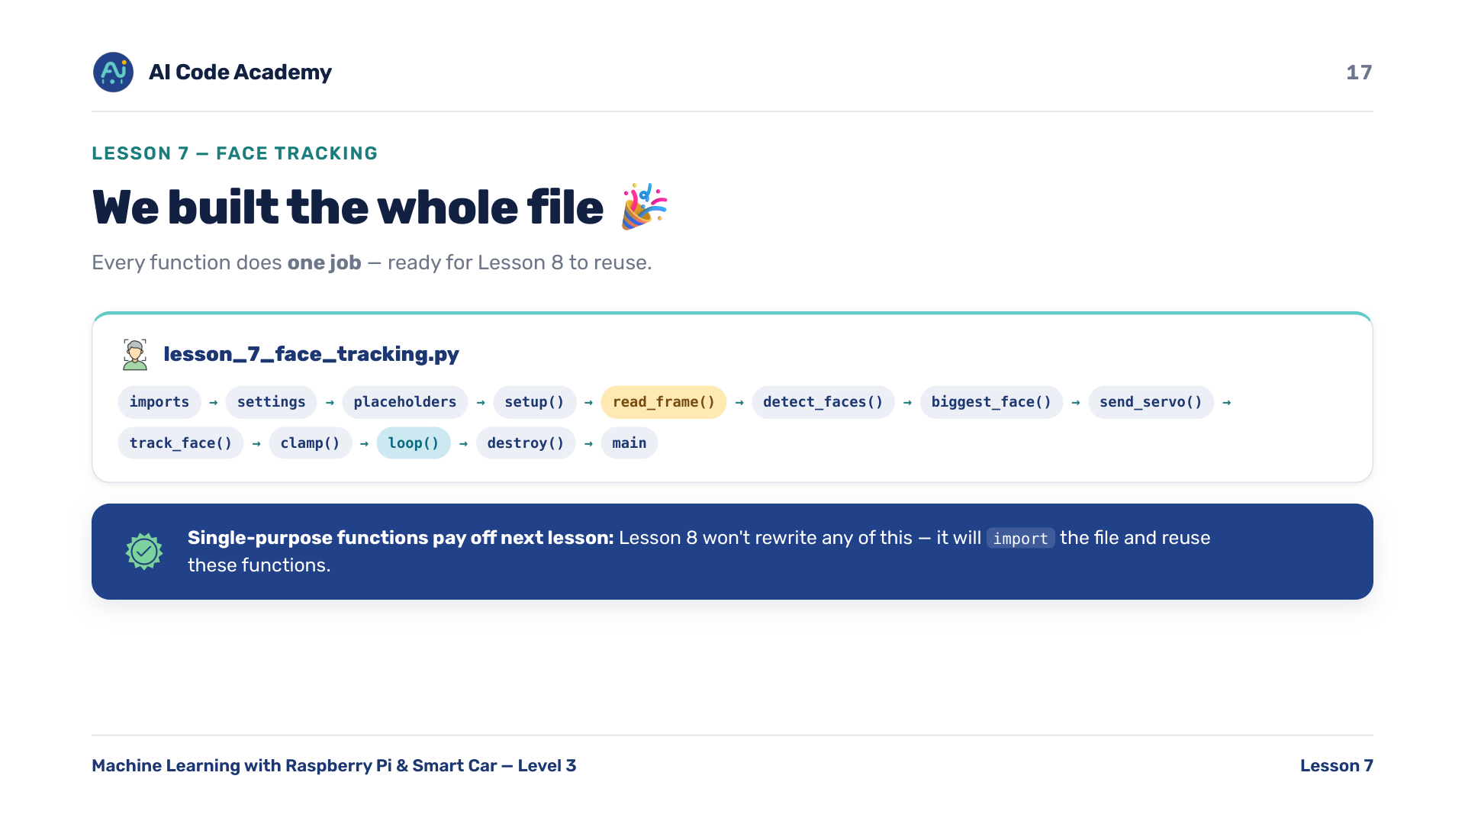
Notes:
We built the whole file — complete lesson_7_face_tracking.py: imports, settings, placeholders, setup(), read_frame(), detect_faces()/biggest_face(), send_servo(), track_face()/clamp(), loop(), destroy(), main. Every function does one job — ready for Lesson 8 to import. Re-emphasize single-purpose functions; it pays off next lesson.

Slide 18
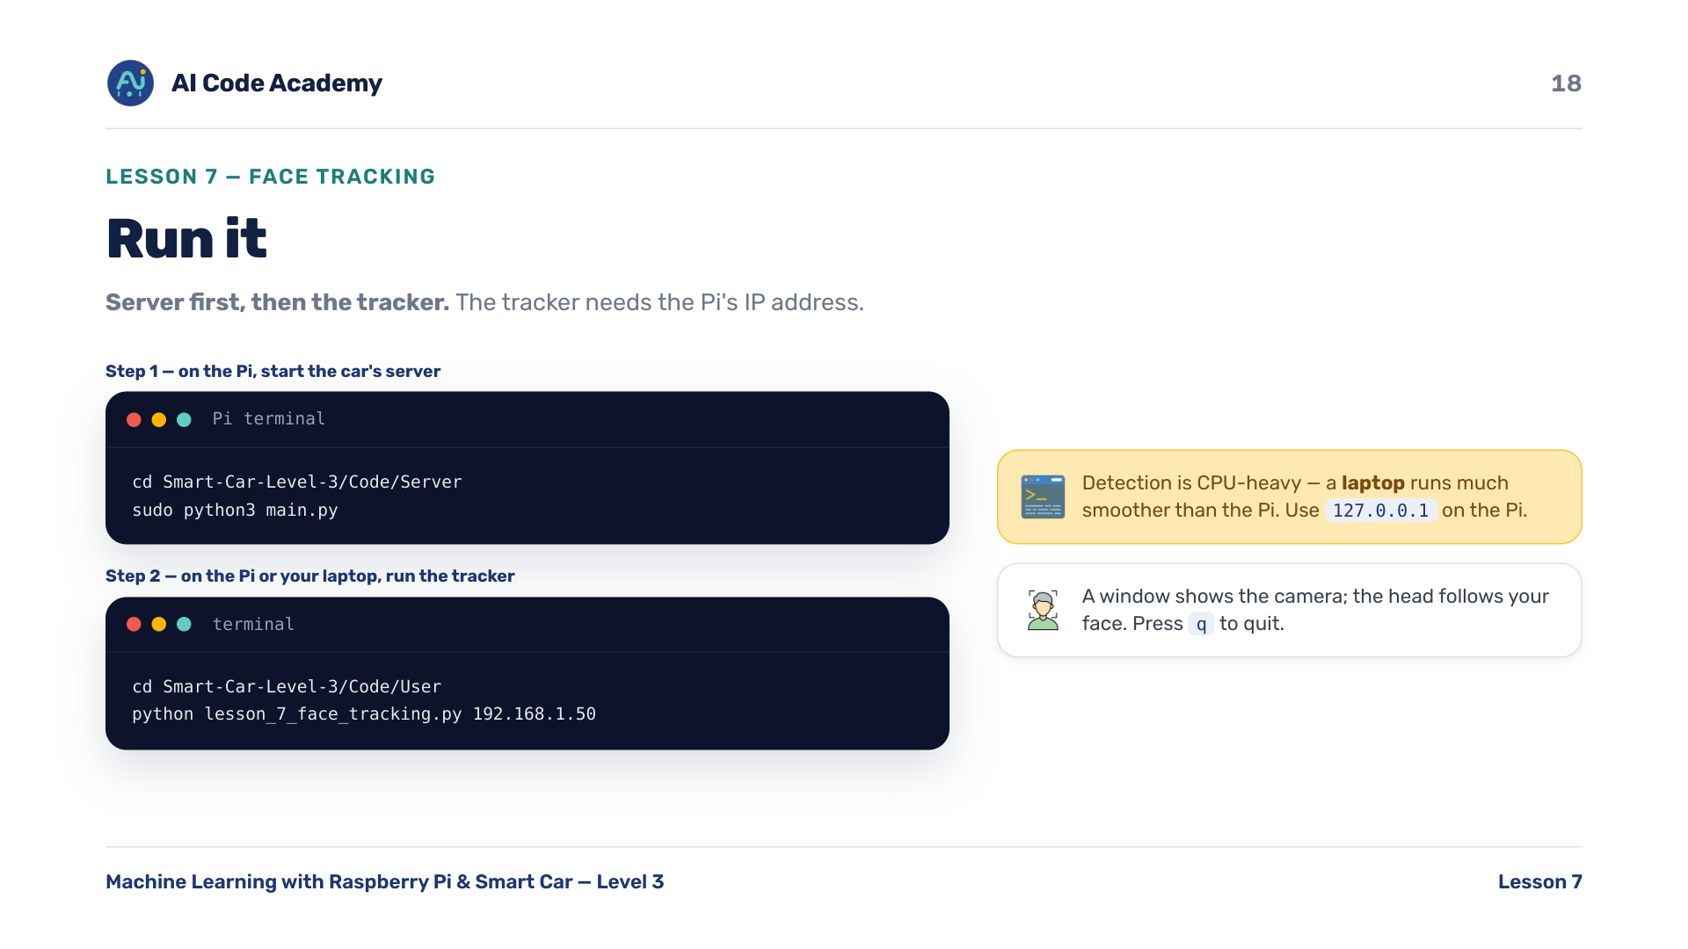
Notes:
Run it — Step 1, on the Pi, start the car's full server: cd Smart-Car-Level-3/Code/Server then sudo python3 main.py. Step 2, on the Pi or your laptop, cd Smart-Car-Level-3/Code/User then run the tracker with the Pi's IP: python lesson_7_face_tracking.py 192.168.1.50. A window shows the camera; the head follows your face. Press q to quit. Face detection is CPU-heavy — a laptop runs it much smoother than the Pi. Use 127.0.0.1 on the Pi.

Slide 19
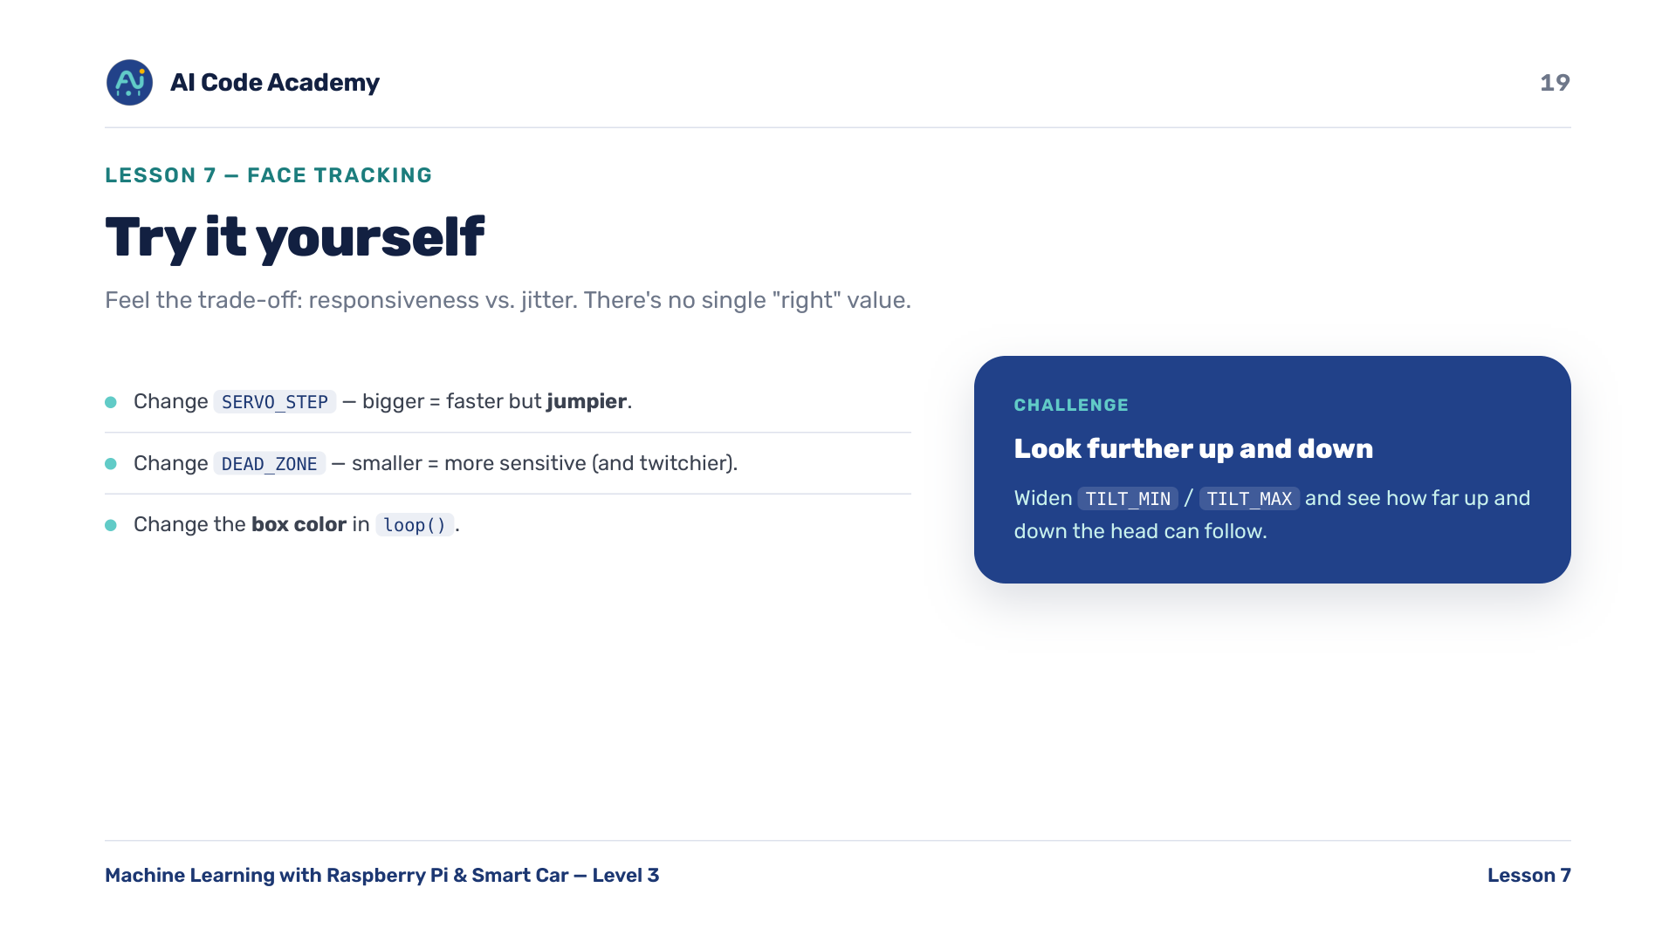
Notes:
Try it yourself — change SERVO_STEP (bigger = faster but jumpier), change DEAD_ZONE (smaller = more sensitive and twitchier), change the box color in loop(). Challenge: widen TILT_MIN / TILT_MAX and see how far up/down it can follow. Let them feel the trade-off: responsiveness vs jitter. There's no single right value.

Slide 20
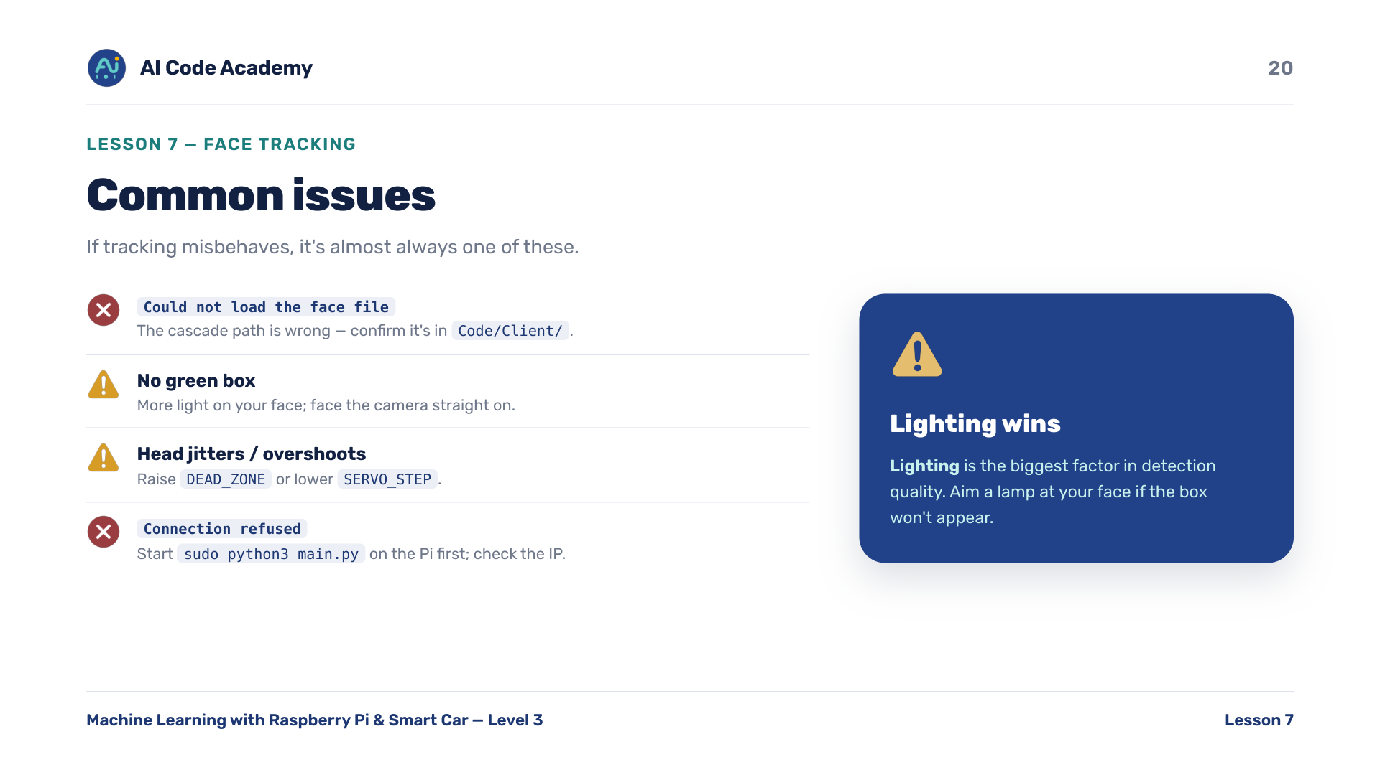
Notes:
Troubleshooting — Could not load the face file means the cascade path is wrong; confirm it's in Code/Client/. No green box means more light on the face and face the camera straight on. Head jitters / overshoots means raise DEAD_ZONE or lower SERVO_STEP. Connection refused means start sudo python3 main.py on the Pi first and check the IP. Lighting is the biggest factor in detection quality — aim a lamp at the student's face if needed.

Slide 21
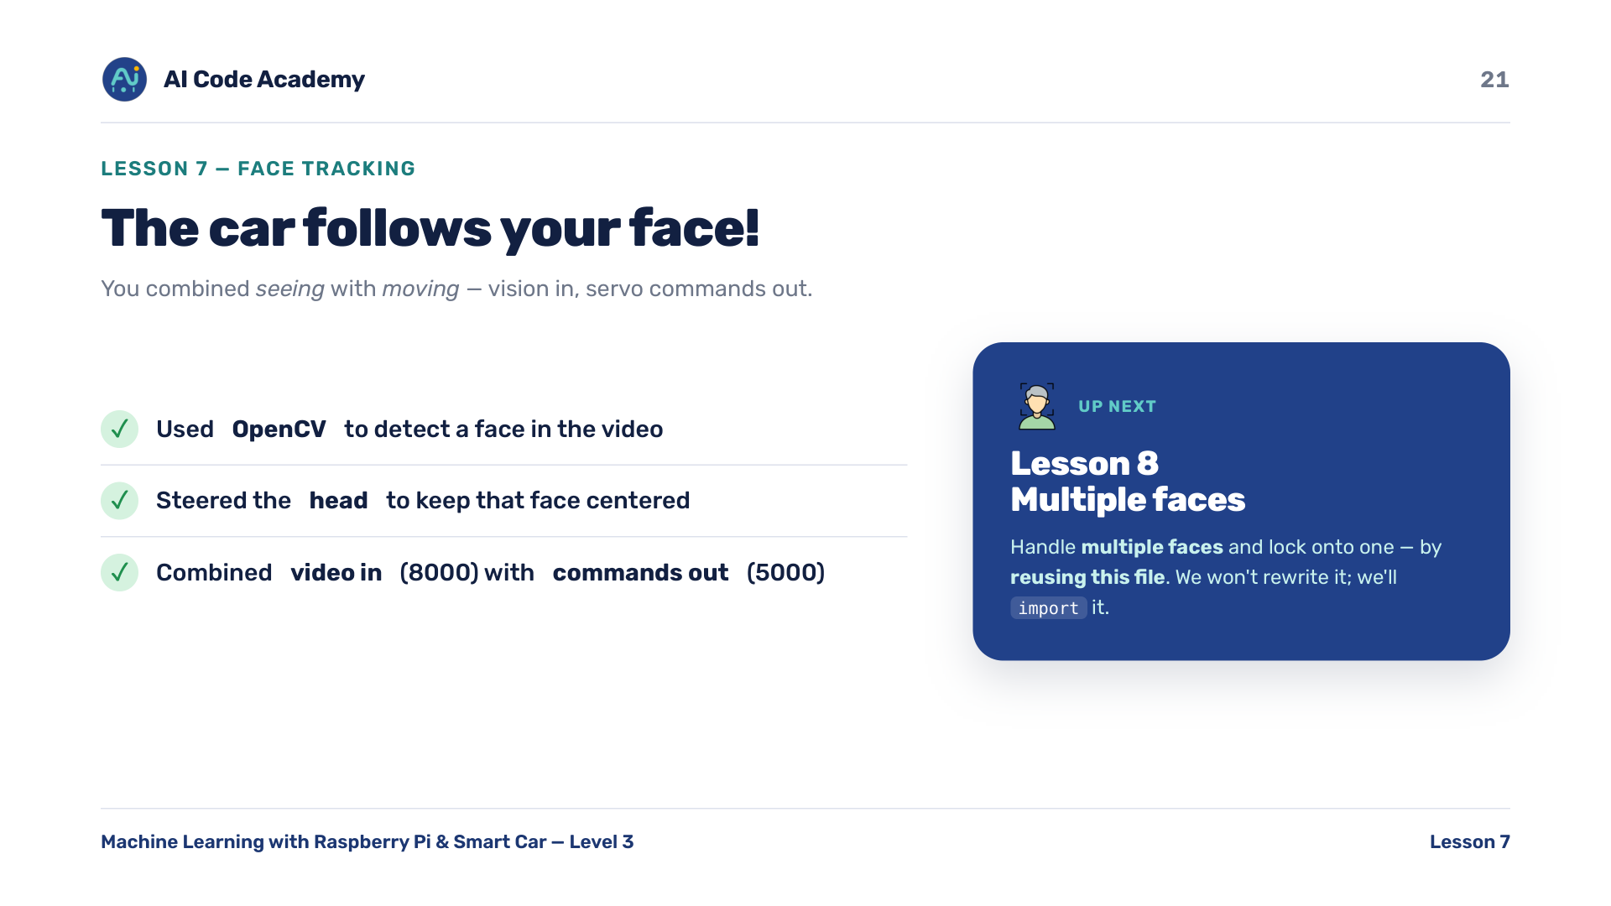
Notes:
Recap & what's next — you used OpenCV to detect a face and steered the head to follow it; you combined video in (8000) with commands out (5000). Next, Lesson 8: handle multiple faces and lock onto one — by reusing this file. Tease L8: we won't rewrite any of this, we'll import it.

Slide 22
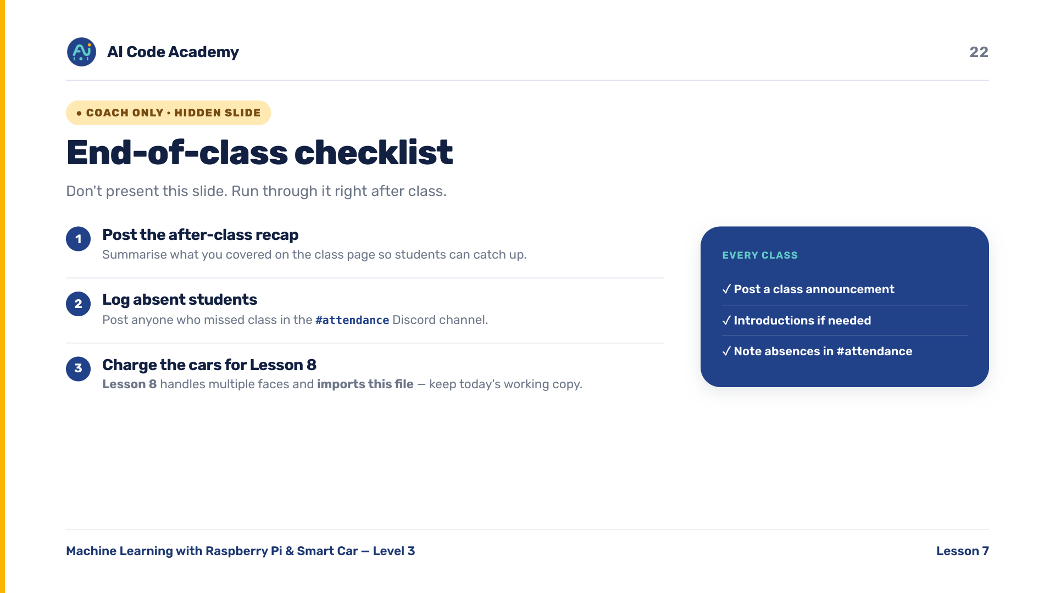
Notes:
COACH (hidden) — do not present. After class: post the recap on the class page, log absent students in the Discord #attendance channel. Timing ~50-55 min: intro + concepts ~14 min, build ~22 min, run + experiment ~12 min, troubleshoot/recap ~6 min. Most common failures: main.py not running (connection refused), wrong cascade path, poor lighting (no detections), jittery head (tune DEAD_ZONE / SERVO_STEP).

