Slide 1
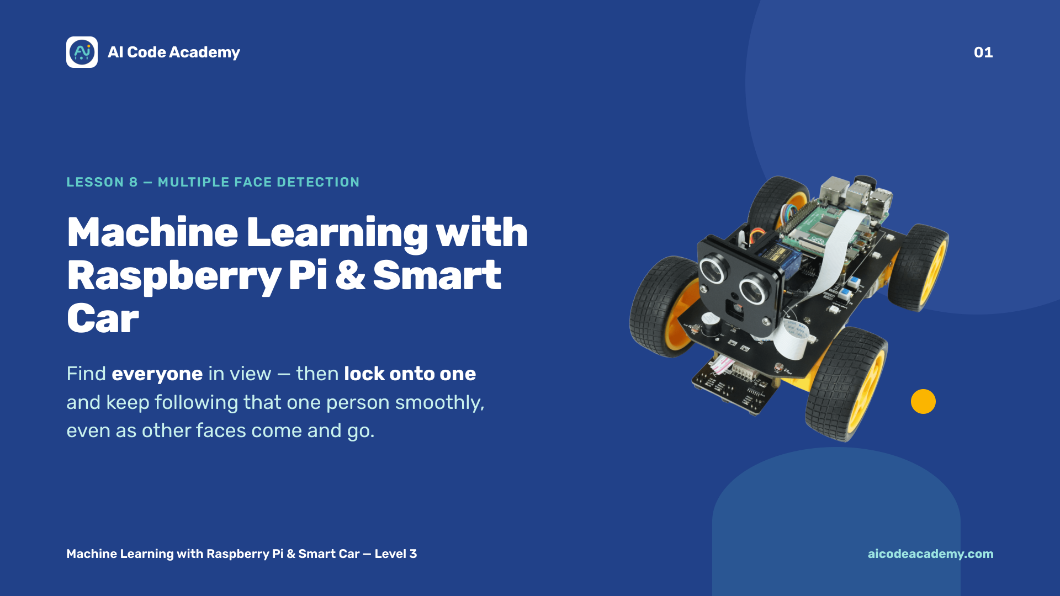
Notes:
Title — ~1 min. This is the last code lesson, and the shortest, because we reuse Lesson 7 almost entirely. Build a little celebration energy: they're about to finish the whole code curriculum. Make sure each Pi runs the full server (sudo python3 main.py) before class, and that every student still has a working lesson_7_face_tracking.py. Site: https://aicodeacademy.com

Slide 2
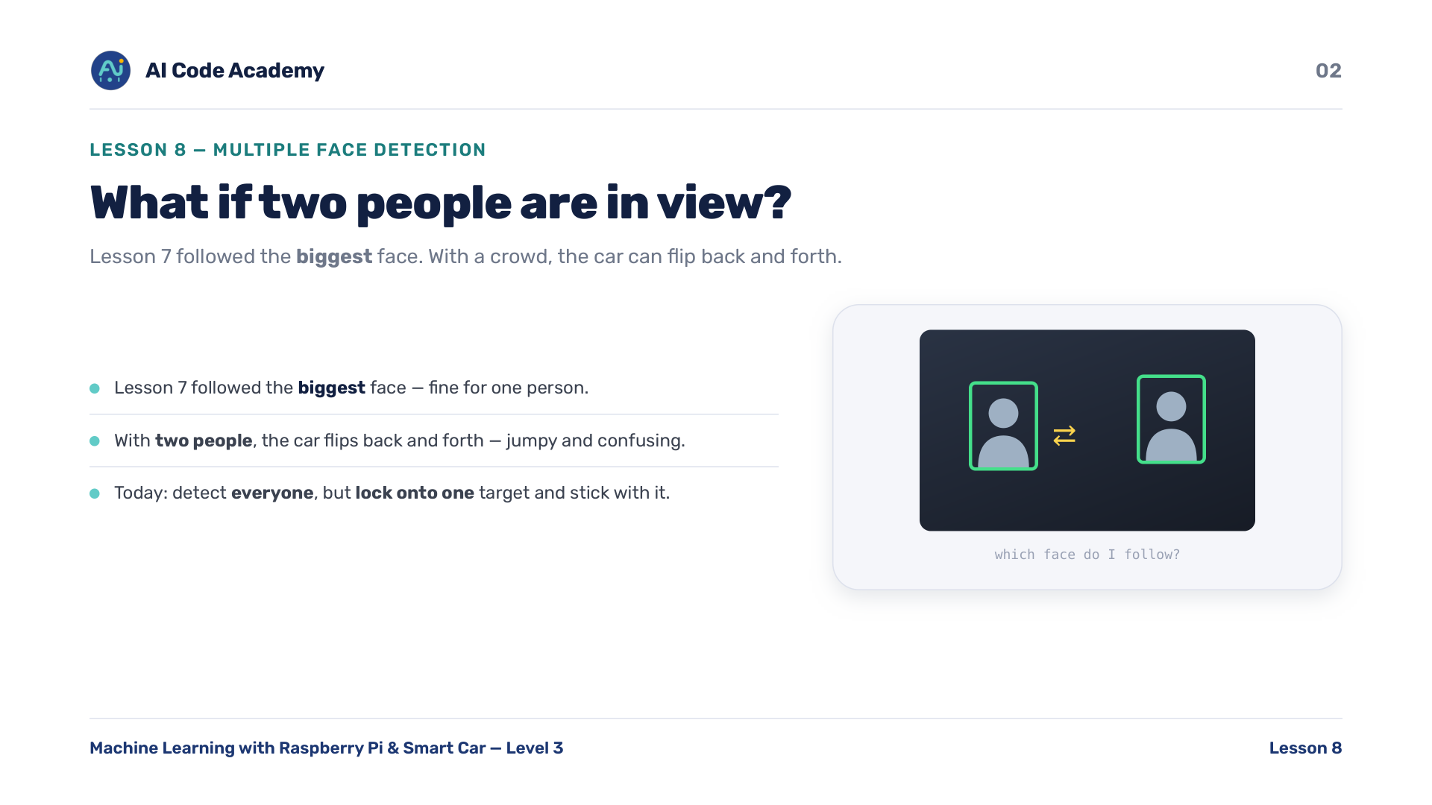
Notes:
Introduction — Lesson 7 followed the biggest face. But what happens with two people in view? The car flips back and forth between faces — jumpy and confusing. Today we detect everyone, but lock onto one target and stick with it. If you can, demo the problem live: get two students in frame and watch Lesson 7 jump around.

Slide 3
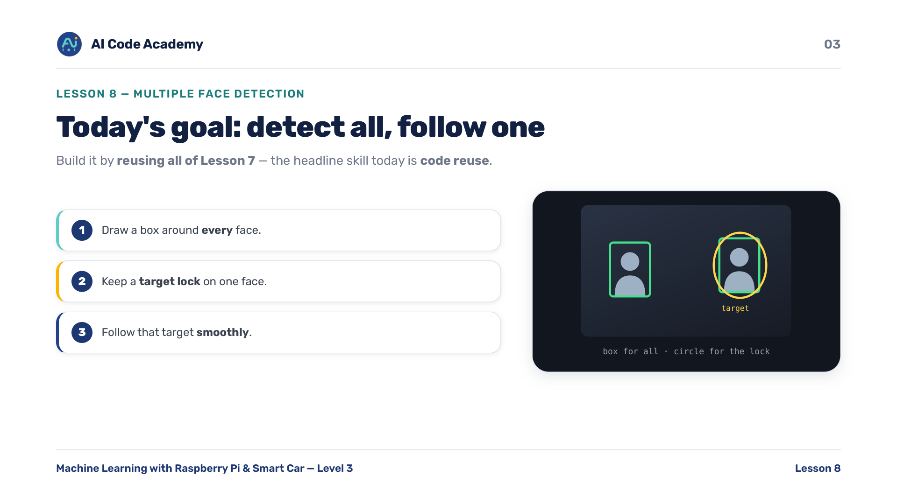
Notes:
Our goals — build a program that draws a box around every face, keeps a target lock on one face, and follows that target smoothly. The headline skill today is code reuse, not new hardware: we do it by reusing all of Lesson 7. Almost no new hardware code at all.

Slide 4
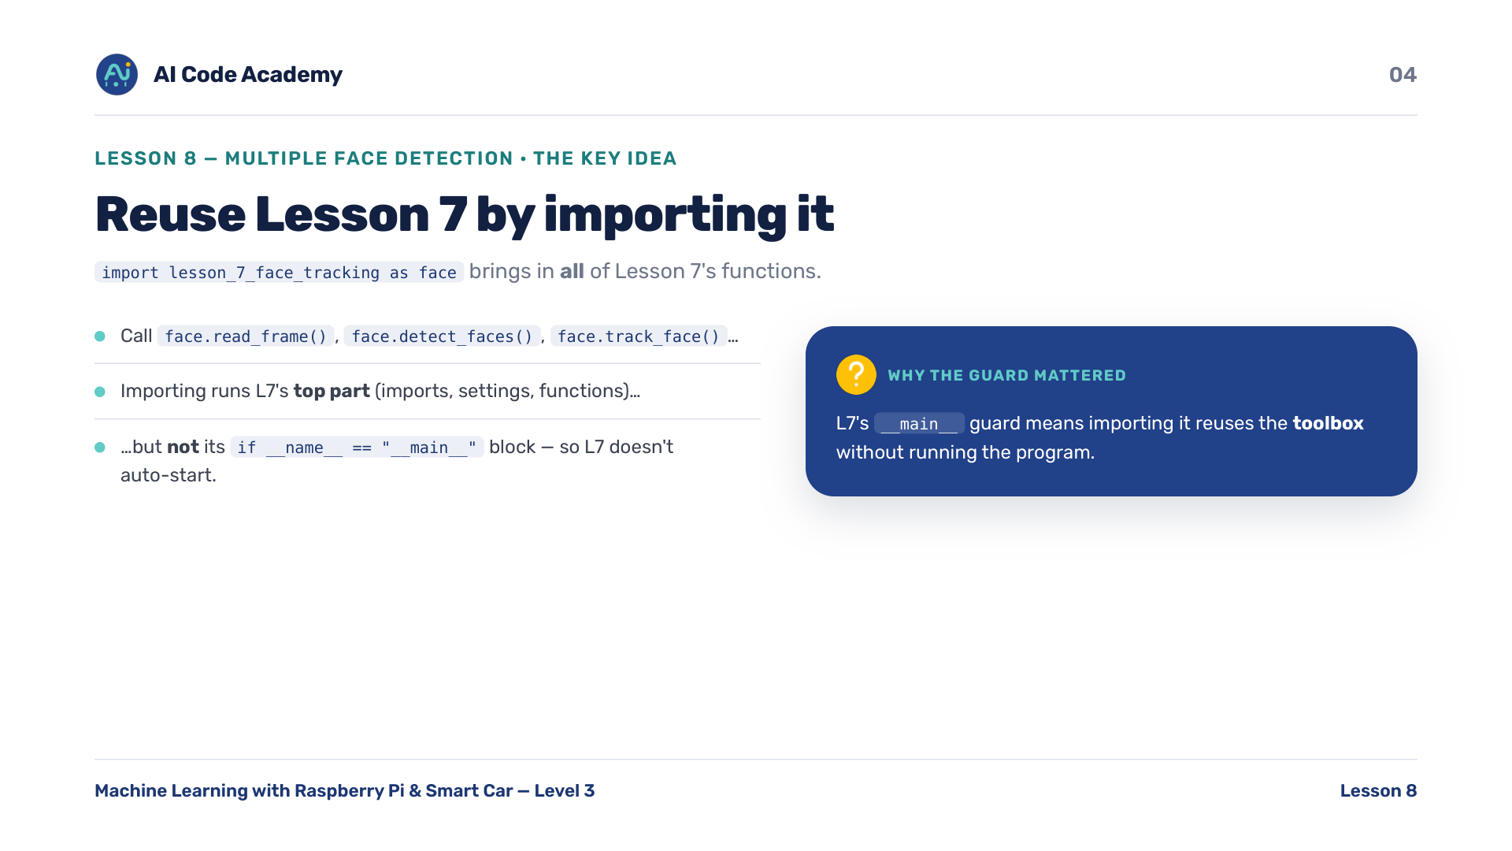
Notes:
Reusing Lesson 7 by importing it — import lesson_7_face_tracking as face brings in ALL of L7's functions. We then call face.read_frame(), face.detect_faces(), face.track_face(), and so on. Importing a file runs its top part (imports, settings, functions) but NOT its __main__ block — so Lesson 7 doesn't start running on its own. This is exactly why L7's __main__ guard mattered: importing reuses the toolbox without running the program.

Slide 5
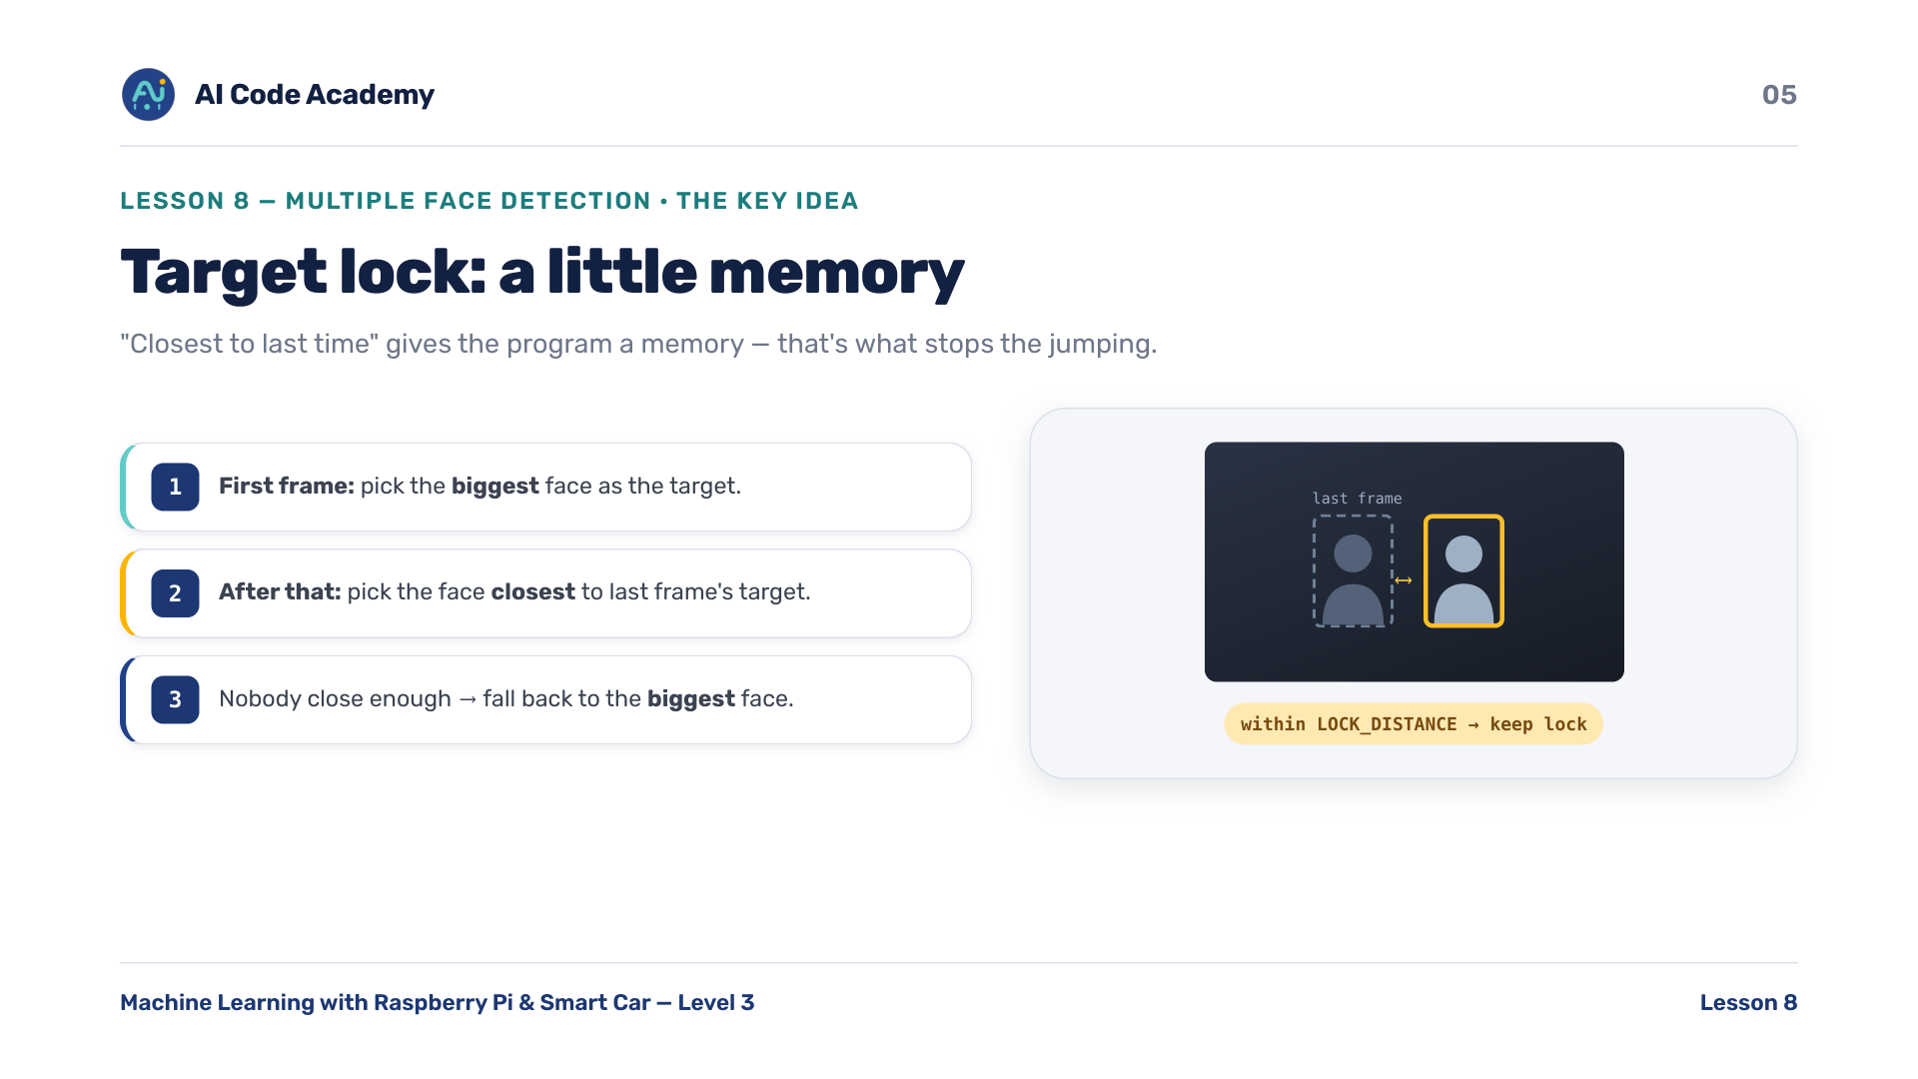
Notes:
Target lock — on the first frame, pick the biggest face as the target. After that, pick the detected face closest to where the target was last frame. If the nearest face is within LOCK_DISTANCE pixels, keep the lock. If nobody is close enough, fall back to the biggest face. 'Closest to last time' gives the program a simple memory — that's what stops the jumping.

Slide 6
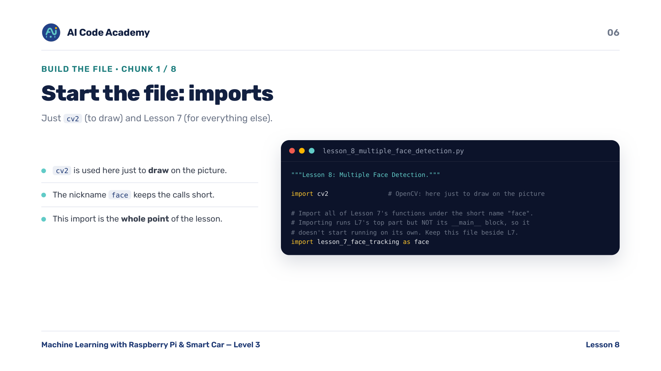
Notes:
Imports (chunk 1/8) — just cv2 (to draw on the picture) and Lesson 7 (for everything else). The nickname 'face' keeps the calls short. Spend a moment on this import line — it's the whole point of the lesson. Keep this file beside lesson_7_face_tracking.py.

Slide 7
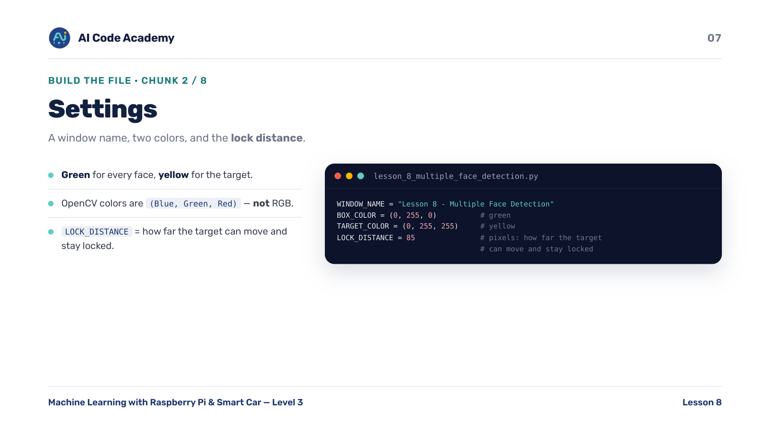
Notes:
Settings (chunk 2/8) — a window name, two colors (green for faces, yellow for the target), and the lock distance. Heads-up: OpenCV colors are (Blue, Green, Red), not RGB. LOCK_DISTANCE is the fun dial students will tune later — bigger sticks harder, smaller switches more easily.

Slide 8
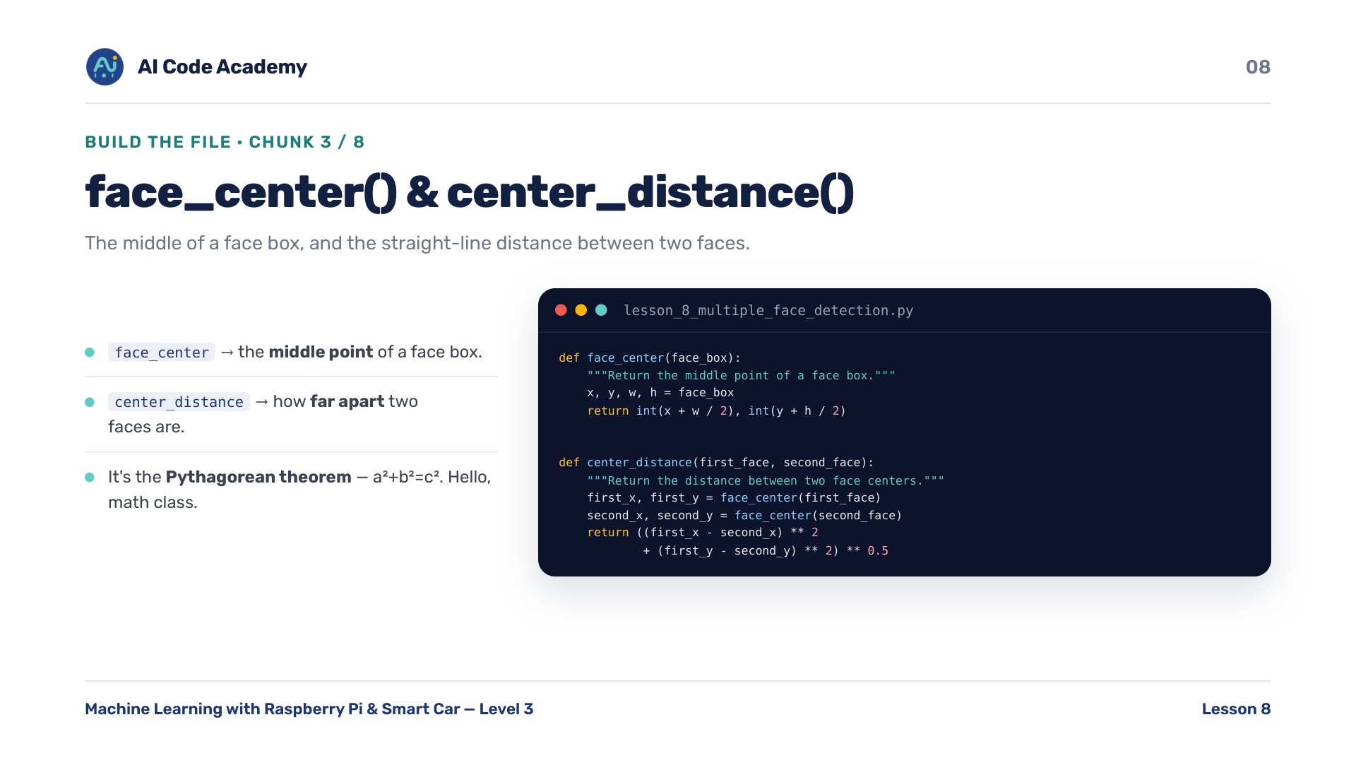
Notes:
face_center() and center_distance() (chunk 3/8) — face_center returns the middle point of a face box. center_distance returns how far apart two faces are, straight-line. center_distance is the Pythagorean theorem (a-squared plus b-squared equals c-squared) — a nice cross-over with math class.

Slide 9
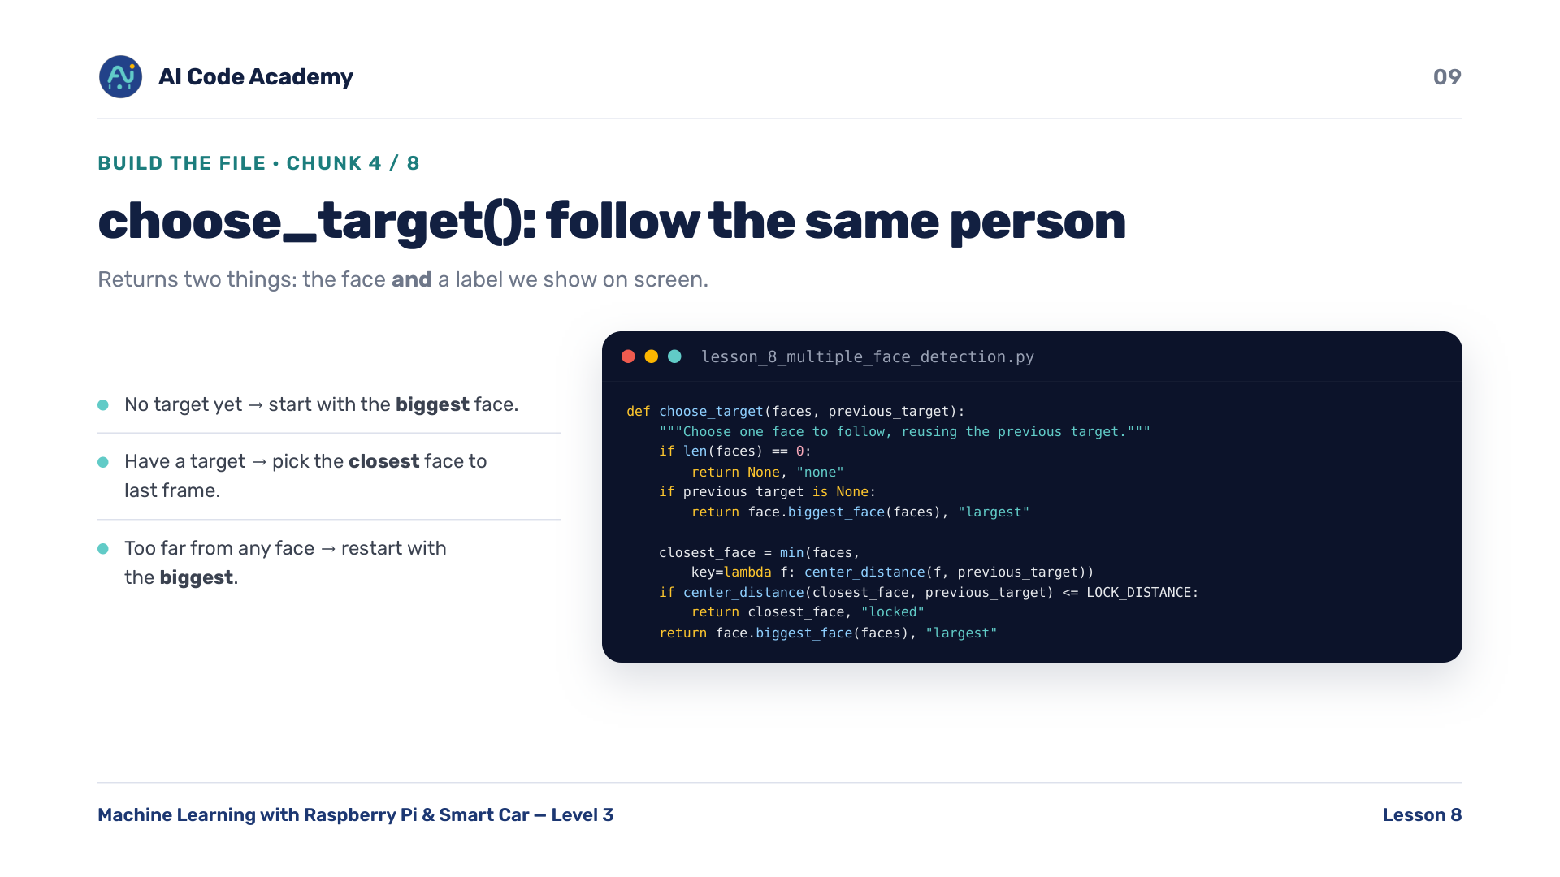
Notes:
choose_target() (chunk 4/8) — no target yet, start with the biggest face. Have a target, pick the closest face to last frame's target. Too far from any face, restart with the biggest. It returns two things: the face AND a label ('largest' / 'locked' / 'none') that we show on screen.

Slide 10
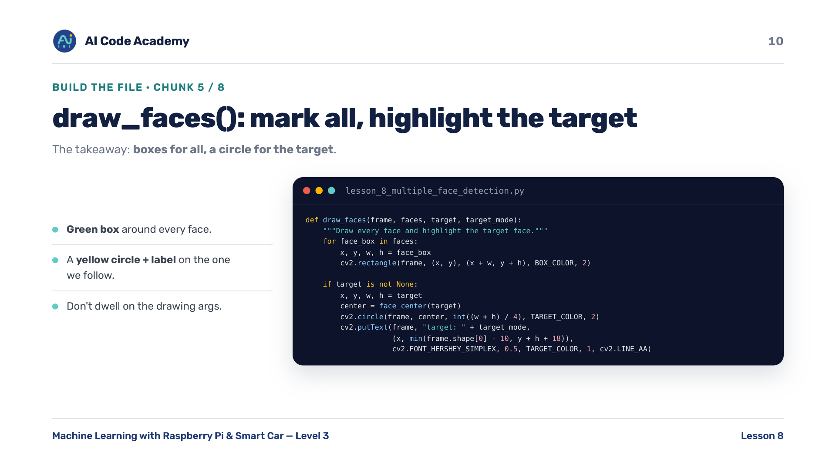
Notes:
draw_faces() (chunk 5/8) — a green box around every face, then a yellow circle plus a label around the one we're following. Don't dwell on the OpenCV drawing arguments — the takeaway is simple: boxes for all, circle for the target.

Slide 11
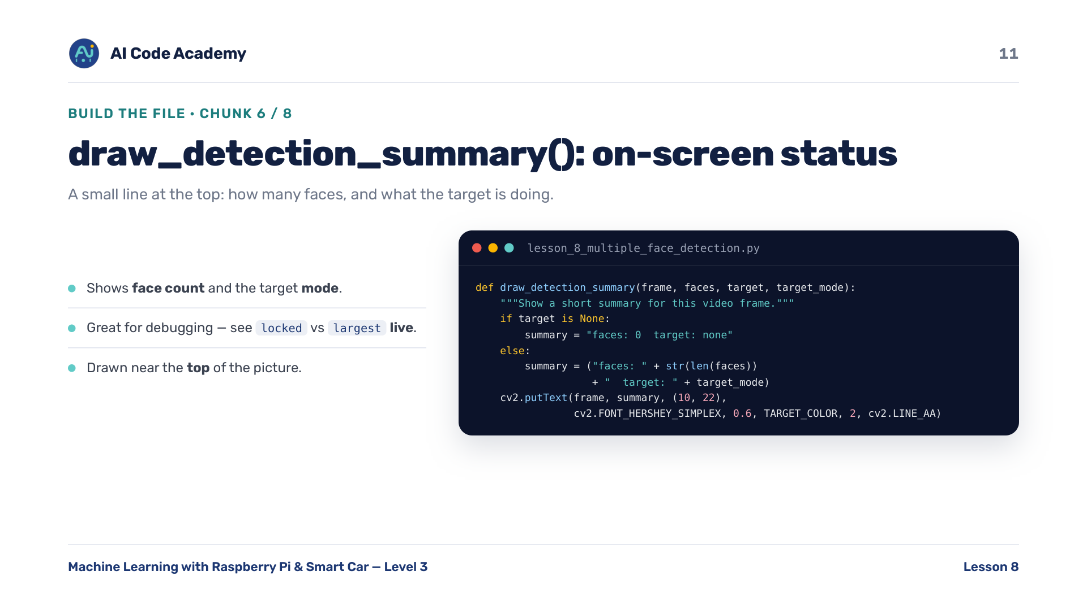
Notes:
draw_detection_summary() (chunk 6/8) — a small line at the top of the picture: how many faces, and what the target is doing. This on-screen text is great for debugging — students can SEE 'locked' versus 'largest' live as they move around.

Slide 12
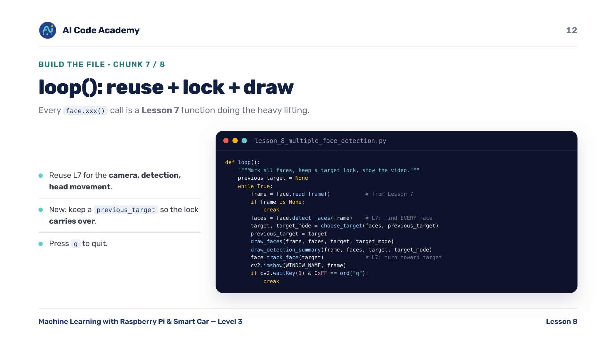
Notes:
loop() (chunk 7/8) — reuse Lesson 7 for the camera (read_frame), detection (detect_faces), and head movement (track_face). The new logic is keeping a previous_target so the lock carries from frame to frame. Point at each face.xxx() call — those are Lesson 7 functions doing the heavy lifting.

Slide 13
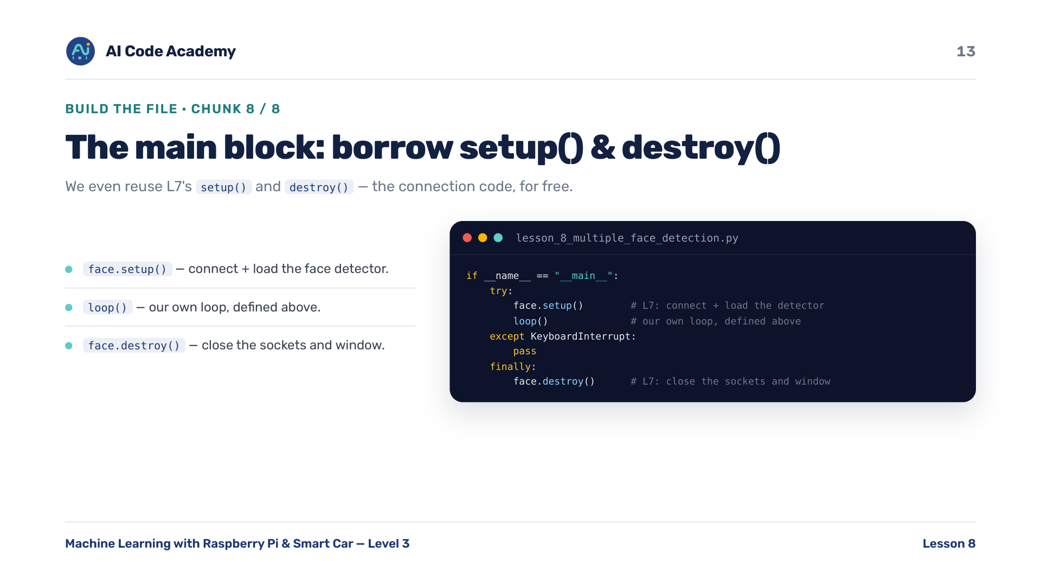
Notes:
The main block (chunk 8/8) — we even reuse Lesson 7's setup() and destroy(), so there's no need to rewrite the connections. face.setup() loads the detector and opens both connections; face.destroy() closes the sockets and window. The connection code from Lesson 7, reused for free.

Slide 14
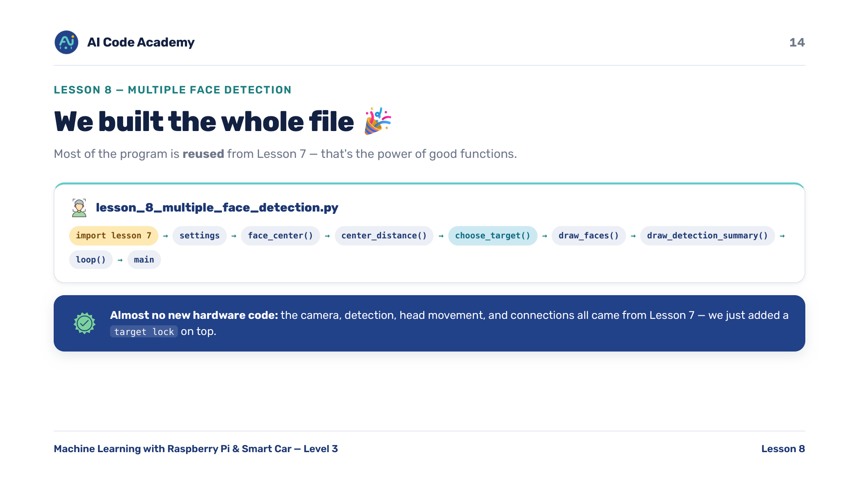
Notes:
We built the whole file — complete lesson_8_multiple_face_detection.py: import L7, settings, face_center()/center_distance(), choose_target(), draw_faces(), draw_detection_summary(), loop(), main. Most of the program is reused from Lesson 7 — that's the power of good functions. Celebrate how little new code this needed; it's the reward for L7's clean design.

Slide 15
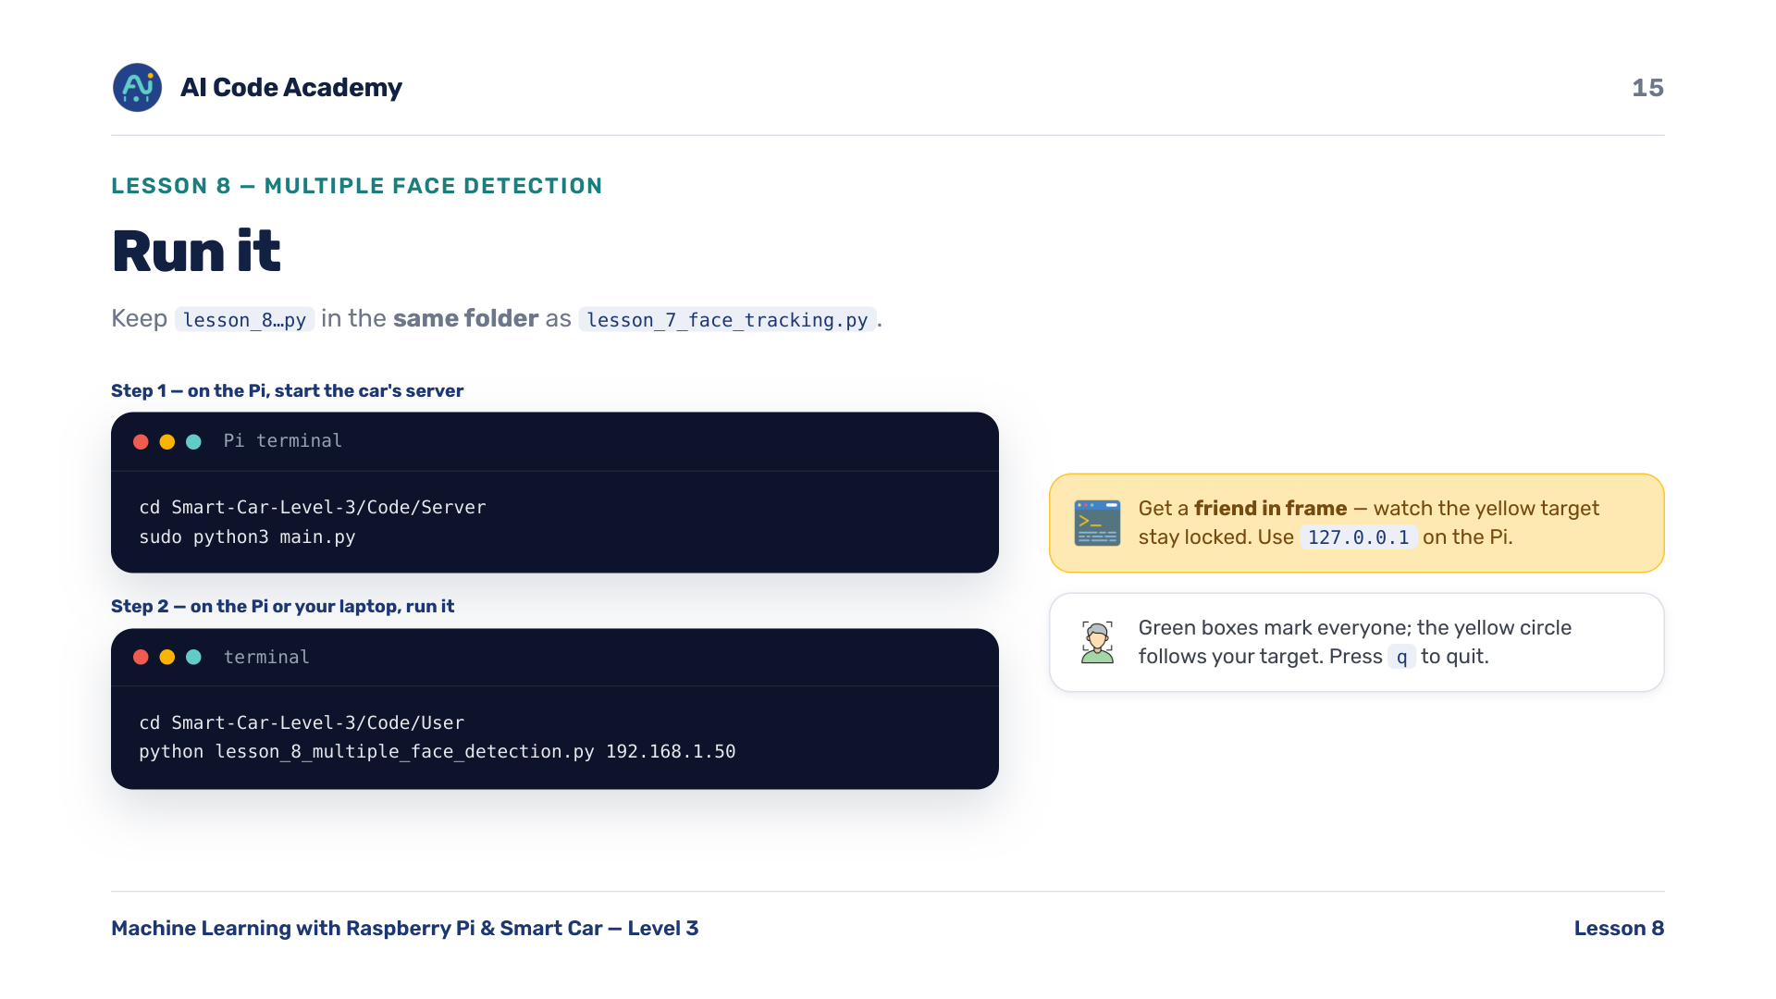
Notes:
Run it — keep lesson_8...py in the SAME folder as lesson_7_face_tracking.py. Step 1, on the Pi, start the car's full server: cd Smart-Car-Level-3/Code/Server then sudo python3 main.py. Step 2, on the Pi or a laptop, cd Smart-Car-Level-3/Code/User then run it with the Pi's IP: python lesson_8_multiple_face_detection.py 192.168.1.50. Get a friend in frame and watch the yellow target stay locked. Press q to quit. Have two students stand in view to show off the lock. Use 127.0.0.1 on the Pi.

Slide 16
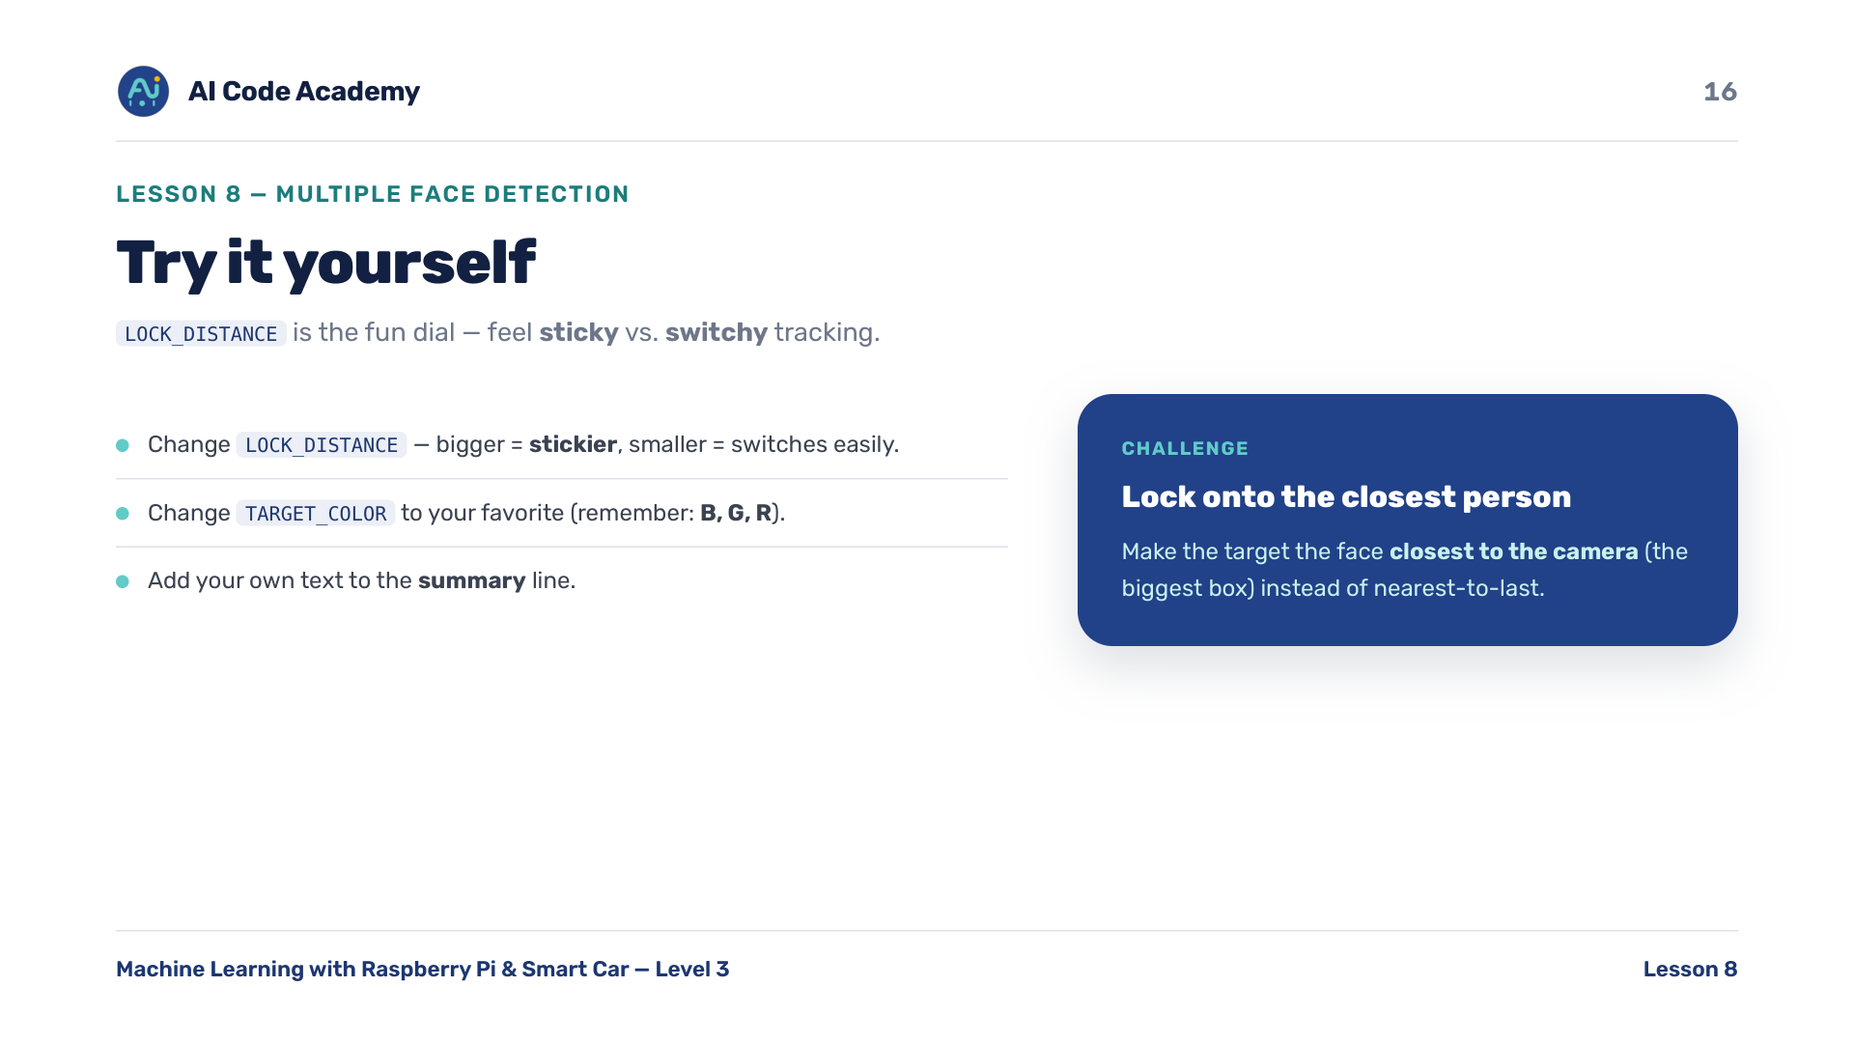
Notes:
Try it yourself — change LOCK_DISTANCE (bigger = stickier lock, smaller = switches more easily). Change TARGET_COLOR to your favorite color (remember B, G, R). Add your own text to the summary line. Challenge: lock onto the face closest to the camera (the biggest) instead of nearest-to-last. LOCK_DISTANCE is the fun dial — let students feel sticky versus switchy tracking.

Slide 17
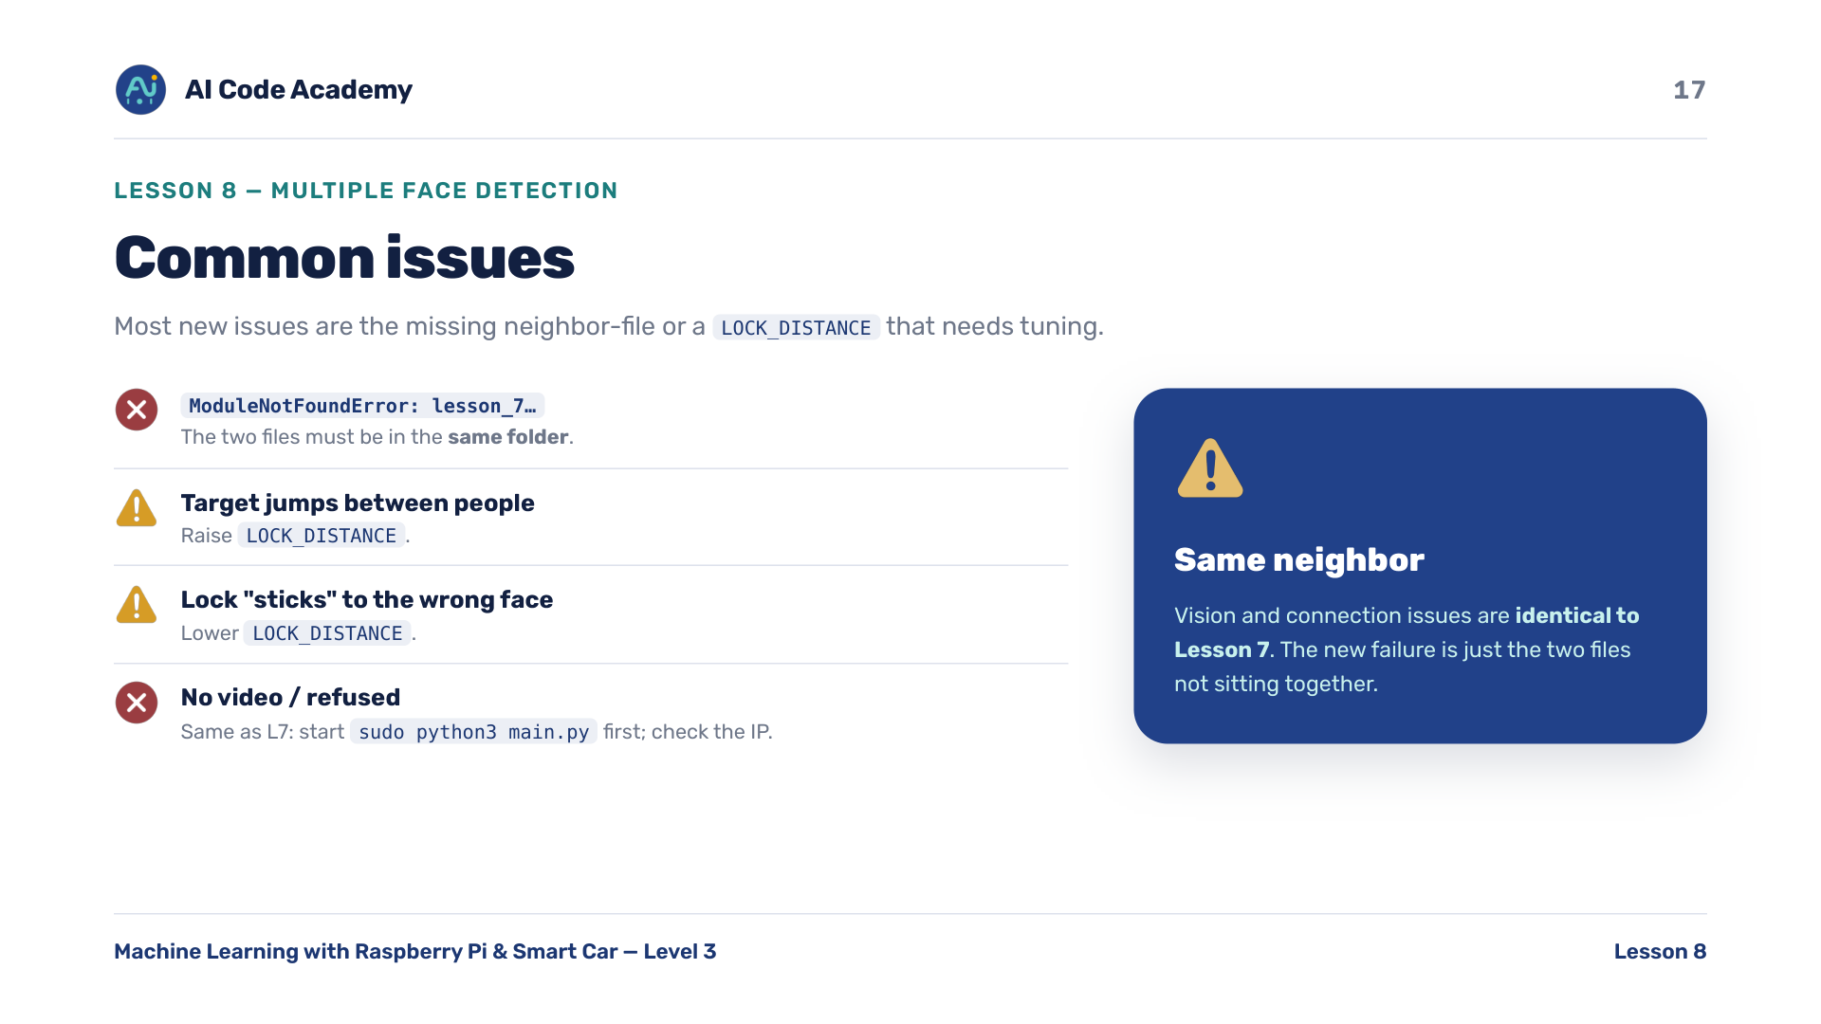
Notes:
Troubleshooting — ModuleNotFoundError: lesson_7_face_tracking means the two files aren't in the same folder. Target jumps between people means raise LOCK_DISTANCE. The lock sticks to the wrong face means lower LOCK_DISTANCE. No video / refused is the same as Lesson 7: start sudo python3 main.py first and check the IP. Most NEW issues are the missing-neighbor-file or a LOCK_DISTANCE that needs tuning; vision and connection issues are identical to Lesson 7.

Slide 18
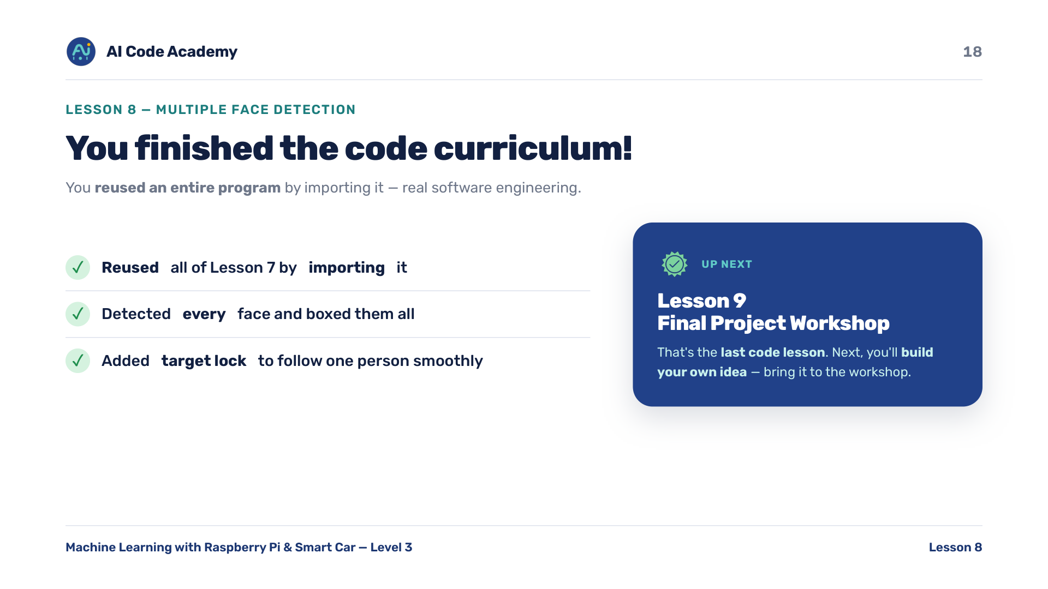
Notes:
Recap & what's next — you reused an entire program by importing it: real software engineering. You added target lock so the car follows one person smoothly. That's the last code lesson! Next, Lesson 9 is the Final Project Workshop — students build their own idea. Big moment: they've finished the code curriculum. Point them toward project ideas for next time.

Slide 19
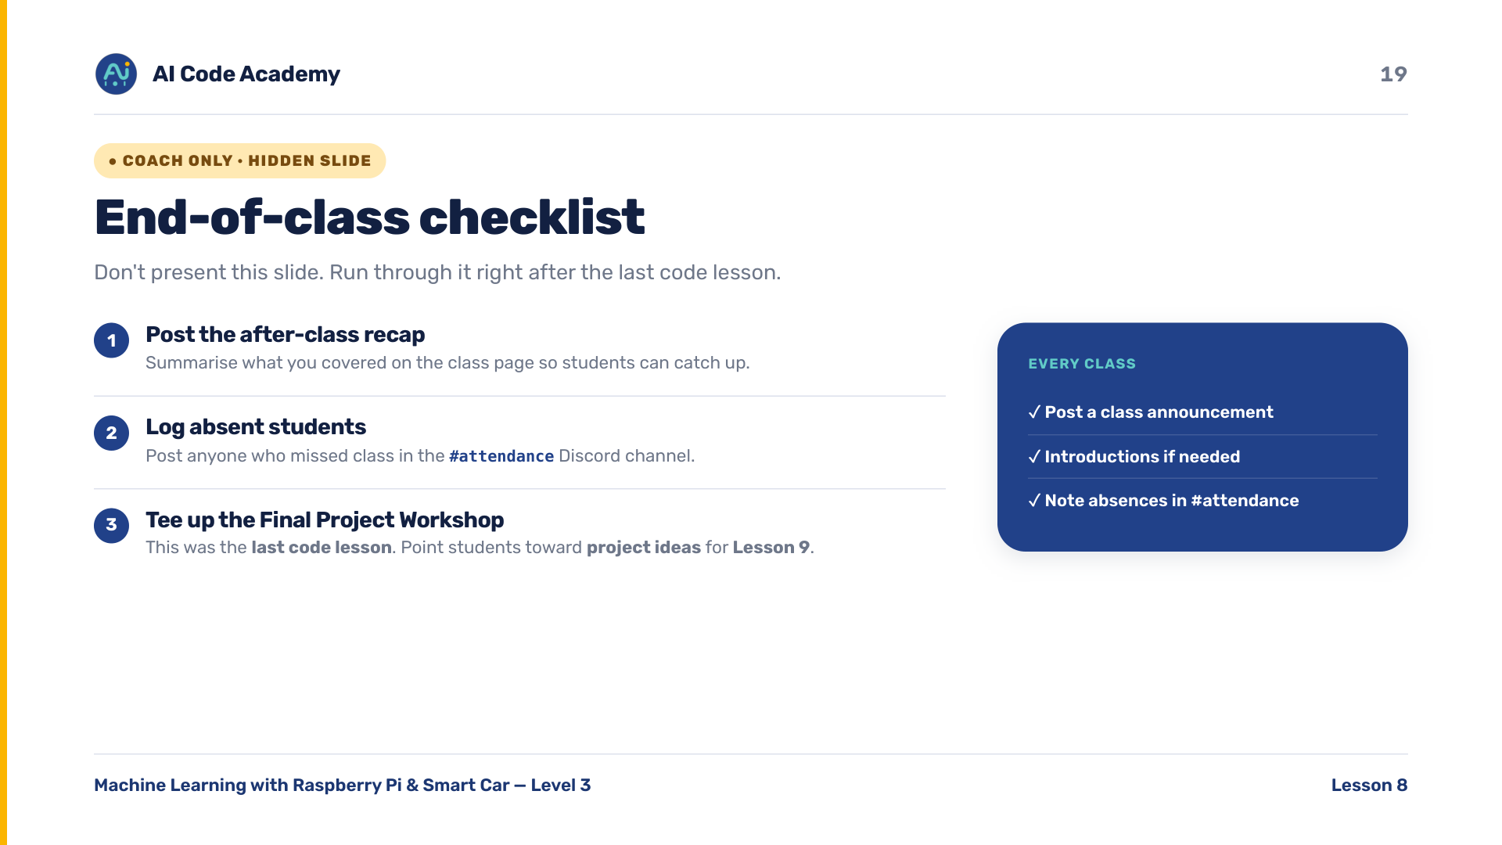
Notes:
COACH (hidden) — do not present. After class: post the recap on the class page, log absent students in the Discord #attendance channel, and remind students this was the last code lesson — Lesson 9 is the Final Project Workshop. Timing ~40-45 min: intro + concepts (slides 1-5) ~12 min, build (6-14) ~16 min, run + experiment (15-16) ~10 min, troubleshoot/recap (17-18) ~5 min. Most common failures: the two lesson files not in the same folder, LOCK_DISTANCE mis-tuned (jumps or sticks), and connection/lighting issues identical to Lesson 7.

