Slide 1

Notes:
Title — ~1 min. Set the tone: today is THEIR day to build. The whole code curriculum is behind them; now they get to combine it into a project of their own. Keep the energy up — this is a celebration, not a new lecture. Site: https://aicodeacademy.com

Slide 2
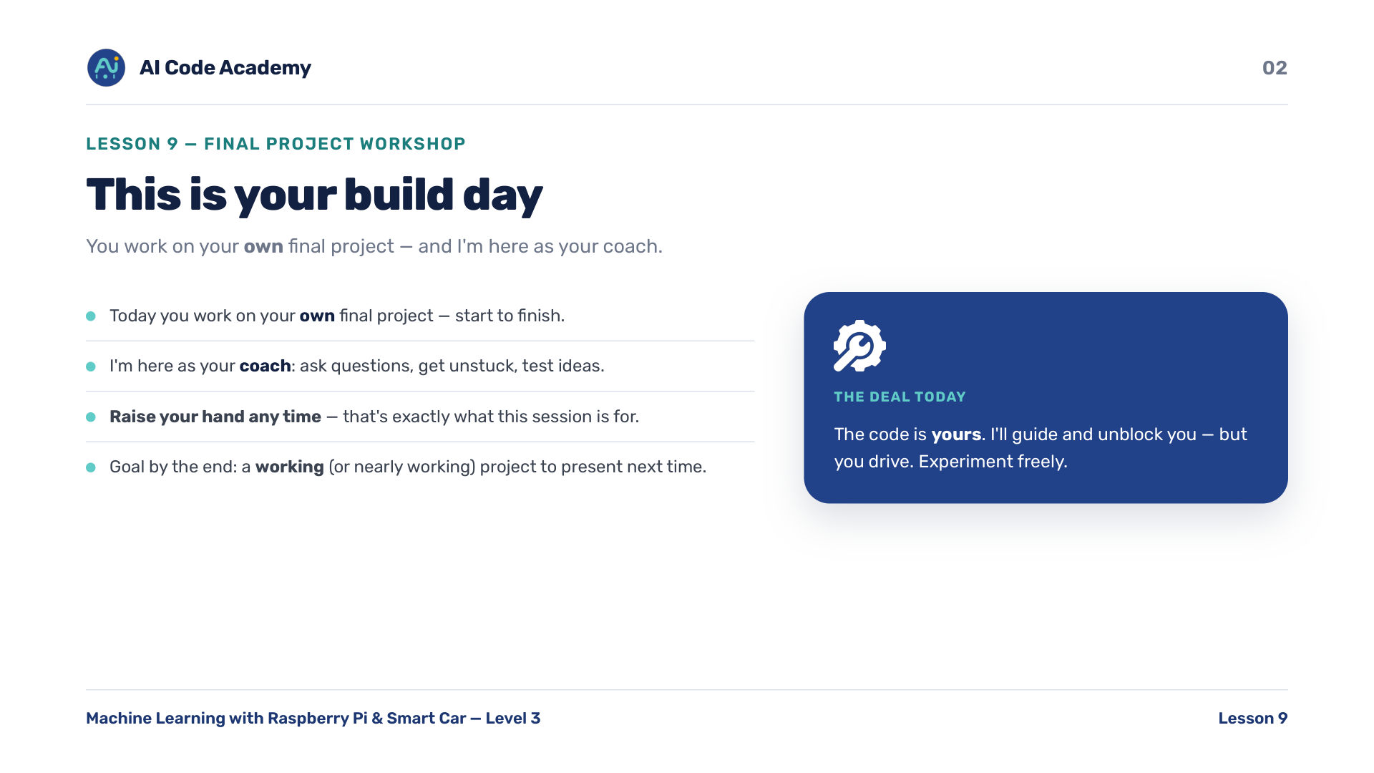
Notes:
Introduction — make it clear this is a build day. You are here as a coach: answer questions, get them unstuck, test ideas with them. The code is theirs — guide, don't write it for them. Tell them to raise a hand any time; that is exactly what the session is for. Goal by the end: a working (or nearly working) project they can present next time.

Slide 3
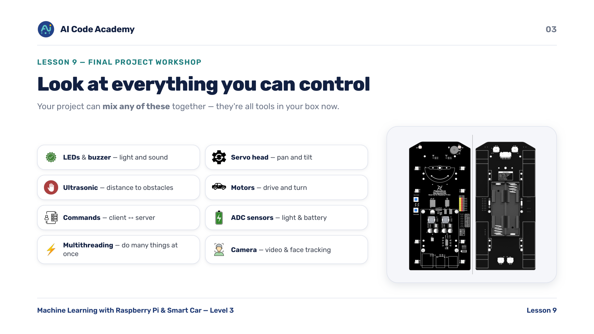
Notes:
Course refresher — quickly name everything they can now control, so they remember the tools in their box: LEDs, buzzer, servo head, ultrasonic distance, motors and the client-server command idea, the ADC light and battery sensors plus multithreading, and the camera with video streaming and face tracking. Keep this to about a minute — it is a memory jog, not a re-teach. Their project can mix any of these together.

Slide 4
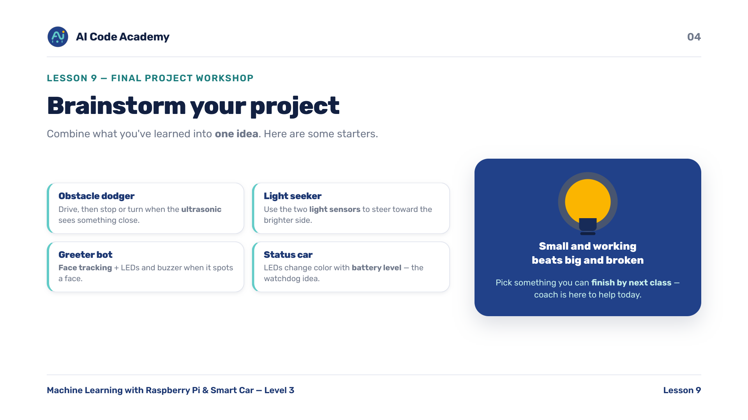
Notes:
Brainstorm — give them starter ideas so nobody freezes: obstacle dodger (drive, stop or turn when the ultrasonic sees something close), light seeker (steer toward the brighter side using the two light sensors), greeter bot (face tracking plus LEDs and buzzer when it spots a face), status car (LEDs change color with battery level — the watchdog idea). Push them to pick something they can finish by next class — it doesn't have to be done today, and the coach is here to help. Small and working beats big and broken.

Slide 5
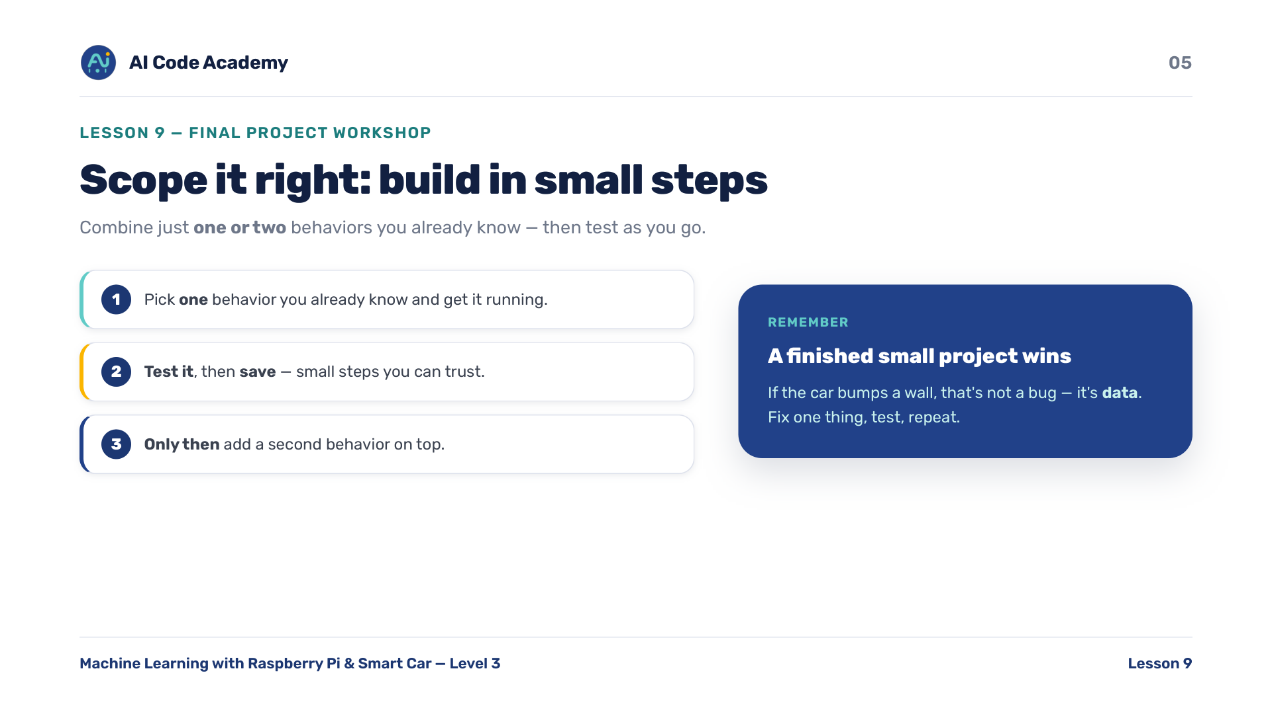
Notes:
Scope it right — this is the single most important coaching message of the day. Steer everyone toward achievable scope: combine just one or two behaviors they already know. Build in small steps and test after each one. Save often. If they get one behavior working, THEN add a second. A finished small project always beats an ambitious broken one — and it presents better next time.

Slide 6
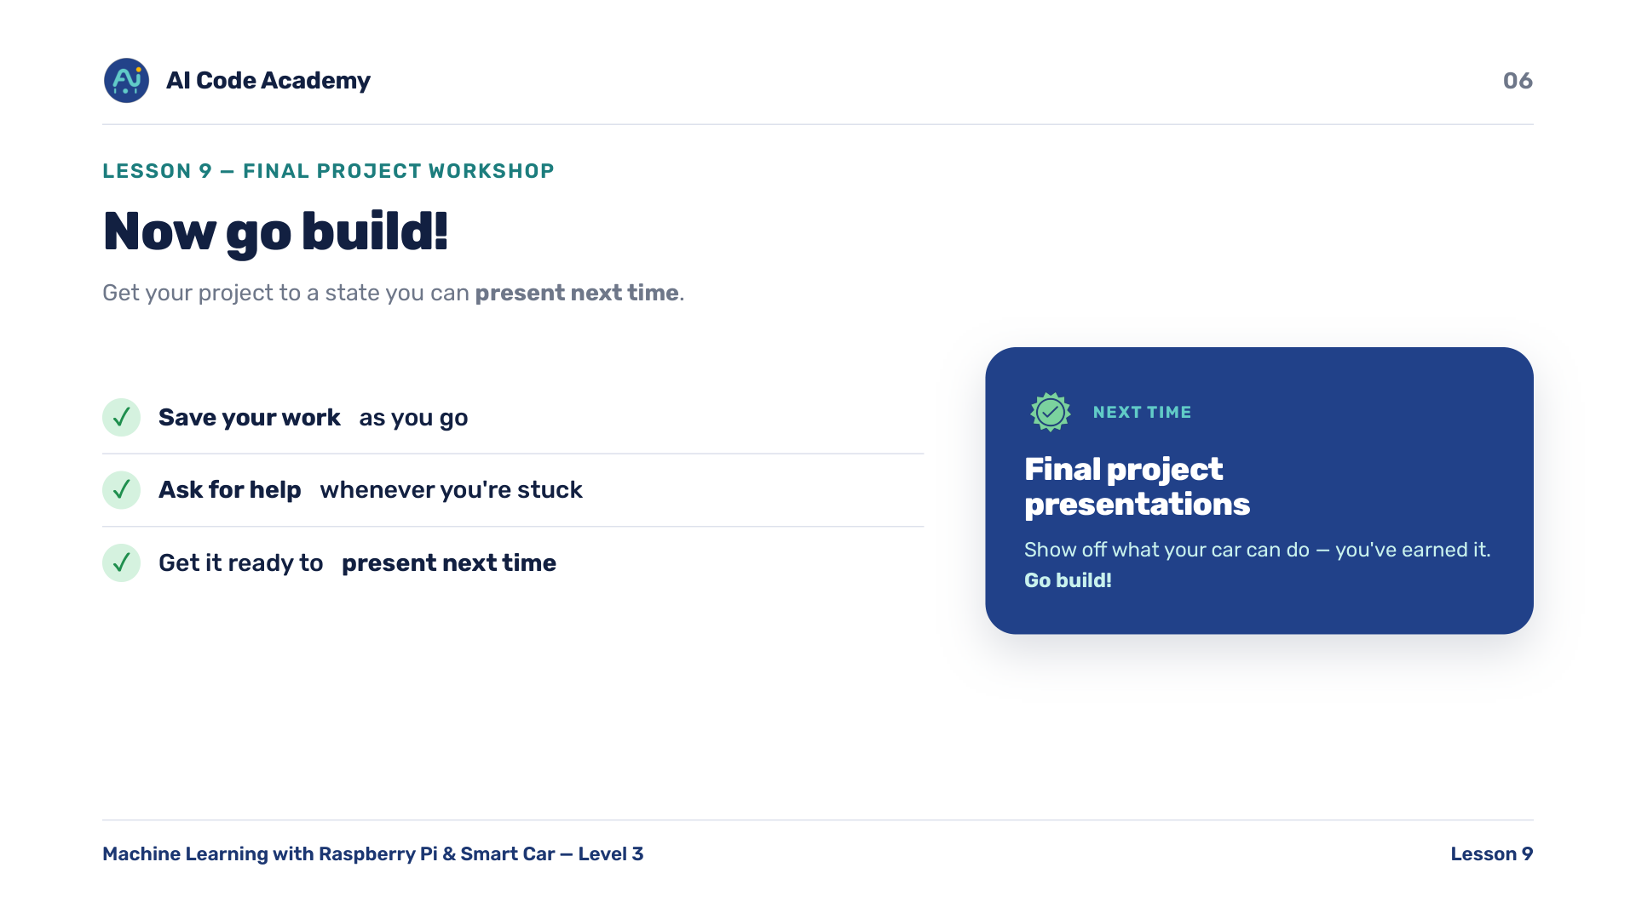
Notes:
Now go build — leave this slide up as a reminder board during work time. Reminders: save your work as you go, ask for help whenever you are stuck, and get the project to a state you can present next time. Give a time check at the halfway point and again about 10 minutes before the end. Next time is Final Project Presentations.

Slide 7
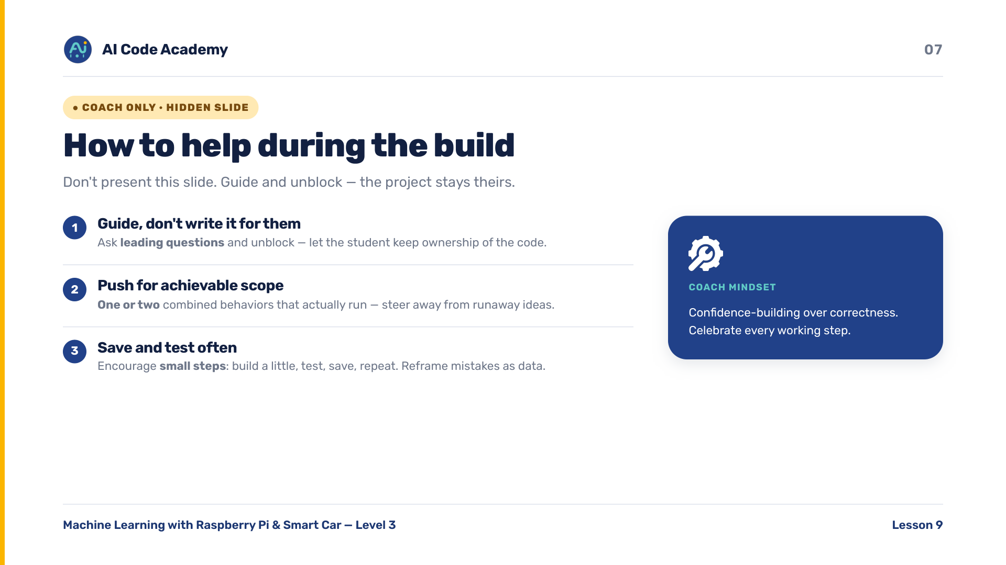
Notes:
COACH (hidden) — do not present. How to help during the build: guide and unblock, don't write their project for them — ask leading questions. Push hard for achievable scope: one or two combined behaviors that actually run. Encourage frequent saving and testing in small steps. Reframe a car bumping a wall as data, not a bug.

Slide 8
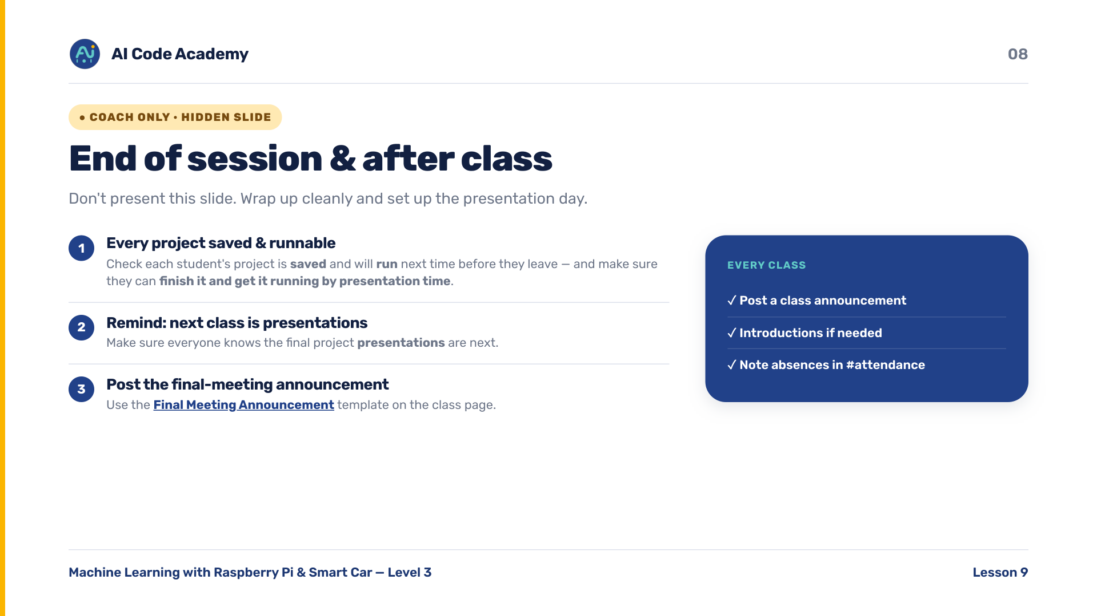
Notes:
COACH (hidden) — do not present. End of session: make sure each student's project is saved and runnable. Remind everyone that next class is presentations. Post the class announcement / final-meeting reminder using the template: https://aicode-coach-resources.notion.site/Final-Meeting-Announcement-9ff5b8cc4d9b4d8ba2691eb52f1b023e . After presentations you will issue certificates to all students and pick the top three (one High Honors, two Honors) via the certificate generator.

