Slide 1

Notes:
Title — ~1 min. Congratulate the group for reaching the final session. Site: https://aicodeacademy.com

Slide 2
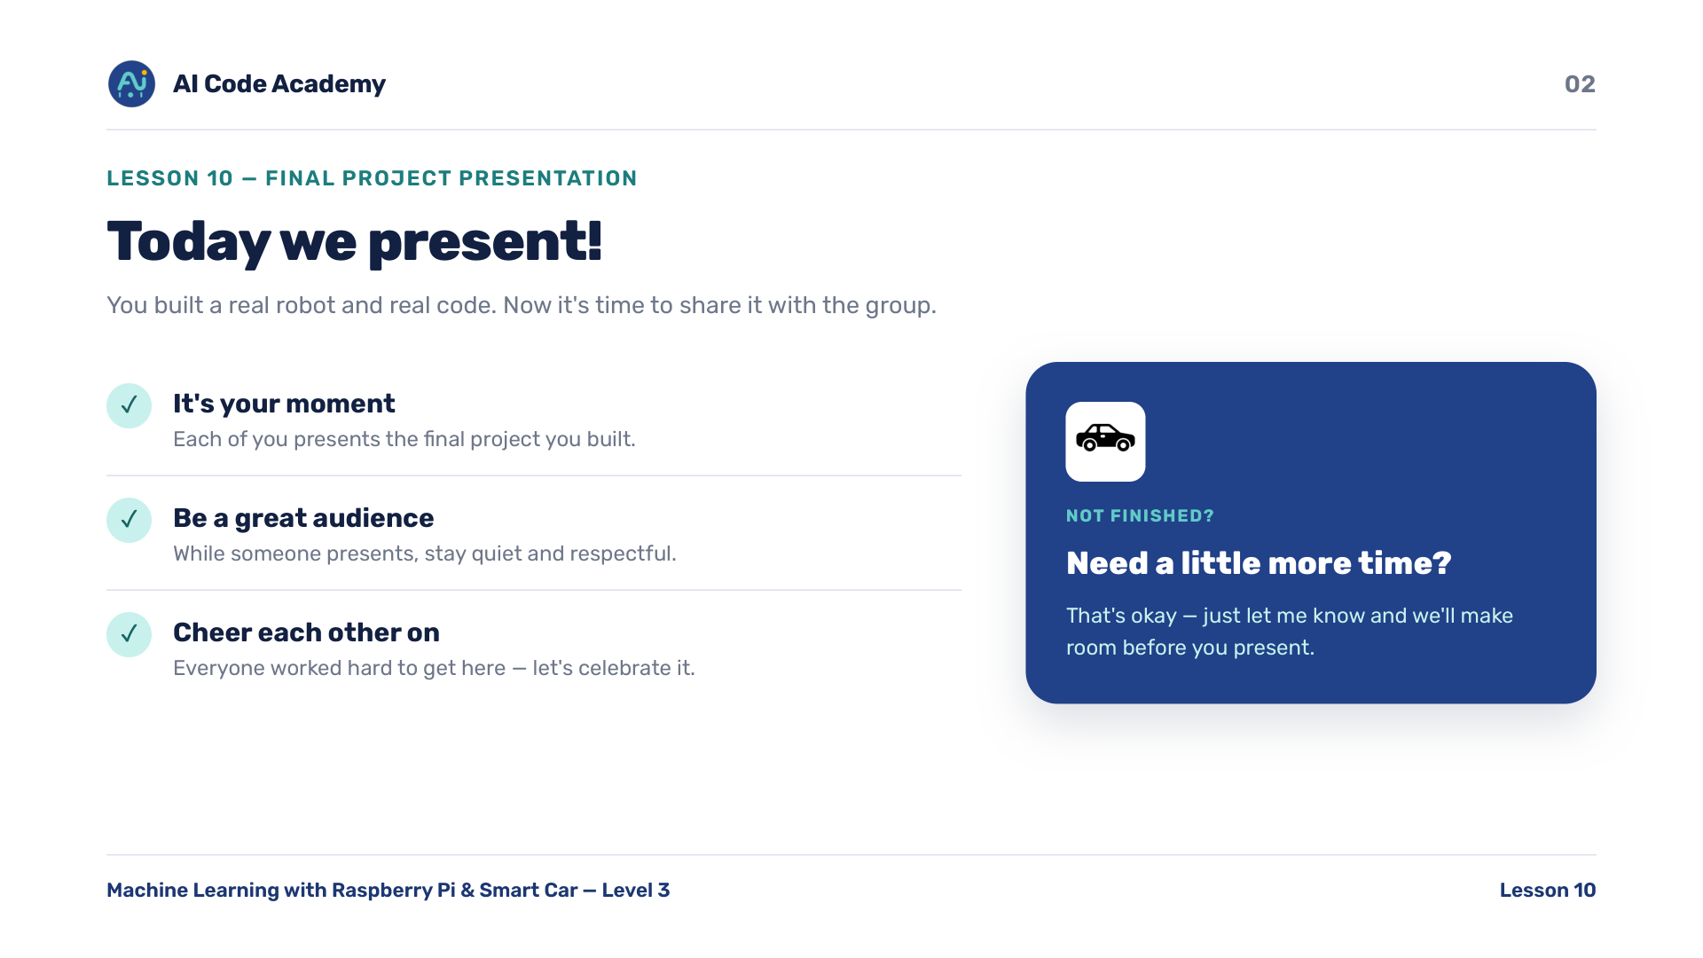
Notes:
Introduction — reassure nervous students. Set the supportive, quiet-audience expectation before the first presenter. If anyone needs a little more build time, offer it now if it fits.

Slide 3
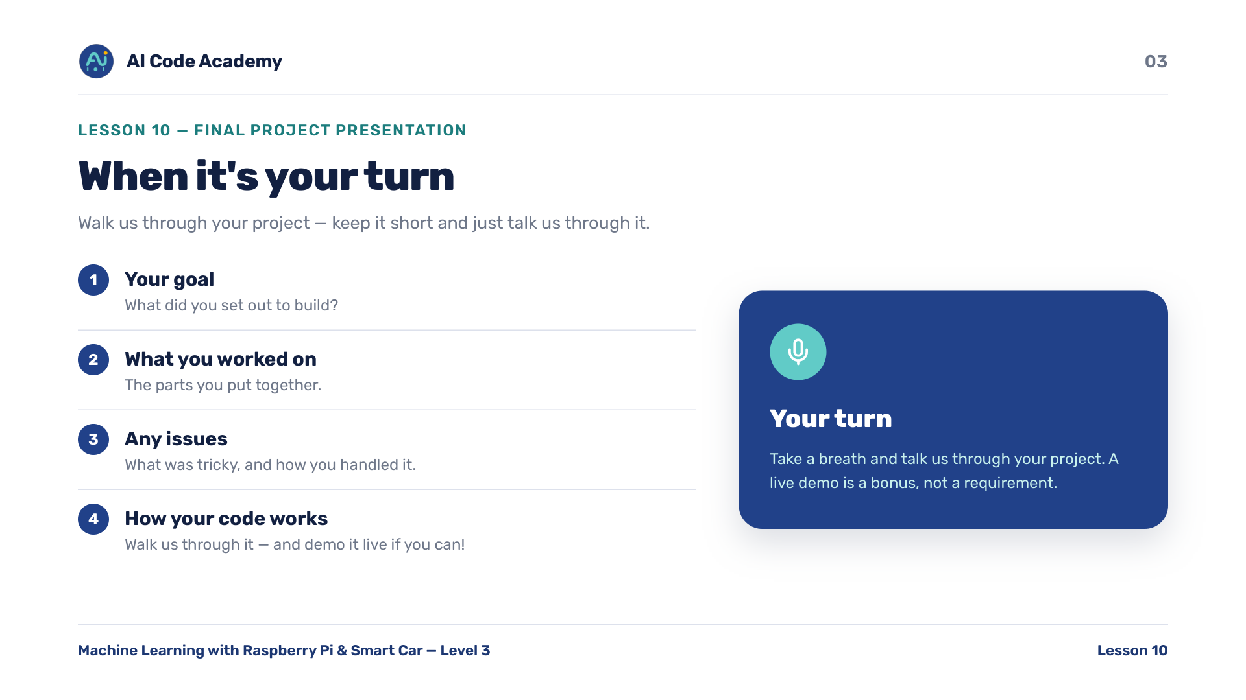
Notes:
Presentation guidelines — keep this slide up during presentations as the rubric. Gently prompt presenters through the four points if they freeze. Encourage a live demo when the project runs.

Slide 4
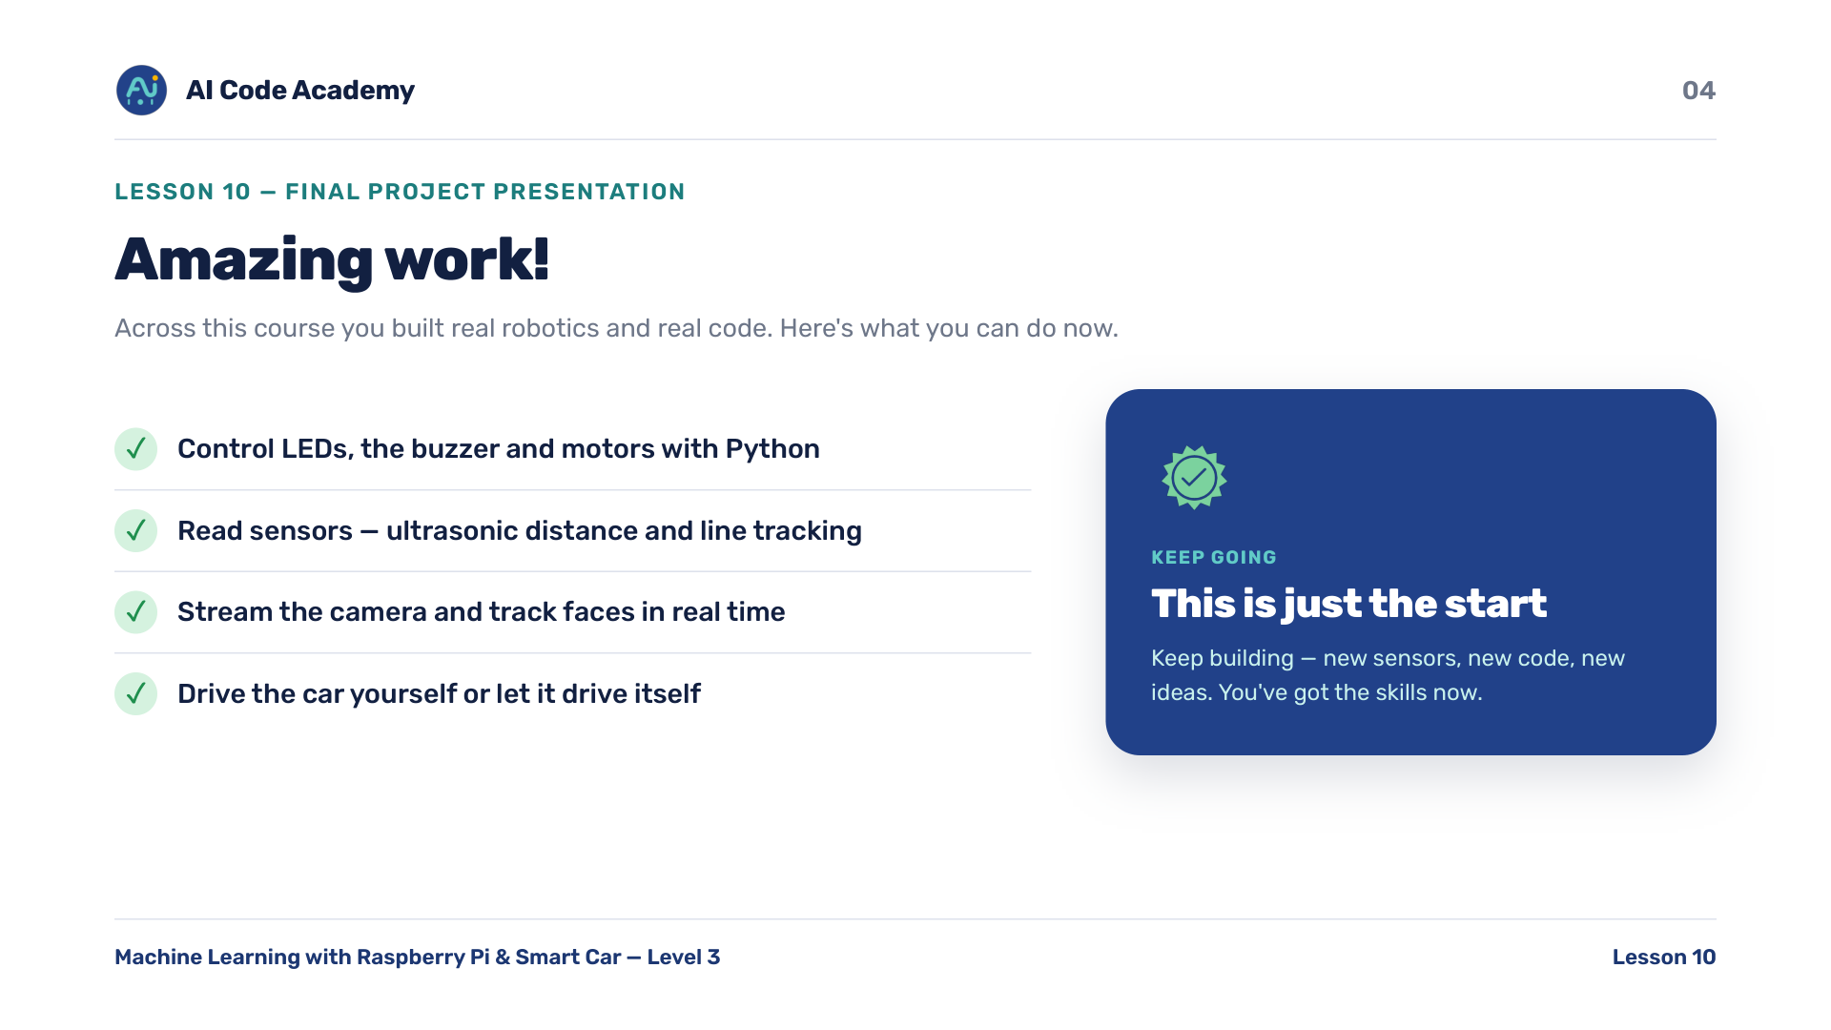
Notes:
Conclusion — celebrate everyone. They built real robotics and real code across the course.

Slide 5
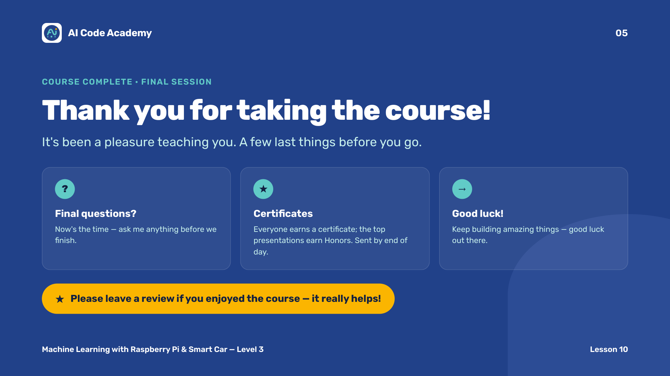
Notes:
Course thank-you — thank students; certificates go out after class. Ask for a review. Final Meeting Announcement: https://aicode-coach-resources.notion.site/Final-Meeting-Announcement-9ff5b8cc4d9b4d8ba2691eb52f1b023e

Slide 6
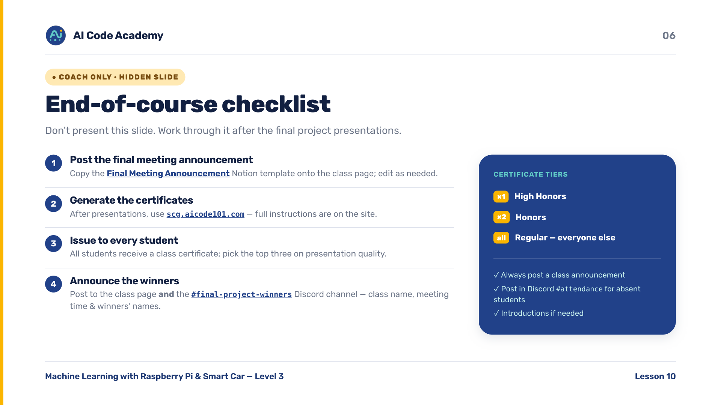
Notes:
COACH (hidden) — do not present. Final Meeting Announcement: https://aicode-coach-resources.notion.site/Final-Meeting-Announcement-9ff5b8cc4d9b4d8ba2691eb52f1b023e | Certificates: https://scg.aicode101.com/ | Post winners (class name, meeting time, names) in the Discord #final-project-winners channel.

