Slide 1
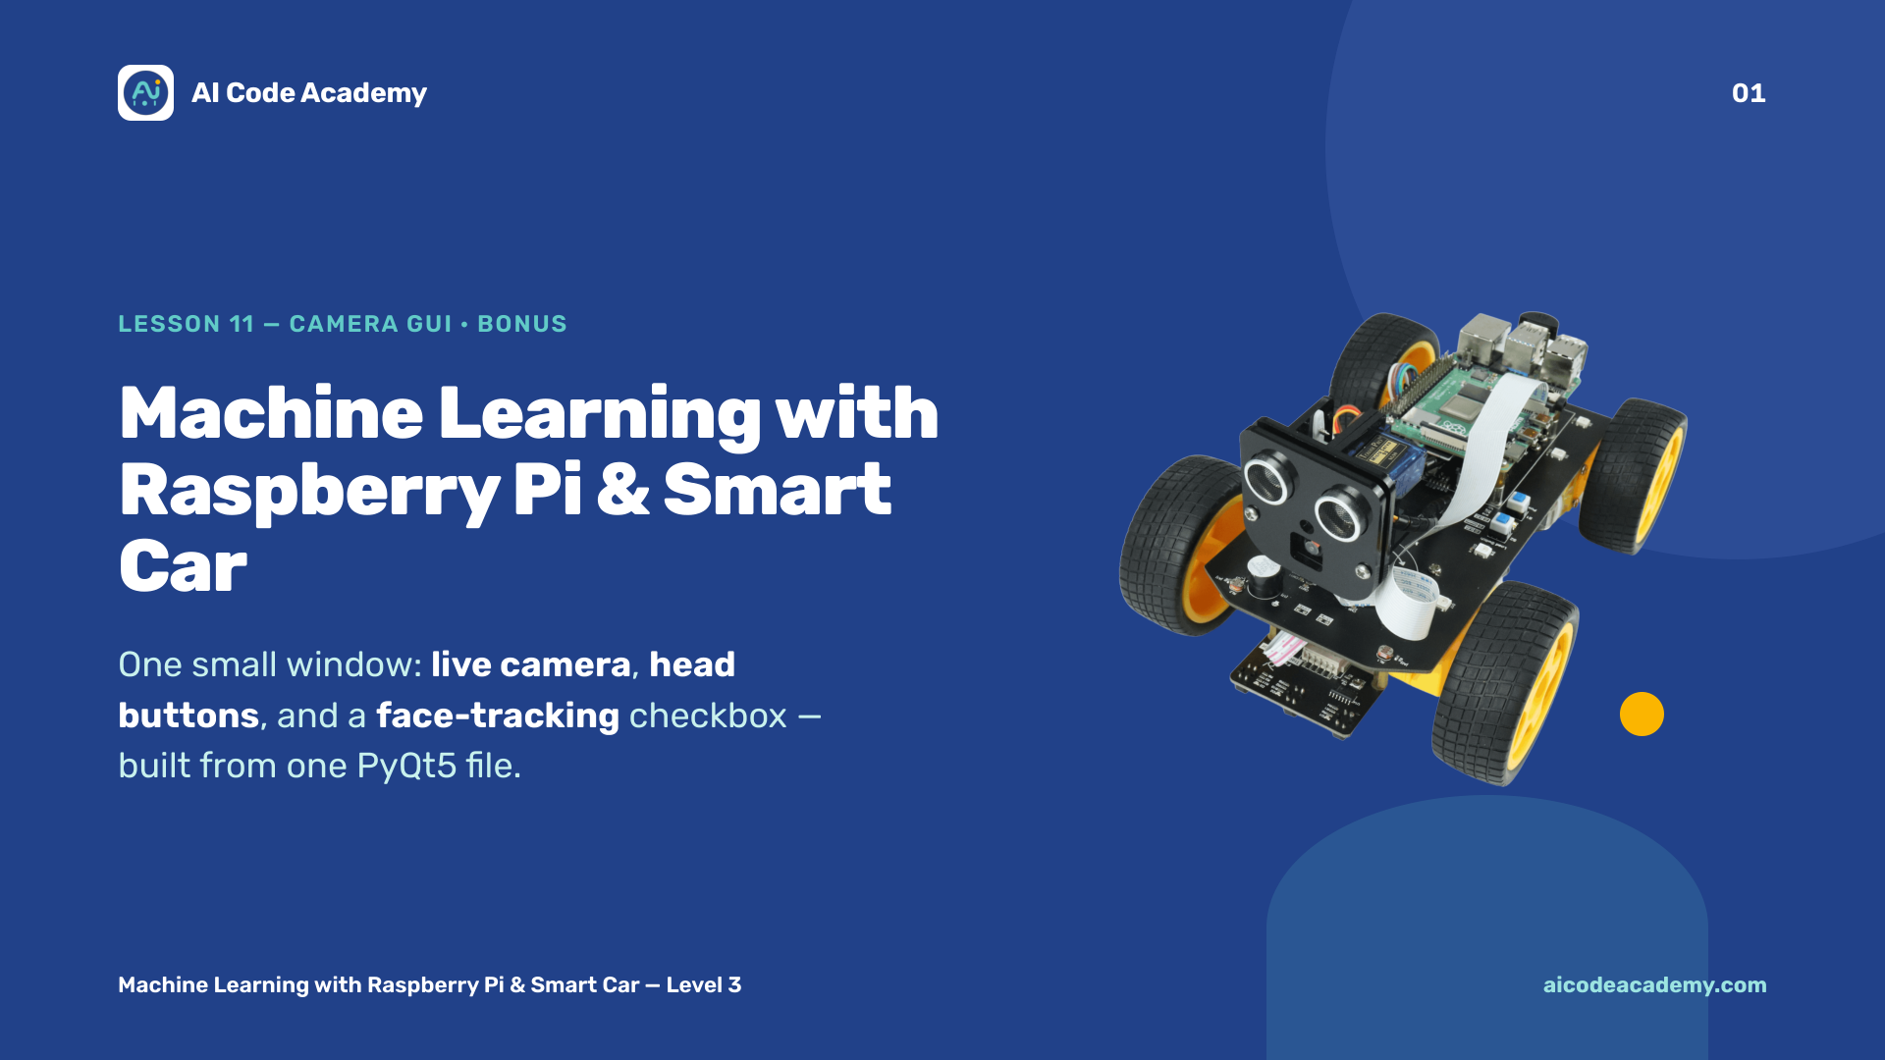
Notes:
Title — ~1 min. This is the bonus, capstone lesson: everything from the video lessons (6, 7, 8) wrapped into one small desktop window — live camera, head buttons, and a face-tracking checkbox, all from one PyQt5 file plus the car server they already run. Build a little energy: this is the polished front door for the whole course. Make sure each Pi can run the full server before class. Site: https://aicodeacademy.com

Slide 2
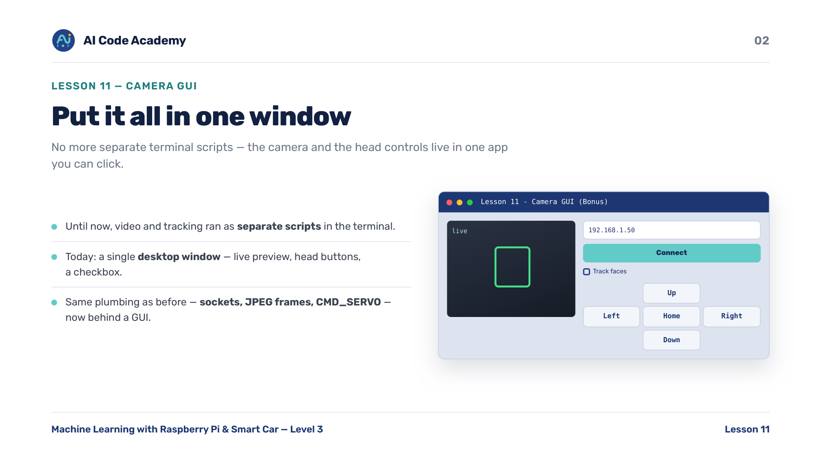
Notes:
Introduction — until now they ran video and face tracking from separate terminal scripts, typing the Pi's IP on the command line each time. Today it all lives in one window you can click: a live preview, Up/Down/Left/Right/Home buttons, an IP box with Connect, and a Track faces checkbox. Same plumbing as before — sockets, JPEG frames, CMD_SERVO — now behind a friendly GUI.

Slide 3
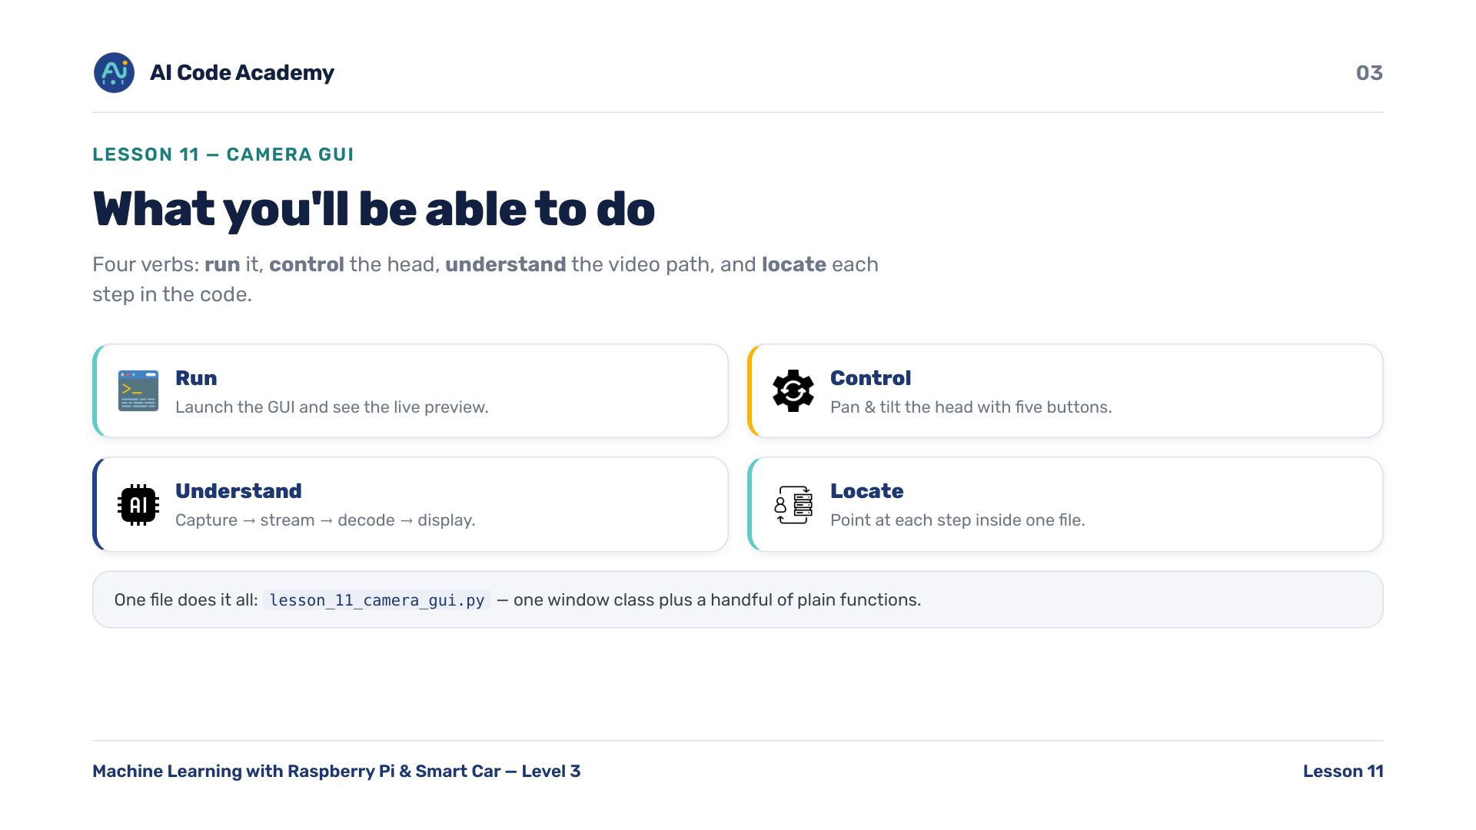
Notes:
Our goals — four verbs. RUN the camera GUI and see live video. CONTROL the head with the five buttons. UNDERSTAND how one frame travels: capture on the Pi, stream over the network, decode on your computer, display in the window. LOCATE where each of those steps lives in the file. By the end they should be able to point at each step in the code.

Slide 4
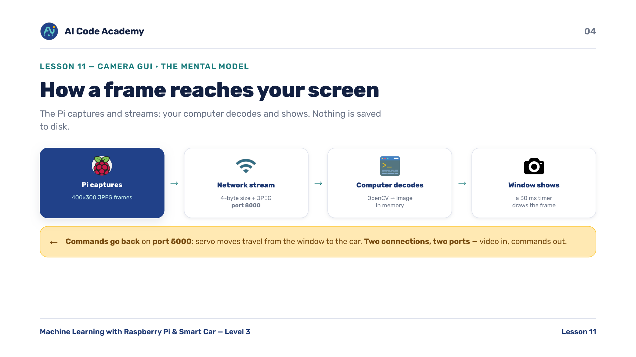
Notes:
The video path — the Pi owns the camera and streams JPEG pictures out on port 8000. Your computer decodes each picture in memory (no file on disk) and draws it in the window. Servo commands flow back to the Pi on port 5000. Two connections, two ports: video in, commands out. The Pi only captures and streams; your computer does all the thinking — decode, draw, and optional face-finding.

Slide 5
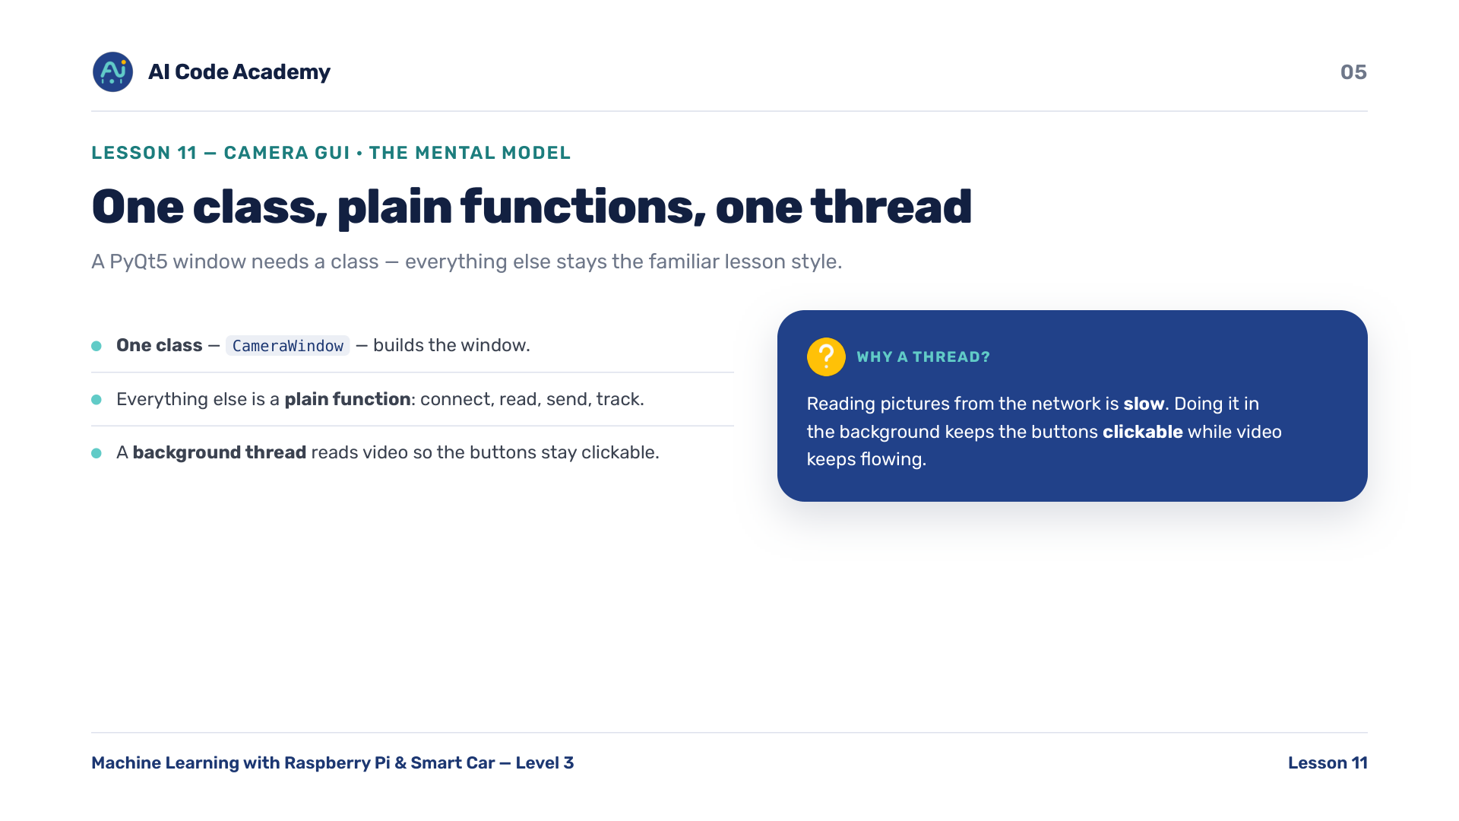
Notes:
Inside the file — a PyQt5 window needs exactly one class, CameraWindow. Everything else stays a plain function, the same lesson style they know. The one genuinely new idea is a background thread: reading pictures from the network is slow, so we do it in the background. That keeps the buttons clickable and the window responsive while video keeps flowing.

Slide 6
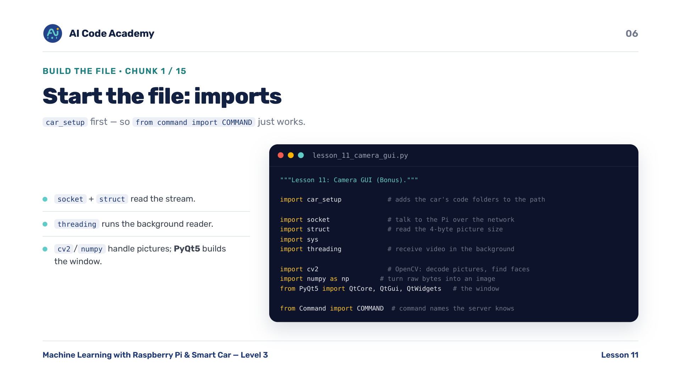
Notes:
Imports (chunk 1/15) — import car_setup leads the list: it adds the car's Server and Client folders to the import path, so from command import COMMAND just works and the cascade file resolves. socket and struct read the stream; threading runs the background reader; cv2 and numpy handle pictures; PyQt5 builds the window.

Slide 7
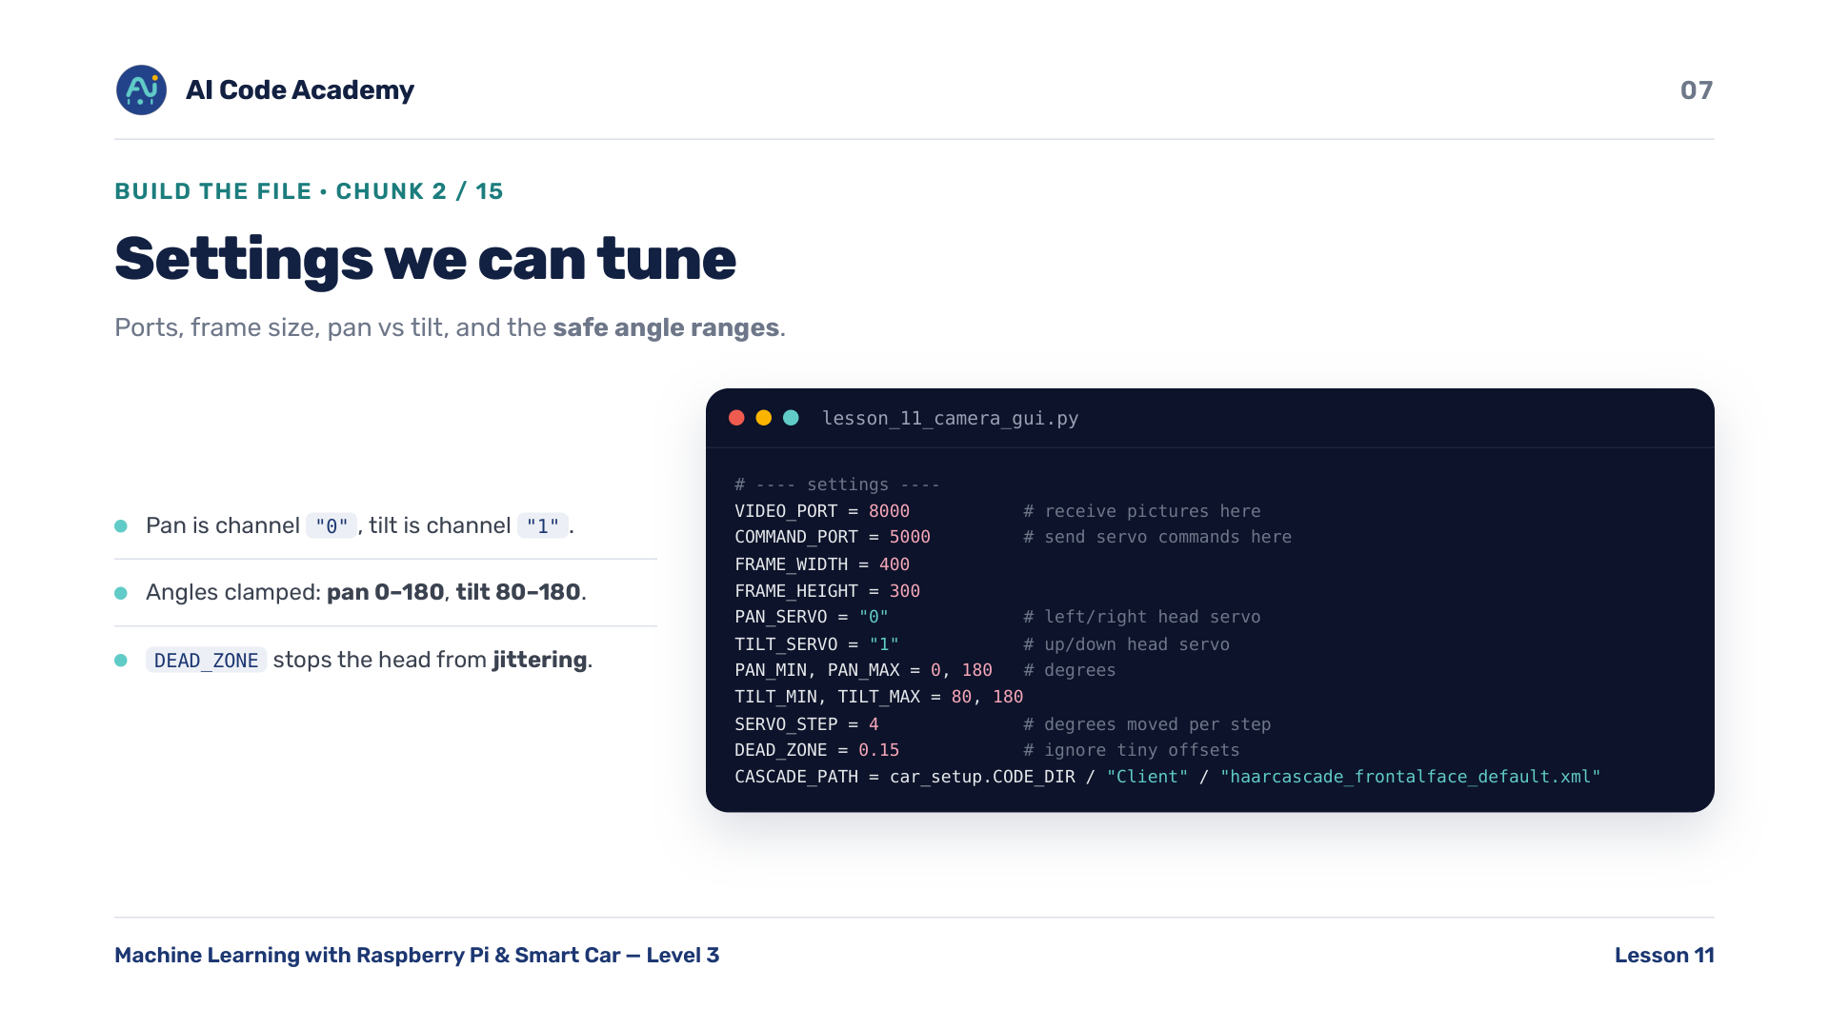
Notes:
Settings (chunk 2/15) — ports (8000 video, 5000 commands — the same ports the car server opens), the frame size, which servo is pan ('0') versus tilt ('1'), and the safe angle ranges: pan 0-180, tilt 80-180. SERVO_STEP is how many degrees each move is; DEAD_ZONE ignores tiny offsets so the head doesn't jitter. CASCADE_PATH points into Code/Client via car_setup.CODE_DIR.

Slide 8
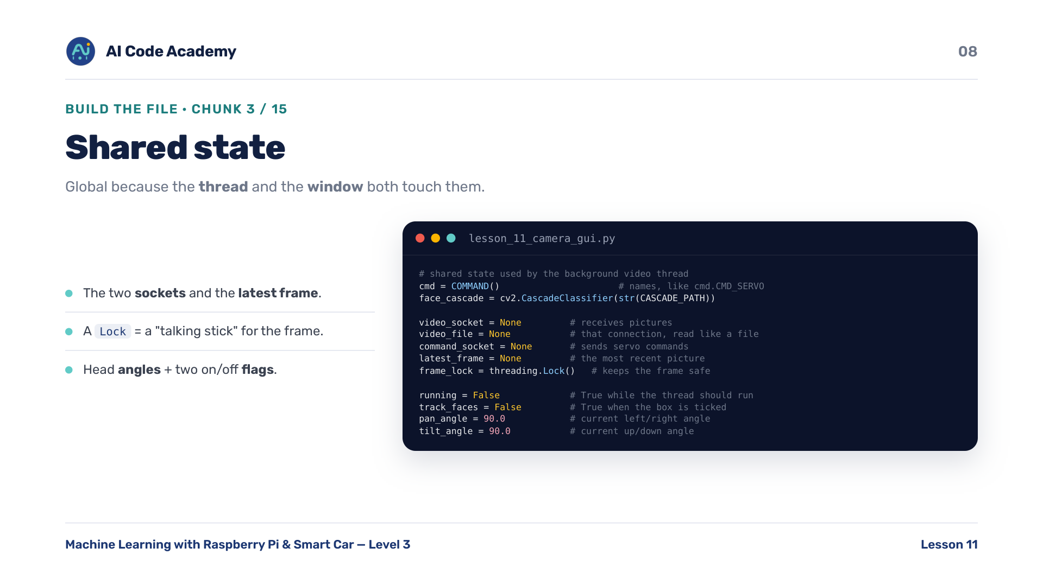
Notes:
Shared state (chunk 3/15) — these are global because the background thread AND the window both touch them: the two sockets, the latest frame, and a Lock that keeps that frame safe. Explain the Lock as a talking stick — only one thread holds the frame at a time, so it's never half-written when the other side reads it. Plus the current head angles and two on/off flags.

Slide 9
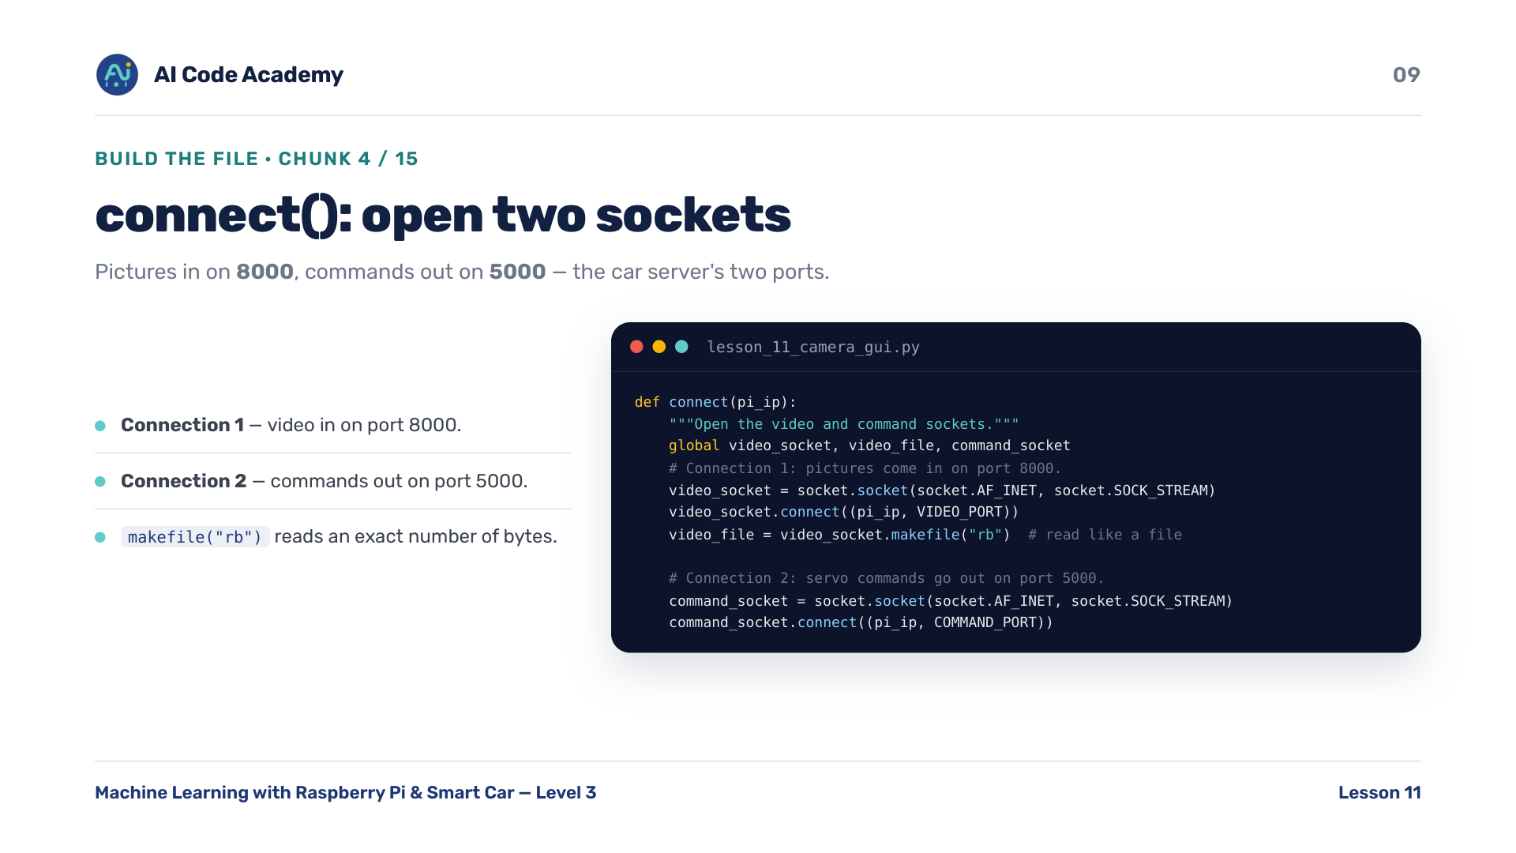
Notes:
connect() (chunk 4/15) — opens two sockets. Connection 1: pictures come in on port 8000, wrapped as a file with makefile('rb') so we can ask for an exact number of bytes. Connection 2: servo commands go out on port 5000. Same two ports as Lesson 6 (video) and Lesson 2 (commands) — this lesson just opens both at once.

Slide 10
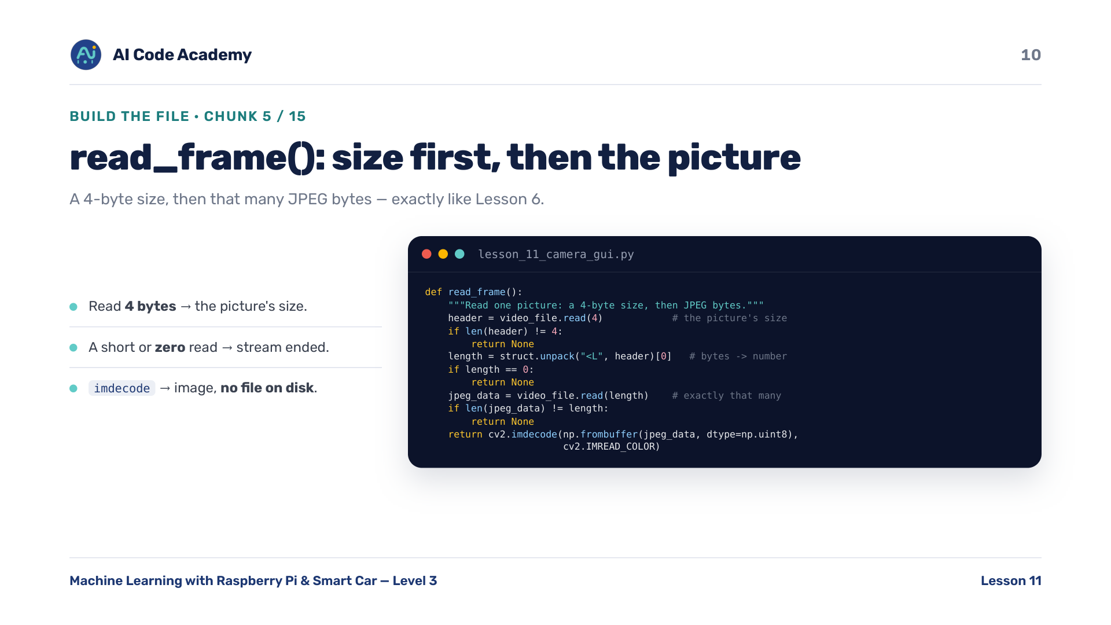
Notes:
read_frame() (chunk 5/15) — each picture is a 4-byte size followed by that many JPEG bytes. struct.unpack turns the 4 bytes into a number. A short or zero read means the stream ended, so return None. cv2.imdecode turns the raw bytes straight into an image — no file on disk. This is exactly Lesson 6's read_frame(); call it out as reused knowledge.

Slide 11
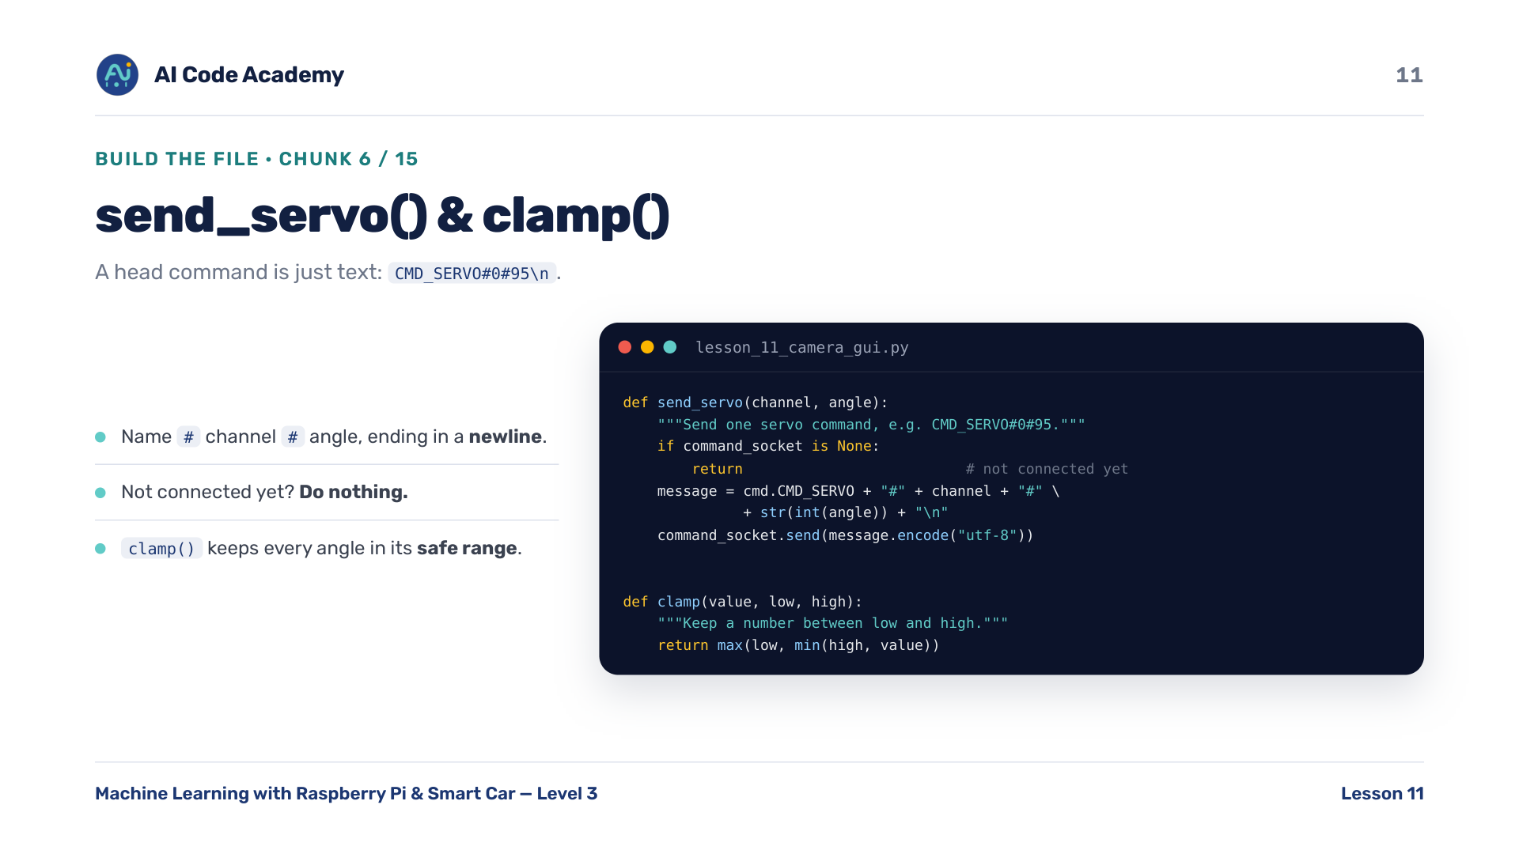
Notes:
send_servo() and clamp() (chunk 6/15) — a head command is just text: the command name, a channel, an angle, ending in a newline so the server knows it's complete. Example: CMD_SERVO#0#95. If we're not connected yet, do nothing. clamp() keeps every angle inside its safe range BEFORE it is ever sent — the same #-separated, newline-ended format from Lesson 2.

Slide 12
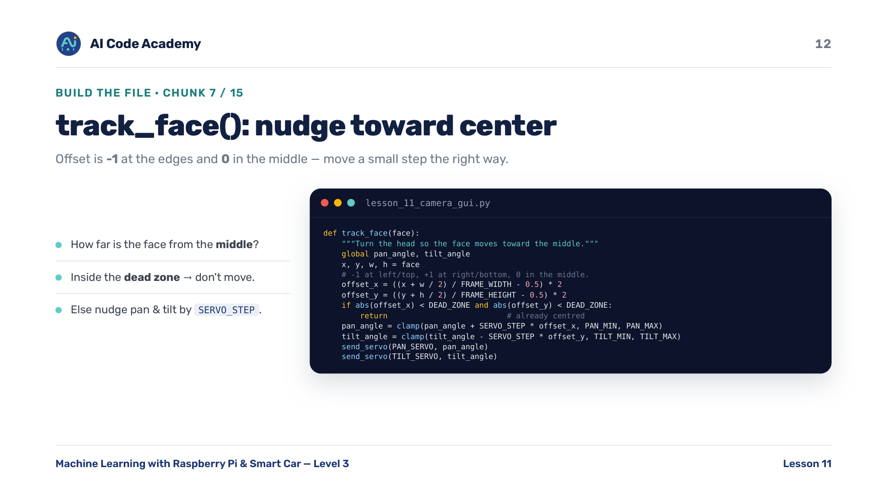
Notes:
track_face() (chunk 7/15) — work out how far the face is from the middle of the frame: offset is -1 at the left/top edge, +1 at the right/bottom, 0 in the middle. If both offsets are inside the dead zone, don't move — that's what stops the twitch when the face is already centred. Otherwise nudge pan and tilt a small SERVO_STEP the right way and send both.

Slide 13
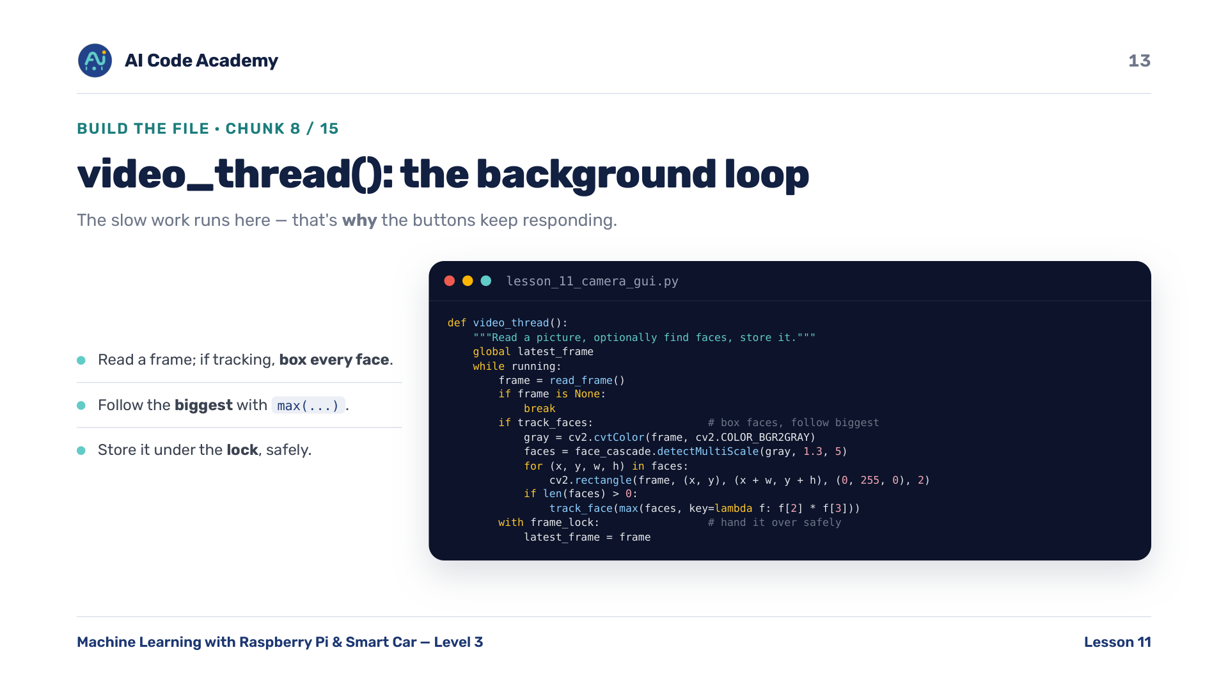
Notes:
video_thread() (chunk 8/15) — the background loop. Read a frame; if tracking is on, convert to gray, find every face, draw a green box on each, and follow the biggest using max(faces, key=area). Then store the finished picture under the lock so the window can read it safely. This slow work (network + face-finding) is kept off the main thread — that's WHY the buttons keep responding.

Slide 14
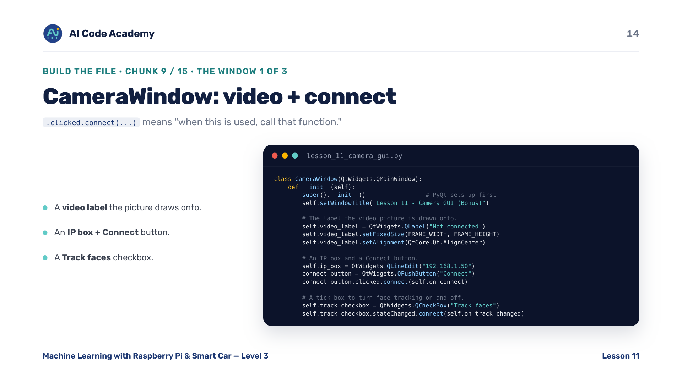
Notes:
CameraWindow 1 of 3 (chunk 9/15) — the class builds the window. First: a video label the picture is drawn onto, an IP text box pre-filled with 192.168.1.50 plus a Connect button, and a Track faces checkbox. .clicked.connect(...) and .stateChanged.connect(...) mean 'when this is used, call that function' — that's the whole event idea.

Slide 15
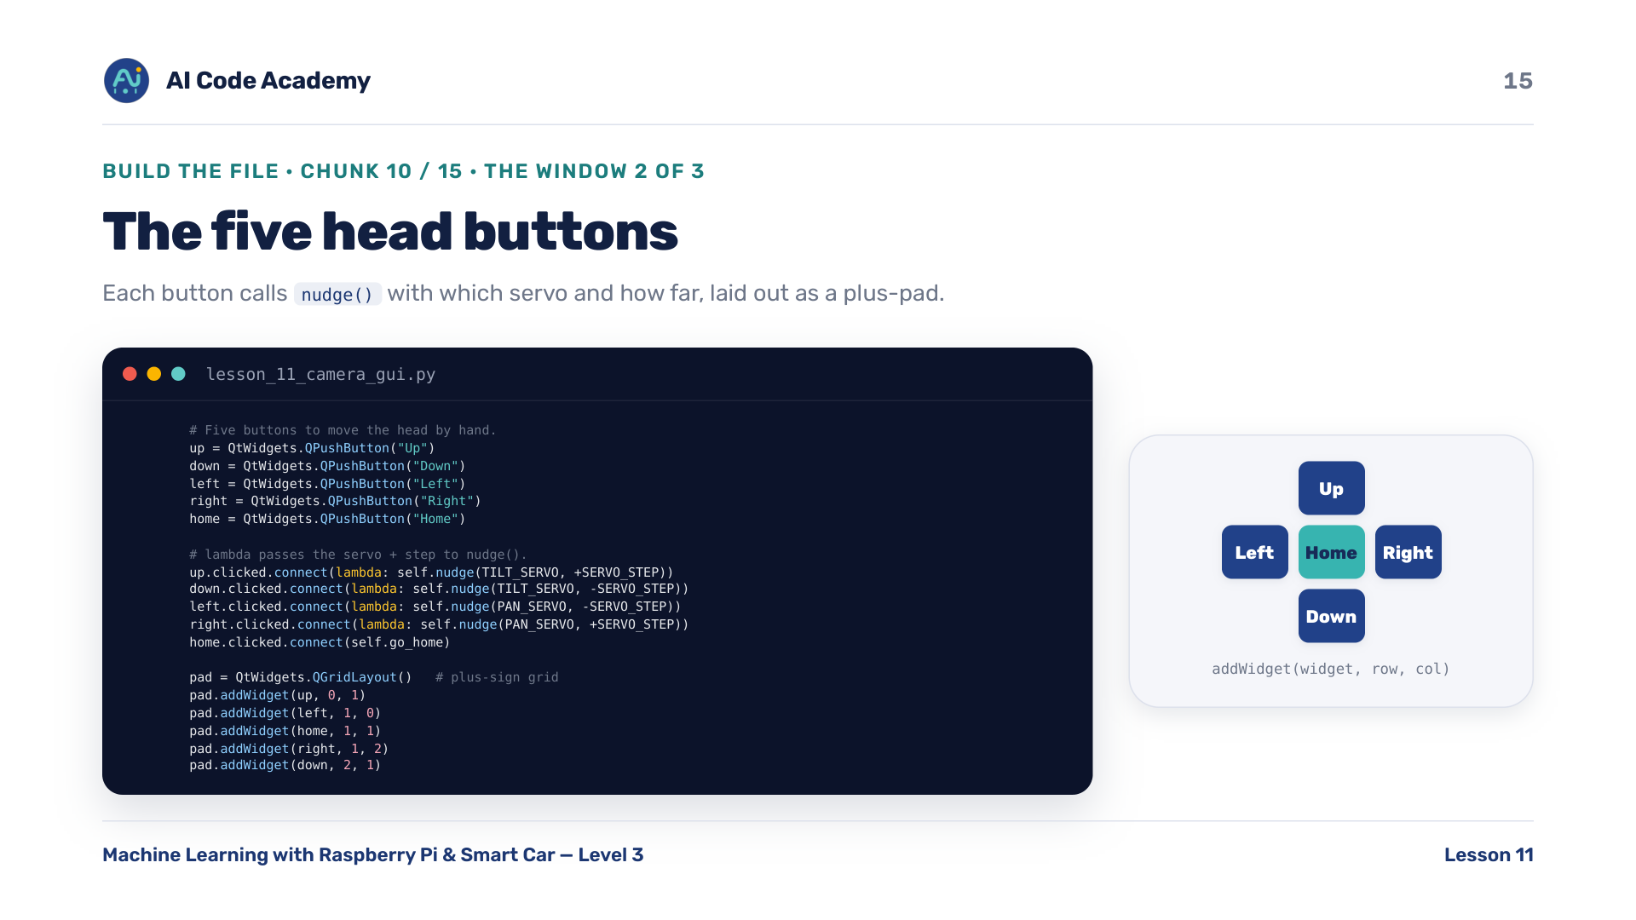
Notes:
CameraWindow 2 of 3 (chunk 10/15) — five buttons to move the head by hand. Each calls nudge() with which servo to move and by how much; lambda is a tiny throwaway function used to pass those values along. Then they're laid out in a plus-sign grid: addWidget(widget, row, col). Up = row 0 col 1; Left/Home/Right across row 1; Down = row 2 col 1. That's the plus shape.

Slide 16
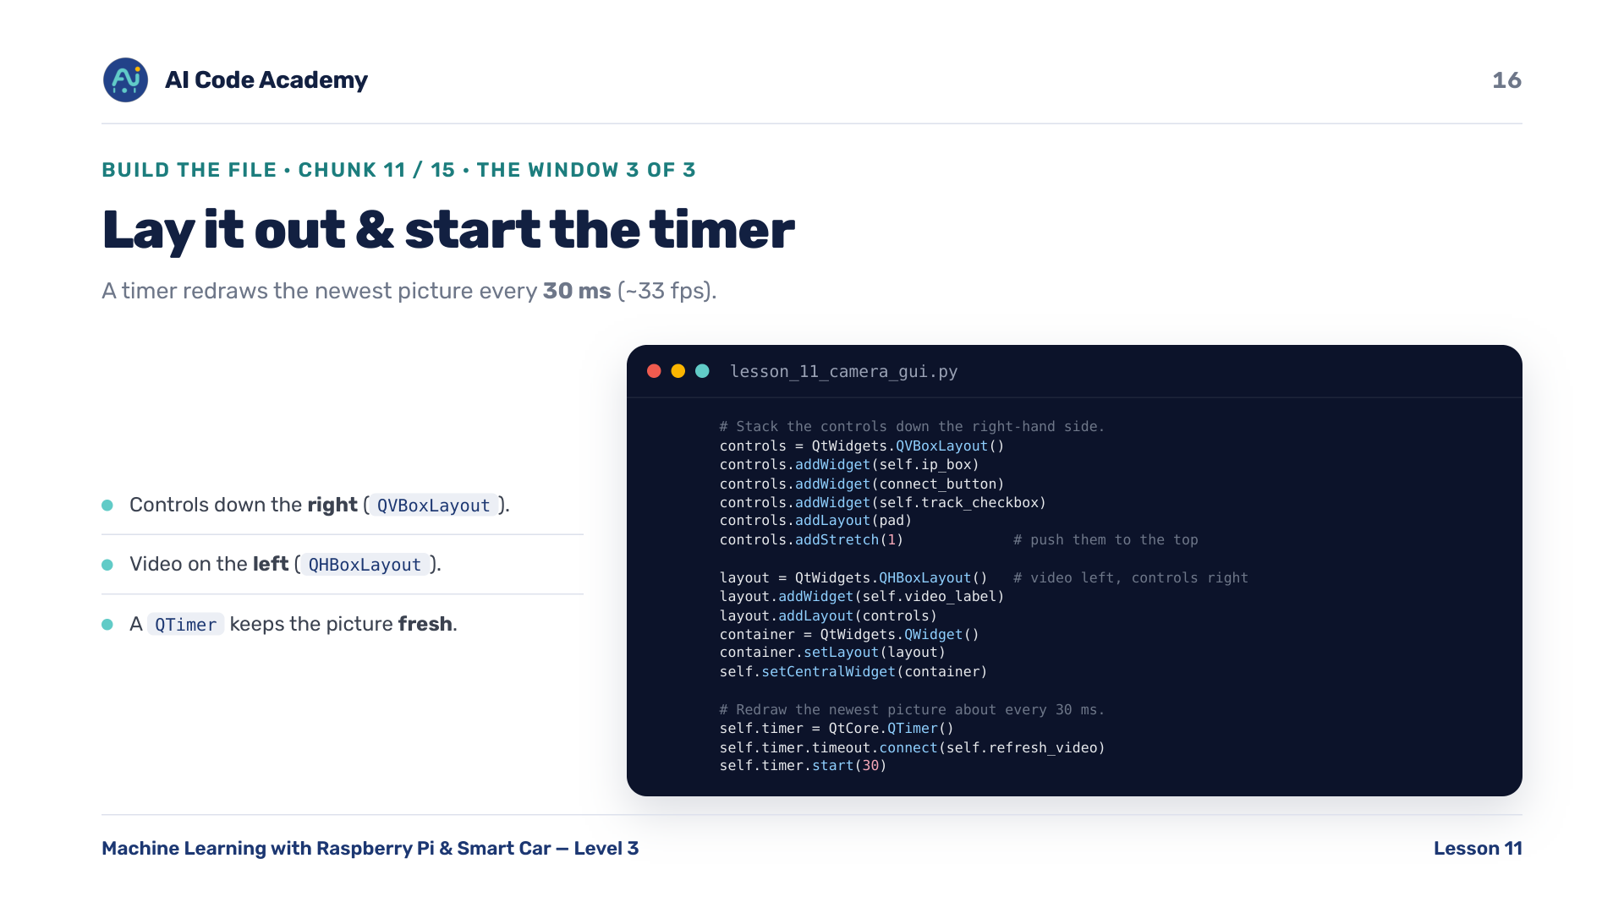
Notes:
CameraWindow 3 of 3 (chunk 11/15) — stack the controls down the right with a QVBoxLayout (and addStretch to push them up), put the video on the left with a QHBoxLayout, and set that as the central widget. Then start a QTimer that calls refresh_video() every 30 ms (about 33 fps) so the video looks smooth. The timer is what keeps the picture fresh.

Slide 17
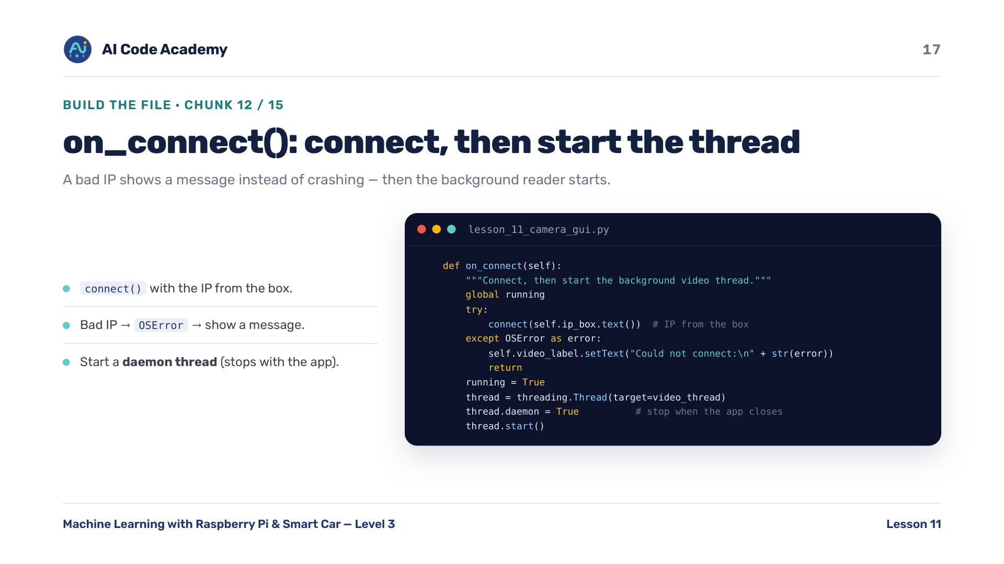
Notes:
on_connect() (chunk 12/15) — try to connect() with whatever IP is in the box. A bad IP raises OSError, so we catch it and show 'Could not connect' on the label instead of crashing. On success, set running = True and start the background video thread as a daemon — daemon means the thread won't keep the program alive, so closing the window lets the loop end with it.

Slide 18
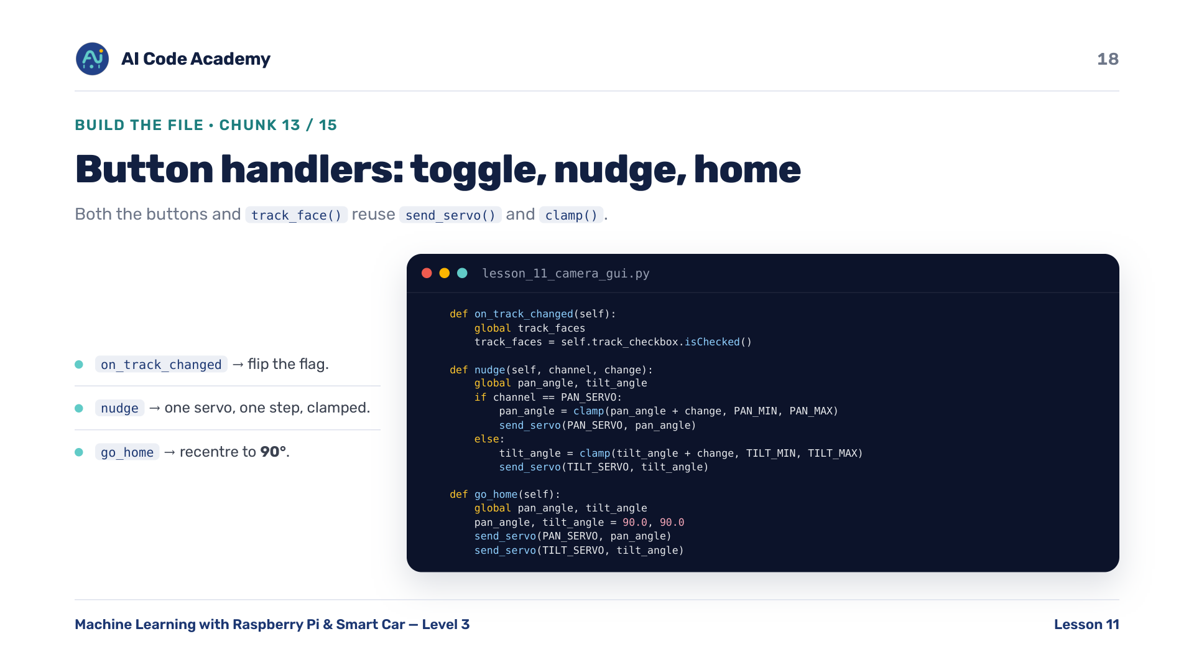
Notes:
Button handlers (chunk 13/15) — on_track_changed flips the track_faces flag from the checkbox. nudge() moves one servo by a step, clamped to its safe range, then sends it. go_home() recentres both servos to 90 degrees. Notice both the buttons and track_face() reuse send_servo() and clamp() — show how the small functions get reused all over the file.

Slide 19
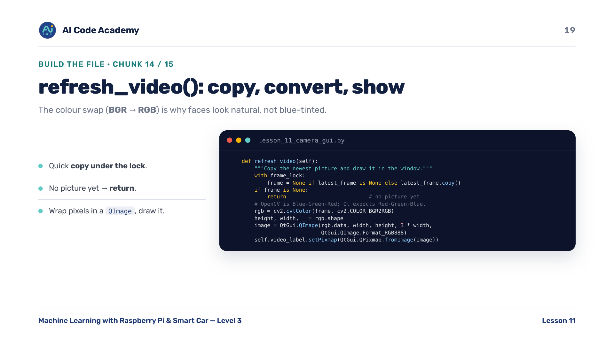
Notes:
refresh_video() (chunk 14/15) — the timer calls this. Take a quick copy of the latest frame UNDER the lock so the thread barely pauses, then return early if there's no picture yet. Swap OpenCV's Blue-Green-Red order to Qt's Red-Green-Blue — that's why faces look natural, not blue-tinted. Wrap the pixels in a QImage and draw it on the label.

Slide 20
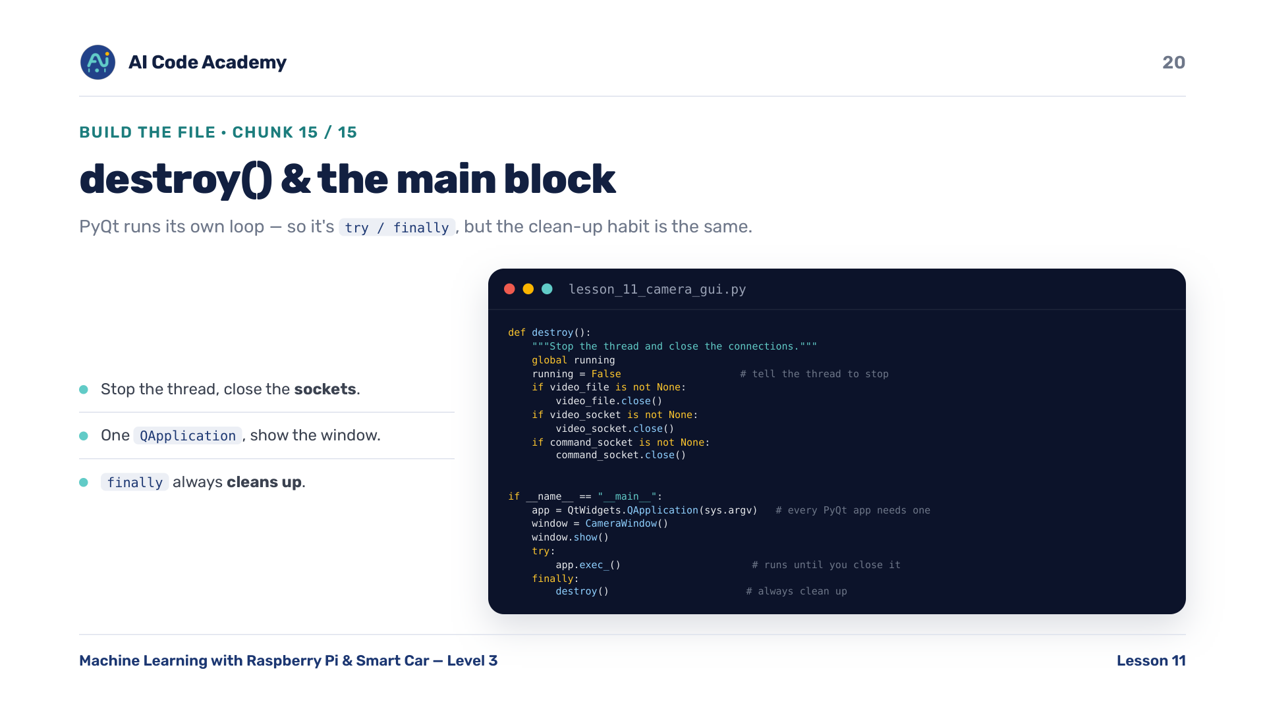
Notes:
destroy() and main (chunk 15/15) — destroy() sets running = False to stop the thread, then closes the video file, the video socket, and the command socket. The main block builds the one QApplication, shows the window, and runs app.exec_() until the window closes. Note the wrapper is try/finally here, not try/except KeyboardInterrupt/finally, because PyQt supplies its own event loop — but the clean-shutdown habit (destroy() in finally) is exactly the same.

Slide 21
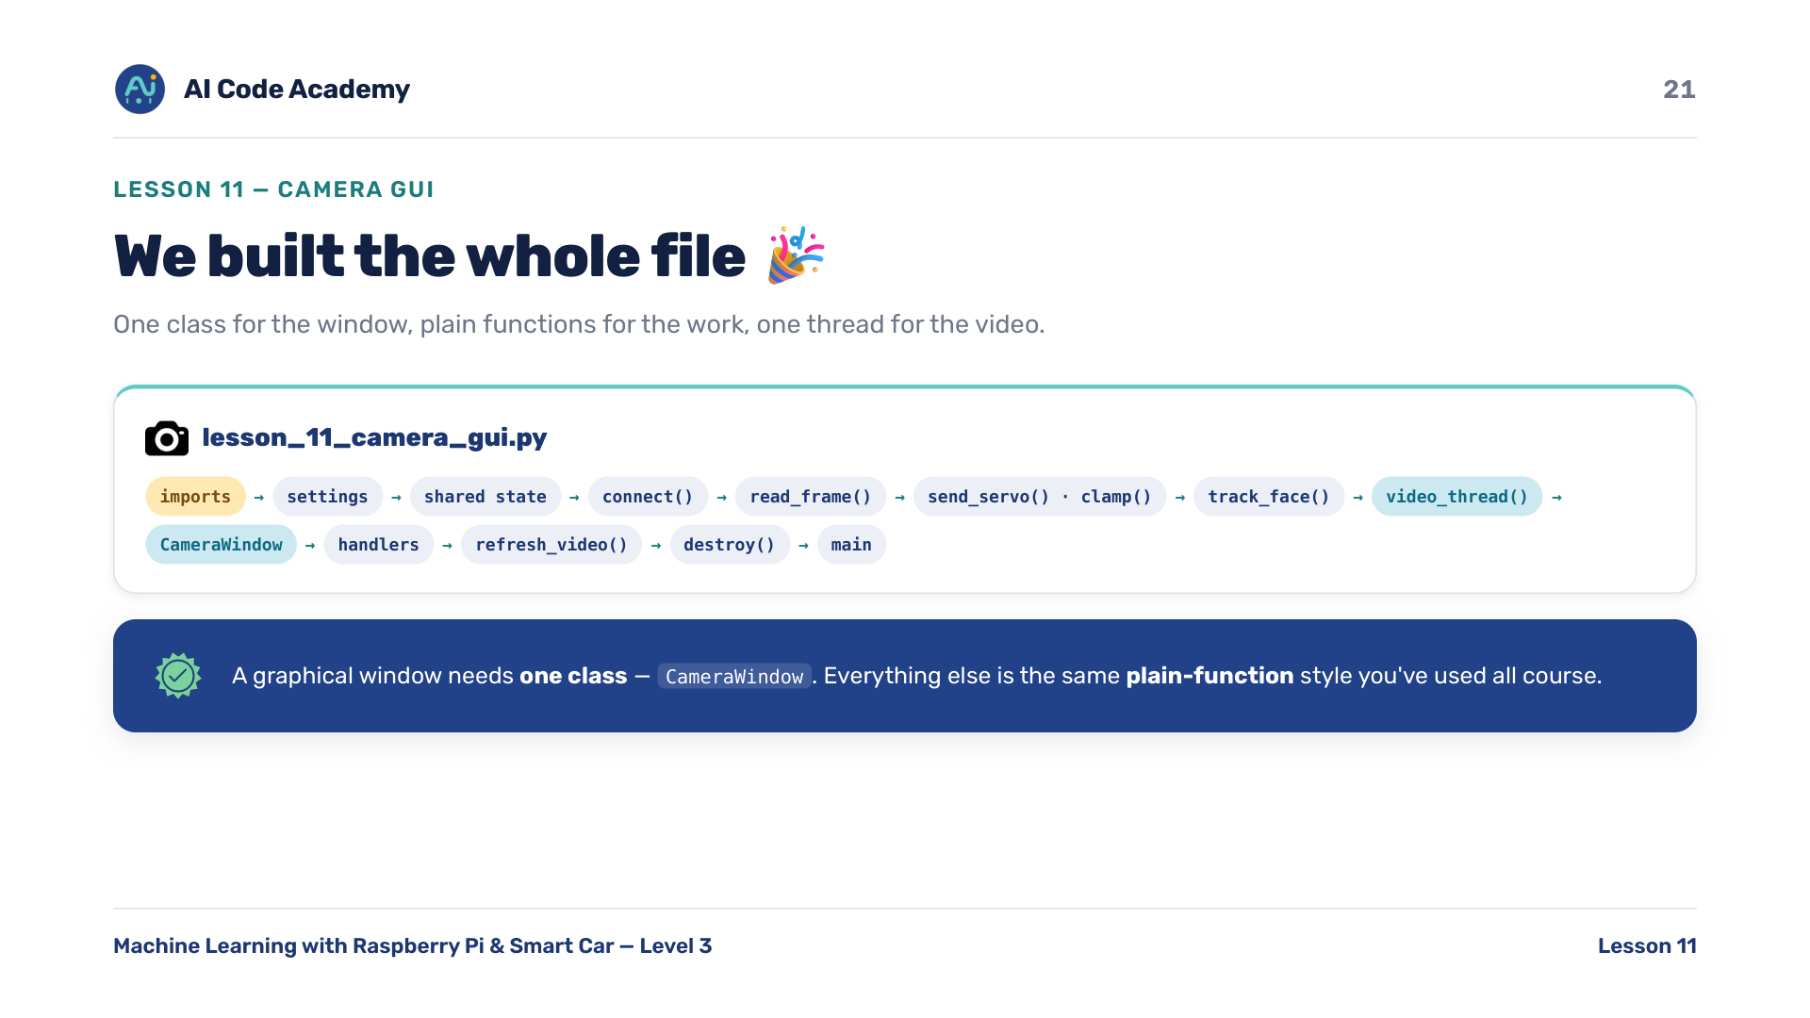
Notes:
We built the whole file — complete lesson_11_camera_gui.py: imports, settings, shared state, connect(), read_frame(), send_servo()/clamp(), track_face(), video_thread(), the CameraWindow class, its handlers, refresh_video(), destroy(), and the main block. One class for the window, plain functions for the work, one thread for the video. Tie it back to slide 5: a class only because PyQt needs one.

Slide 22
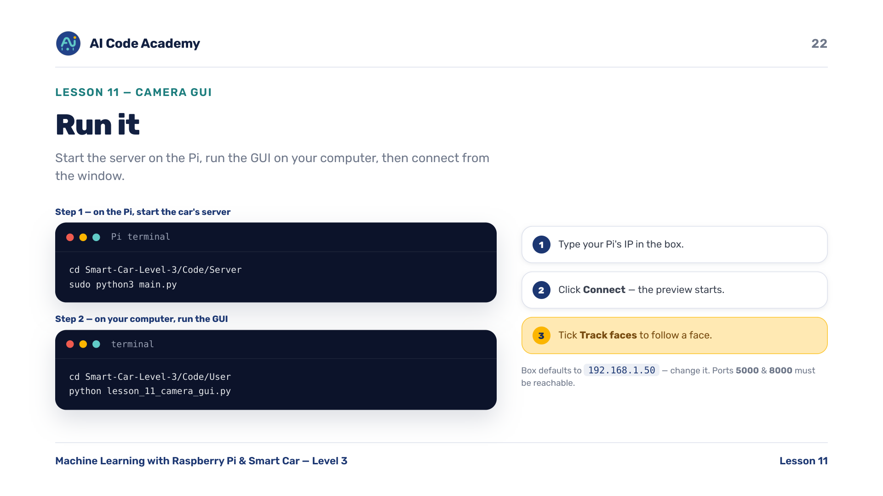
Notes:
Run it — step 1, on the Pi, start the car's full server: cd Smart-Car-Level-3/Code/Server, then sudo python3 main.py. Step 2, on your computer: cd Smart-Car-Level-3/Code/User, then python lesson_11_camera_gui.py. In the window: type your Pi's IP, click Connect, and tick Track faces to follow a face. The IP box defaults to 192.168.1.50 — students must change it to their Pi's IP. Ports 5000 and 8000 must be reachable.

Slide 23
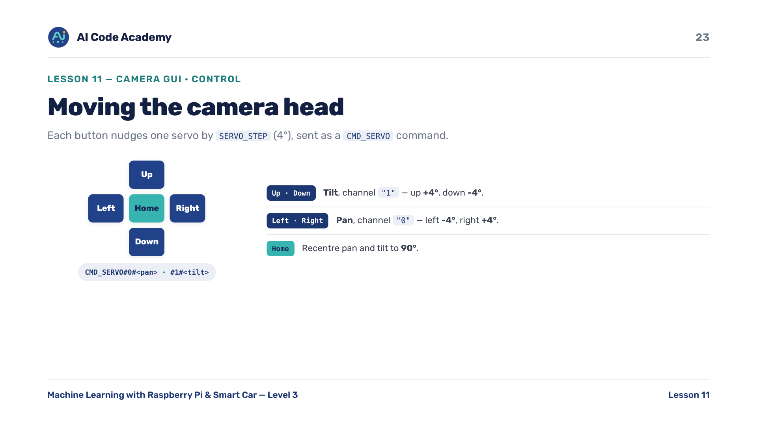
Notes:
Moving the camera head — each button nudges one servo by SERVO_STEP (4 degrees), sent as a CMD_SERVO command. Up/Down move tilt, channel '1' (+4 / -4). Left/Right move pan, channel '0' (-4 / +4). Home recentres pan and tilt to 90 degrees. The command format is CMD_SERVO#0#<pan> and CMD_SERVO#1#<tilt>. Connect the plus-pad layout back to chunk 10 — the grid coordinates make the shape.

Slide 24
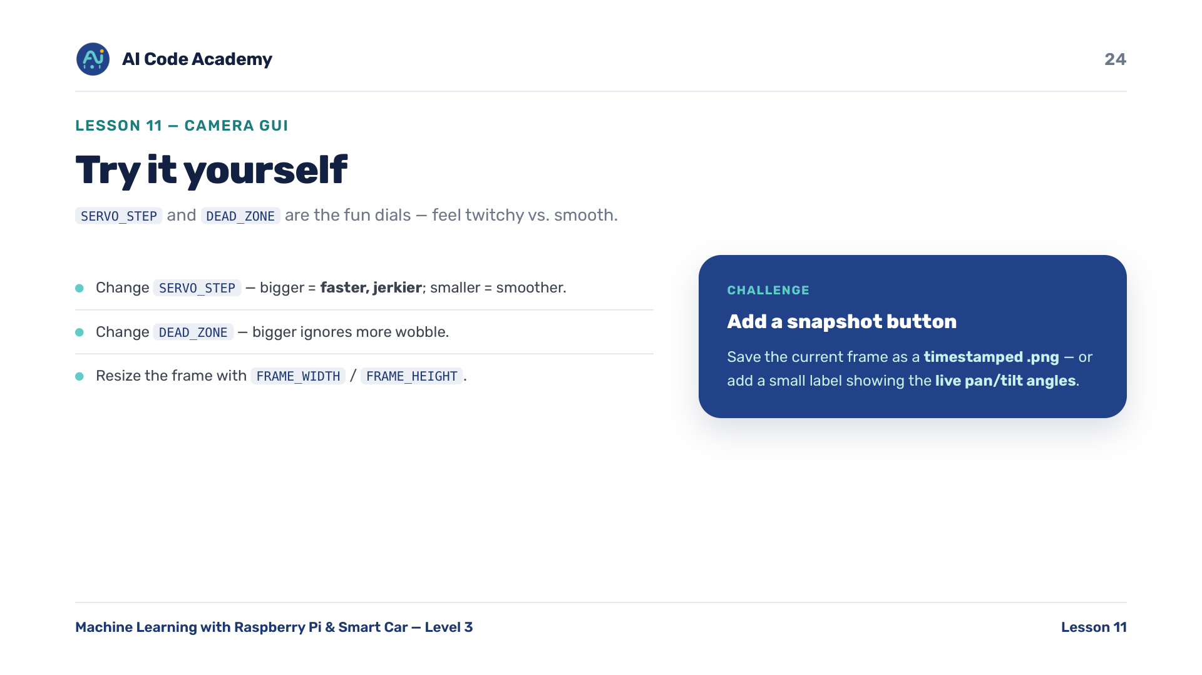
Notes:
Try it yourself — change SERVO_STEP (bigger = faster, jerkier head; smaller = slower, smoother). Change DEAD_ZONE (bigger ignores more wobble; smaller follows more eagerly). Resize the frame with FRAME_WIDTH / FRAME_HEIGHT. Challenge: add a snapshot button that saves the current frame as a timestamped .png, or a small label showing the live pan and tilt angles. SERVO_STEP and DEAD_ZONE are the fun dials.

Slide 25
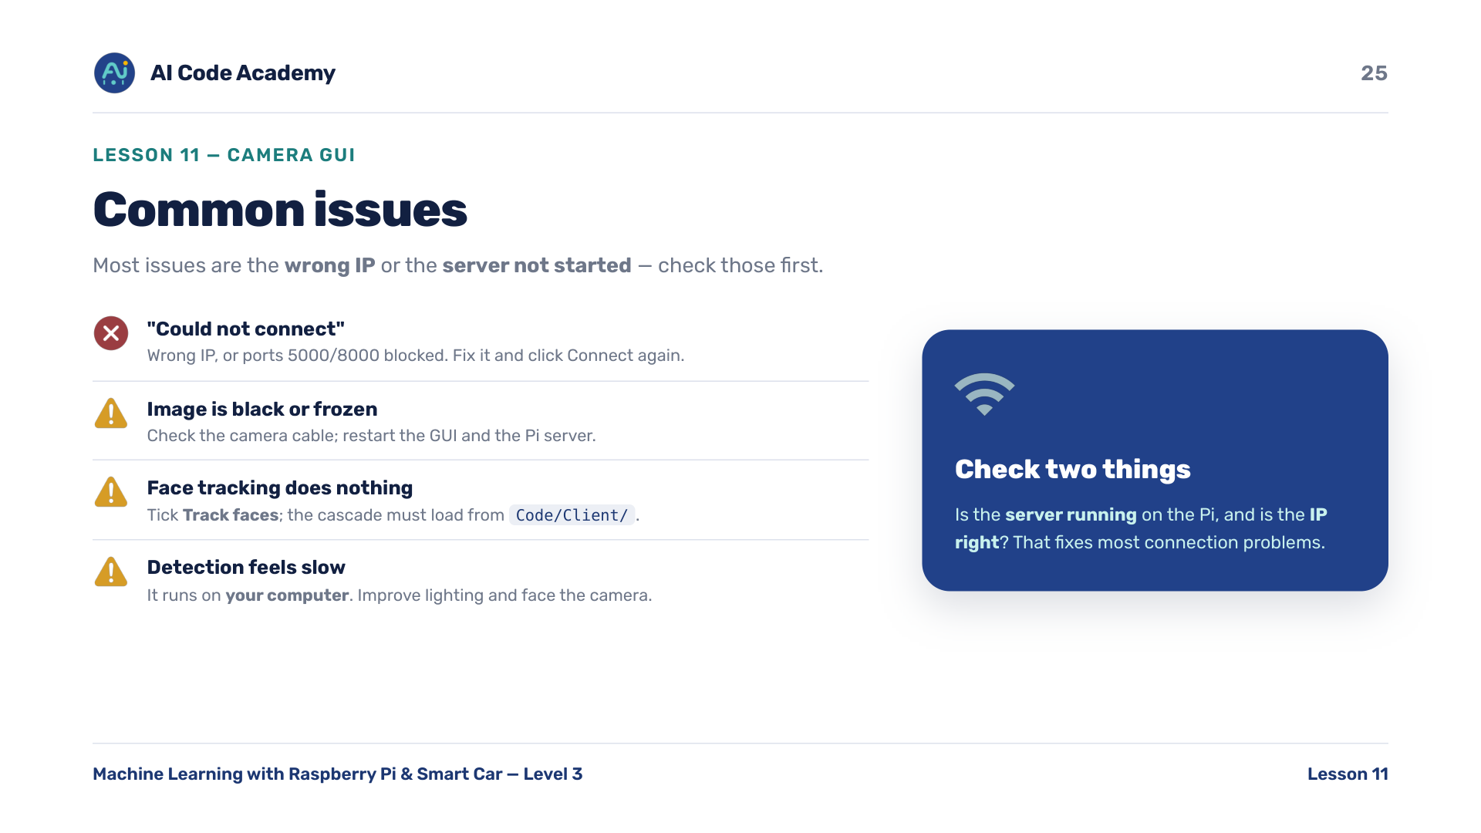
Notes:
Troubleshooting — 'Could not connect' means a wrong IP or ports 5000/8000 blocked; fix it and click Connect again. A black or frozen image means a camera-cable issue; restart the GUI and the Pi server. Face tracking does nothing if the box isn't ticked or the cascade can't load from Code/Client. Detection feels slow because it runs on your computer, not the Pi — improve lighting and face the camera. Most issues are the wrong IP or the server not started; check those two first.

Slide 26
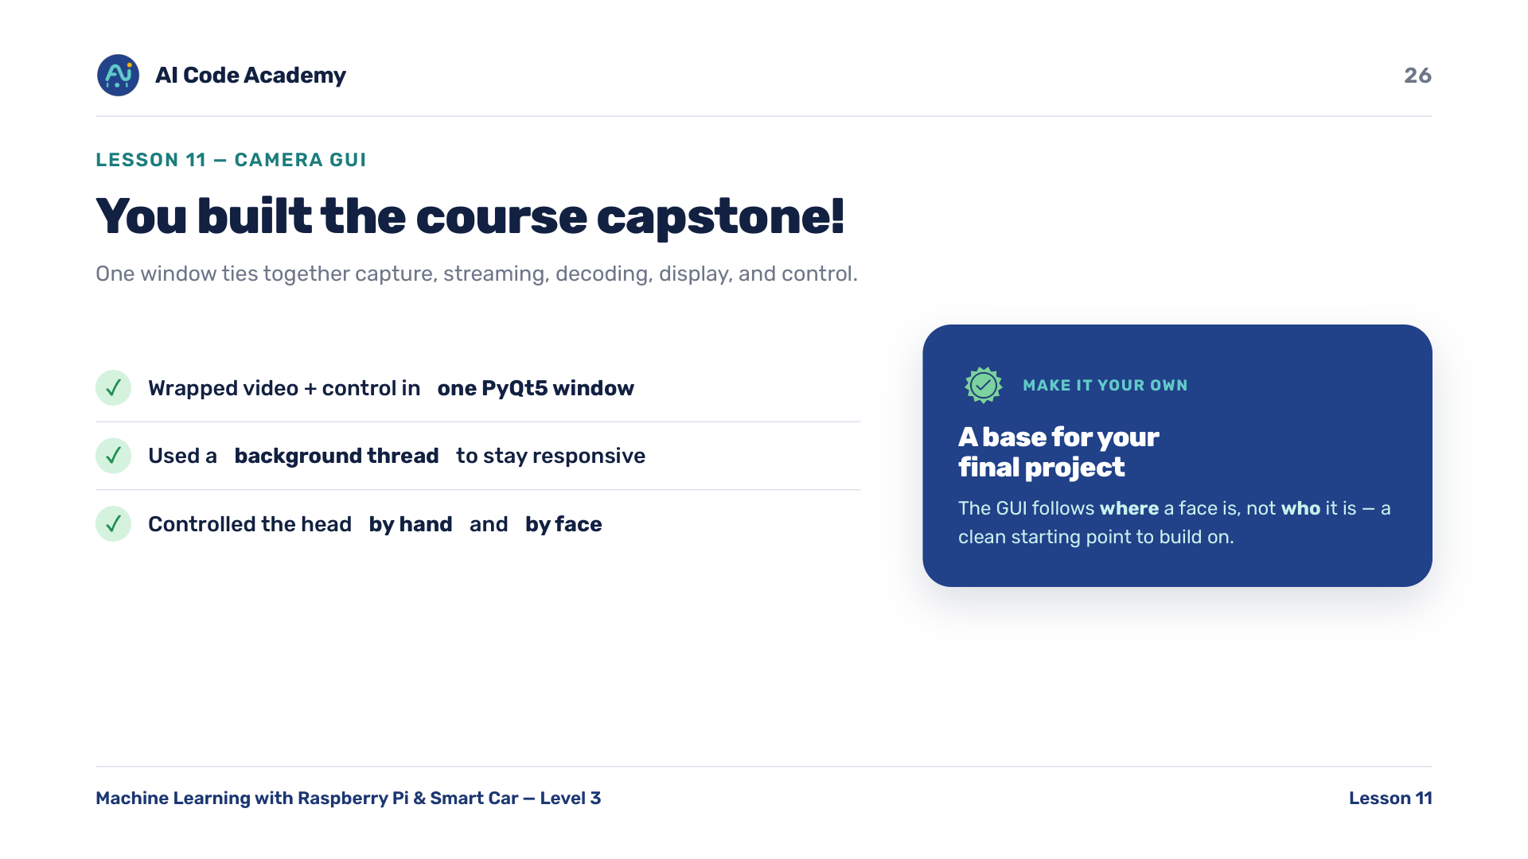
Notes:
Recap & what's next — you built a desktop GUI that ties together Pi capture, TCP streaming, OpenCV decoding, PyQt display, and servo control. The big new idea was a background thread keeping the window responsive. Key idea: the GUI follows WHERE a face is, not WHO it is — a clean base for a final project. This is the course capstone; send them off with the extension ideas to make it their own.

Slide 27
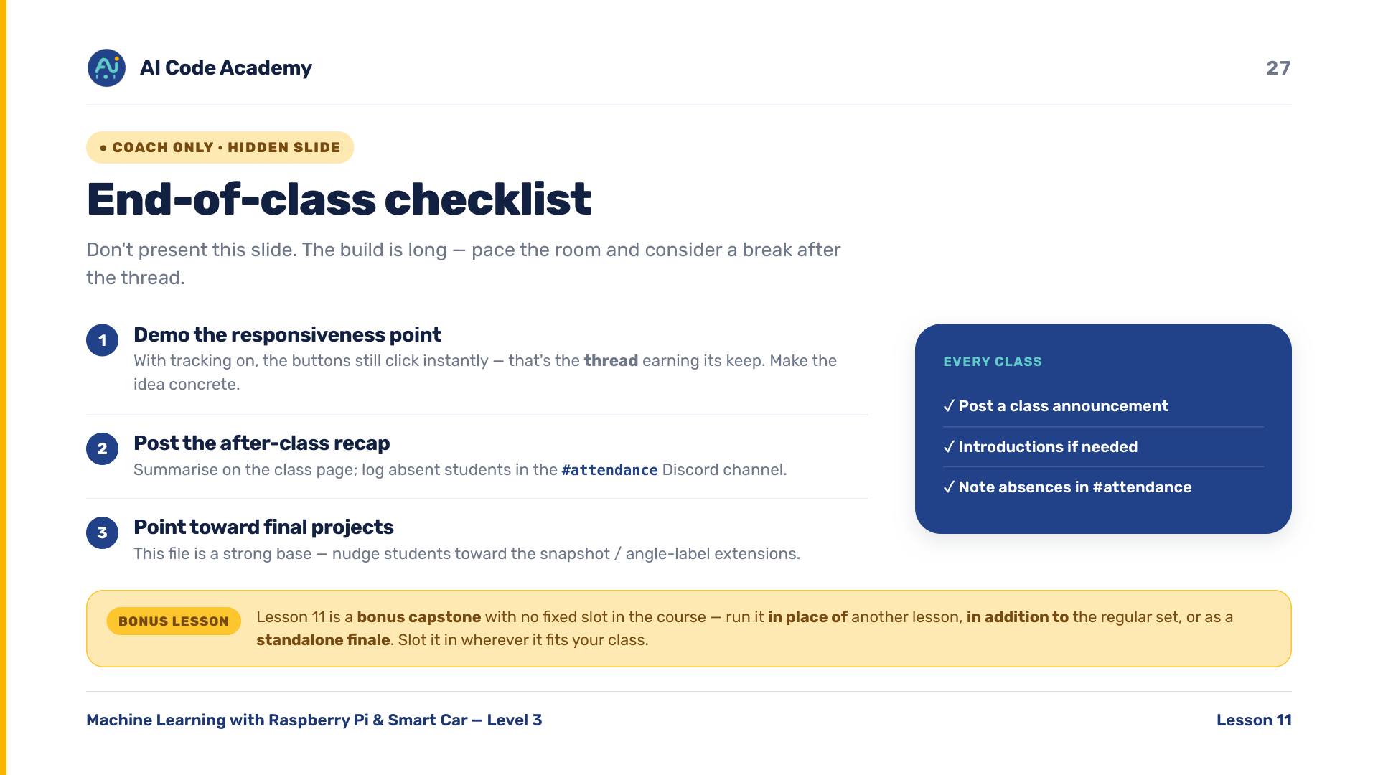
Notes:
COACH (hidden) — do not present. Timing ~50-55 min: intro + concepts (1-5) ~12 min, build the file (6-21) ~25 min, run + control (22-23) ~10 min, experiment/troubleshoot/recap (24-26) ~8 min. The build is long — consider a short break after the thread (slide 13). Most common failures: wrong Pi IP or server not started, PyQt5/opencv/numpy not installed, cascade file missing from Code/Client, or a camera-cable issue. Demo the responsiveness point: with tracking on, the buttons still click instantly — that's the thread earning its keep. After class: post the recap and log absent students in the Discord #attendance channel.

