Slide 1




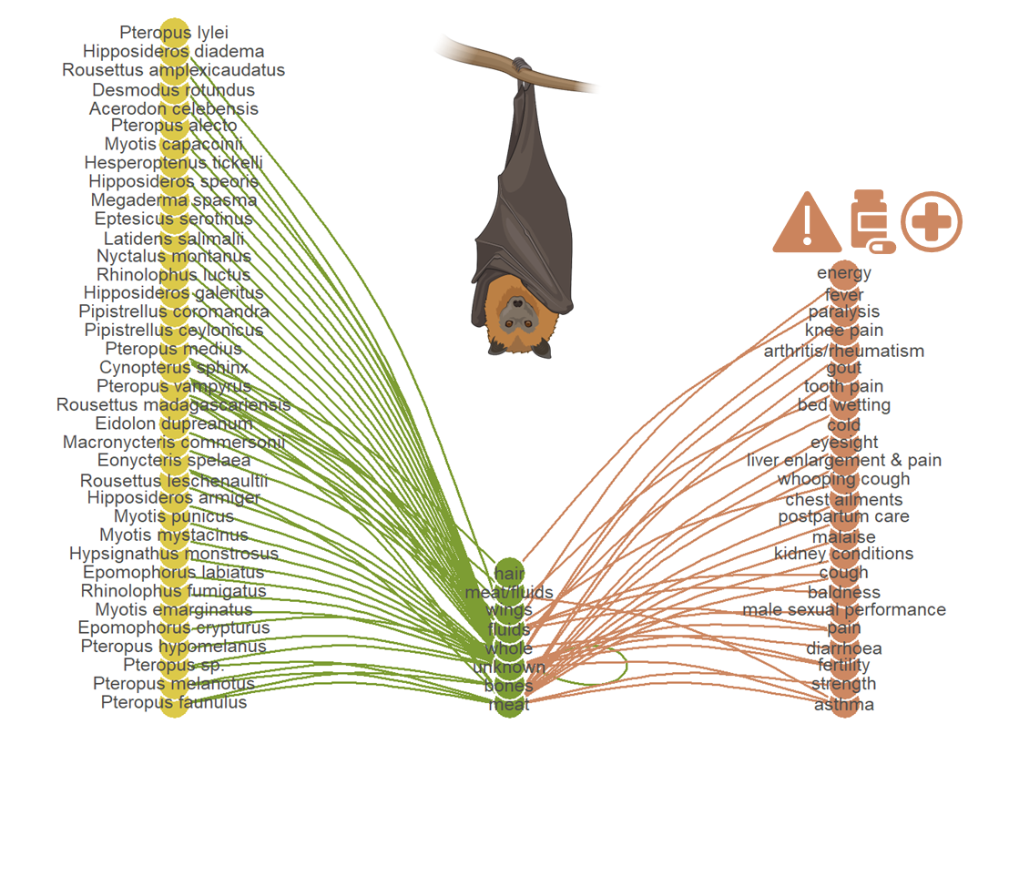


Future directions
in SEN research
Ecological network
Social network
SEN links
Levels
Metrics and models
In the dark
Nodes:
Keystone SE nodes
Links:
Duality of interactions
Hidden interactions
Forbidden interactions
External:
Environmental effects on SENs
Networks:
Emergent properties
Robustness, Flow betweenness, Hierarchy centralization, Modularity and participation, assortativity
Linear models, Mixed-effects models (GLMMs, GAMMs), Spatial autoregressive models (SAR), Bayesian models, Latent space models, Exponential Random Graph Models (ERGMs), Machine Learning models, Multivariate tests.
Degree, centrality, clustering, temporal activity, functional roles
Interaction strength, hub scores, node centrality
The network
we see

