Slide 1




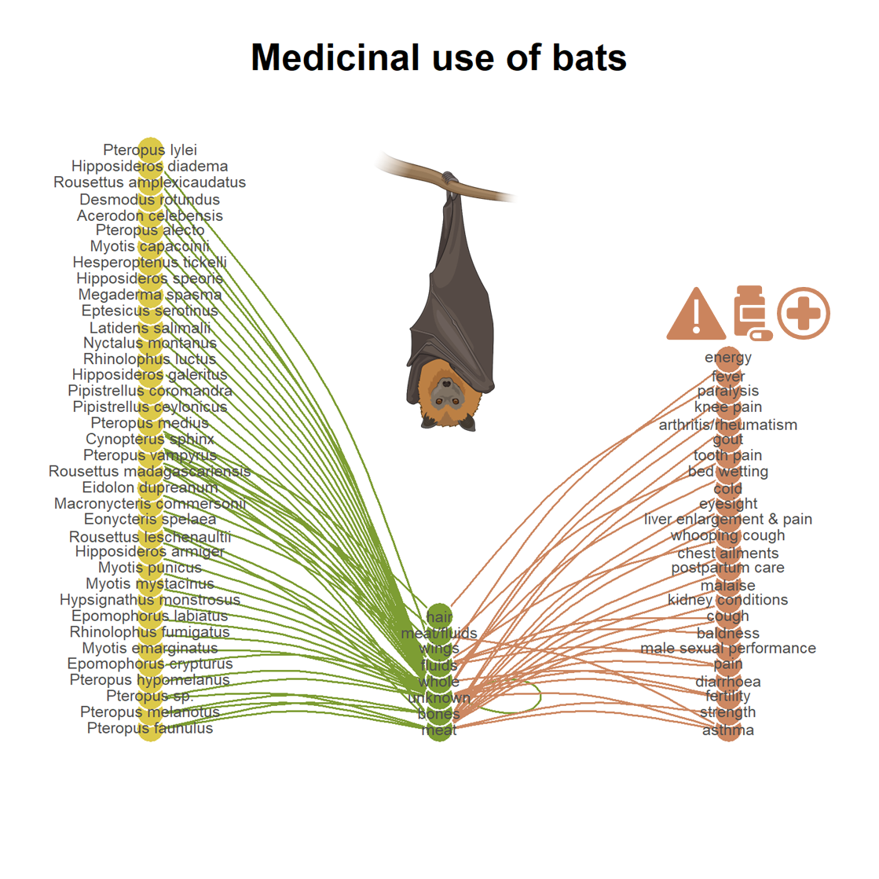
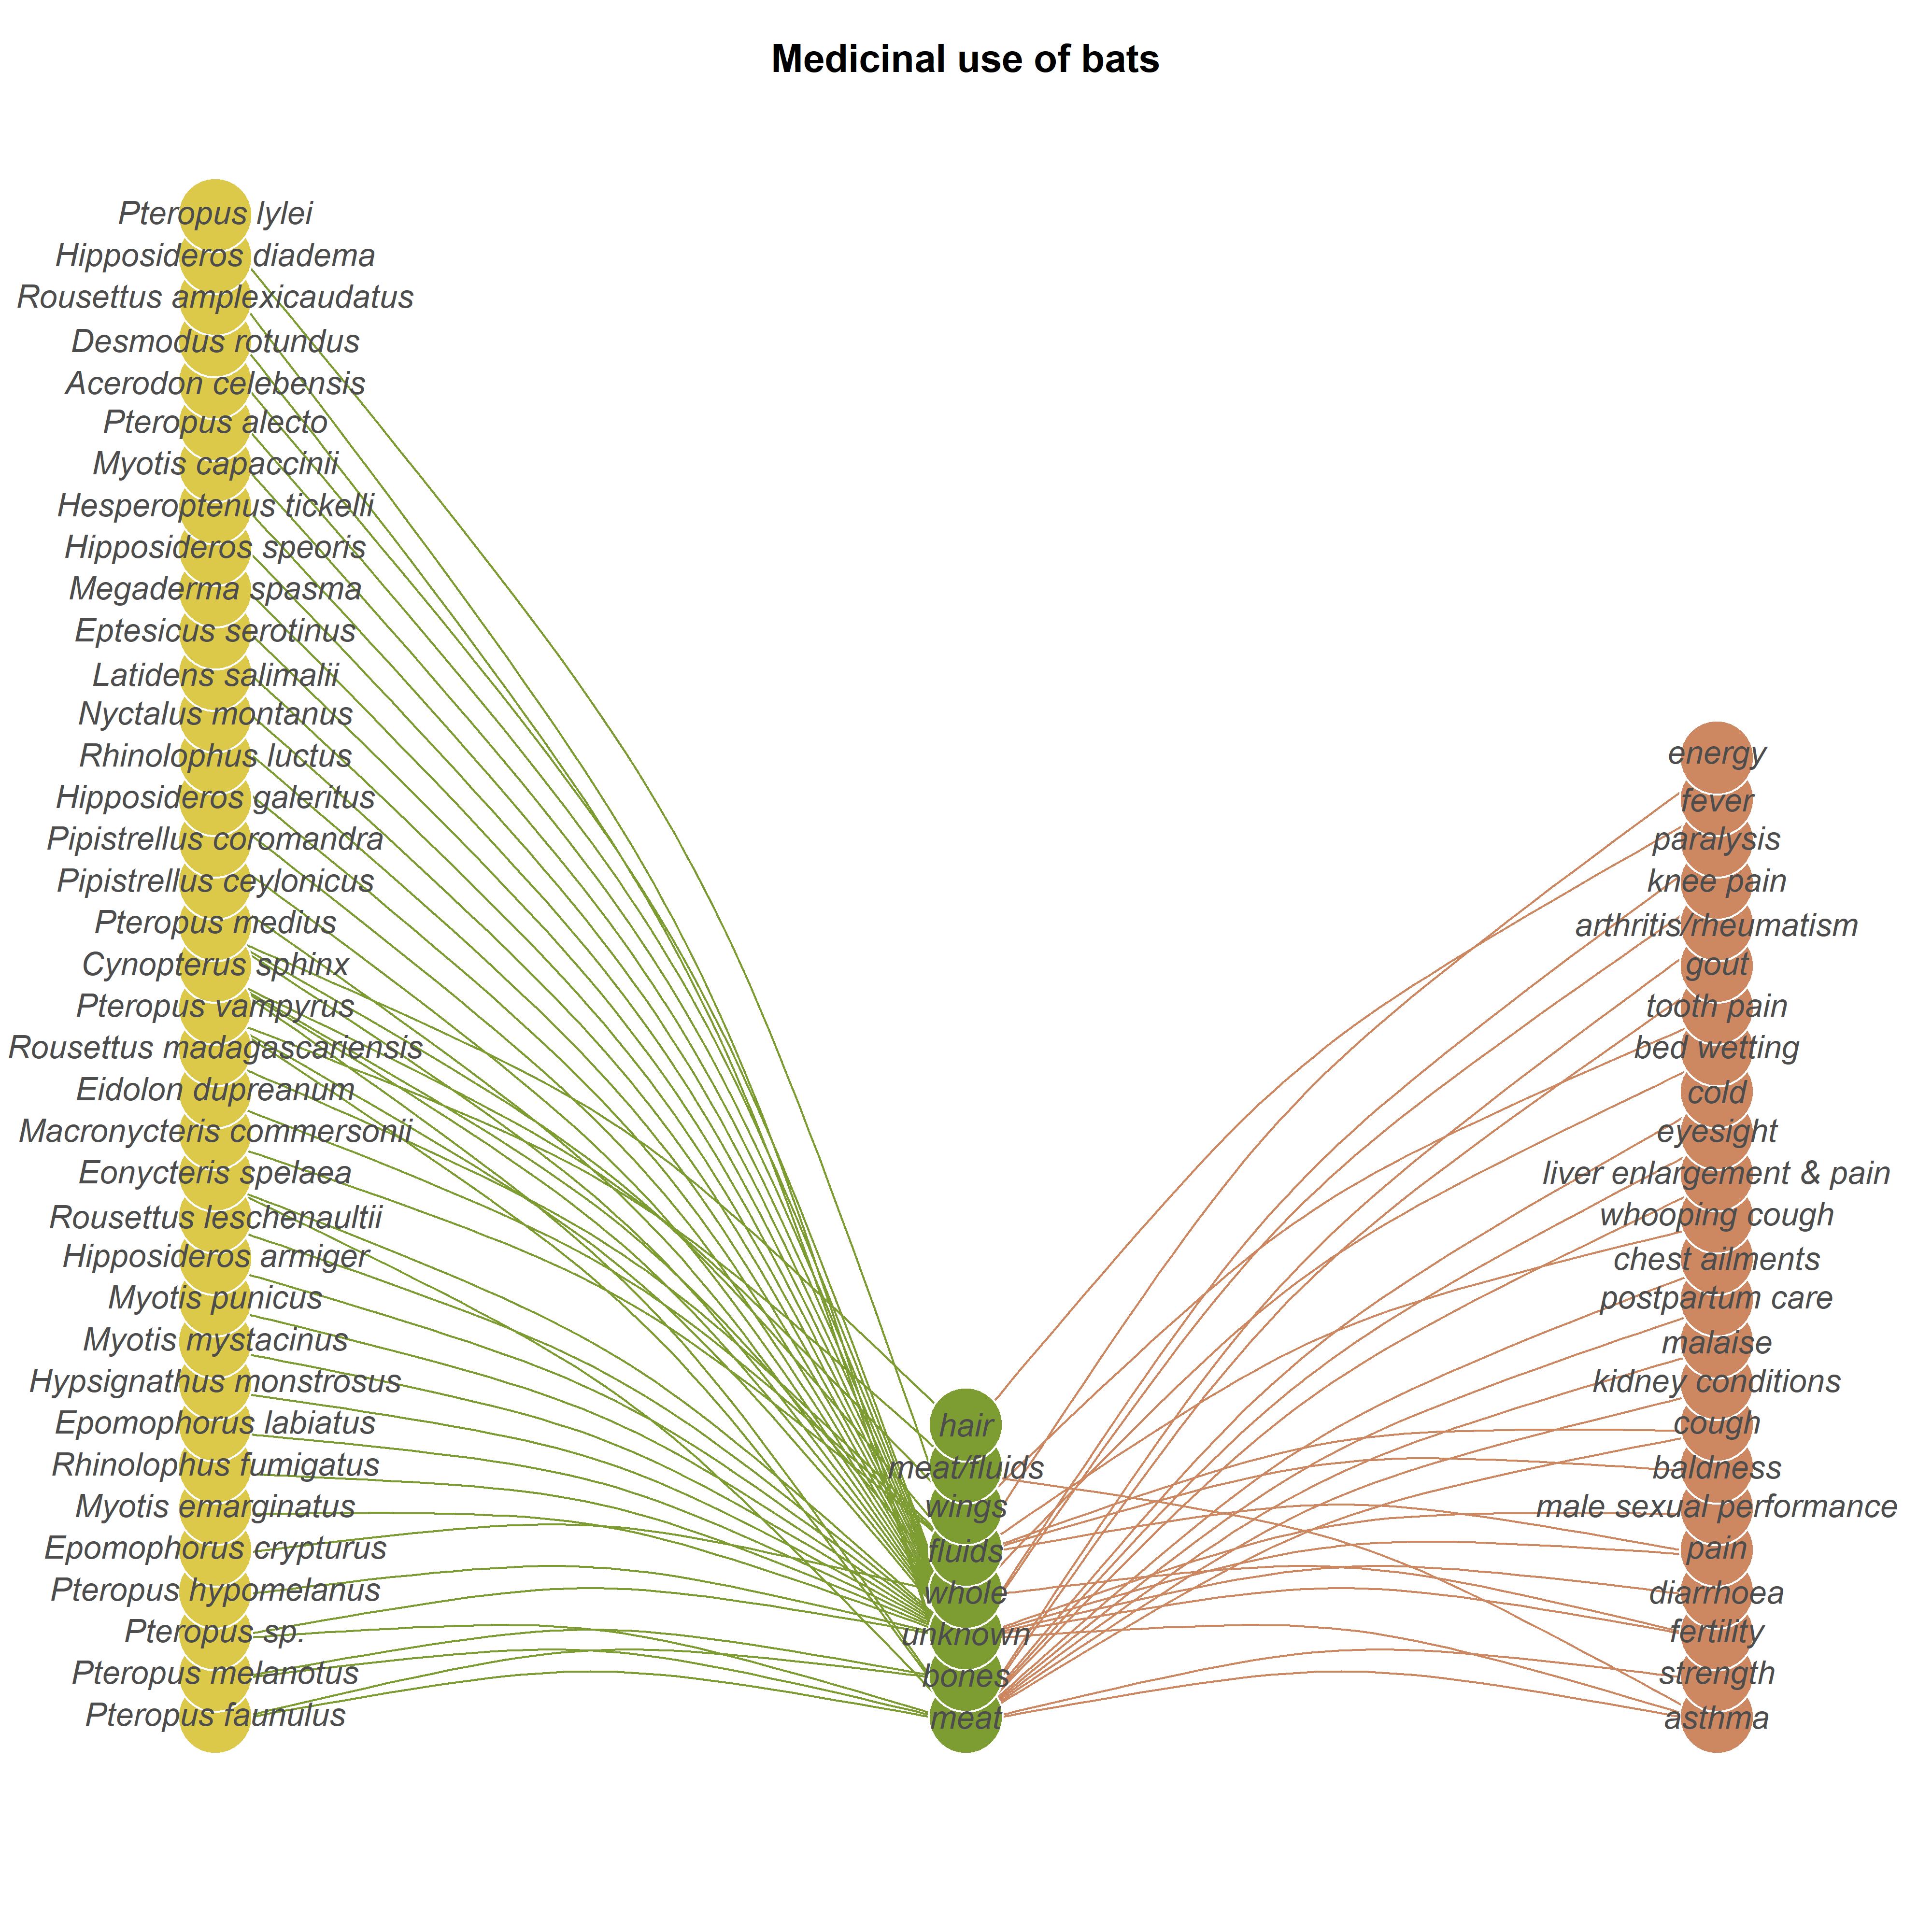


Future directions
in SEN research
Ecological network
Social network
SEN links
Levels
Metrics and models
Nodes:
Keystone SE nodes
Interaction strength, hub scores, node centrality
Links:
Duality of interactions
Hidden interactions
Forbidden interactions
Degree, centrality, clustering, temporal activity, functional roles
In the dark
The network
we see
External:
Environmental effects on SENs
Linear models, Mixed-effects models (GLMMs, GAMMs), Spatial autoregressive models (SAR), Bayesian models, Latent space models, Exponential Random Graph Models (ERGMs), Machine Learning models, Multivariate tests.
Networks:
Emergent properties
Robustness, Flow betweenness, Hierarchy centralization, Modularity and participation, assortativity

