Slide 1
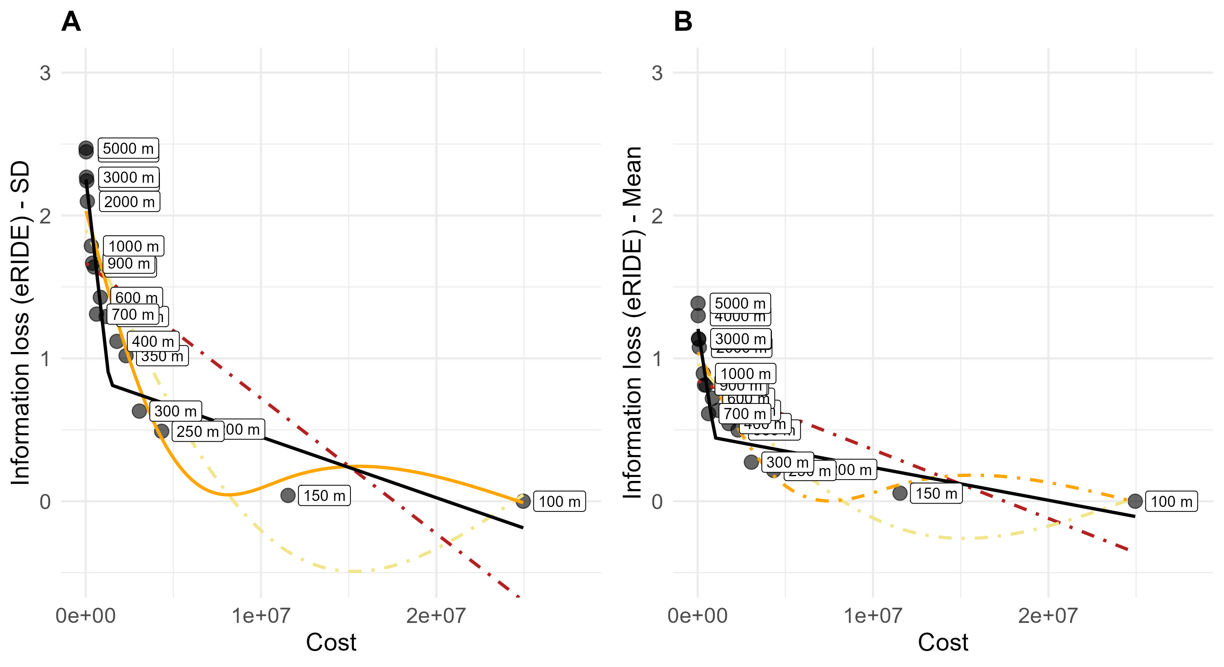
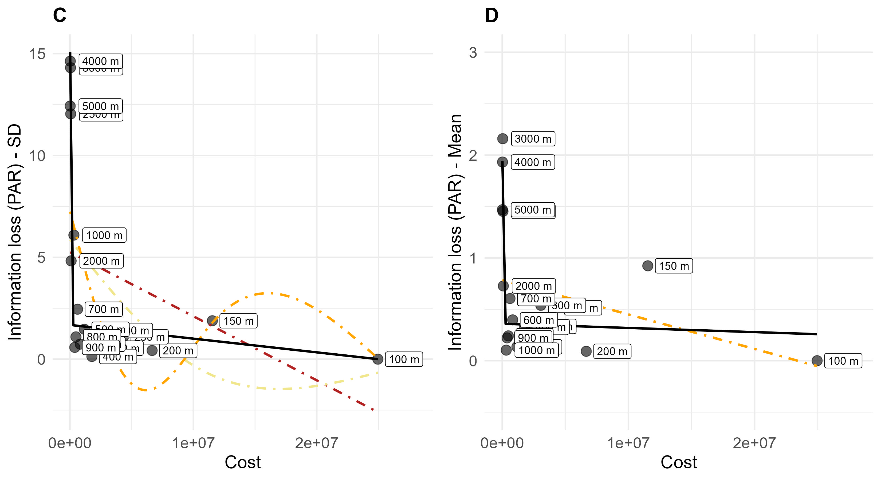

Slide 2
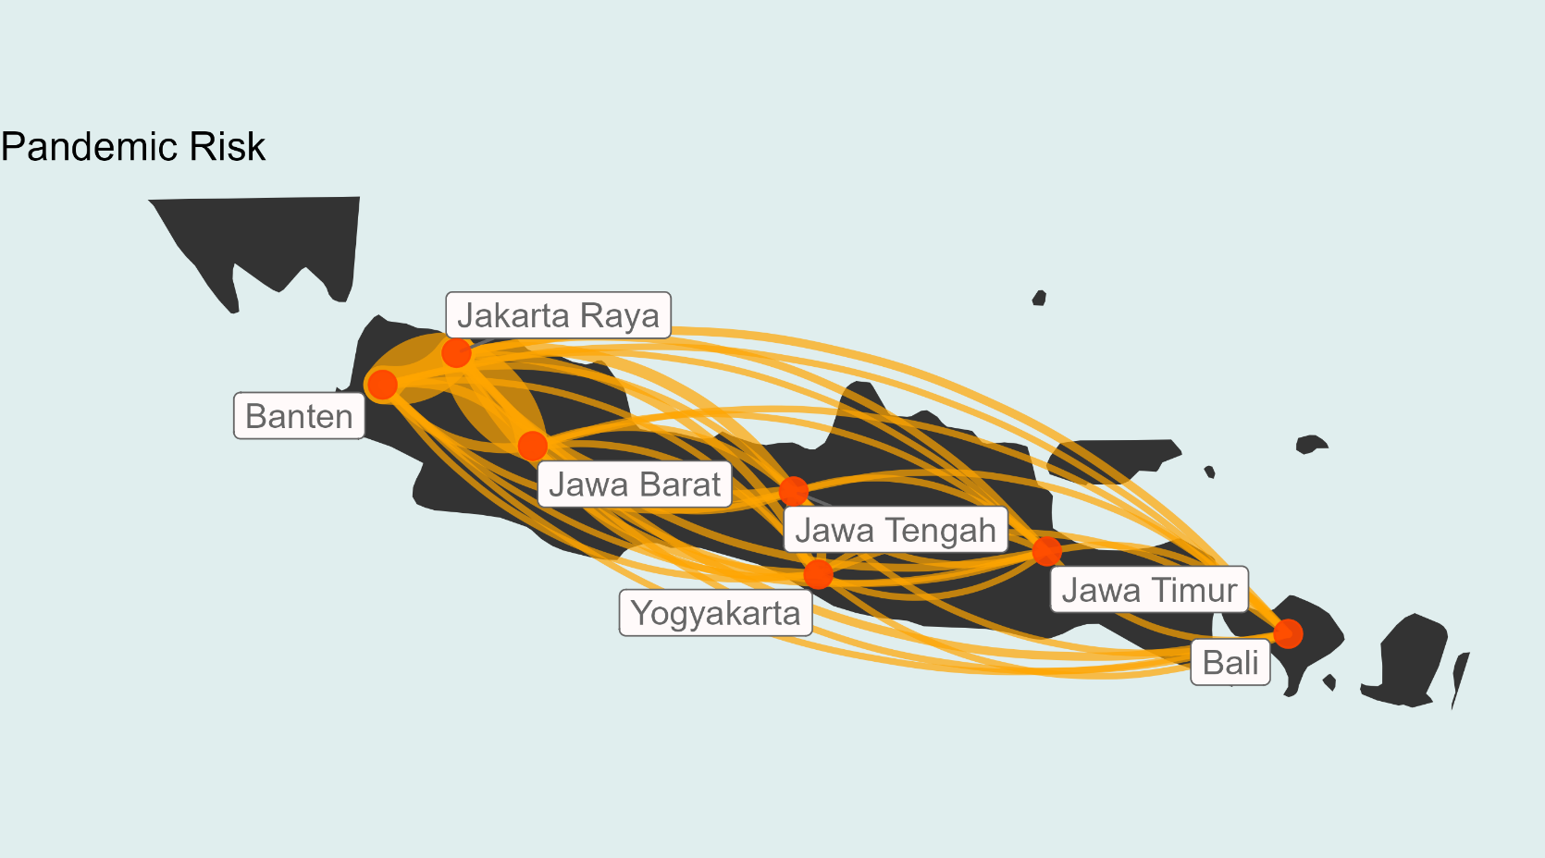
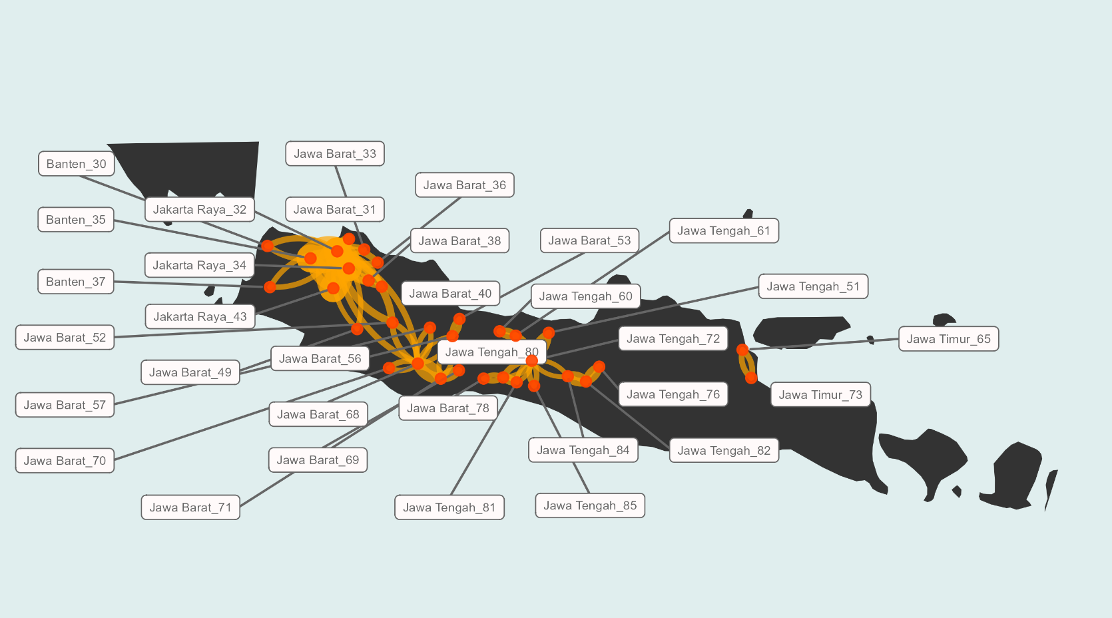
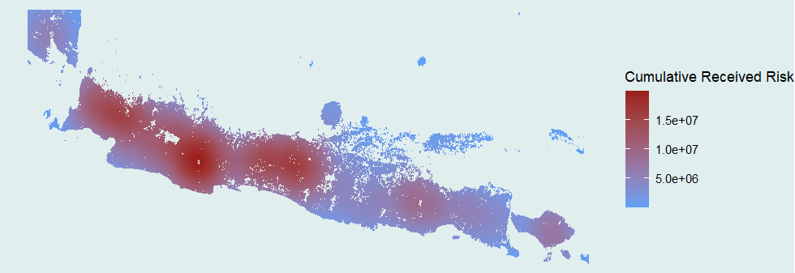
A
B
C
High
Low

Slide 3


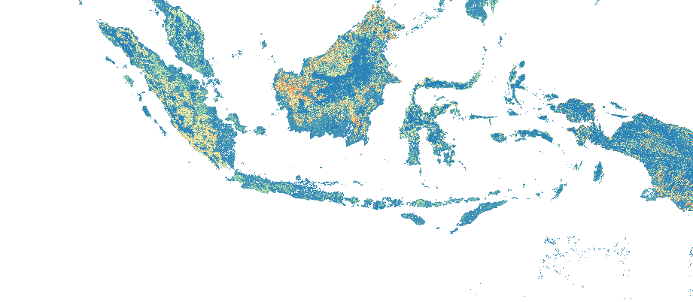
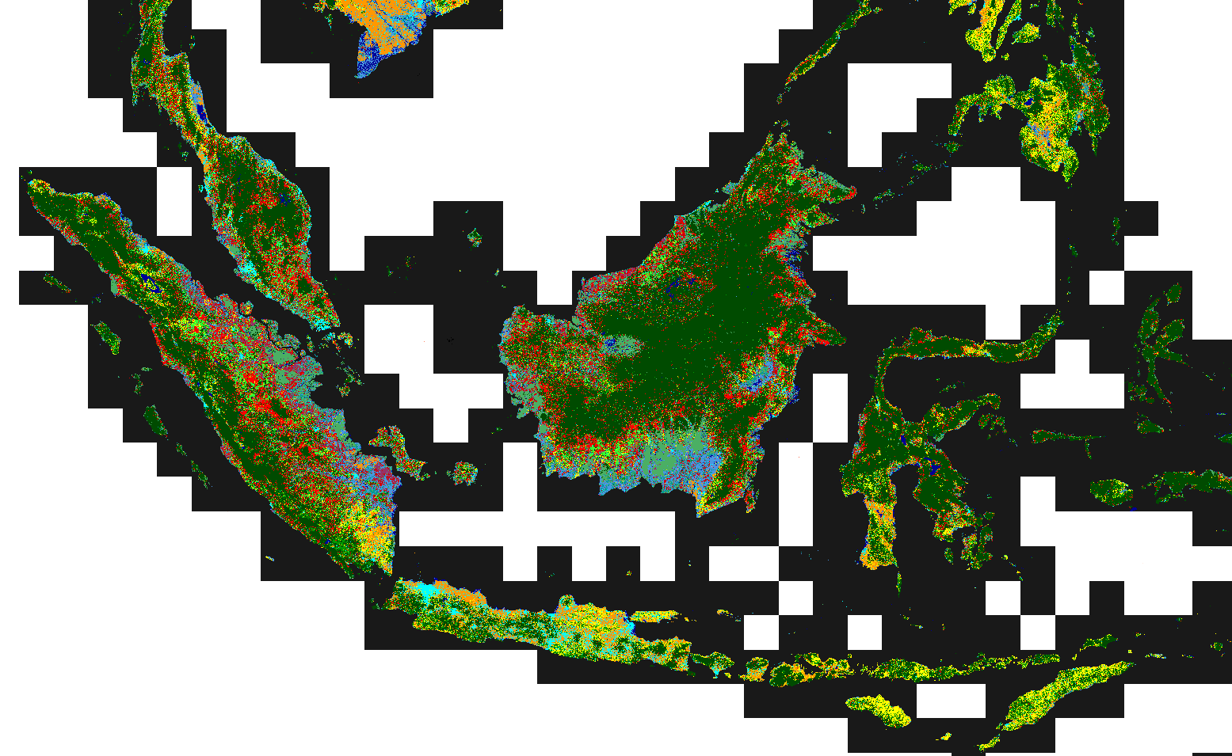
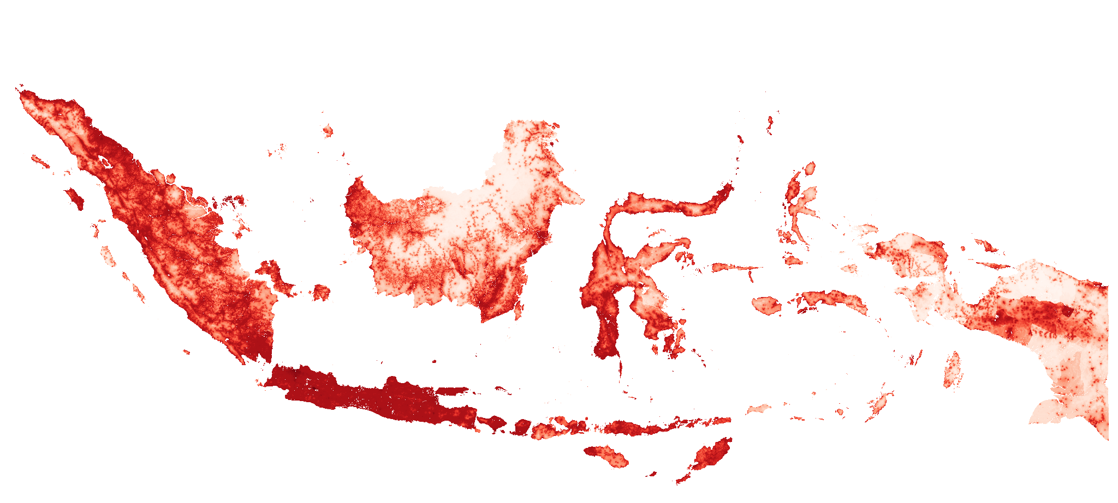
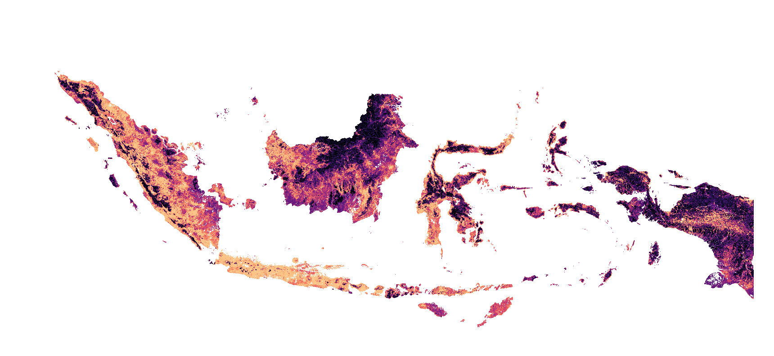
Environment set up
Region set up
eRIDE source function
Region projection
eride_run("rast", "pop")
eRIDE
v.import
execGRASS("g.proj", flags = "c", parameters = list(raster = "rast"))
Init GRASS
Region
resolution
human population
wres <- '100'
land use rast
execGRASS("g.region", parameters = list(raster = “rast"), res=wres)
PAR
EPSG:4326 - WGS 84
Region extent
EPSG:3857 - WGS 84 / Pseudo-Mercator
execGRASS("g.region", parameters = list(raster = "pop")

