Slide 1
Create a correction formula for richness of an area that is corrected by latitude. The rule is: areas with smaller values for latitudes will have higher maximum richness numbers allowed, while areas that that have higher absolute values for latitude will never reach large numbers for richness.

Slide 2
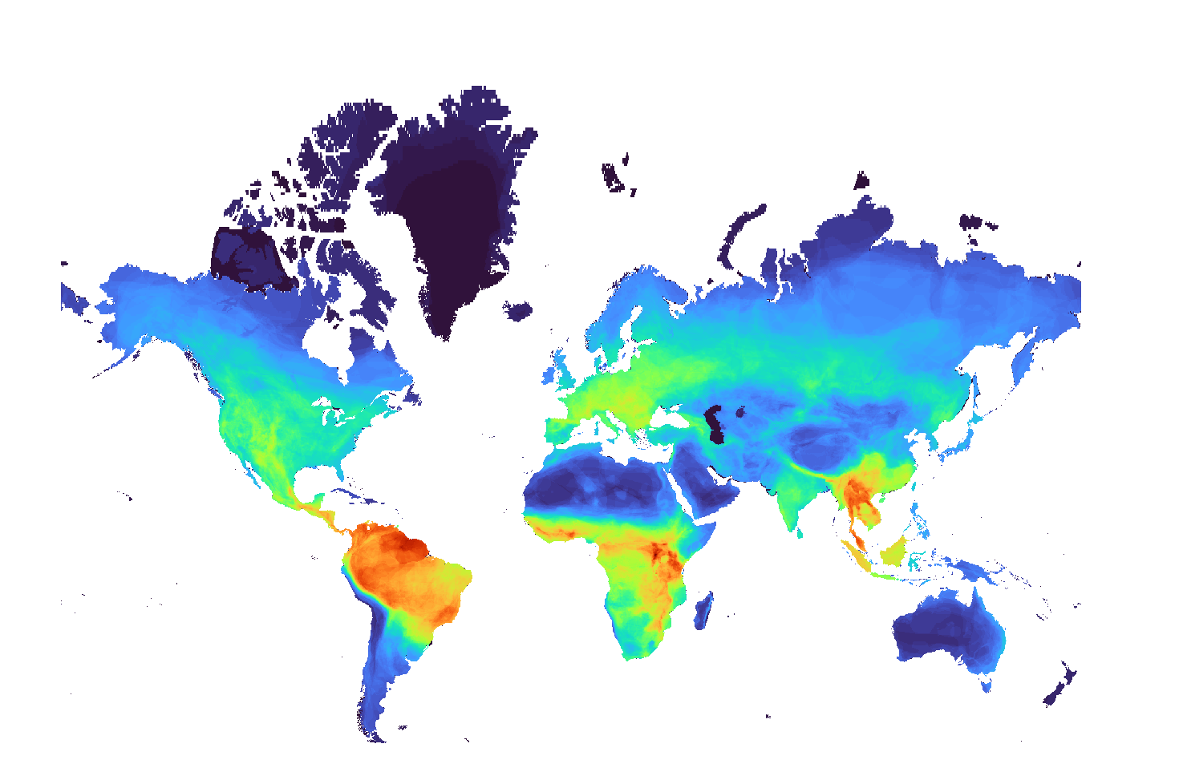
Mammal hosts 1km

Slide 3
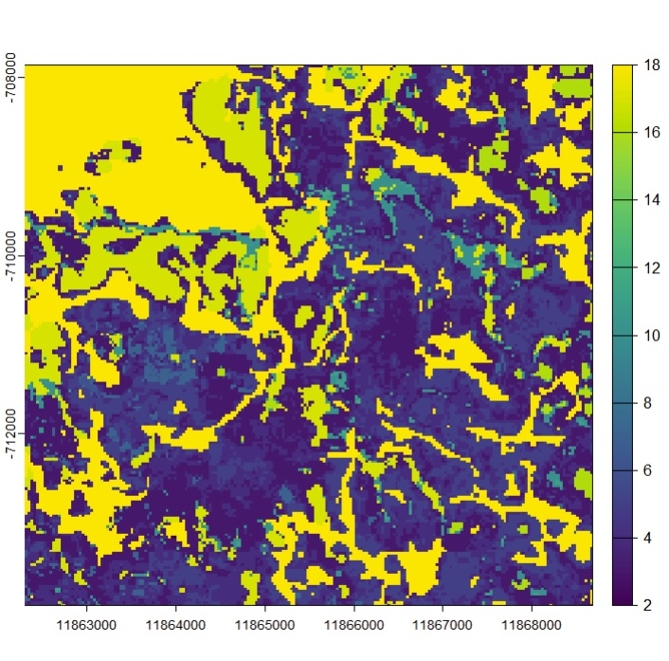
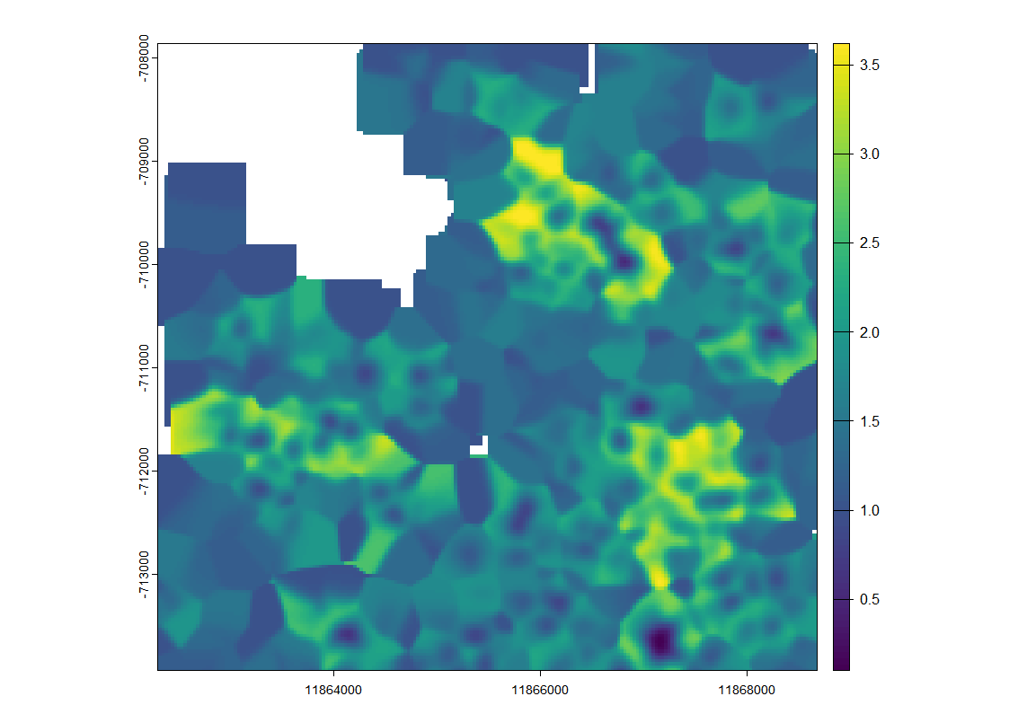
Tropical area 700km below the ecuator abs(700000)

Slide 4
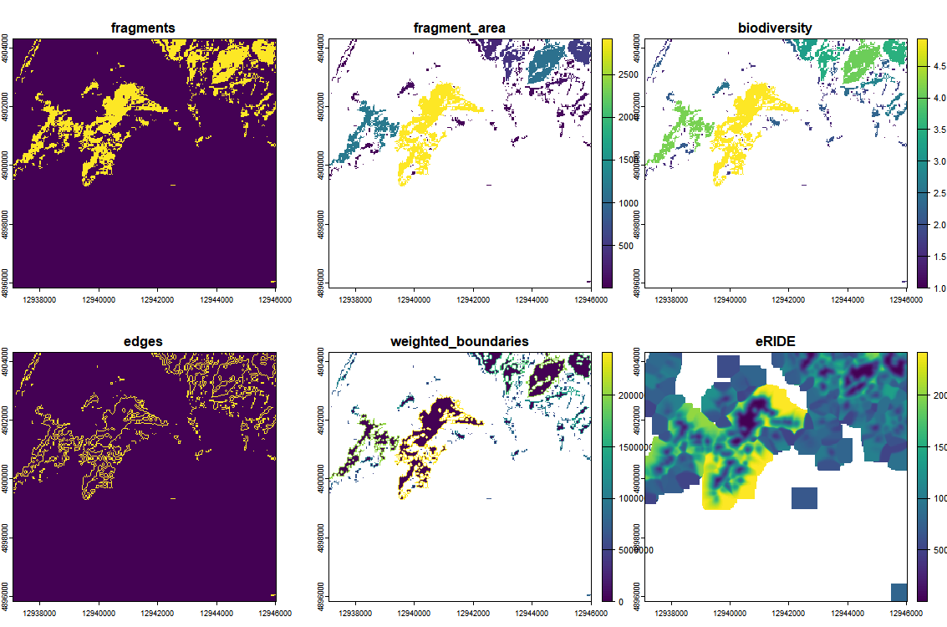
Beijing ~40N 4851km 4851421 m

Slide 6
Alaska 60N ~ 8400 km above equator 8399738 m

Slide 7
New Zealand 40S 4.8k km -4865942 m

Slide 8
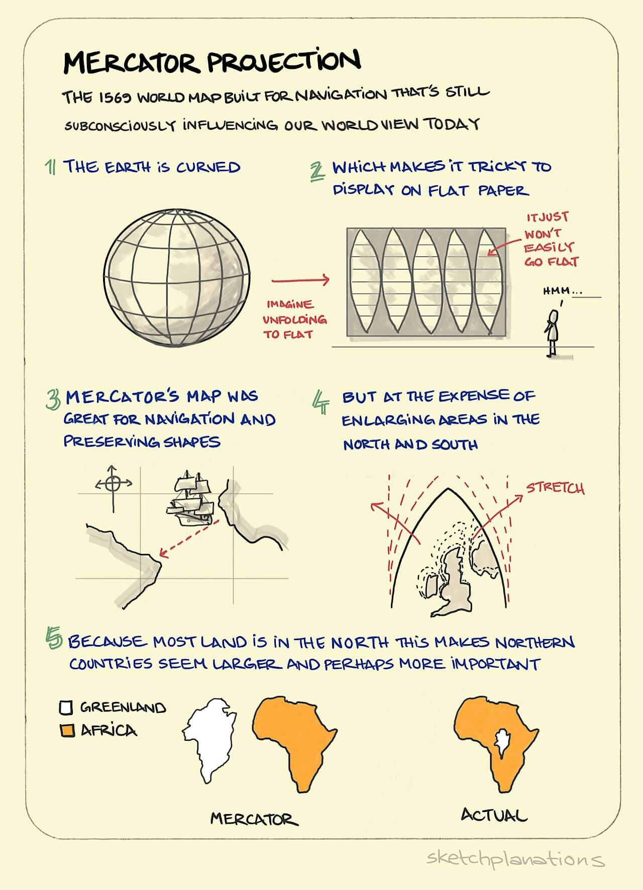
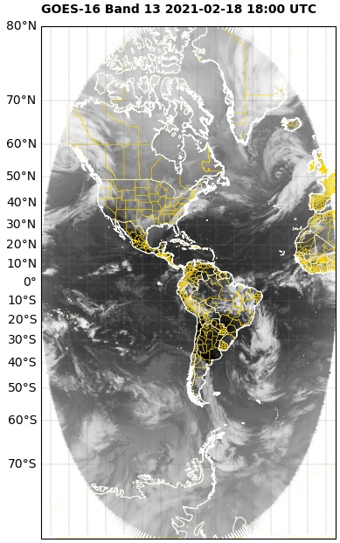
Notes:
https://geonetcast.wordpress.com/2021/04/12/reprojection-to-mercator-epsg3857/
https://michaelminn.net/tutorials/gis-projections/

Slide 9
