Slide 1


Eride global dev
Closed issues
Open issues
Lsmetrics dev
ErideR dev
Nature paper Comms dev
Other pubs
August and September 2023
Nesi-GRASS compatibility
Latitudinal gradient chats
October
Nesi
Global Mosaic job failed (Nov)
Nature Comms paper accepted
Dec
Brazil
USP, UNESP & Leave
2023
Degrade it to 100 m
Jan
Back from Brazil
Feb
Capital City Complex Systems
Epi Interactive Meeting
April-May
Global One Health
Austria Task Force
May -June
Fingerprint
FYM
Other pubs
July
Chat with David Wilkinson
August
Backups to G: (8TB)
Toy Github repo
August-
Latitude issue
Mosaic issue
2024

Slide 2

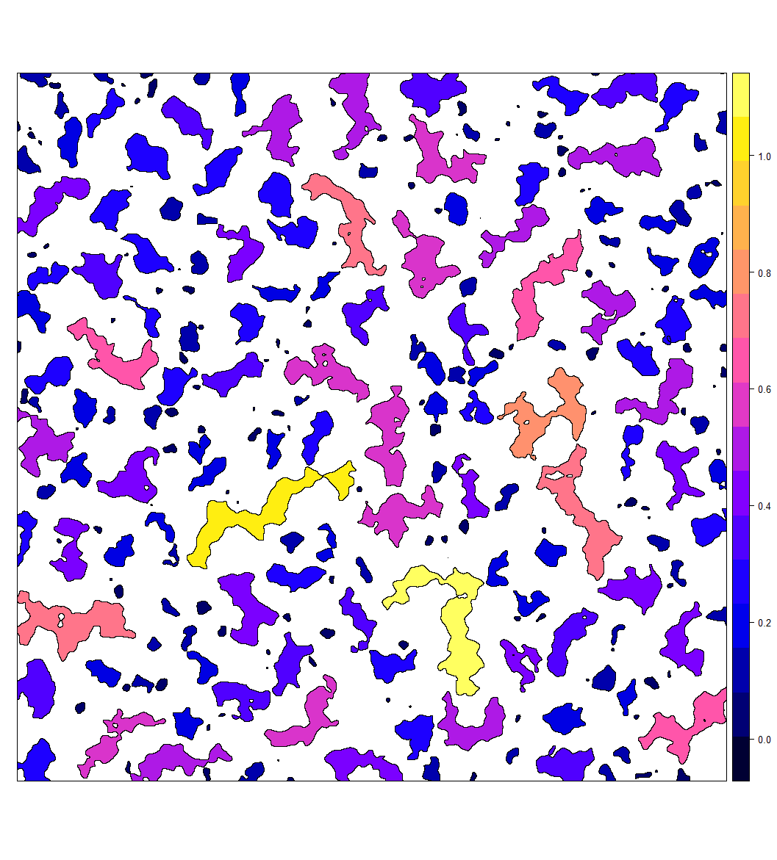



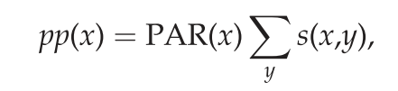
Context: Edges
Hazard
Edge amount
eRIDE
Estimated risk for novel infectious disease emergence: scales linearly with patch biodiversity and patch perimeter
population at risk (PAR) for each pixel: product of the pixel eRIDE and pop density
The pandemic risk following initial spillover depends on subsequent human to human transmission and thus will be driven by pop density and connectivity (Dijkstra’s algorithm).
Biodidiversity
in a forest patch
eRIDE ~
PAR = eRIDE x Pop density
Received
Generated
Notes:
An eRIDE index (sumof the product of number of edge pixels from each patch and their corresponding patch bio- diversities) were calculated within a 20 X 20 moving window for each pixel of these data. The
A division index (number of unique patches), an edge density index (number of edge pixels) and an eRIDE index (sumof the product of number of edge pixels from each patch and their corresponding patch bio- diversities) were calculated within a 20 ? 20 moving window for each pixel of these data. The estimated population at risk (PAR) for each pixel was defined as the product of the pixel eRIDE index and the population density at that location.

Slide 3


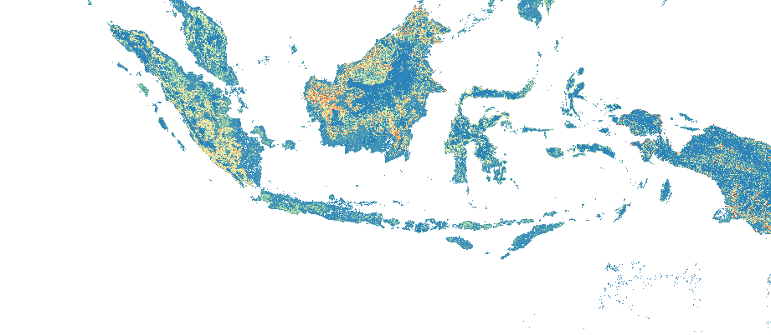
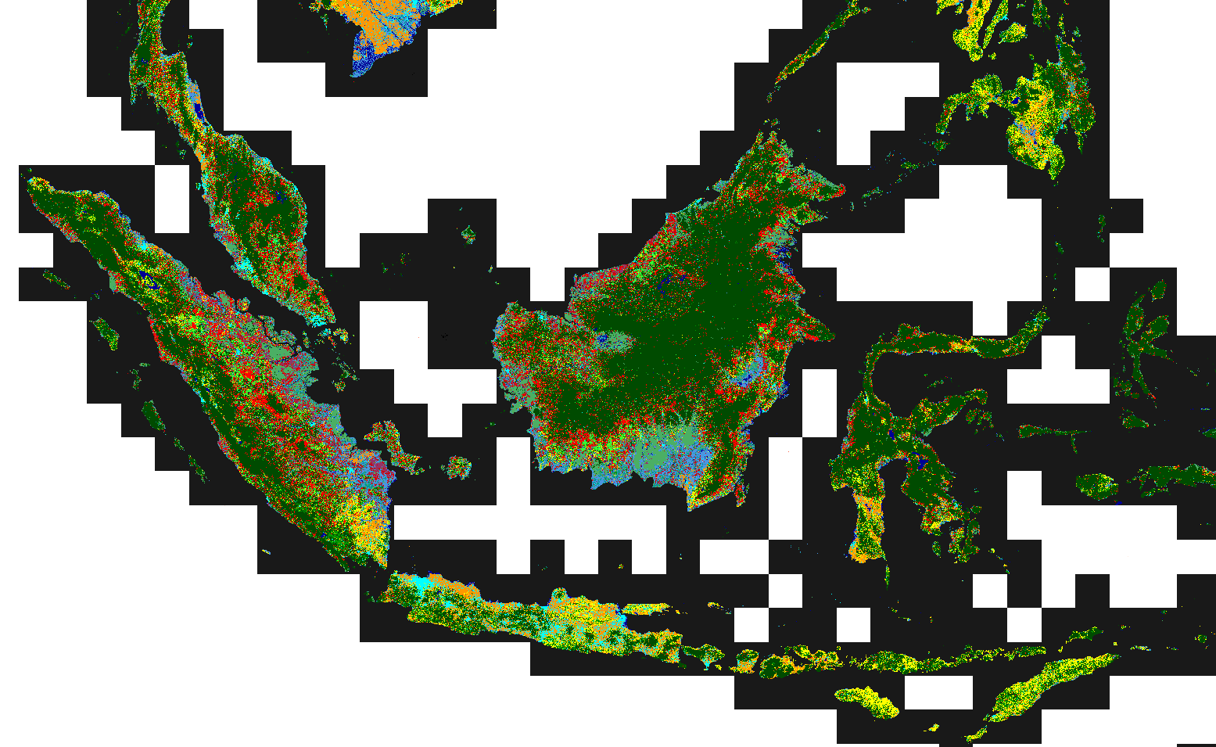
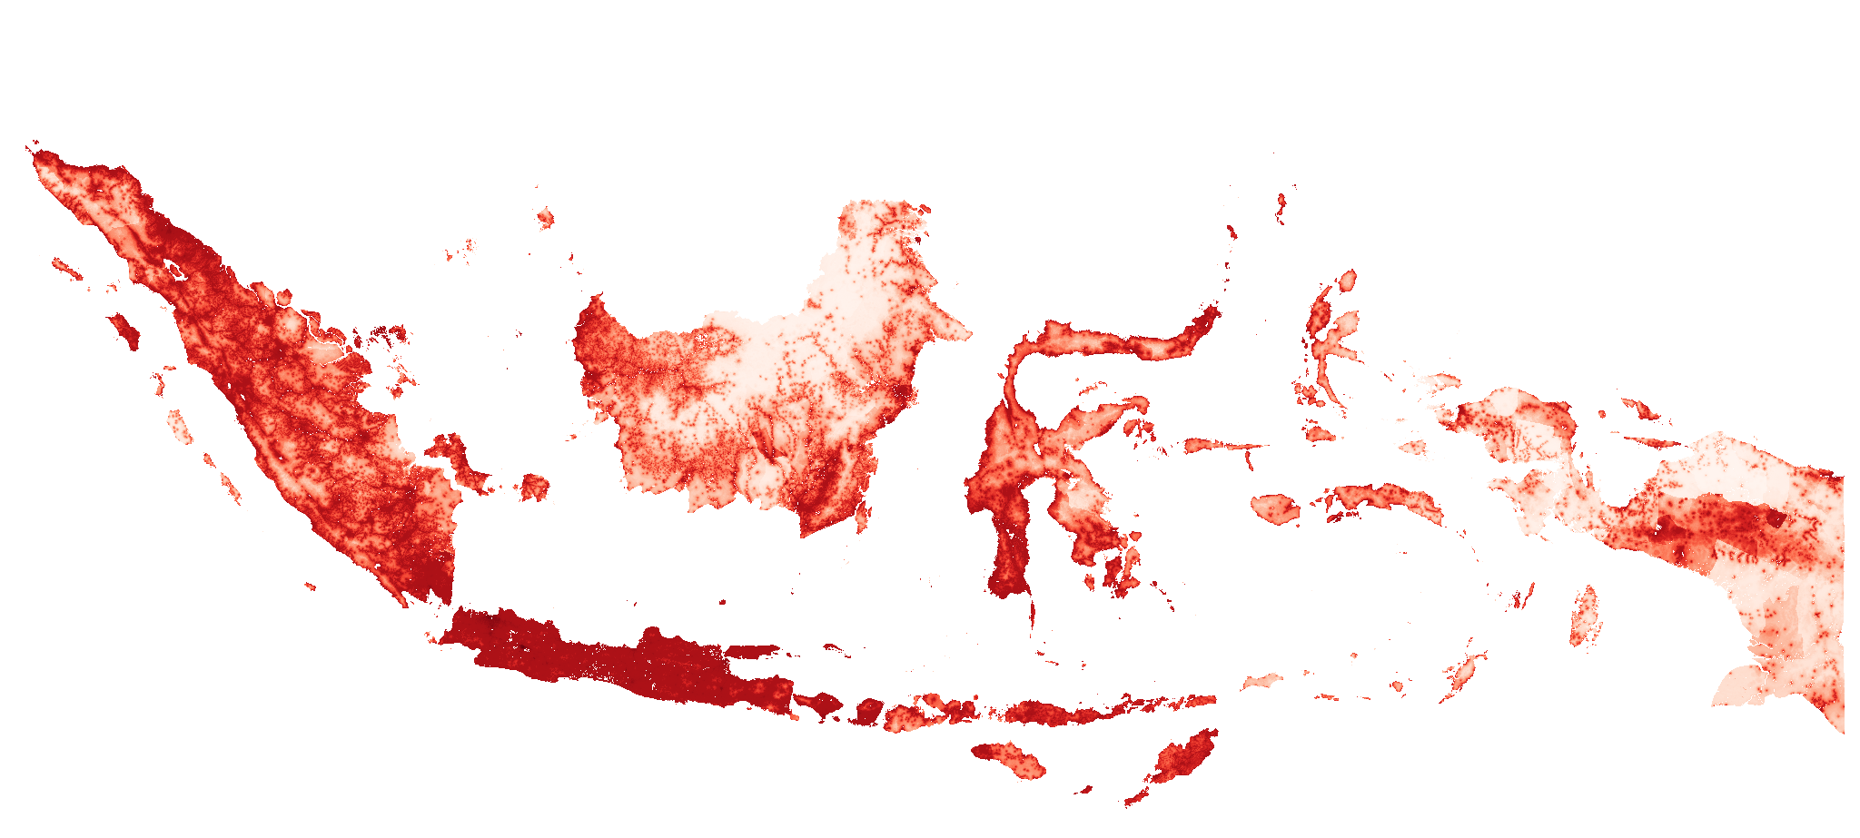
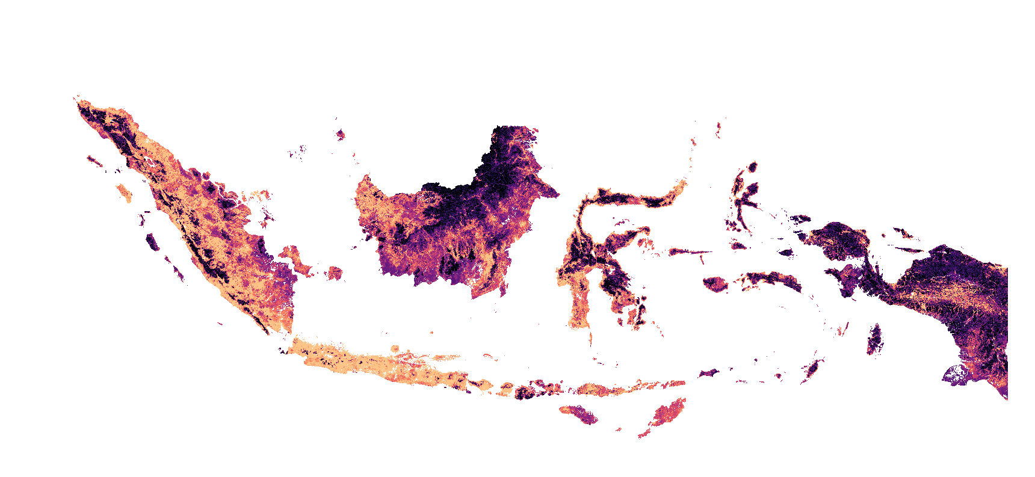
Environment set up
Region set up
eRIDE source function
Region projection
eride_run("rast", "pop")
eRIDE
v.import
execGRASS("g.proj", flags = "c", parameters = list(raster = "rast"))
Init GRASS
Region
resolution
human population
wres <- '100'
land use rast
execGRASS("g.region", parameters = list(raster = “rast"), res=wres)
PAR
EPSG:4326 - WGS 84
Region extent
EPSG:3857 - WGS 84 / Pseudo-Mercator
execGRASS("g.region", parameters = list(raster = "pop")

Slide 4

gravity_run(“PAR")
PAR
Pandemic risk
Relative received pandemic risk
for each zone
% Contribution from zones
Zones
Received pandemic risk is calculated for each country, and stacked bars indicate the relative contributions to risk from each country. Inset, increased magnification of the risk associated at the tail end of the graph.

Slide 5
# g.region versus r.mask
g.region adjusts the computational region to match the extent and resolution of pop, impacting where calculations occur.
r.mask establishes a mask that restricts operations to the non-null values of pop, affecting how calculations are performed within the defined region.
Outcome:
Using g.region impacts which area is considered for computations.
Using r.mask affects how values in that area are treated (i.e., ignoring nulls).

Slide 6
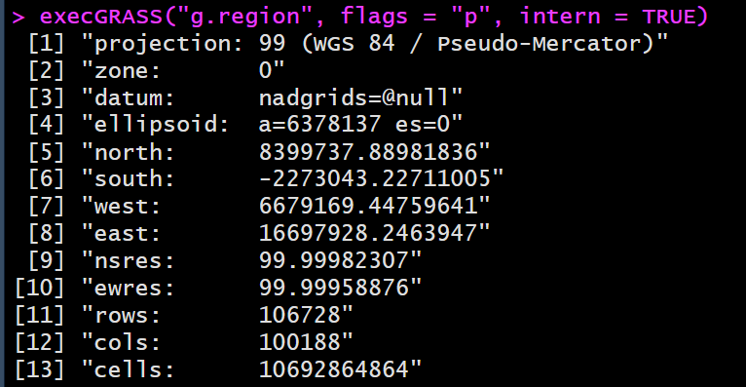
Asia region dim as 100 m

Slide 7
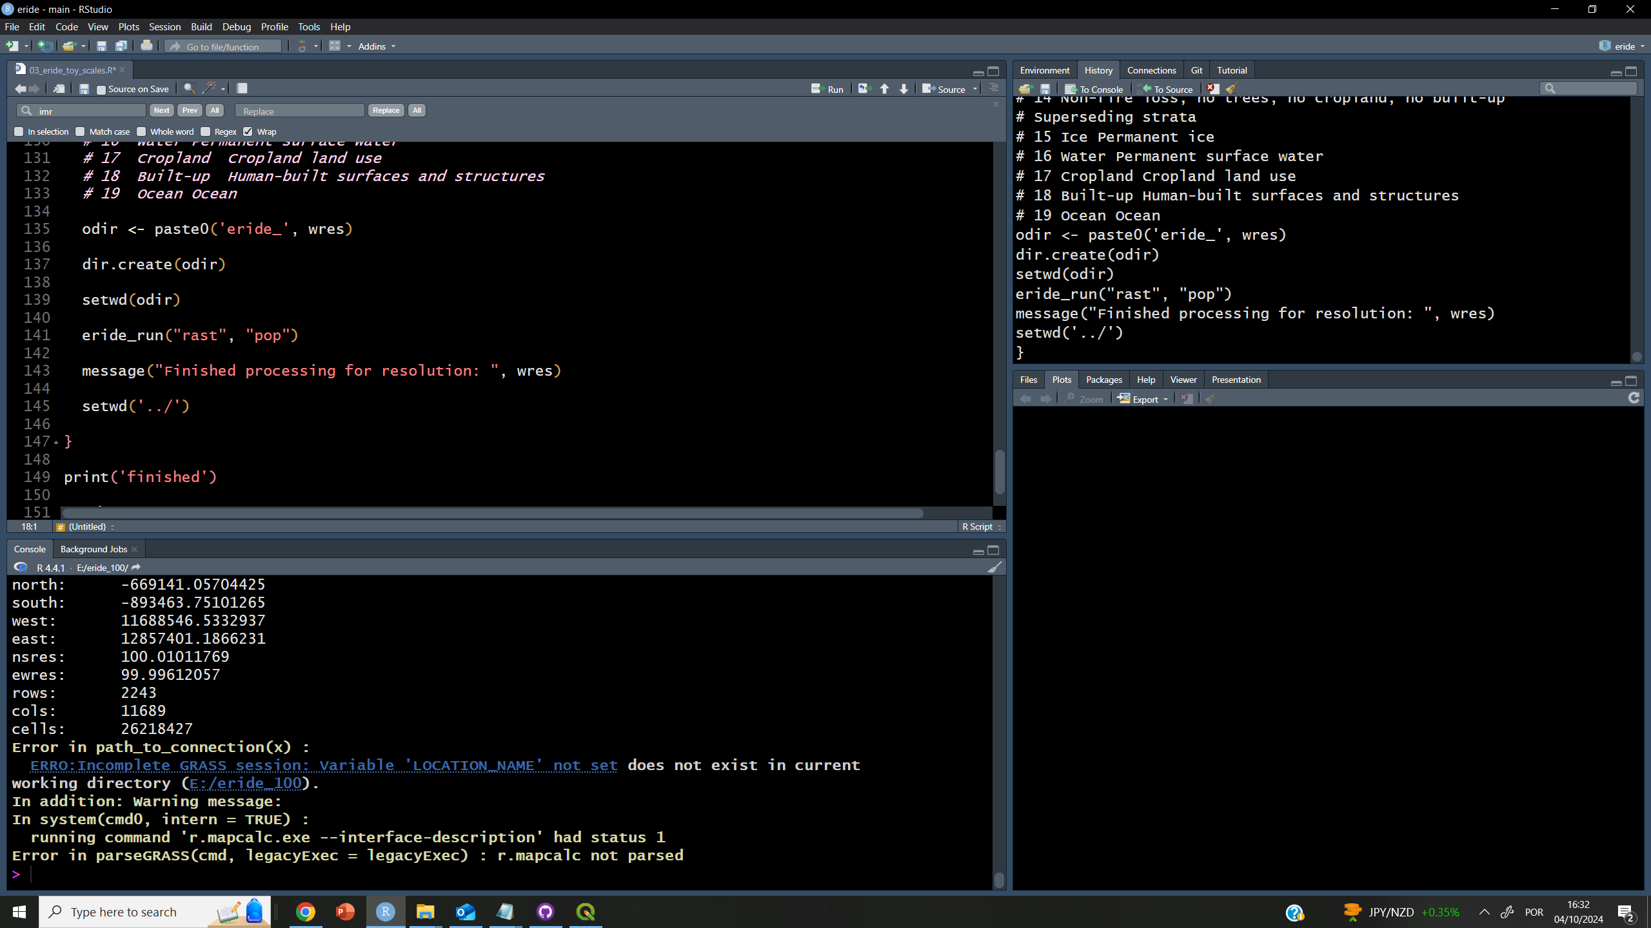
Loops break location workflow

Slide 8
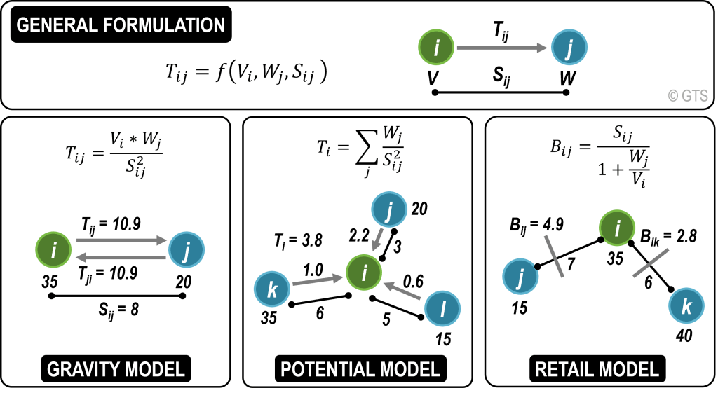
Notes:
https://transportgeography.org/contents/methods/spatial-interactions-gravity-model/spatial-interactions-basic-models/

Slide 9
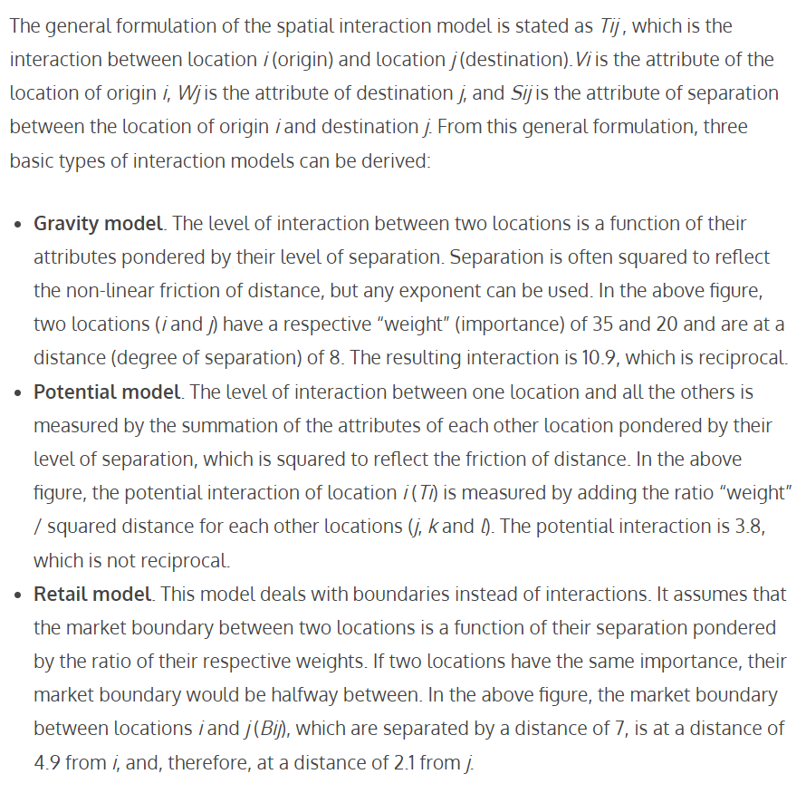

Slide 10
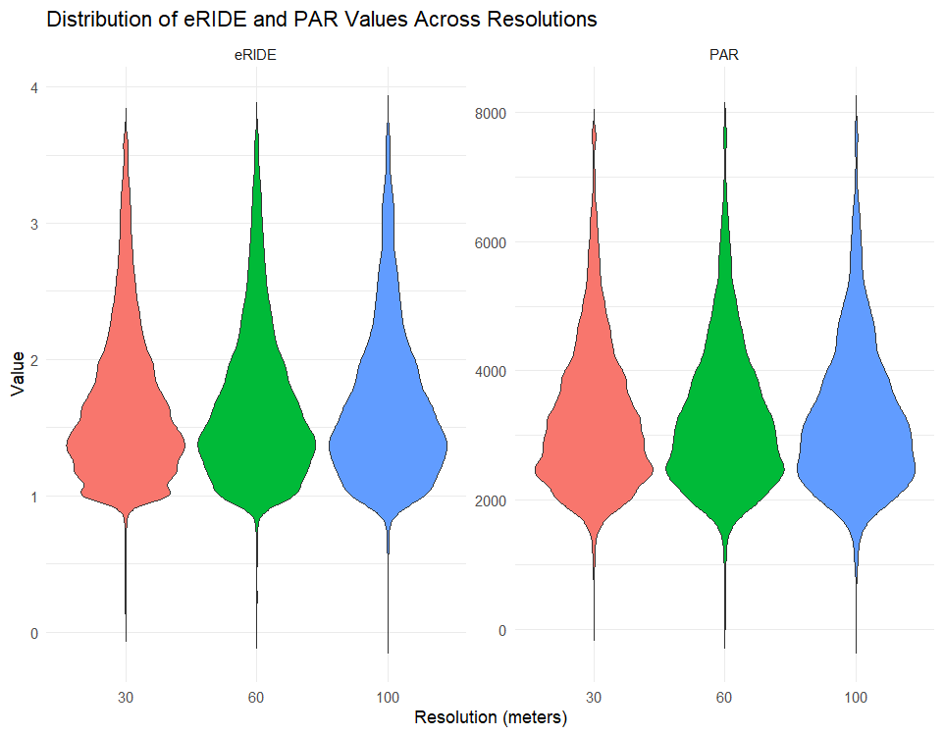
Is a patch-based model globally relevant?
Does a mechanistic model (based on island biogeography) compare to the global patterns of coarser, correlative models previously published?

Slide 11
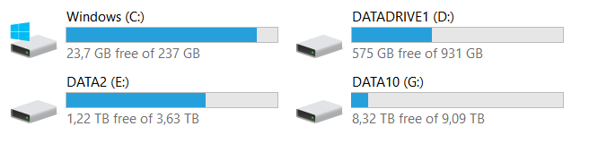
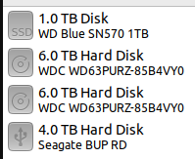
Computational power
Minimal requirements ( Massey PC 2023):
7 cores, 32 RAM, a lot of local mem
Massey PC 2024
DW PC Reunion

Slide 12
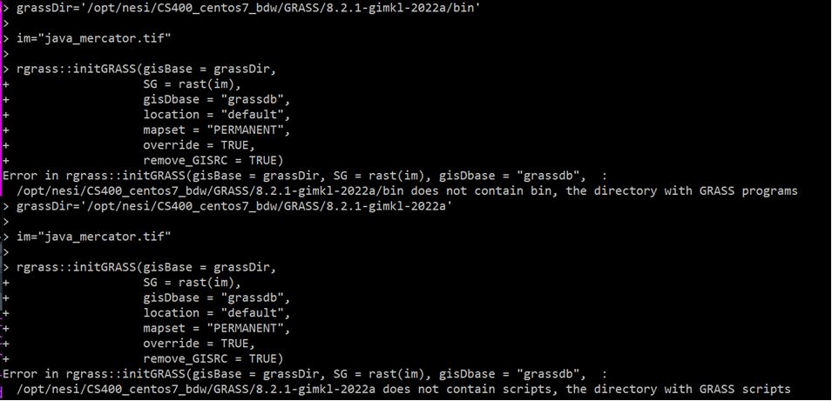
Almost there with GRASS in HPC! R update done Grass module (hidden) installed

Slide 13

Working!
But...

Slide 14
To be continued..

