Slide 1


Eride global dev
Closed issues
Open issues
Lsmetrics dev
ErideR dev
Nature paper Comms dev
Other pubs
August and September 2023
Nesi-GRASS compatibility
Latitudinal gradient chats
October
Nesi
Global Mosaic job failed (Nov)
Nature Comms paper accepted
Dec
Brazil
USP, UNESP & Leave
2023
Degrade it to 100 m
Jan
Back from Brazil
Feb
Capital City Complex Systems
Epi Interactive Meeting
April-May
Global One Health
Austria Task Force
May -June
Fingerprint
FYM
Other pubs
July
Chat with David Wilkinson
August
Backups to G: (8TB)
Toy Github repo
August-
Latitude issue
Mosaic issue
2024

Slide 2
Is a patch-based model globally relevant?
Does a mechanistic model (based on island biogeography) compare to the global patterns of coarser, correlative models previously published?

Slide 3
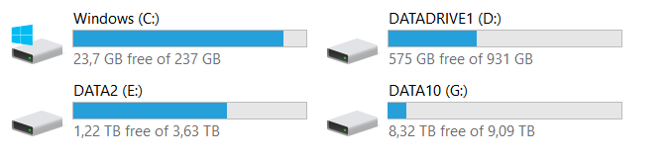
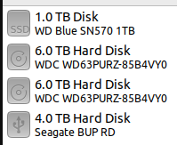
Computational power
Minimal requirements ( Massey PC 2023):
7 cores, 32 RAM, a lot of local mem
Massey PC 2024
DW PC Reunion

Slide 4
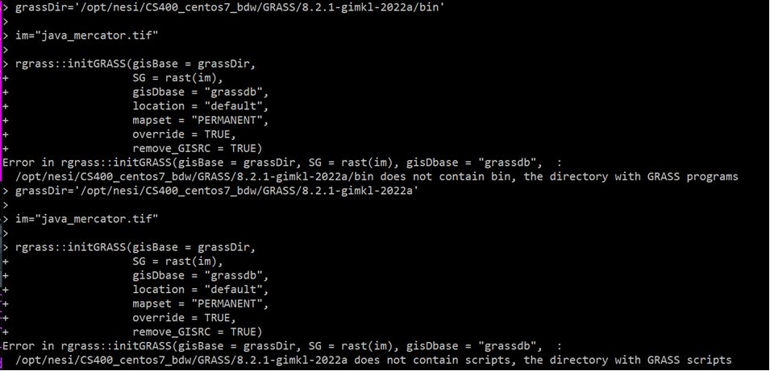
Almost there with GRASS in HPC! R update done Grass module (hidden) installed

Slide 5

Working!
But...

Slide 6
To be continued..

