Slide 1
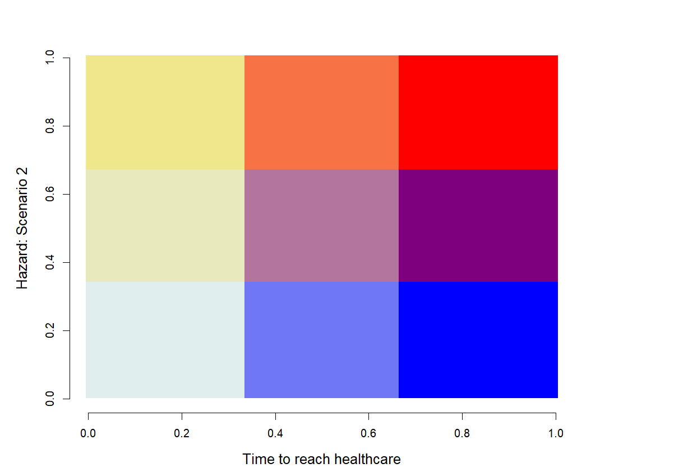
Sink
Source
Spillover debt:
Urgent action
Moderate priority for discovery,
prioritise understanding known hosts
Prioritize
OneHealth,
Host discovery
and public health access
(surveillance, fixed and mobile clinics)
- Hazard: Scenario 1 +
Host bias reduction from surveillance
Conditionally safer zones: focus on other
risks
Safer zones
- Time to reach healthcare +

Slide 2
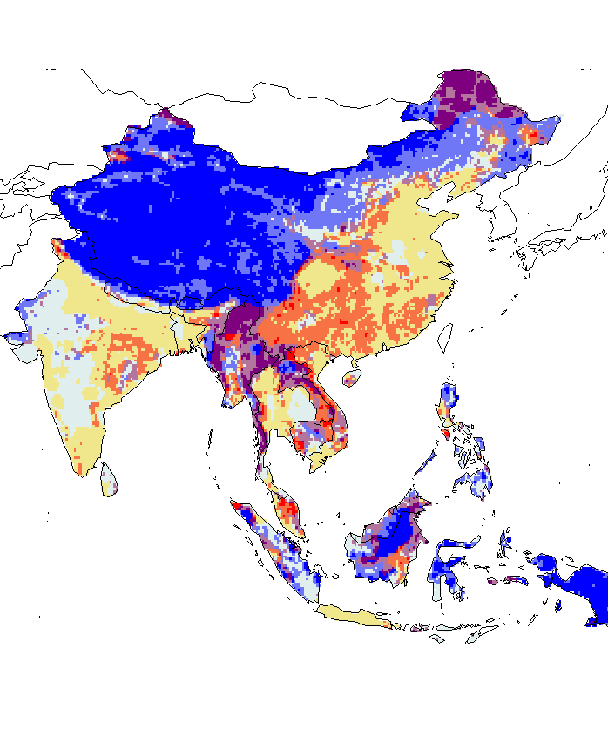

All mammals (redundancy)
- Hazard: Scenario 1 +
- Hazard: Scenario 2 +
- Time to reach healthcare +
- Time to reach healthcare +

Slide 3
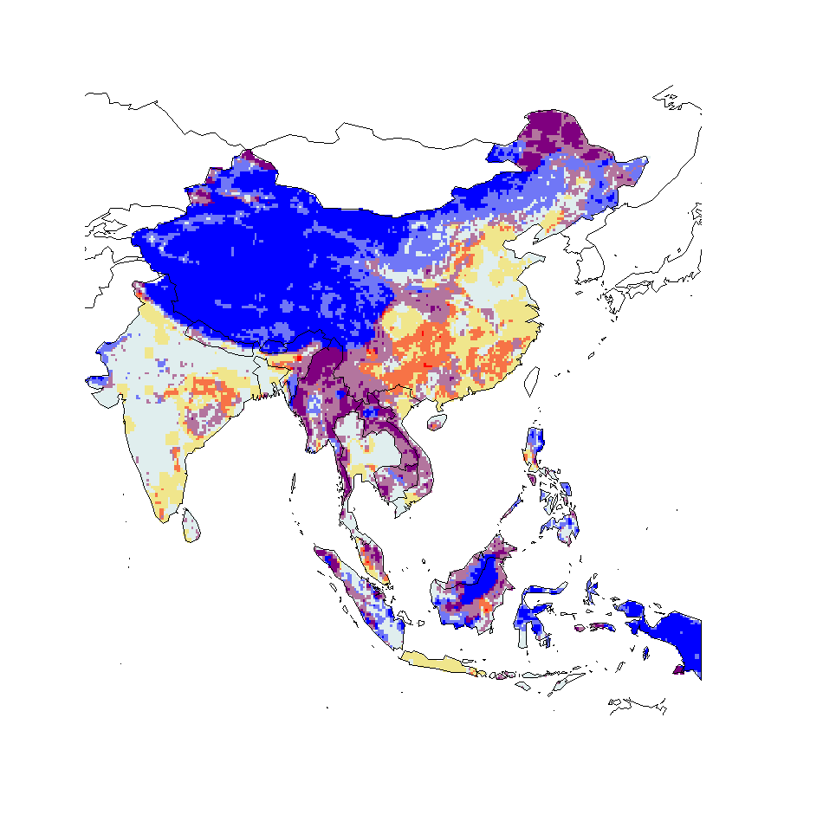
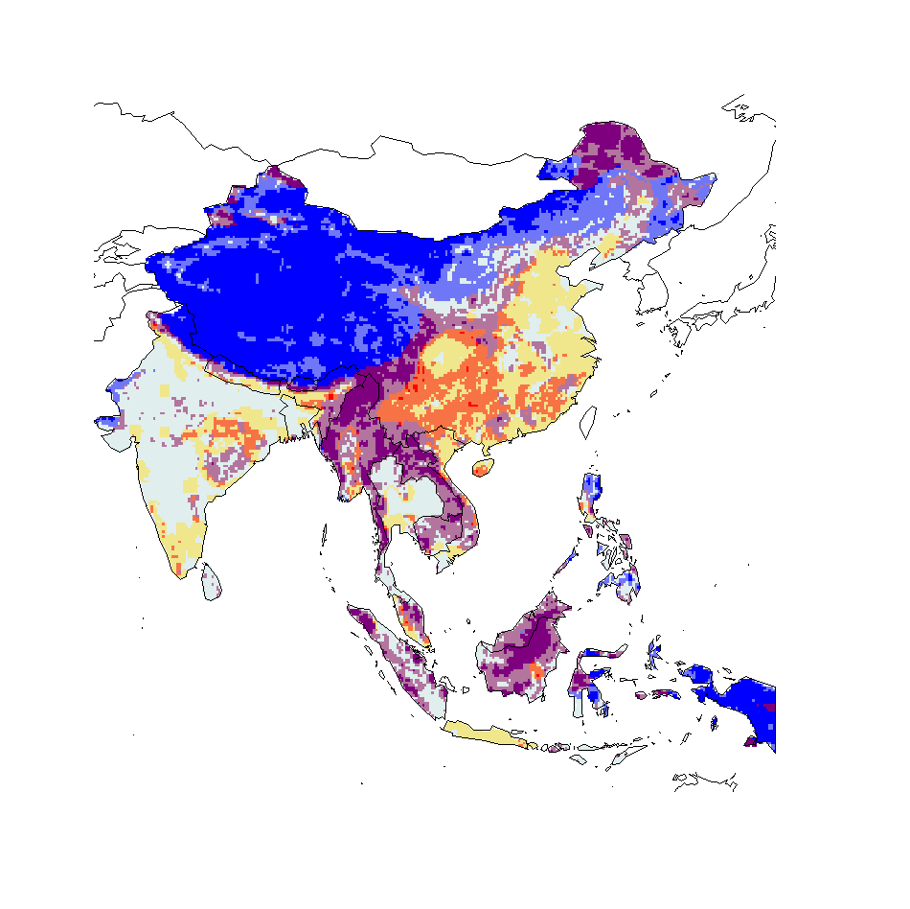
Mammals minus bat
All mammals minus bat hosts (redundancy removed)
- Hazard: Scenario 1 +
- Hazard: Scenario 2 +
- Time to reach healthcare +
- Time to reach healthcare +

Slide 4

Mammals minus bat
All mammals minus bat hosts (redundancy removed) – scenario 2 not nested
- Hazard: Scenario 1 +
- Hazard: Scenario 2 (mius bat hosts) +
- Time to reach healthcare +
- Time to reach healthcare +

Slide 5
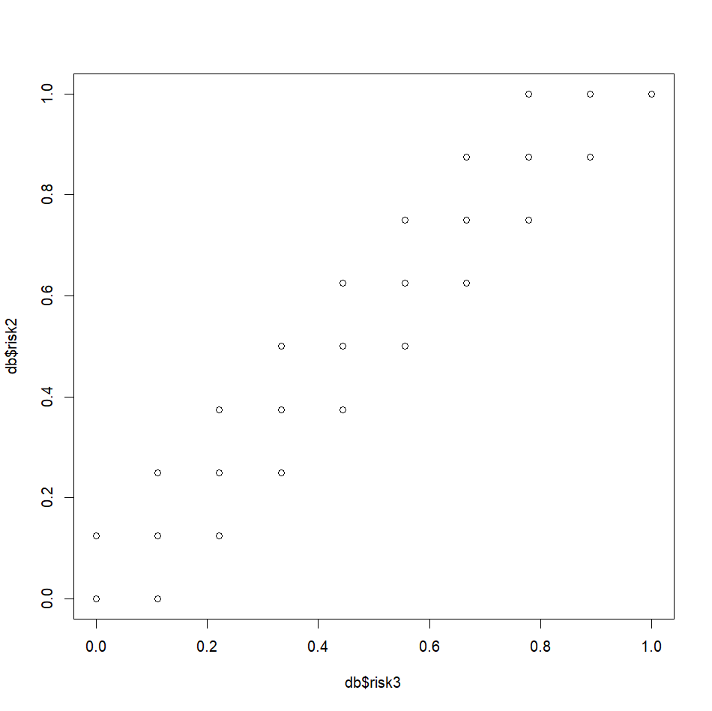
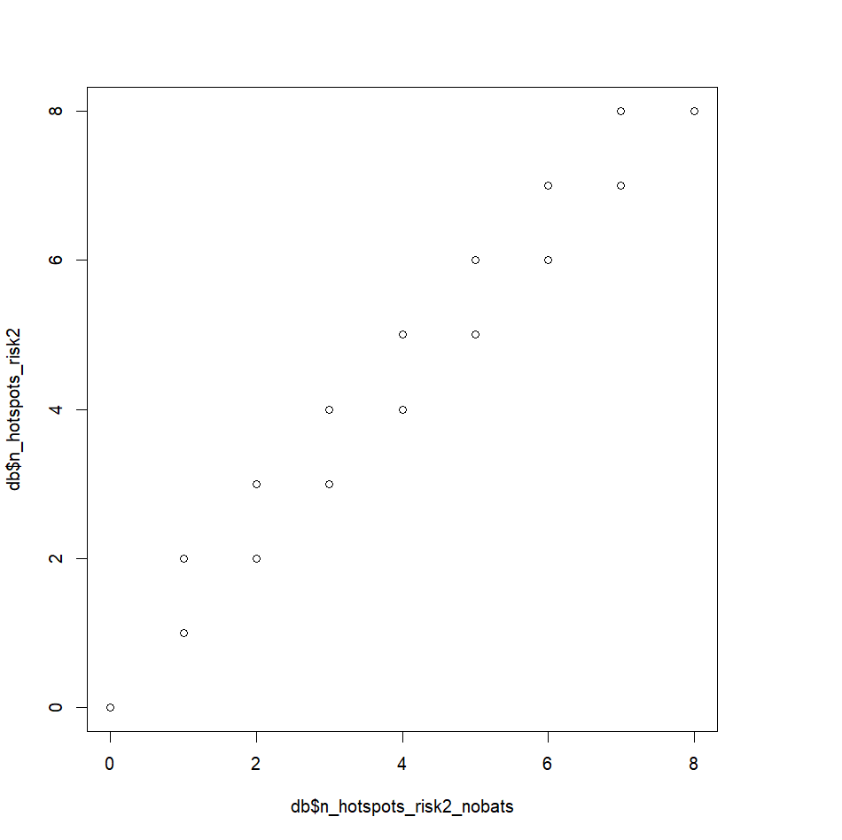
Differences are small
Risk 2 – just cattle
Risk 3 – all bovidae

Slide 6

Bovliv mammals minus bat
- Hazard: Scenario 1 +
- Hazard: Scenario 2 (all bovidae) +
- Time to reach healthcare +
- Time to reach healthcare +

Slide 7
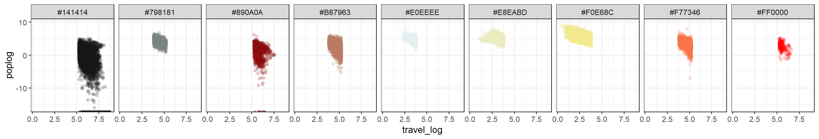
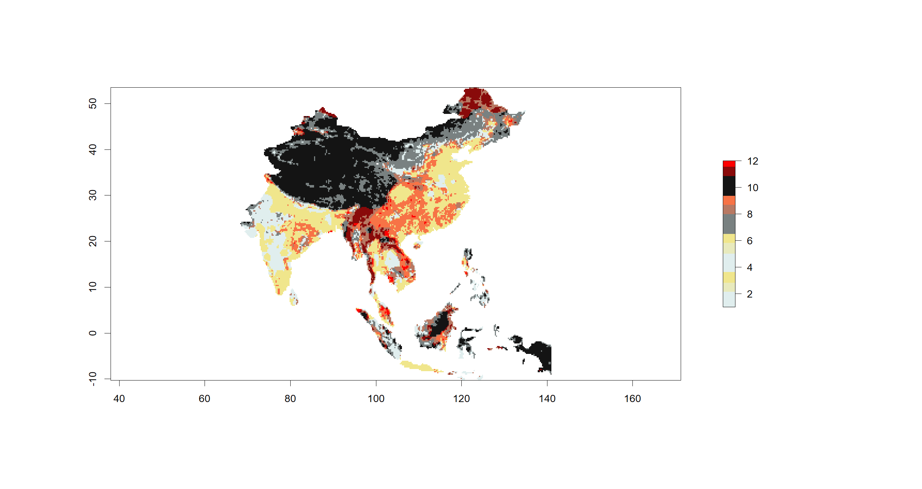
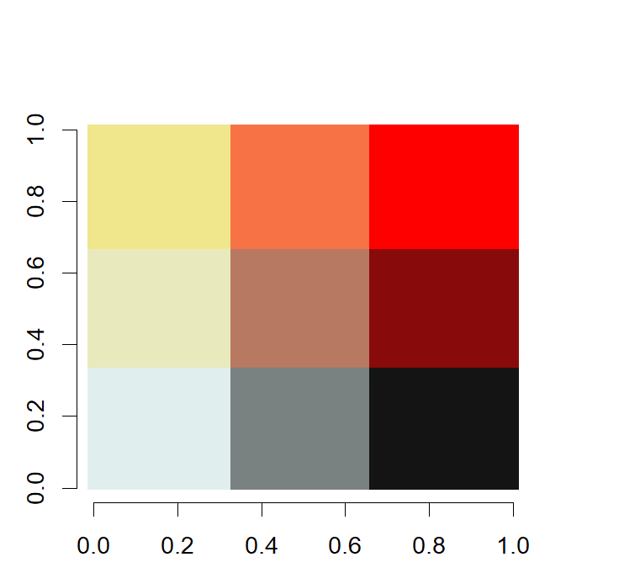
3
9
12
2
8
11
1
7
10

Slide 8
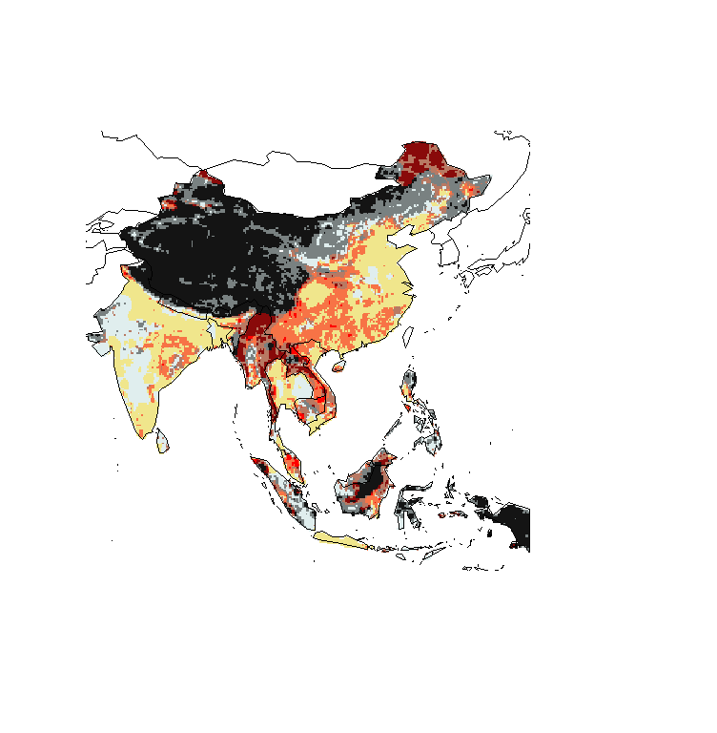
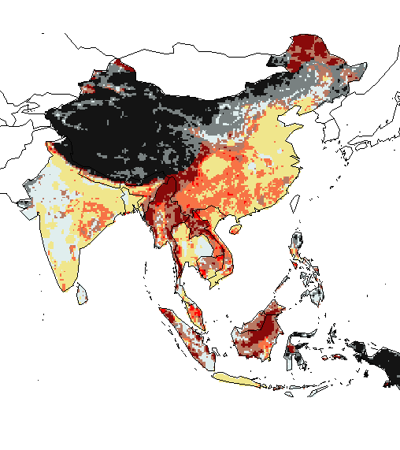
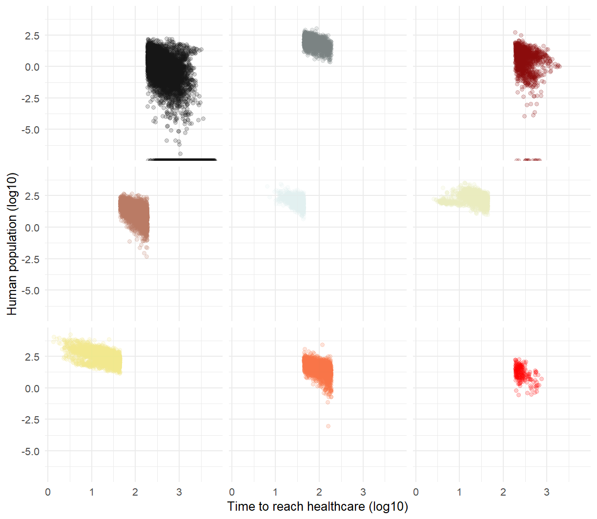
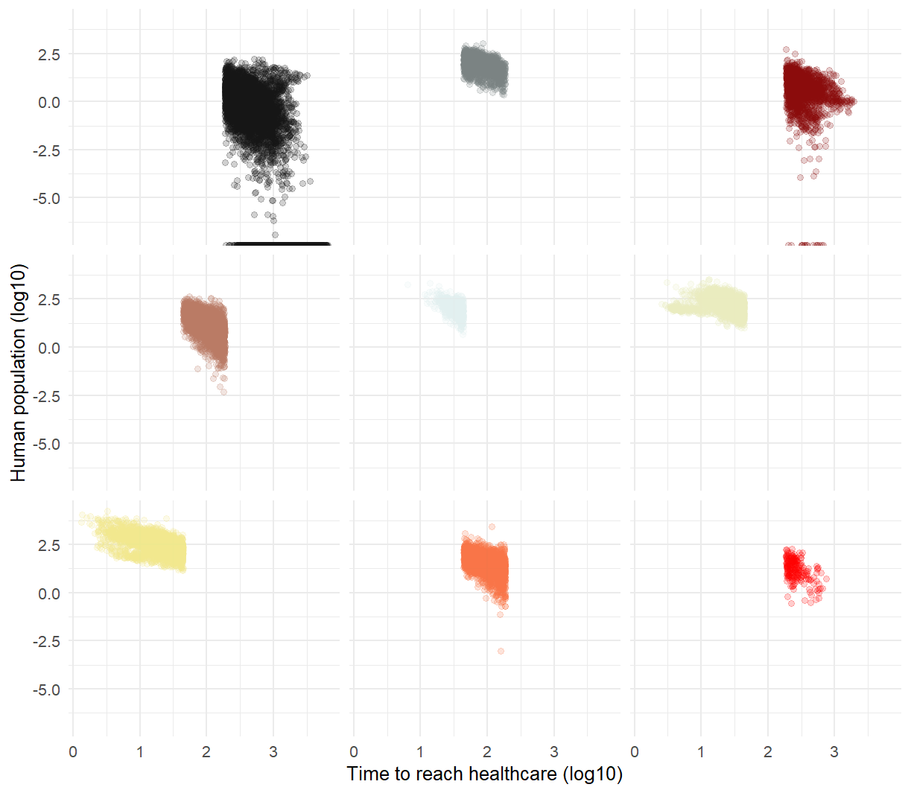
- Hazard: Scenario 1 +
- Hazard: Scenario 2 +
- Time to reach healthcare +
- Time to reach healthcare +

