Slide 1
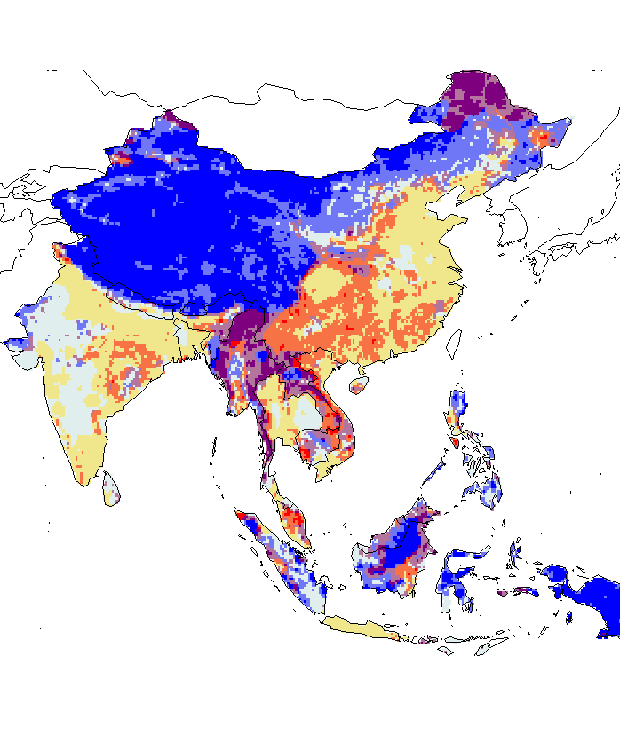

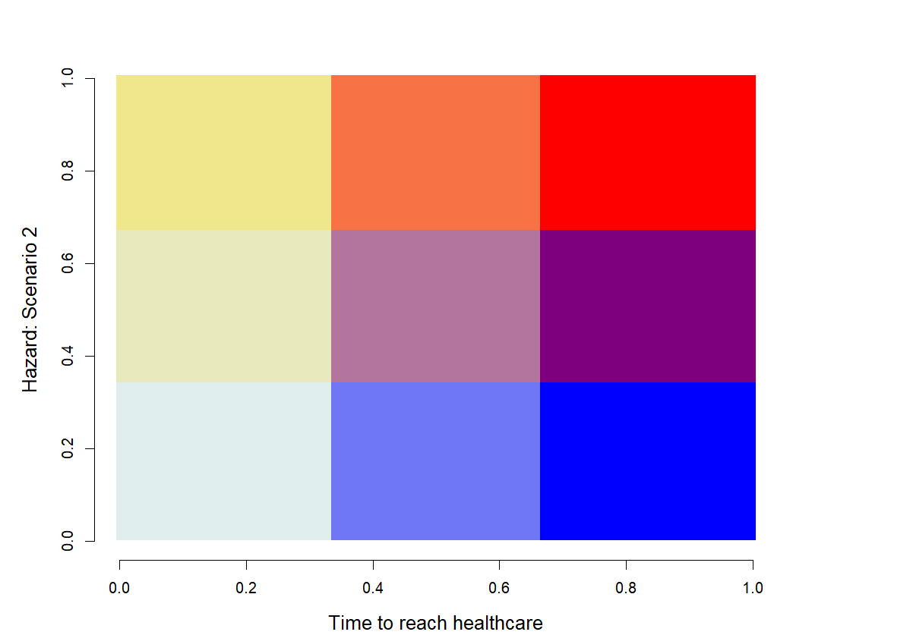
All mammals
- Hazard: Scenario 1 +
- Hazard: Scenario 2 +
- Time to reach healthcare +
- Time to reach healthcare +

Slide 2
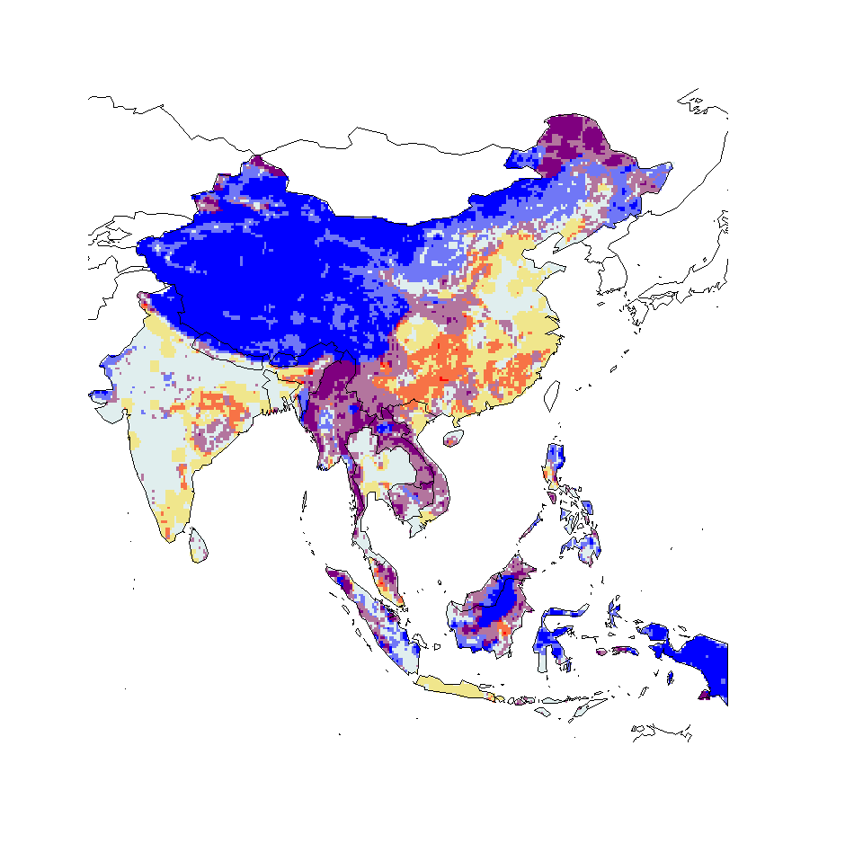
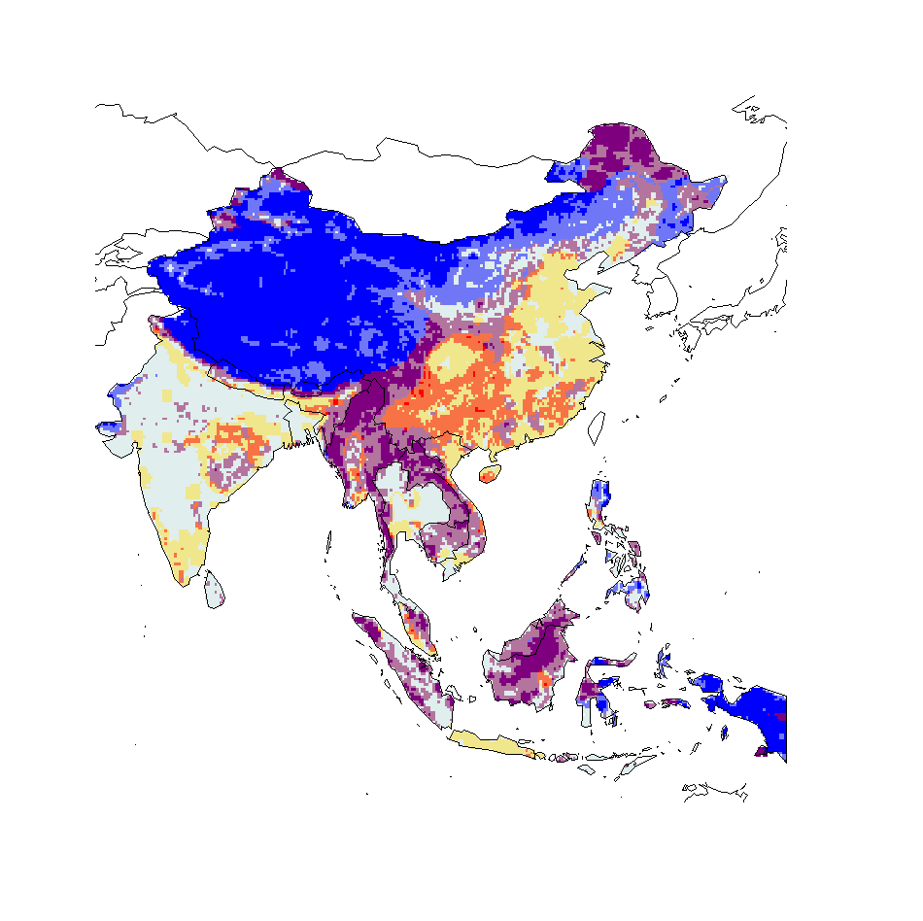
Mammals minus bat
- Hazard: Scenario 1 +
- Hazard: Scenario 2 +
- Time to reach healthcare +
- Time to reach healthcare +

Slide 3
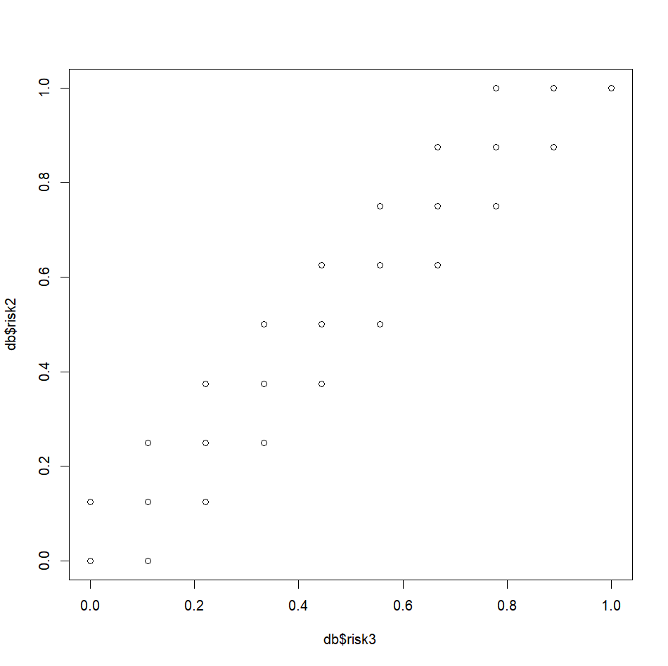
Bovliv mammals minus bat

Slide 4

Bovliv mammals minus bat
- Hazard: Scenario 1 +
- Hazard: Scenario 2 (all bovidae) +
- Time to reach healthcare +
- Time to reach healthcare +

Slide 5
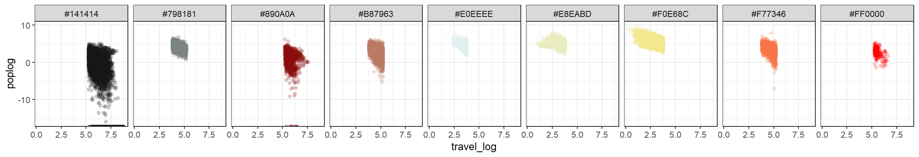
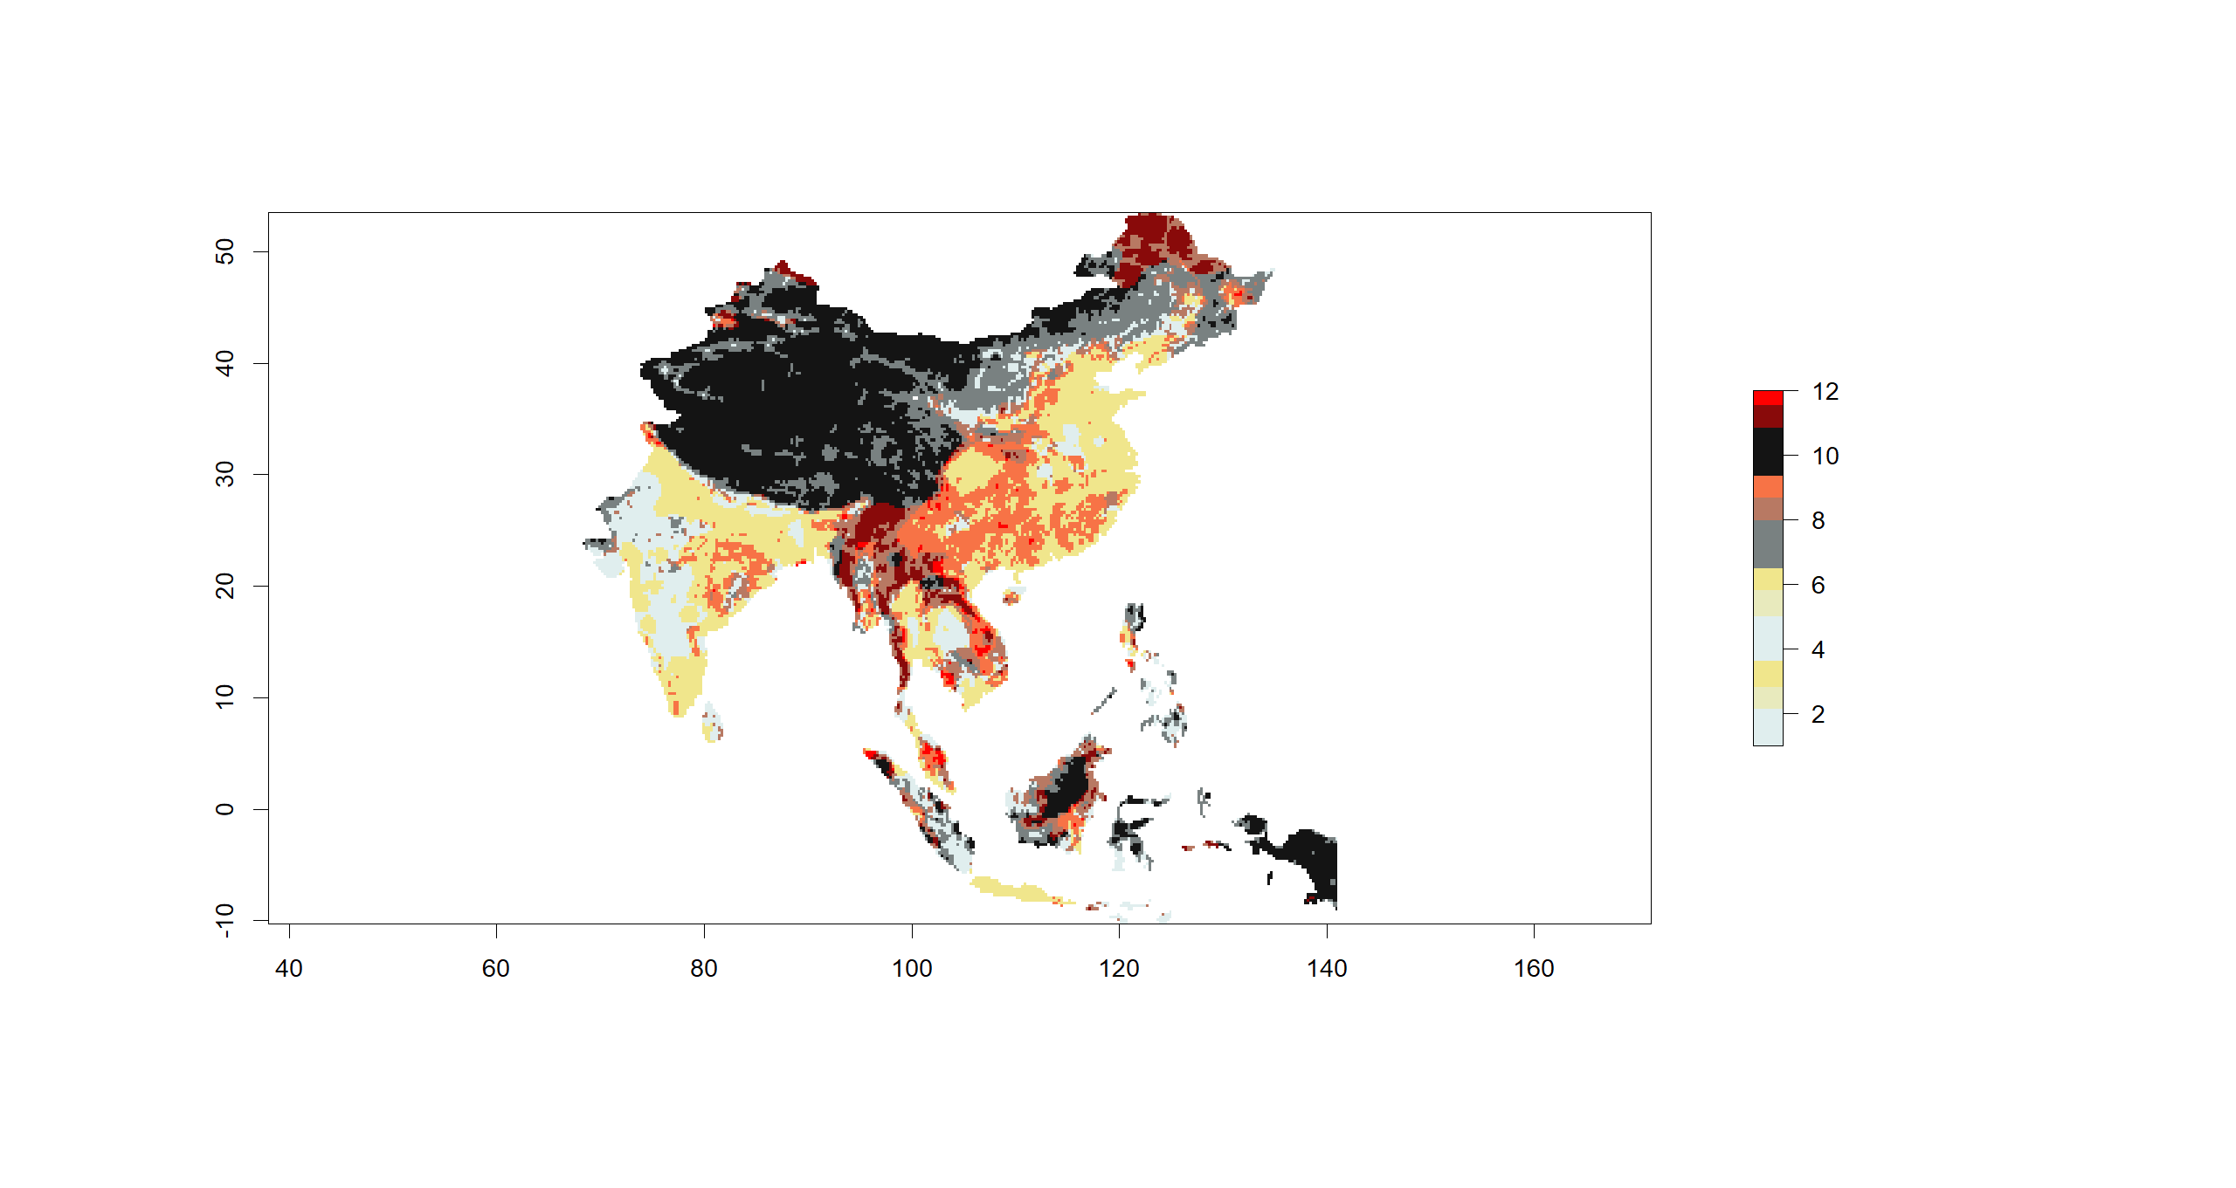
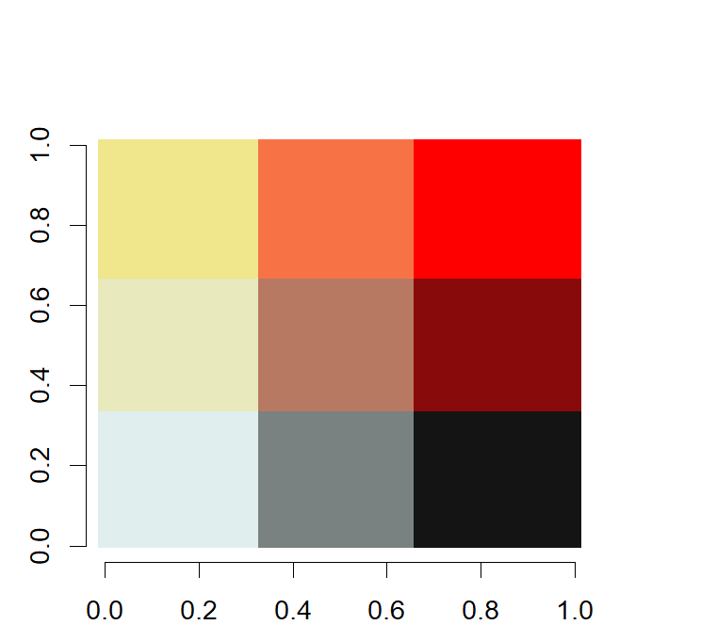
3
9
12
2
8
11
1
7
10

Slide 6
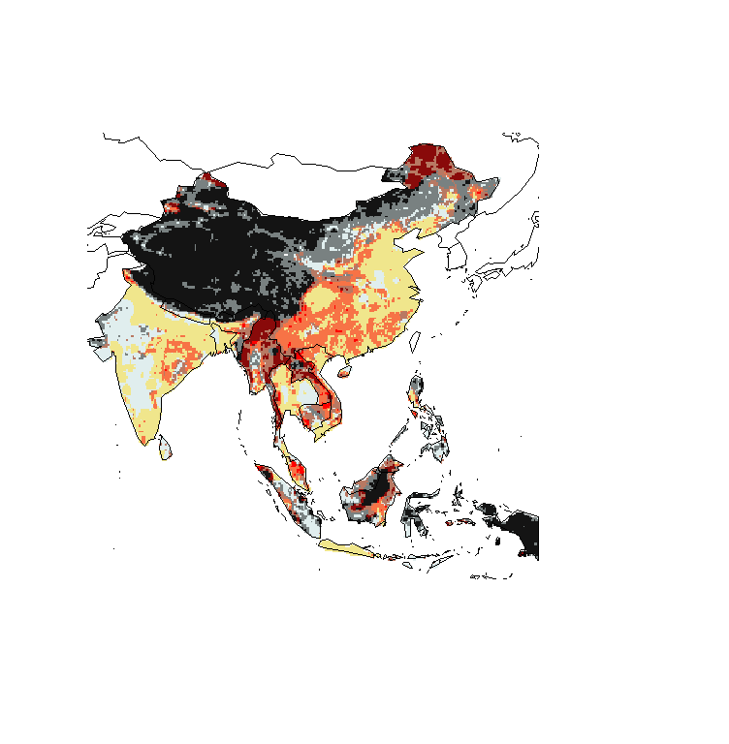
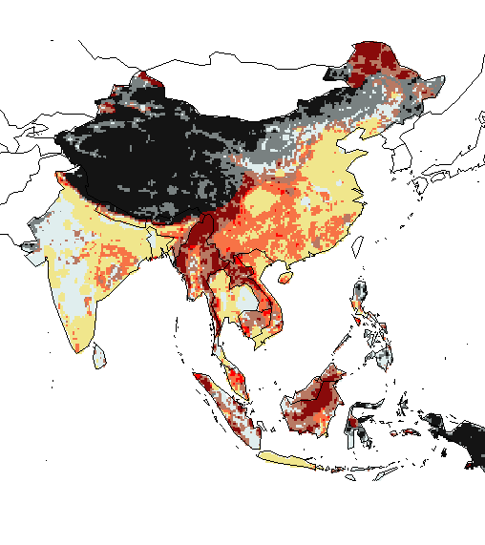
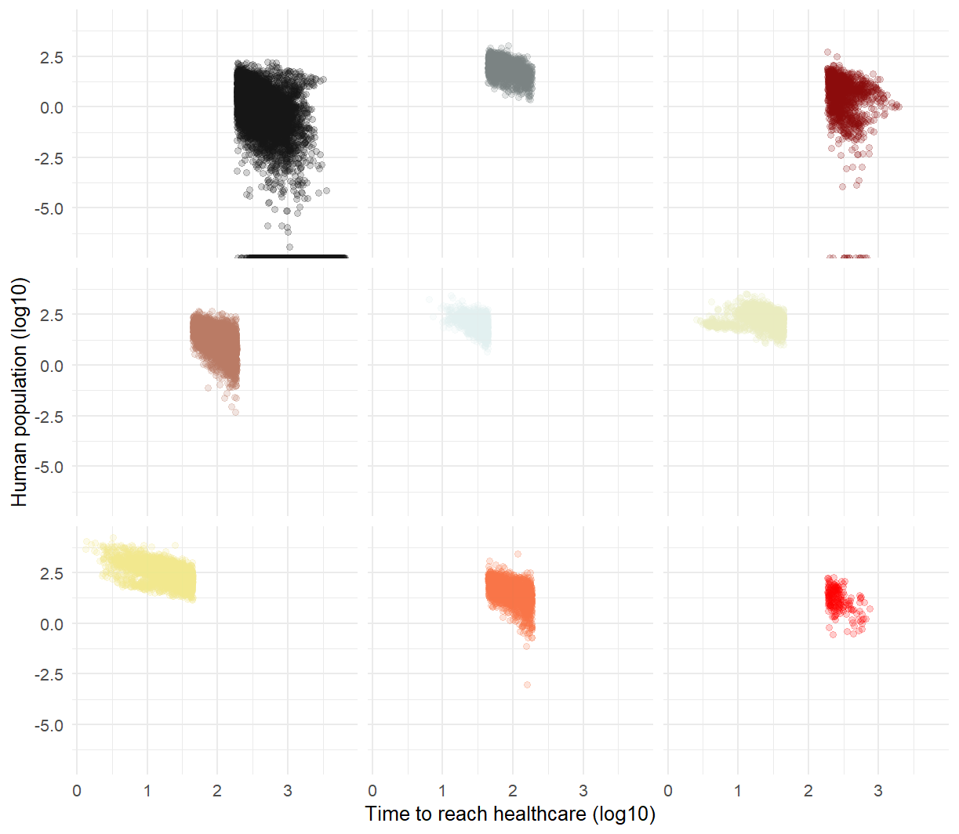
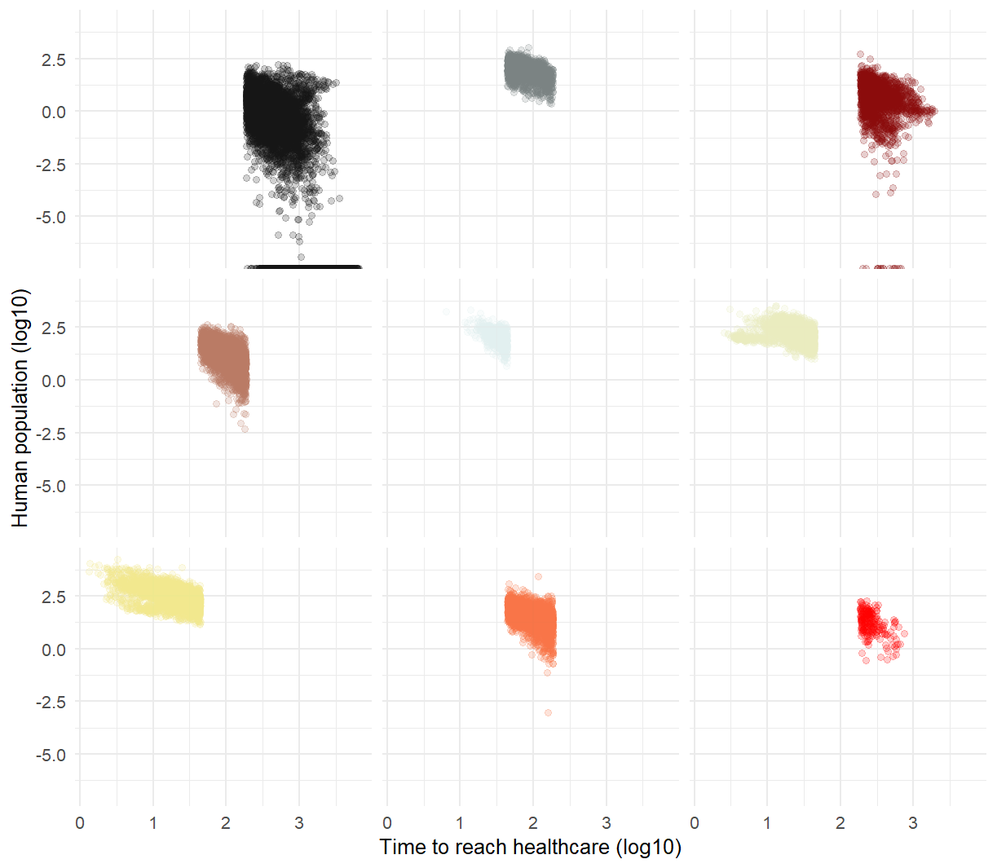
- Hazard: Scenario 1 +
- Hazard: Scenario 2 +
- Time to reach healthcare +
- Time to reach healthcare +

