Slide 1
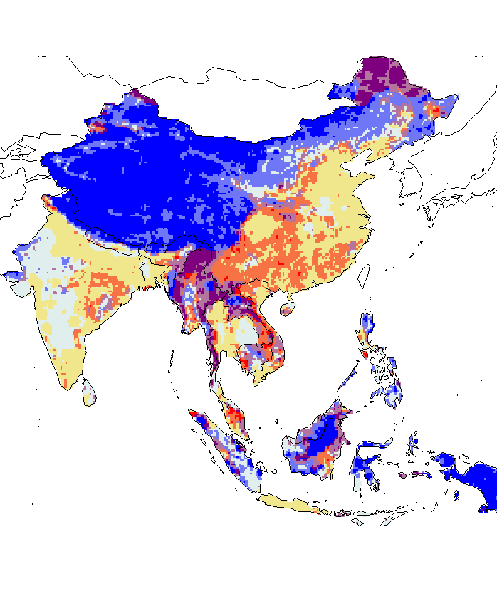

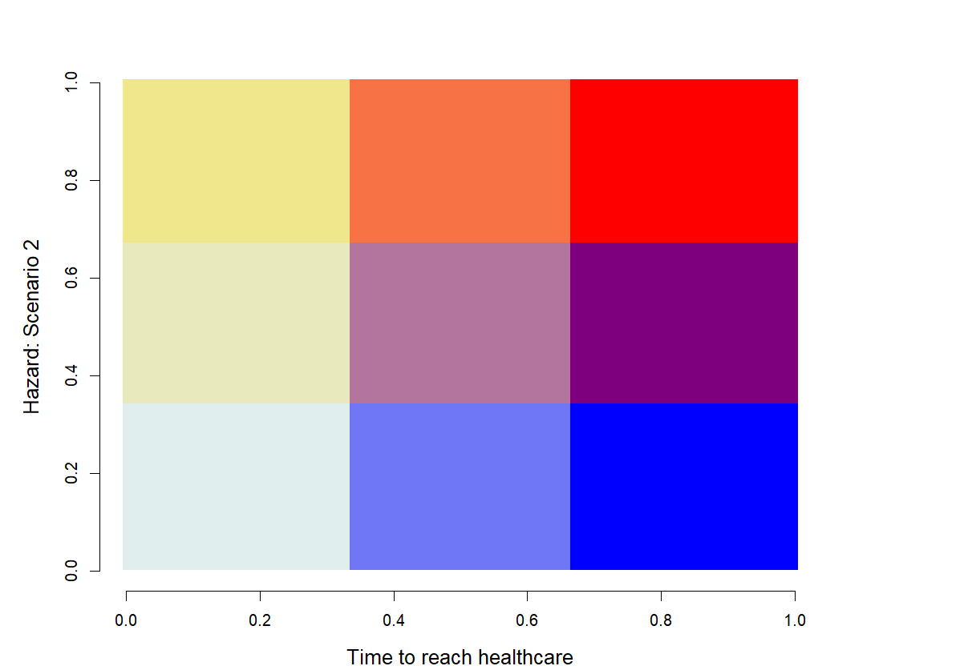
All mammals (redundancy)
- Hazard: Scenario 1 +
- Hazard: Scenario 2 +
- Time to reach healthcare +
- Time to reach healthcare +

Slide 2
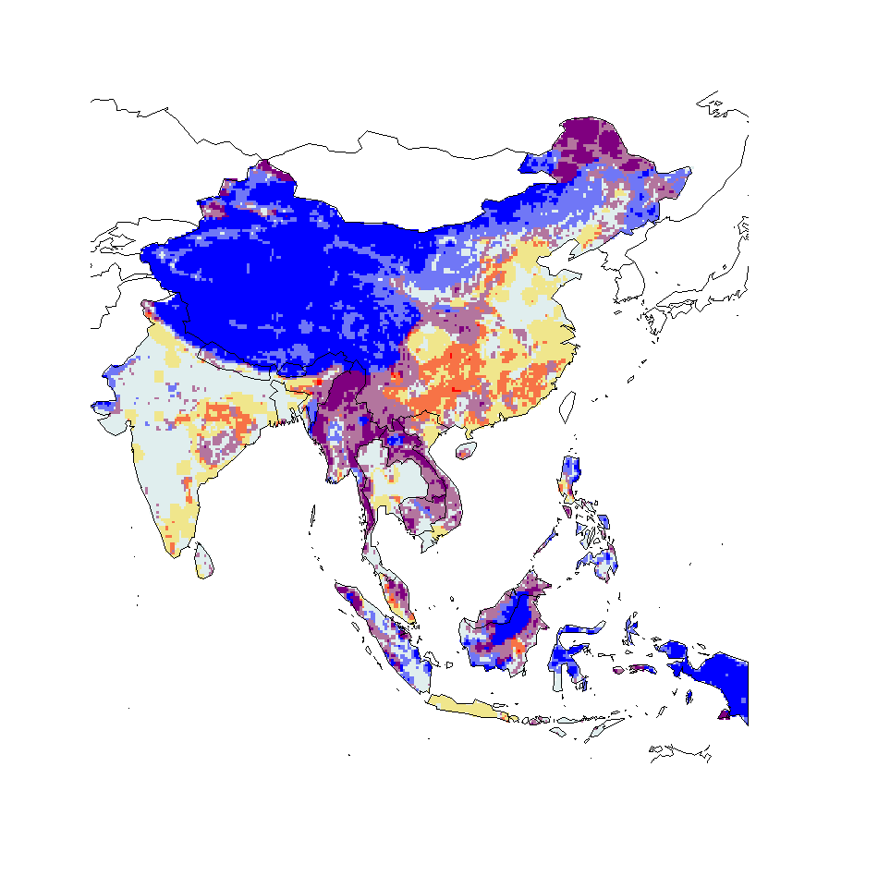
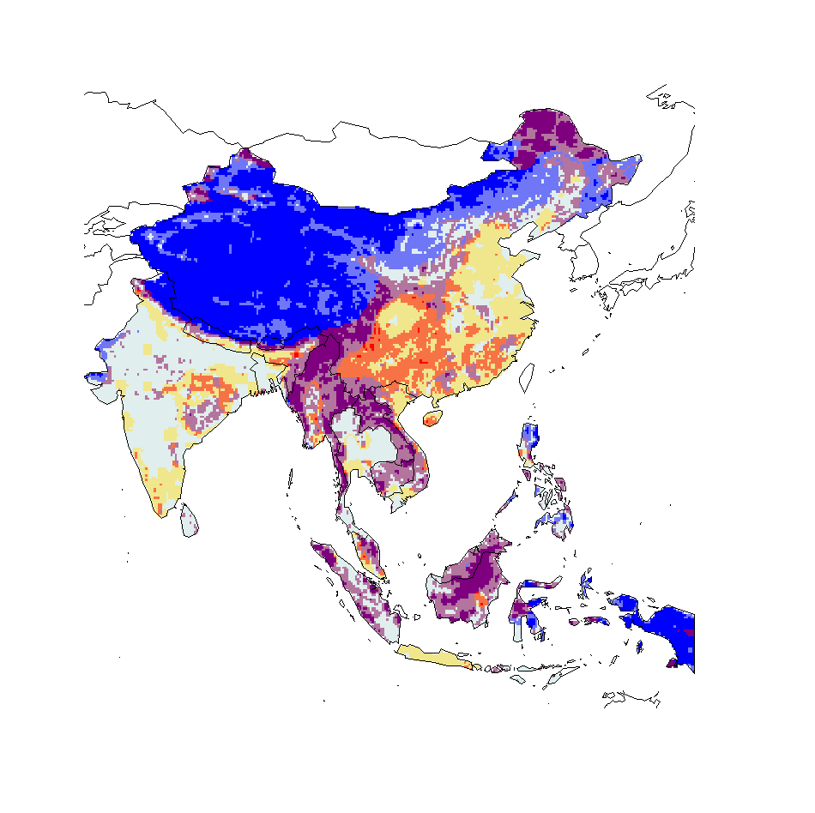
Mammals minus bat
All mammals minus bat hosts (redundancy removed)
- Hazard: Scenario 1 +
- Hazard: Scenario 2 +
- Time to reach healthcare +
- Time to reach healthcare +

Slide 3

Mammals minus bat
All mammals minus bat hosts (redundancy removed) – scenario 2 not nested
- Hazard: Scenario 1 +
- Hazard: Scenario 2 (mius bat hosts) +
- Time to reach healthcare +
- Time to reach healthcare +

Slide 4
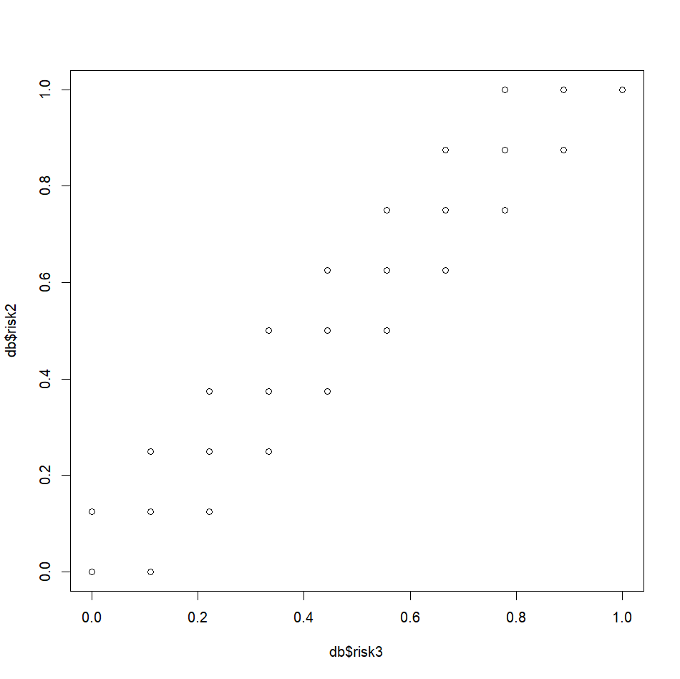
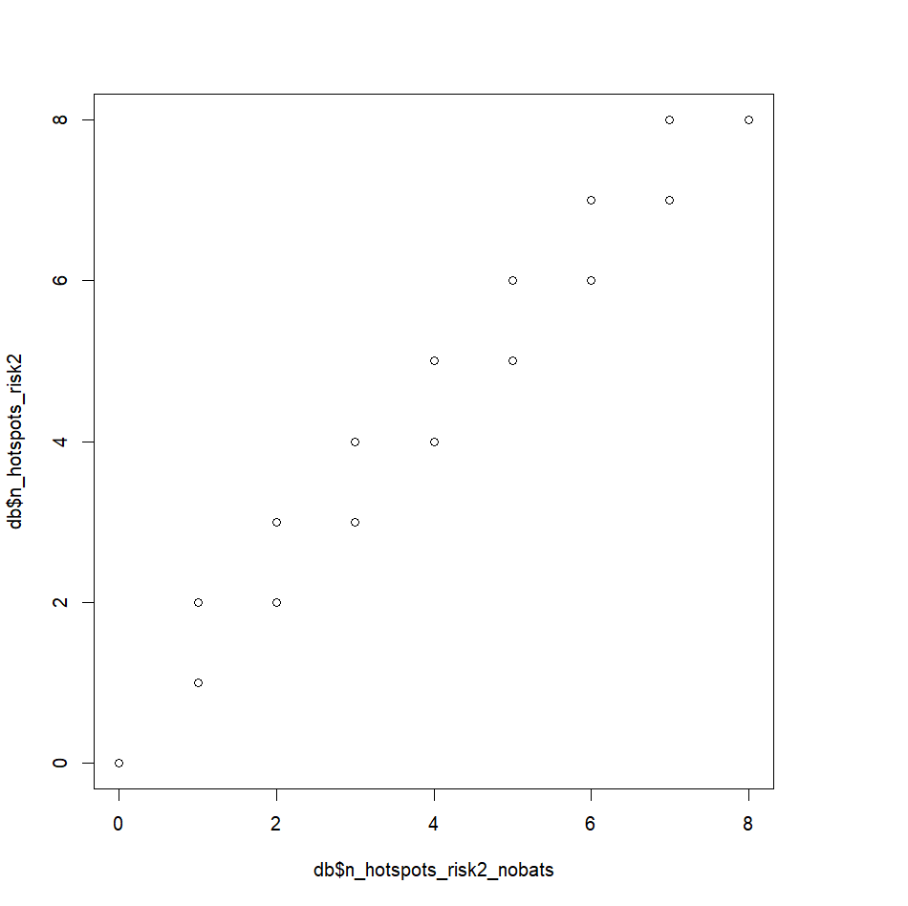
Differences are small
Risk 2 – just cattle
Risk 3 – all bovidae

Slide 5

Bovliv mammals minus bat
- Hazard: Scenario 1 +
- Hazard: Scenario 2 (all bovidae) +
- Time to reach healthcare +
- Time to reach healthcare +

Slide 6
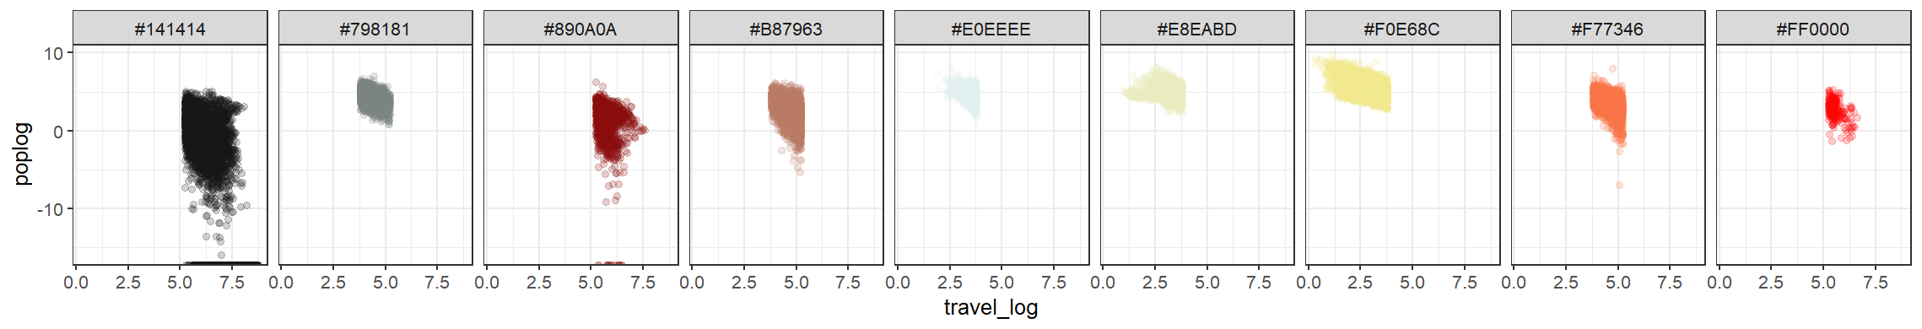
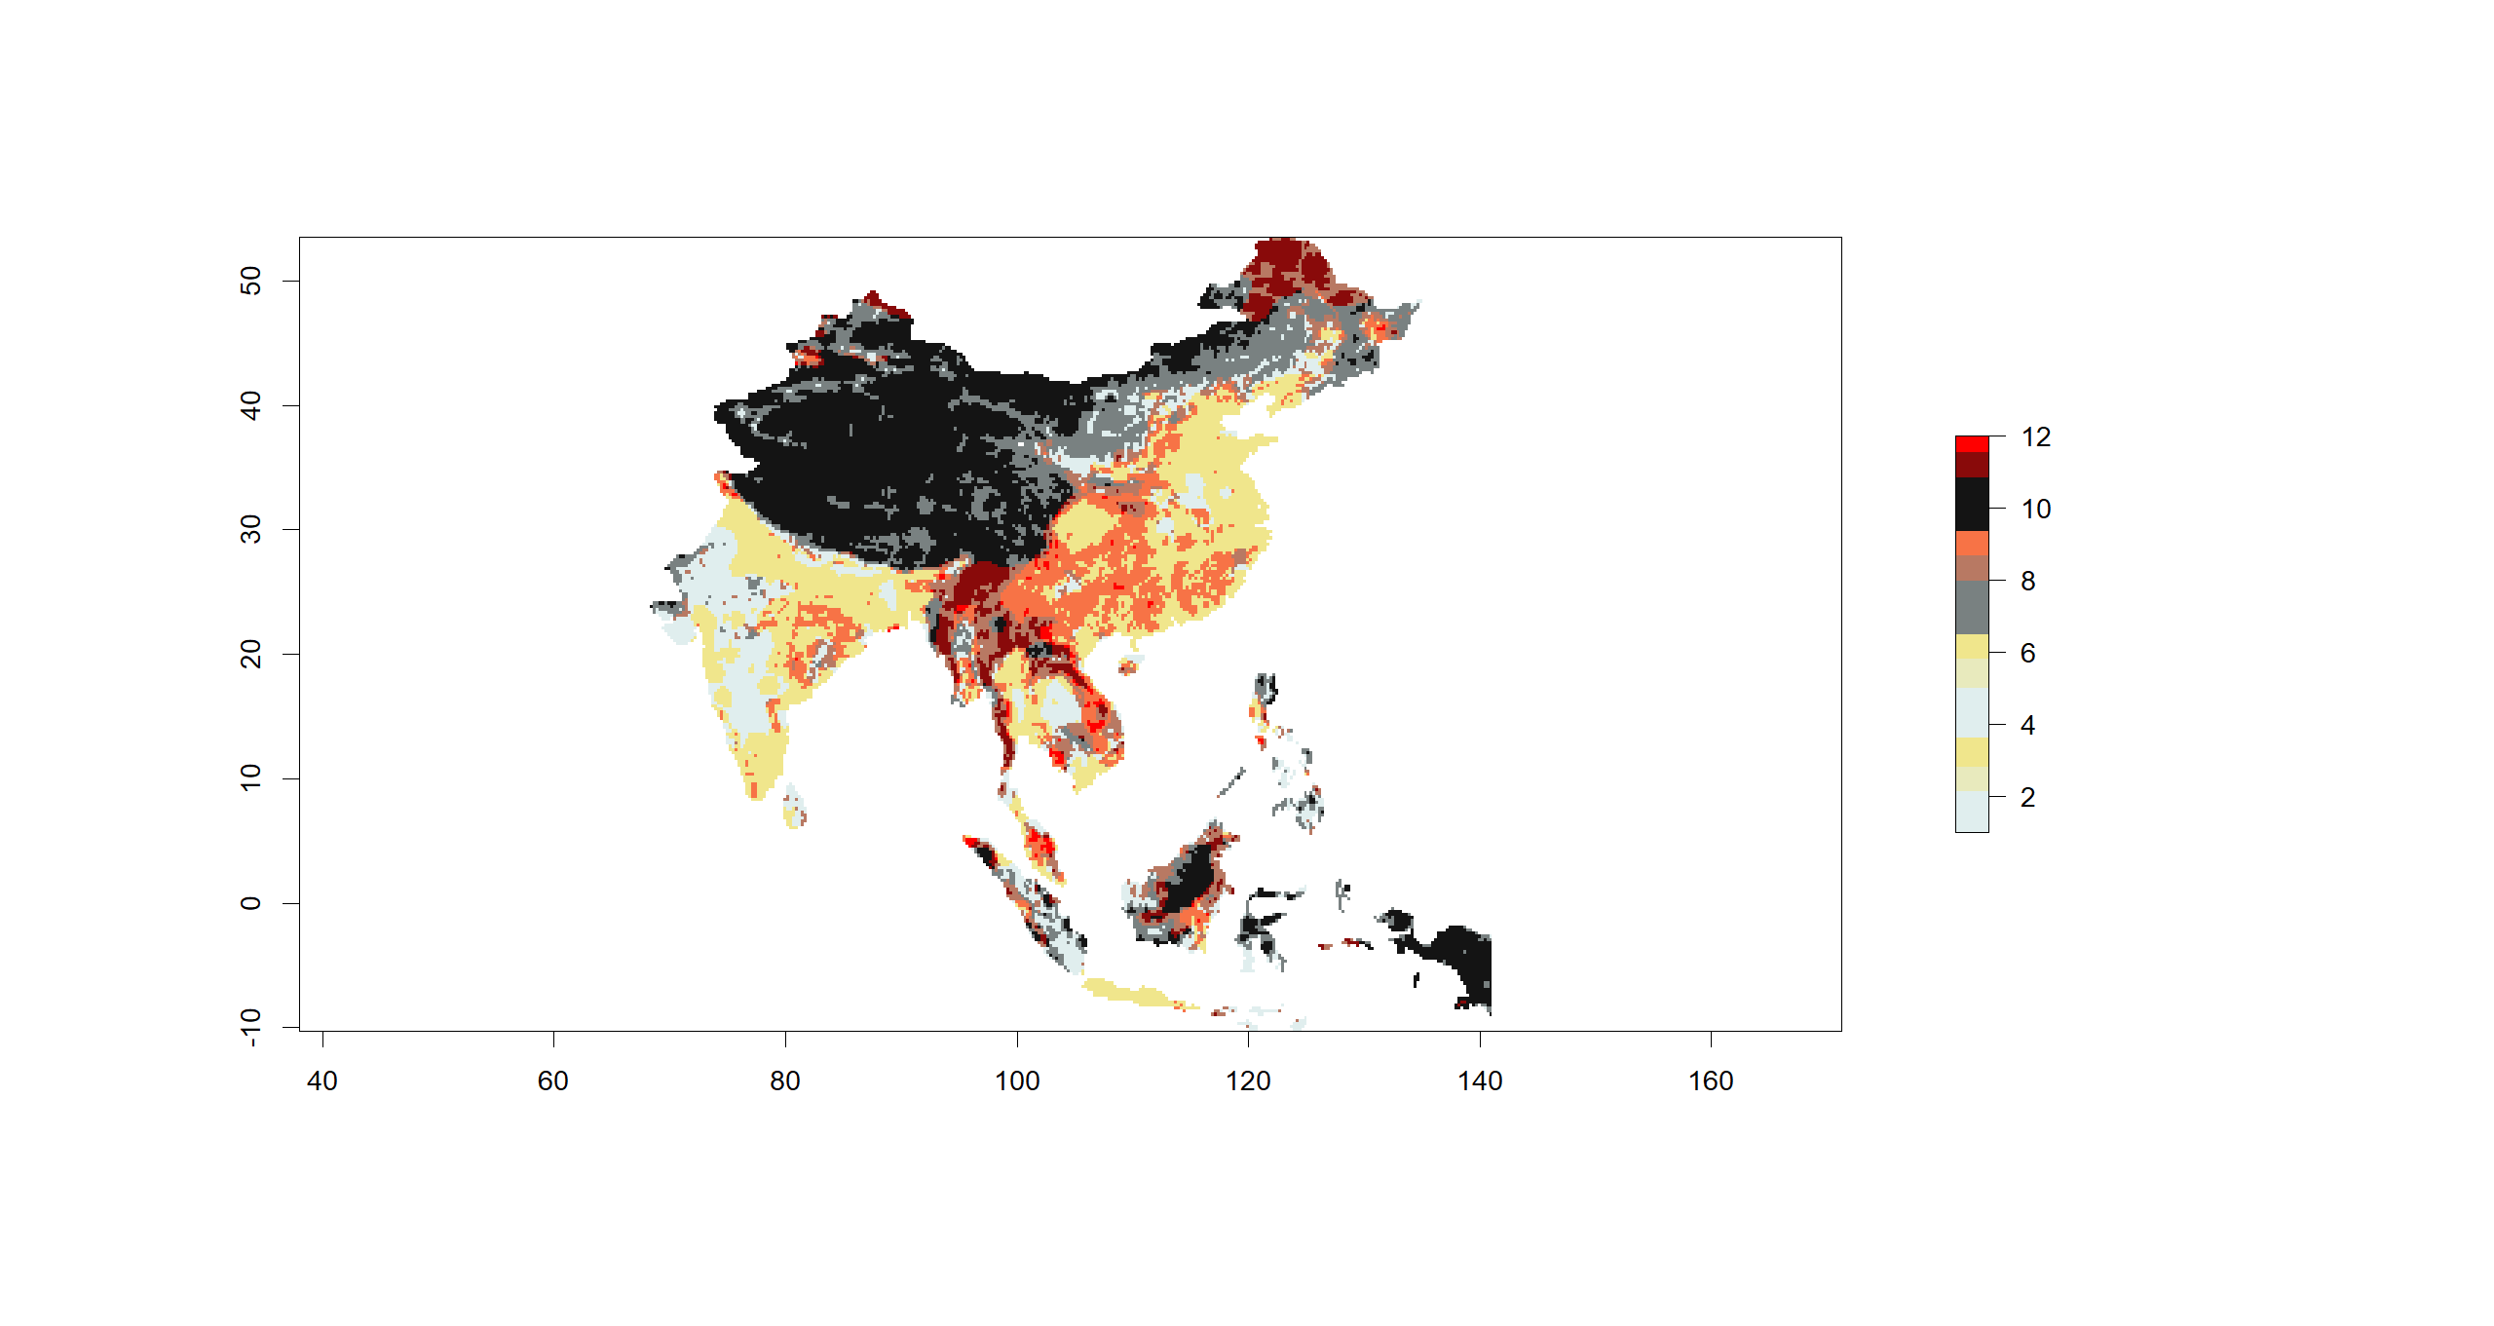
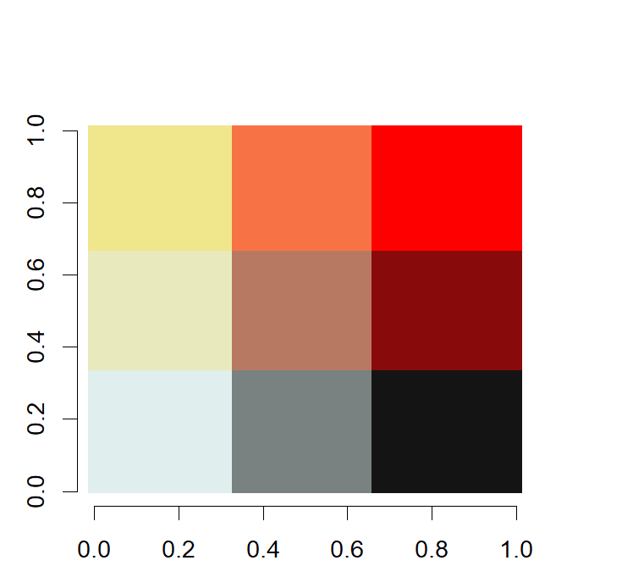
3
9
12
2
8
11
1
7
10

Slide 7
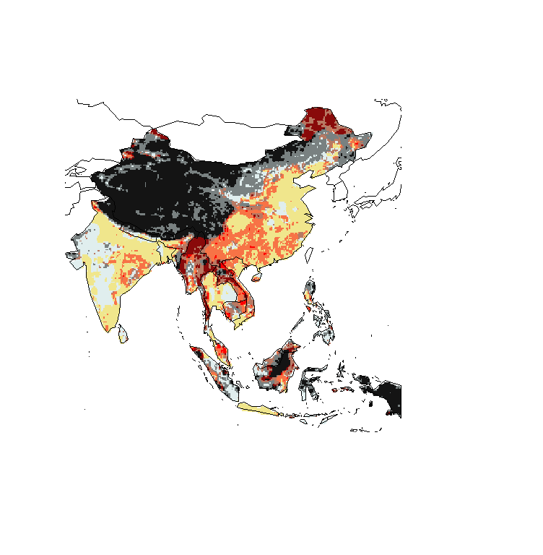
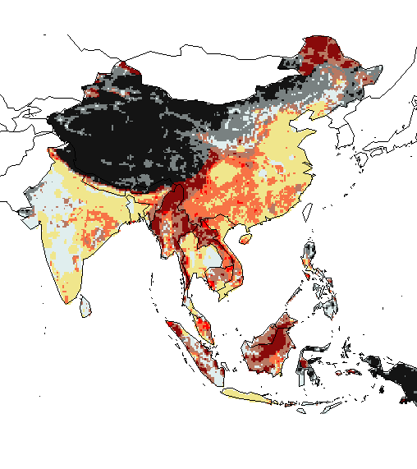
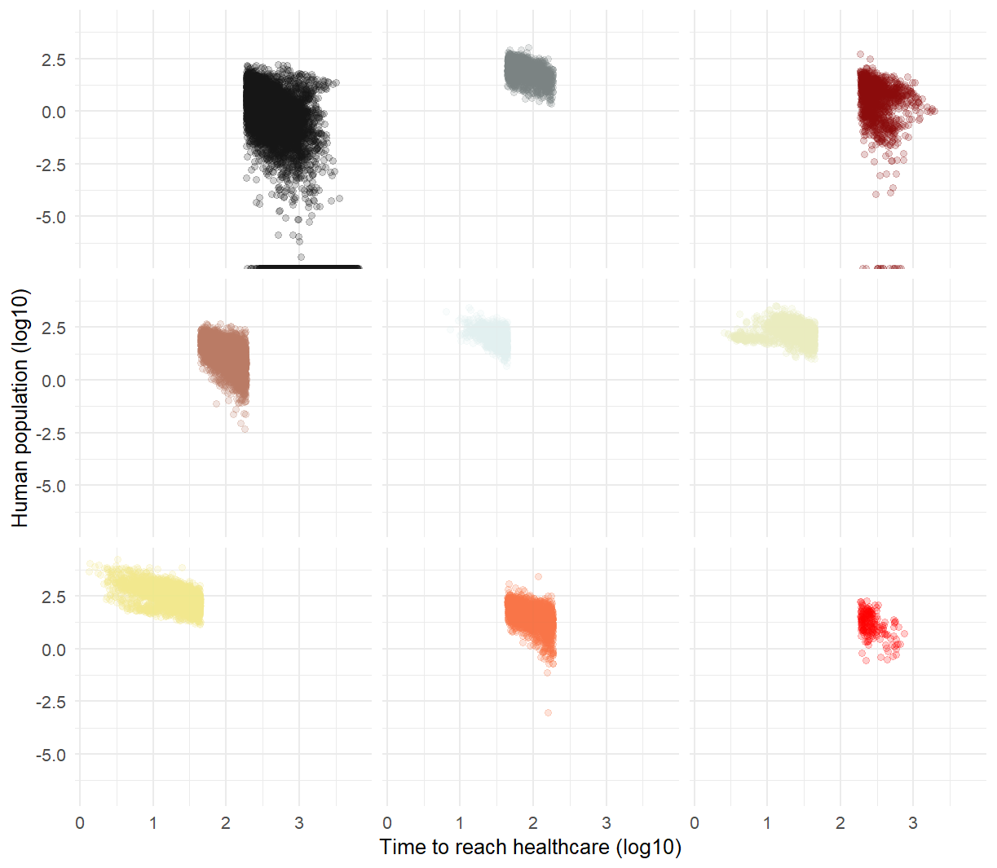
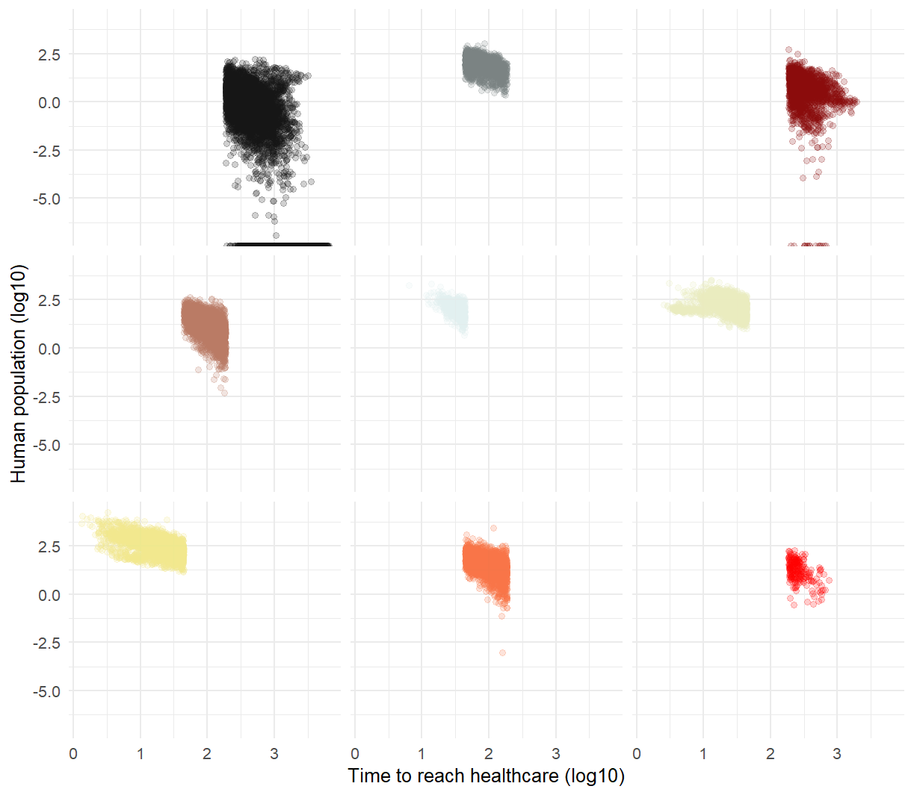
- Hazard: Scenario 1 +
- Hazard: Scenario 2 +
- Time to reach healthcare +
- Time to reach healthcare +

