Slide 1
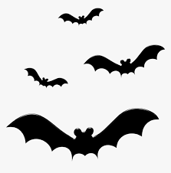


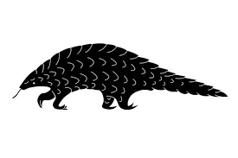
*
Cross species transmission pathways from bat to people to be modelled
--- Identifies risk areas and what changes might be making areas high risk
^
^
*
time to healthcare (^{## see note}) as a proxy for potential human – human spread speed
i.e. as an alternative to a gravity or radiation model
--- Identifies highly connected risk areas
# #
Scenario +
* Variations on livestock intermediate host tbd – move to supplementary if not interesting
^ All mammals (removing bat hosts from IUCN distributions to avoid redundancy)
# # Time to healthcare also indicates areas of high risk where outbreaks could occur, without early detection (i.e. long times to healthcare)

