Slide 1
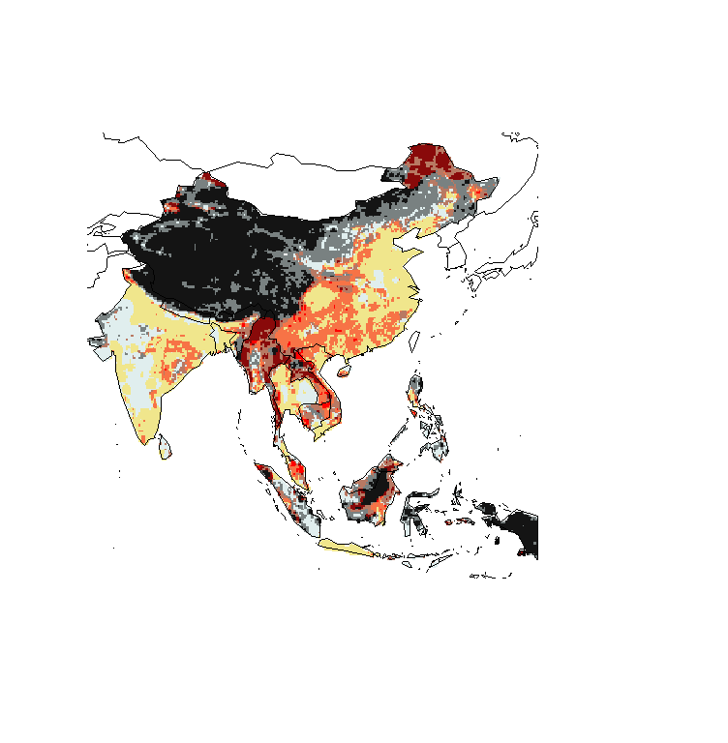
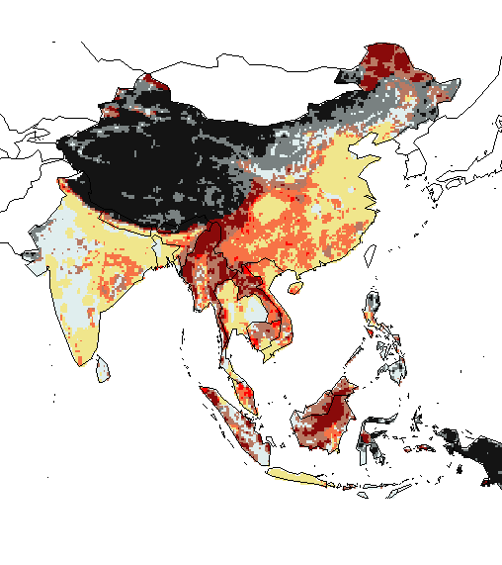
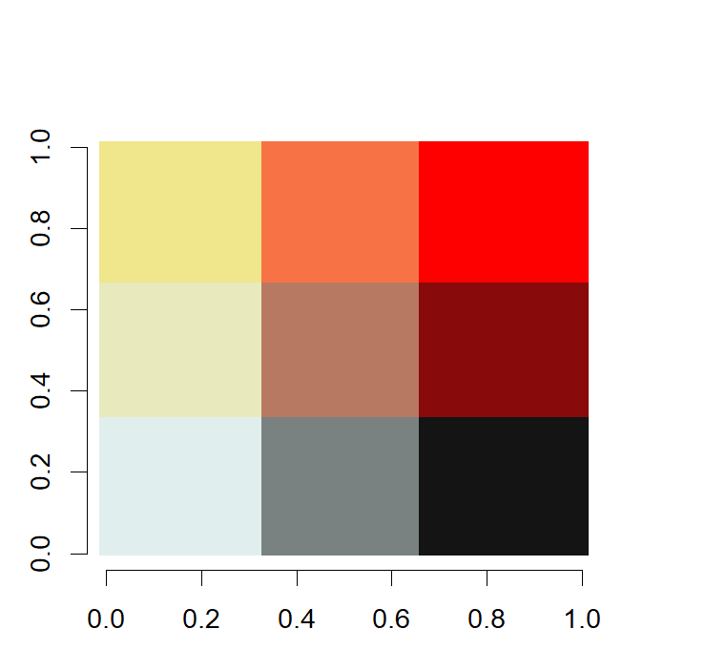
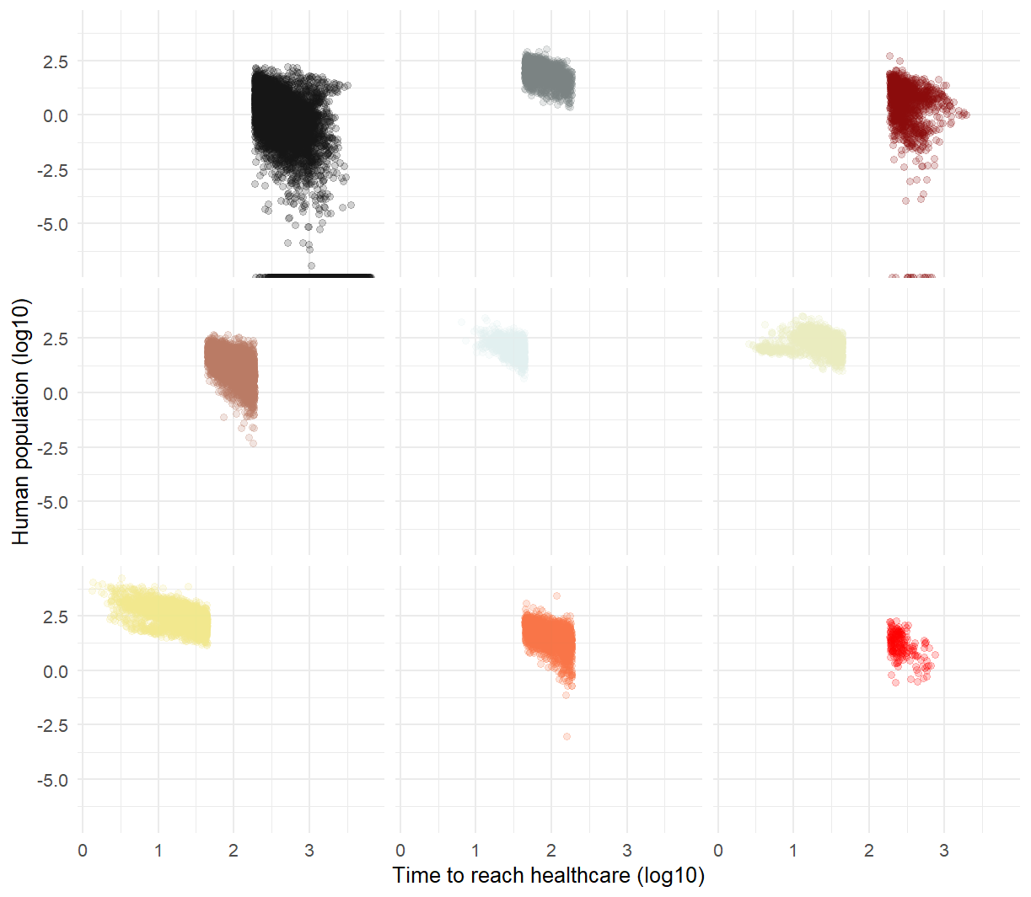
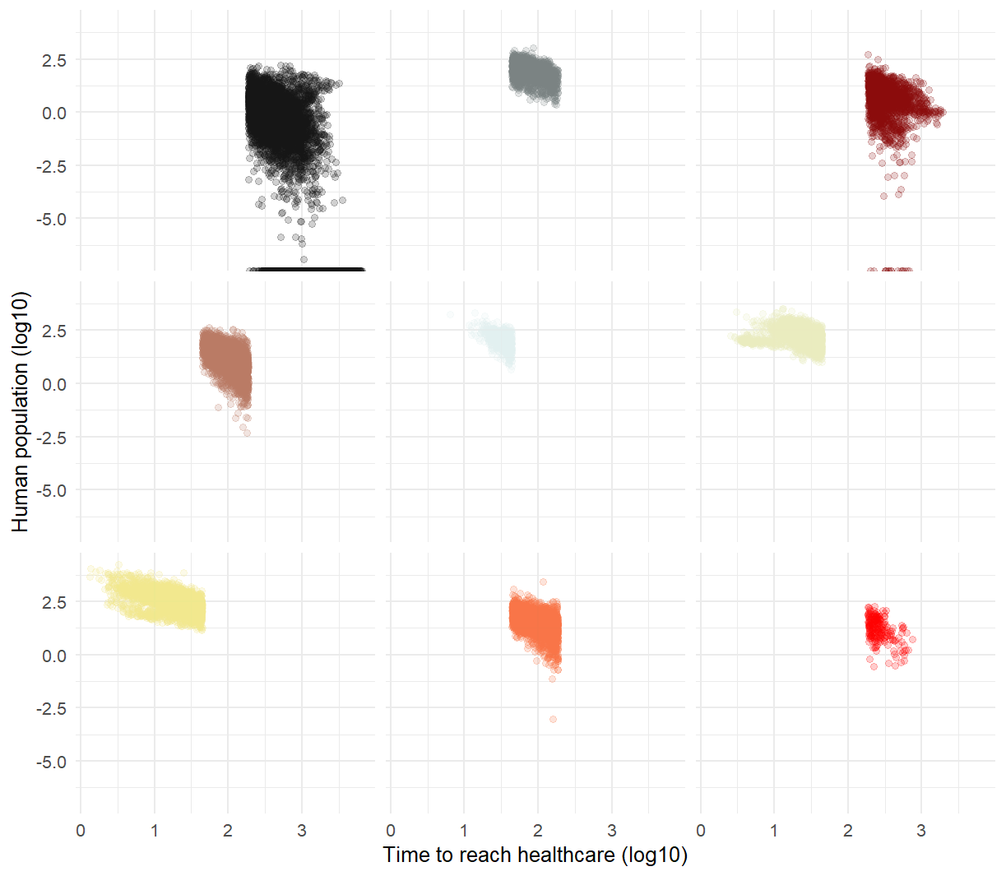
- Hazard: Scenario 1 +
- Hazard: Scenario 2 +
- Time to reach healthcare +
- Time to reach healthcare +

Slide 2
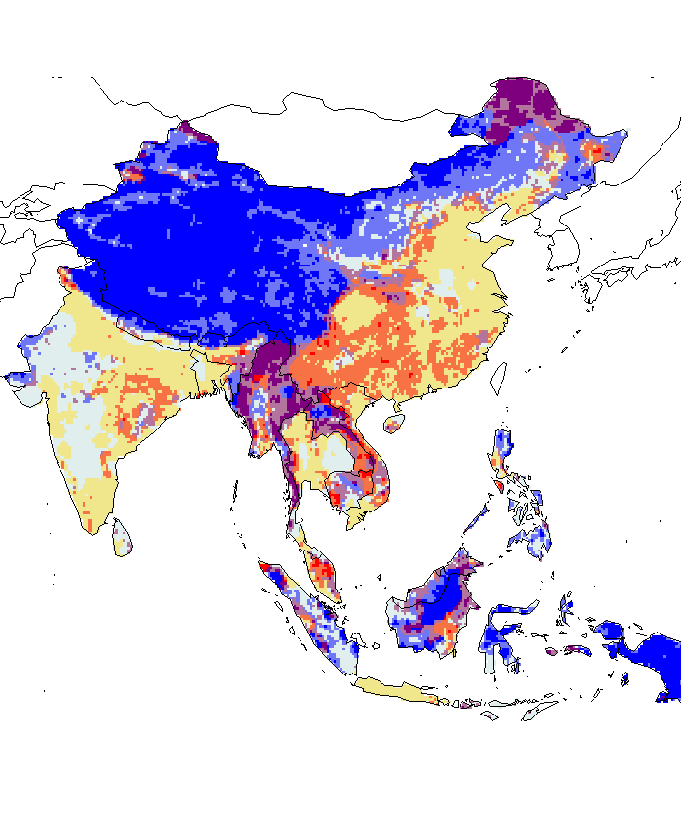

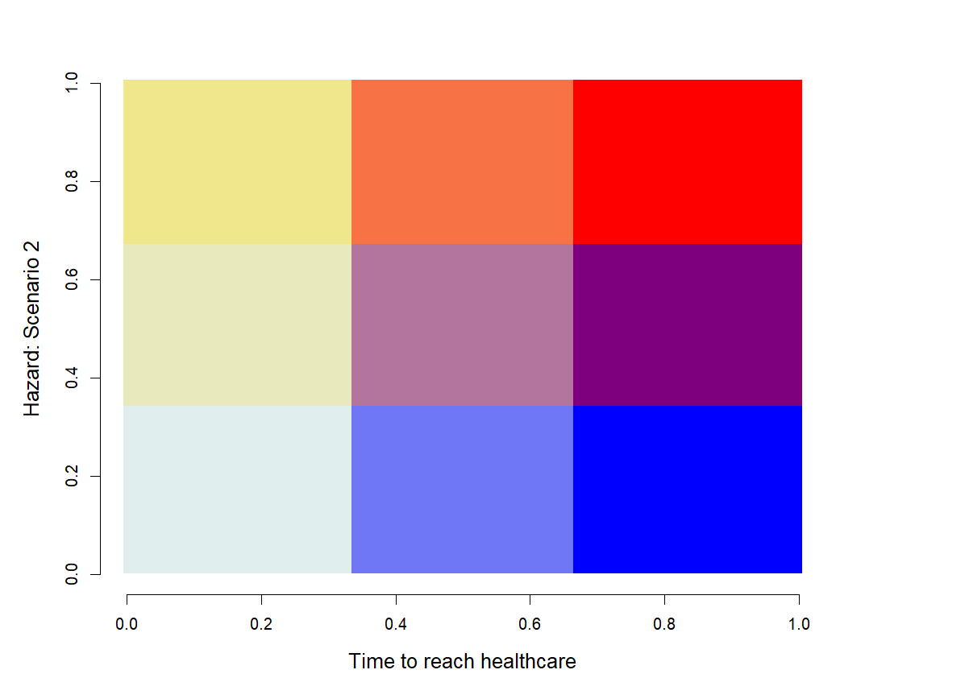
- Hazard: Scenario 1 +
- Hazard: Scenario 2 +
- Time to reach healthcare +
- Time to reach healthcare +

Slide 3
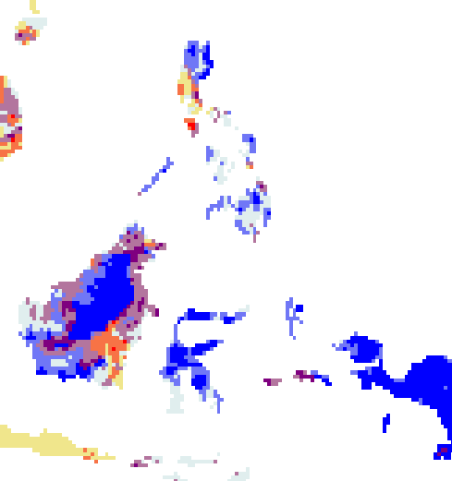
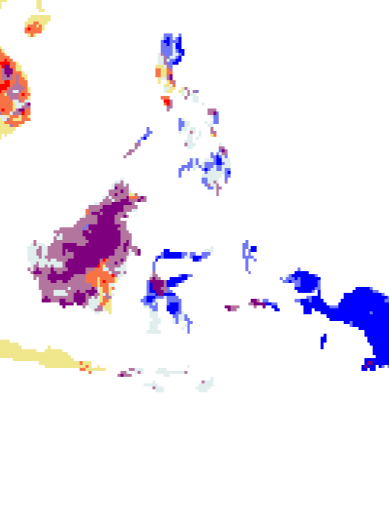
- Hazard: Scenario 1 +
- Hazard: Scenario 2 +
- Time to reach healthcare +
- Time to reach healthcare +

Slide 4
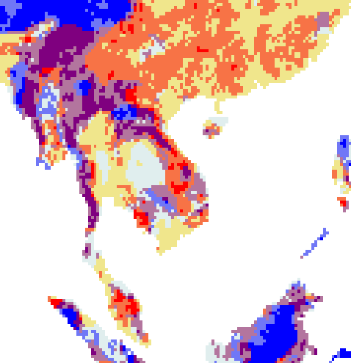
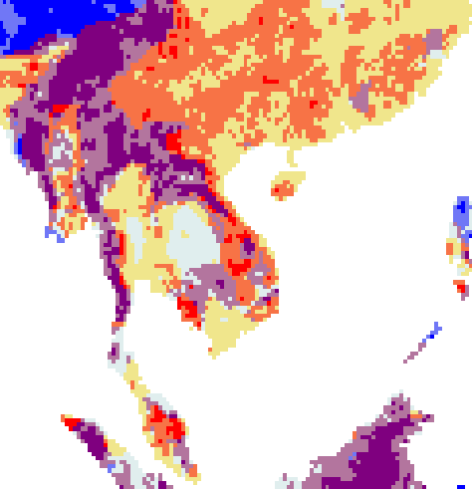
- Hazard: Scenario 1 +
- Hazard: Scenario 2 +
- Time to reach healthcare +
- Time to reach healthcare +

Slide 5
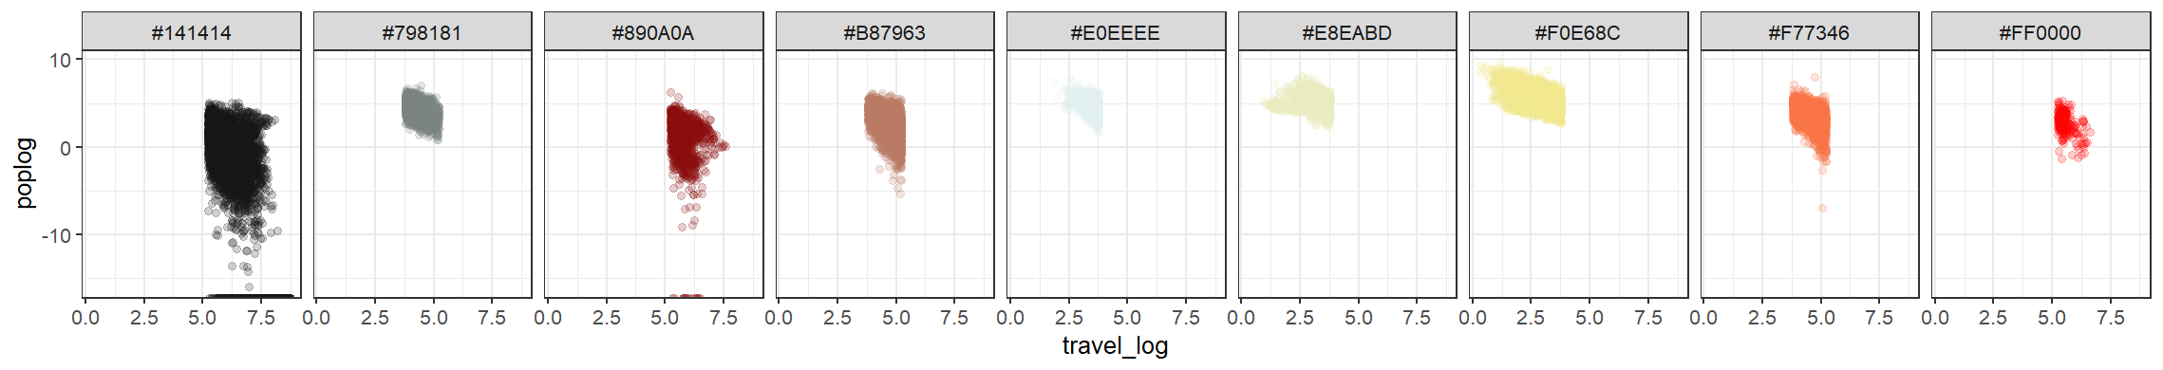
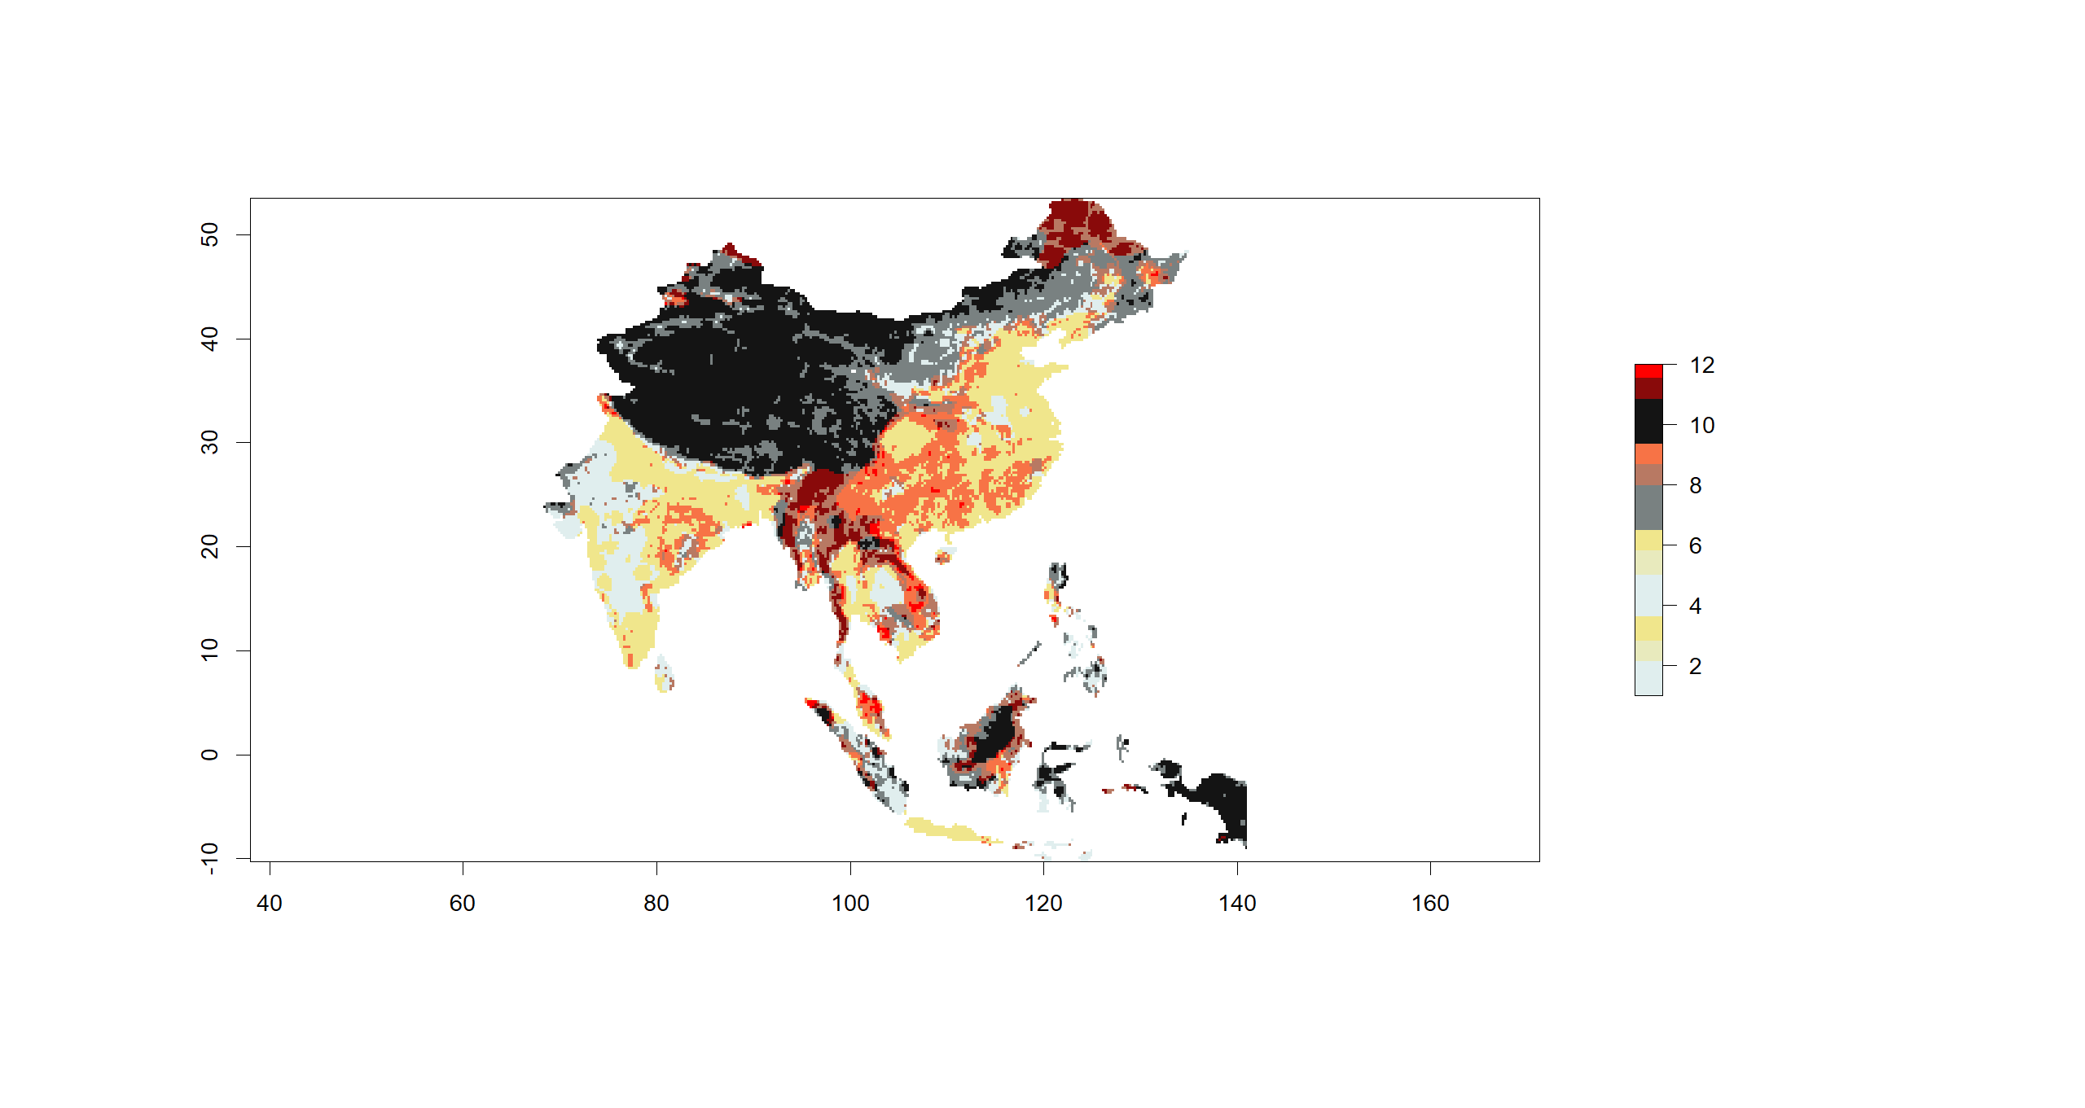
3
9
12
2
8
11
1
7
10

Slide 6
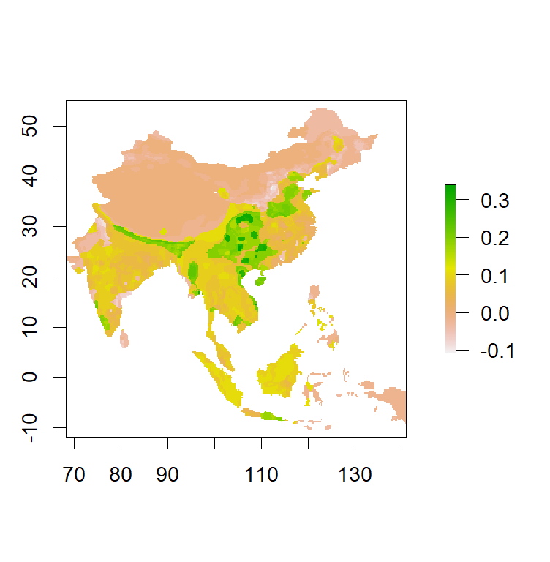
Hazard excess
in scenario 2
Hazard excess
in scenario 1

